Slide 1
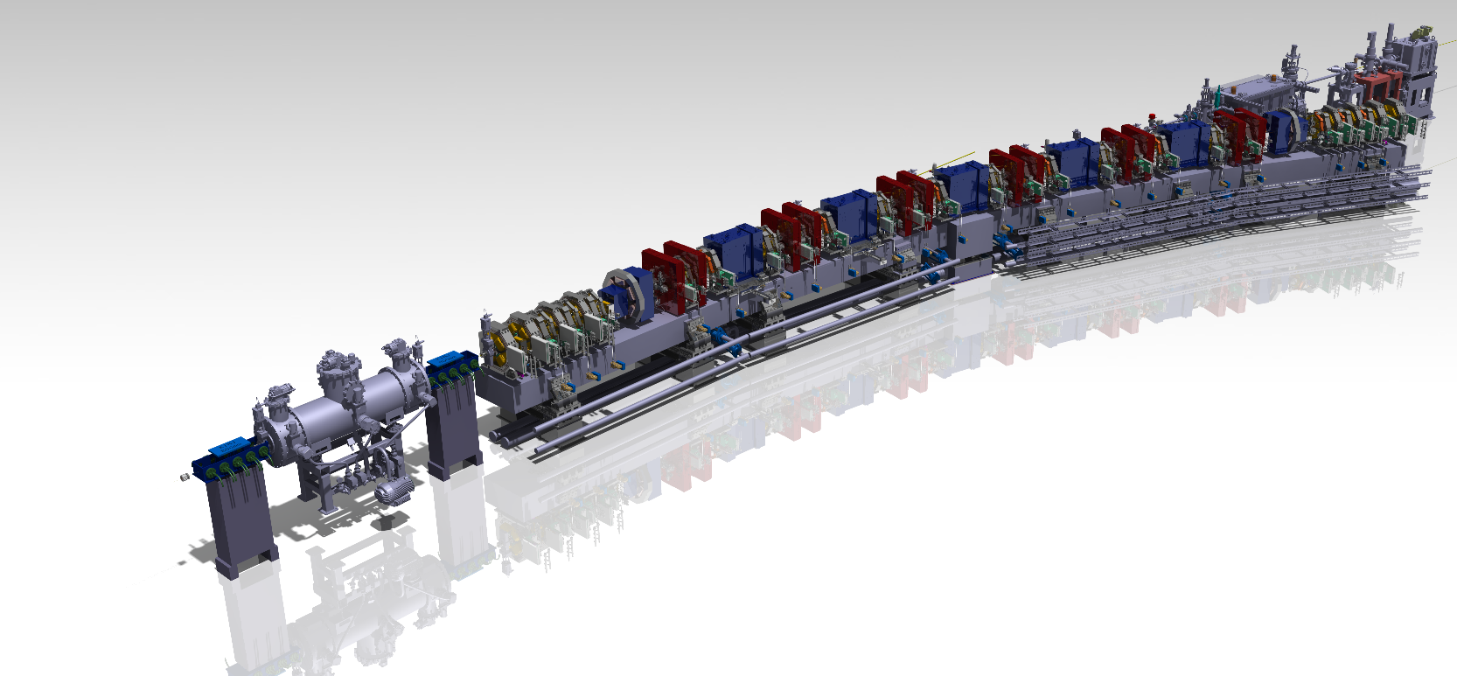
Status Projekt SLS 2.0 with slides from Romain Ganter, Markus Jörg, Phil Willmott and Alun Ashton
Hans Braun :: PSI
LAB #9, 1.7.2022

Slide 2
Recent project news
User workshop on February 28th to inform SLS users about our plans
Kt. Aargau committed 9.75 MCHF for TomCat at SLS 2.0
Storage ring hardware preparation (and spending-rate) takes up speed.
Project retreat June 13-14
Launch of the ESup project very important to get a clear perspective and coherent resource planning
for all SLS2.0 beamline up-grades in the coming years.
With the definition of the milestones, activities and first use cases the beamline experiment control system (BEC)
made good progress.
The present global situation leads to significant price increases relative to our estimates for most articles procured externally.
In addition, we observe a tendency with suppliers that delivery schedules are not respected with the excuse that supply chain issues prevent timely production and delivery.

Slide 3
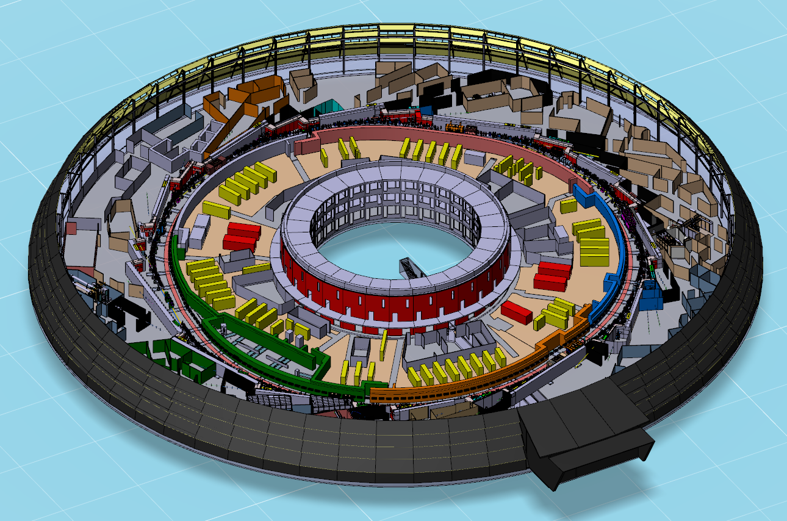
Overall planning and boundary conditions – time schedule
1.7.2022
8
start user operation, BL-Grp.1
01.08.2025
1
storage ring lattice defined
30.06.2020
3
SLS2.0 funding secured
01.01.2021
6
tunnel closure
20.12.2024
10
re-start user operation
01.06.2026
2020 | 2021 | 2022 | 2023 | 2024 | 2025 | 2026
2
beamlines & beamline positions defined
30.09.2020
4
ready for
dark time
19.10.2022
5
start dark time
02.10.2023
7
nominal beam available
01.05.2025
9
start shutdown phase 2
21.12.2025

Slide 4
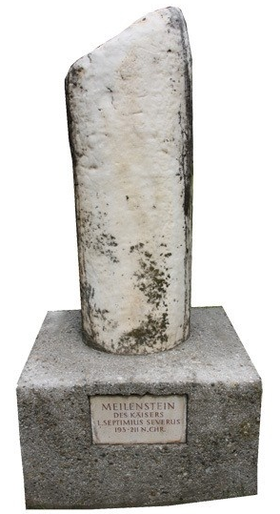
Path to Milestone IV
October
September
17.10 SteCo
Final
Decision
20-21 SLS PRC
SLS 2.0 Milestone IV
19 October 2022
August
19-20.9 MAC
External view
and feedback
Iteration
with WPs
on
open issues
July
1.7
PSIM
Summary retreat with SteCo comments
June
13-14.6
Retreat
PL team
& WP leaders
Status check for all WPs except end-stations
24.6
SteCo

Slide 5
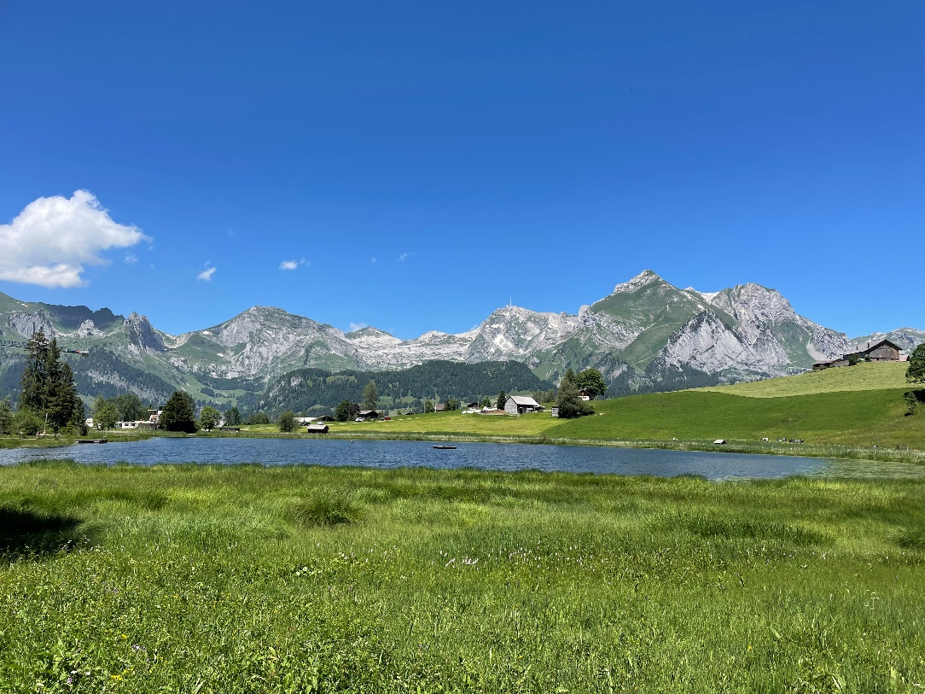
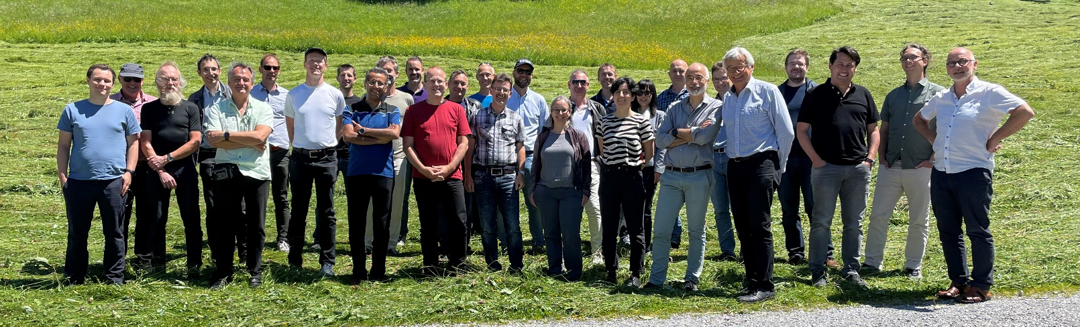
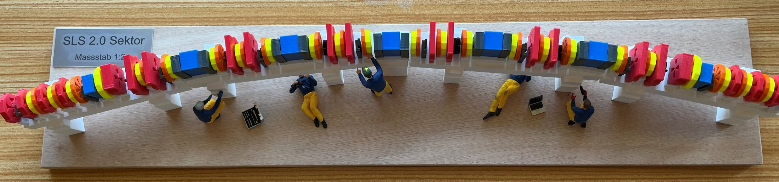
SLS 2.0 “ready for darktime” retreat
Wildhaus SG, June 13-14

Slide 6
Follow up project retreat “ready for dark time”, 19.10.2022
For the decision milestone we have to answer two key questions:
Do we believe that all critical components for installation and beam commissioning are available in time?
Do we have confidence that our installation plans and procedures are sound and feasible?
At the retreat no clear showstoppers were identified, but several WP leaders expressed concerns about the
lack of time contingencies in the procurement and assembly plan.
The project management has from the retreat outcomes a “homework list” of urgent tasks
In view of milestone IV and the retreat results the project management keeps the present project schedule,
i.e. stopping SLS end September 2023, tunnel closure after ring installation December 2024)
unless
a) bids for ongoing calls for tender for magnets reveal that the magnet delivery schedule cannot be met,
or
b) severe problems from the vacuum chamber assembly tests surface until October this year.
The SLS2.0 steering committee supports this approach.
The project management and the steering committee are aware of the risk
that a major mishap in component delivery may will force us to extend the installation period of SLS2.0.

Slide 7
Magnets Delivery Plan
Contract to be signed in Nov. 22
Last delivery in Feb. 24
  Measurements
  Installation
  Commissioning
  => Critical Path for Dark Time completion
Slide courtesy of S. Sanfilippo

Slide 8
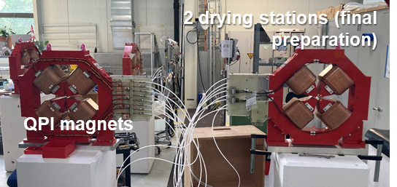
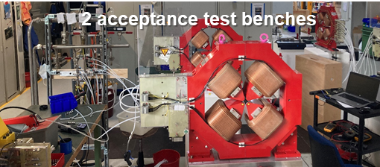
Quadrupoles QP Series
QP Series (108 Magnets)
Delivery going as planned
50% already measured and within specs !
QPI magnet
Pictures courtesy of S. Sanfilippo

Slide 9
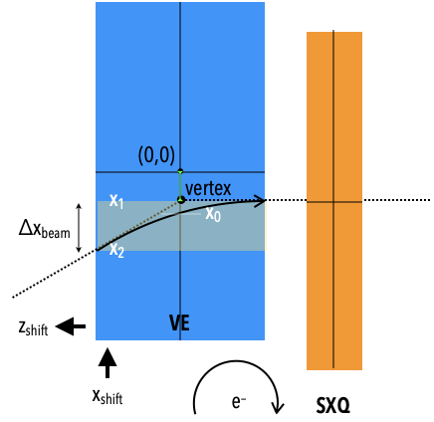
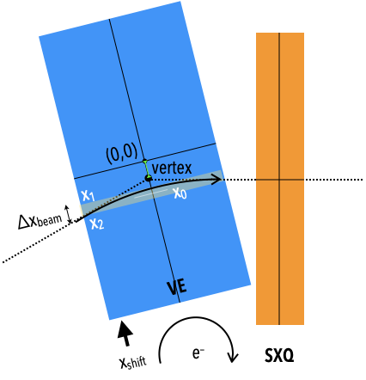
Magnet Cross Talks
Neighborhoods Spacing [mm]
AN – OC 32 -> 42
ANO – CV 56 -> 66 and exchange CV <=> CH
CH – BEI 63 -> 63 (exchange CV <=> CH)
SX – OC 56 : OK (simulation)
BN – VB – SX 64 : OK (simulation)
SX - AN/ANM 42 : work in progress
VE – SXQ 51 : work in progress
BE – SXQ 49 : work in progress
CV – OC 40 : not started
QP – OC 68 : should be small
QP – SX 78 : should be small
QP – CH 62 : should be small
Design Change Request 001
Field Map (Opera)
and tracking code
Drawings courtesy of V. Vrankovic

Slide 10
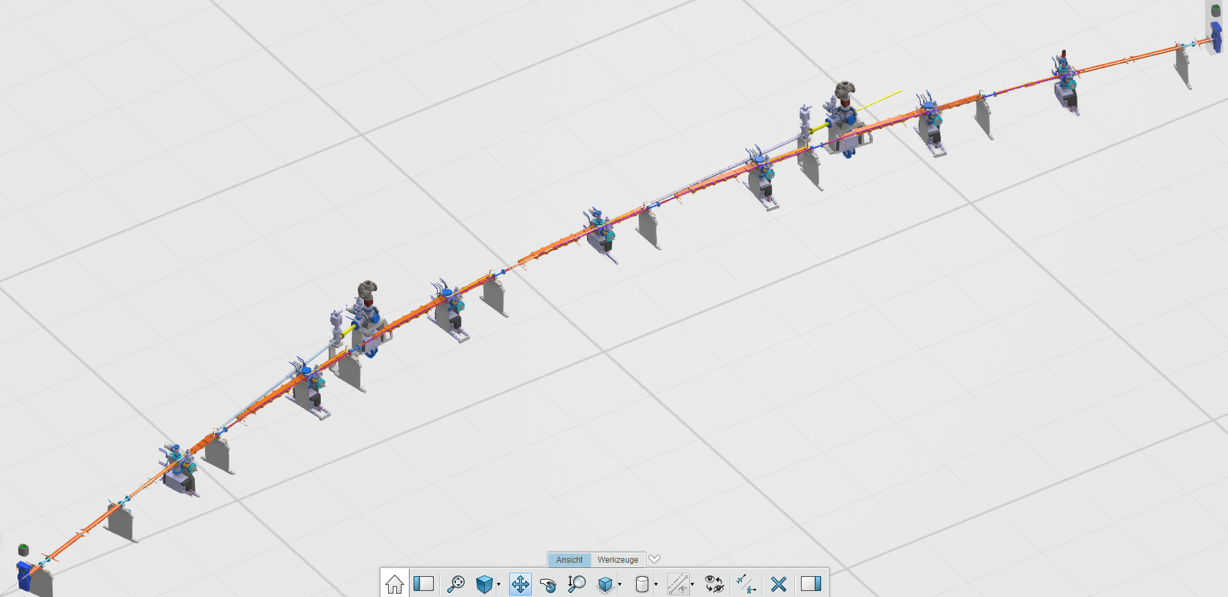
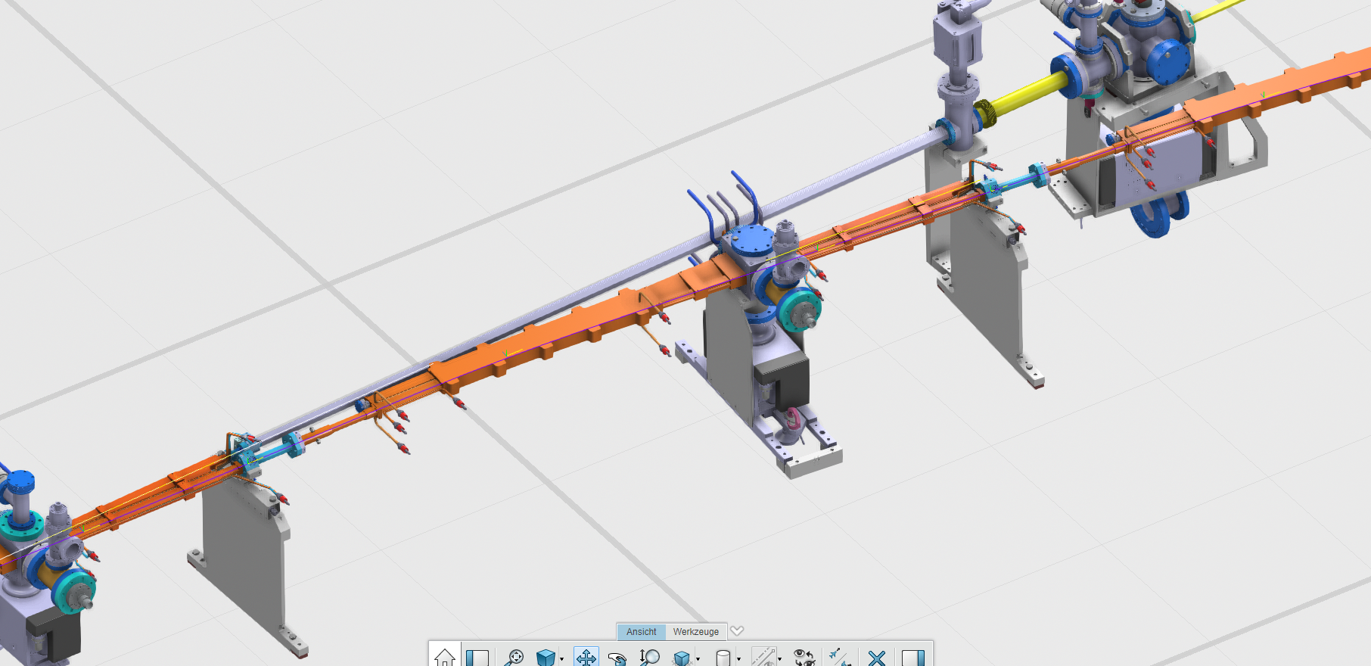
Status Vacuum
Vacuum procurement for Arcs:
460 chambers from external company (production started)
70 dipole chambers produced and coat in house (2 prototypes produced)
Straight Sections: many components still in design

Slide 11
Delivery Arc Vacuum Chamber
Dark Time
6 Arcs limited by dipole vacuum chambers delivery !

Slide 12
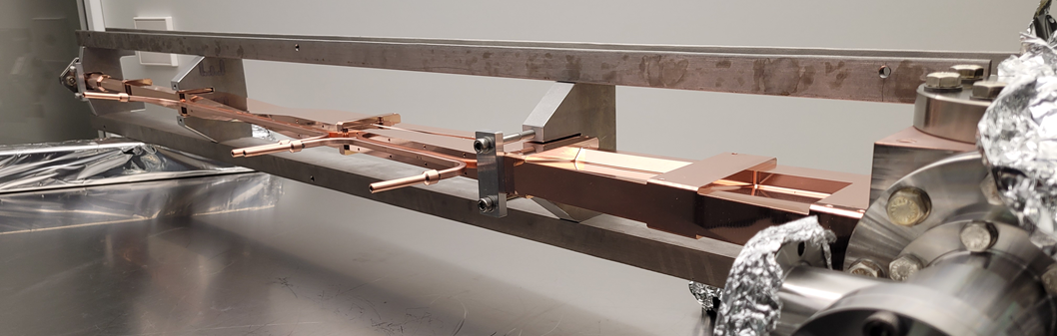
Superbend Dipole Chamber
Chamber soft and fragile (1 mm wall thickness)
Annealed copper
3 mm sagitta deformation
K. Dreyer

Slide 13
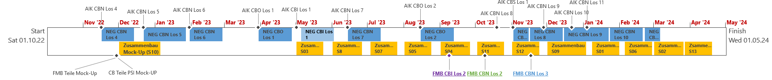
Arc Assembly limited by chamber delivery
  Overlapp Pre-assembly and Dark Time
  (ressources currently not planned for that)
  Dipole chambers NEG Coating
  Arc pre-assembly and activation
  SLS1 De-assembly & storage (Injection straight, …)
  SLS2 Arc in Tunnel Assembly
Courtesy of N. Koziol

Slide 14
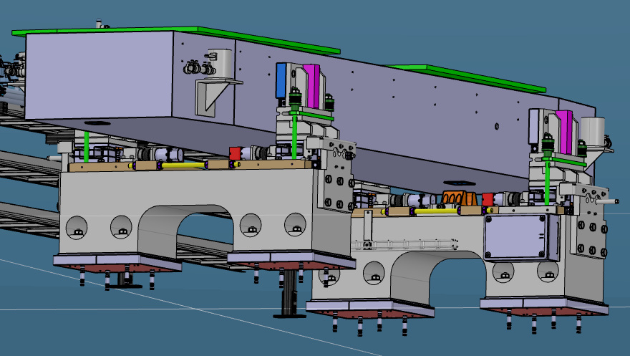
Mechanical Supports: Girder
Main Body (FRAMAG)
Adjustment mechanism (Height)
Feet
Procurement:
Feet + Body Series: to be ordered in August 22 (Delivery: Nov. 22 – March 23)
Adjustement mechanism: prototyp under test !
Prototype Tests:
First Eigenfrequency ~24.5 Hz transversal
Girder motion overconstrained: to be optimized …
Pictures courtesy of H. Joehri, X. Wang

Slide 15
Some critical SLS2.0 storage ring activities of next months
Several important tests / information until «Ready for Dark Time Milestone»
      Finalisation girder motion mechanism: July 22
      Delivery Plan of last magnet series: July / August 22
      Production of leak tight CBN_2: August 22
      Test of octupole prototype #3 (wider yoke): August 22
      Completion of cross talks studies: September 22
      NEG coating of a CB chamber: September 22
      Test Transport mini-mocke up: September 22

Slide 16
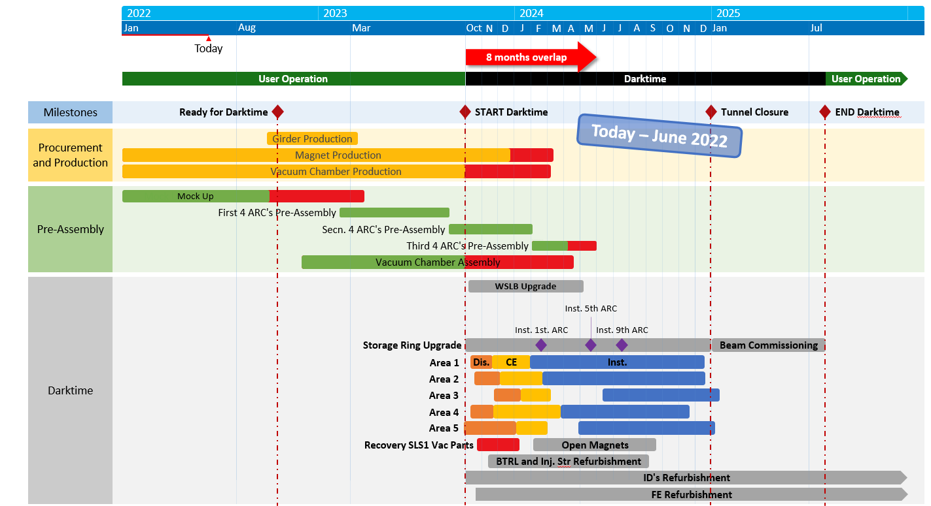
SLS 2.0 Sub-project Infrastructure & Logistics
Optimization of Pre-assembly and Darktime planning
Current situation is critical regarding parallel work → limited work force and crane utilization
  Caused by late delivery of some
  components (e.g. magnets and
  vacuum chambers)
  Need for updated planning by
  using 2-shift strategy and add.
  work force
  Additional “crane days” will be
  needed before DT. This is pre-
  aligned with PSD.
  Updated planning to be done
  during Next weeks
  cost impact for add. work force
  to be expected

Slide 17
SLS 2.0 Sub-project Infrastructure & Logistics
Logistics for clearance process for old girders
Logistics concept for girder dismantling and clearance measurements has been optimized
  Originally, it was planned to disassemble the old girders and do the radiological clearance directly after removal
  New decision: Postpone disassembly and clearance measurement after tunnel closure (start in 2025)
    Advantages:
      Utilize of important workforce for SLS 2.0 installation instead of disassembly of old girders
      Avoid extra and expensive tent for girder handling for clearance process
      Use of a simple tent just for storage of the old girders (BAG requirement)
  Opportunity:
    Use Portmannhalle for disassembly and clearance
    measurements, after the pre-assemblies for cable and
    water pipe trays are dispatched for installation
    (starting in 2025)

Slide 18
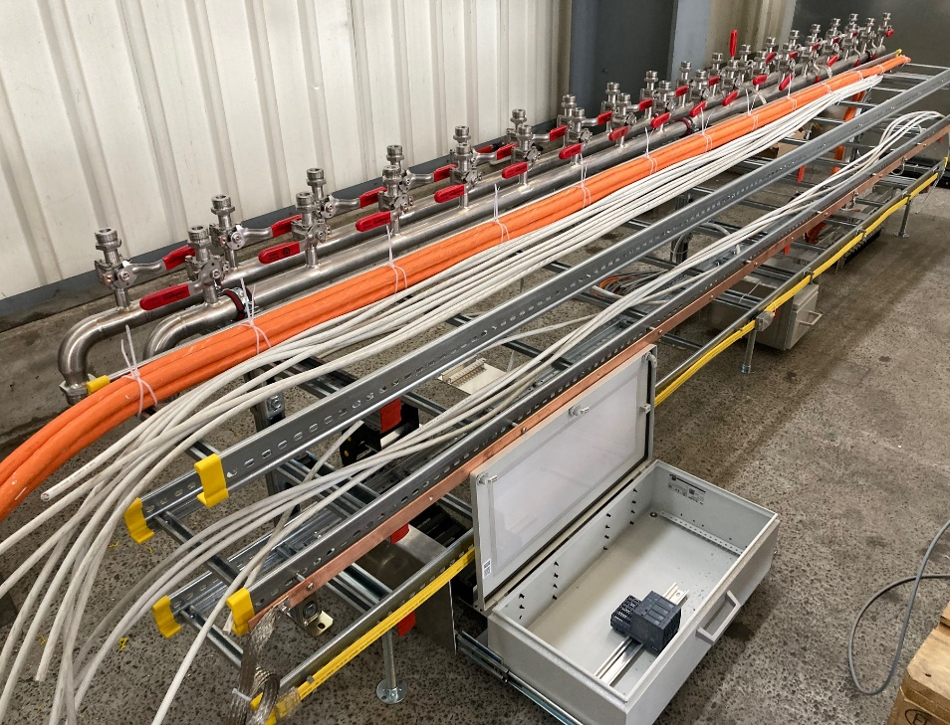
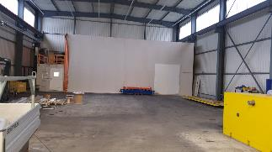
SLS 2.0 Sub-project Infrastructure & Logistics
Pre-assemblies for trays for cabling and water pipes
Pre-assembly of tray for cables and water pipes for girders
  First sample currently in preparation
  Sample will be used together with girder Mock-up to optimize final design
  Each unit will be pre-assembled and stored in Portmannhalle
  Exact design and positioning of the drawers for I/O modules and control systems will be optimized together with the respective Fachgruppe

Slide 19
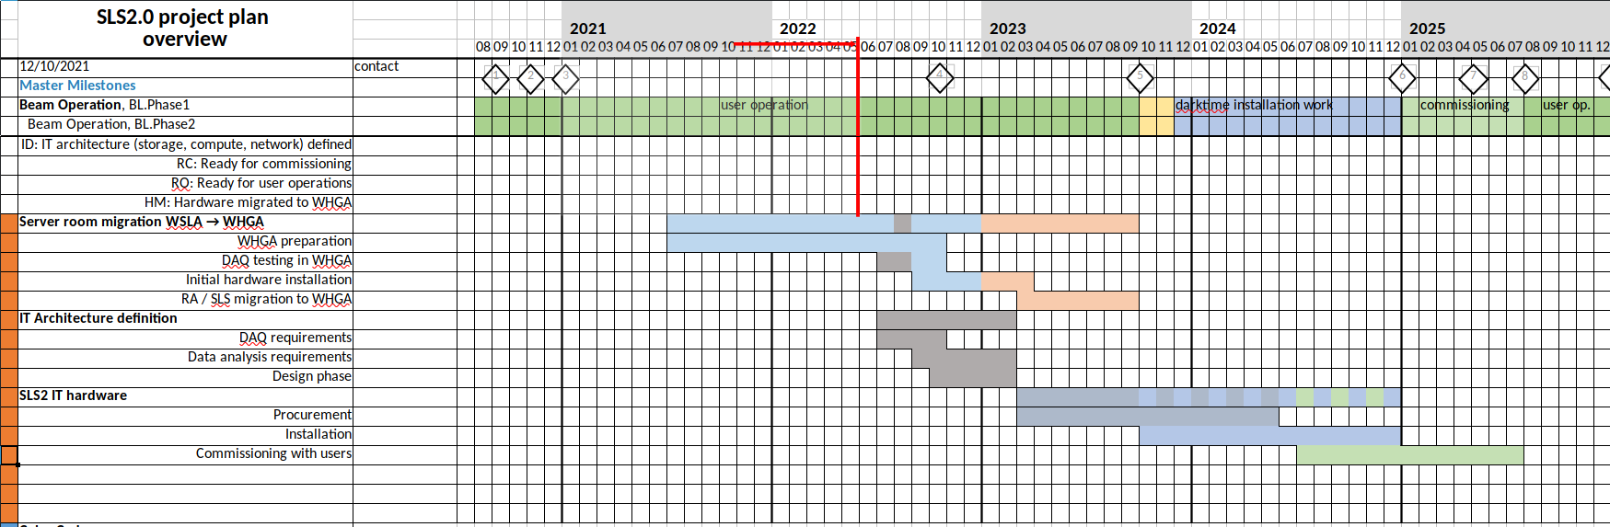
Storage and compute updates
Draft project plan for IT infrastructure:
Preparing WHGA cold isle with AIT
Understanding WHGA server room limitations
Preparing preliminary compute and DAQ testbeds
Need to get storage and compute architecture requirements very soon

Slide 20
SLS2.0 budget vs. cost forecast
The present cost forecast is ≈10% above the committed budget of 129 MCHF
Main cost increases are due to increased procurement cost
for storage ring and photon science sub-projects.
Thorough up-dating of cost-to-completion estimate essential to keep track of the real cost evolution.
Provide any information on significant cost changes of your WP to Uwe as soon as you become aware of them!
It is presently not clear if additional budgets can be found or if project de-scoping is required.

Slide 21
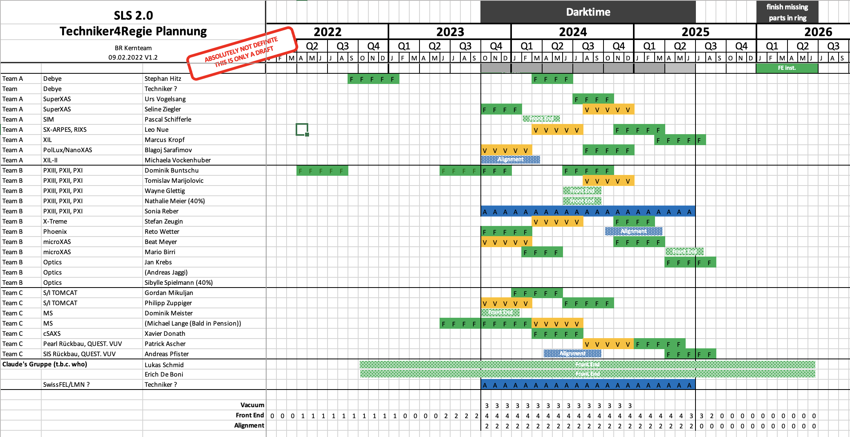
Techniker4Regie
Technicians substituting “Regie” from PSD pool and the teams in which they will work have now been defined

Slide 22
ESup organigram
Oliver Bunk (Chair)
Thierry Strässle (Co-chair)
PSD lab heads
Gabriel Aeppli
Mike Seidel
Phil, Hans
Susanne Wagner
Markus Joerg
Alun Ashton
SLS 2.0
SteCo
Strategy and Reporting
Prioritization
SLS 2.0 Project Leader Photon Science
ESup Project Leader
Frithjof Nolting
PSD-FG:
FE
XIL I. Mochi
RIXS Th. Schmitt
SX-ARPES (partial) V. Strokov
SIM endstation A. Kleibert/J. Raabe
SuperXAS endstation components M. Nachtegaal
Debye M. Nachtegaal
PolLux/nanoXAS endstations J. Raabe/B. Watts/L. Artiglia
microXAS D. Grolimund
PX I K. McAuley
PX II A. Pauluhn
X-Treme C. Piamonteze
PHOENIX Th. Huthwelker
MS N. Casati
VUV endstation components A. Bödi
cSAXS endstation components A. Menzel
QUEST (SIS & PEARL) M. Radovic
PSD-FG:
ID
PSD-FG:
Optics
Requests
Requests
Jörg Raabe
Wayne Glettig, Juri Honegger, Dominik Meister, Stefan Zeugin
Frontends
IDs
SLS 2.0 funded BLs/components
SX-ARPES
SIM optics
XIL
PX III
microXAS
Optics
S-TOMCAT
I-TOMCAT
cSAXS
QUEST
Overview Resource planning and distribution†
P. Schifferle
+ 6 Techniker*
W. Glettig
+ 6 Techniker*
D. Meister
+ 6 Techniker*
Detailed Resource planning and distribution
PSD Technicians
FG LOG/GFA
FG LOG/GFA
FG LOG/GFA
† See also: http://i.psi.ch/KxXF6
* Of the 6 Techniker, ≡ 2 FTE
for darktime FEs and vacuum

Slide 23
ESup: SLS 2.0 – Phased beamline construction
Phase 1
I-TOMCAT
PX I
PX II
MS
cSAXS
SuperXAS
PolLux/nanoXAS
Optics/diagnostics
Phase 2
XIL
RIXS
SX-ARPES
microXAS
X-Treme
PHOENIX
VUV
QUEST (SIS & PEARL)
Install 5-T SBs
Phase 0
SIM
Debye
PX III
S-TOMCAT
Beam diagnostics
+
Phase 0
SIM
Debye
PX III
S-TOMCAT
Beam diagnostics
1
storage ring lattice defined
30.06.2020
3
SLS 2.0 funding secured
31.12.2020
6
tunnel closure
20.12.2024
8
start user operation
01.08.2025
10
re-start user operation
01.06.2026
2020 | 2021 | 2022 | 2023 | 2024 | 2025 | 2026
2
beamlines & beamline positions defined
30.09.2020
4
ready for
dark time?
19.10.2022
5
start dark time
02.10.2023
7
nominal beam available
01.05.2025
9
start shutdown
21.12.2025
24.06.2022
Slides courtesy Frithjof Nolting

Slide 24
ESup focus (EndStation upgrade)
Several larger beamline/endstations upgrades/rebuilds: mainly (but not exclusively) Phase II
Smaller upgrade of beamlines and endstations to improve performance
Improve overall infrastructure to make best use of SLS 2.0 machine
Coordinate
  larger upgrades of individual beamlines
  research sabbaticals of scientific staff during dark period
  between SLS 2.0 upgrade and operation of SLS
Continuation after SLS 2.0 funding is finished (December 2024)
Funding reserve for flexible cash flow
In short: All activities related to the upgrade of the SLS which are not funded by the SLS 2.0 project, but by PSD EM/DM (ESup direct) and by PSD ZM proposals (ESup umbrella)

Slide 25
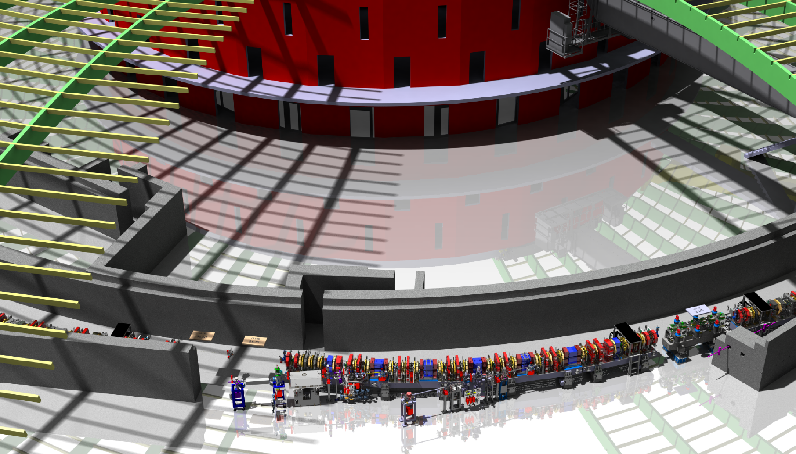
Looking forward to see this live in 2024
Courtesy Max Wurm

