Slide 1
SwissFEL Exchange Meeting
Machine report
Week 26/2022
Didier Voulot, SEM, 3 July 2022

Slide 2
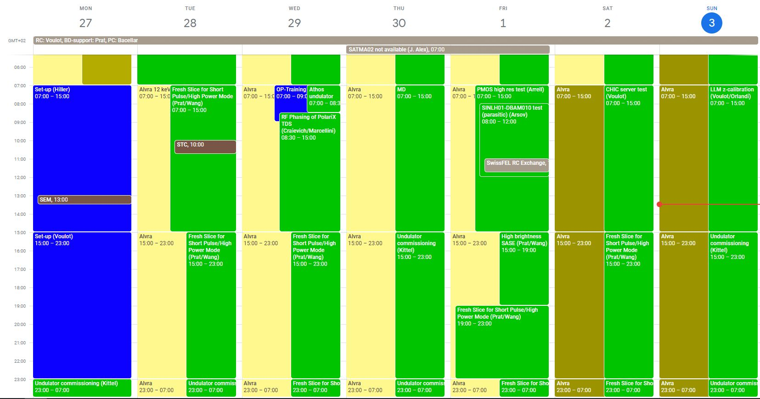

Slide 3
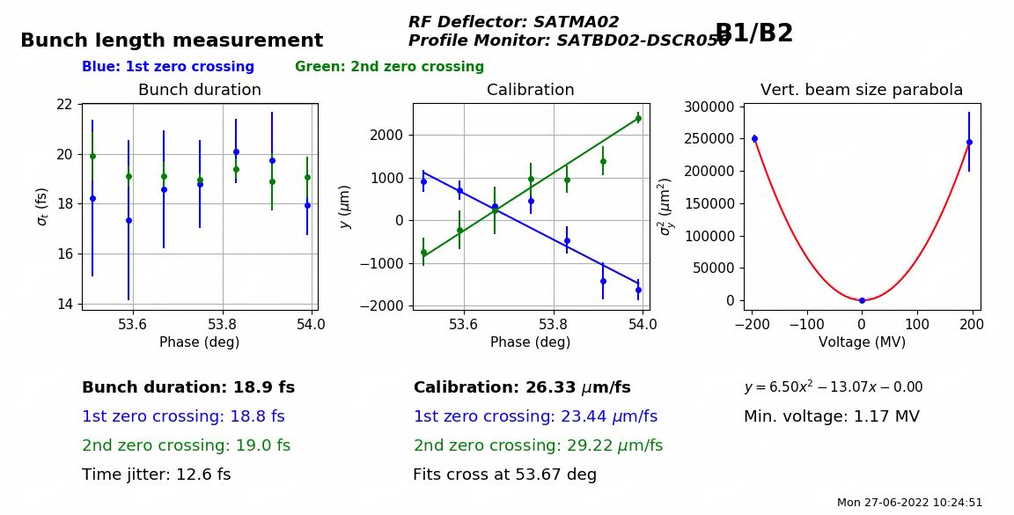
Set-up
Aramis
  911 uJ at 12 keV (new record)
  Check pointing with Alvra
Athos
  2.38 mJ at 600 eV
Set-up completed within one shift then tried to increase Mizar power to reach higher charge for MD, changed optics and removed some components. Unfortunately Alcor UV aperture feedback could not run anymore (not clear why). Lasing down to 850 uJ.
Test bunch length measurement with SATMA02: still limited in power, a few bugs in the bunch length tool

Slide 4
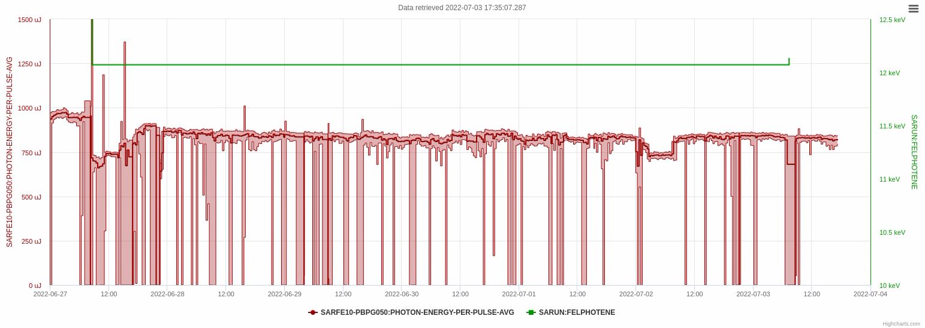
Problem with compression feedback
SINSB04
Set-up
Alvra

Slide 5
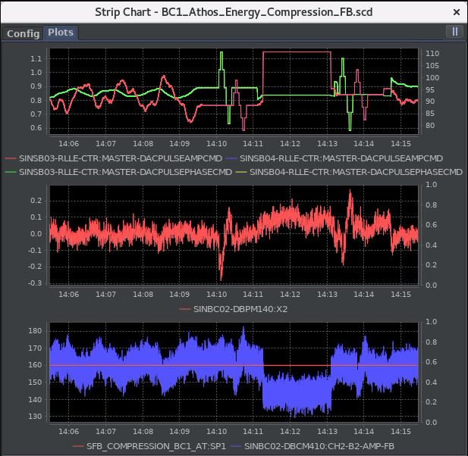
Technical Issues
Compression feedback BC1 for bunch2 is unstable, problem with sensor or feedback itself (oscillations), occasionally the feedback is running out of position
SINSB04 down on Sunday morning due to controls problems (2h)
Some instability in the beam (maybe due to missing laser feedback?)
Retuned periodically gun solenoid: suspect gun RF is drifting but could not find anything
Losses in LH still present, will try to remove LH chicane on Monday to protect the LH undulator

