Slide 1
SwissFEL Exchange Meeting
Machine report
Week 29/2022
Didier Voulot, SEM, 25 July 2022

Slide 2
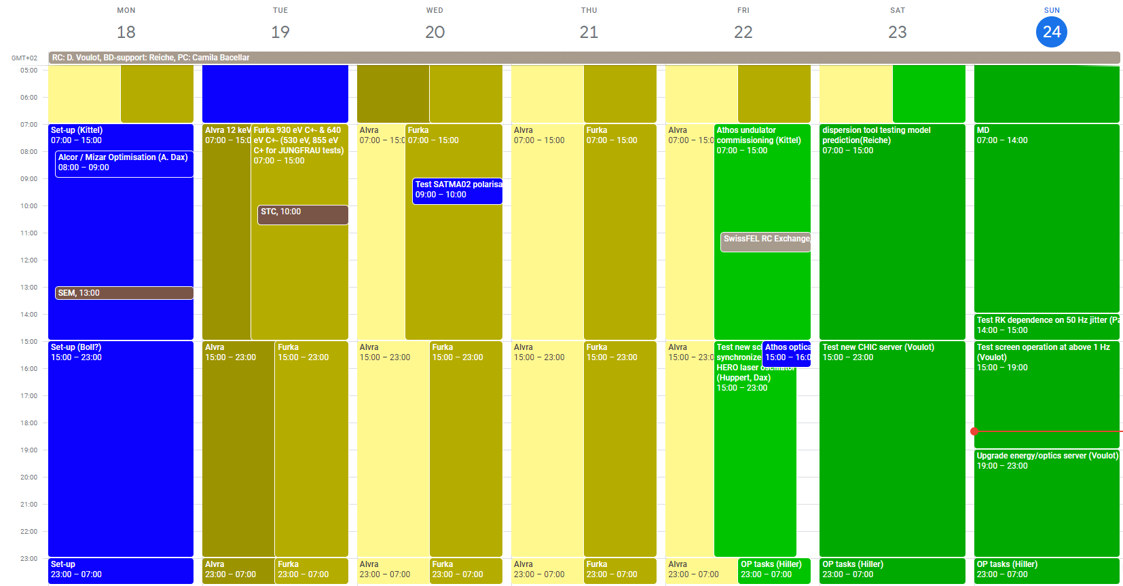

Slide 3
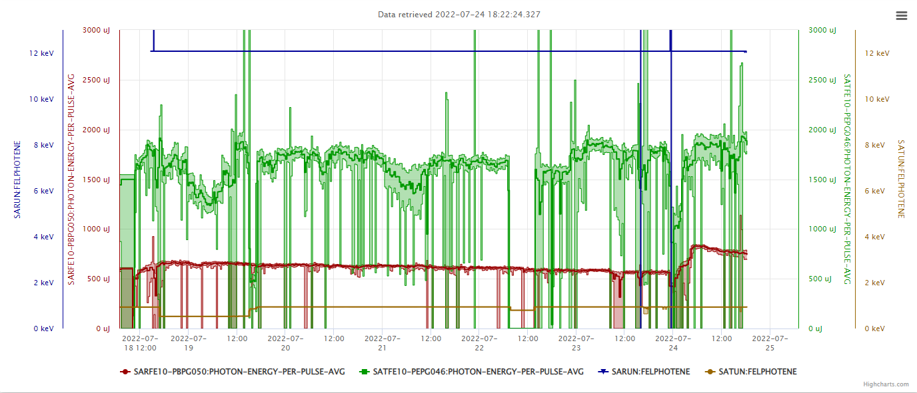
Nicole retuning Alcor (laser position?)
Athos drifting during the night,
compression FB at the limit
Set-up
Alvra
MD Aramis
Furka
MD Athos

Slide 4
Technical Issues
Opening undulators to lower Athos pulse energy makes lasing unstable, would be better to use the gas attenuator (a calibration tool is in preparation)
Could not restore the best 12 keV settings on Monday, seems the laser aperture position was the key? (Nicole’s investigations during the night shifts)
Some vacuum interruptions due to SATMA02 conditioning in the beginning of the week, conditioning settings target were made less aggressive.

Slide 5
MD
Week-end
HERO laser commisisoning
Development/consolidation of operation and linac tuning tools: new CHIC server, dispersion tool, optics server…
Athos undulator commissioning
Next week:
Mostly new modes for Athos (Beam Dynamics)
Commissioning and upgrades (RF, controls, BPMs)

Slide 6
