Slide 1
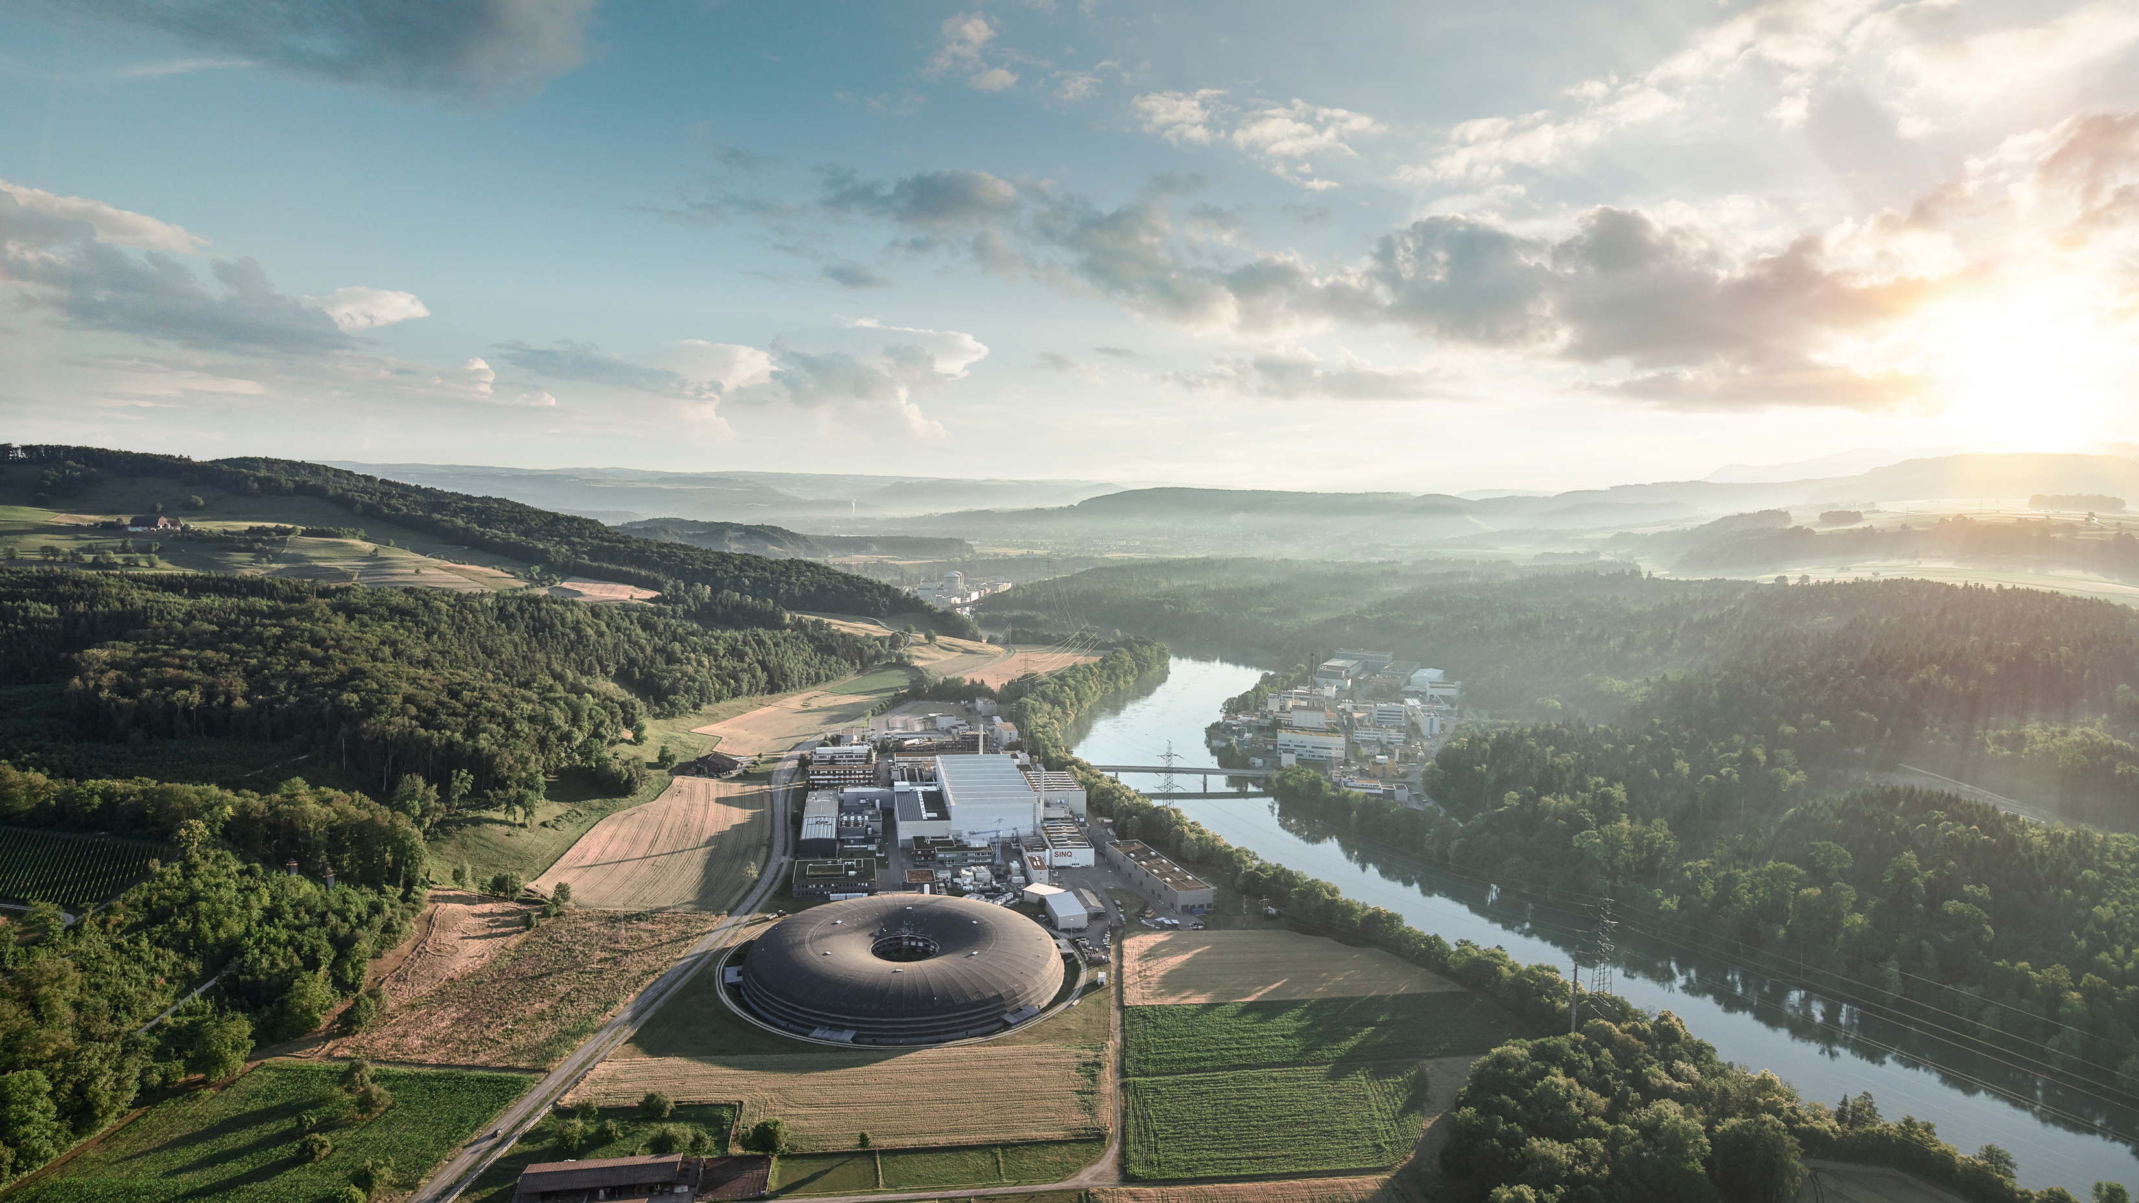
Bi-Monthly Meeting 7900 Host
Alun Ashton
AWI General Introduction

Slide 2
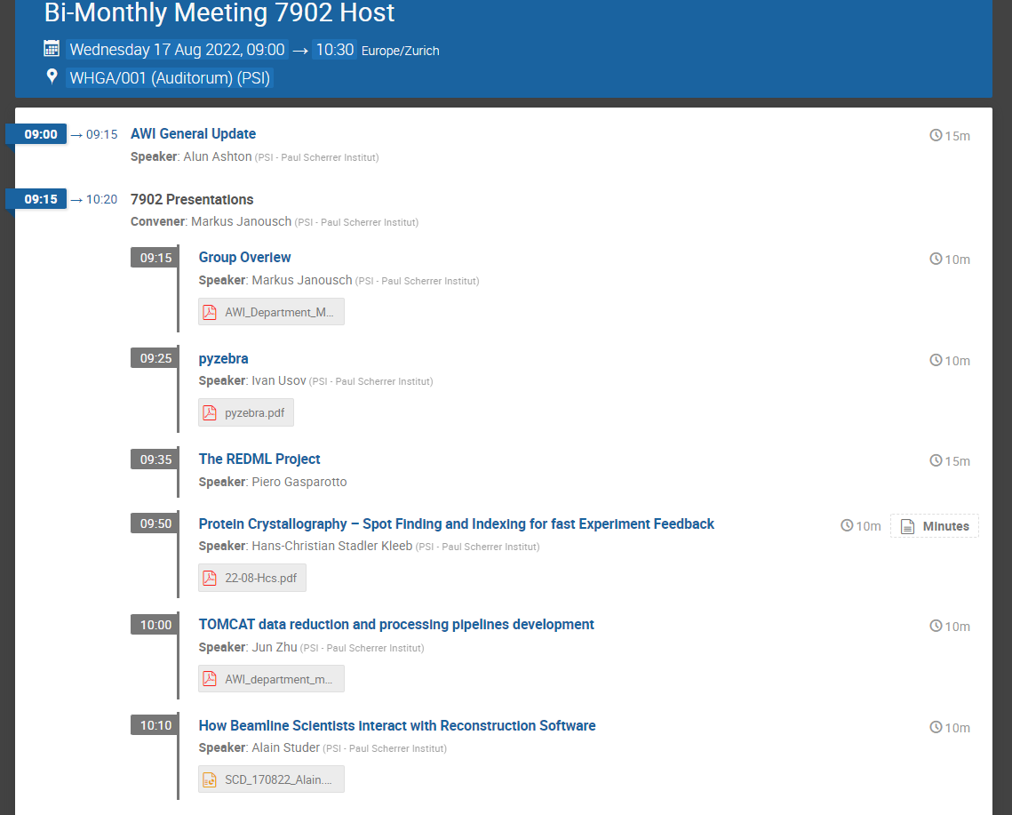

Slide 3
Updates on AWI organization/recruitments.
Alun Ashton
(Head of AWI
Xingxing (Marie) Yao
(Coordinator and Architect, SLS2.0)
Leonardo Sala
Data and Analysis Research Infrastructure
Stephan Egli
Scientific Data Curation
(ORD)
Markus Janousch
Data Processing Development and Consulting
Alun Ashton a.i.
Experiment IT Development and Operations
Derek Feichtinger
HPC and Emerging Technologies
Spencer Bliven
Scientist (BIO)
Marc Caubet
Scientists
(Merlin)
Achim Gsell
Senior Scientist
Vacancy TransALPS
Ivano Talamo
(Ra Sys Admin)
Alvise Dorigo
(SwissFel)
Joshua Taylor
(SLS Online)
Krisztian Pozsa
(ExPaNDS EOSC)
Carlo Minotti
(ExPaNDS EOSC)
HC Stadler
(cSAXS)
Alain Studer
(TOMCAT)
Ivan Usov
(SwissFEL/NUM)
Jun Zhu (1/22)
SLS 2.0 Data reduction and compression
PSD DAQ
Dmitry Ozerov
(SwissFEL)
Sven Augustin
(SwissFEL/ATHOS)
Klaus Wakonig
(SLS DAQ)
SLS 2.0 Online Analysis
EOSCFuture Use Case
Piero Gasparotto (REDML)
GL: Leonardo Sala a.i.
Core Linux Research Services
Konrad Bucheli (2/22)
System Engineer
System Engineer
Vacancy TransALPS
Markus Janousch started as GL on 1/11/21
Jun Zhu 1/1/22
Konrad Bucheli 2/2/22
[re-]advertise
  GL & SE Core Linux Research Services
  GL Experiment IT Development and Operations.
  SE SLS 2.0 Online Analysis
  2x TransAlps roles
JANUARY 2022
Key to Fixed Term Roles
EU Funded (3 funded roles)
PSI Funded fixed term (4 funded, 4 TBC)
Swiss Funded initiatives (3 funded, 3-4 TBC)

Slide 4
AWI organizational update
Alun Ashton
(Head of AWI
Xingxing (Marie) Yao
(Coordinator and Architect, SLS2.0)
Leonardo Sala
Data and Analysis Research Infrastructure
Stephan Egli
Scientific Data Curation
(ORD)
Markus Janousch
Data Processing Development and Consulting
Sven Augustin
Experiment IT Development and Operations
Derek Feichtinger
HPC and Emerging Technologies
Spencer Bliven
Scientist (BIO)
Marc Caubet
Scientists
(Merlin)
Achim Gsell
Senior Scientist
Elsa Germann TransALPS
(1/8)
Ivano Talamo
(Ra Sys Admin)
Alvise Dorigo
(SwissFel)
Joshua Taylor
(SLS Online)
Krisztian Pozsa
(ExPaNDS EOSC)
Carlo Minotti
(ExPaNDS EOSC)
HC Stadler
(cSAXS)
Alain Studer
(TOMCAT)
Ivan Usov
(SwissFEL/NUM)
Jun Zhu (1/22)
SLS 2.0 Data reduction and compression
PSD DAQ
Dmitry Ozerov
(SwissFEL)
(SwissFEL/ATHOS)
Klaus Wakonig
(SLS DAQ)
SLS 2.0
Piero Gasparotto (REDML)
GL: Leonardo Sala a.i.
Core Linux Research Services
Konrad Bucheli (2/22)
System Engineer
System Engineer
Hans Viessmann
TransALPS
(1/7)
Early Career Sys Admin (hire)
16/08/22
Sven took over EIDO
Hans and Else joined HET
GL for Core linux research services announced soon
Interviews for
  System Engineer
  Early Career Sys Adm
  SLS 2.0 7901
Advertising
  RSE/SS in 7901
Krisz now on ESOCFuture
Viviana now our admin help
Key to Fixed Term Roles
EU Funded (3 funded roles)
PSI Funded fixed term (4 funded, 4 TBC)
Swiss Funded initiatives (3 funded, 3-4 TBC)

Slide 5
Progress towards our new ‘home’
There is a hole in the ground….
Office layout plans/process
Current target date for moving

Slide 6
Cost predictions for 2023
Please work with the GL to forecast :
  Conferences and workshops (assume anything before May will be virtual)
  Training (actual training not just desirable, some prioritization may be necessary)
  Personal IT hardware replacements

Slide 7
News in brief
ETH-ORD program
  PSI as proposals in M1 and planning for M2
NOBUGS!
AI4SI EU PaN collaboration grant on AI in facilities unsuccessful
  Alternatives now being investigated
Site visits
  CSCS (TansALPS and REDML), DLS (SLS2.0), ESRF (EOSC), NSLS II (SLS2.0), SLAC (for PSAC)….
Department engagement
  Investigations in place for late summer off-site visit or just a social event
  Suggestions open for end of year event
    E.g. bowling, skating…… followed by social event.
Congratulations to Krisz!

