Slide 1
Overview of the group “Data Processing Development and Consulting”
Markus Janousch:: Group Leader :: Paul Scherrer Institut
AWI Department Meeting (7902); August 17, 2022

Slide 2
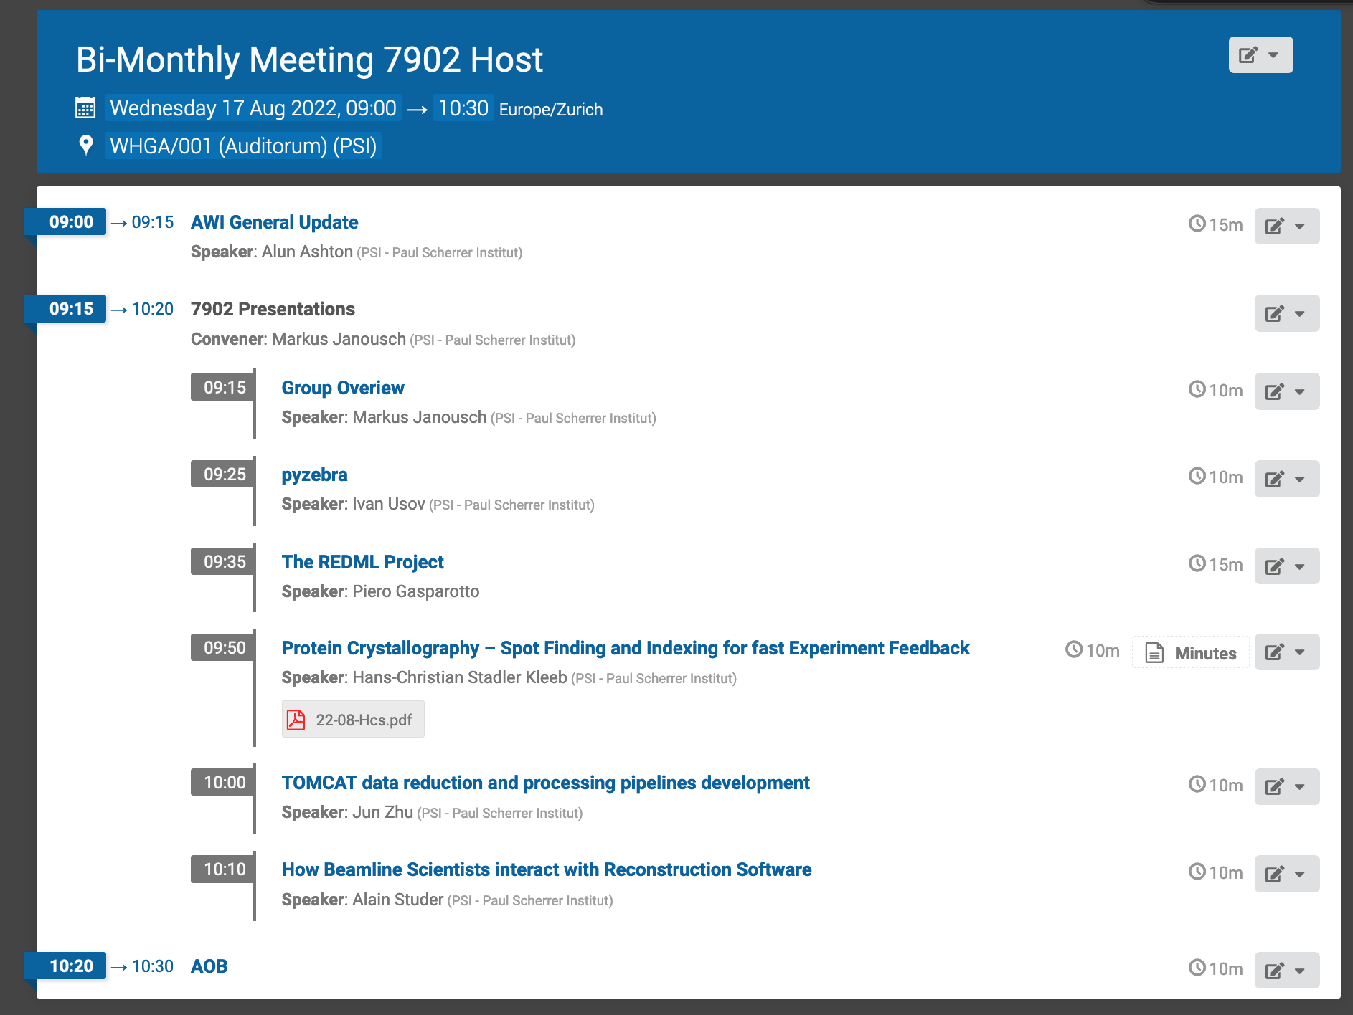
Timetable

Slide 3
Overview
Organisation
Main topics and activities
LEAPS-INNOV

Slide 4
AWI organization
Alun Ashton
(Head of AWI
Xingxing (Marie) Yao
(Coordinator and Architect, SLS2.0)
Leonardo Sala
Data and Analysis Research Infrastructure
Stephan Egli
Scientific Data Curation
(ORD)
Markus Janousch
Data Processing Development and Consulting
Sven Augustin
Experiment IT Development and Operations
Derek Feichtinger
HPC and Emerging Technologies
Spencer Bliven
Scientist (BIO)
Marc Caubet
Scientists
(Merlin)
Achim Gsell
Senior Scientist
Elsa Germann TransALPS
(1/8)
Ivano Talamo
(Ra Sys Admin)
Alvise Dorigo
(SwissFel)
Joshua Taylor
(SLS Online)
Krisztian Pozsa
(ExPaNDS EOSC)
Carlo Minotti
(ExPaNDS EOSC)
HC Stadler
(cSAXS)
Alain Studer
(TOMCAT)
Ivan Usov
(SwissFEL/NUM)
Jun Zhu (1/22)
SLS 2.0 Data reduction and compression
PSD DAQ
Dmitry Ozerov
(SwissFEL)
(SwissFEL/ATHOS)
Klaus Wakonig
(SLS DAQ)
SLS 2.0
Piero Gasparotto (REDML)
GL: Leonardo Sala a.i.
Core Linux Research Services
Konrad Bucheli (2/22)
System Engineer
System Engineer
Hans Viessmann
TransALPS
(1/7)
Early Career Sys Admin (hire)
16/08/22
Data Processing Development and Consulting (7902)
Key to Fixed Term Roles
EU Funded (3 funded roles)
PSI Funded fixed term (4 funded, 4 TBC)
Swiss Funded initiatives (3 funded, 3-4 TBC)

Slide 5
Topics and Main Activities
Our central mission is to provide scientists and user communities with expertise in data reduction and processing algorithms in order to meet their experimental and data analysis needs, i.e., to ease the process of answering data-driven particular scientific questions.
Grants
  AI4SI, not successful
  SDSC --> Jun
  PSI Research grant (Goran Lovric, PI)

Slide 6
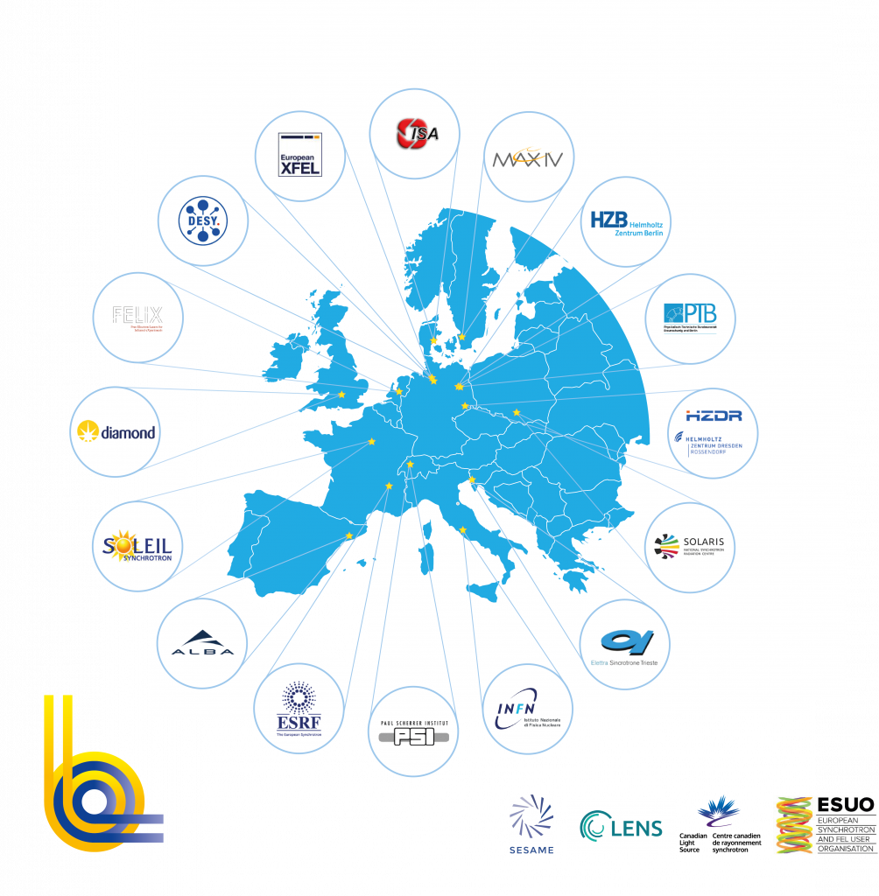

LEAPS
League of European Accelerator-based Photon Sources
It is a strategic consortium initiated by the Directors of 16 Synchrotron Radiation and Free
Electron Laser user facilities in Europe. Its primary goal is to actively and constructively ensure
and promote the quality and impact of fundamental, applied and industrial research carried out
at each facility to the greater benefit of European science and society.
Founded in 2017, initiated by DESY.
Lenny Rivkin (PSI) is the current Chair

Slide 7
LEAPS Roadmap

Slide 8

LEAPS -INNOV
Comprised of the 16 LEAPS members plus 6 research and industry laboratories (ENEA, KTI, STFC, nob, RAITH, XRnanotech)
Funded by the European Horizon 2020 programme with 10 M€.
Lead by DESY (Elke Plönjes)
Submitted May 2020, started a year later.
Organized in 7 work packages

Slide 9
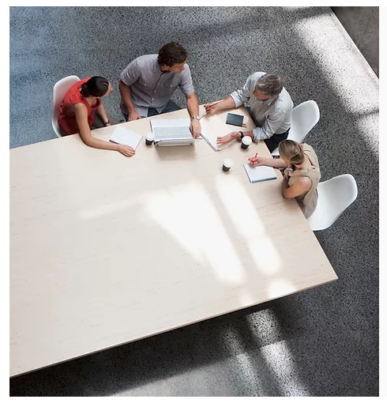



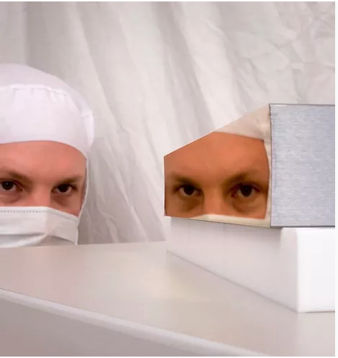
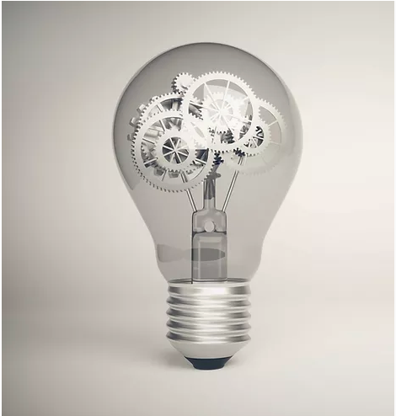
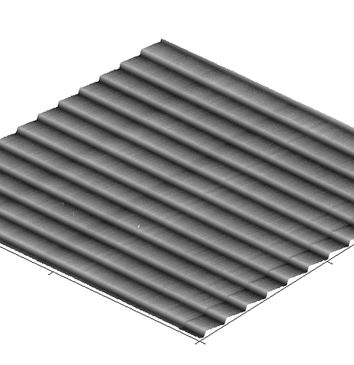
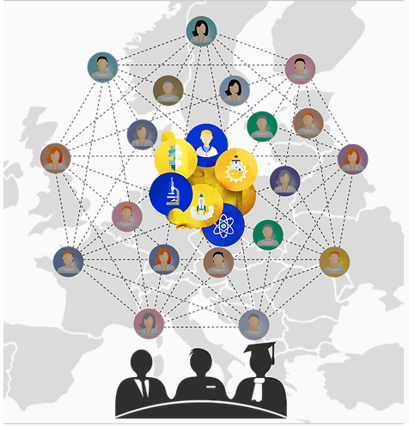
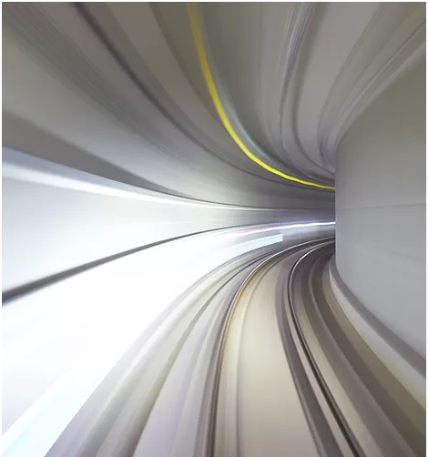
LEAPS-INNOV Work Packages
WP 1
Project Management
and Dissemination (DESY)
WP 6
LIDs
(SOLEIL, PSI, ELETTRA)
WP 2
Development of High Throughput X-
ray Spectroscopy Detector System
(DIAMOND, SOLEIL)
WP 7
Data Reduction and Compression
(MAXIV, DESY)
WP 3
SuperFlat
(ESRF, SOLEIL)
WP 8
Industrial Innovation through Light Source
(ESRF, DIAMOND, ALBA-CELLS)
WP 4
NeXtgrating
(PSI, HZB)
WP 9
Innovation by Co-creation towards
Global Challenges (MAXIV)
WP 5
New positioning and scanning
systems for speed and accuracy (HZB, DIAMOND)

Slide 10
LEAPS-INNOV WP 7
Data Reduction and Compression
With the ever increasing detector size and frame rates we see a dramatic grow in data rates and volume.
WP 7 addresses this issue through 4 tasks
Work package leader Darren Spruce (MAXIV) and David Pennicard (DESY)

Slide 11
WP 7 Tasks
Collaboration platform for data reduction and compression (MAXIV, DESY)
    D7.1 Evaluation report on data rates & volumes and assessment of future needs of LEAPS facilities
Assessment of future needs and development of metrics for data compression and reduction (Alba, ESRF)
    D7.2 Report on metrics for data reduction and compression
Evaluate and adopt new strategies for data reduction and compression (HZDR)
    D7.3 Report results on promising data reduction pipelines on datasets provided by LEAPS facilities and release as open-source to the community
Research infrastructure integration with detector suppliers on data (PSI)
    D7.4 Best practices and guidelines for applying data reduction and compression at LEAPS facilities

Slide 12
WP 7.4 task
Bring the research laboratories and industry together
Start a knowledge exchange between research laboratories and industry
Create a dialogue and the necessary communication flow of technical specifications transmitted in both directions between detector suppliers and participants of WP7
Define and establish best practices, guidelines, and interfaces
Propagate them through new developments and products in the community

Slide 13
Wir schaffen Wissen – heute für morgen
Many thanks to my colleagues at AWI and in particular to my group members!

Slide 14
Timetable

