Slide 1
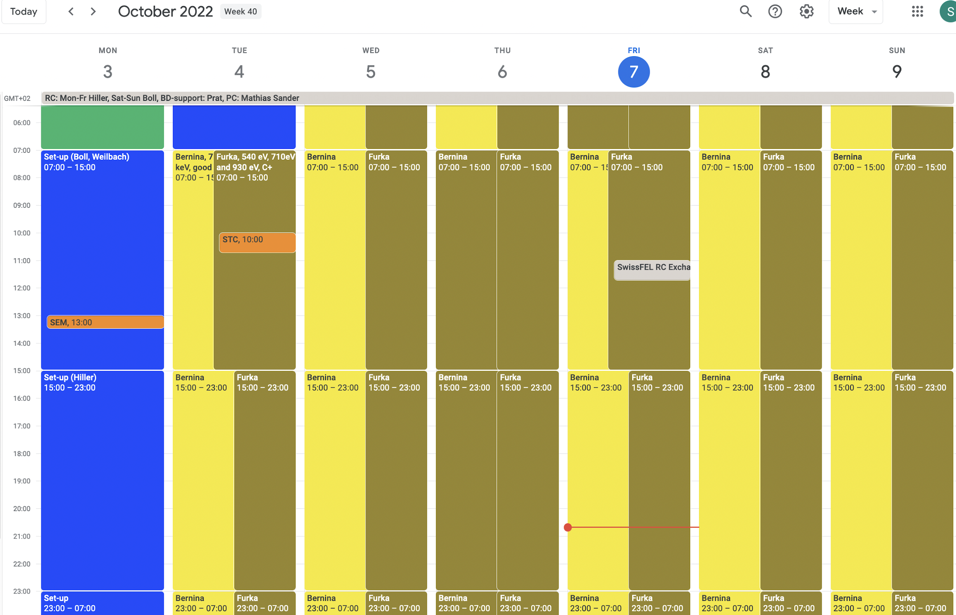
RC Report 2022 week 40 3.-10.10.2022
Aramis: Bernina commissioninig (Tue, Wed) then user experiment 7.1 keV later 9.5 keV
Athos: Furka 535 eV, 710 eV, 930 eV

Slide 2
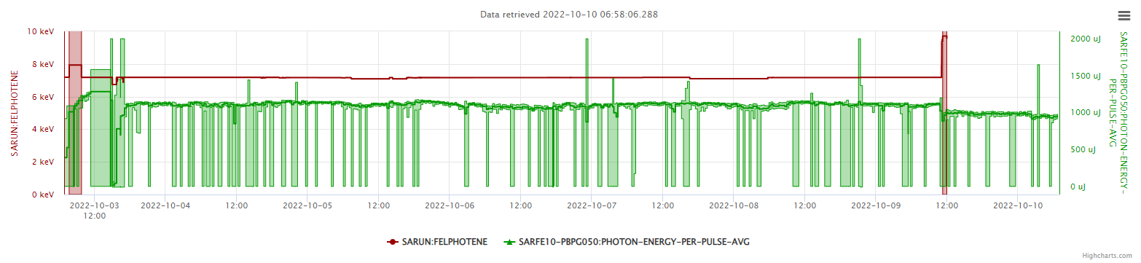
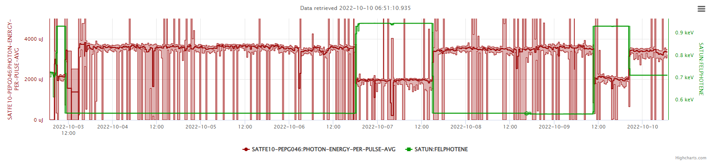
The week
Aramis
Photon energy
Please fill the plots
Pulse energy in µJ
Athos

Slide 3
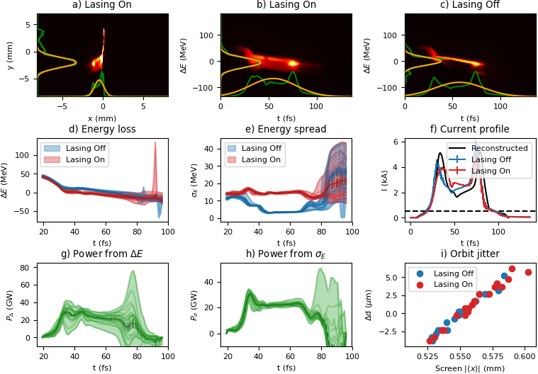
Setup
  7.14 keV for Bernina, FEL pulses are about 45 fs FWHM

Slide 4
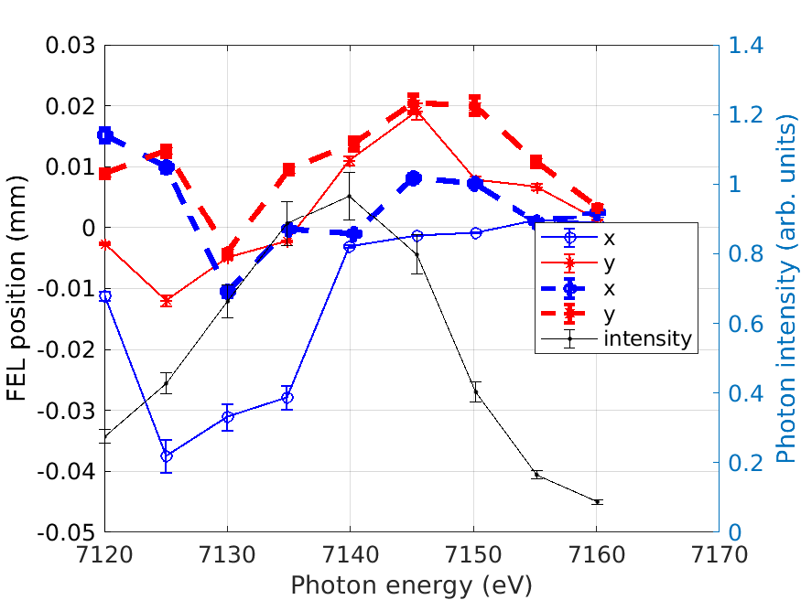
Spatial Chirp optimised
Mono scans to optimise the spatial chirp
The dashed lines are the final settings after optimisation

Slide 5
The issues last week
  During setup
    S30CB14 collimator was stuck -> power brick needed to be restarted and the motor convinced to move and home
    Measuring with S30CB14 caused huge losses and a DRPS alarm with a new detector -> not clear why the losses are so large -> will look into this during next setup
  Several times during the week
    Losses in Athos -> 2 bunch settings had to be restored then things worked again
    we also had to enable it that B2 is automatically stopped when B1 is down (e.g. due to a linac 3 RF failure) otherwise the losses were too big
    frequent vacuum interlocks due to the conditioning of SATMA02 (got better during the week and we also asked the RF group to be a bit less aggressive)
  Thursday afternoon: Tunnel access needed to fix an end switch for the Athos diffusor (it was showing in and out at the same time) -> was fixed rather quickly and the machine restarted without troubles

Slide 6
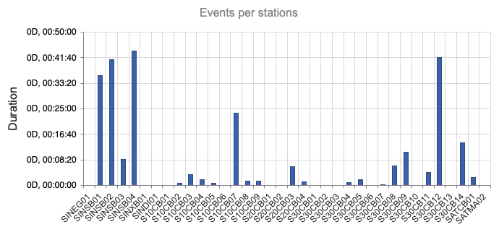
RF Events
Several S-Band breakdowns, S10CB07 had 3 breakdowns that took up to 11 min, S30CB12 was down in one go for 40 min

Slide 7
A couple of comments
text

