Slide 1
SwissFEL Exchange Meeting
Machine report
Week 41/2022
Didier Voulot, SEM, 17 October 2022

Slide 2
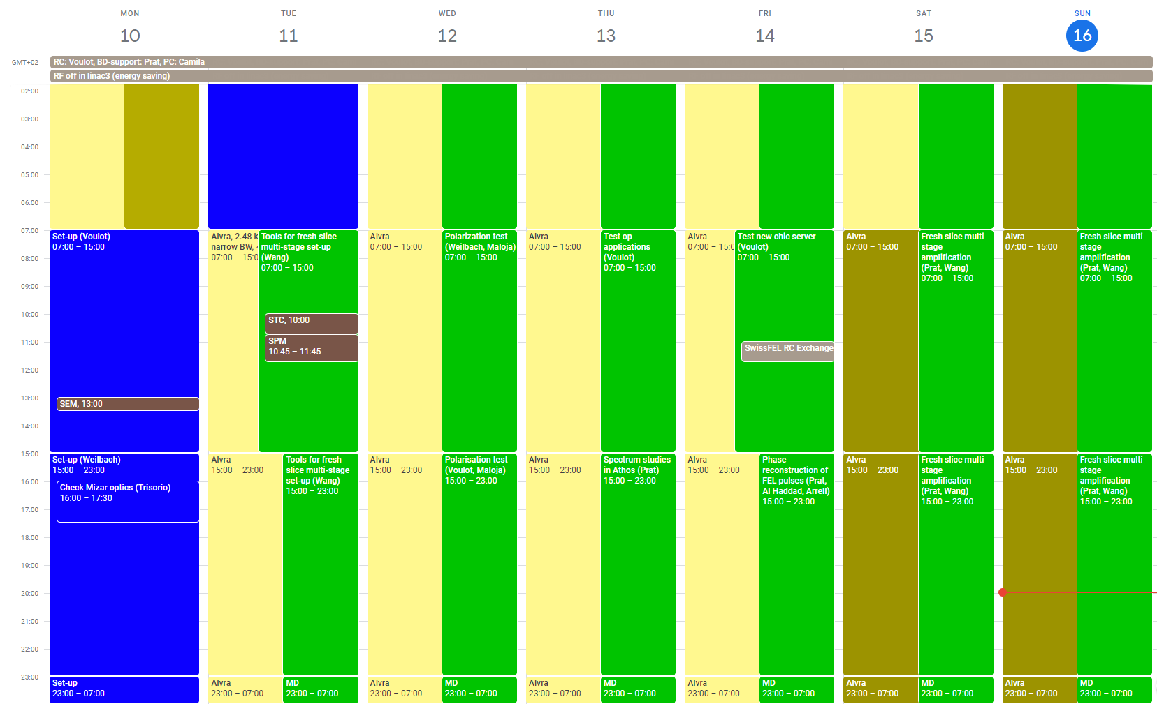

Slide 3
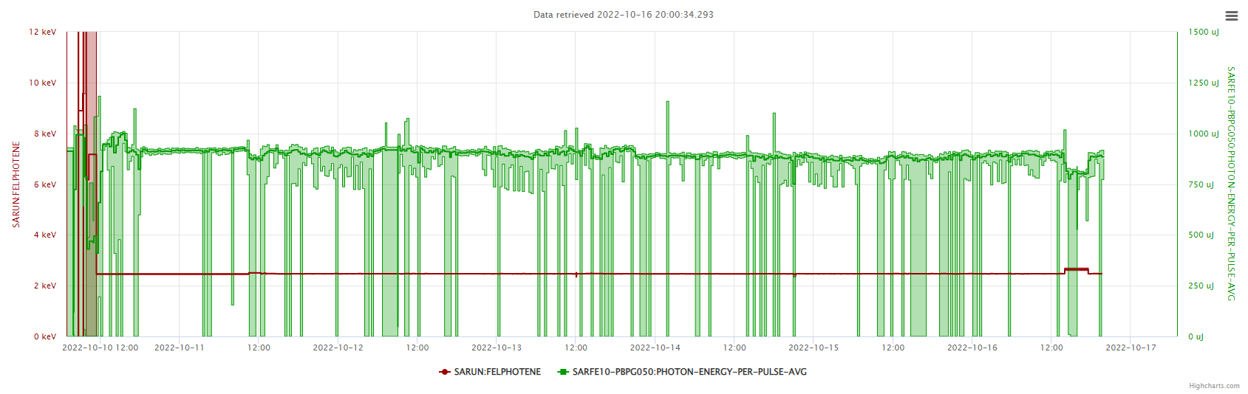
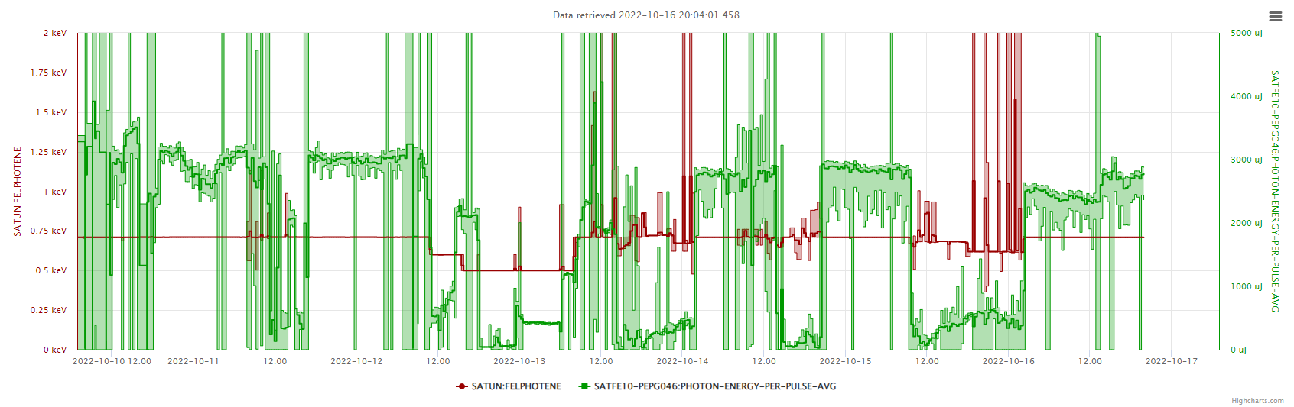

Slide 4
Set-up
Aramis 1 mJ at 2.487 keV
  Switch off 11 of the 13 stations in linac3, the machine was very stable all the week
  check pointing
  optimize BW with compression and X-band amplitude (mono-scans) 0.65 => 0.4% FWHM
Athos 3.5 mJ at 710 eV

Slide 5
MD activities on Athos
Fresh slice multi-stage set-up (Wang/Prat) Tue-Sat-Sun
Athos polarization test/measurement (Maloja/Kittel) Wed
Test operation tools: CHIC server, scaling tools, snapshot restore tool (Voulot) Thu-Fri
Spectrum studies in Athos (Prat) Thu?
Phase reconstruction of FEL pulses (Prat, Al Haddad, Arrell) Fri
Test of C-band at lower repetition rate, preparation ofr week 44 and 48 (Beard) Wed

Slide 6
Technical Issues
Several crash of dechirper/collimator controllers in linac3, the deltaTau power-bricks seem rather unreliable, need ioc restart and motor homing, in some case hard reset in the gallery, the device moved in the beam at least on one occasion
Mizar optics degrading optics replaced on Monday afternoon, this brings a large improvement in lasing stability
SATMA02 is too unstable in phase (drift and jitter) this is making measurements difficult
A bunch of magnet PS show errors/warning in Athos undulators: “Aux Supply Redundancy Warning (38)”, PS group informed
Overall a very good week…

