Slide 1
SwissFEL Exchange Meeting (SEM)
Machine Report
Week 42/2022

Slide 2
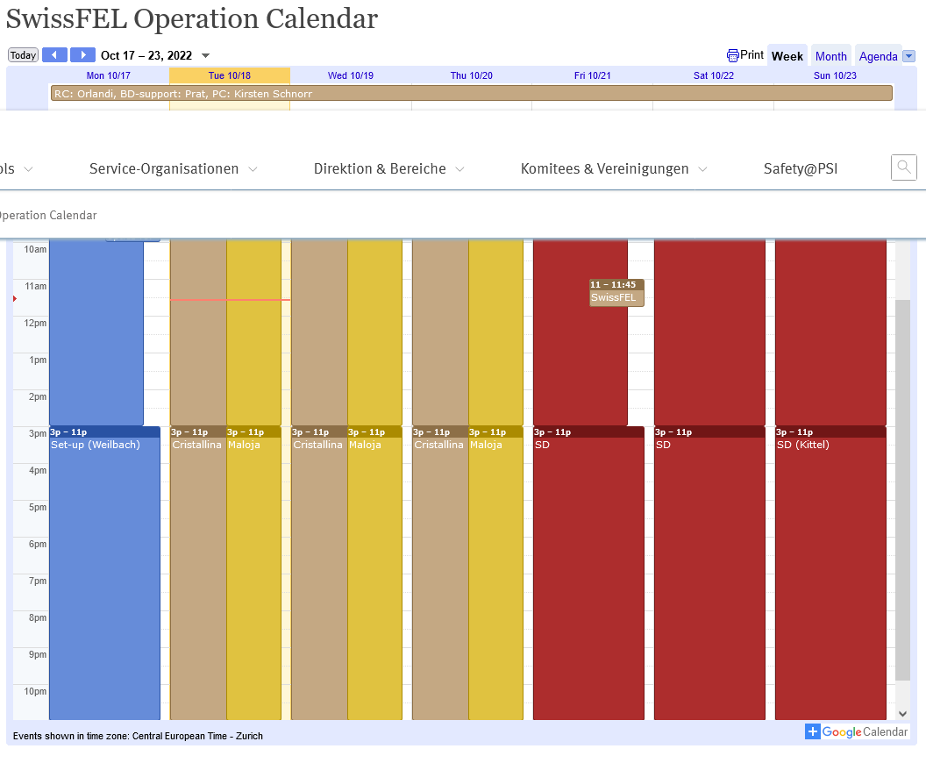

Slide 3
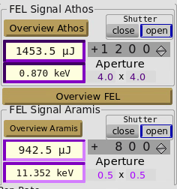
User requests
Cristallina: 11.34keV; Long pulses (20 fs rms = 50 fs FWHM); Pulse energy the >/=700 uJ; pointing stability required (minimize the 50Hz jitter)
Cristallina: switch from 11.34keV to 9.3keV
Maloja: central energy 870 eV and scan +/-10eV with undulator K (max 970eV) ; linear polarization; pulse energy >1 mJ; pulse duration adjustable
Machine set-up
Monday 17 Oct
Restore full power operation of 11 over 13 linac3 RF station (power saving plan): issues encountered in switching on the station (oil leak and switching unit broken) not related with the RF lethargy state of the previous week
ARAMIS set up according to requested specifications; 50Hz jitter in pointing not urgent issue according to Cristallina crew
Initial set up of ATHOS with LV polarization and achieved pulse energy 1.6mJ; polarization switched to LH after request of Maloja crew with pulse energy of 1.4 mJ.
Thursday 20 Oct
Restored normal machine operations after replacement of SINSB04 Klystron
Aramis: switch from 11.34keV to 9.3keV
Friday 21 Oct (7:00am) ➔ Sunday 23 Oct (19:00) PSI OPEN DAY shut-down

Slide 4
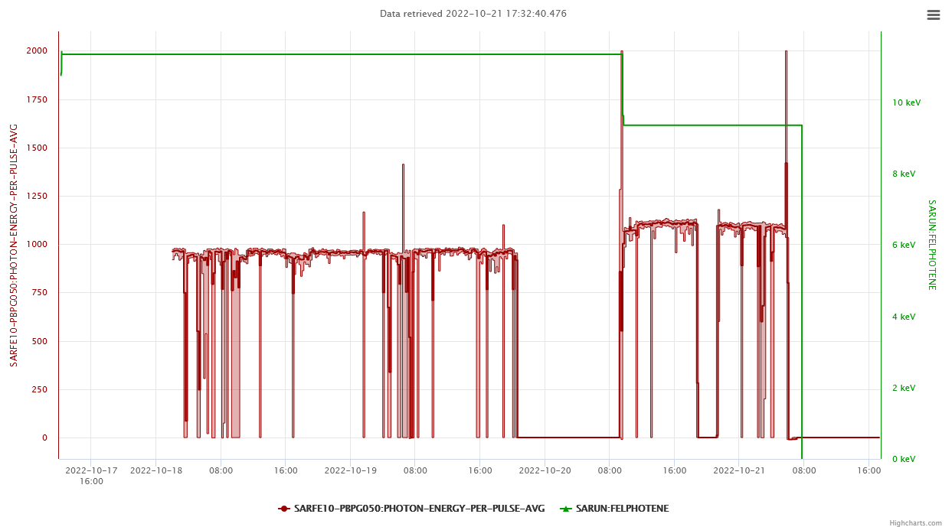
ARAMIS lasing week
SINSB04 FAULT
9.3keV
11.34keV

Slide 5
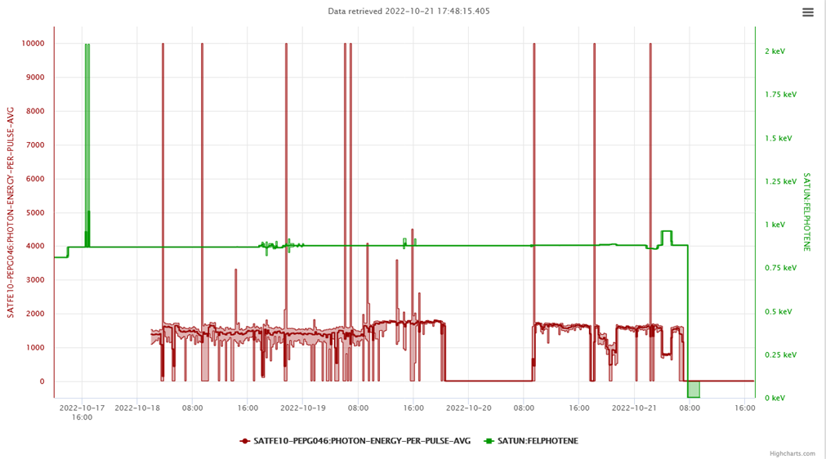
ATHOS lasing week

Slide 6
Technical issues
Weird sudden and random drops to almost zero of the laser pulse energy in Athos and large Sum error in the plot of the FB Athos orbit.
Florian investigated this issue and found “that the magnet IOCs in this region are overloaded after the new magnets were added in the last shutdown”. To mitigate the effect of the possible source of the laser energy drop, “reduced the speed of the orbit feedback to lower the load on the magnet IOC”. This action was beneficial to the laser pulse energy stability
SINSB04 Klystron failure and replacement…more on this issue on next slide…
S20CB03 problems in ramping up after the general switch-on of the RF on Thu morning. Conditioning needed.
Replacement by the Laser group of a degraded wave-plate on Friday

Slide 7
SINSB04 klystron replacement
Extraordinary intervention involving 4+2 people, far beyond the ordinary picket service (1 single expert on duty)
In about 1/2h at around 21:30 on Wed night, the RF section gathered and organized the necessary manpower for the intervention
The klystron replacement was managed by:
Wolfgang Tron, Ralf Menzel, Martin Caspar (water Group picket) and Carl Beard, from 22:30 until 06:00.
Juergen Alex and Thomas Lippuner from 06:00 until operational
Remarkable example of efficiency and competence from the RF section!
Many thanks to the RF colleagues for the great job!

Slide 8
Communication issue (Machine⬅➔Photonics)
Fatal fault and replacement of SINSB04 klystron was an exceptional event not manageable by RF picket (1 person)
Extraordinary intervention of the RF group (4+2 people) - as the one on last Wed night – is not the routine of the SwissFEL equipment maintenance: the decision on the real feasibility of such an intervention can only be decided by the expert-group and expert-management!
Extraordinary intervention requires a solid and objective justification and motivation:
Photon beam line commissioning is not a decisive argument… according to my opinion…
Local and (mainly external) user experiments may have a more relevant impact on taking a decision
On last Wed, decisive argument was the short photon user week (shutdown on Friday at 7:00 PSI Open Day)
RC-machine should be in the condition to figure out rapidly the effective scenario on the photon user side (status, progress and expected achievements of the measurement) directly speaking with the RC-photonics.
In general and perfectly comprehensible, whoever is working in a user station, the experiments/measurements carried out on a photon beam line are absolutely crucial and cannot be delayed…
Suggestion…Brainstorming of users+RC-photonics to evaluate the measurement/experiment progress and to present arguments justifying an extraordinary intervention
Final decision on the basis of a direct info exchange RC-machine⬅➔RC-photonics + final feasibility agreement and decision from expert-group+expert-management

