Slide 1
SwissFEL Exchange Meeting
Machine Report
Week 43/2022
Zheqiao Geng, SEM, 31 Oct. 2022

Slide 2
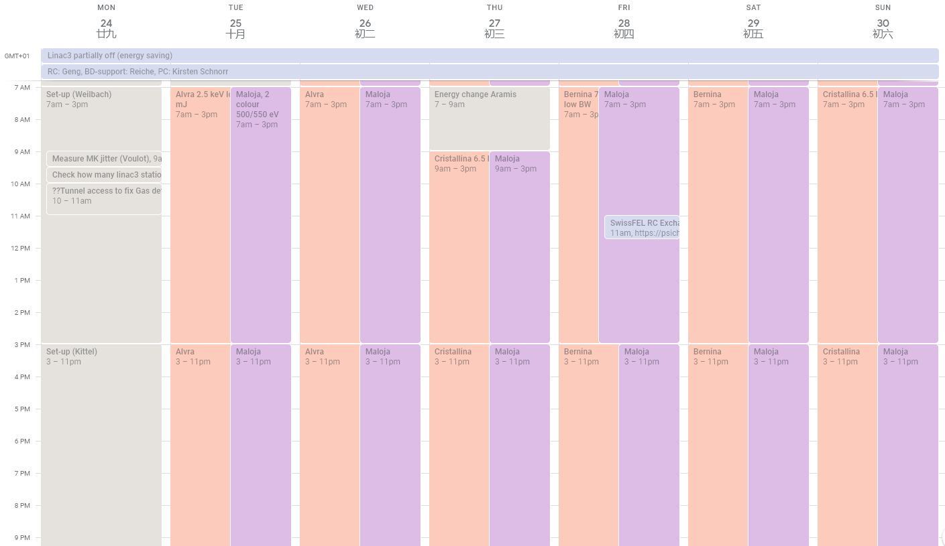
SwissFEL Operation Calendar
Aramis operation as planned
Athos planned changed:
  2-color mode was successfully setup on Thursday
  Monday to Wednesday – polarization

Slide 3
User Requests and Machine Setup
Aramis
  Alvra: 2.5 keV, low bandwidth, ~1 mJ, 20-25 fs rms
    S30CB03 ~ 13 in blackheating for energy saving
    Reload 2.5 keV and retune compression on both bunches. We get 940 uJ at 2.5 keV
  Bernina: 7 keV, low BW, > 800 uJ, 40 fs fwhm, small BW, optimized 50Hz jitter
    Check lasing at 7 keV without last 4 linac3 stations we get more than 800 uJ without any tuning and we can reach 8 keV with the K
    S30CB10 ~ 13 in OFF (later blackheating)
  Cristallina: 6.5 keV, > 800 uJ, 20 fs rms
    S30CB10 ~ 13 in OFF (later blackheating)
Athos
  Maloja: 2-color mode 500 / 550 eV
    Monday setup not successful
    Determined to postpone 2-color mode to Thursday and setup polarization for plan B

Slide 4
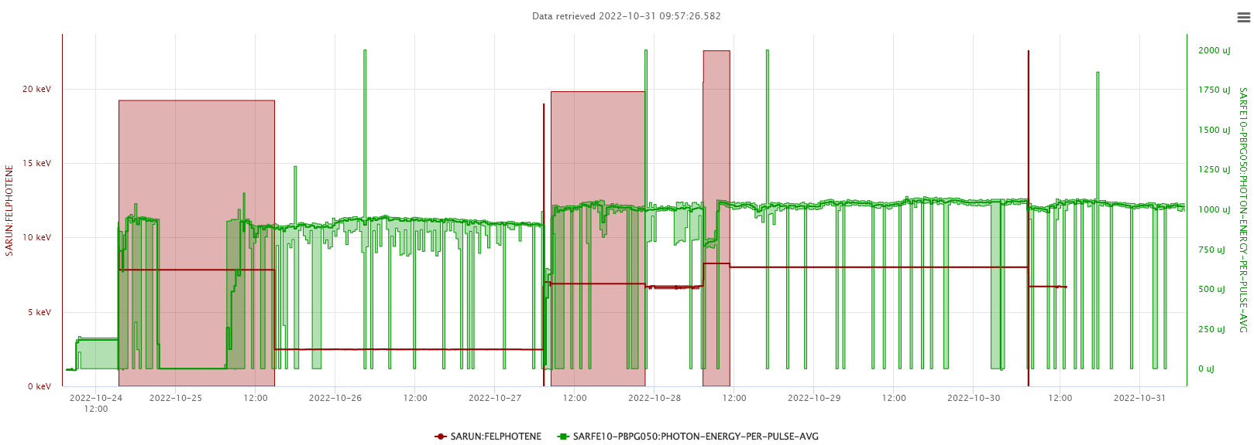
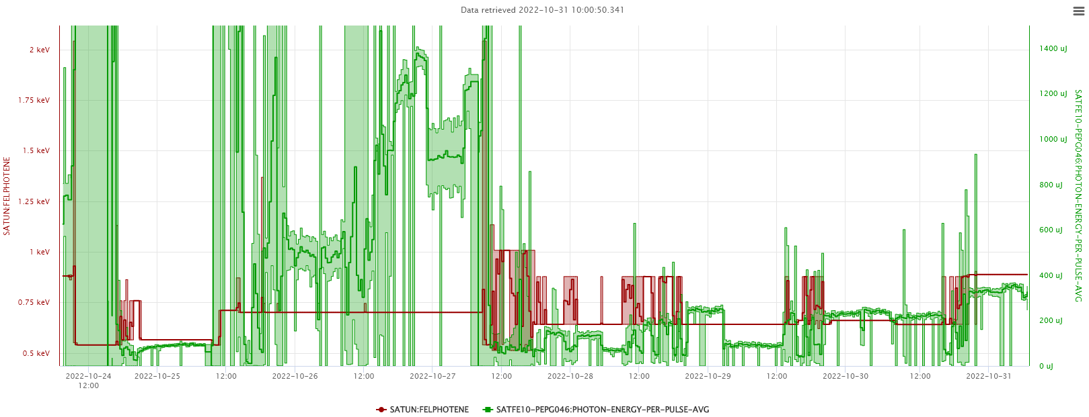
Photon Historical Data

Slide 5
Technical Issues
Tunnel access for repairing Gas detectors. Injector RF stations fell to OFF that needed 1 hour heating time. Should inform RF when making longer tunnel access, so that they can extend the filament->OFF waiting time
Mirror blocked in Aramis, slightly delayed the pointing check and BW optimization for Alvra
FEL shutter closed multi-times without alarm due to wrong configuration of Aramis Photonics Mode Monitor
SINSB04 high amplitude jitter (reasons found, partly mitigated, will further optimize during maintenance days in this week)
Dechirper (S30CB15-UDCP200) position alarm, determined not to touch during weekend

