Slide 1
Bunch length measurement with synchrotron radiation monitor
F. Salomone, Summer student, e-beam instrumentation group
Supervisors: S. Bettoni, G. L. Orlandi

Slide 2
Summary
BC1 SRM for bunch length measurements:
  Description of the method
  GUI
  Experimental benchmarking of the method in two machine shifts at SwissFEL
Machine Learning (ML) for bunch length determination:
  Recall to the model
  ML prediction of the bunch length based on experimental results
Conclusions and future plans

Slide 3
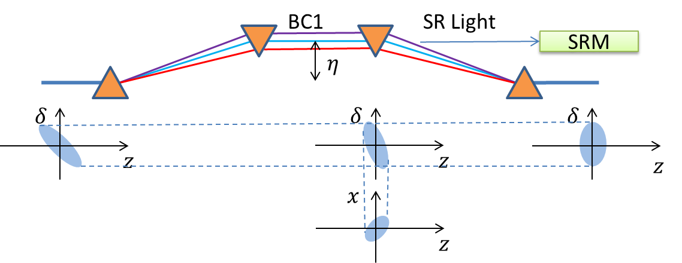
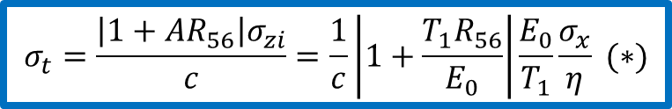
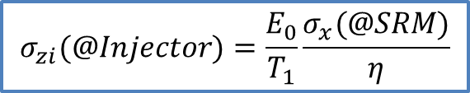
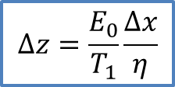
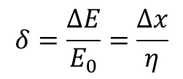
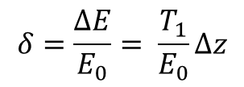
BC1 SRM: bunch length monitoring…
Relative energy spread @Injector:
$$δ=\frac{ΔE}{E_{0}}= \frac{T_{1}}{E_{0}}Δz$$
$$Δz=\frac{E_{0}}{T_{1}}\frac{Δx}{η}$$
Relative energy spread @BC1-SRM:
$$δ=\frac{ΔE}{E_{0}}=\frac{Δx}{η}$$
$$σ_{zi}(@Injector)=\frac{E_{0}}{T_{1}}\frac{σ_{x}(@SRM)}{η}$$
$$σ_{t}=\frac{\left|1+{AR}_{56}\right|σ_{zi}}{c}=\frac{1}{c}\left|1+\frac{T_{1}R_{56}}{E_{0}}\right|\frac{E_{0}}{T_{1}}\frac{σ_{x}}{η} (∗)$$
(*) G. L. Orlandi, R. Xue, H. Brands, F. Frei, Z. Geng, V. Thominet, S. Bettoni, bunch length and energy measurements in the bunch compressor of a free-electron laser, Phys. Rev. Accel. Beams 22, 072803 (2019)

Slide 4
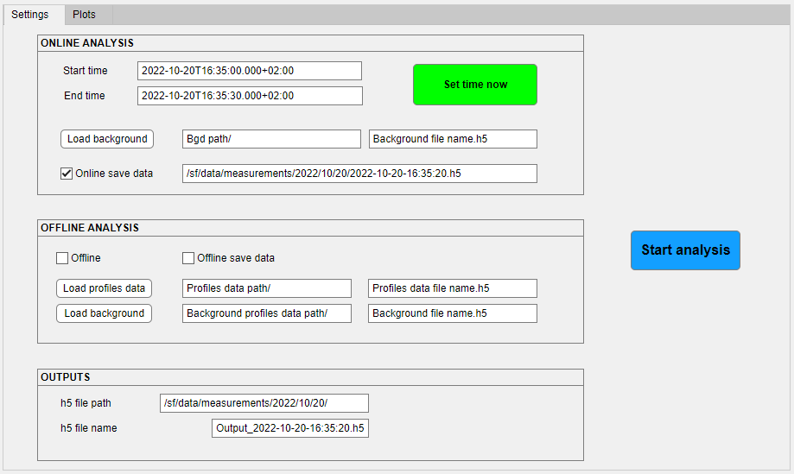
SRM GUI example: Settings

Slide 5
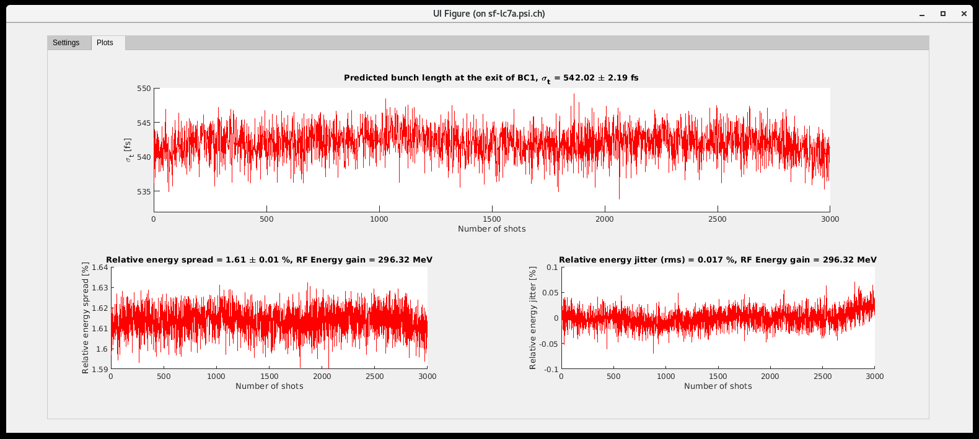
SRM GUI example: Plots
GUI plots as a function of the number of shots:
Bunch length at the exit of BC1 predicted by measuring the horizontal distribution of the SRM profile and acquiring the RF parameters of the injector.
Relative energy spread in percentage, retrieved from the transverse profile and the dispersion of BC1.
Relative energy jitter (rms) in percentage, retrieved from the centroid variation and the dispersion of BC1.

Slide 6
TDS measurements and BC1 SRM method: comparison
The plots refer to two different machine shifts one month apart.
Reproducibility of result: very good agreement between both angular coefficients and offsets in the two shifts.

Slide 7
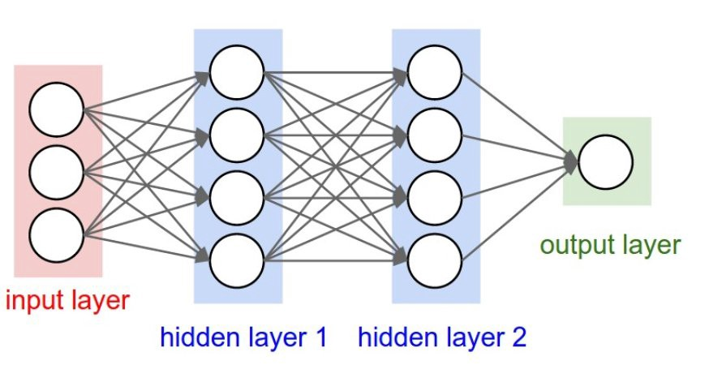
Machine Learning: structure of the neural network
Parameters to be tuned to optimize the performance of the network (*):
N. layers
N. neurons
To be fixed at the beginning:
N. splits
ML implementation, two steps:
Training phase
Validation phase
One can model the problem as f(x)=y. The training phase determines the functional relation “f”. In our case x are the machine parameters (RF phases, amplitudes), and y are the SRM bunch lengths.
(*) Model provided by Romana Boiger

Slide 8
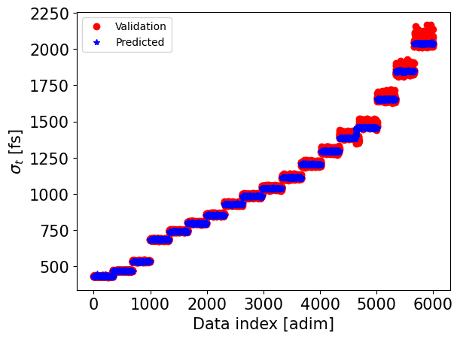
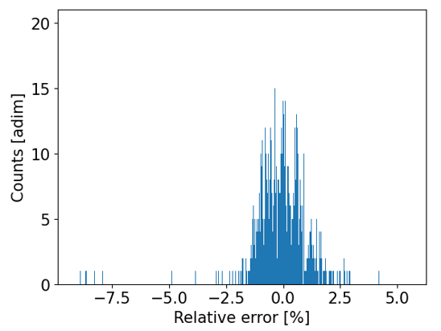
Prediction example: plots
N. layers | 5
N. neurons | 5
Splits | 9
N. setups | 18
N. points / setup | ~3000
rms error~1.17%

Slide 9
Achievements and future plans
Achievements:
SRM and TDS compatible within systematic offset and very good reproducibility of results over different machine shifts.
SRM GUI to determine central energy, energy spread and bunch length.
ML algorithm applied to reconstruct the bunch length (rms error of 1.17%), initially based on training on SRM bunch length data (100 Hz).
Future plans:
Optimization of the rms error on ML prediction vs number of layers and neurons.
Other ML algorithms to be studied.
Direct ML training on TDS (1 Hz): test of the robustness of the ML prediction by reducing the data set per compression setting point and optimization of the number of layers and neurons. Minimize the rms error vs data set size to use TDS (1 Hz) instead of SRM (100 Hz).
ML for profile reconstruction

Slide 10
Acknowledgements:
Thanks to
Romana Boiger for the ML support
Rasmus Ischebeck and the e-beam instrumentation group
all the SwissFEL operation team for the support in the shifts
the Controls section

