Slide 1
SwissFEL Exchange Meeting
Machine Report
Week 48/2022
Zheqiao Geng, SEM, 05 Dec. 2022

Slide 2
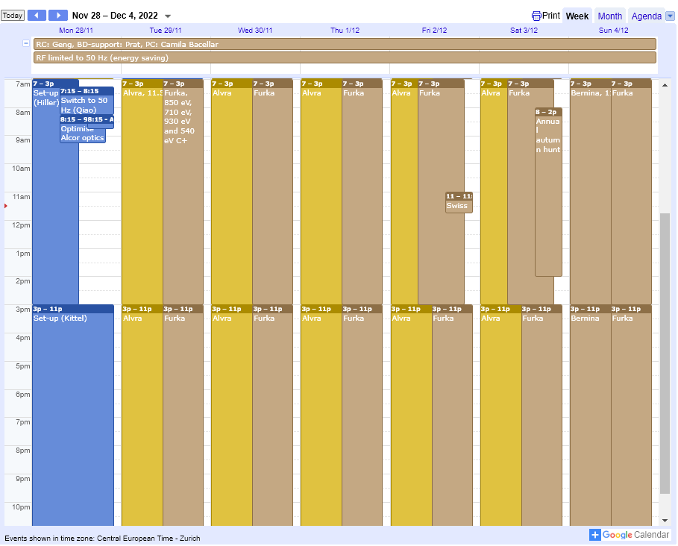
SwissFEL Operation Calendar
50 Hz operation

Slide 3
User Requests and Machine Setup
Aramis
  Alvra: 11.5 keV, pink beam, standard pulse length (25 fs rms), as many photons as possible, no requirements on BW (Tuesday to Saturday)
    S10CB03 jitter mitigated by increasing klystron power
    Alcor laser optimization brought the photon pulse energy > 1 mJ
  Bernina: 11.5 keV, same req. with Alvra (Sunday)
Athos
  Furka: 850 eV, 710eV, 930 eV and 540eV C+, 50Hz, pulse energy as much as possible, smallest BW as possible

Slide 4
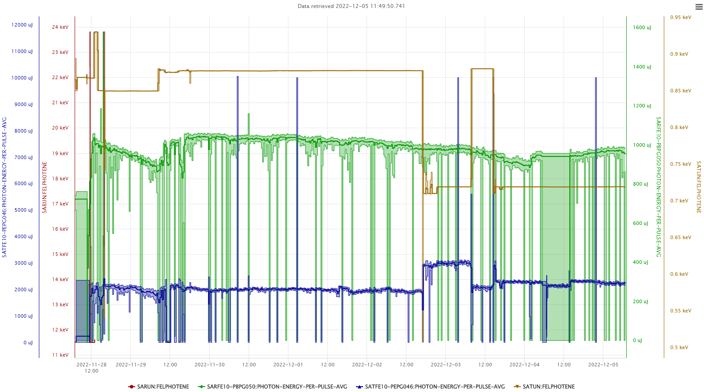
Photon Historical Data

Slide 5
Technical Issues
S30CB05 modulator switch unit failure – caused > 8 hours downtime in Arams. We managed to keep bunch2 running

