Slide 1
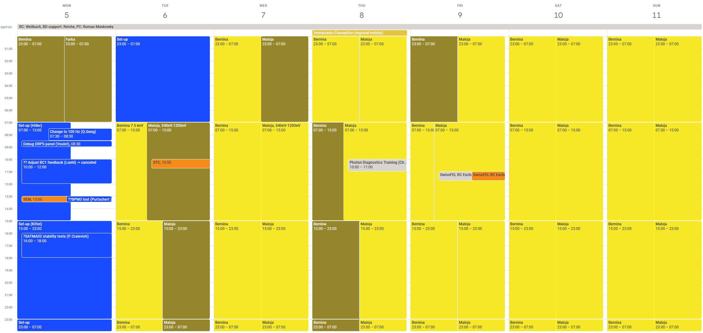
RC Report 2022 week 49 5.-12.10.2022
Aramis: Bernina user experiment 7.5 keV (Thu Aramis photonics development)
Athos: Maloja user experiment: 540eV, 650eV, 800eV, 1000eV and 1200eV.

Slide 2
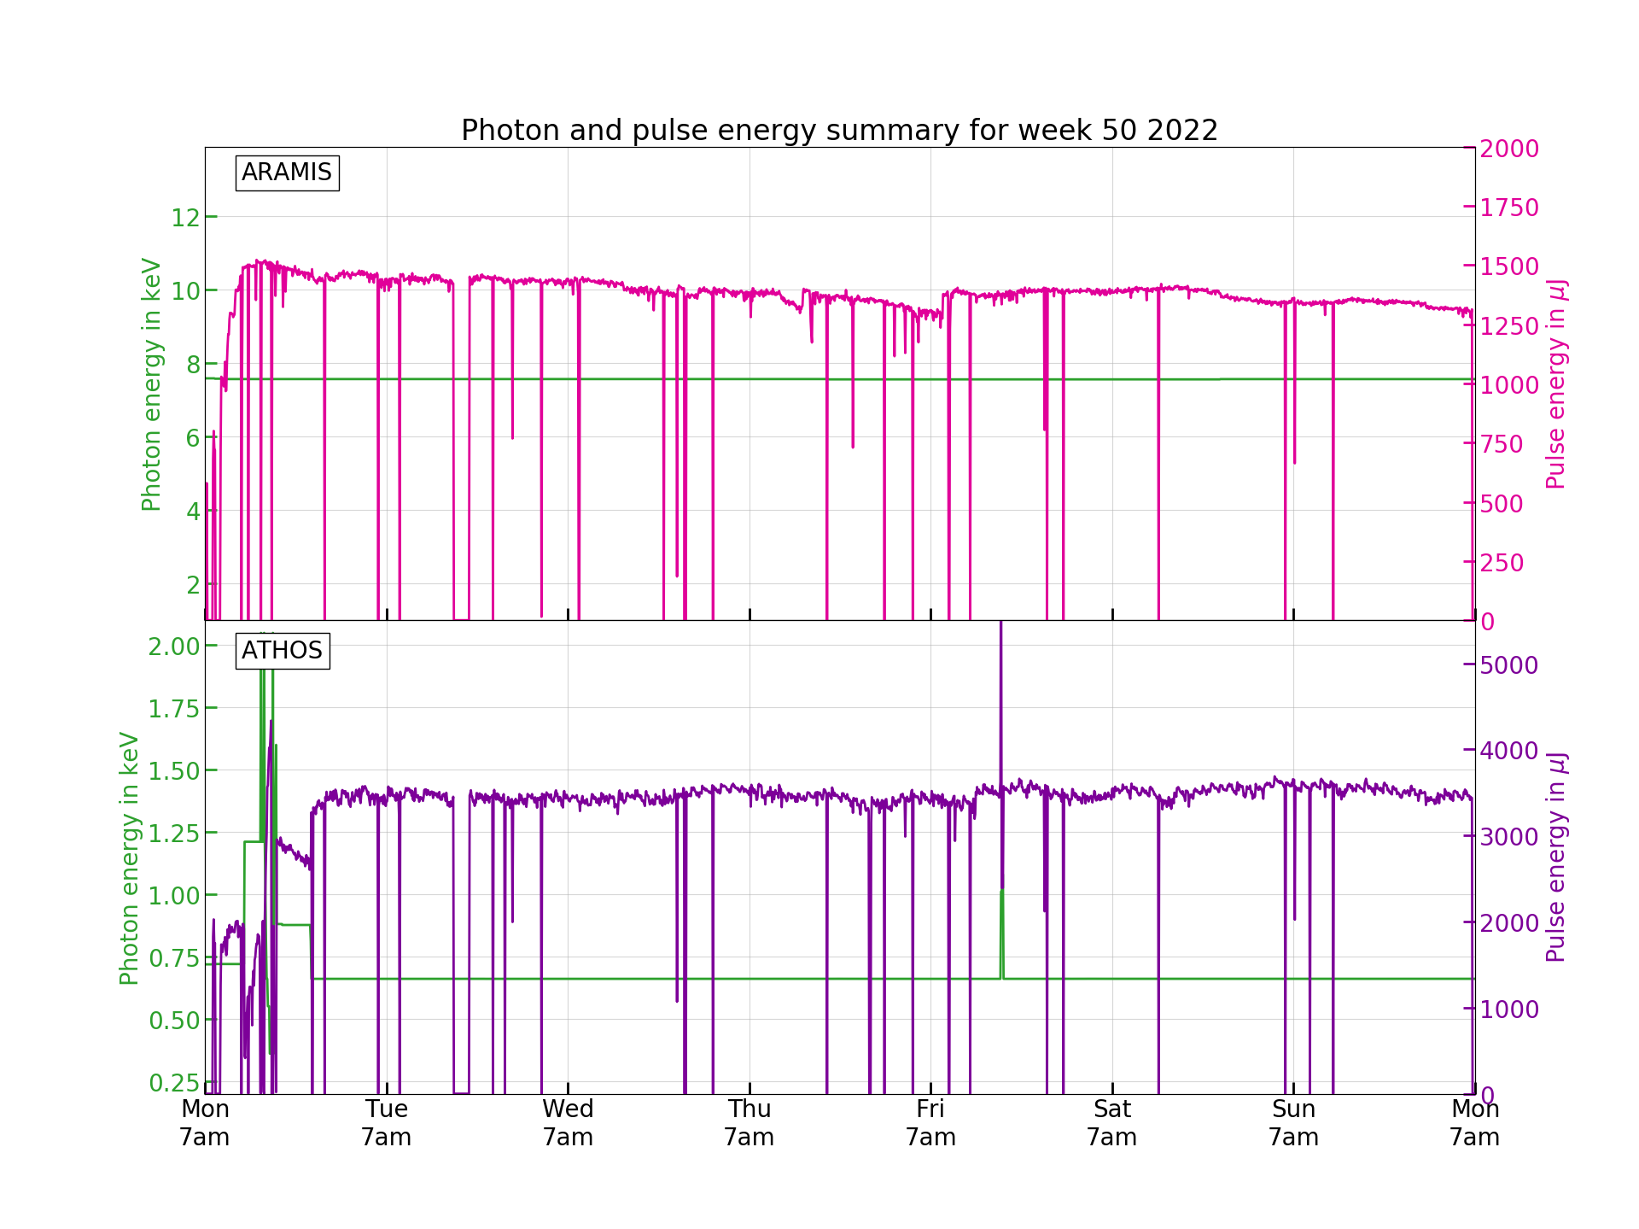
The week

Slide 3
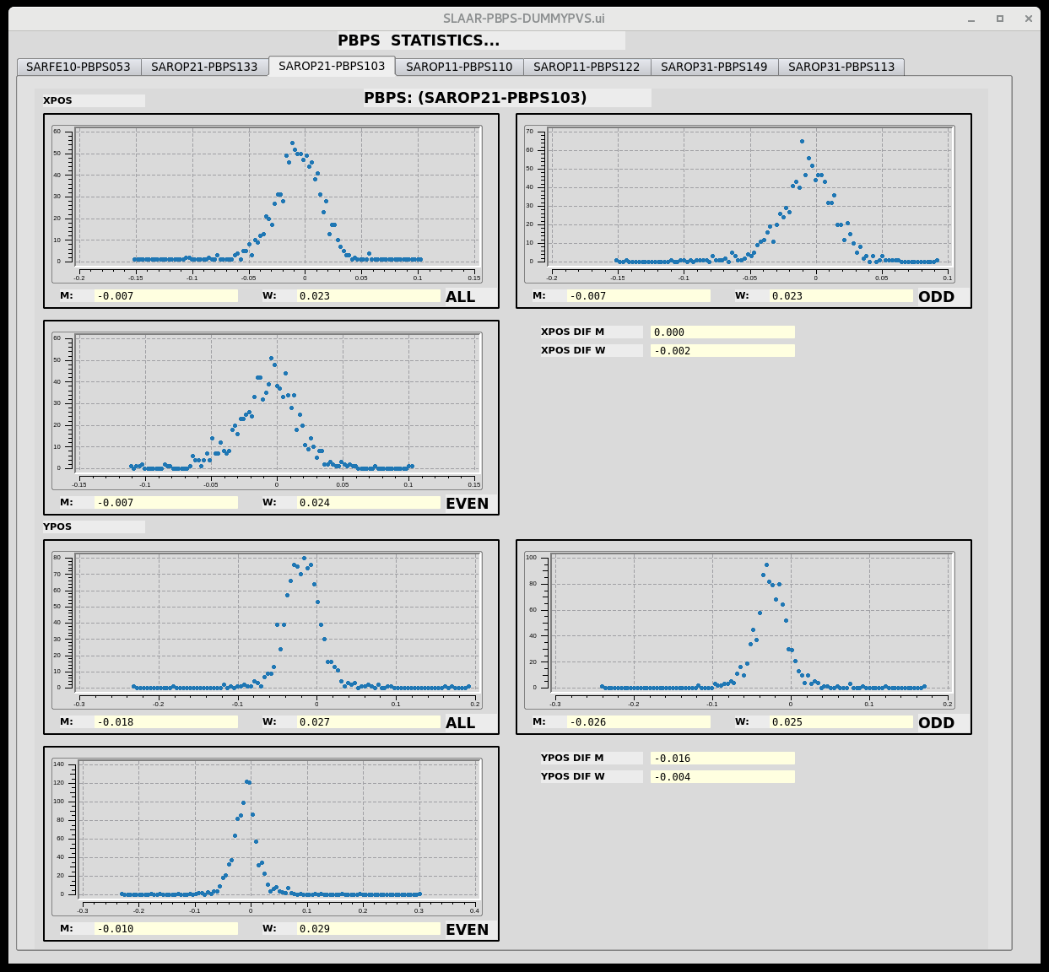
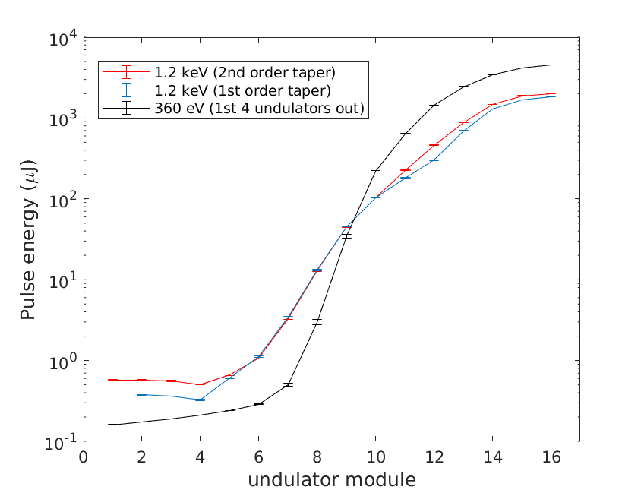
The Setup
  After changing back to 100Hz, very good setup with record or near record breaking performance in both lines (thanks to BD support: Eduard)
    Aramis: 7.5 keV 1.5mJ
    Athos: 1.2keV with 2mJ, 1keV with 2.5mJ, 800eV with 3mJ, 650eV with 3.5mJ and 540eV with 4.1mJ
Optimized 50Hz jitter
Gain curve measurement in Athos

Slide 4
The issues last week
  Accelerator:
  Mizar LAM alarm (Tue 23:15)-> power cycling of VME crate solved the problem
  S20CB03 showed IOC com. error after trip (Tue 16:38)-> hardware reset on site necessary (2 h downtime)
  SINSB01 and SINSB04 Ampl. headroom low -> Increased modulator voltage (Thu 13:30) -> small retuning of BC 1
  Optimized UV aperture in for Alcor (Fri 9:15), non invasive
  Pointing server (AR) switched off/crashed? (Fri 10:15)-> restart server and pointing FB
  Mizar intervention to reduce wave plate value to get enough headroom for the weekend (Fri 13:30)
  Other:
  Data Buffer and dispatcher down (Wed 10:17-16:45)
    Non invasive troubleshooting was not successful -> restart necessary
    Restart slowed down by installation of new certificates (old ones expired)
    Data buffer was available again from 16:45 -> total downtime of ~6.5h

Slide 5
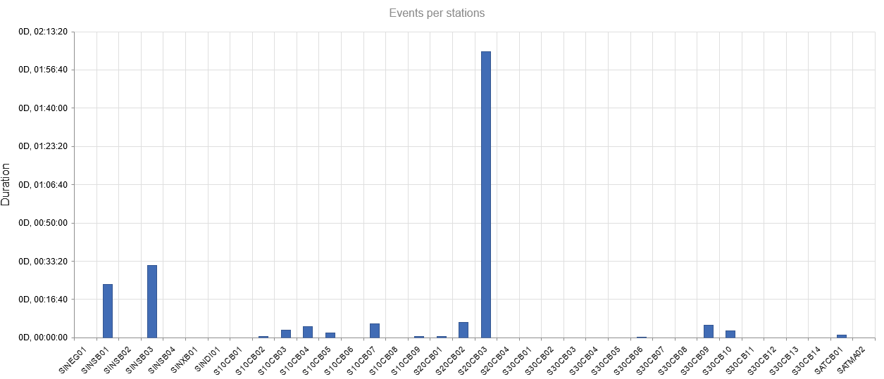
RF Events
Mostly one big event (S20CB03 modulator sum error on Tue 16:30, ~2h downtime) and some smaller events mainly in injector (SINSB01 and SINSB03)

Slide 6
A couple of comments
text

