Slide 1
AWI Department meeting update
Alun Ashton
221212

Slide 2

AWI organizational update
Alun Ashton
(Head of AWI
Xingxing (Marie) Yao
(Coordinator and Architect, SLS2.0)
Leonardo Sala
Data and Analysis Research Infrastructure
Stephan Egli
Scientific Data Curation
(ORD)
Markus Janousch
Data Processing Development and Consulting
Sven Augustin
Experiment IT Development and Operations
Derek Feichtinger
HPC and Emerging Technologies
Spencer Bliven
Scientist (BIO)
Marc Caubet
Scientists
(Merlin)
Achim Gsell
Senior Scientist
Elsa Germann Scientific Computing System Engineer
Ivano Talamo
(Ra Sys Admin)
Alvise Dorigo
(SwissFel)
Joshua Taylor
(SLS Online)
Krisztian Pozsa
(ExPaNDS EOSC)
Carlo Minotti
(ExPaNDS EOSC)
HC Stadler
(cSAXS)
Alain Studer
(TOMCAT)
Ivan Usov
(SwissFEL/NUM)
Jun Zhu
SLS 2.0 Data reduction and compression
Dmitry Ozerov
(SwissFEL)
(Research Software Engineer or Software Scientist)
Klaus Wakonig
(SLS DAQ)
SLS 2.0
Piero Gasparotto (REDML)
Simon Ebner
Core Linux Research Services
Konrad Bucheli
System Engineer
System Engineer
Hans Viessmann Scientific Computing System Engineer
Boris Sharapov
(Junior Sys Admin)
PSD DAQ
Jonathan Per Stalberg
(Junior Software Scientist)
ORD OpenEM
10/11/22
Viviana Sabatini
Assistant SCD Division
33 roles
28 in place
Funding for 7 new roles pending.
Key to Fixed Term Roles
EU Funded
PSI Funded fixed term
Swiss Funded initiatives

Slide 3
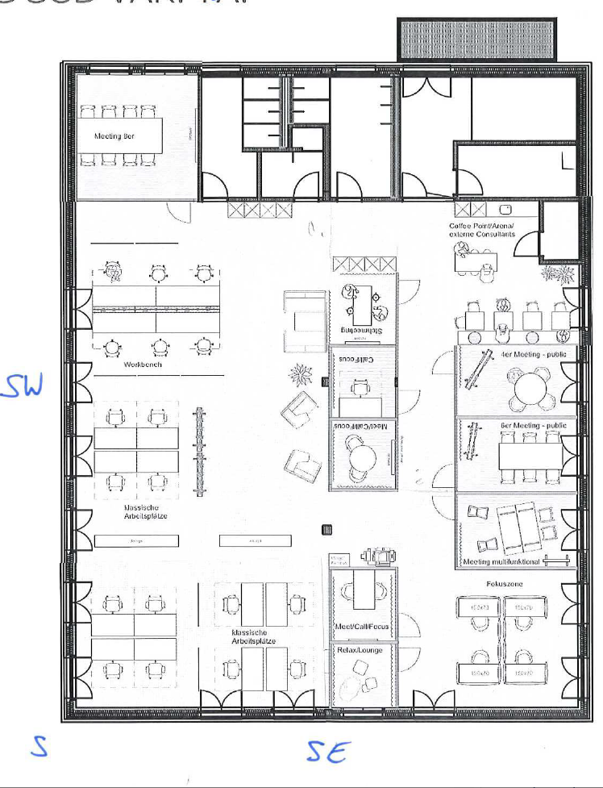
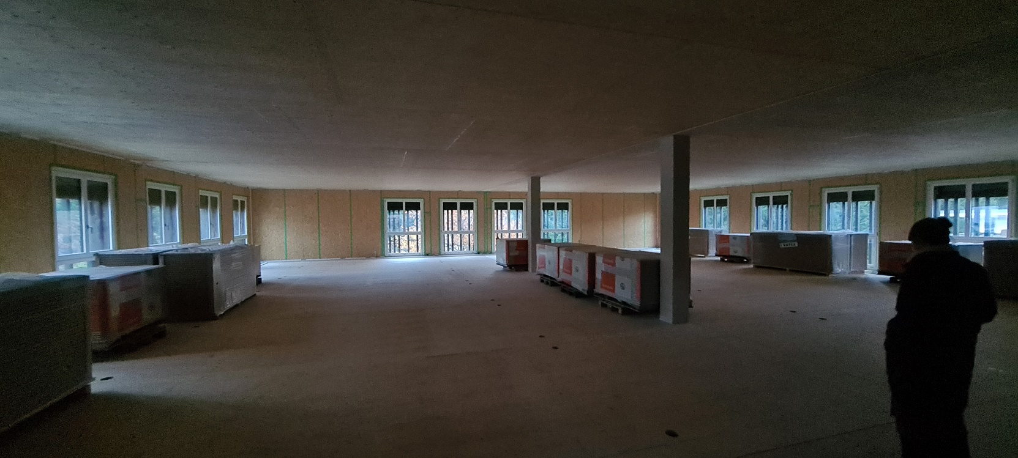
New offices
Office ready date now likely to be summer 2023 (June/July)
Likely layout ->
  Uncertainty on the door zoning.
  It was not possible to mirror the layout as positions of office walls limited.

Slide 4
Some good news
Budget was not cut, increase is aprox 2%
Who can explain the salary increases?

Slide 5
2022 report card (in no particular order)?
Managing COVID and working practice, in new offices and working hybrid
Recruitments ongoing but new ones and with increased diversity
SLS2 will be architectured, responsibilities identified and proceeding with activities in 7901/2/3/4/6
TransALPS will be progressing, managing the delays and opportunities.
Linux strategy will be agreed and leading to RH8 and centrally supported remote access
SwissFEL have clear coordinated and coherent development and support plan stronger than sum of the individual parts
Cloud based services with broad PSI division uptake/adoption, roadmap for analysis services with links maybe to distributed file system?
ML and Edge computing Exemplar and future dev plan
Data analysis services, and framework with international partners that all fits into FAIR data direction
ORD roles and projects on services and infrastructure covering ETH domain an EOSC/ExPaNDS
Funded PSD hardware roadmap, data retention and usage policy + lifecycle and accommodation + TransALPS
New SCD collaborations, e.g. materials cloud and SDSC
Establishment of Swiss RSE community (https://researchsoftware.org/)
Divisional, site, national and international reputation etc

Slide 6
Some bad news….
I think these meetings should be more frequent with Groups hosting at least once a year!
2?

Slide 7
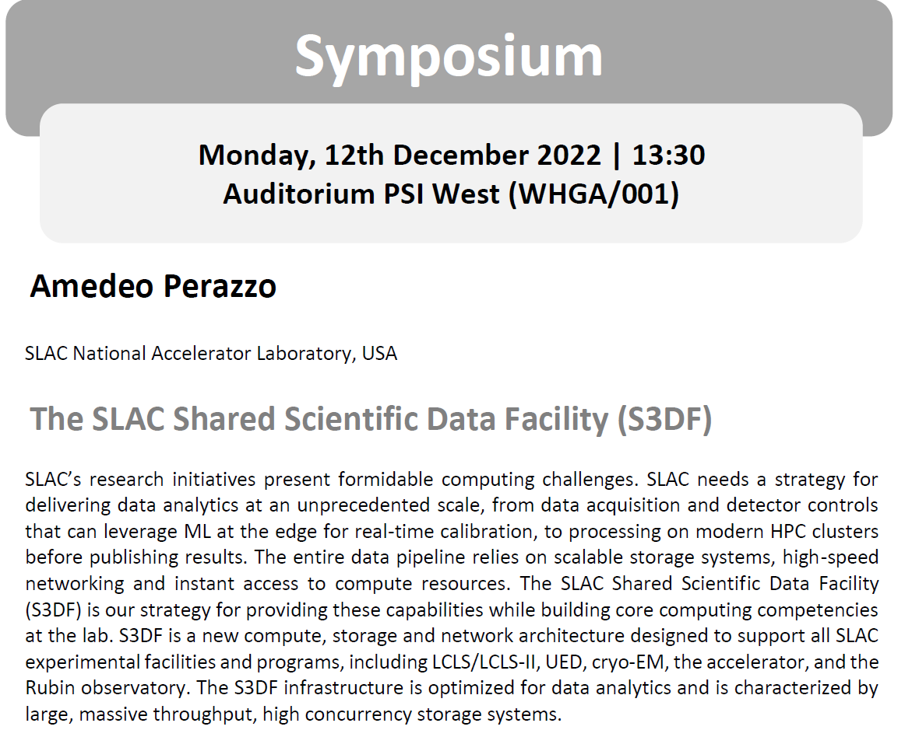
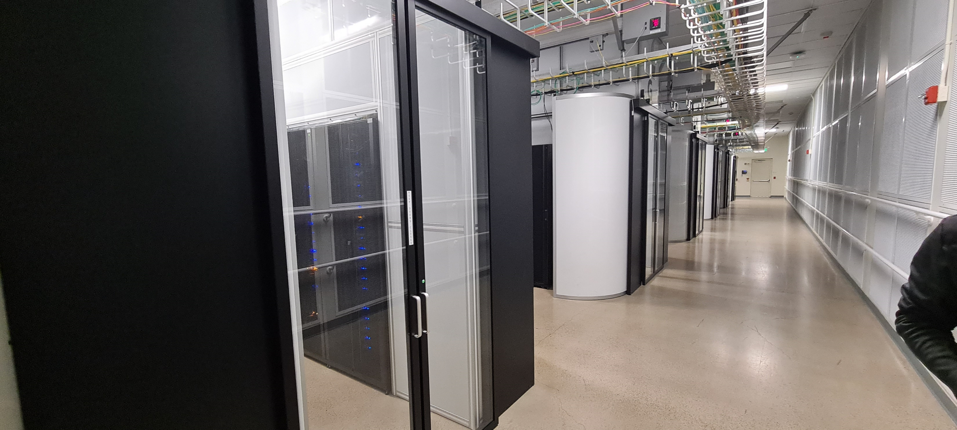
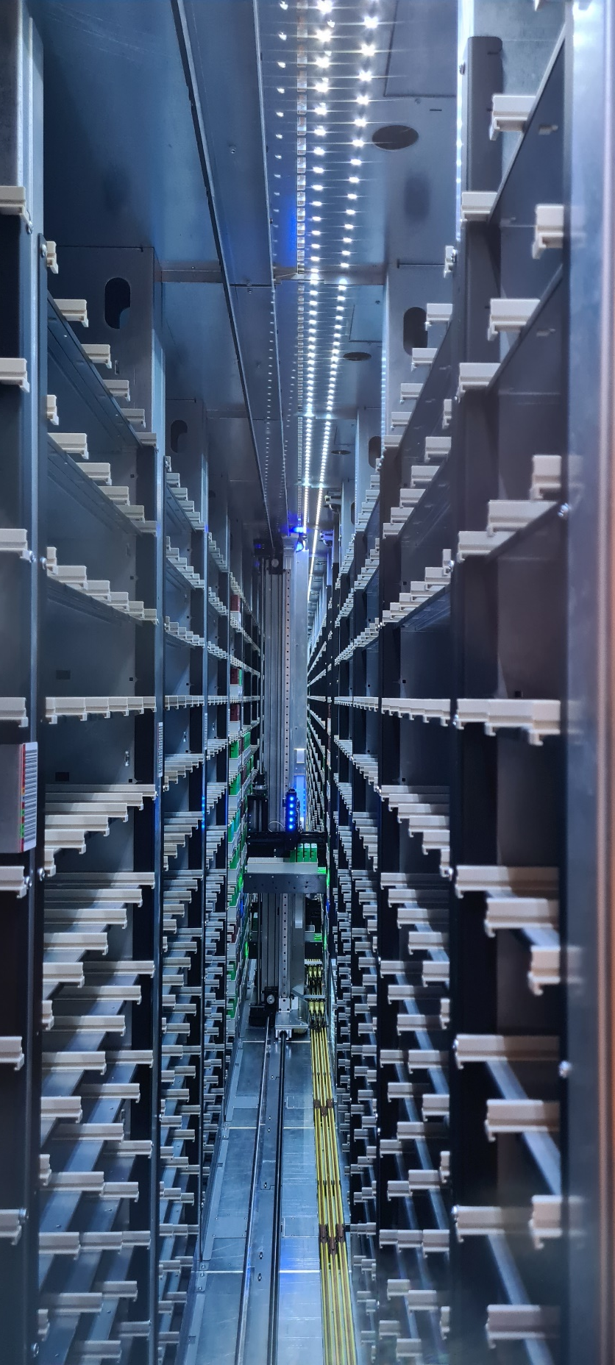
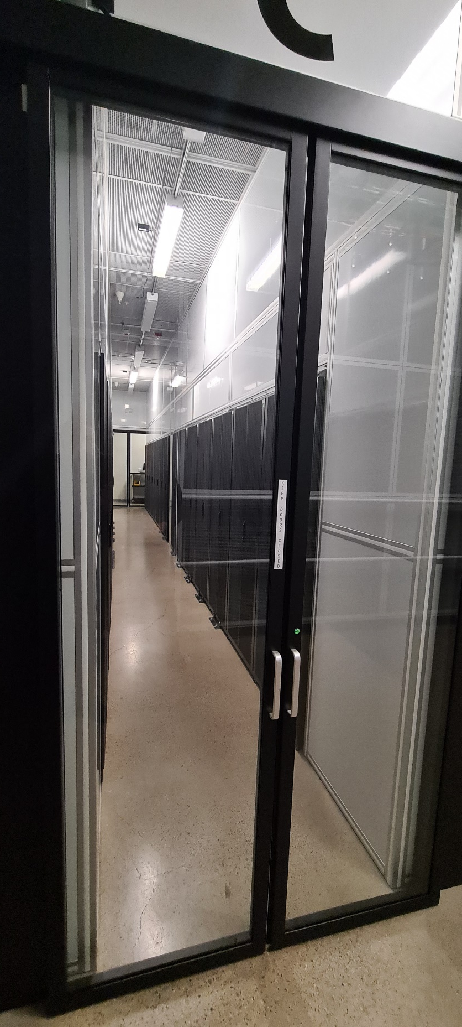
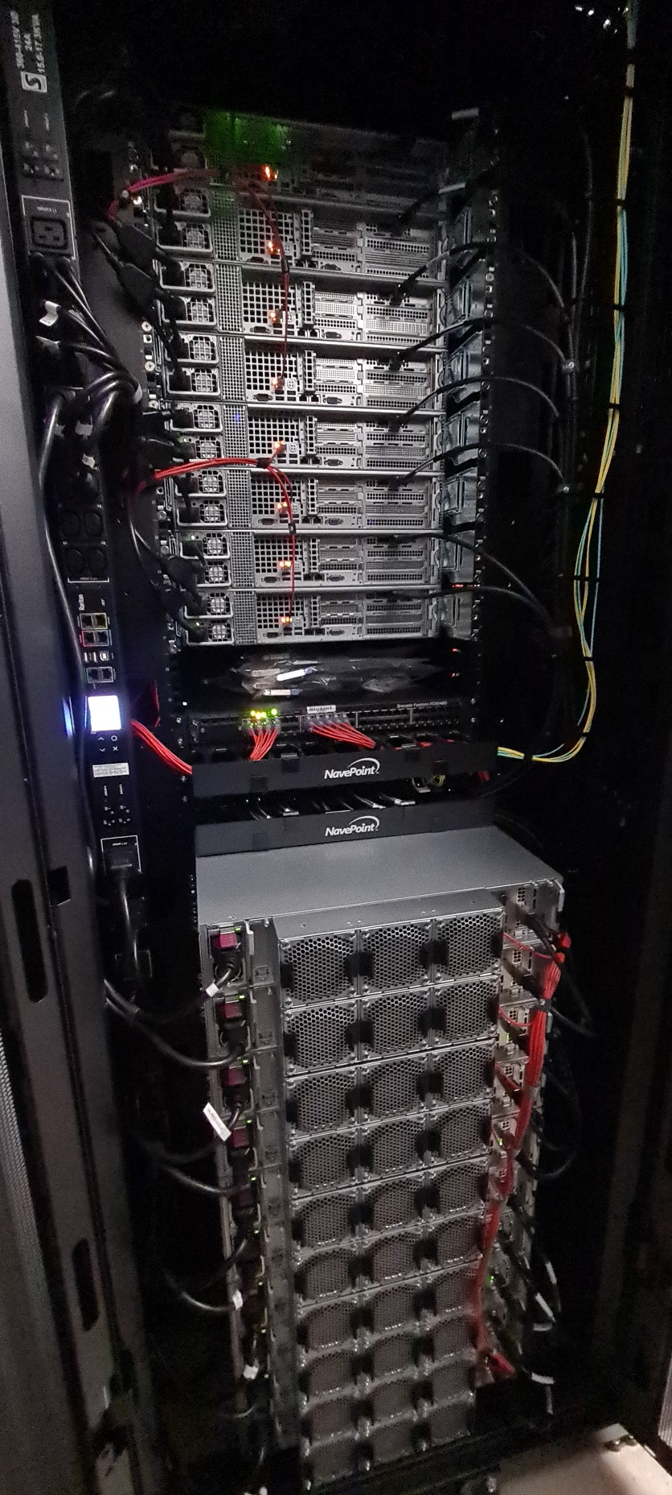
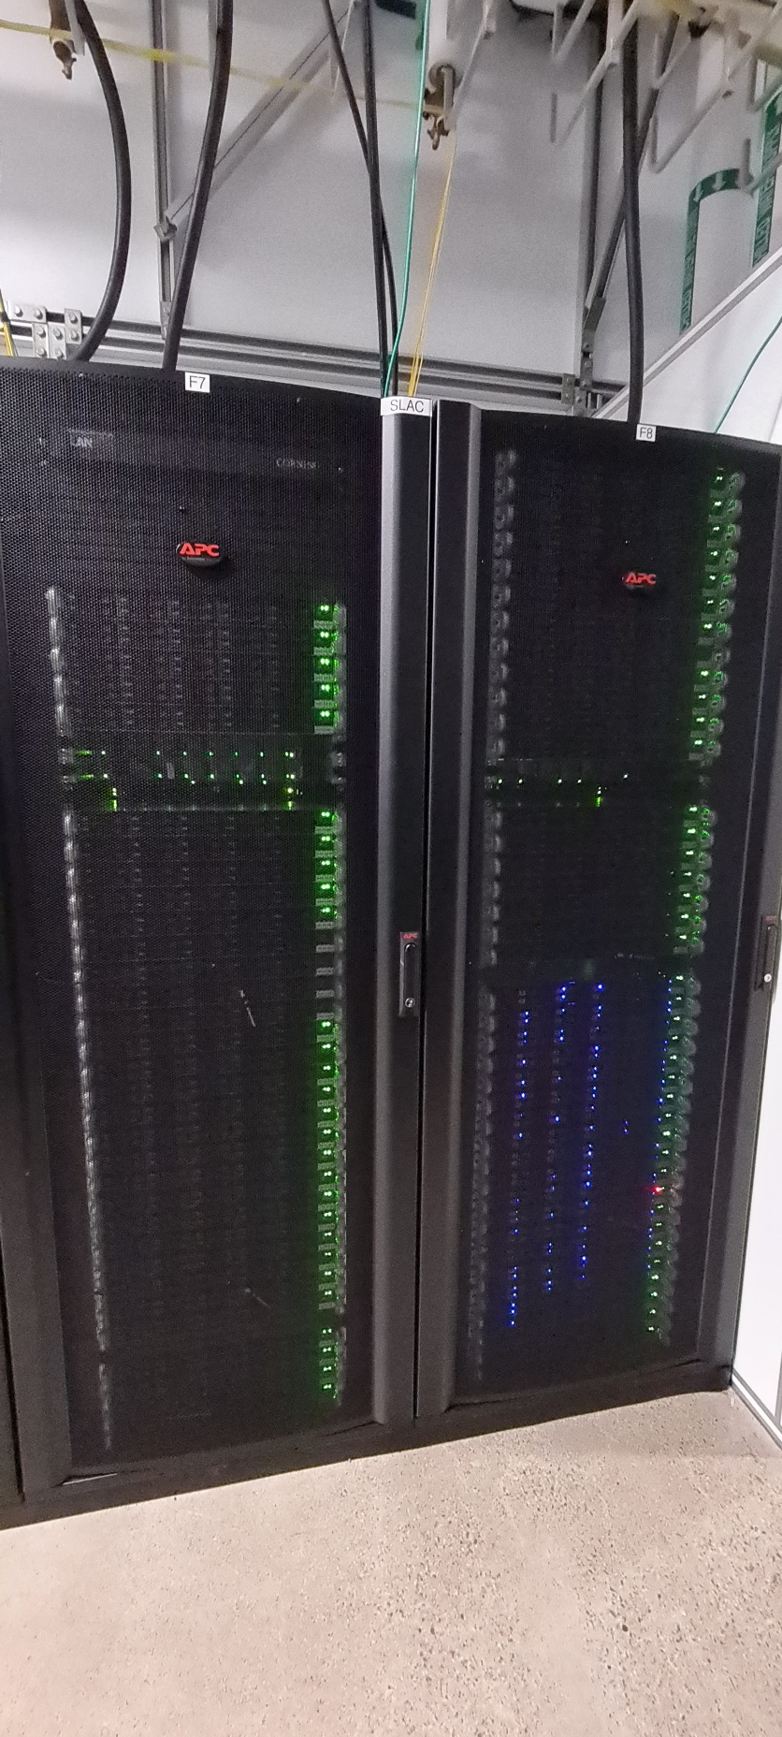
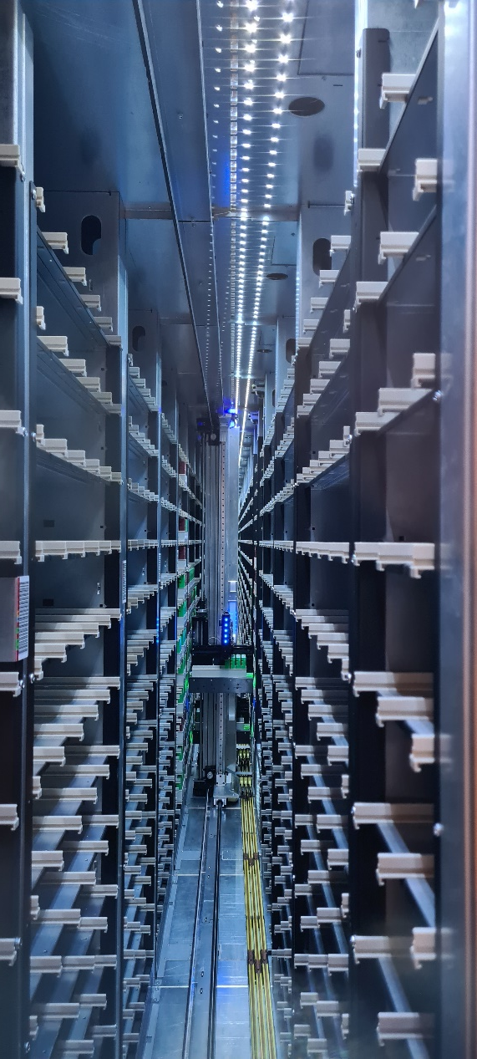

Slide 8
Klaus!

