Slide 1
IMPACT
The next big project at PSI
Daniela Kiselev
IMPACT Informationsveranstaltung, PSI, 19.3.2025

Slide 2
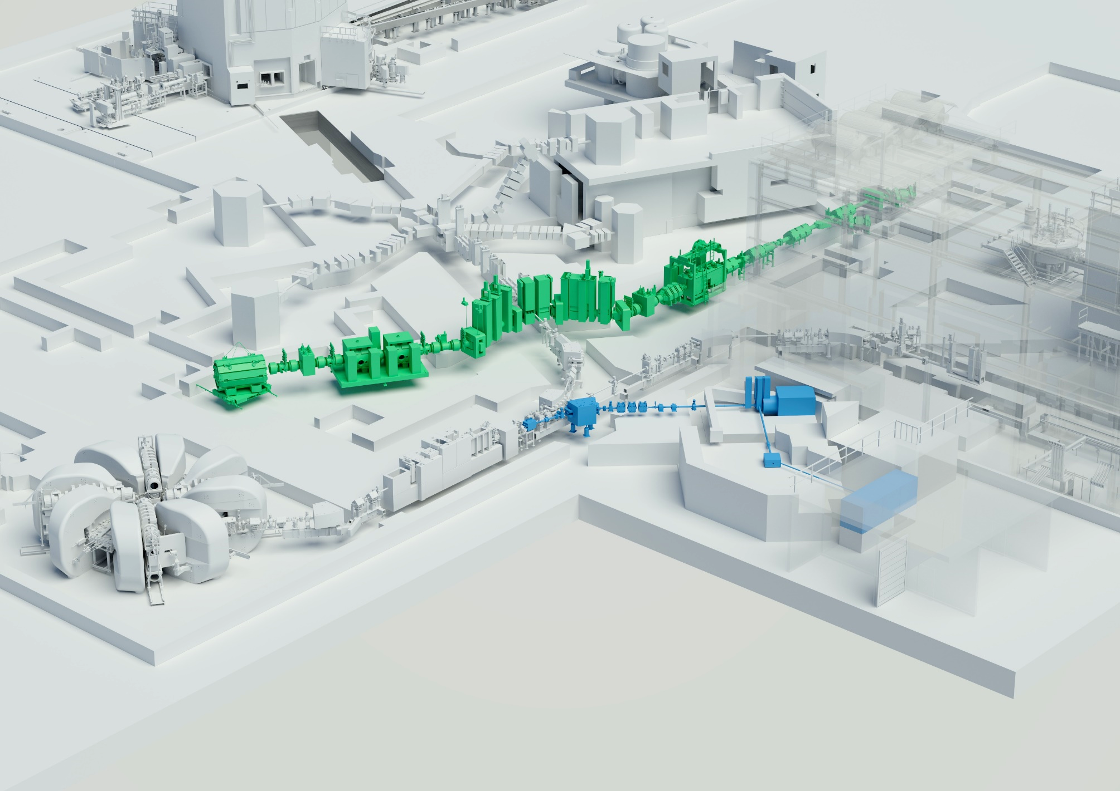
Project IMPACT = HIMB + TATTOOS
Courtesy of Mahir Dzambegovic
SINQ
Timeline of IMPACT:
2027/28 HIMB installation
2029/30 TATTOOS installation
TgE
Material science
Experimental hall
WEHA
TgM→HIMB
UCN
Particle physics
TATTOOS
590-MeV- Ring
cyclotron
100 µA
Life science
New building
> 2.2 mA protons
TATTOOS: Radionuclides for cancer therapy and diagnostics (clinical studies)
only research application
(non-commercial)
HIMB: Muon flux * 100
→ 10¹⁰ surface muons/s
= “Thera(g)nostics”

Slide 3
Steps on the way to approval and financing
April 2021 2-page proposal: «Motivation & Intention», 1. cost estimate
Dez. 2021 SNF-Proposal: scientific motivation
Klaus Kirch, Roger Schibli, Ben Kilminster (UZH), Philipp Kaufmann (USZ)
Jan. 2022: Conceptional Design Report https://www.dora.lib4ri.ch/psi/islandora/object/psi%3A41209
July 2022: Scientific evaluation best marks!
Dec. 2022: Evaluation of techn. feasibility + finances
→ ETH Board recommends IMPACT for Swiss Roadmap
June 2023: Publication of Swiss Roadmap
Jan. 2024: Implementation plan
Timeline, planning, spending profile, organization
March 2024: ETH Board supports financing of IMPACT
Swiss Roadmap .....
Swiss Roadmap for
Research Infrastructures
2025-2028 ERI Dispatch
Final step:
Dec. 24: Decision of Swiss parliament about funding in 2025-2028
Seite 3

Slide 4
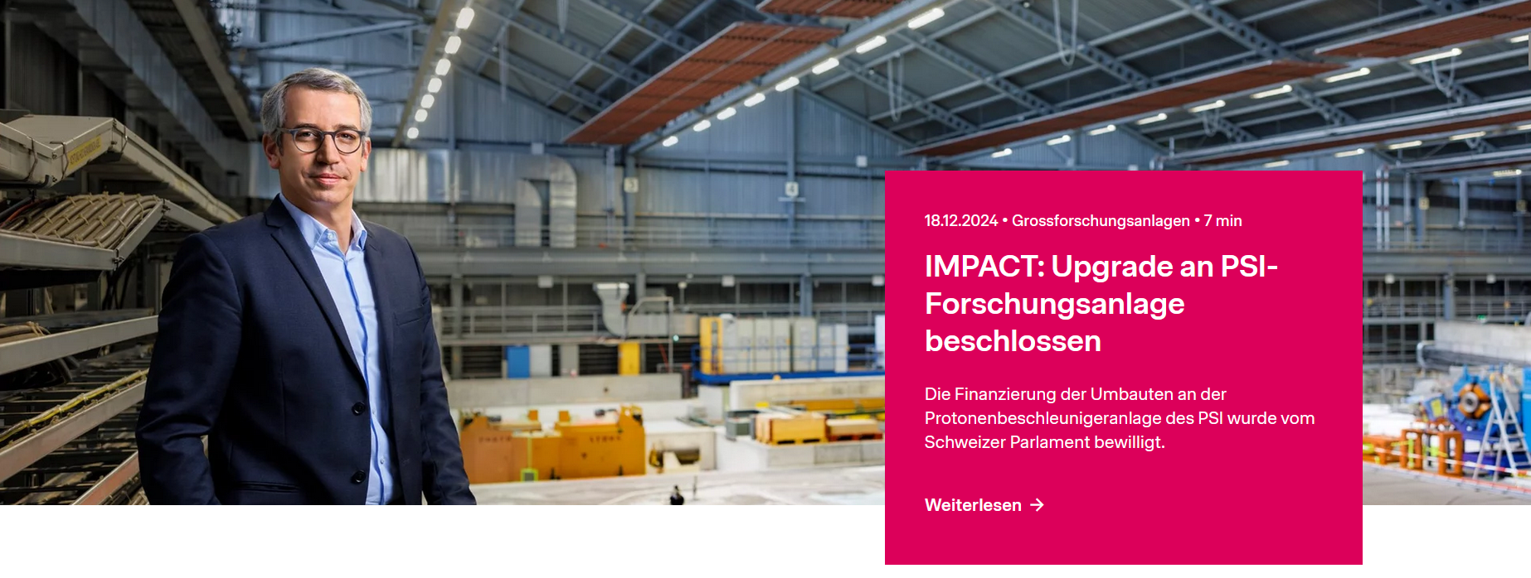
IMPACT: 18.12.24: Financing of IMPACT ensured!
General-Anzeiger 01/2025
Development plan 2025-2028, p. 23:
IMPACT: project with highest strategic relevance for the period 2025–2028
Priority 1 also for SLS to reach the milestone user operation (~ mid25).
potential conflict of resources for SLS/IMPACT,
especially in shutdowns
Working group under the lead of the project office (M. Lüthy):
Goal: find solutions before the problem occur
  Evaluates available & needed resources
  Reports on resource bottlenecks
helpful in Q1/2025 SD of SLS & HIPA (+ IMPACT prep.)
Next:
SLS SD Q1/2026, user op.: 1.6.2026
similar to HIPA SD (+ IMPACT prep.)
Notes:
SLS SD 21.12.2025 – 31.5.2026
Upcoming events:
19.3.25 13:00 for project members:
Coffee, speech of director, Info talks, apero
Sept: 25: Info for all interested employees at PSI

Slide 5
Project IMPACT Spending profile
Pre-project:
Total: 3.6 MCHF
MCHF | Pre-project | Project | Contribution
DIRK | 0.9 | 10 | 10.9
Centers | 2.7 | 7.2 | 9.9
Roadmap |  | 60 | 60
Total | 3.6 | 77.2 | 80.8
Centers contributing financially to IMPACT:
CNM, CAS, CLS, NES
+ Dismantling fond (managed by CCS)
Wanted: 3-party money
grants, contributions from companies/canton,

Slide 6
Revision Budget Q4.2021/cost estimate Q3.2024
(Construction cost for TATTOOS building not revised)
Cost drivers:
Steel-Shielding HIMB & TATTOOS: good estimate of volume
BUT: steel price + 45 %, (+ additional special blocks for HIMB, roof on MuH2)
2.8 M → 5.6 M (+2.8 M HIMB) 4.5 M → 6 M (+1.5 M, TATTOOS)
Radiation-hard magnets: 2.0 → 3.2 M
Power supplies: + 1.3 M : larger number, higher currents (already a bit reduced!)
Vacuum system: + 900 k larger vacuum chambers, more pump power needed
Pos | TOTAL [kCHF]
IMPACT 2021 Q4 | 77200
IMPACT 2023 Q1 (Partial revision) | 78500
IMPACT 2024 Q3 (∆ on 2021 Q4) | 9592
Contingencies on ∆ (+5%) | 480
Inflation on ∆ (+3%) | 288
Pre-project budget | -3600
TOTAL IMPACT Budget 2024 Q3 | 83959
Correction in Q3/2022 due to
price increase steel & Pb:
85249 k
more radiation-hard
magnets
6.76 M (~ 10 %) above planned budget
Distribution on PSP’s: -10 %
Larger uncertainties in TATTOOS cost estimate
Director: save 2 M!
Notes:
1/3 Formsteine (3x teurer), 2/3 Normsteine

Slide 7
Organisation/Project structure
5 centers involved!
CAS
CCS
CLS
CNM
NES
+ UZH & USZ:
no extra financial support
for IMPACT
Contribution UZH, USZ: Detector lab Demeter + Infrastructure for preparation of medical radionuclides
External Advisory Committees (EABs) for HIMB and TATTOOS: twice/year (each)

Slide 8
Measures/ideas for savings (HIMB)
Manufacturing of components internally instead of externally (whenever possible)
Optimization of shielding MuH2 (left/right from beamline):
Check of size and material: concrete for steel, where possible
Vertical & longitudinal done:
Reduction in height was checked but remanent dose would be too large for service (~3 mSv/h)
Temporary staff (Regiepersonal): 7.3 MCHF in budget!
~ Q1/2026: Call to Centers (“Techniker -4- Regie”): also done for SLS2
Time frame 06/26-12/27: Assembly, test of components, dismantling, installation
Planning is ongoing!
Notes:
10 x weniger Kosten Beton gegenüber Stahl

Slide 9
Outlook
Status Design/TDR:
TDR: Chapters written & delivered by expert groups → Start editing (PL & PO)
Priority on clarifying/solving design questions regarding beamlines
Goal: Finishing CAD drawings for manufacturing and orders (WTO’s)
In progress: Specifications for infrastructure, Controls/Electronics
Request for approval (Freigabeantrag) regarding remodelling PiE1 and MuE1
Deadline mid of April → BAG: important for beam permit in PiE1 and MuE1
Collaboration agreements regarding “Design & operation of ISOL facilities”
TRIUMF: since Aug. 24 Framework agreement
Status: content agreed, checked by PSI (TT), sent to TRIUMF legal office
CERN/ISOLDE: Framework agreement exists
Status: content agreed, sent to CERN legal office
Uni Manchester:
Status: content agreed, checked by PSI (TT), sent to legal office of Uni Manchester

Slide 10
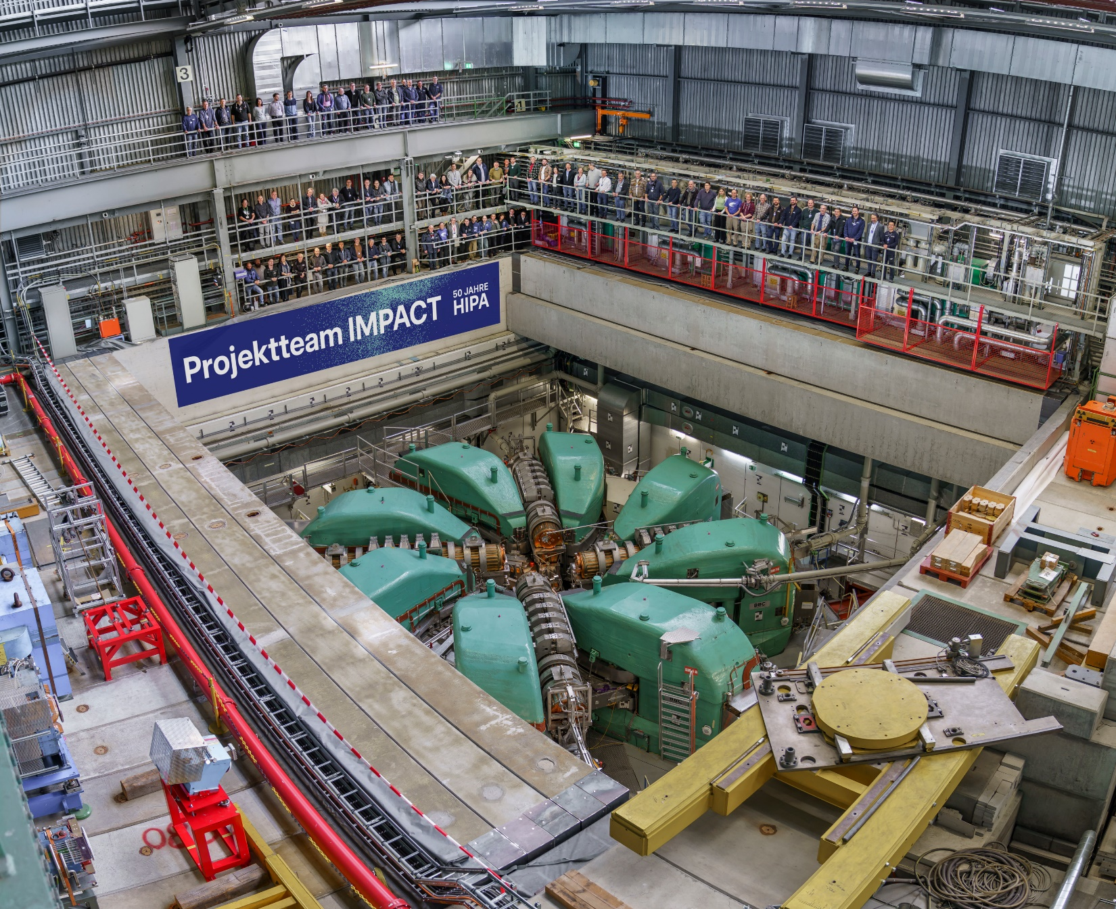
IMPACT Team at 50th anniversary of HIPA
about 100 project members
→ 85 on photo!

Slide 11
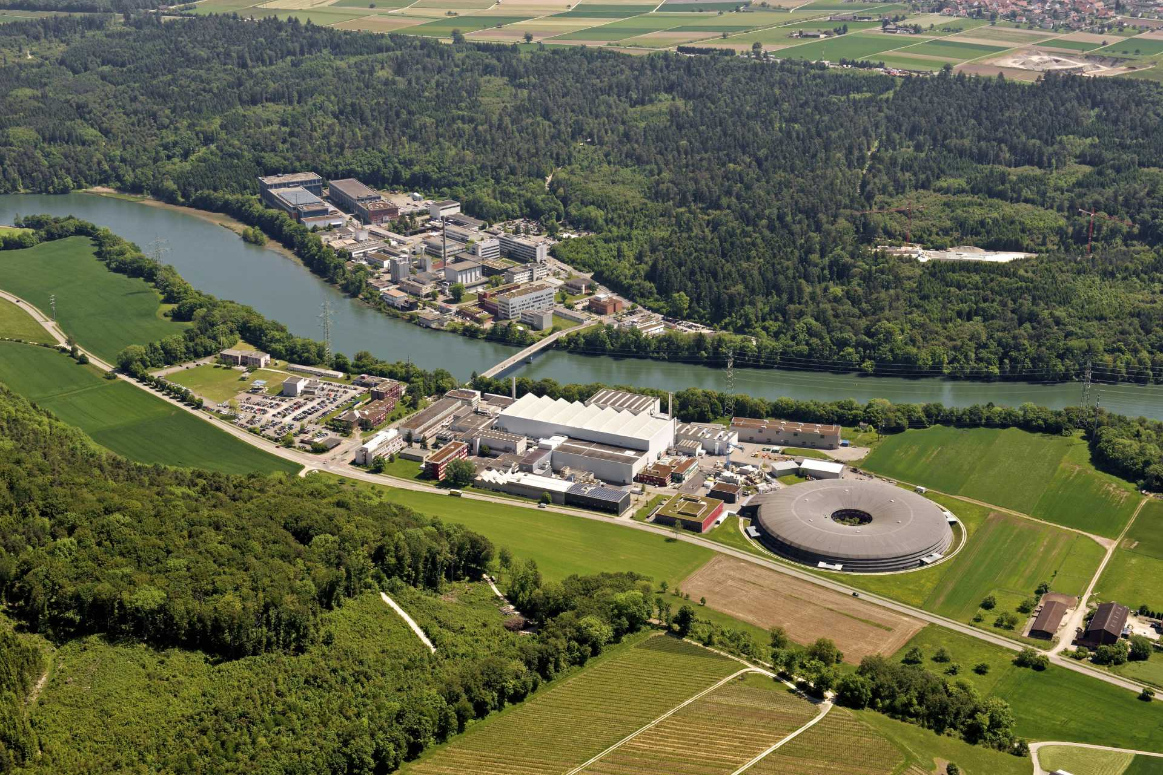
Summary
IMPACT money from Roadmap secured. Savings on budget necessary.
Tight time plan between possible orders/manufacturing 2025/26 and installation (2027)
TDR HIMB: big progress! Ready for editing! Delay: prio on pushing forward
Project handbook VA-8100-897 available on Compliance
Introduction to the PSI High Intensity Proton Accelerator (HIPA)
Extraction from the Ring Cyclotron
Beam transfer to the meson production targets M/E and SINQ spallation source
Beam diagnostics for setup & optimization
Feasibility study of beam rotation for SINQ
Beam switchover to the UCN source
Conclusion
Thanks to all
contributing to IMPACT

