Slide 1
From Dismantling to Installation: A Brief Overview
IMPACT - Infoevent
Christoph Schmid & Christian Nyfeler
Subproject Design & Integration
19.03.2025

Slide 2
Planning
A comprehensive bottom-up planning approach was initiated early to consolidate all details for the long shutdown scheduled to begin in 2027. This shutdown will last 18 months until HIPA restarts for user operation.
Parallel Construction of the TATTOOS Building
Construction of the new TATTOOS building will begin at the same time as the long shutdown
Beamline and Infrastructure Modifications
Given the extensive modifications required in the beamline areas and the experimental hall infrastructure, selected preparatory work will be carried out in advance during the regular shutdown periods in 2025 and 2026
Reconstruction of the North Hall
The reconstruction of the North Hall will be carried out to align the new beamline setup with current safety regulations
Relocation of the Cryostation to MuE1 Area
This move will ensure a continuous supply of liquid helium during and after the long shutdown
Infrastructure Adjustments for the TATTOOS Building
Key infrastructure within the WMFA Building will be relocated to facilitate the construction of the TATTOOS Building in 2027
Current Status and Next Steps
Significant planning has already been completed, and preparations for the long shutdown are progressively ramping up

Slide 3
Aug 23 - Oct 25
Oct 28 - Mar 18
Jan 11 - Aug 20
Dec 3 - Mar 1
Jan 1 - May 31
Jan 1 - Nov 13
Jun 13 - Apr 12
Mar 17 - Mar 7
Jan 4 - Mar 19
107.5 days
254.5 days
147.5 days
6/7 - 12/31
225.5 days
216 days
108 days
63.5 days
456.5 days
272 days
377 days
159.5 days
101.5 days
45.5 days
107.5 days
54.5 days
107 days
109 days
108 days
150.5 days
90 days
43 days
508.5 days
114.5 days
83 days
56 days
66 days
44 days
521 days
77 days
460 days
2024
2031
Today
Planning
Jul 3
Oct 30
Nov 28
User Operation SINQ, UCN, SμS, CHRISP
Aug 7
HIMB Beam
May 1
Retreat
Jun 1
Sep 2
HIPA Beam
Go / No-Go
Start Shutdown
Jan 1
User Operation HIMB
TATTOOS Beam
2024
2025
2026
2027
2028
2029
2030
2031
Eastwall Access
'
North Area Reconstruction
Site Preparation
MuE1 Shielding
'
Cryostation Movement
TATTOOS - WMFA Prep.
'
UCN PKCO Access
Magnets
Feb 1 - Jul 1
Inserts
Jan 1 - May 31
Pre-Assembly
Mock Up / Target H Set up
Jan 12 - May 18
Jan 1 - Jun 1
Separator
Jan 1 - Jun 1
Nov 30 - Nov 11
TATTOOS Beamline
Sep 25 - Jun 25
Jul 25 - Jan 4
Building Construction
Jul 20 - Aug 4
Remove Beamlines
New Proton Channel Tunnel
Remove PK1 Beamline
Installation Tg, Beamlines, Shielding
Dismount Target M
Remove PK1 Shielding
Execution
Nov 11 - Mar 7
Dec 27 - Mar 13
Install Target H
Sep 20 - Feb 26
Apr 30 - Jul 31
Install Beamline in Shielding
Install Steel Shielding
Install Concrete Shielding
Jan 1 - Dec 31
Jan 9 - Apr 25
Mar 1 - Apr 30
May 1 - Jun 30
Install PK1 Beamline
Aug 26 - Jun 1
Aug 1 - Dec 31
Install Beamlines
Jun 1 - Dec 30
HIPA Com.
Commissioning
HIMB Com.
TATTOOS Com.

Slide 4
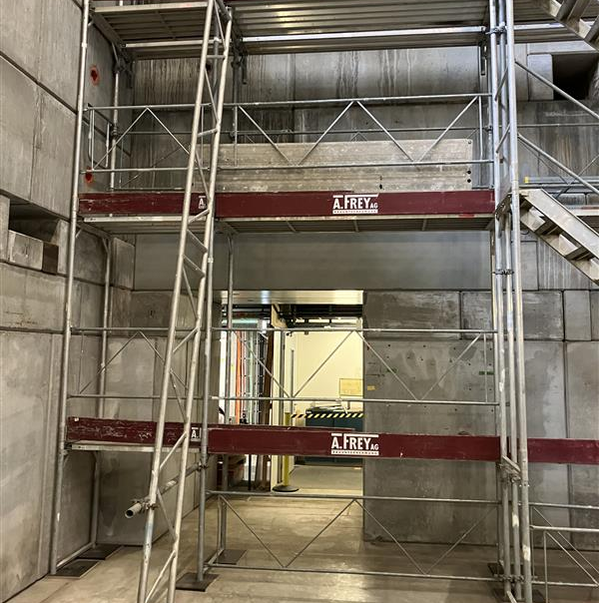
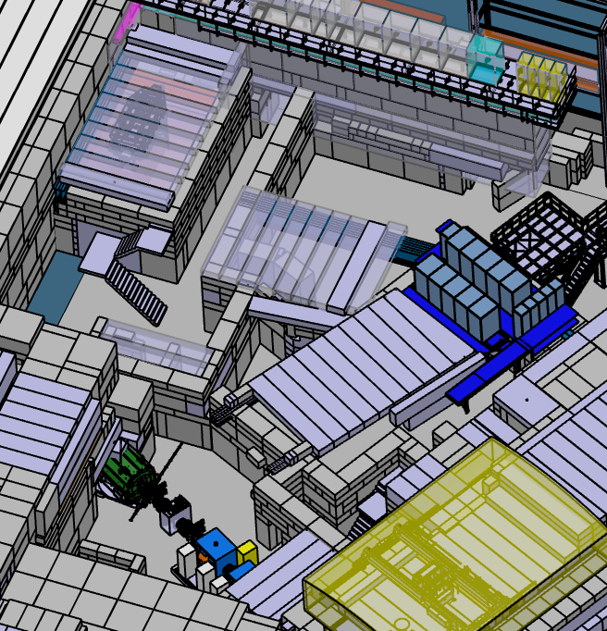
Site Preparation – WEHA North Area
To comply with current emergency exit safety regulations, the North Area of the Experimental Hall will undergo a comprehensive redesign.
New Access Route
A new access point from the WBGA office building will be established
Optimization of Shielding
With the shutdown of Injector 1 and its associated beamlines, unused shielding will be removed or reduced to optimize space
Relocation of the Neutron Bunker Experiment
The experiment will be relocated outside the WEHA, and non-utilized areas will be dismantled
Expansion of Existing Beamlines
Additional space will be created for existing beamlines, enhancing operational flexibility
New Courtyard for Logistics and Experiment Preparation
A dedicated courtyard will be established, providing improved logistical support and experimental preparation areas

Slide 5
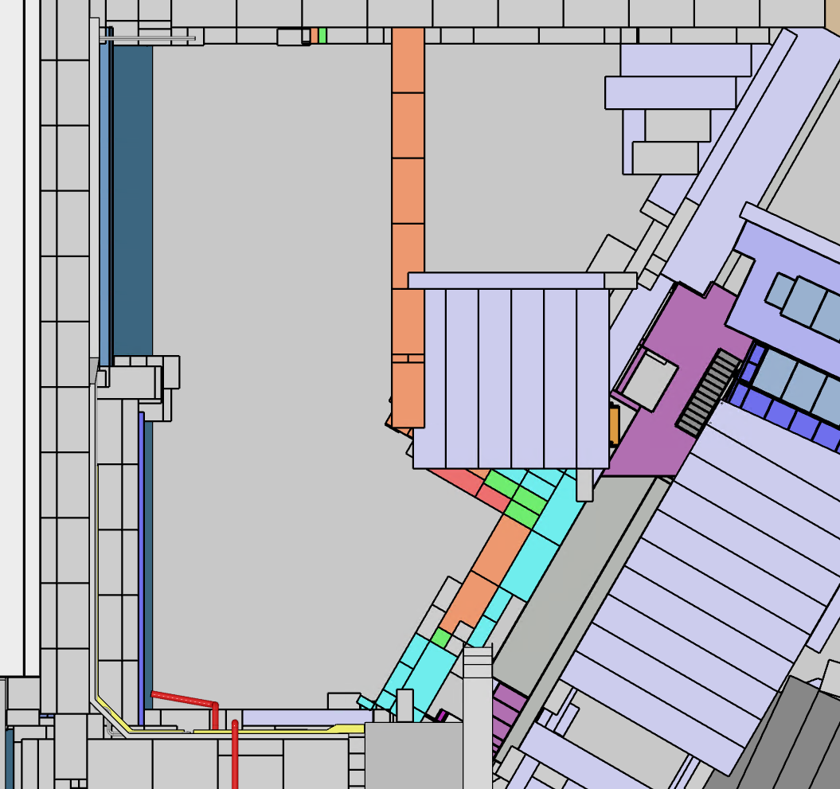
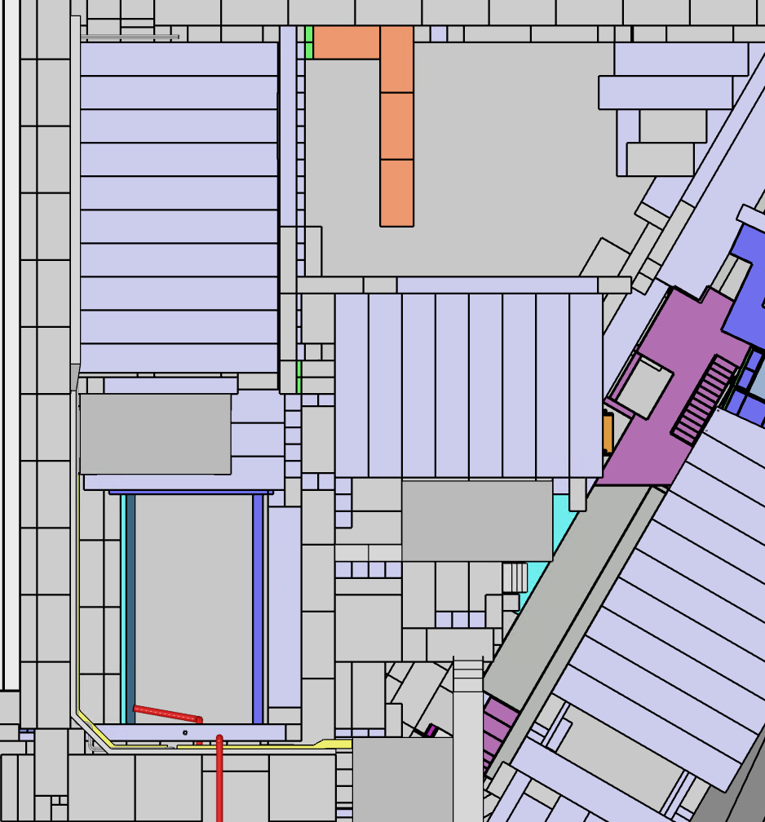
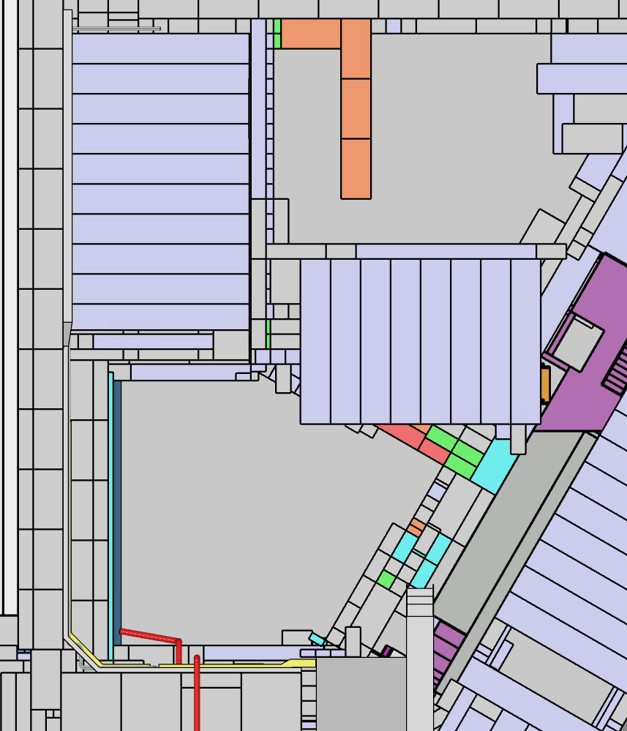
Site Preparation – WEHA North Area
The North Area will undergo a phased reconstruction during the current and upcoming shutdowns.
As part of the preparations for the long shutdown, this area will serve as a pre-assembly area for the new Target H Station
Q1 – Q2 2025
Q3 – Q4 2025
Q1 2026
1
6
4
5
2
3

Slide 6
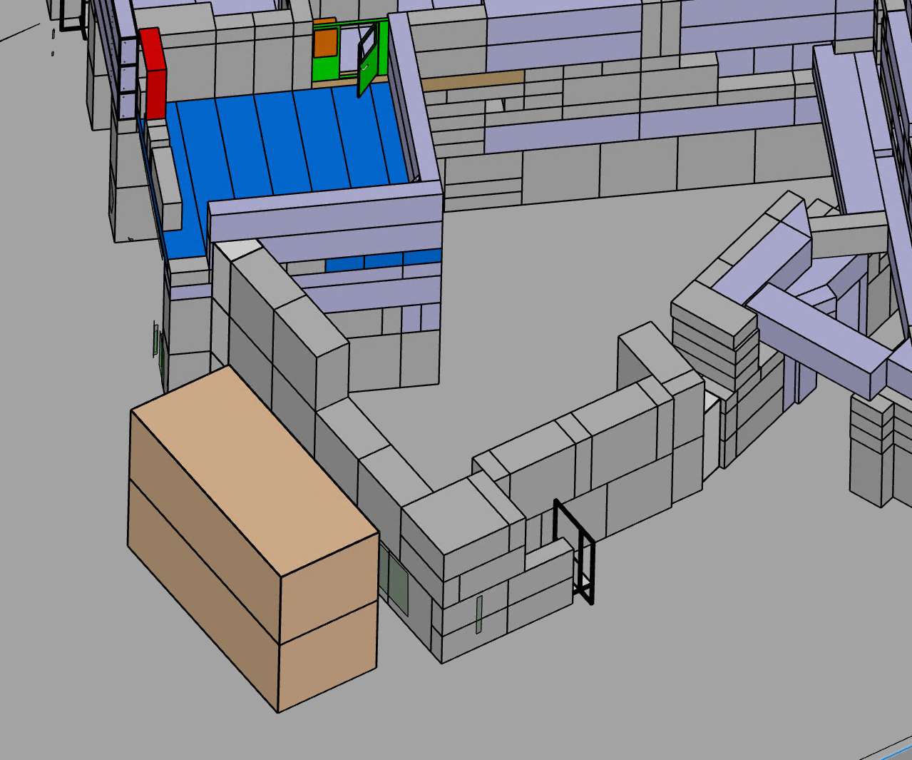
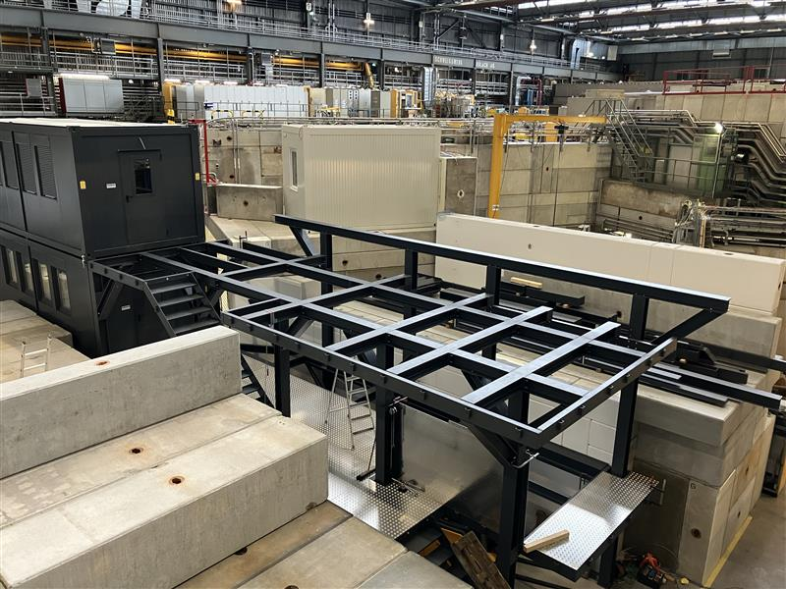
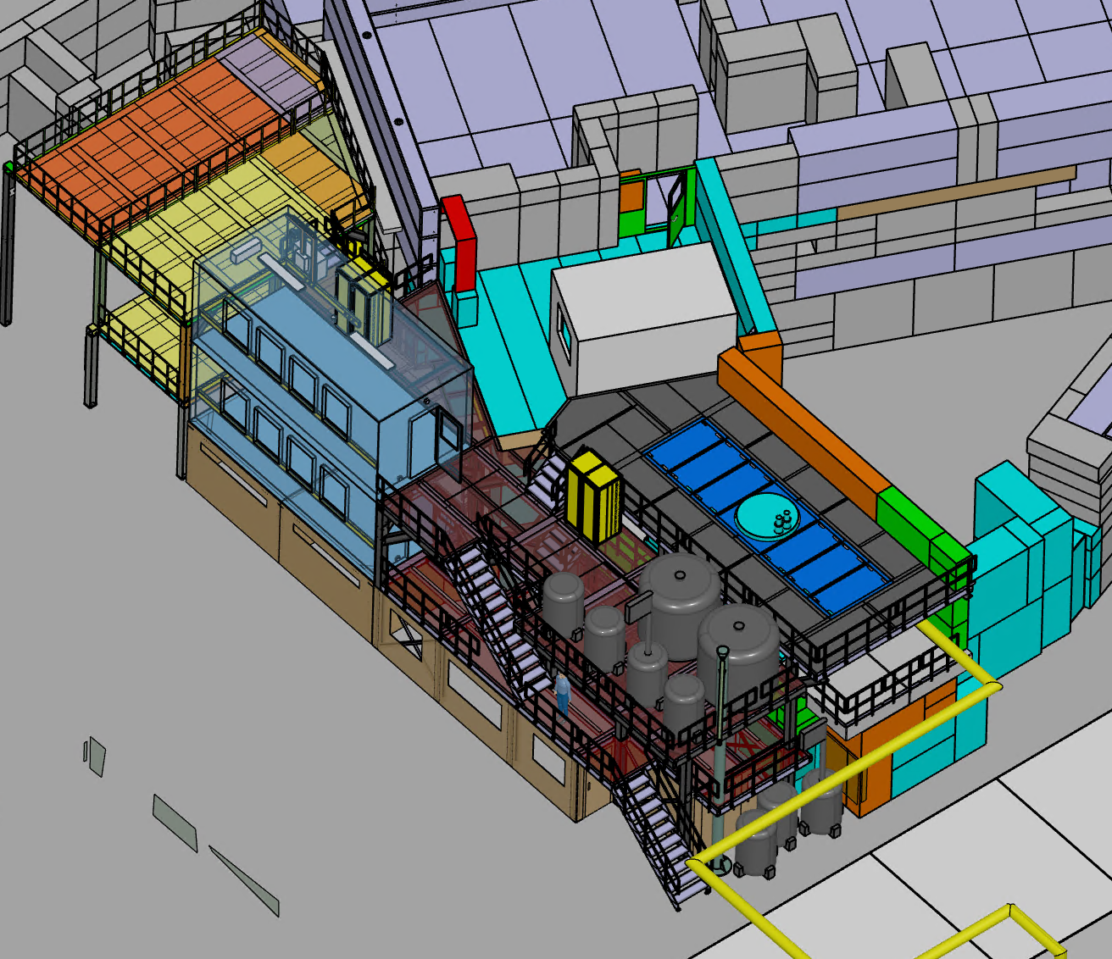
Site Preparation – WEHA Cryostation
The existing cryostation, currently located near Target M, is positioned along the planned path of the new MuH3 beamline. To accommodate this development, the cryostation will be relocated to the MuE1 area.
This relocation will be completed ahead of the long shutdown, enabling an immediate start to the dismantling of Target M once the long shutdown begins in 2027
Q1 – Q2 2025
Before 2025
Q1 2026

Slide 7
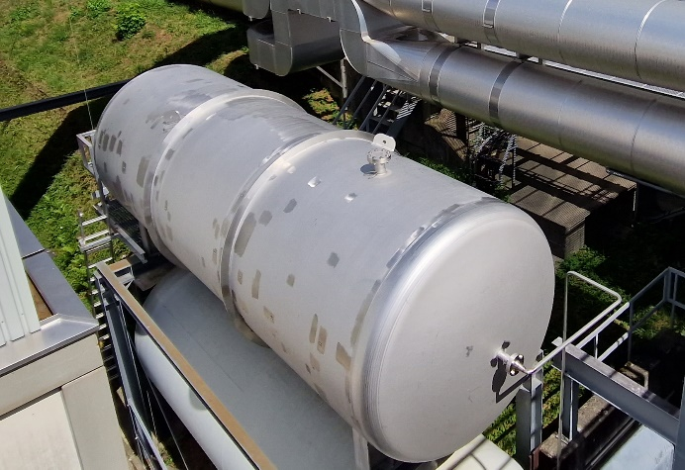
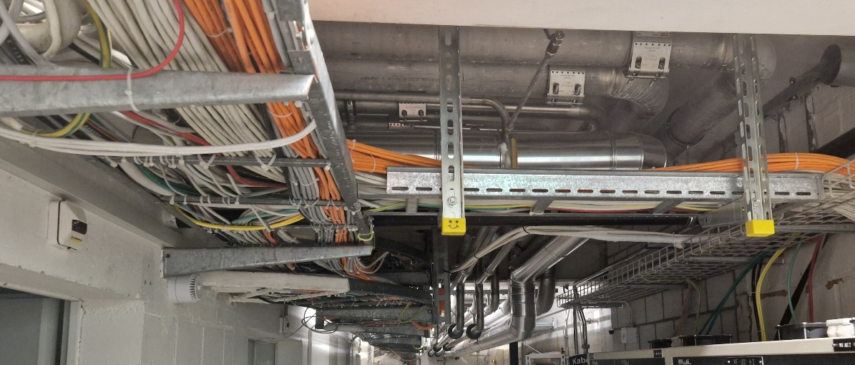
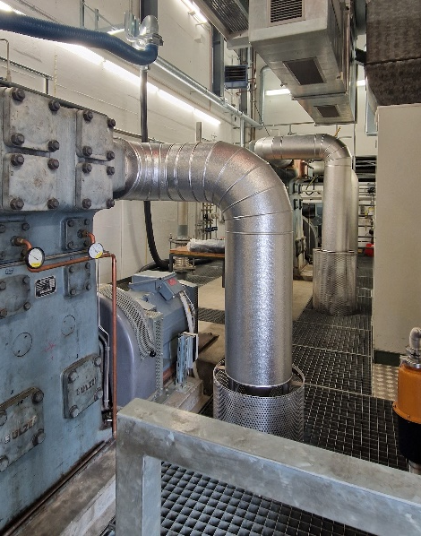
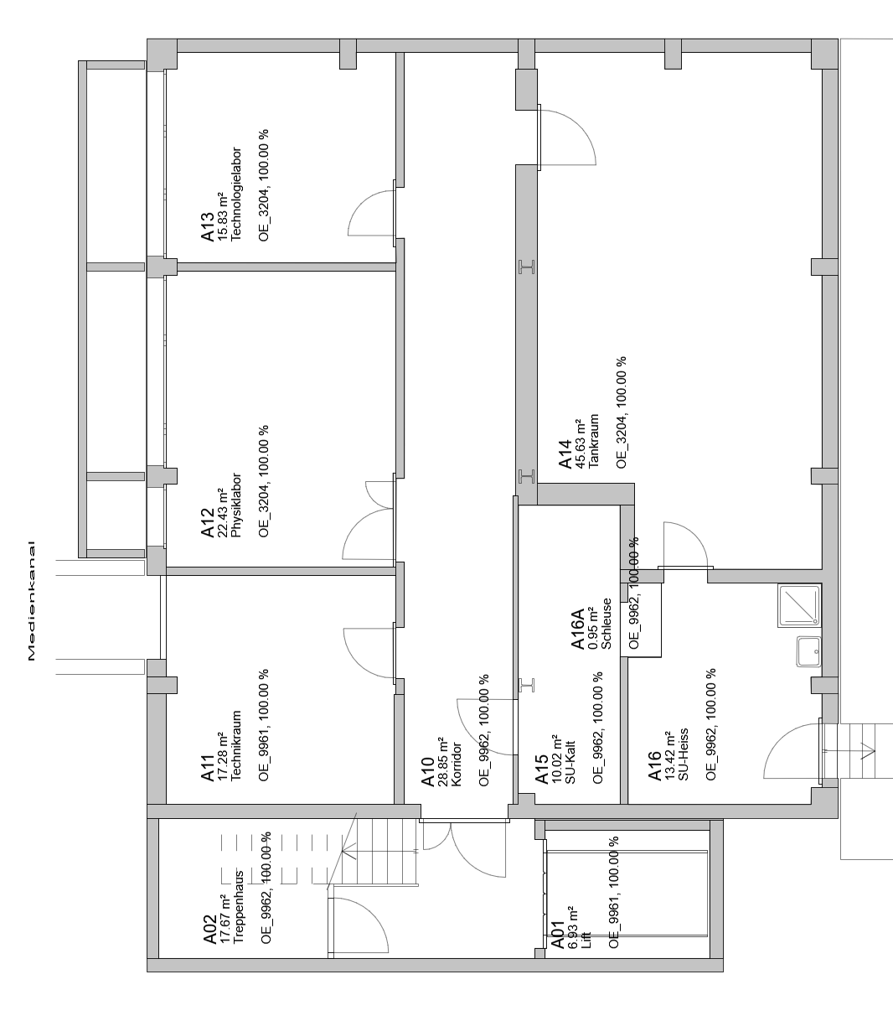
Site Preparation – TATTOOS
✓ done
ongoing
To enable the construction of the TATTOOS building in 2027, several UCN-related infrastructure interfaces within the WMFA Building must be relocated.
Progress so far:
Relocation of Helium Tanks
Dismantling of Compressors
Removal of Unused Shielding Blocks outside the building
These preparatory measures ensure a smoother transition and facilitate the timely start of construction.
✓ done
Kompressoren
WMFA UG
Pkc0
UCN Exp.
Kontrollraum
Sultan
WSGA
Schwerwasser-tankraum

Slide 8
Logistics and Areas
To ensure the successful execution of the project, dedicated areas for assembly, storage, logistics, and disposal will be established.
Pre-Assembly Areas
Inserts, magnets, and other components will be pre-assembled in the ELMA Hall and the PiA workshop
Centralized Storage
A central material intake and pallet storage will be set up in ELMA
Test set up of Target H
A dedicated pre-assembly area for the new Target H station will be established in the experimental hall
Intermediate Storage for Activated Materials
The Injector 1 bunker and WAKA will serve as intermediate storage for highly activated materials from the dismantling of Target M and PK1.
Management of Activated Materials:
The dismantling of the Proton Channel, secondary beamlines, and supporting infrastructure will generate a significant amount of potentially activated material. This material will be stored on-site until further disposal measures are implemented.
A detailed logistics and area utilization plan is currently under discussion and development.

Slide 9
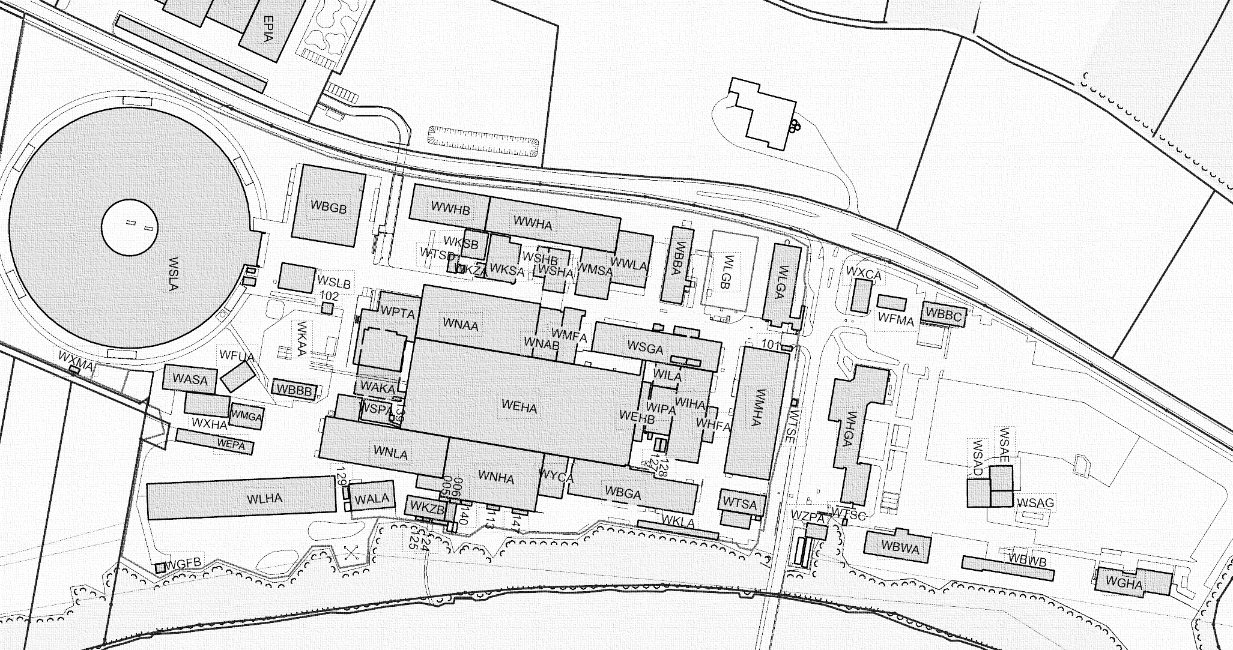
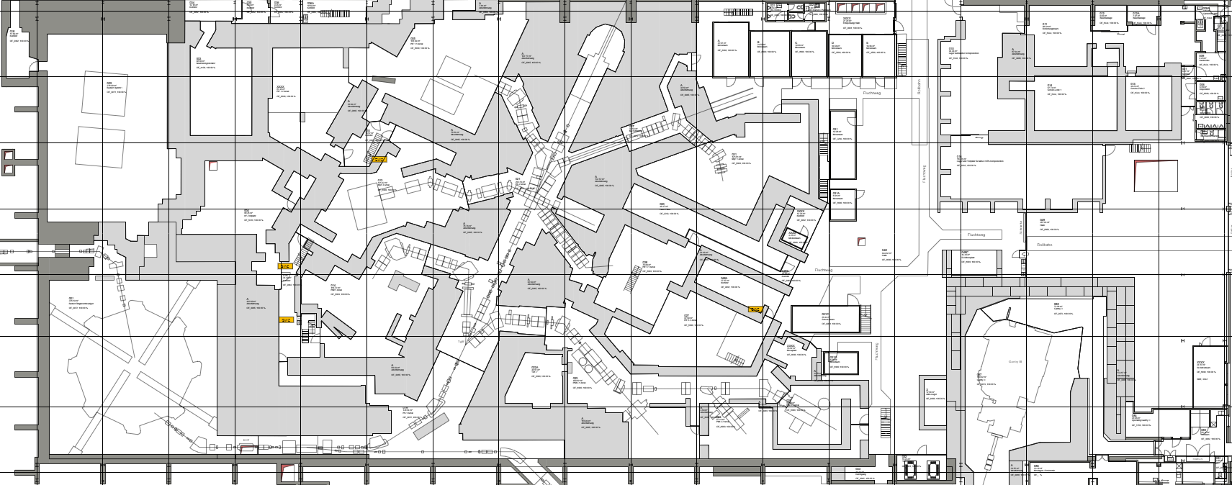
Logistics and Areas
7
under discussion
PiA
.
Storage activated Material
Pre-Assemby Chambers, Cooling Circuits ...
4
5
Logistics In-Take, Paletts, disp. mat...
Tests magn. Measrurments, …
10c
3
10b
8
1d
1
9a
2
10a
1c
1b
6
1a
12
ELMA
11
9b

Slide 10
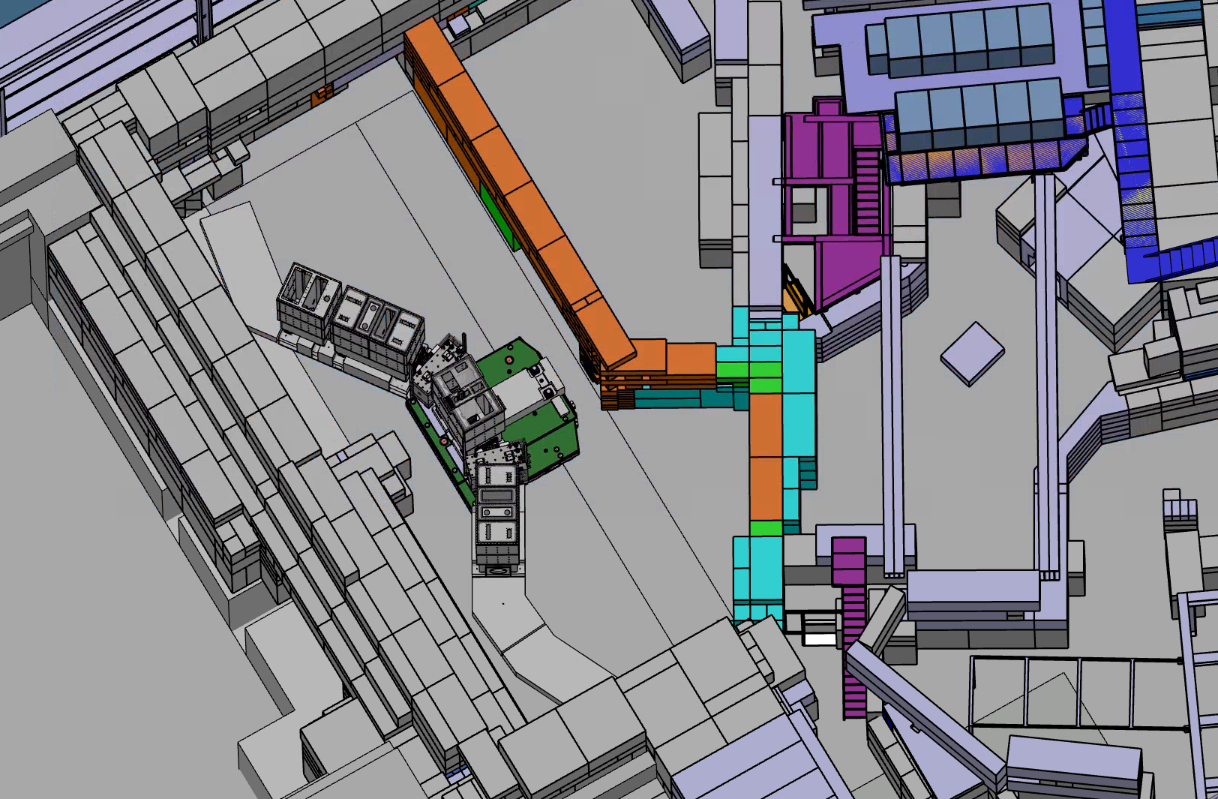
Pre-Assembly
In preparation for the long shutdown, the new Target H region, including the large vacuum chambers of MuH2/3, will be pre-assembled and tested in its final installation setup.
Planned Tests & Verifications:
Installation and surveying procedures for the vacuum chambers
Vacuum pumping tests
Installation and handling procedures for inserts, including Target H, collimators, solenoids, and other key components
The Experimental Hall is one of the few locations that meets the crane capacity and height requirements necessary for this pre-assembly.
To create the required space within the hall, the area besides to the Injector 1 bunker will be dismantled, including the RF test stand and the neutron bunker
PiE1.2
Access to WBGA
MuE4
Injector 1
PiM1

Slide 11
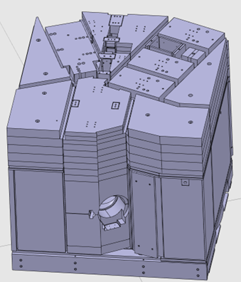
Long Shutdown - Dismantling procedure
Early Decommissioning & Dismantling
  Initiation of dismantling activities at PiM1, PiM3, and MuE4 sites (starting ~November 2026)
Dismantling of Proton Beam Components
  Removal of proton beam elements (PK1)
Service Level & Target M Infrastructure
  Dismantling of infrastructure on the service level of Target M
  Extraction of Target M, collimators, and associated components
Structural Modifications & Radiation Protection Measures
  Removal of the concrete wall of the P-Channel (right side, Villigen)
  Installation of a lead window and cameras to enable remote dismantling of TgM
  Implementation of a protection shield around TgM to contain contamination
Complete Dismantling of the Target M Station
  Disassembly of the entire Target station
  Removal of the protection shield and full shielding of the P-Channel
Start the Installation of new Target H station
Illustration of the target station

Slide 12
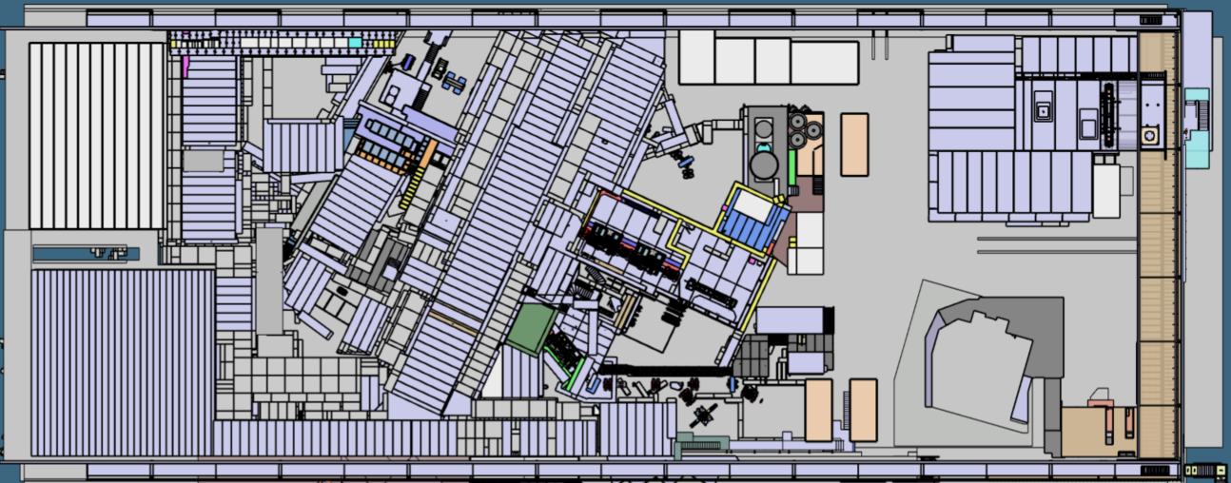
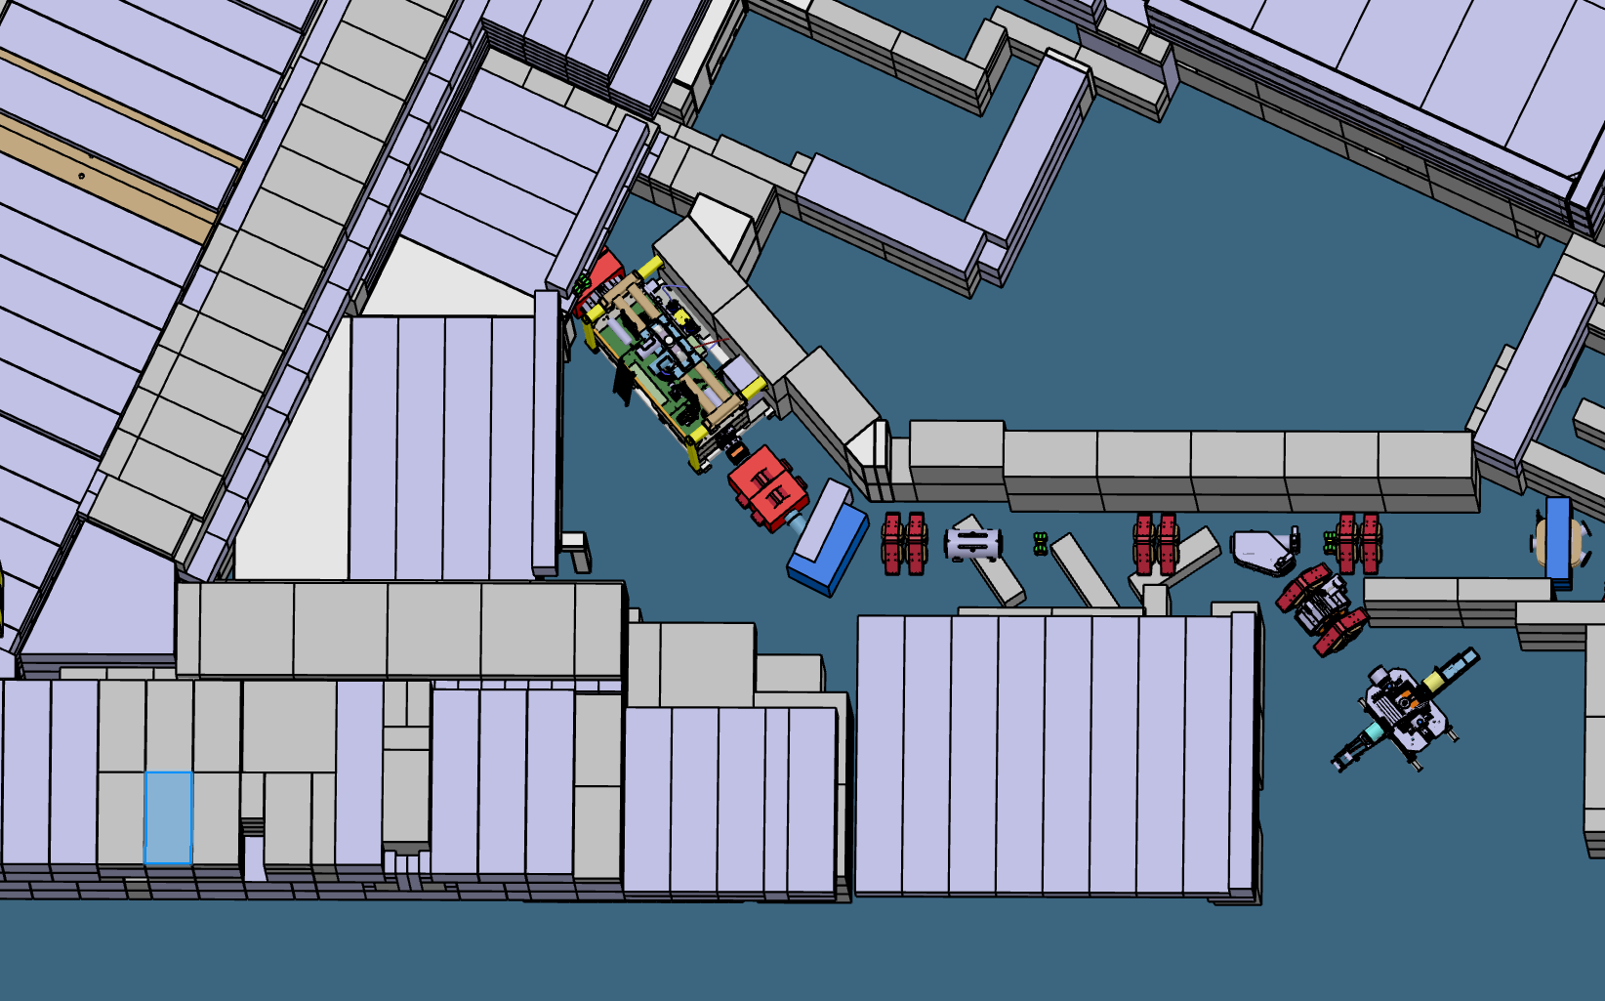
Early Decommissioning & Dismantling
PiM1, PiM3 and MuE4 (starting ~November 2026)
Dismantling MuE4
Dismantling PiM1
Dismantling PiM3

Slide 13
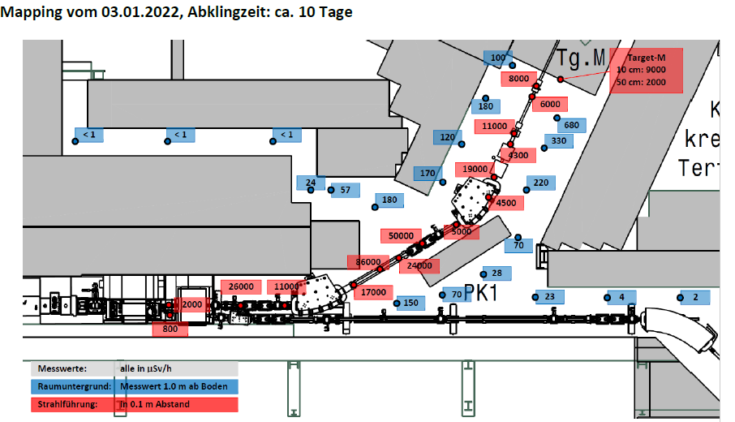
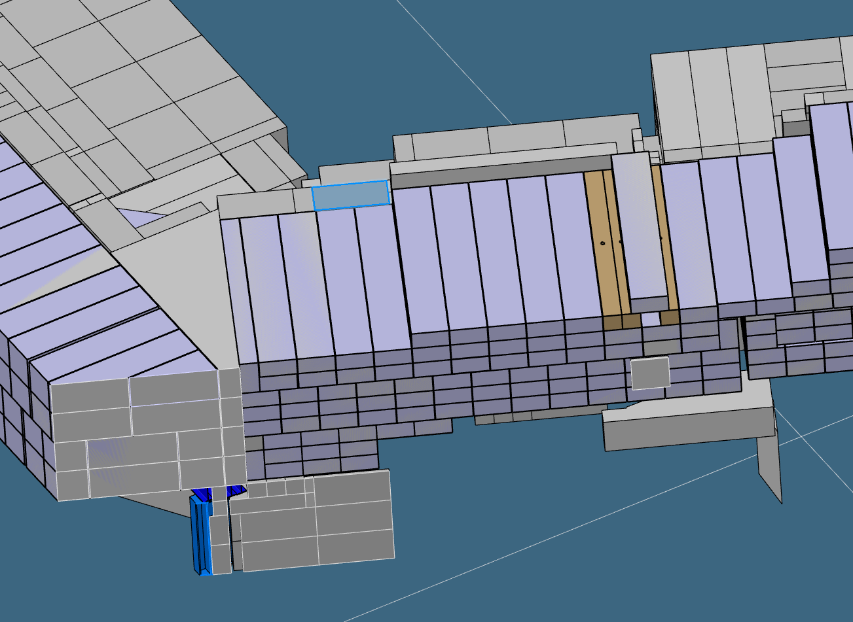
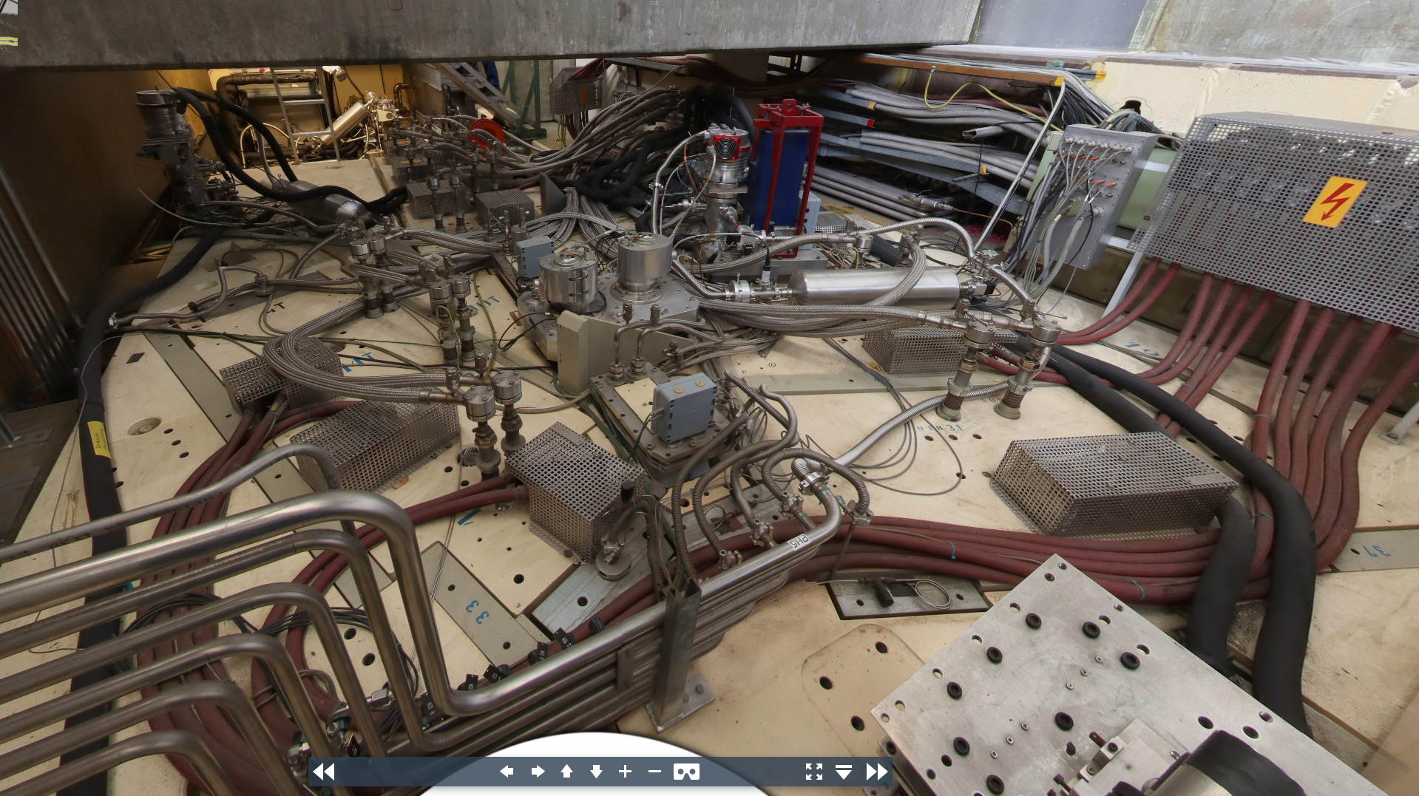
Dismantling the Proton Beam components PK1
Challenges
High radiation dose rates in the PK1 area
Safe transfer of dismantled components to the WAKA active storage
Dismantling of Target M
Removal of the roof and associated infrastructure (e.g., cabling)
Disassembly of collimators (KHM2, FS31)
Sealing of vacuum chamber flanges
PK1

Slide 14
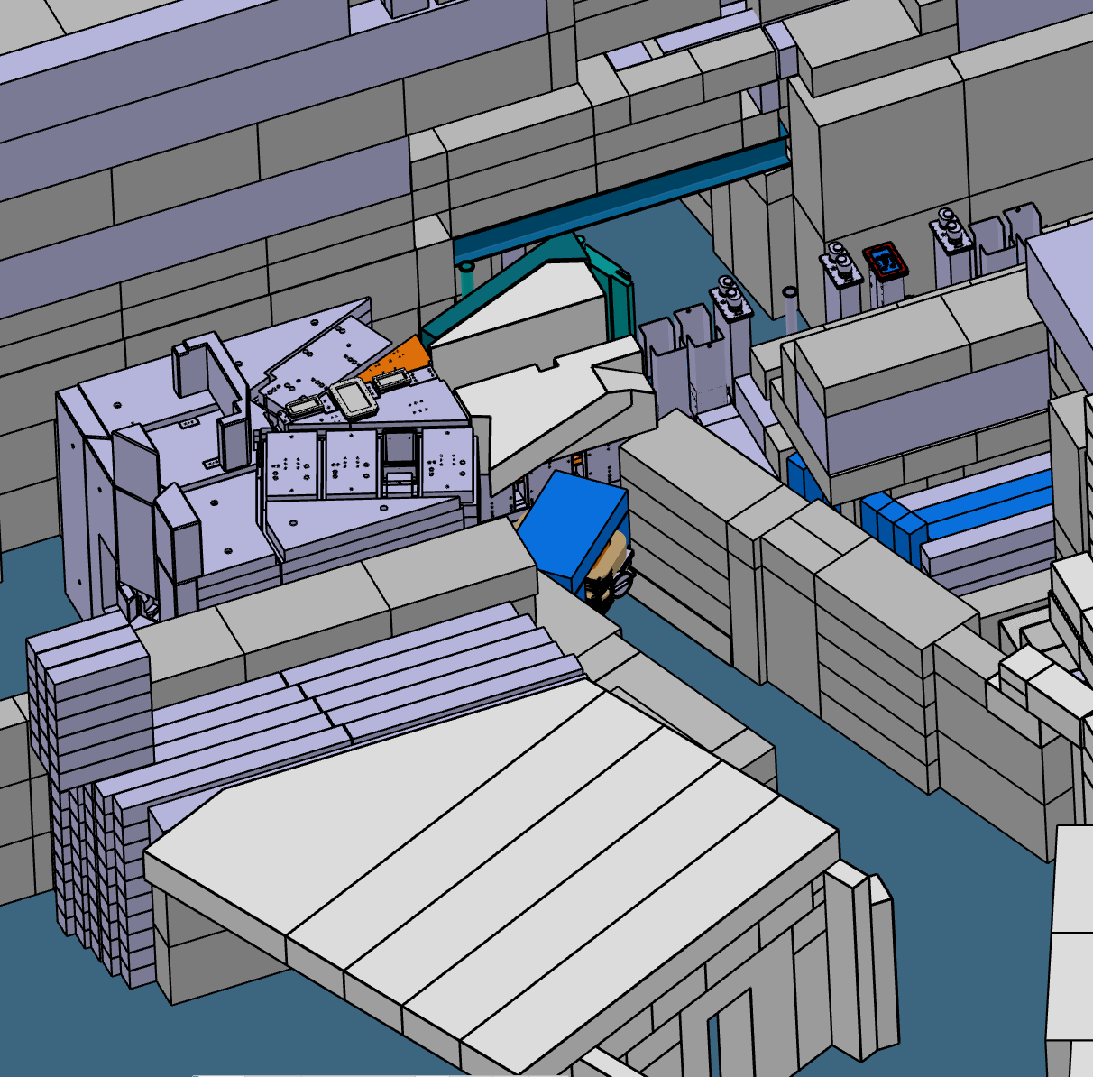
Dismantling of P-Channel wall (right side, Villigen)
Main shielding will be dismounted on the south side
Main shielding will be re-installed partly
Lead Window as redundancy of the camera system
Platform for Operators to dismount Target M remotely

Slide 15
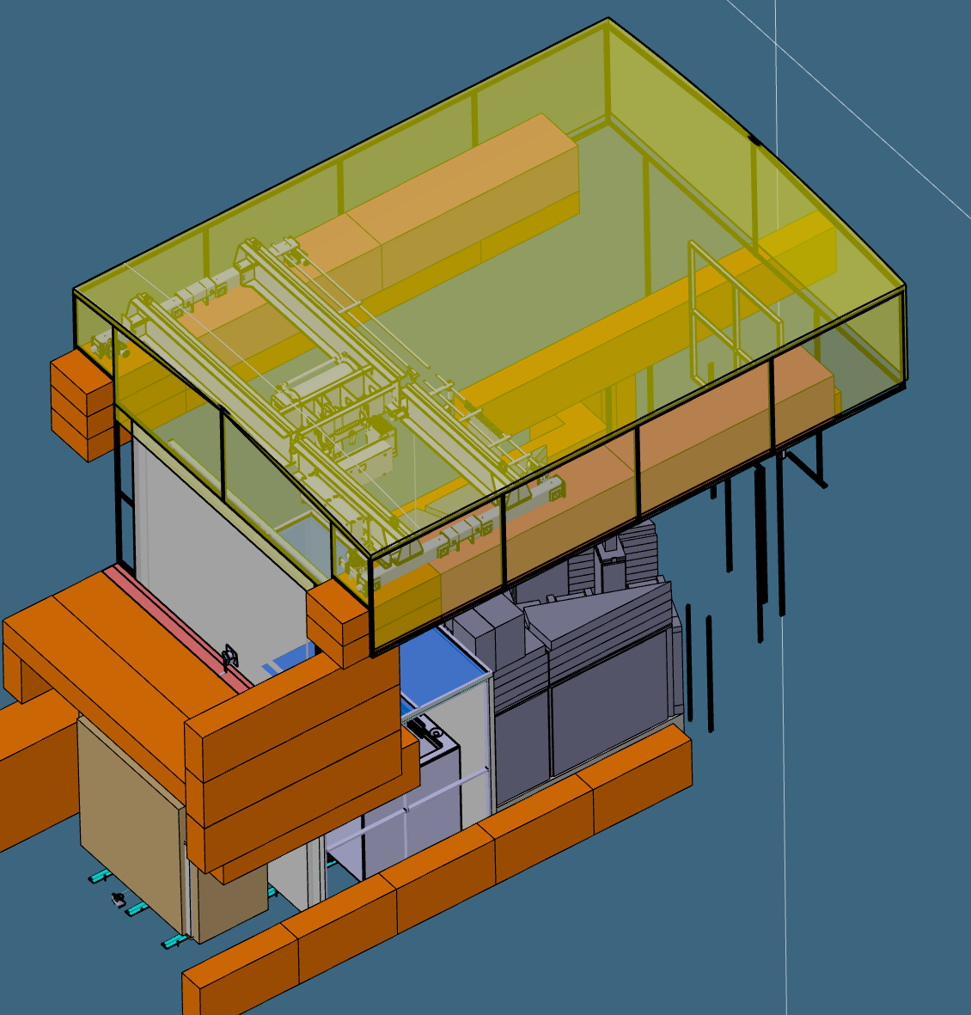
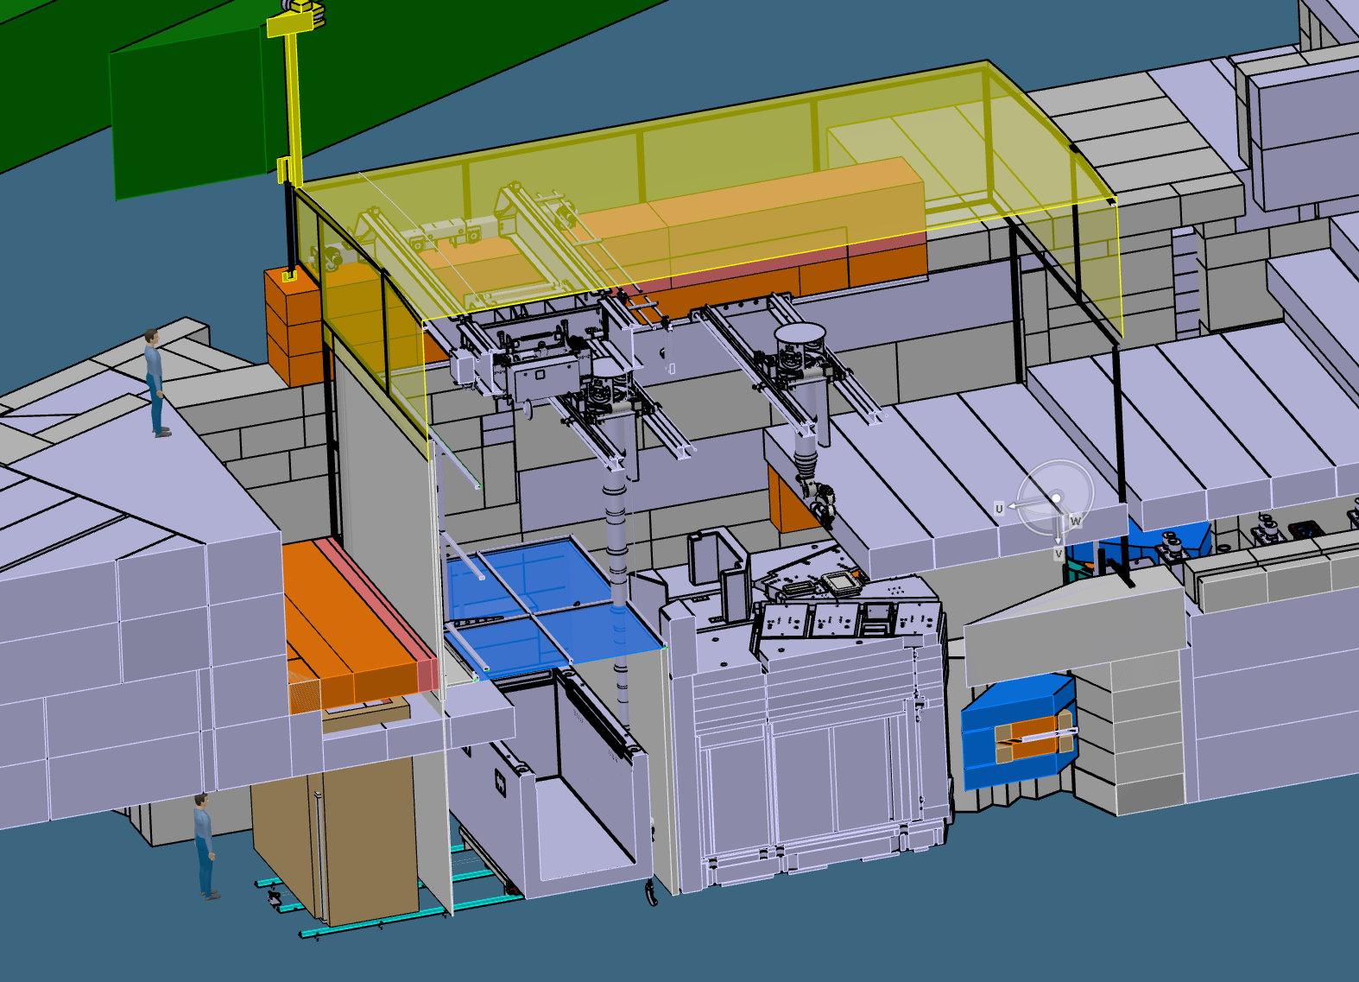
Installation protection shielding
Installation of the Protection Shield to contain contamination
Installation of an additional Crane, dedicated to dismantling Target M
Integration of an ATEC Power Manipulator to enable remote dismantling of Target M
Implementation of a Railway System to transport containers through a lock, where they will be filled with activated material

Slide 16
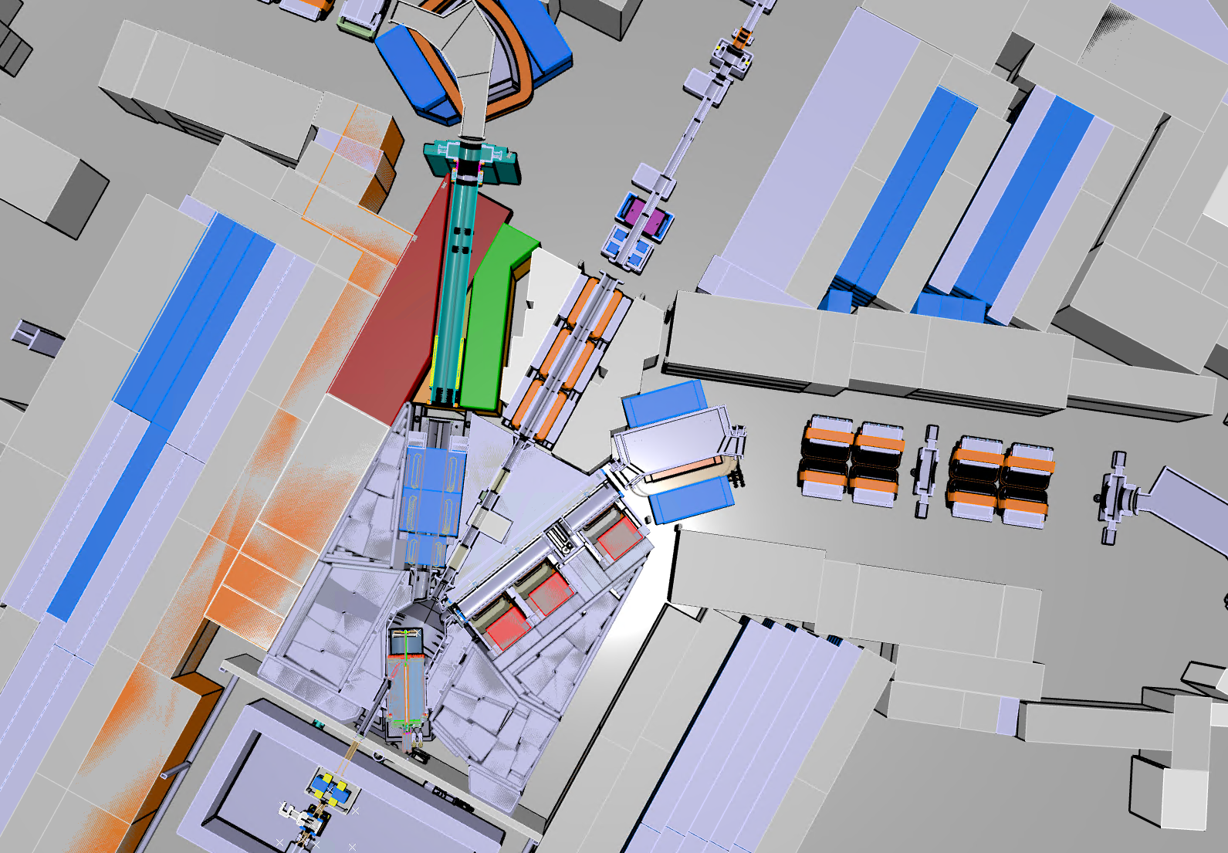
Installation protection shielding
Protection shield
PK2 will remain in place
Frame with Alu-profiles and Alu-sheet
Sealing with Alu-Scotch tape
The space of the removed Beamline, withing the shielding, will be closed as well. However, will be used as Entrance for maintenance.
Under pressure of 50mbar
A steady air flow in the Target vacuum chamber will be kept with vacuum pumps at the open Target M port
PiM1 on trolley
Air flow
PiM3 on trolley
Vacuum Pumps

Slide 17
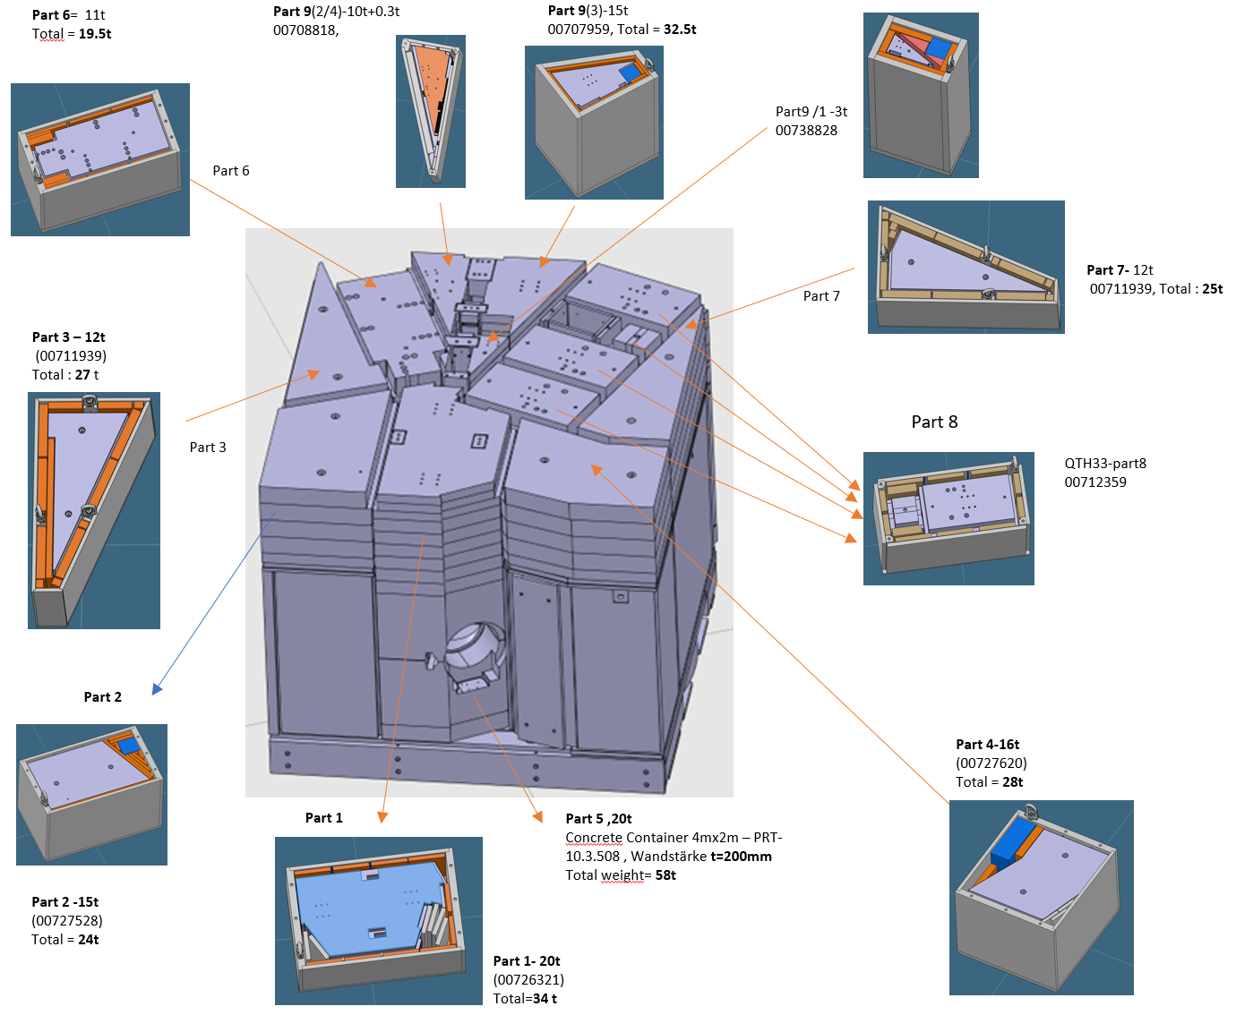
Dismantling the Target M station
Concept:
Approximately 75 - 80 % of the volume of the target station will be reused
The components to be reused will be placed in newly designed shielding containers so that they can be handled them without remote
The highly activated waste will be stored in shielded containers until disposal withing the ATEC facility
Challenges:
Very high dose rates and contamination
Installation over 40 years ago, incomplete documentation
Disposal was not taken into account when the components were manufactured at the time
No prior tests possible

Slide 18
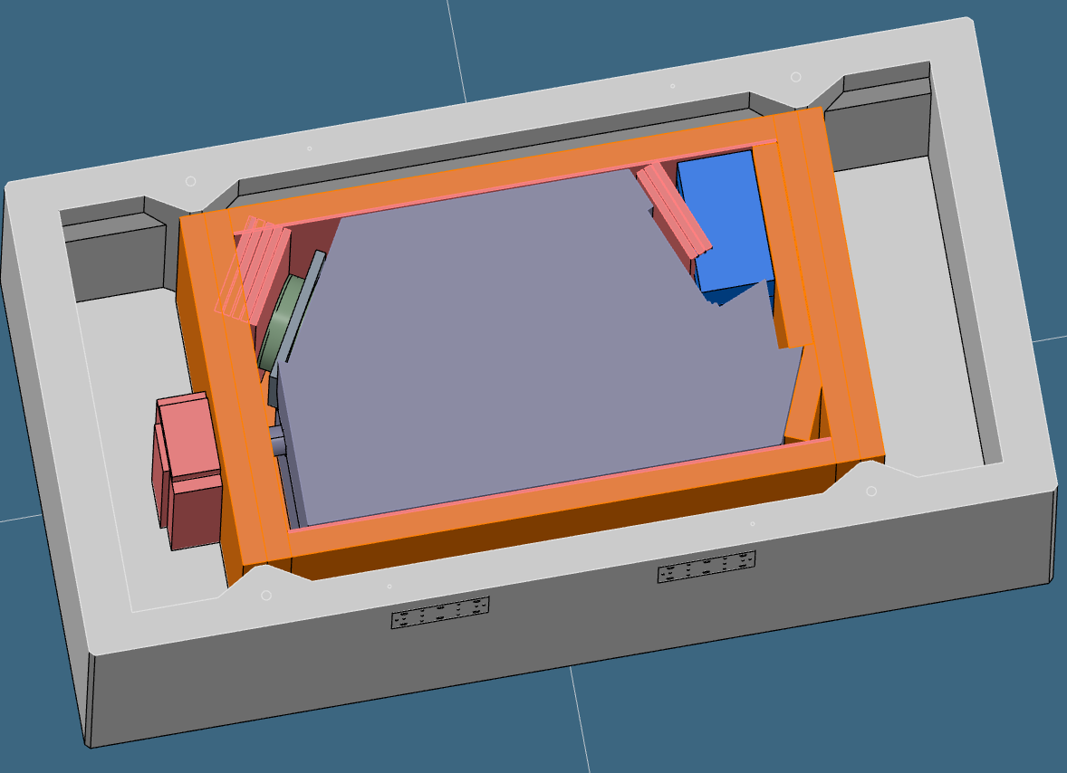
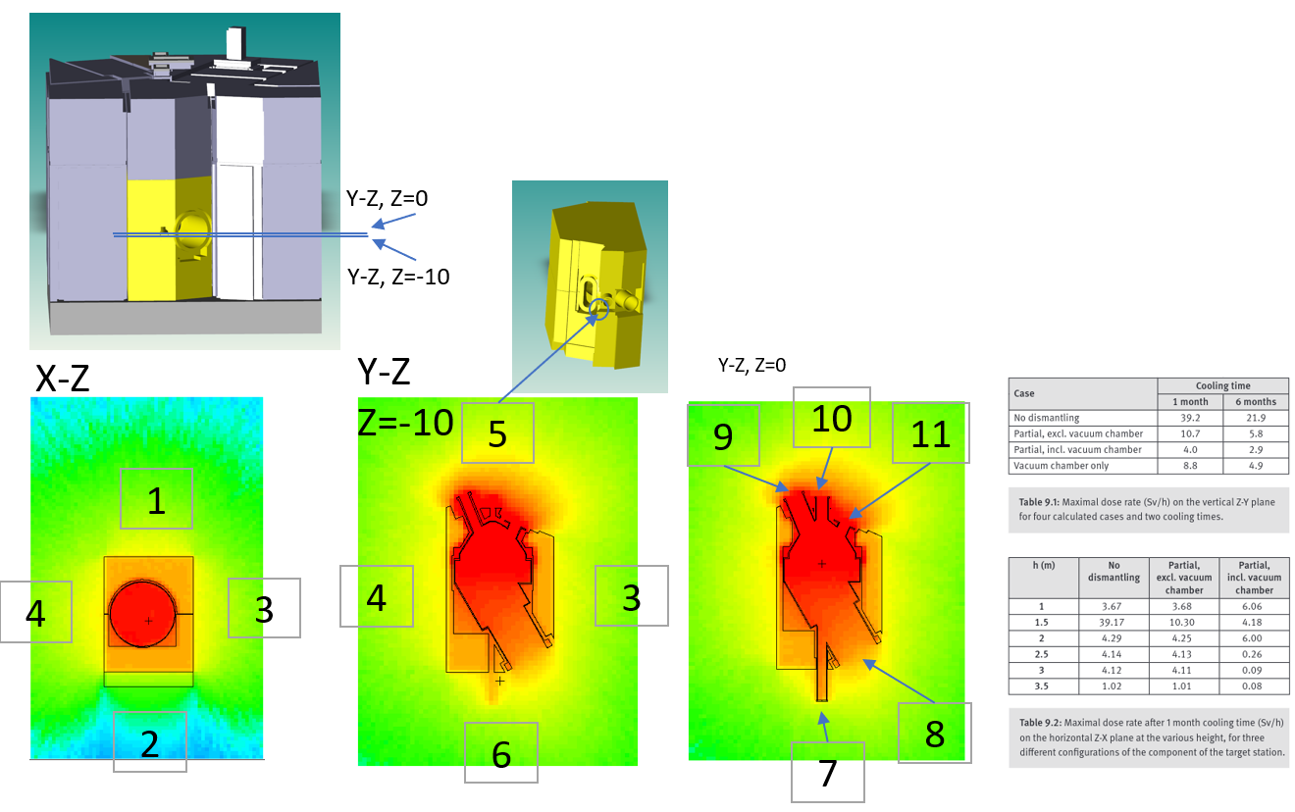
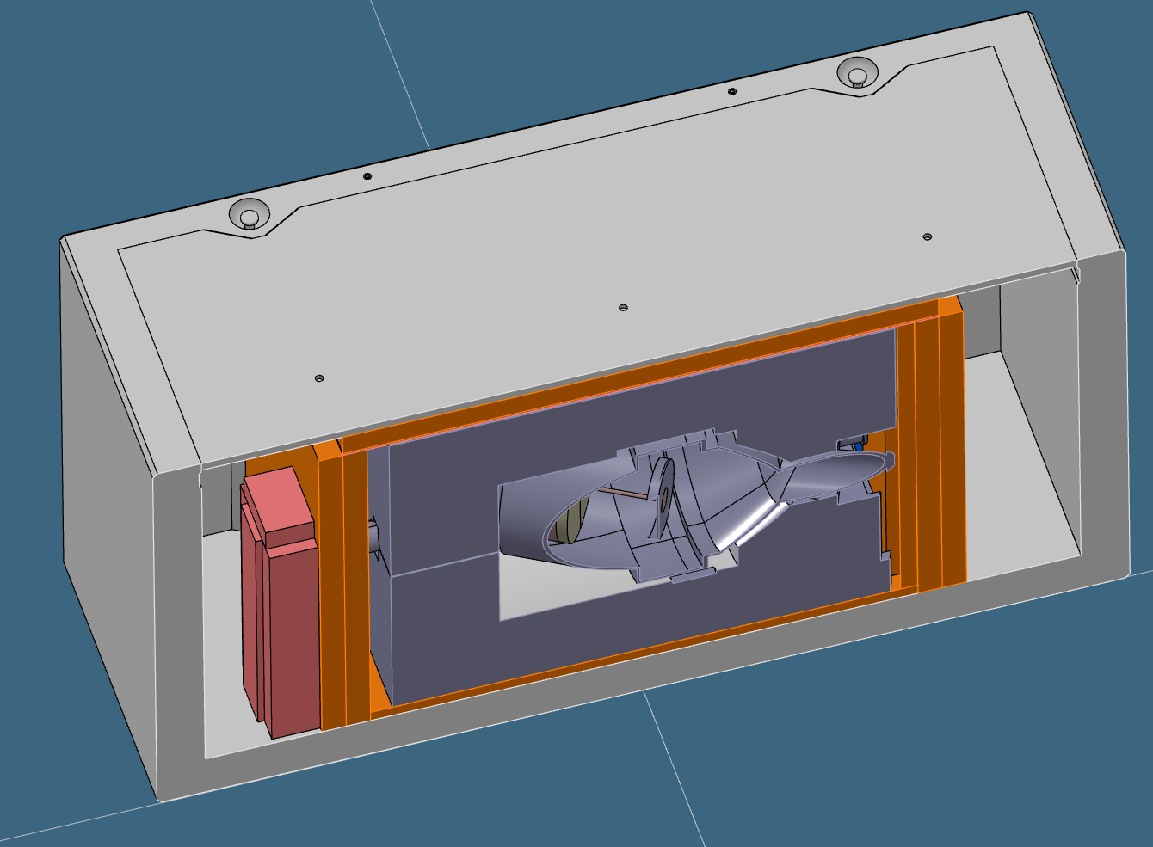
Dismantling the Target M station
Concept for waste treatment, two examples (Targetstation and vacuum chamber):
part5 +vc | pSv/s | mSv/h
1 | 5.10E+07 | 183.57
2 | 8.94E+06 | 32.18
3 | 5.23E+07 | 188.44
4 | 5.55E+07 | 199.96
5 | 1.62E+08 | 584.75
6 | 8.29E+07 | 298.60
7 | 3.29E+07 | 118.37
8 | 1.05E+08 | 376.78
9 | 2.62E+08 | 942.08
10 | 2.39E+08 | 860.54
11 | 4.78E+08 | 1722.28

Slide 19
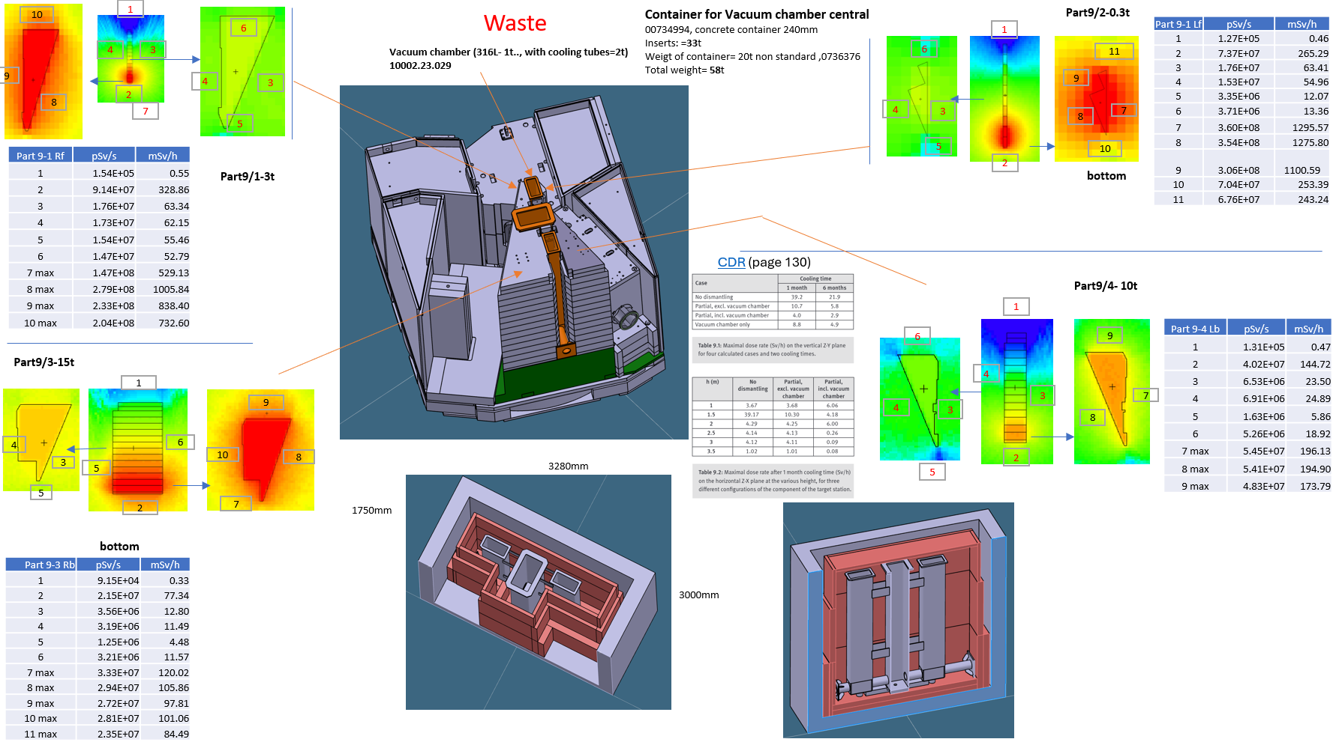
Dismantling the Target M station
Part 9-3 Rb | pSv/s | mSv/h
1 | 9.15E+04 | 0.33
2 | 2.15E+07 | 77.34
3 | 3.56E+06 | 12.80
4 | 3.19E+06 | 11.49
5 | 1.25E+06 | 4.48
6 | 3.21E+06 | 11.57
7 max | 3.33E+07 | 120.02
8 max | 2.94E+07 | 105.86
9 max | 2.72E+07 | 97.81
10 max | 2.81E+07 | 101.06
11 max | 2.35E+07 | 84.49

Slide 20
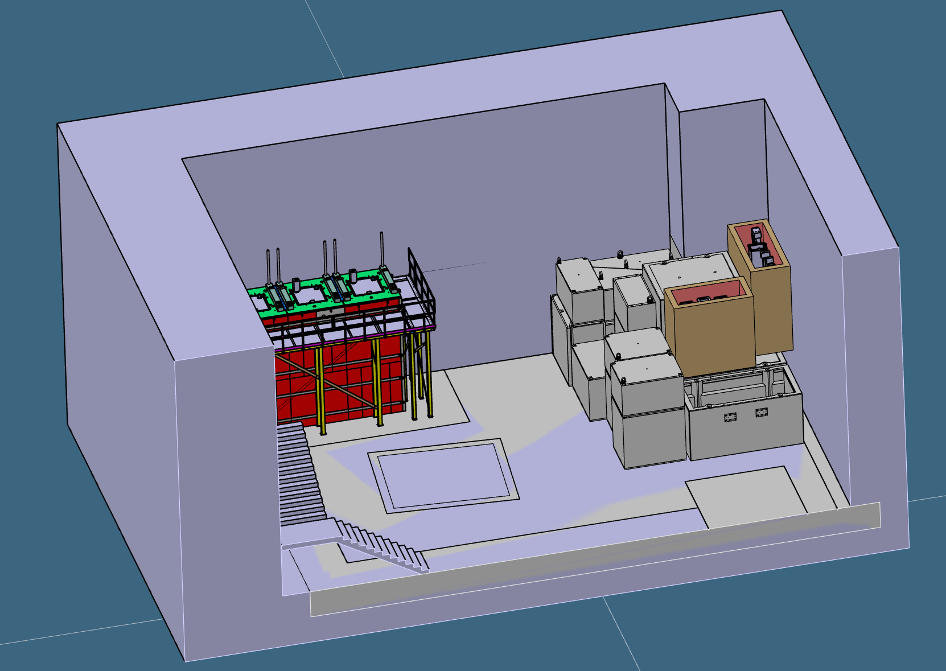
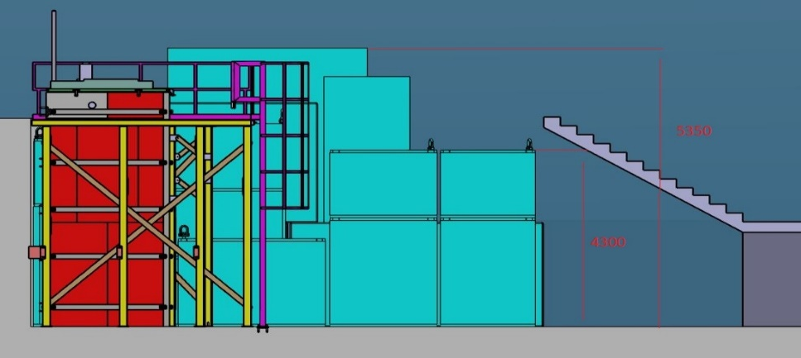
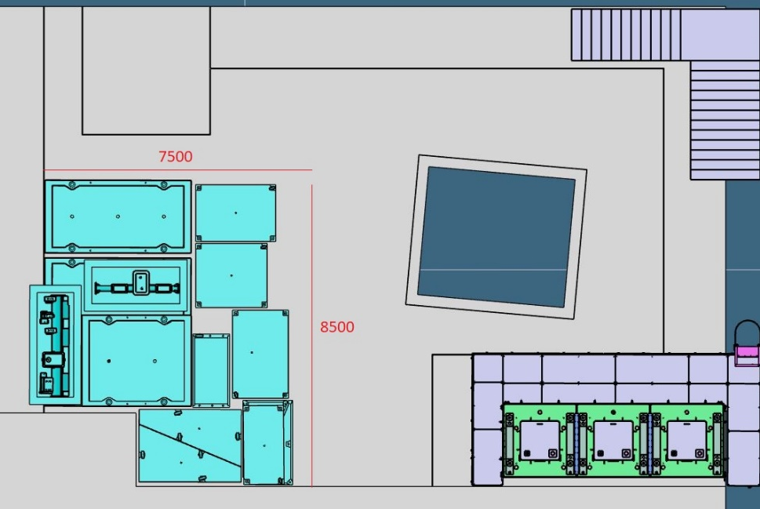
Storage of highly activated components
In the Injector 1 bunker, the highly activated material from Target M will be temporarily stored. Some containers will be reused for the shielding of the new Target H, others will be disposed in a later stage.

Slide 21
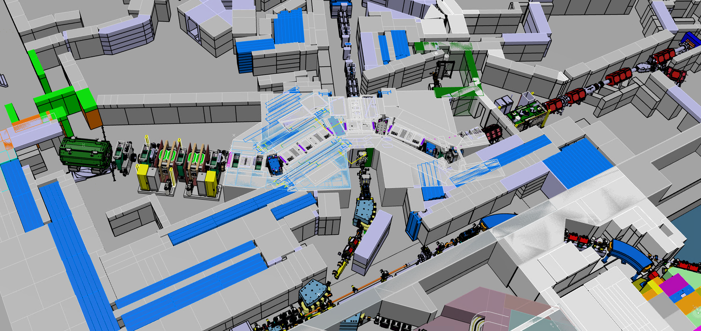
Target H, Overview
Northern Area
Target H
MuH3
MuH2

Slide 22
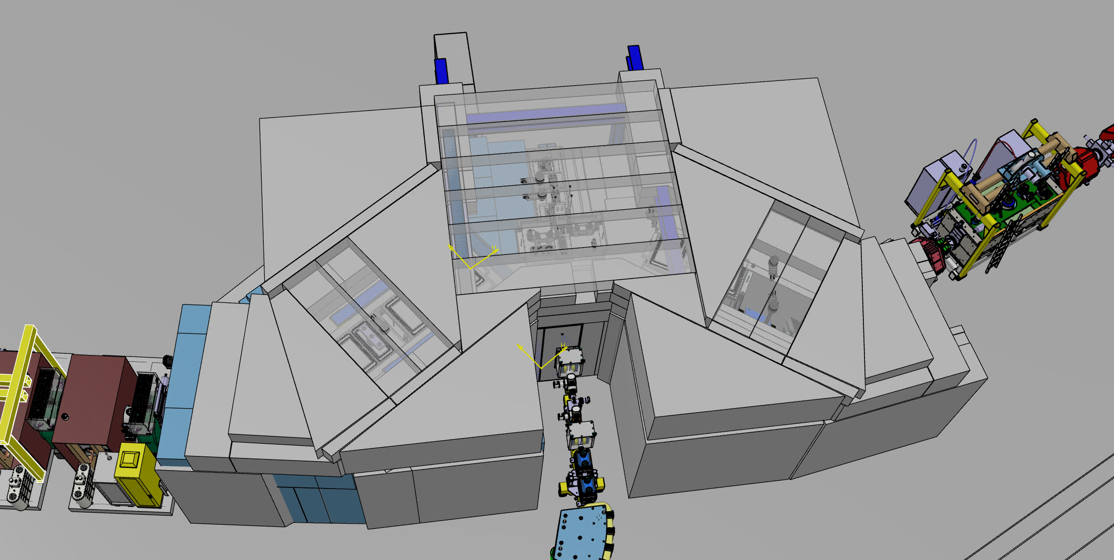
Target H, Shielding
The Target H shielding's volume is specified. The next steps include designing the shielding in appropriate blocks and determining the location of the old Target M shielding containers.
Steel Shielding 304m³
Concrete Shielding 166m³
15m
9.4m
5.6m

Slide 23
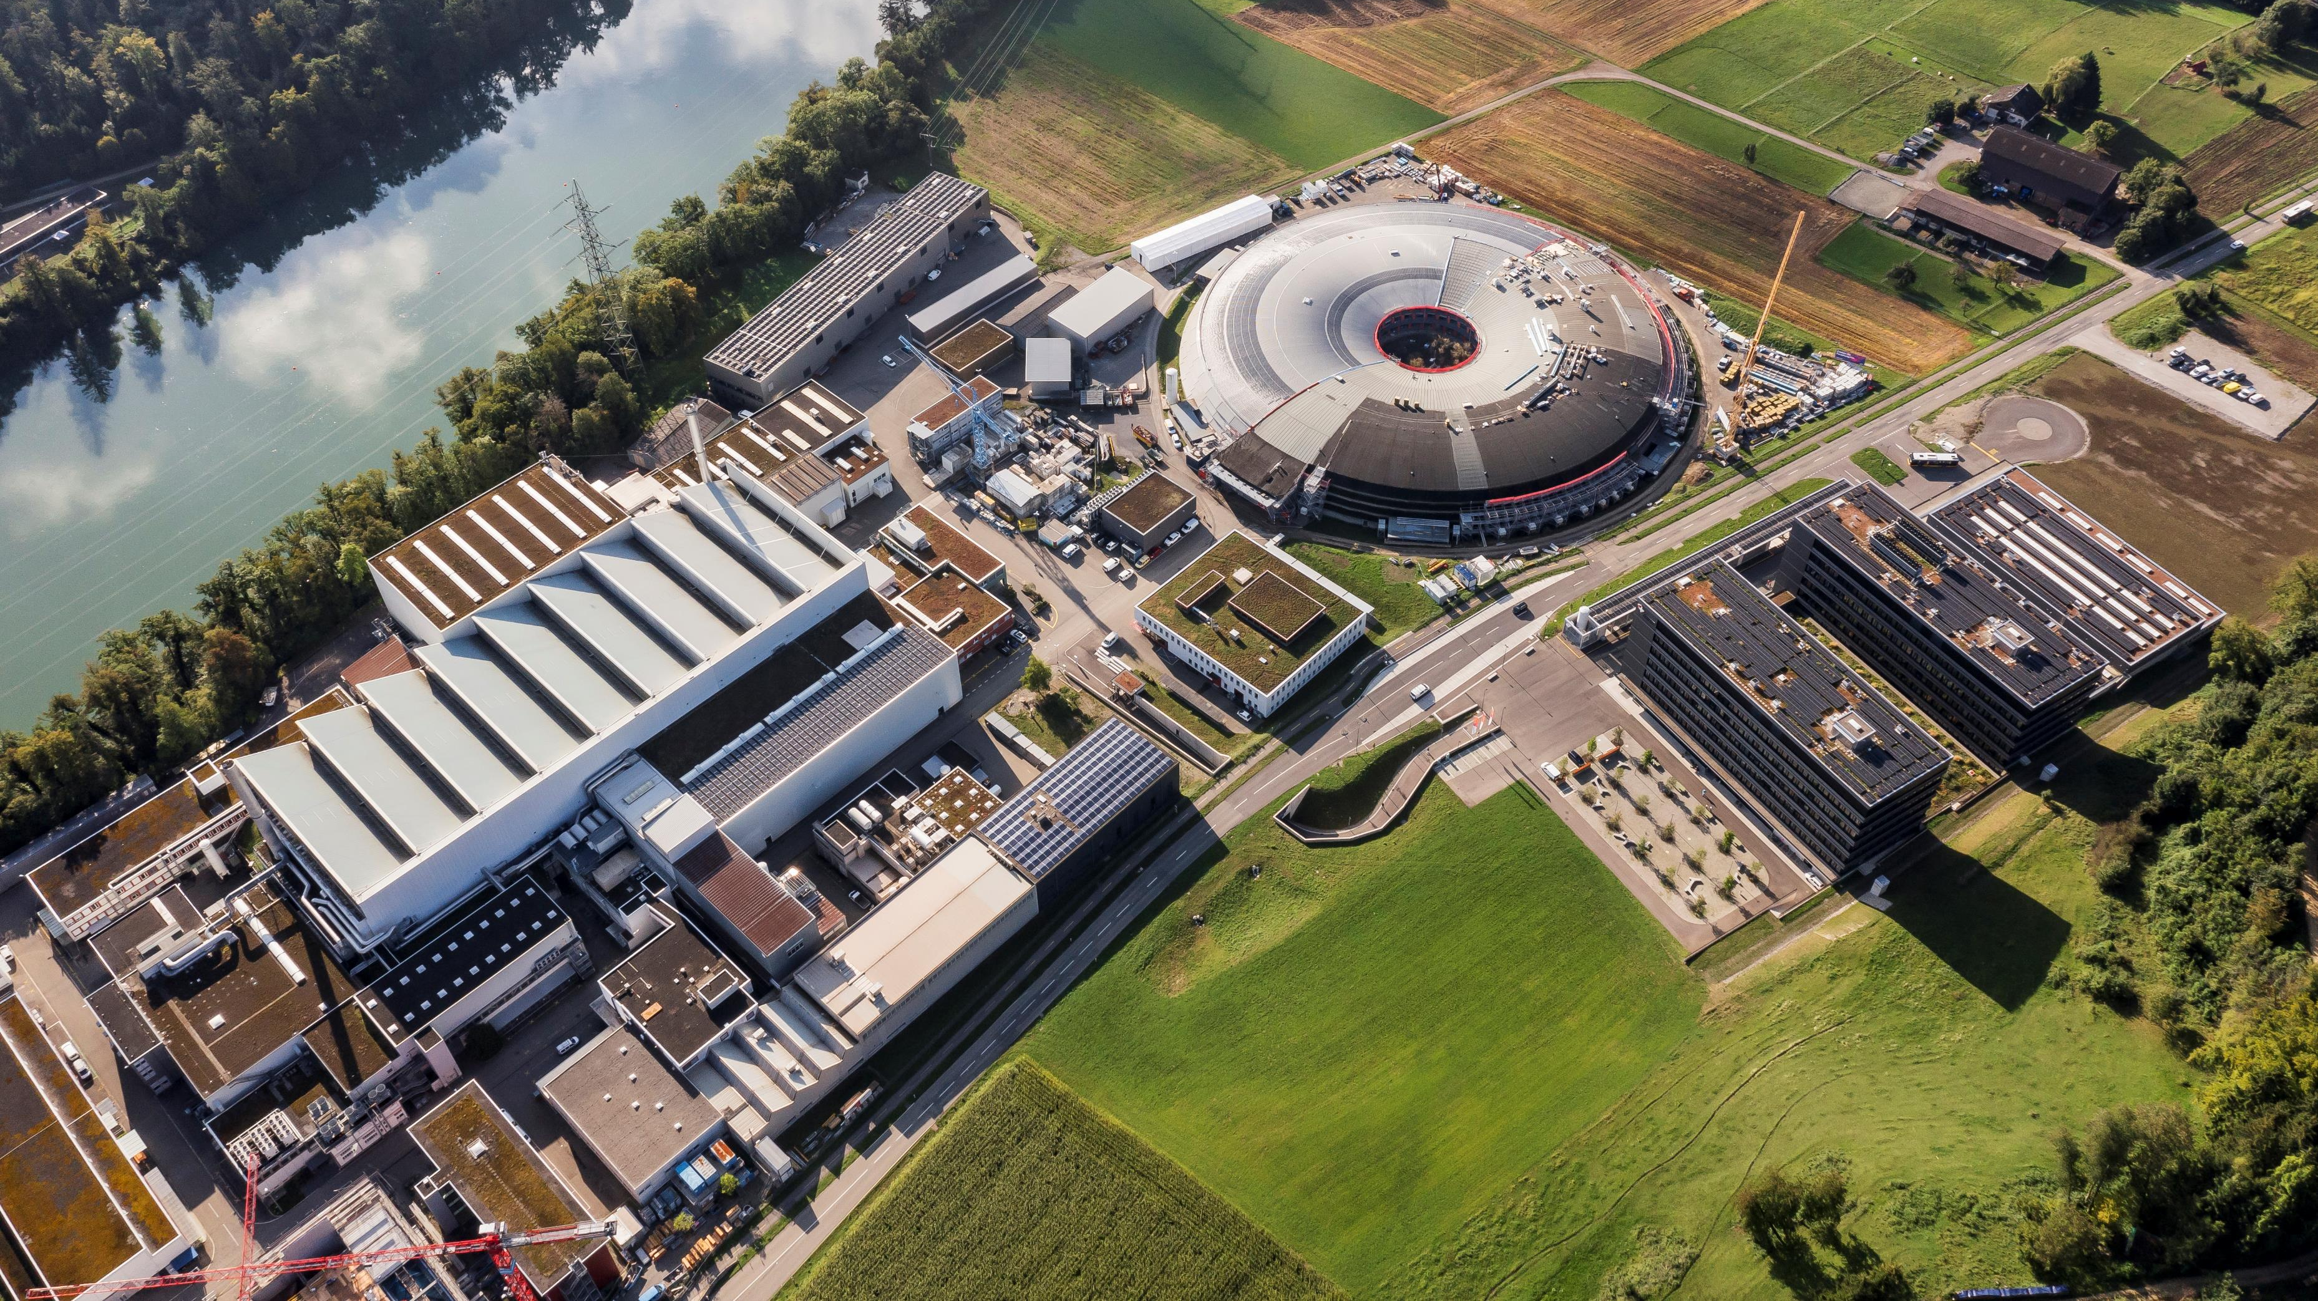
Thank you for your attention

