Slide 1
IMPACT: The current large-scale research infrastructure project of PSI
Funding BFI 2025-2028 and BFI 2029-2032
Project delivery 2025-2030
Christian Rüegg :: Director :: Paul Scherrer Institut
IMPACT Info, PSI, 19th March 2025

Slide 2
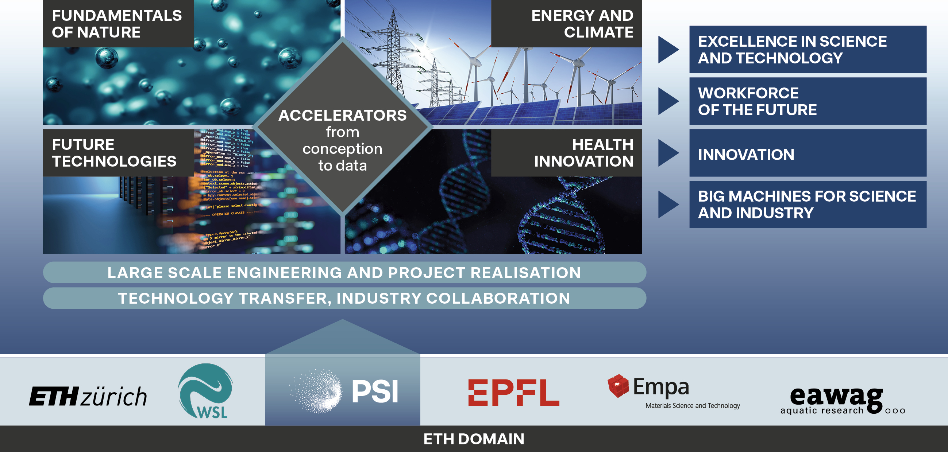
Paul Scherrer Institute – Mission
Notes:
Laura Grigori:
SIAM is the major international society in applied mathematics
About the prize: awarded every two years to a senior researcher in recognition of their broad and distinguished contributions to the field of algorithm research and parallel scientific and engineering
computing

Slide 3
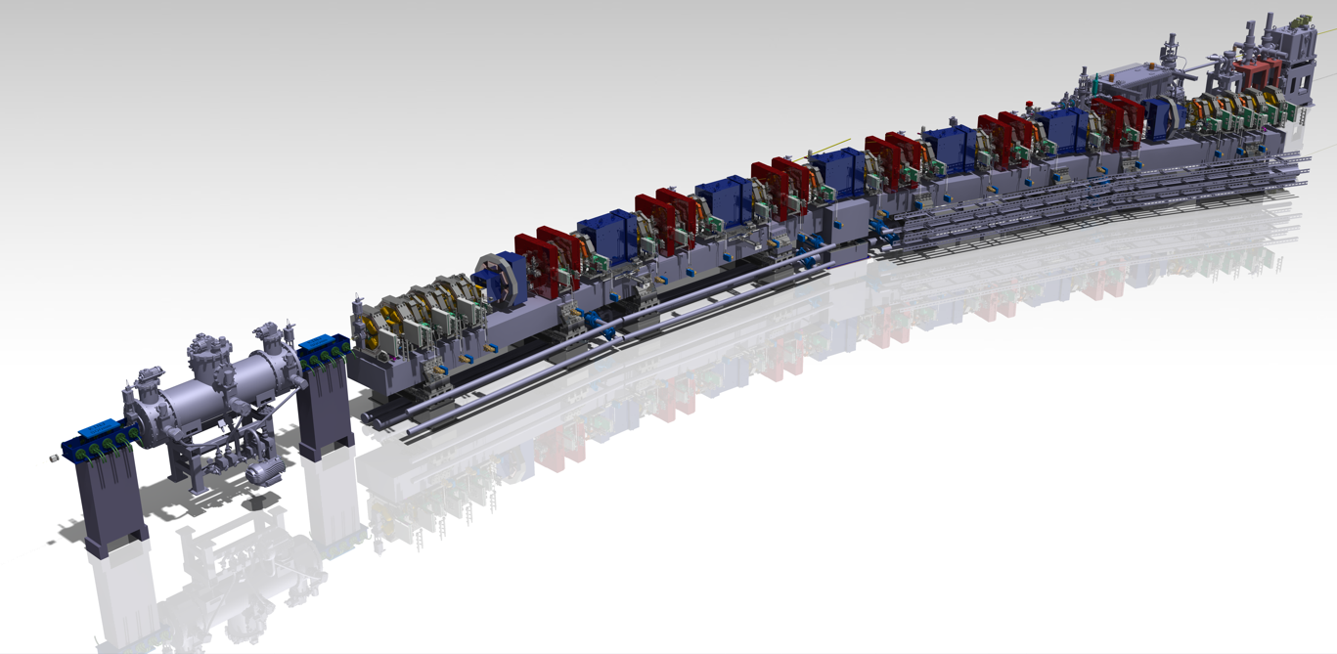
SLS 2.0 Upgrade on track – All milestones achieved
Milestone start "Dark Time" reached September 2023
Milestone first segment installed reached March 2024
Milestone tunnel closed reached December 2024
Commissioning: >100 mA stored beam in March 2025
Renewal of conventional infrastructure
Upgrades of the beamlines (Esup project)
But we are not done yet …
Tunnel closure
20.12.2024
Start user operation
01.08.2025
Re-start user operation
01.06.2026
… | 2023 | 2024 | 2025 | 2026
Start dark time
30.9.2023
Nominal beam available
01.05.2025
Start shutdown
21.12.2025

Slide 4
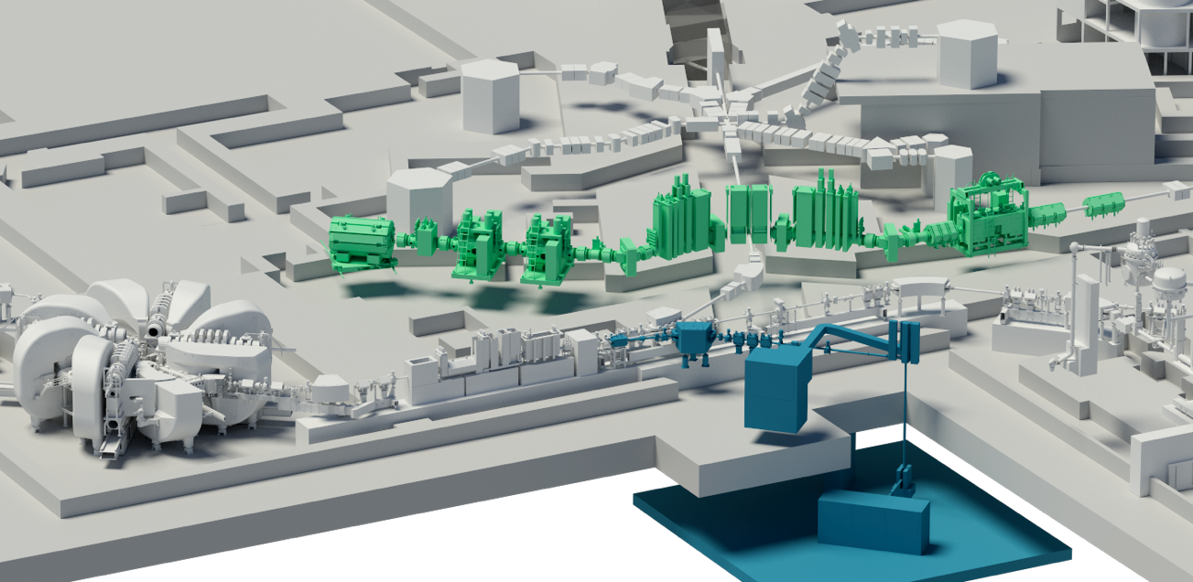
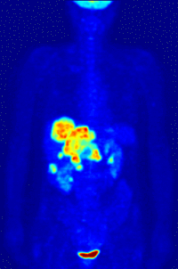

IMPACT – New isotopes and muons for science and medicine
IMPACT: Project delivery 2025-2030, Investment 77 MCHF
HIMB: High-Intensity Muon
Beam for particle physics and
material science
TATTOOS: new radionuclides
for cancer therapy
HIPA: proton cyclotron

Slide 5
Planning and Realisation of Large-scale Projects
BFI 2017–2020
BFI 2021–2024
BFI 2025–2028
BFI 2029–2032
ARAMIS/SwissFEL
Operation
ATHOS/SwissFEL
Realisation
ATHOS/SwissFEL
Operation
Roadmap 2015
SLS 2.0
Pre-study
SLS 2.0
Realisation
SLS 2.0
Operation
Roadmap 2019
IMPACT
Pre-study
IMPACT
Realisation
IMPACT
Operation
Roadmap 2023 (approved/funded)
PORTHOS I und II
Pre-study
PORTHOS I
Realisation
Roadmap 2027 (in preparation)

Slide 6
Thank you !
project lead, project team, everybody involved

