Slide 1
Radiation protection issues related to IMPACT
S. Harzmann, WG Safety
Department of Radiation Safety and Security
IMPACT - Infoveranstaltung
PSI, March 19th 2025

Slide 2
Radiation protection requirements

Slide 3
Dose Limits by Radiation Protection Ordinance
Category of people | Quantity | Limit
Occupationally exposed to radiation Category A | effective dose | 20 mSv/ year*
 | skin dose | 500 mSv/ year
 | Eye lens dose | 20 mSv/ year*
Occupationally exposed to radiation Category B | effective dose | 6 mSv/ year
 | skin dose | 150 mSv/ year
 | lens dose | 15 mSv/ year
Age 16 until 18 | effective dose | 6 mSv/ year
Pregnant women | effective dose for unborn child | 1 mSv
General public | effective dose | 1 mSv/ year
 | skin dose | 50 mSv/ year
 | lens dose | 15 mSv/ year
Personal dose outside company premises due to direct radiation | effective dose | 0.1 mSv/year
* With permit of regulating authority, limit can be increased by exemption to 50 mSv/year if the cumulative dose of 5 successive years is below 100 mSv.

Slide 4
Dose Limits by Radiation Protection Ordinance
Category of people | Quantity | Limit
Occupationally exposed to radiation Category A | effective dose | 20 mSv/ year*
 | skin dose | 500 mSv/ year
 | Eye lens dose | 20 mSv/ year*
Occupationally exposed to radiation Category B | effective dose | 6 mSv/ year
 | skin dose | 150 mSv/ year
 | lens dose | 15 mSv/ year
Age 16 until 18 | effective dose | 6 mSv/ year
Pregnant women | effective dose for unborn child | 1 mSv
General public | effective dose | 1 mSv/ year
 | skin dose | 50 mSv/ year
 | lens dose | 15 mSv/ year
Personal dose outside company premises due to direct radiation | effective dose | 0.1 mSv/year
* With permit of regulating authority, limit can be increased by exemption to 50 mSv/year if the cumulative dose of 5 successive years is below 100 mSv.

Slide 5
Ambient Dose Rates ADR
Optimization: 10% of ADR in controlled areas

Slide 6
Ambient Dose Rates ADR
Especially important during dismantling

Slide 7
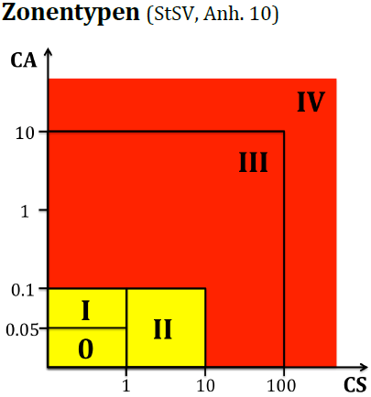
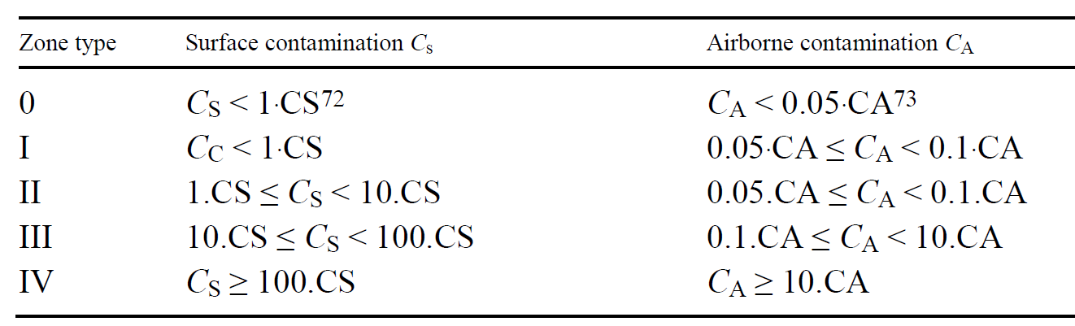
Radiological zoning concept
In supervised (zone 0) and controlled areas:
1 mSv/year possible
CS: nuclide specific guidance value for surface contamination [Bq/cm²]
CA: nuclide specific guidance value for airborne contamination [Bq/m³]
                Radiation protection clothing accordingly
#
+ Classification by area types
according to the local dose rate
+ Restriction of stay
#Radiation Protection Ordinance SR 814.501, appendix 10
Notes:
Radiological Zoning Concept due to potential expected contamination

Slide 8
Radiation protection requirements:
HIMB

Slide 9
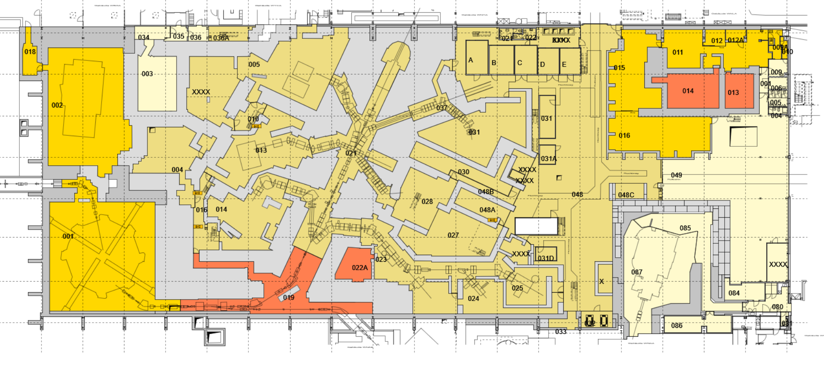
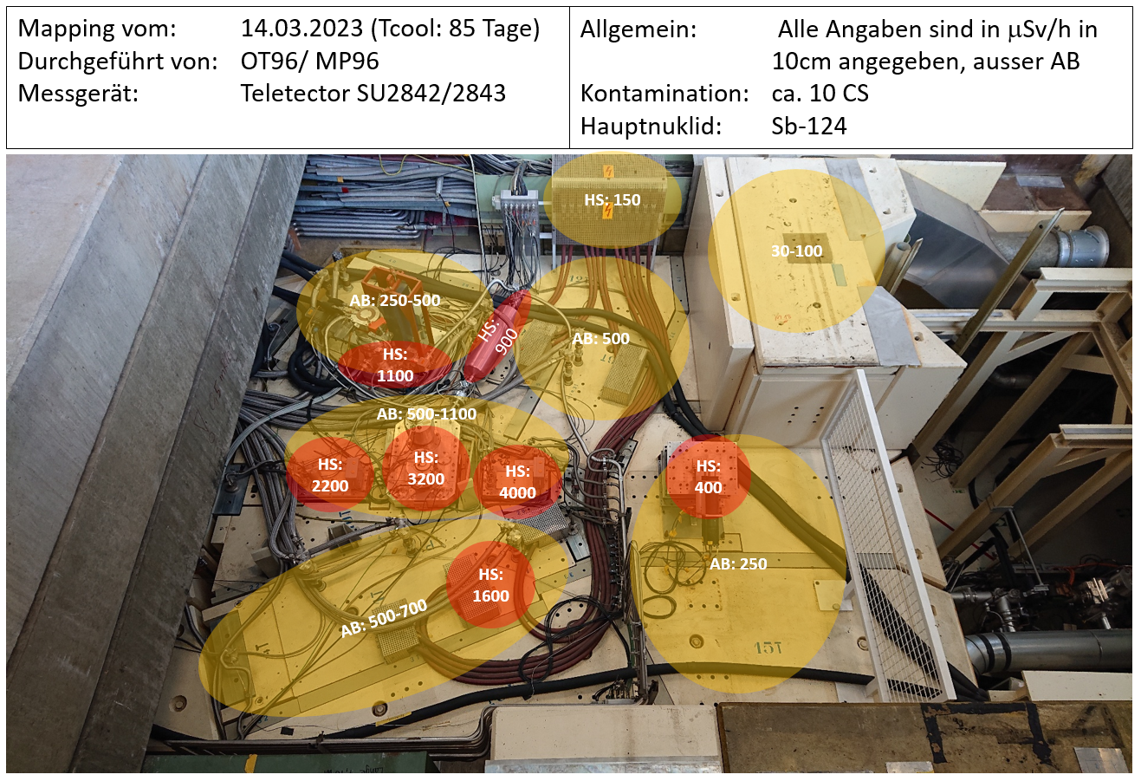

Overview of experimental hall WEHA
*
*
Target M
II
Zone types
Cooling Time: 85 days, dose rates in µSv/h ; AB: «Arbeitsbereich», working area; HS: Hot Spot
contamination: ≈ 10 CS (main nuclide: Sb-124) → zone type II
0 I II III IV
Notes:
Befinden uns auf der Bedienebene, d.h. Stahlabschirmung direkt um Target + weitere Betonabschirmung nach wie vor vorhanden

Slide 10
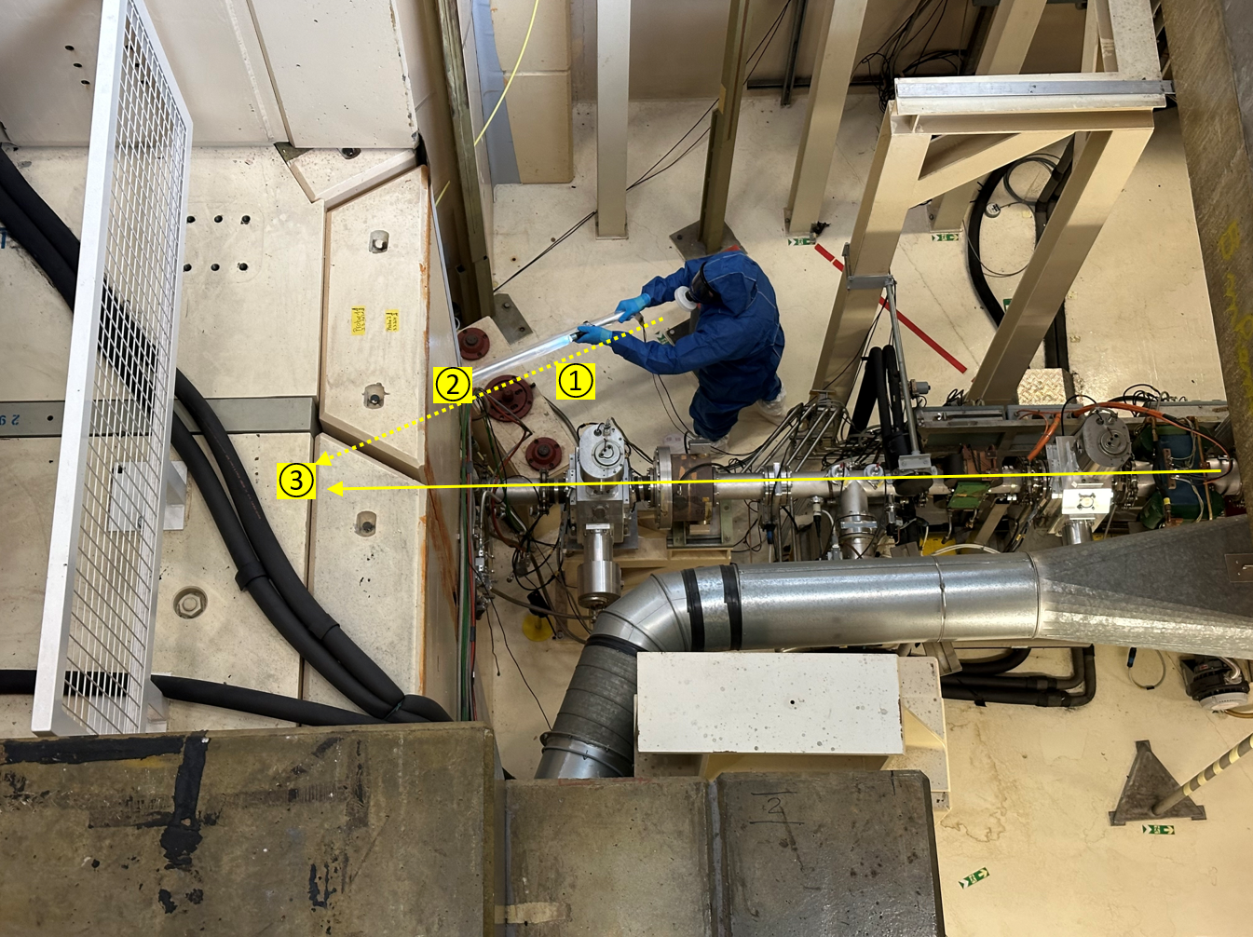
Dismantling Target M station
Measurement position | Dose rate [mSv/h]
1 | 15-20
2 | 170
3 | Max. 4000
Contamination inside target chamber:
≈ 330 CS
Main nuclides:
  Be-7: 300 CS (30‘000 Bq/cm²)
  Na-22: 30 CS (90 Bq/cm²)
→ Contamination: highest zone type IV
→ Dose rate: Remote Handling necessary
Beam direction

Slide 11
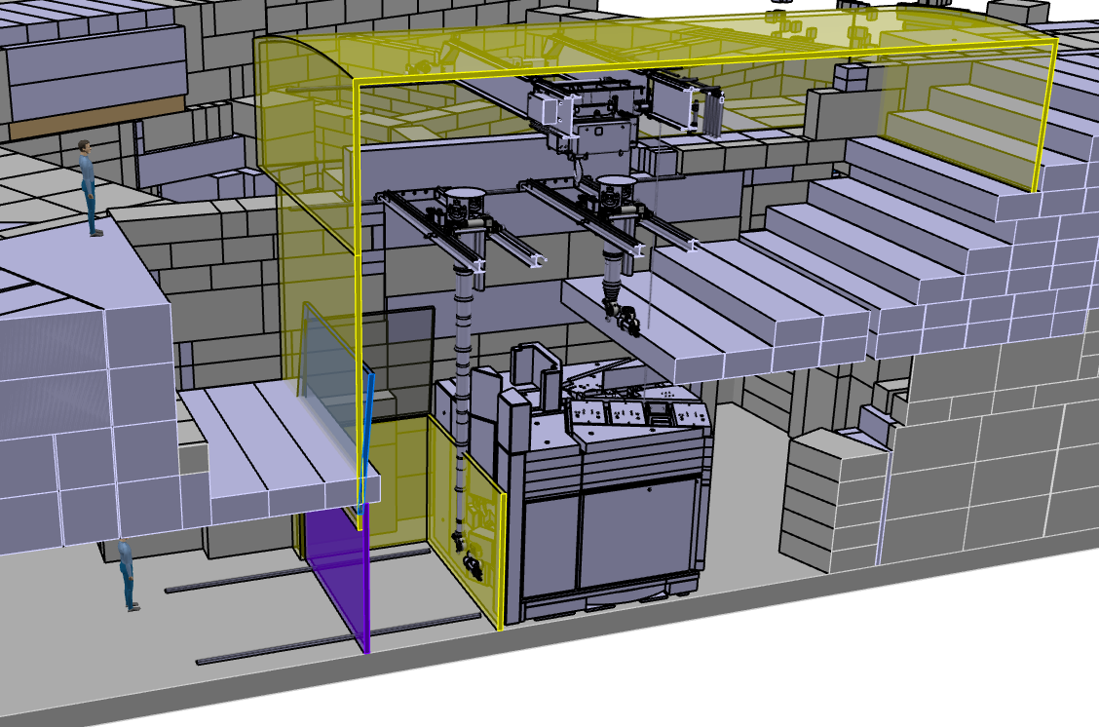
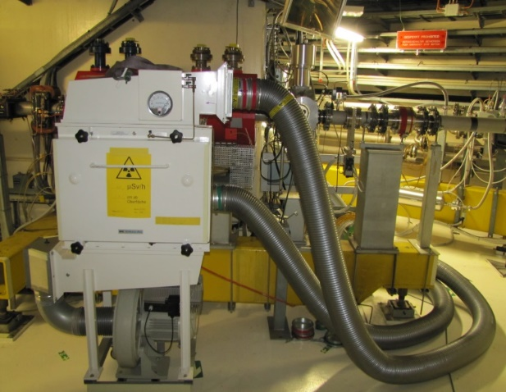
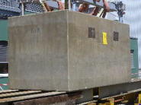
Dismantling Target M station
manlock
Double door system with negative air pressure staging
(I → IV)
Outside the enclosure:
Zone I: < 1 CS
(experimental hall)
Zone I
Zone IV
Zone III
Zone I
negative air pressure staging (I → IV)
Zone III
Material lock
Position of the cameras for remote handling

Slide 12
Radiation protection requirements:
TATTOOS

Slide 13
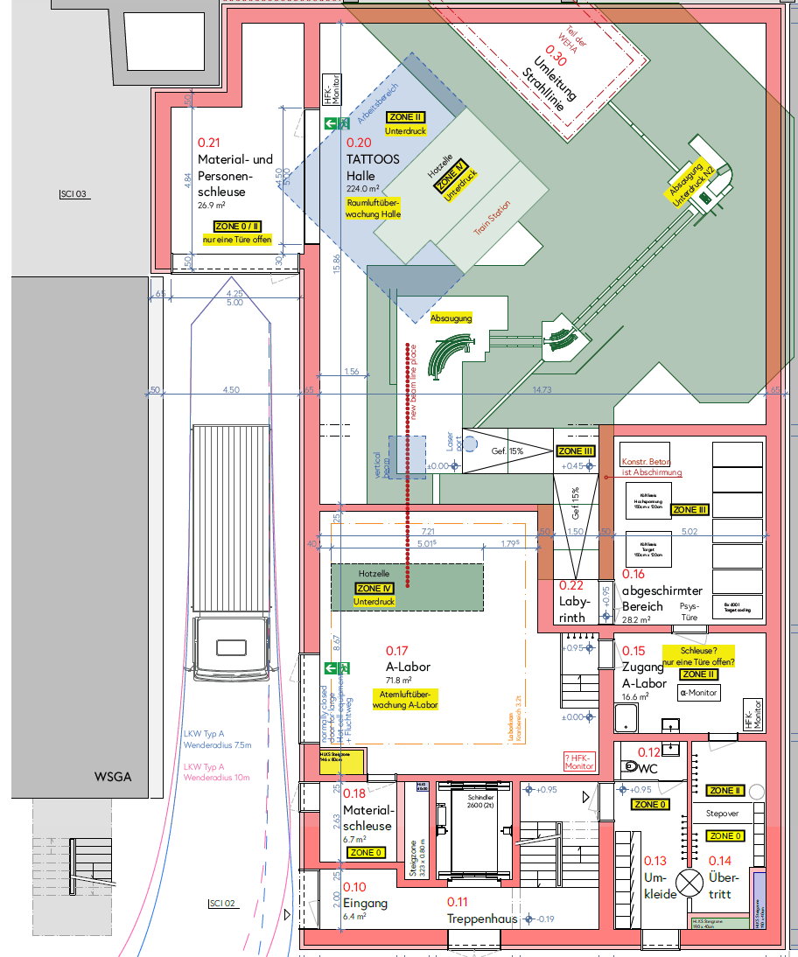
Zoning concept TATTOOS
(current status)
Gamma
0
I
II
III
IV
Laboratory Type A
EG

Slide 14
Zoning concept TATTOOS
(current status)
Gamma
0
I
II
III
IV
Laboratory Type A
EG

Slide 15
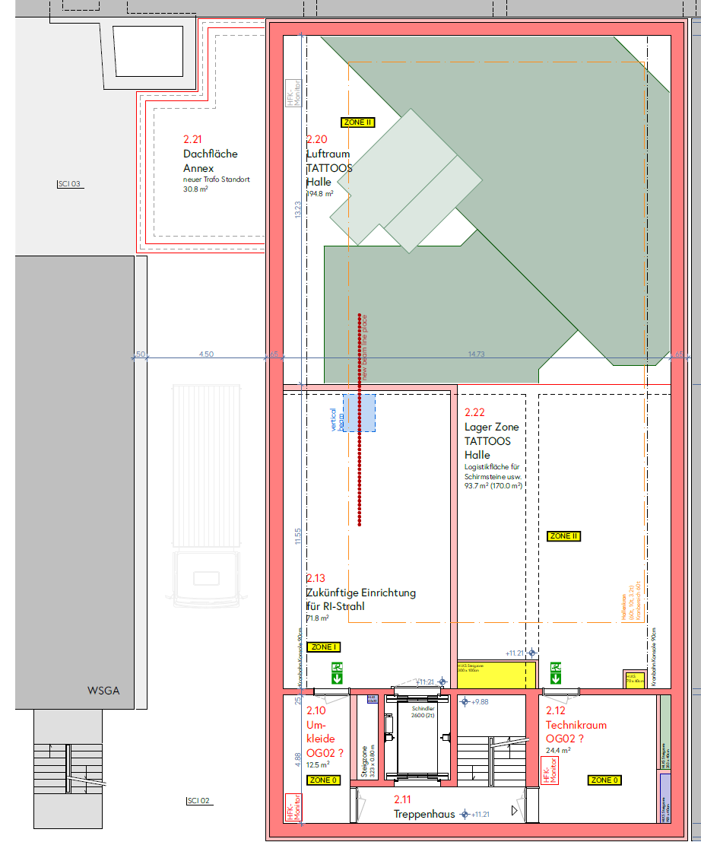
Zoning concept TATTOOS
(current status)
Gamma
0
I
II
III
IV
Laboratory Type A
OG 2
(TATTOOS hall)

Slide 16
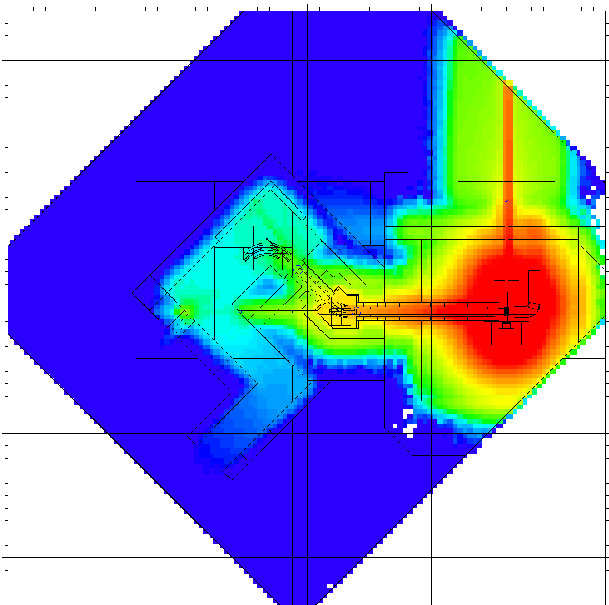
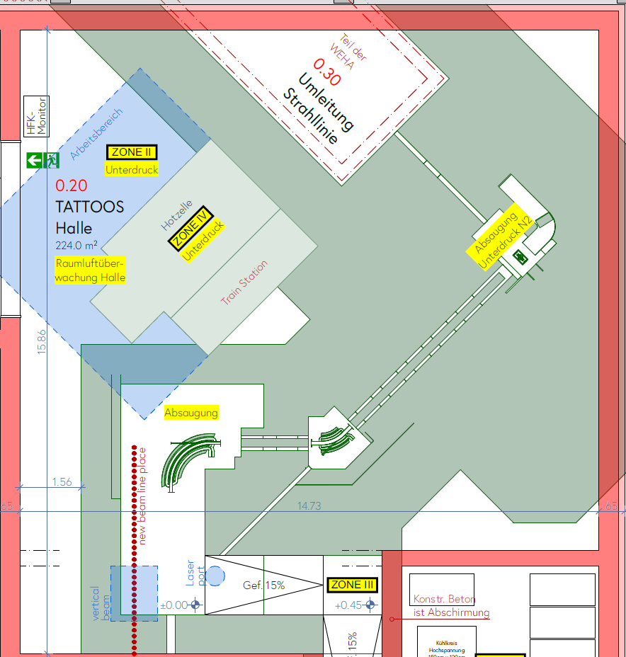
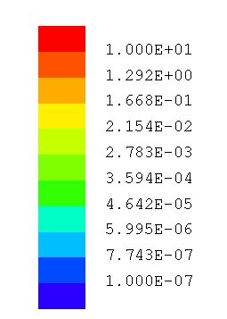
Ambient dose rate photons
(current status)
Gamma
Photons
Ambient dose rate (photons)
[Sv/h]
EG

Slide 17
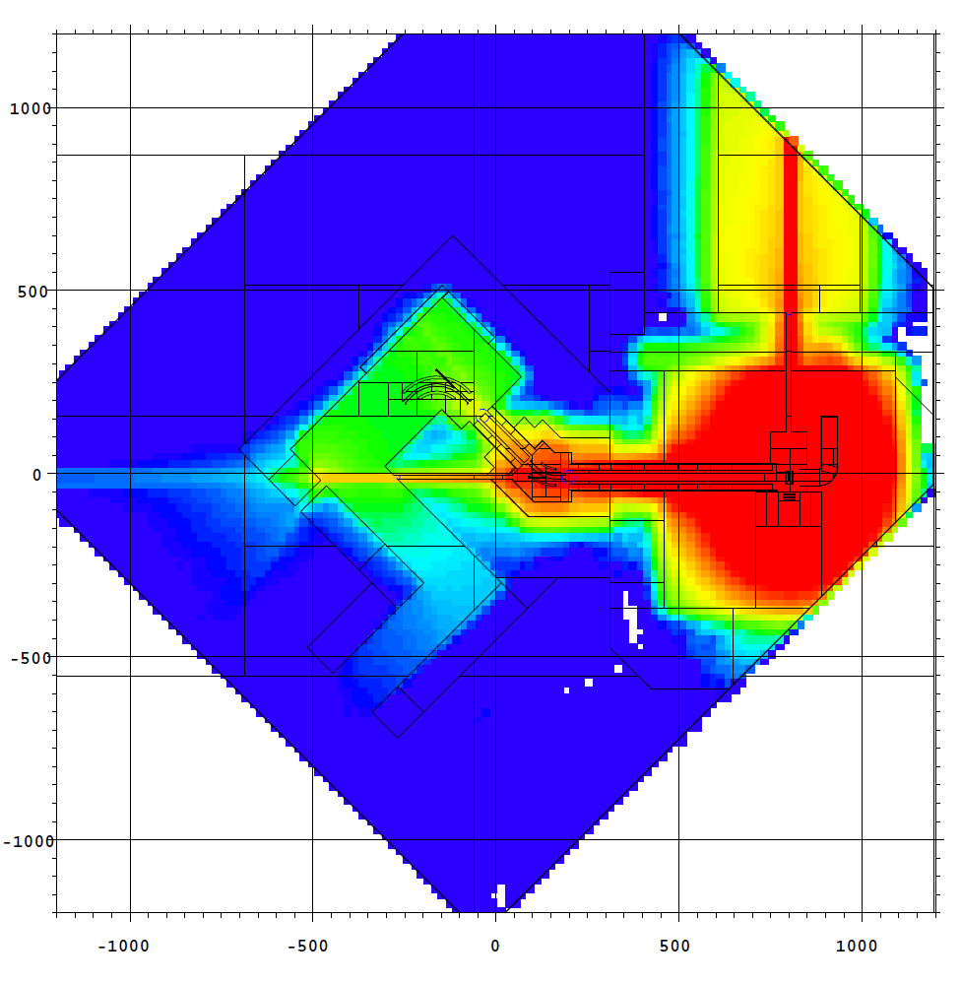
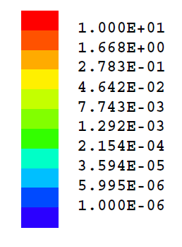
Ambient dose rate neutrons
(current status)
Gamma
Neutrons
Ambient dose rate (neutrons)
[Sv/h]
EG

Slide 18
Measurement campaigns

Slide 19
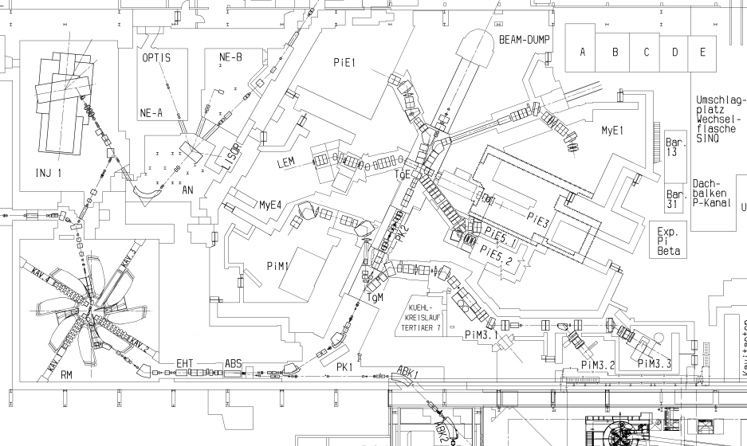
Measurement campaigns for IMPACT
piE1: shielding investigations for its readaption in the frame of IMPACT. [*]
pK1: shielding studies considering the splitter operation in view of TATTOOS. [*]
PiM1.3: neutron dose rate assessment in these areas for a pre- VS post-HIMB comparison.
“Gusti-Loch”: dose rate (n + γ) study when the current splitter is in action, to determine the shielding needed for the TATTOOS building.
MuE4: Normalization measurements necessary for Monte-Carlo-shielding calculations; beamline similar to MuH2
[*] Measurements corroborated by MC simulations

Slide 20
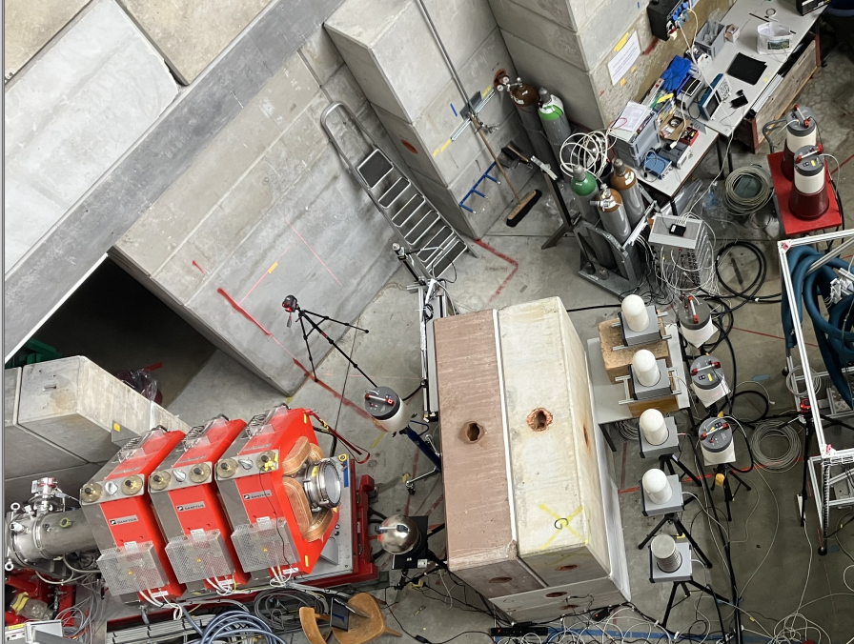
piE1 campaign
Neutron (→ LUPIN detectors) and gamma (→ NAUSICAA detectors) dose measurements.
Beam stopped on shielding in two configurations: 1) 50 cm of heavy concrete, 2) 50 cm of heavy concrete (HC) + 50 cm of normal concrete (NC).
heavy concrete
normal concrete
Highlights:
Crucial to verify experimentally the beam spot and size for proper instrument positioning and dose measurement.
High gradient of the field (dose) in space → need for precise positioning
Normal concrete not sufficient for the new shielding

Slide 21
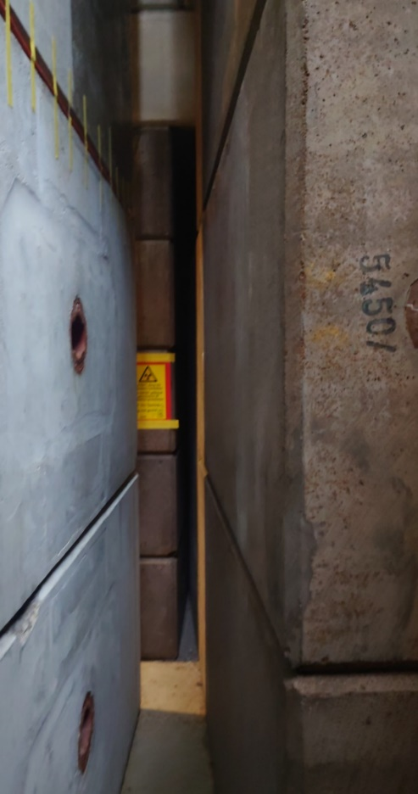
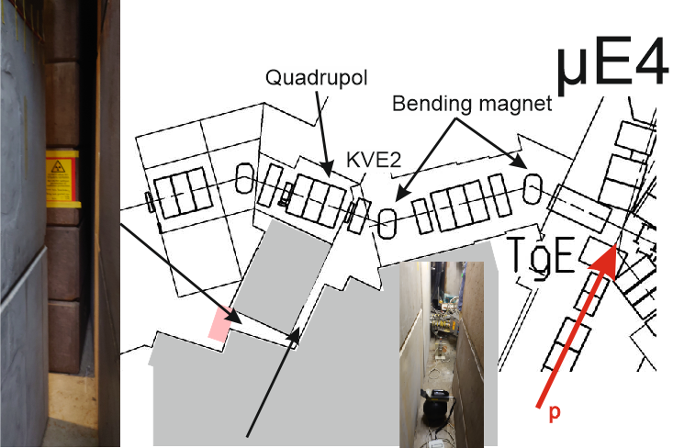
MuE4 campaign
Characteristics of beam line are similar to the new MuH2 for IMPACT
Normalization measurements necessary for Monte-Carlo-shielding calculations
Active and passive
  dose(rate)measurements
Challenges: narrow space constraints
Necessity: correct positioning of (neutron) dosimeters

Slide 22
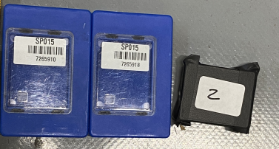
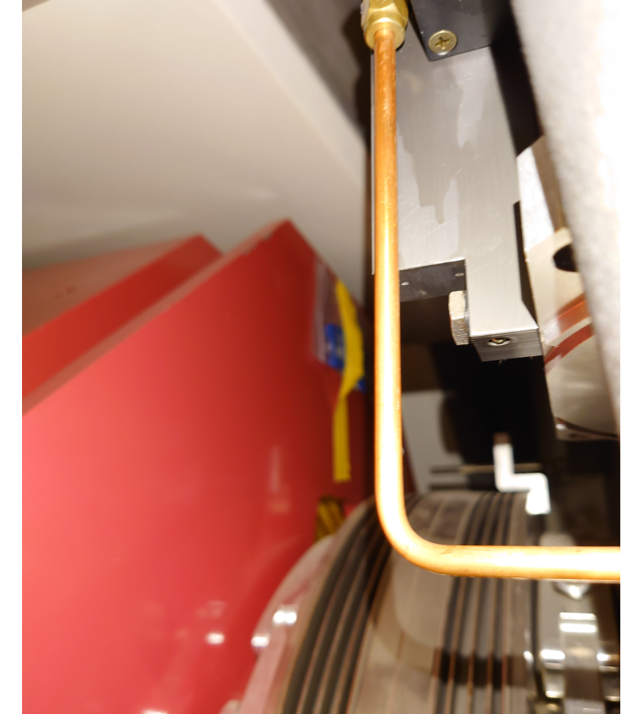
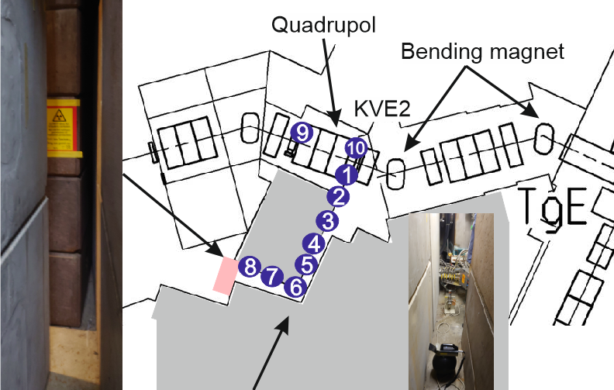
MuE4 campaign
neutrons (PADC) photons (BeO)
mGy
Dose integration time: ~2 h during normal operation

Slide 23
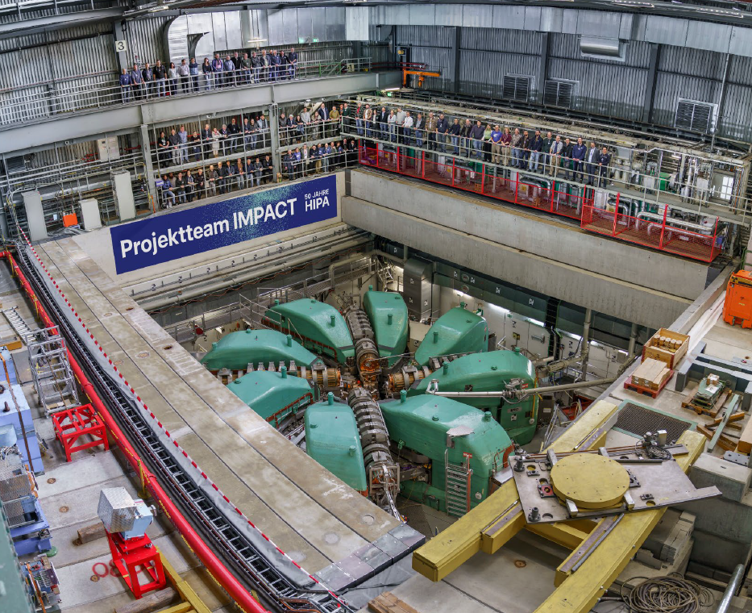
Many thanks to the whole IMPACT team, especially to:
D. Kiselev, R. Eichler, A. Knecht, A. Koschik
Many thanks for the contributions for this talk, especially to:
S. Mayer, E. Hohmann, C. Harm, M. Bolzonella, L. Pedrazzi, M. Tisi, M. Müller, P. Meyer, A. Ivanov C. Nyfeler, C. Schmid, N. Preiss, M. Baumann
…many thanks to many more!

