Slide 1
SwissFEL Exchange Meeting
Machine Report
Week 7/2023
Zheqiao Geng, SEM, Feb. 20, 2023

Slide 2
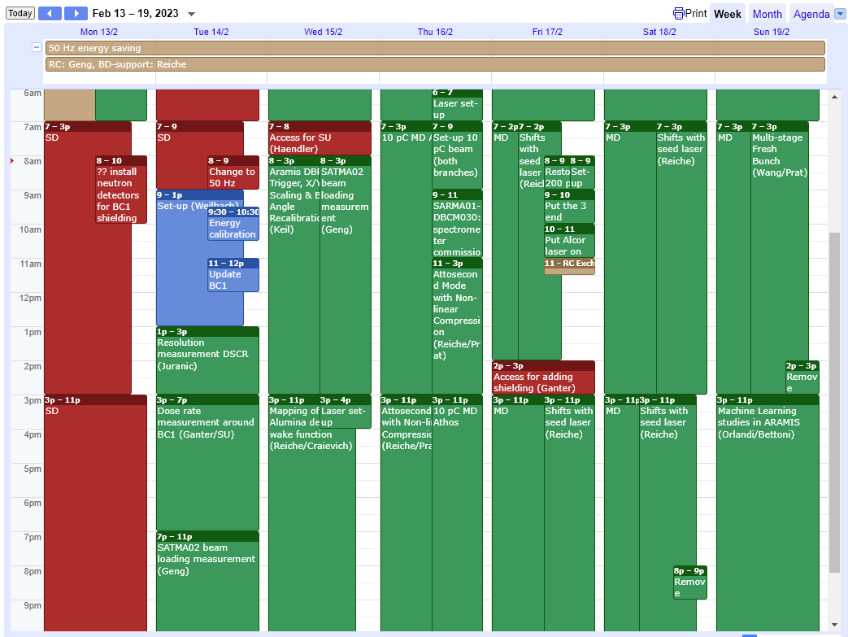
SwissFEL Operation Calendar
50 Hz operation

Slide 3
Highlights of MD Studies
BC1 dose rate measurement (Tuesday/Friday)
  Radiation measured with horns cut after adding additional shielding in service day
  More shielding added on Friday
10 pC studies - attosecond mode (Thursday)
  Successfully generated ultrashort pulses in both Aramis and Athos by strongly compressing a 10 pC electron bunch
HERO study (Friday/Saturday)
  Mode-locking spectrum looks fantastic
Multi-stage amplification studies (Saturday/Sunday)
Machine learning study (Sunday)
  Beam was measured with diagnostics (S-/C-band TDS, BCM, SRM) for different compression phases
Detailed report of the MD shifts will be done in SPM!

Slide 4
Technical Issues
X-band reference instability. T&S tightened the cable connectors. Stability will be further validated with FEL stability this week.
Improper restore after maintenance or MD test:
  Linac1/2 C-band stations forgot resetting the circuit breaker to enable the operation after maintenance
  Laser pointing was not correctly restored after maintenance (created difficulties on Tuesday after switching to 50 Hz operation)
  Mizar laser bucket was wrong after laser MD shift (created difficulties on Thursday for 10 pC operation)
Collimator motion control problem that required on-site power cycle
C-band deflector phase fluctuation due to klystron multipacting

