Slide 1
Open EM Data Network (OpEM)
Spencer Bliven :: High Performance Computing & Emerging Technologies :: Paul Scherrer Institute
2023-05-02 PSI ORD

Slide 2
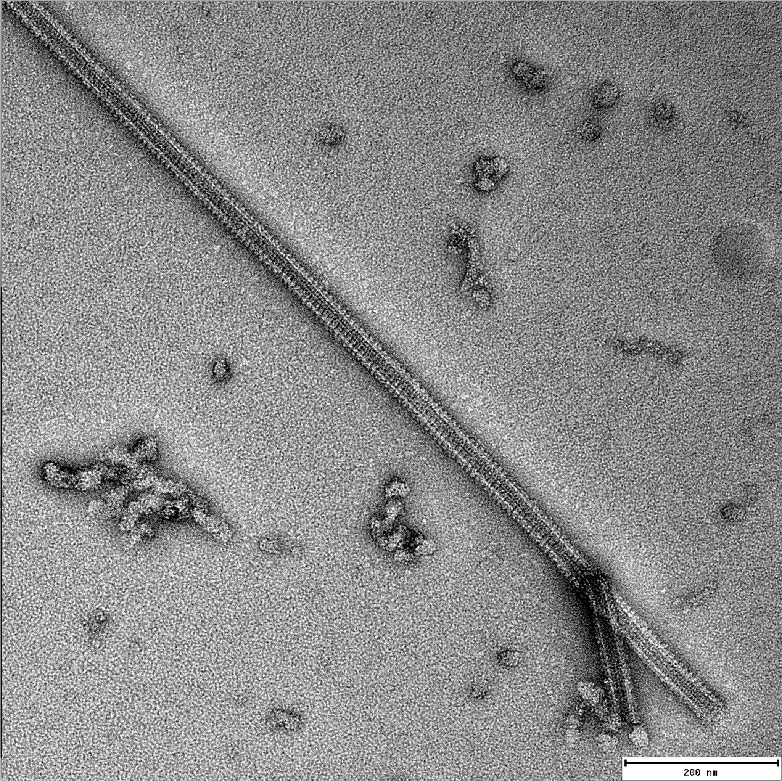
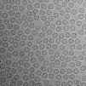
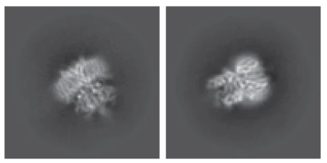
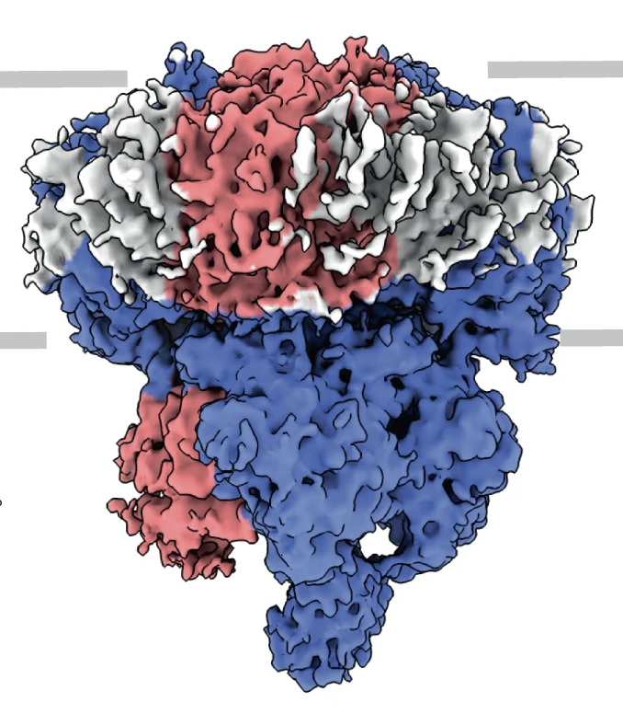
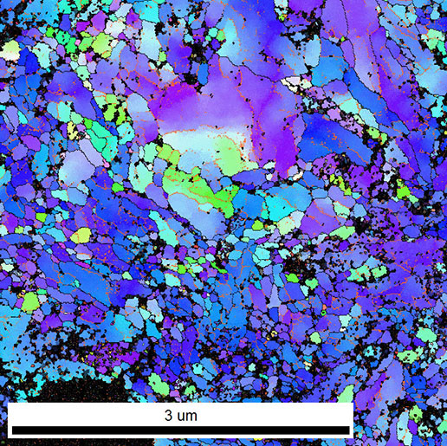
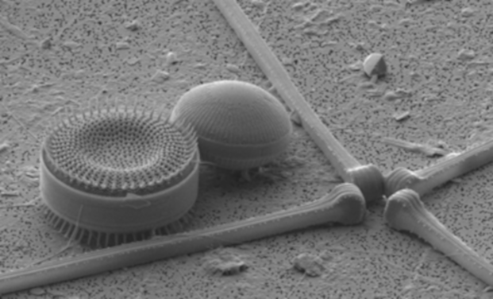
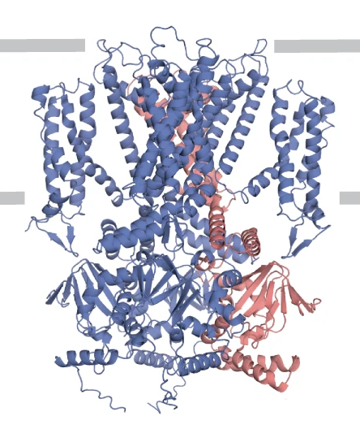
Electron Microscopy (EM) Data
Raw Data
Derived Data
Particles & classes
(Barret, PSI)
Typical size:
1-10 TB/dataset
3-4 PB/year for major facilities
Electron Maps
(EMDB)
TEM
Single particle cryoEM
(EMD-12718, Barret, PSI)
(Sejwal, PSI)
(EMPIAR-11016, Harder, EPFL)
Molecular Models
(Protein Databank)
SEM
(7o4h, Barret, PSI)
(Müller, PSI)
Orientation Maps
Also: Spectrograms, electron tomography, ptychography, 4D STEM, …
(Kunze and Sologubenko,
ETHZ)
Also: Tomographic reconstructions, segmented models, …
Notes:
Sources:
Kushal Sejwal, Microtubules bound to a Kinesin motor protein
Harder, O. F., Voss, J. M., Olshin, P. K., Drabbels, M. & Lorenz, U. J. (2022). Acta Cryst. D78, 883-889. EMPIAR-11016
Dr. Karsten Kunze and Dr. Alla Sologubenko, ScopeM. Crystallographic orientation map by Transmission Kikuchi Diffraction (TKD) of nanocrystalline Titanium (TEM foil). https://scopem.ethz.ch/competences/ElectronMicroscopy/scanning-electron-microscopy/ESBD.html#par_greybox_1117830976
https://www.psi.ch/en/emf/research-and-publications
Barret, D.C.A., Schertler, G.F.X., Kaupp, U.B. et al. The structure of the native CNGA1/CNGB1 CNG channel from bovine retinal rods. Nat Struct Mol Biol 29, 32–39 (2022). https://doi.org/10.1038/s41594-021-00700-8. EMDB-12718, PDB:704H

Slide 3
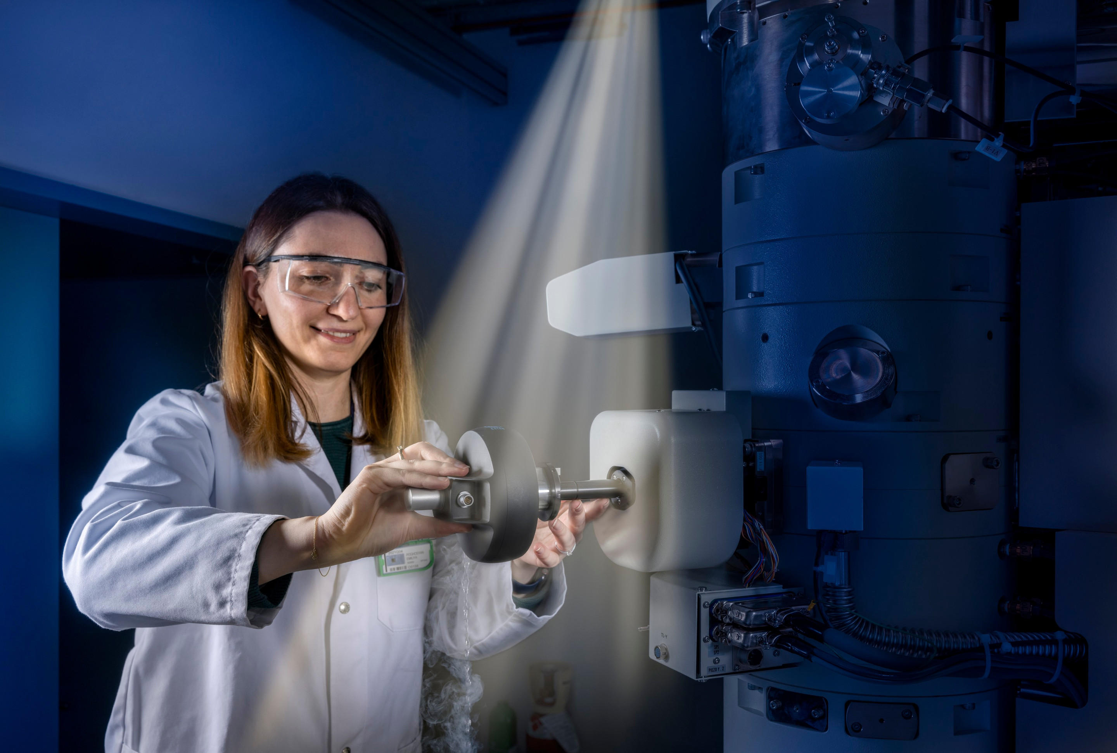
Users
Data Producers
  Microscope users
  EM Facility Scientists
  Microscope & detector researchers
Data consumers
  Data scientists, structural biologists, informaticians
  Students
  Training AI/machine learning
Notes:
Different needs (save time, reduce errors, easy transition between facilities, collaboration / search capabilities, easy download, standard formats)
Images:
Emiliya Poghosyan, PSI EM Facility, https://www.psi.ch/de/media/forschung/cooler-newcomer
Photo by National Cancer Institute via Unsplash (https://unsplash.com/photos/pCqzMe04s8g)

Slide 4
Benefits of open data for electron microscopy
Publishing raw data is essential
  Reproducibility. Check results & apply new methods to old data
  Verifiability. Detect processing mistakes and protect against scientific fraud
  Education. Learn processing techniques by reproducing cutting-edge papers
  Method development. Datasets provide training data for future AI methods
  Interdisciplinary. Images may be relevant for questions beyond the original scope
Examples from crystallography:
  PDB redo
  Phasing old data with molecular replacement (or AlphaFold models)

Slide 5
Open EM Data Network (OpEM)
How can we improve ORD practices in the electron microscopy (EM) community? → Open EM Data Network
  ETH ORD M1 Establish application by Henning Stahlberg: 1.5 MCHF
  swissuniversities by Robbie Loewith: 0.92 MCHF
  6.5 new positions
  ETH: June 2023–Dec 2025 (30 months)
  Swissuniversities: Jan 2023–Dec 2024 (24 months)

Slide 6













Open EM Data Network (OpEM)
4 ETH Institutes
5 Universities
Alun Ashton, Spencer Bliven, Gregor Cicchetti, Stephan Egli, Volodymyr Korkhov, Carlo Minotti, Elisabeth Müller, Gebhard Schertler
Mohamed Chami, Timm Maier
Rolf Erni
Benoît Zuber
Nicolas Blanc, Daniel Böhringer, Christophe Briand, Christophe Copéret, Miroslav Peterek, Bilal Qureshi, Andrzej J. Rzepiela
Andreas Boland, Orsolyz Barabas, Andy Howe, Robbie Loewith
Marco Cantoni, Alexandra Radenovic, Henning Stahlberg
Christel Genoud
Notes:
26 participants
Possibly missing:
UNIBAS Markus Dürrenberger (Nano Imaging Lab), Ben Engel (Prof., Biozentrum), Marcus Wyss
UNIBE: Wanda Kukulski (Prof., DCI-Bern), Dimitrios Fotiadis (Inst. Biochem. & Mol. Medicine), Beat Haenni (EM lab head)
UNIGE: Paul Guichard (Prof., DCI-Geneva)
UNIZH: Raimund Dutzler (Prof., Dep. Biochem.), Ohad Medalia (Prof., Dep. Biochem.), Urs Ziegler (Cent. F. Microsc. & Image Analysis), Andres Käch (Cent. F. Microsc. & Image Analysis)

Slide 7
Architecture

Slide 8
Project Plan
Automated collection of metadata during acquisition.
  Initial focus on single particle cryoEM, but with support for additional domains like material science
  Coordinate with EU & international standards and initiatives, eg. INSTRUCT-ARIA, 3DEM

Slide 9
Project Plan
Ingestion of metadata from all sites in the Data Catalog
  PSI will provide data storage for some sites; others adapt existing site-specific storage (e.g. ETHZ LTS)
  Users deposit derived datasets after processing

Slide 10
Project Plan
Seamless deposition in international repositories (EMPIAR/EMDB/PDB)
  Pre-populate fields from metadata

Slide 11
Project Plan
Training & outreach
  Provide user training for researchers, facility managers, and data consumers
  Find sustainable funding model

Slide 12
For data producers
Standardized data management at all facilities
Raw data & metadata are automatically entered in the catalog
Swiss-wide data transfer with unified authorization (SWITCH AAI)
Complies with institutional and federal data policies
Integrates with popular processing software, eg relion, CCPEM-pipeliner, cryoSPARC
DOI assigned for publication
Prepares single-particle cryoEM datasets for deposition at EMPIAR+EMDB+PDB

Slide 13
For data consumers
Findable via OpenAIRE, European Open Science Cloud, Google
Dataset search, etc.
Linked to publications and international repositories
Searchable via metadata (http://discovery.psi.ch)
Data retrievable from storage via asynchronous systems
Scriptable via REST API

Slide 14
Major Tasks
Now hiring!
Data Catalog Tasks
  Federated login outside PSI
  Permissions model independent of PSI
  Ingestion from remote sites
  Support external data storage
Microscope Facility Tasks
  Standardize EM scientific metadata
  Ingestion service for each facility
  Integrate with institutional storage & services
Data Publication
  Collaboration with EBI for EMPIAR/EMDB/PDB deposition
Train staff & scientists
Find sustainable funding model

Slide 15
Thanks!
Henning Stahlberg (EPFL), Robbie Loewith (UNIGE), Gebhard Schertler, Gregor Cicchetti, and other OpEM members
Stephan Egli, Carlo Minotti, Max Novelli (ESS), Laura Shemilt (RFI) & other SciCat developers
Derek Feichtinger & the HPCE Group
Alun Ashton, Leo Sala, & AWI colleagues
EM Facility staff

