Slide 1
Benefit of open research data in atmospheric science
Thorsten Bartels-Rausch :: Scientist :: Paul Scherrer Institut
ORD Meeting

Slide 2
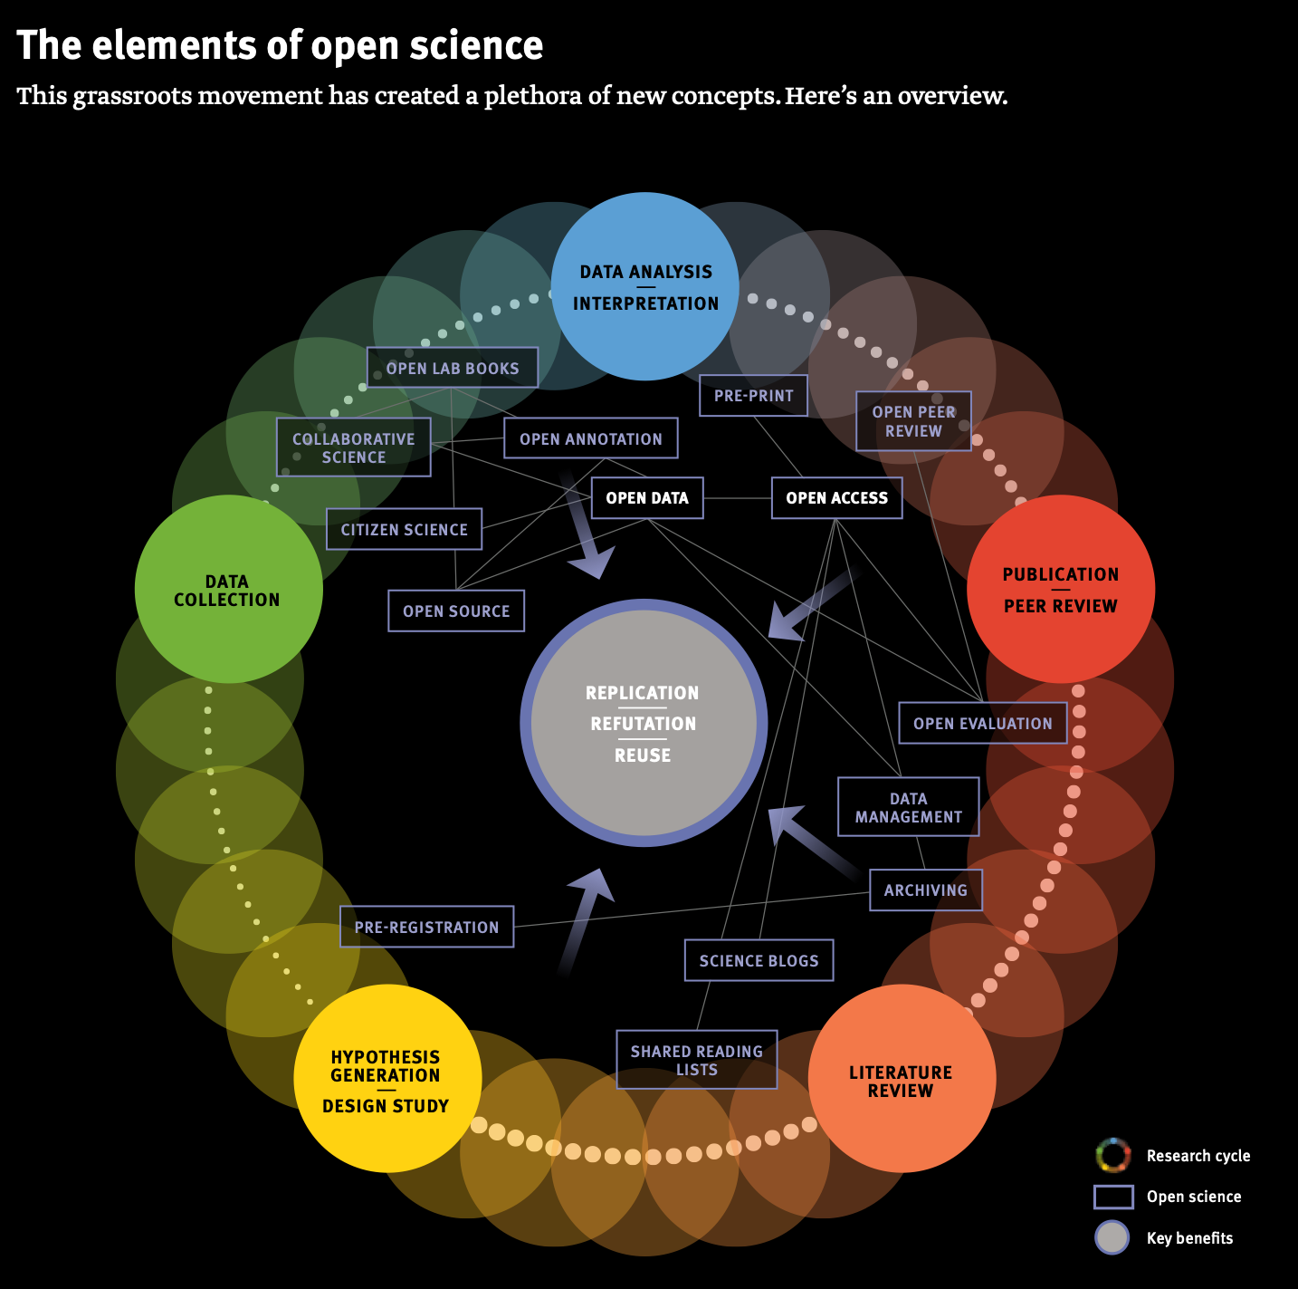
Open Research Data
«There is, however, a real problem with open lab notebooks: they can eat up too much time.»
    SNF Horizonte 2016

Slide 3

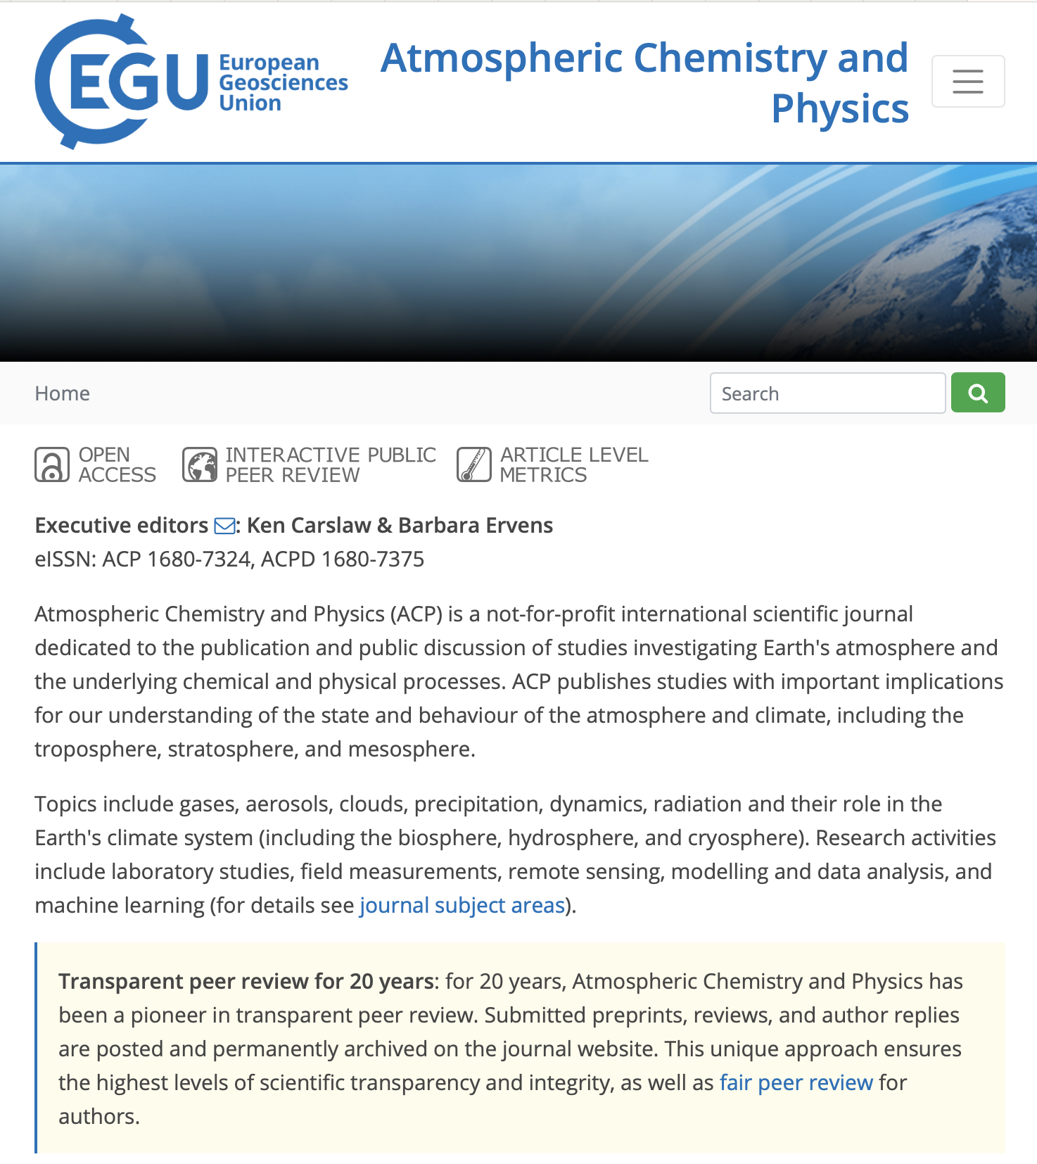
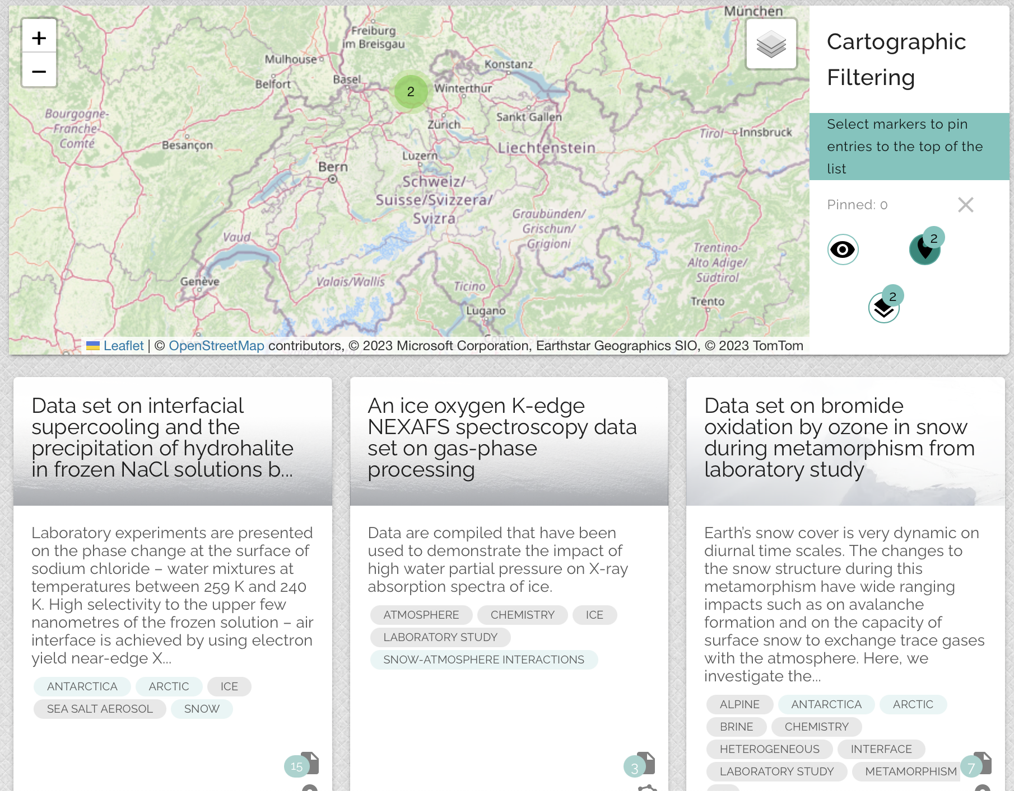


Current Status :: Publication & data
  FAIR and open
  DOI links data and publications
  Extended published data
  Connection to raw data and lab notes not clear

Slide 4
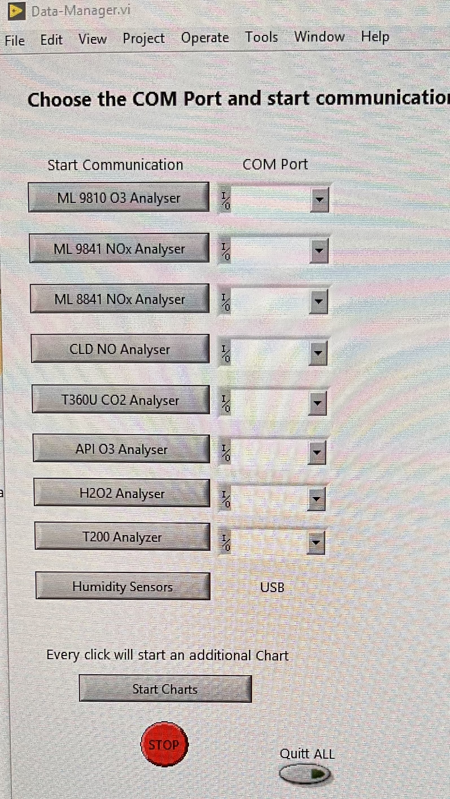
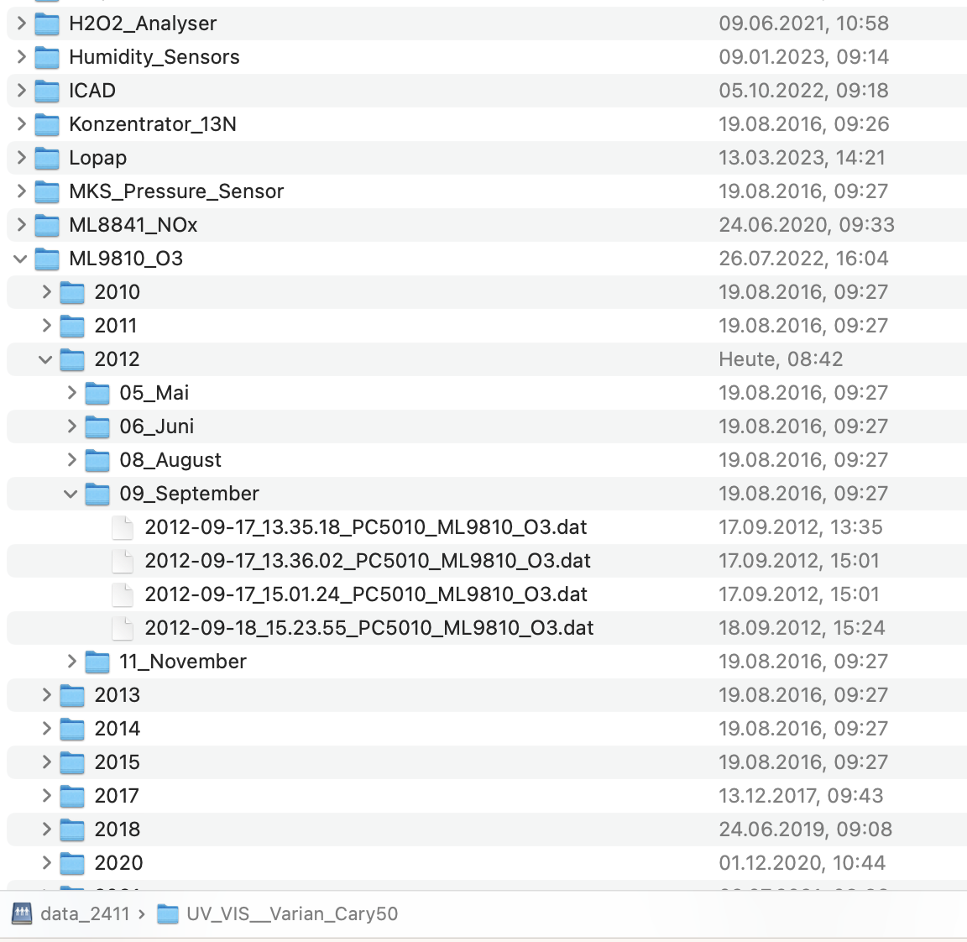
Current Status :: Data
  Automated data storage
  Automated backup
  Date based naming convention
  Meta data & data not linked
  Note books not linked
  Only LabView data

Slide 5
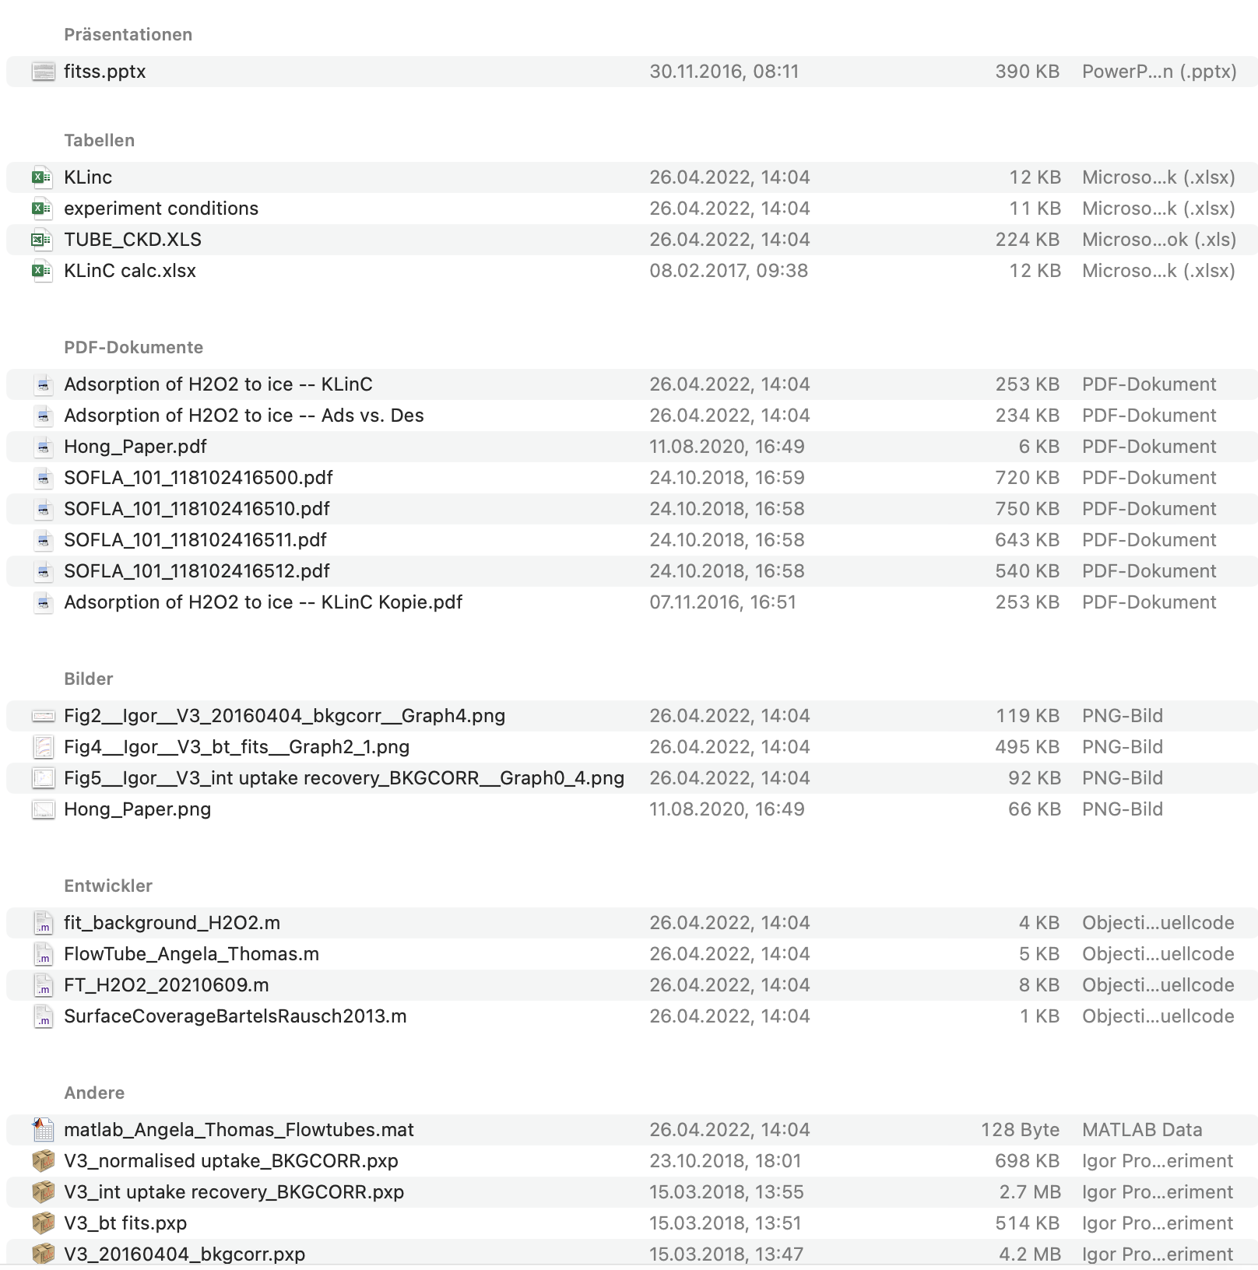
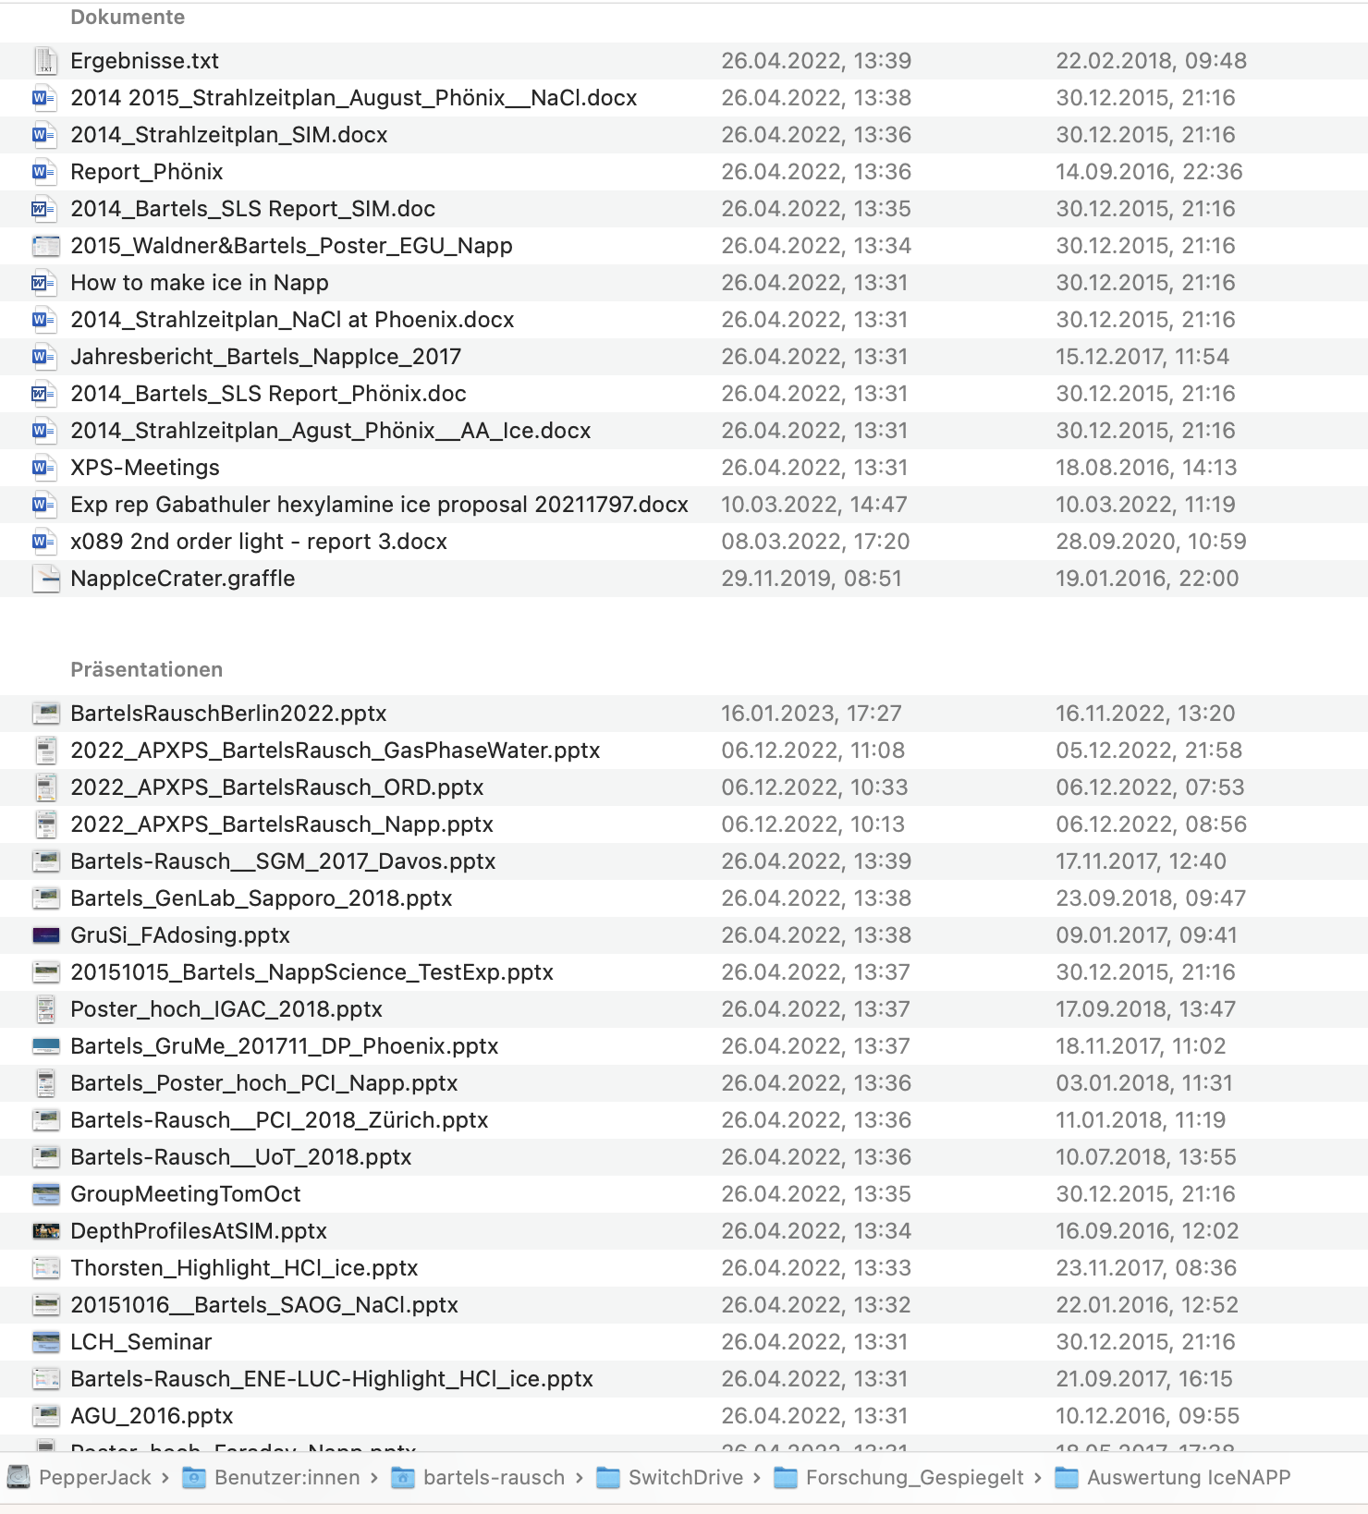

Current Status :: Analysis
  Individual notes, internal reports, presentations & manuscripts
  Variety of file types
  No naming convention
  No version control
  No link to data or publication
  No structure

Slide 6
Link data – analysis – publication
Make data & meta data & notes findable
The human factor: Automate data linking and storage location.
Interoperable <-> naming convention
Findable and Interoperable: Controlled vocabulary
Accessible: Import procedures

Slide 7
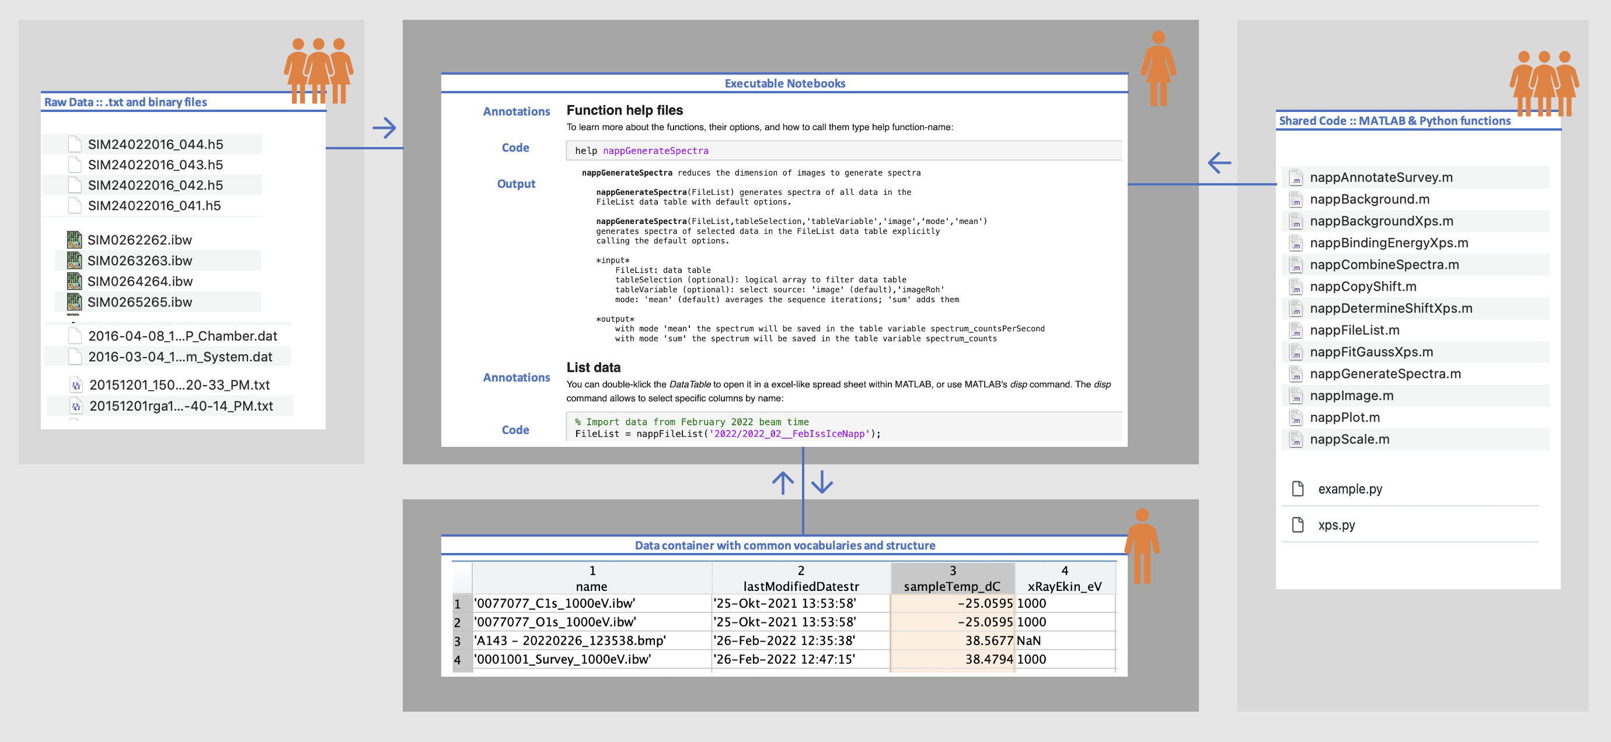
Connecting meta data & data & notes
  Findable data & meta data & notes
  Accessibility: File location and naming
  Interoperable: Only MATLAB
Bartels-Rausch & Ammann., Journal of Chemical Education, in review (2023)

Slide 8
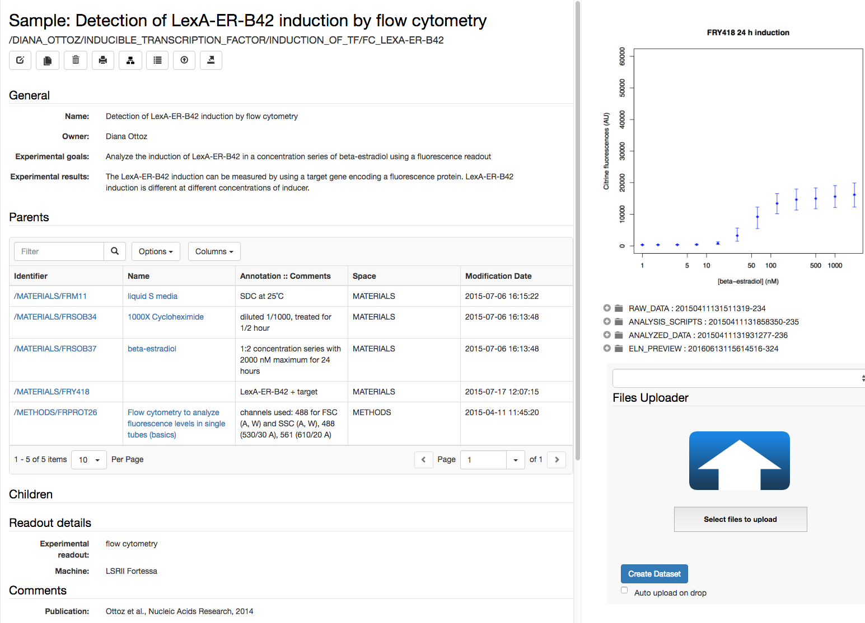
Lab notebook: key features
Links to samples and protocols. In the description of experimental procedures it is possible to establish and annotate links to samples and protocols stored in the inventory.
2. Links to other experimental steps

Slide 10

ORD Project :: IVDAV
  PSI: openBIS data import
  SLS: vocabulary and file format
  PSI: Procedures in openBIS
  P-Shell integration
  SciCat integration
  SciDat integration
Findable:
  Define input masks, structure, and naming for openBIS notebooks
  Integrate GIT for code
Interoperable:
  Define Hand-over points
  Define data format and structure for those (netCDF, h5)
Accessible:
  Establish a process to effectively explore and visualize data at any stage of the FAIR research cycle.

Slide 11
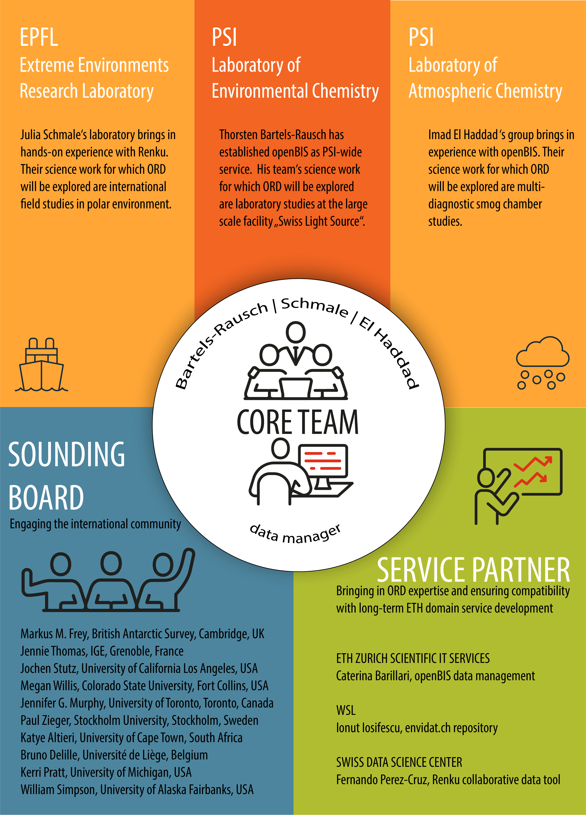
ORD Project :: IVDAV
1 scientific programmer
3 research groups
6 science cases
30 researchers
Wide range of instrument types (shared among groups)
International Outreach
Customize openBIS with report functionality

Slide 12
Wir schaffen Wissen – heute für morgen
Thanks

