Slide 1

Measure 3: Development of Online Course Material for RDM and ORD
ETH-Domain ORD Program
Anusch Bachofner, 04.05.2023

Slide 2
Measure 3 – Goal & Project
Goal
Produce and disseminate online training modules for Research Data Management (RDM) and Open Research Data (ORD), specifically tailored to the researchers of the ETH Domain, using an existing and appropriate online platform.
Project proposal
Development of the overall concept
Project proposal approved on 02.05.2023
Implementation of project
Starts after half year of recruiting of project team members
Project duration is 2 years, planned completion end of 2025
Notes:
2222

Slide 3



Measure 3 - Motivation
I am Andy, a researcher, and I need to fill a Data Management Plan for my funding agency.
I need to know how to manage & store my data and what are FAIR repositories??
One of many cases with commonalities
Not much time available
RDM is relevant but also a pain
The result of measure 3 should give Andy the chance to
Close knowledge gaps
Flexible and optimised learning
Quick & easy access
I should ask my colleagues or wait it’s late perhaps I google or look at the webpage of my institution
Know your customer
Training goes digital
Well marketed visibility
Measure 3 helps improving RDM skills of researchers – the customers of the online trainings

Slide 4
Measure 3 – Project proposal
Consists of 7 work packages (WP):
WP1: Modules
Identifies the topics for modules which are relevant for researchers, gathers content and improves modules based on user feedback
Develops discipline- & tool-specific modules in close exchange with researchers and rewards researchers for contribution also financially
WP2: Communication
Communicates about the project and its products within the ETH Domain throughout the project duration
Emphasizes the benefits of ORD practices for researchers, with a focus on short-term benefits and how the modules can support researchers in their daily work
WP3: Online platform
Evaluates an online platform for publishing all training material from WP1 Modules
WP4: Continuous operation and sustainability
Organizes the ongoing and long-term operation and maintenance of the products developed in the project (including funding options)
WP5: Transformation
Adapts training content from a didactic and learning perspective and imports the material into the chosen online platform by enriching it with (interactive) features of the online platform
WP6: Knowledge exchange
Improves training possibilities for researchers in 4 RI (PSI, Empa, Eawag, WSL) via knowledge transfer from ETHZ and EPFL to Lib4RI
WP7: Project management
Improves jointly with WP1 Modules the online modules based on user feedback
Considers only existing online platforms whose operation and maintenance can be guaranteed in the long-term
Know your customer
Well marketed visibility
Training goes digital
Know your customer

Slide 5
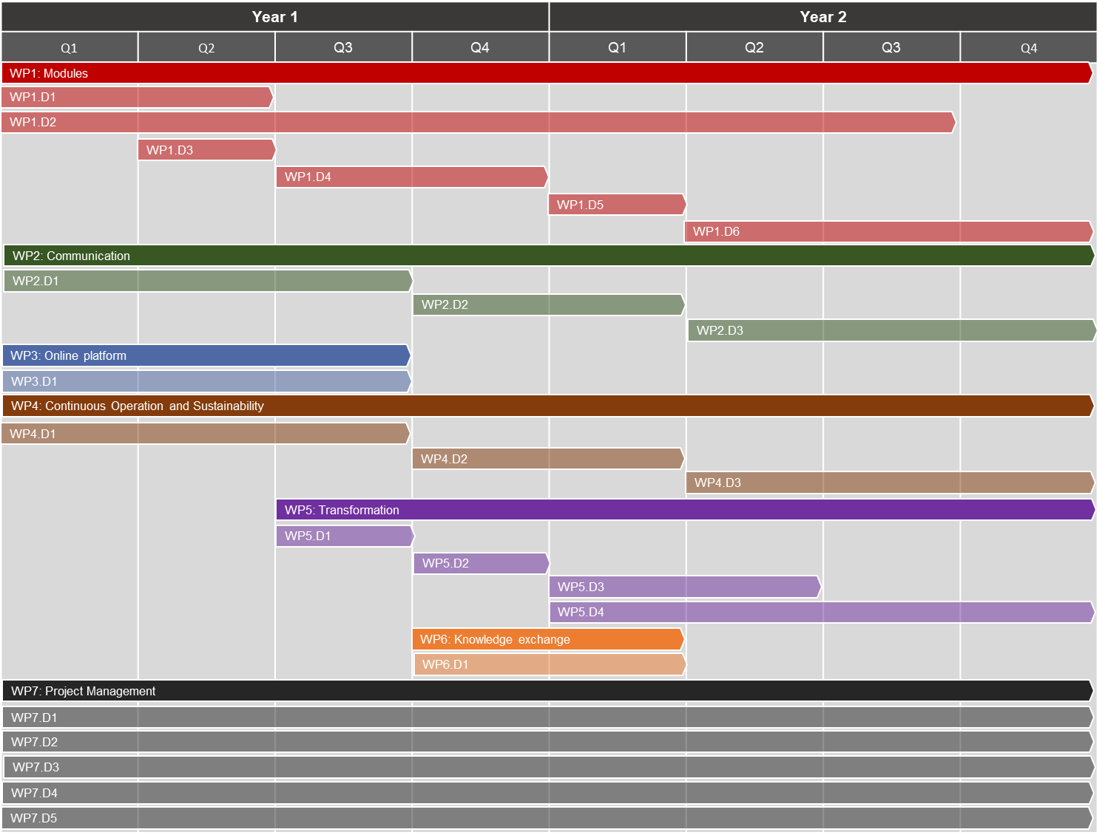
Measure 3 – Gantt chart of project
All main deliverables will be evaluated by stakeholder committees
7 work packages (WP) and their deliverables (D)
WP1.D1 – Researchers’ needs for Measure 3 gathered
WP1.D2 – Catalog of existing training material in ETH Domain & module content available
WP1.D3 – Relevant profile of test users defined
WP1.D4 – Procedure of involvement of researchers implemented
WP1.D5 – User testing done and user feedback gathered
WP1.D6 – Improvements of first modules based on feedback from test users
WP2.D1 – Marketing & communication concept with continuous channel to researchers set up
WP2.D2 – Ensured sustainability of WP2.D1
WP2.D3 – Marketing in institutions for end product on all suitable channels set up
WP3.D1 – Online platform chosen and evaluation with selection criteria described
WP4.D1 – Input on long-term sustainability of platform to WP3.D1
WP4.D2 – Funding options are documented as part of concept for long-term operability
WP4.D3 – Concept and funding for long-term maintenance of modules available
WP5.D1 – Transformation concept with suggestions for adaption to online content outlined
WP5.D2 – First modules implemented on online platform
WP5.D3 – First modules improved for usability based on user feedback
WP5.D4 – All modules available on online platform
WP6.D1 – Concrete and planned measures for knowledge exchange for 4RI documented
WP7.D1 – Tracks and supports project goal achievement
WP7.D2 – Stakeholder liaison (e.g. steering committee)
WP7.D3 – Organization of project (e.g. project team meetings)
WP7.D4 – Communication of evaluation reports to stakeholders
WP7.D5 – Responsible for financial reporting to stakeholders

