Slide 1
THRACE: Traceable thermodynamic datasets for chemical modelling
George Dan Miron :: Tenure Track :: Laboratory for waste management :: NES PSI
dan.miron@psi.ch
PSI-ORD, 04 May 2023

Slide 2
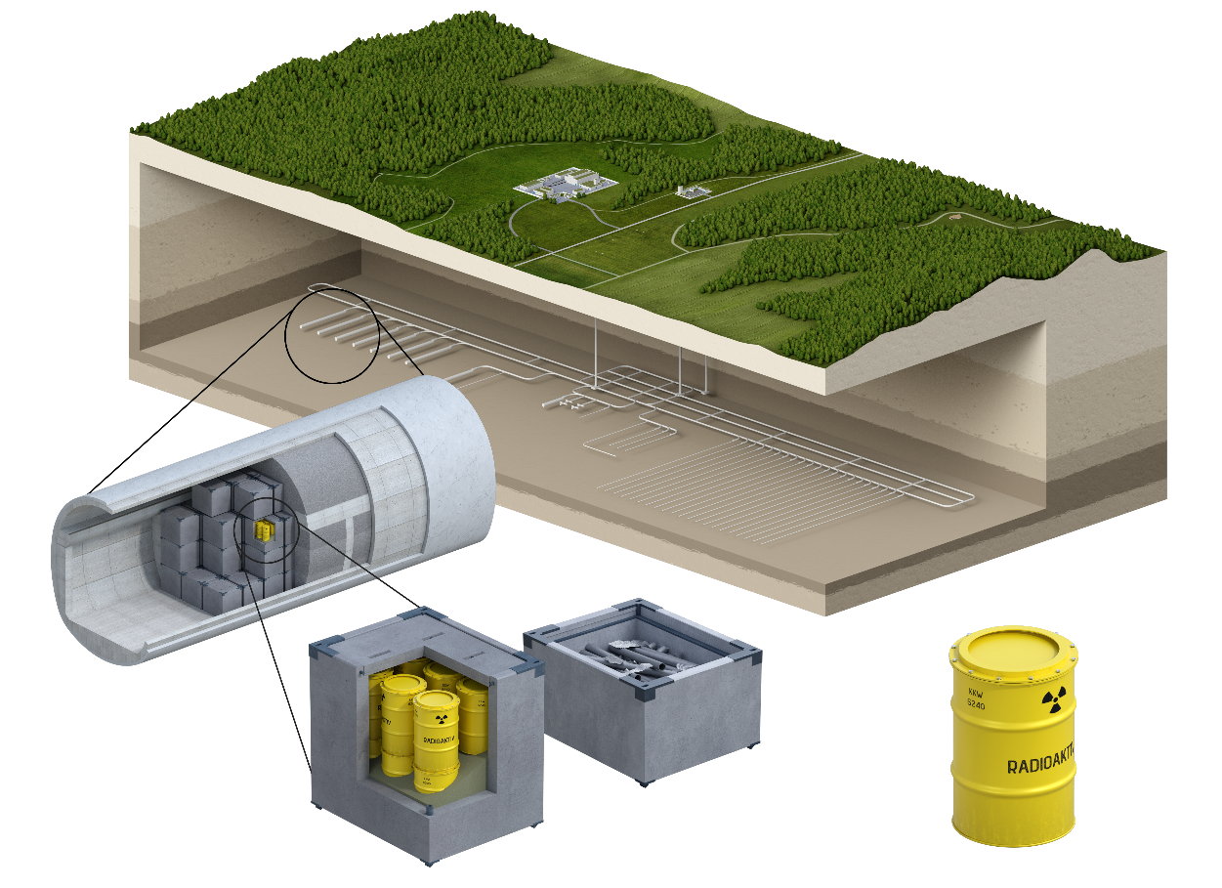
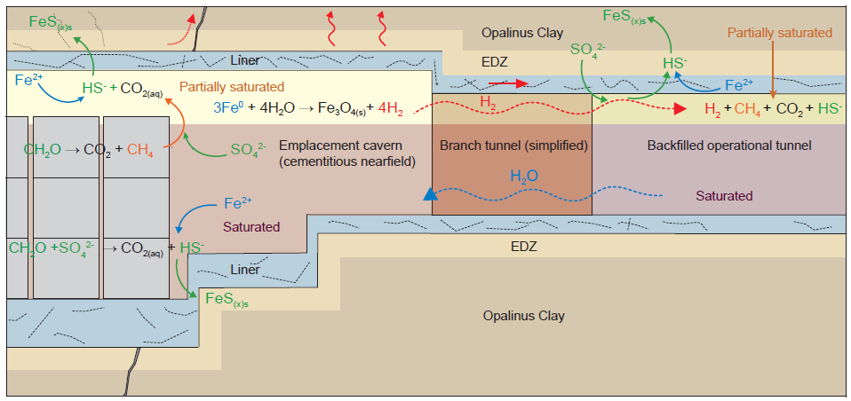
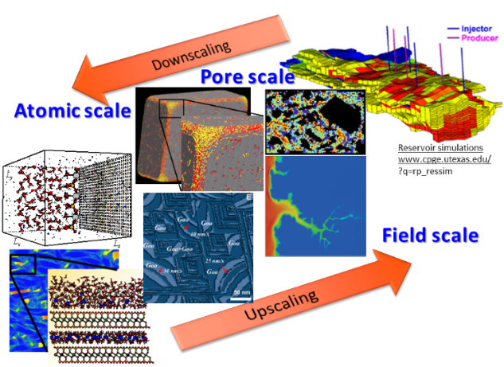
Laboratory for waste management (part of NES)
Laboratory for waste management - scientific basis for the safe geological disposal of radioactive waste
Use of geochemical modeling for gaining fundamental understanding of chemical processes in natural and engineered geochemical systems.

Slide 3




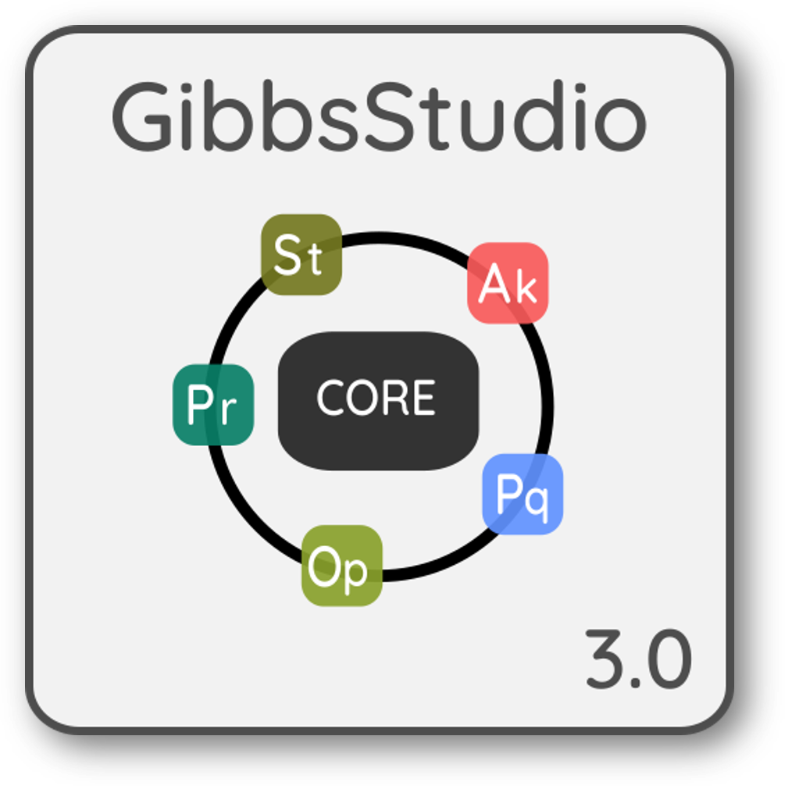



Geochemical modeling and tools
Thermodynamic models
relations between thermodynamic properties,
calculation of measurable properties
+
Thermodynamic datasets
actual values of thermodynamic properties
(compilation, derivation, consistency, errors, bookkeeping)
https://gems.web.psi.ch/
Modeling tool package
chemical equilibrium speciation solver code

Slide 4
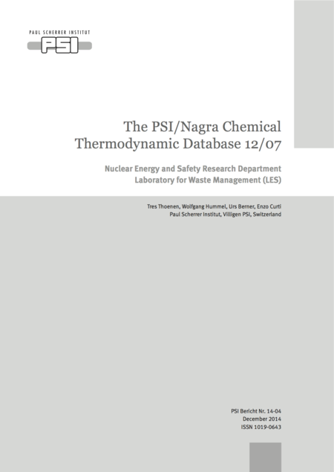
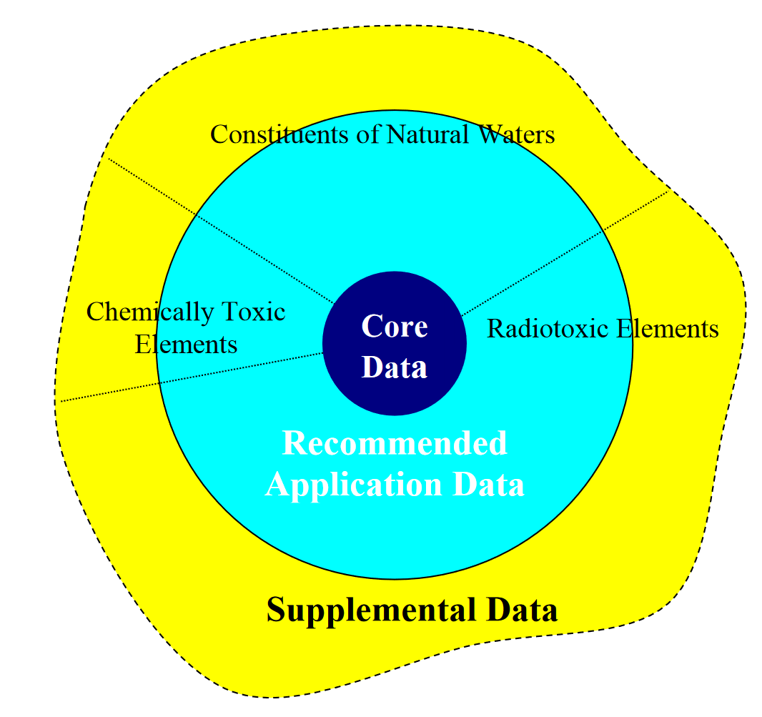
Tools and datasets at PSI-LES
Open-Source GEMS codes
Developed at LES PSI since early 2000s
Open source (C++/Python) powerful research tool
900+ active users in geochemical community
Do it all geochemical modeling tool (monolith)
The PSI/Nagra Chemical Thermodynamic database
State of the art compilation of thermodynamic data
Critical in-house reviews and data assessments (since 1990)
Support in safety assessment for the planned repository
Monumental work detailed in lengthy reports
https://gems.web.psi.ch/
1300 p.
I am a member in the development teams and responsible for future development of GEMS and TDB)

Slide 5

Problems/questions of a modeler
Not yet
Appropriate code and database package for my application?
What thermodynamic data should I use?
What sources do data come from, how was it compiled/derived?
What is the quality of the data, errors?
How can I use it in a modeling code?
How to compare alternative models and datasets?
How can I manage (Create, Read, Update, Delete, Search) the thermodynamic database? How can I import/export the data?
Is there a way to check formal consistency between properties?
How can I retrieve new sets of internally consistent parameters?
Developer issues
Lack of funding, staff support (IT engineer technicians like lab technicians)
Usually in-kind development, 3rd party secondary support through main scientific projects

Slide 6

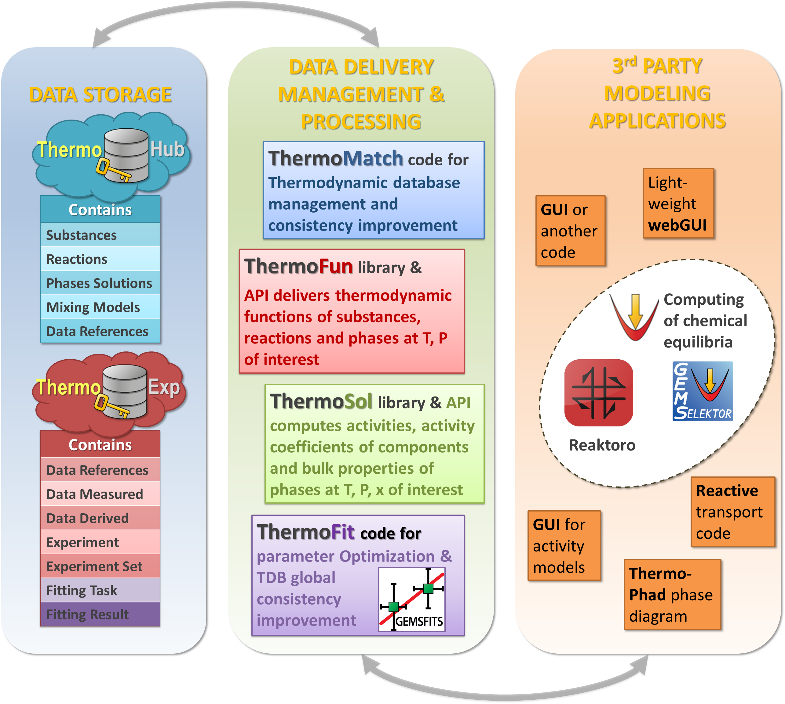
ORD project focus
https://themohub.org Collaborative work in progress
https://github.com/thermohub

Slide 7

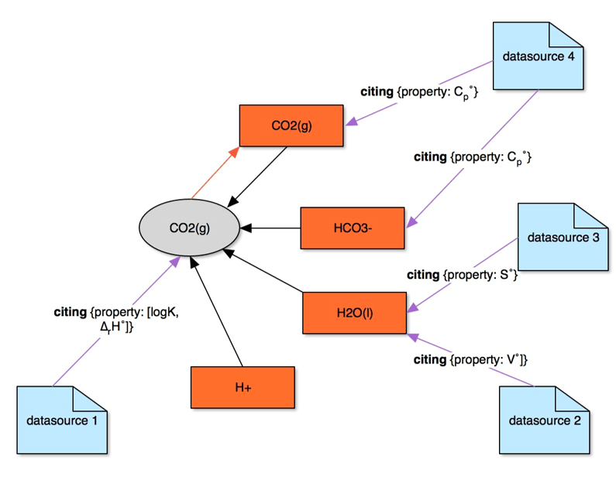
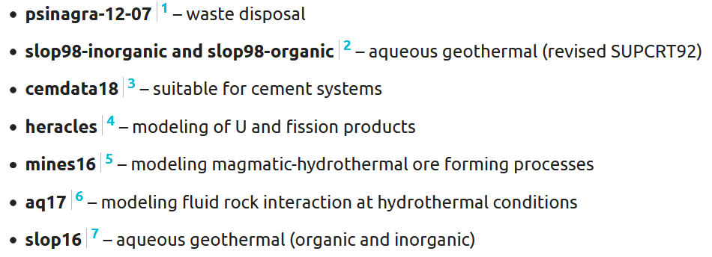
Is an online property graph database that stores thermodynamic datasets
Stores various type of structured data
  Flexible structured format (JSON) storage of diverse data types (schemas)
  Data consistency and traceability through property graph links
  Easy-access local or remote (cloud) storage
…

Slide 8


Main data management operations: Querying – Editing – Importing – Exporting
Queries and import/export scripts as user-defined JSON documents that can also be saved into the ThermoHub database
  Define a format file that matches the data fields of the imported file to those in our own data format
  Import from foreign formats: structured data, text stream, key-value, or CSV
  Define a reverse match to export data from the database format into other formats

Slide 9
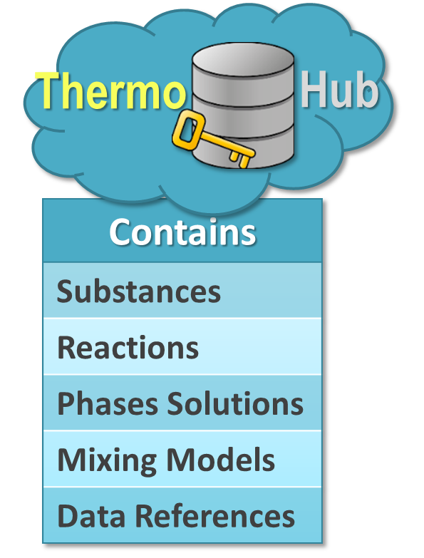
Aim of the contribute project
Bring ThermoHub to its full potential and demonstrate its ORD/FAIR
Ensure the consistency traceability of thermodynamic datasets
A unified thermodynamic database in a general JSON format, with datasets ready to use for geochemical modelling applications
Some mainstream databases used in chemical modeling, to be curated and imported to ThermoHub during the work proposed in the project
Writing and adapting the import export scripts
Adapting the JSON schemas of data and metadata
Setting up an automatic suite of tests for the import/export procedure
Semiautomatic workflow for contributing to the ThermoHub database after the end of the project

Slide 10


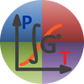
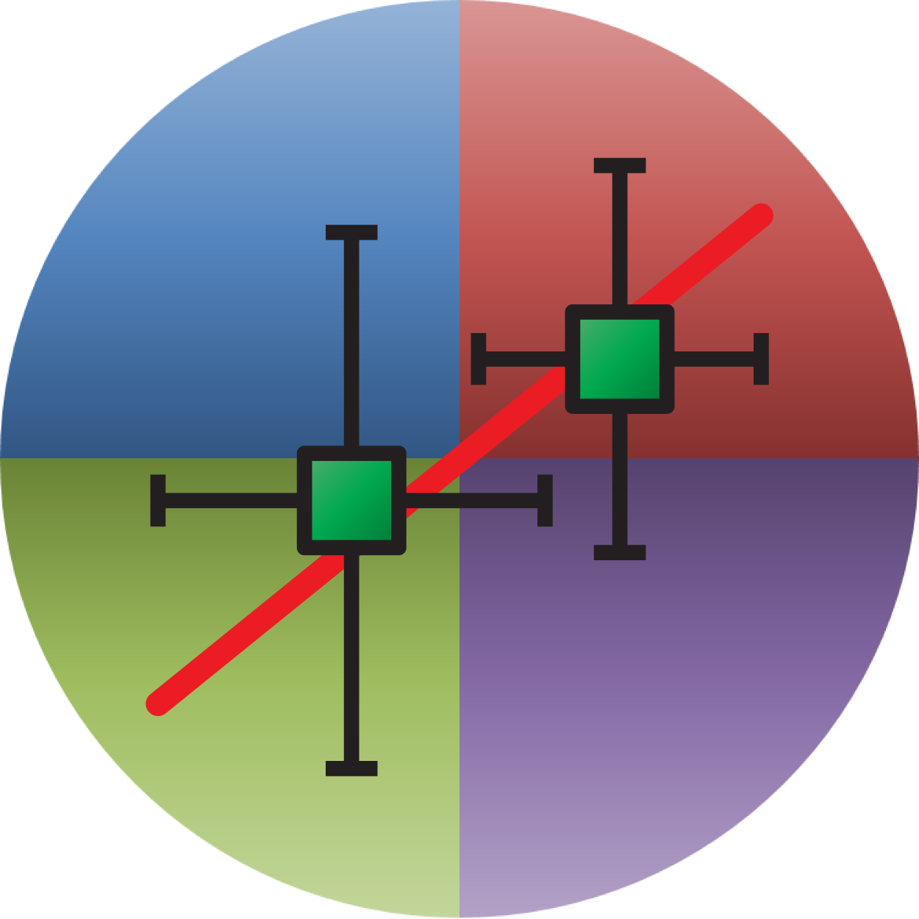


Future vision
Experiments
High-quality traceable thermodynamic data and tools for accurate (geo)chemical modeling of real-world scenarios.
Modeling
Real world Applications Scenarios
Open Research Data: Databases, code tools and web services for chemistry and thermodynamic modelling.
Databases for experiments and thermodynamic data
Tools for optimization and prediction, chemical modeling
Microservices and web applications, tuned for specific application. Running locally or in the cloud.

Slide 11
We create knowledge today – for use tomorrow
Acknowledgments:
ORD PSI and ETHZ
LES/NES
Dmitrii Kulik
Barbara Lothenbach
Sergey Churakov
Thank you!
Questions?

Slide 12

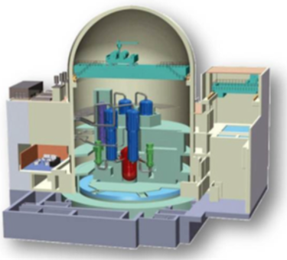




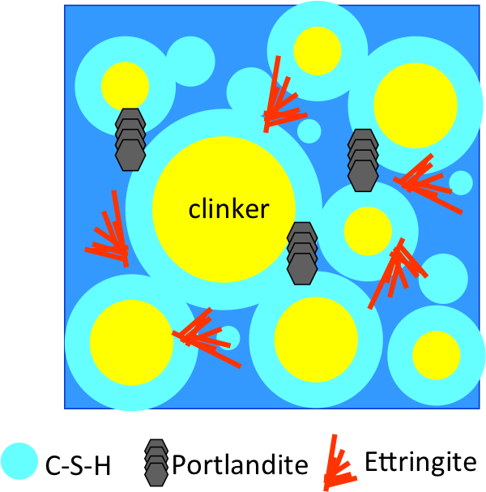





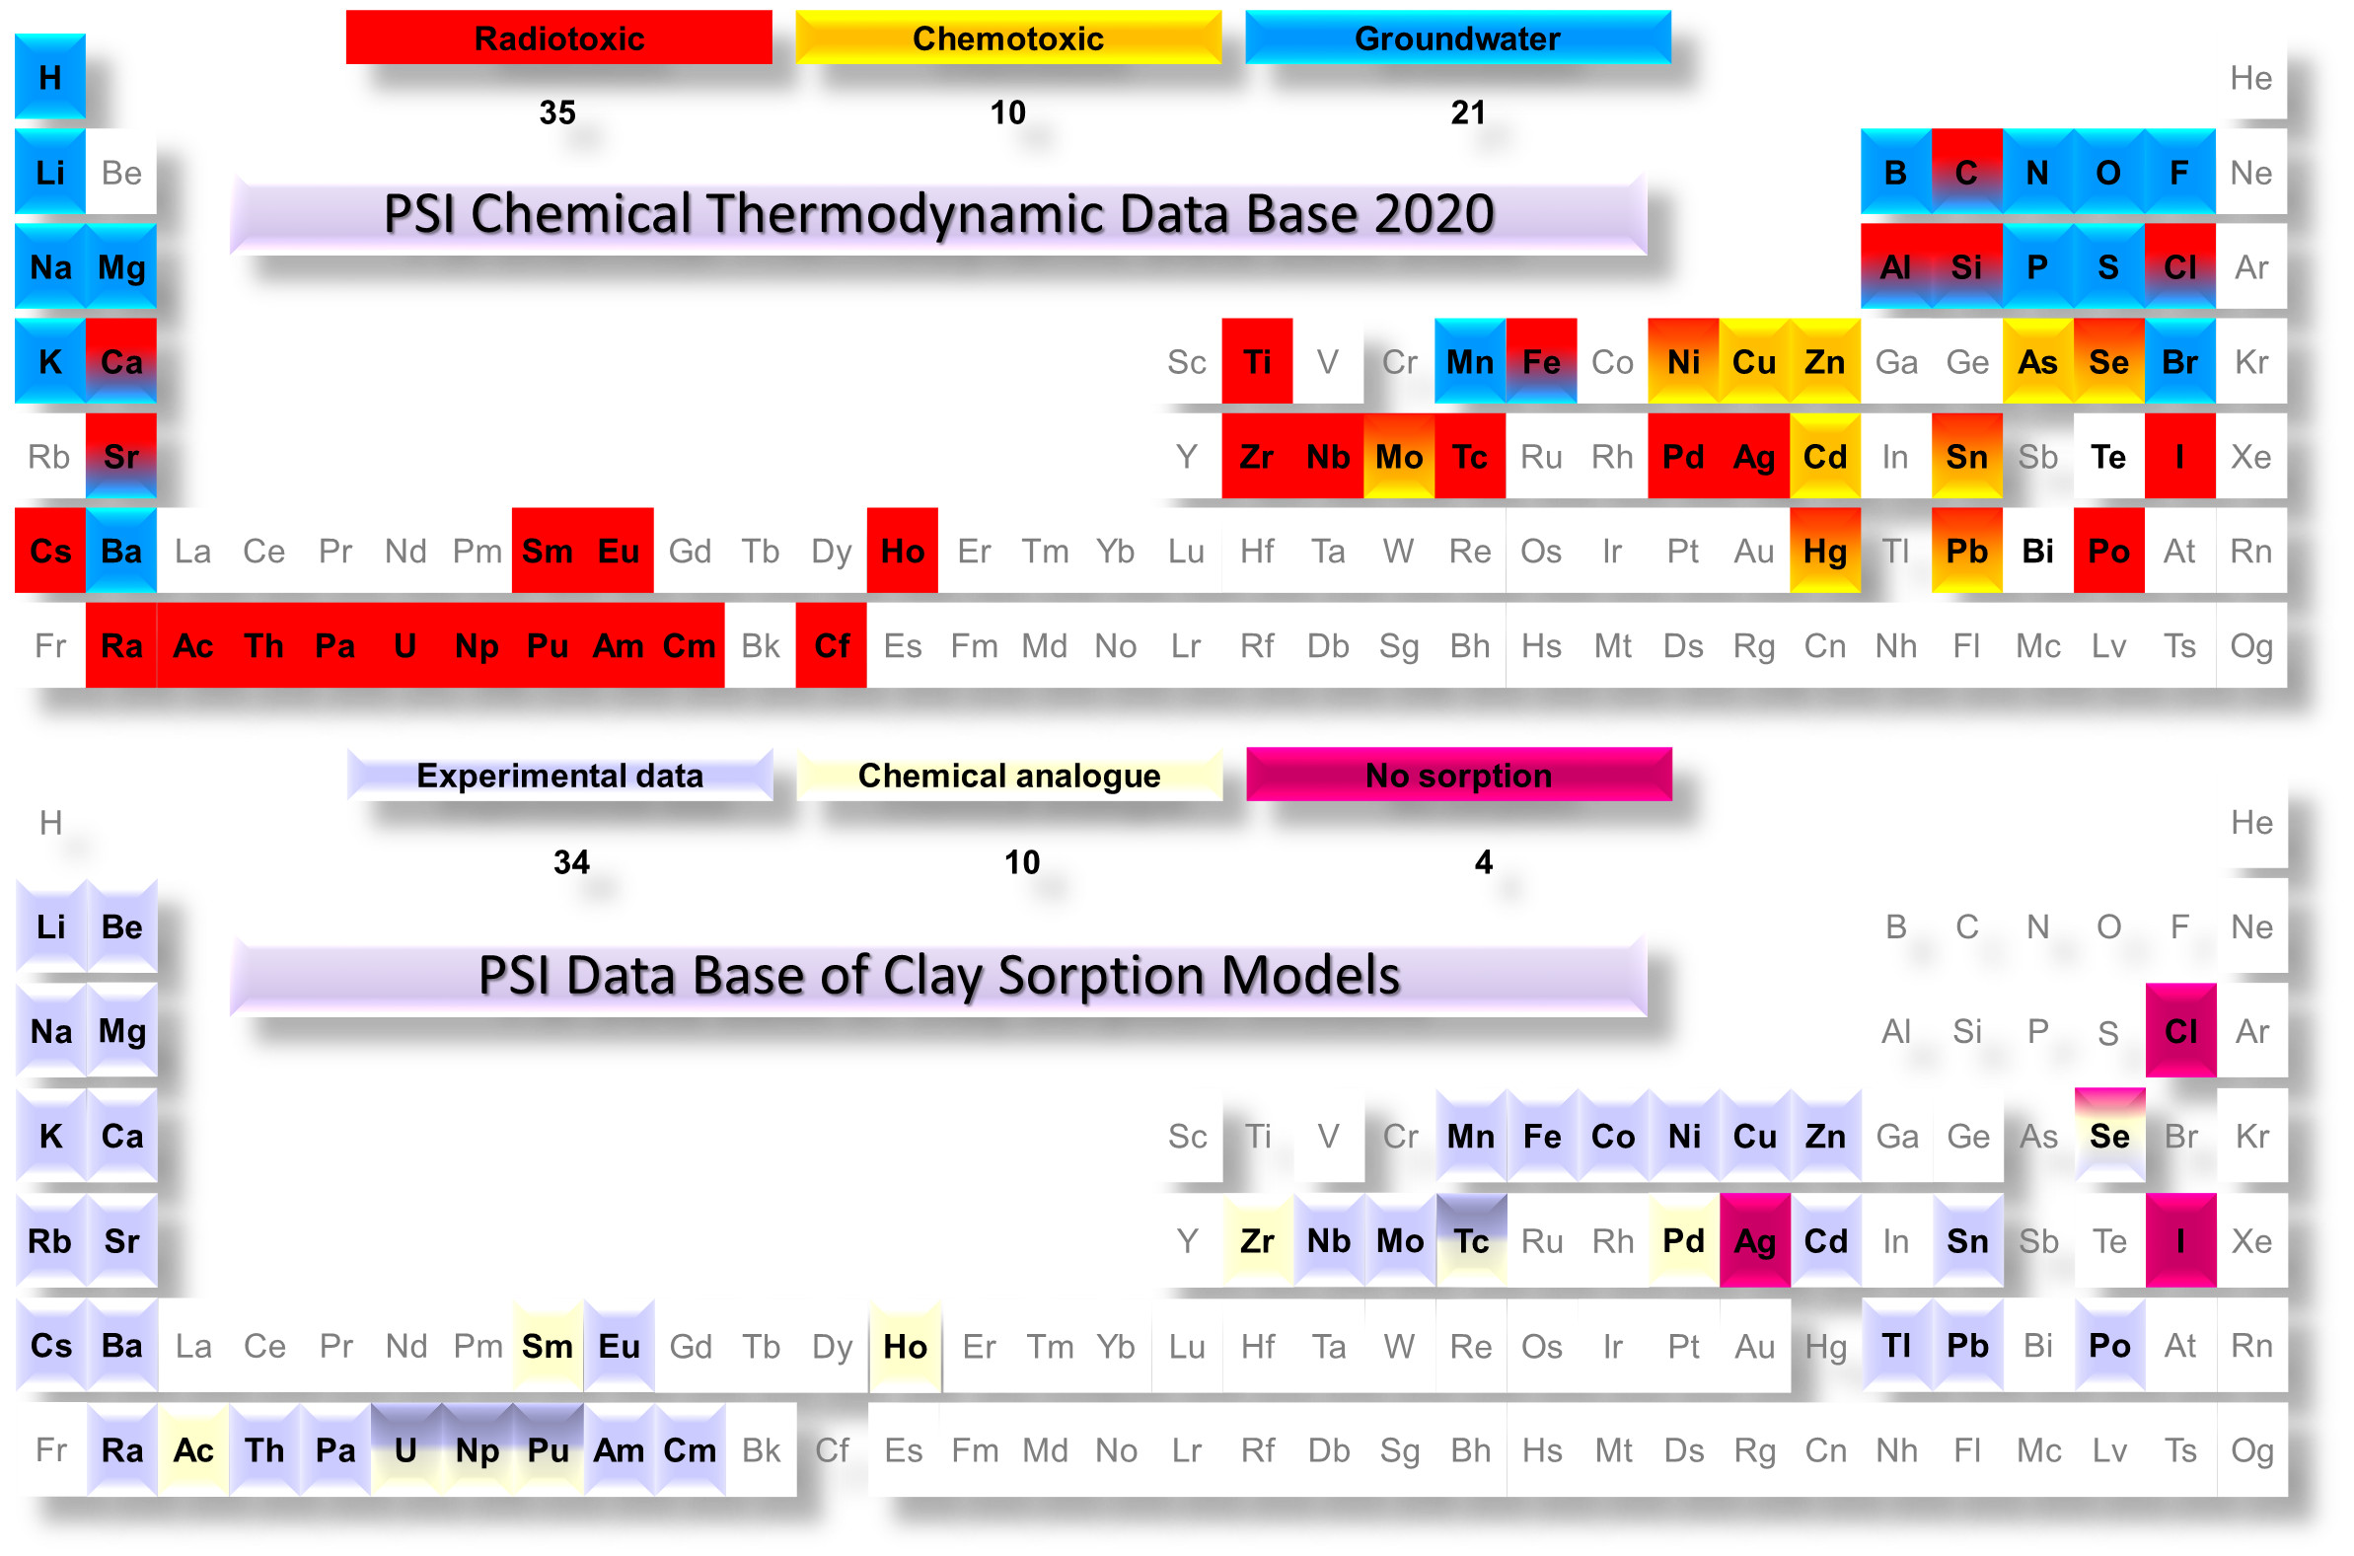

data consistency improvement
web services
CemGEMS
thermodynamic functions
phase-solution models
reactor chemistry
model optimization
Data
Applications
cement
Modeling
Codes
Processing
Algorithms
cement chemistry
Data Storage & Access
reactive transport
Thermo
Hub
online database
Databases
PSI-Nagra TDB
Cemdata TDB
…
experimental data:
solubility, spectroscopy,
…
nuclear fuel
waste disposal
cement
geothermal
…
http://gems.web.psi.ch/
https://thermohub.org/
https://cemgems.app/
https://geoml.eu/
Thermo
Exp

