Slide 1
SEM Machine Report, Week 9/2023
6.3.2023, D. Voulot

Slide 2
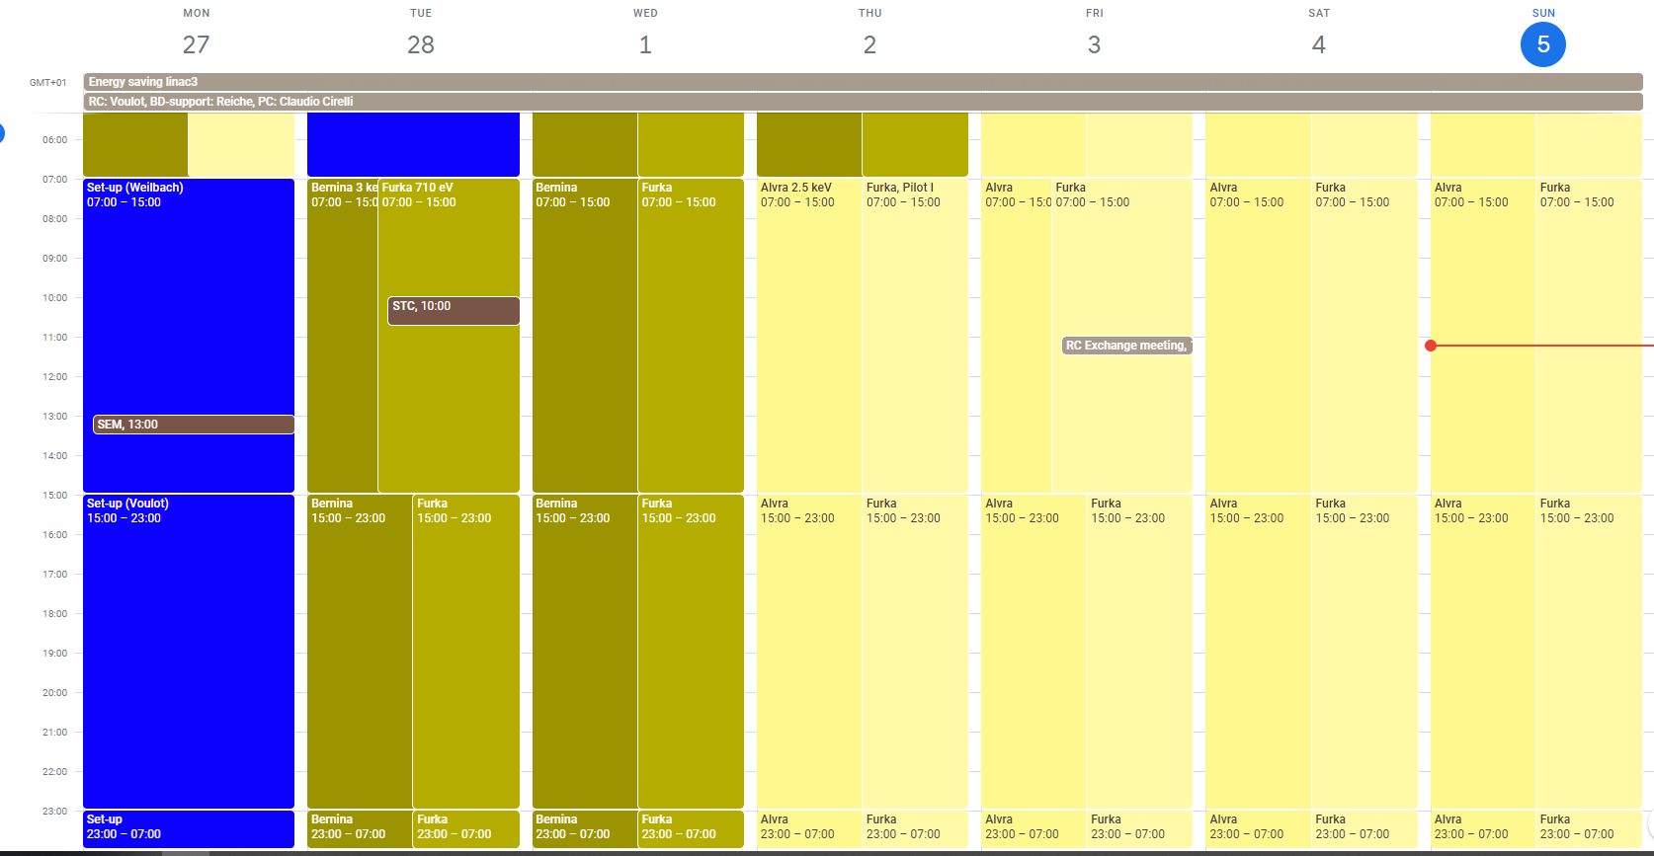
Aramis: Bernina 3 keV Tue-Wed, Alvra 2.5 kev Thu-Sun
Athos: Furka 710 eV (optional 1295, 1350 eV) C+/LH/LV

Slide 3
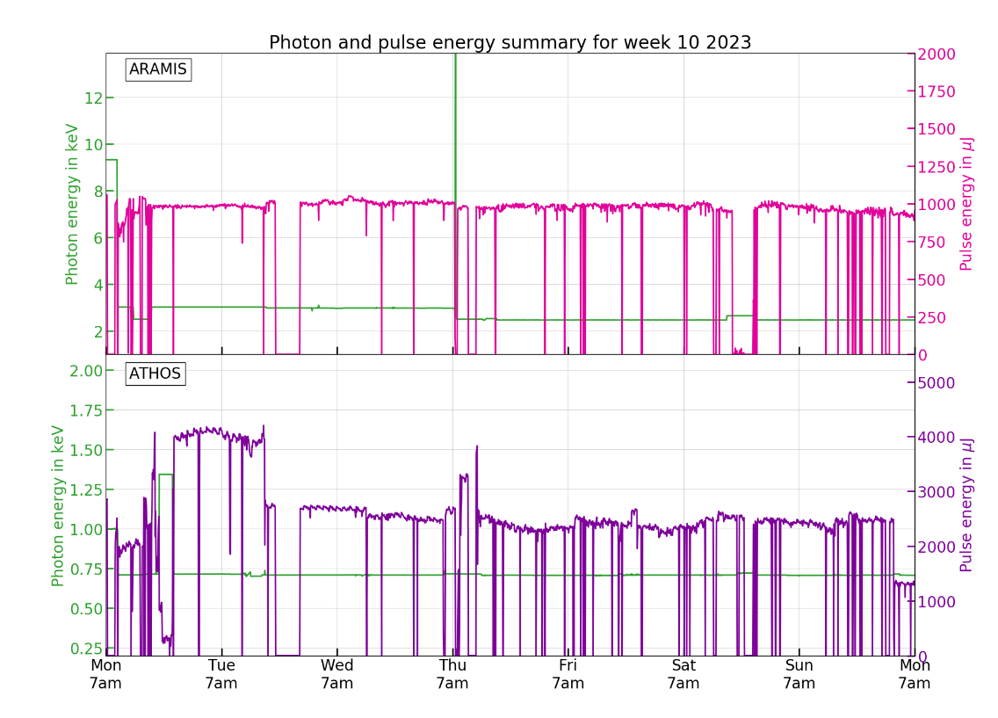

Slide 4
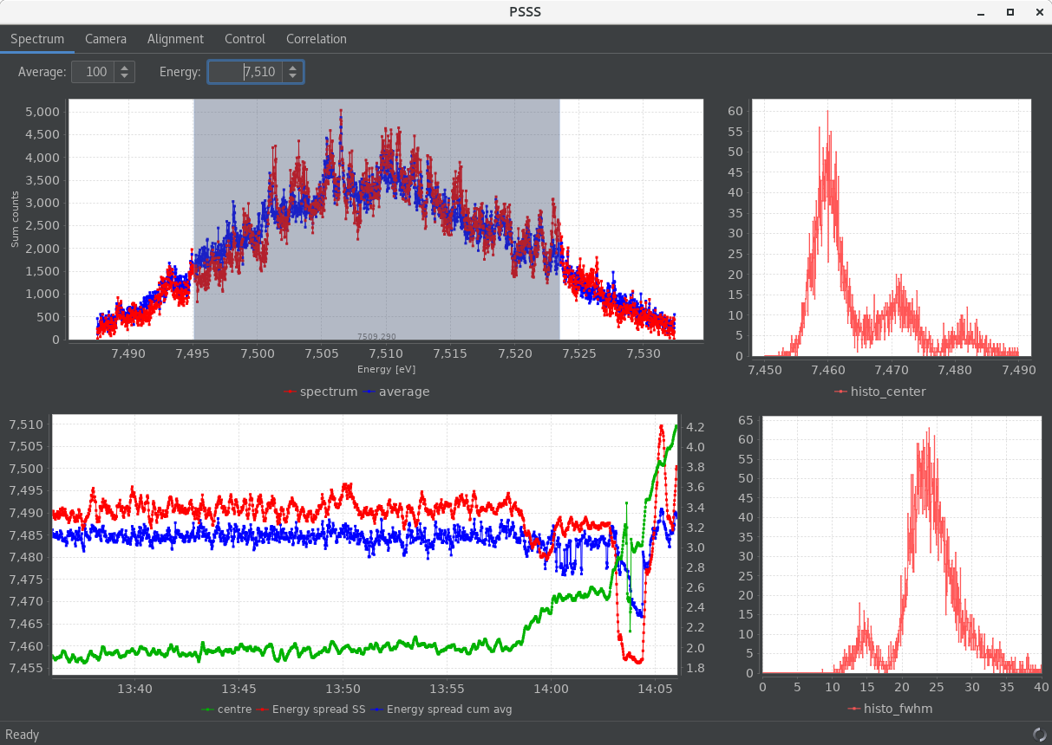
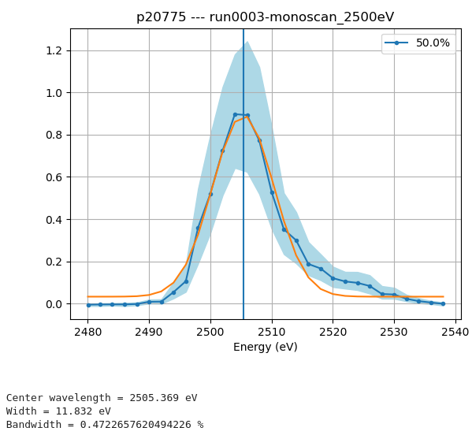
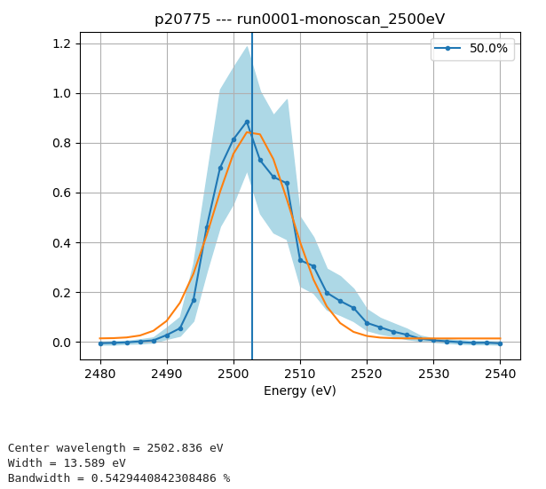
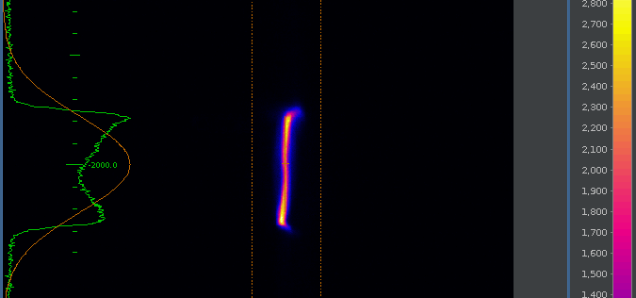
BW optimization
PSSS third harmonic set-up for 2.5 keV (C. Arrell)
BW 0.3% (cumul. average)
Mono scans give 0.4-0.5%
Difficult to optimize: the energy spread is larger than the PSSS window, would need a dedicated diagnostic
Bunch1: 24.4 fs rms
https://elog-gfa.psi.ch/SwissFEL+commissioning+data/47919
https://elog-gfa.psi.ch/Alvra/2077

Slide 5
Restoring settings
All settings prepared on Monday, save one snapshot for each beam, optimizing chic and taper for each configuration
Got good performances for most beams: AR: 2.5 keV 1 mJ, AT: 0.71 keV C+ 4 mJ, LH 2.75 mJ, LV 2.5 mJ, 1.35 keV C+ 1 mJ, but not very good at 1.35 keV LV/LH 350-400 uJ
Use semi-automatic tool to restore settings during the week: relatively successful but some problems with optimized compression settings-> they seem not to be reproducible (maybe linked with the instability problem…) also some problems with polarity changes, not always reproducible (mechanical/magnetic hysteresis effect) -> MD to investigate this problem
Most beam changes were done successfully by the shift crew (alone). We still need to work on this but it is going the right way.
For the moment please stick to beam changes during the day or coordinate with the RC (changes on Thursday night and Sunday night not correct)

Slide 6
Technical problems
Problems causing downtime
S10CB05: HV module driving board failure (pikett needed) (Tue, 5h)
SATUN21 mover failed-> controller card for gap motor had to be exchanged, tunnel access (Thu, 1h30)
Aramis gas detector vacuum pump failure, tunnel access (Sat, 2h)
Several trips of SINSB02, fault on solenoid power supply, will be checked during service day
Other problems
Observe sporadic instabilities in Athos, can be compensated with Mizar delay or compression, suspect Mizar laser optics degrading, was checked by Andreas on Sunday morning
Athos polarity hysteresis effect

