Slide 1
EIDO (7901) Update
March 6, 2023
Notes:
<number>

Slide 2
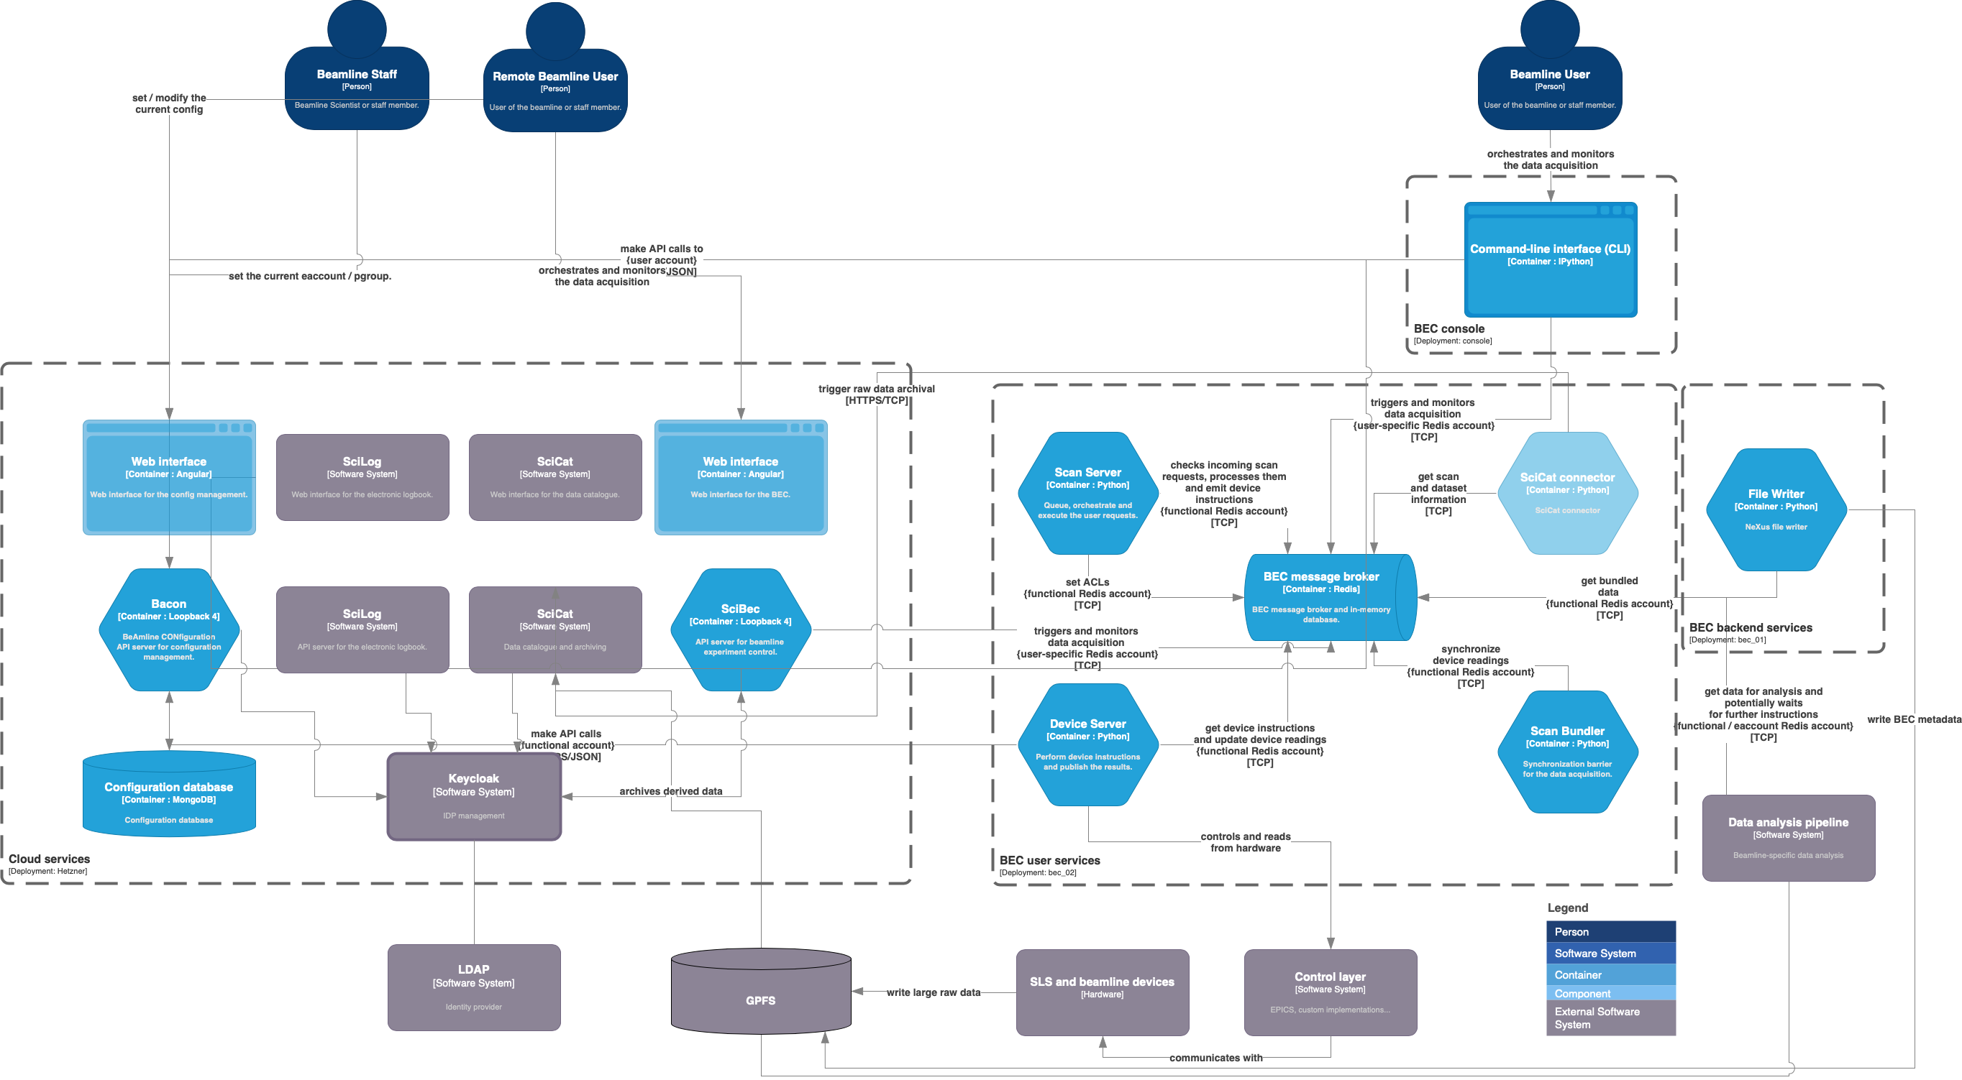
BEC
Preparation for user tests at SLS (X-Treme and cSAXS)
Work on a web-based configuration and access management system.
Preparation for the envisioned deployment
SciHub connector (SciLog, SciCat, BEC)
Page <number>

Slide 3
slic & sfdata
y
recorded Sensor
slic:
New type: Sensors
GUI:
  Improved feedback on math entries
  Display pgroup meta info: owner(s), title, type
  DBUS notifications
CLI:
  Address Adjustables by name (vs. by variable)
  Device filtering (by type / by name)
And various improvements under the hood...
scanned Adjustable
x
sfdata:
Meta data handling (slightly smart: lazy loading with caching)
Page <number>

Slide 4
nomachine
Updates from version 7 to 8 ongoing
Page <number>

