Slide 1
Screen Calibration Measurement Through E-Beam Energy Scaling
Pavle Juranić, Eduard Prat, Didier Voulot:: Staff Scientists:: Paul Scherrer Institute
SwissFEL Progress Meeting 28.03.2023

Slide 2
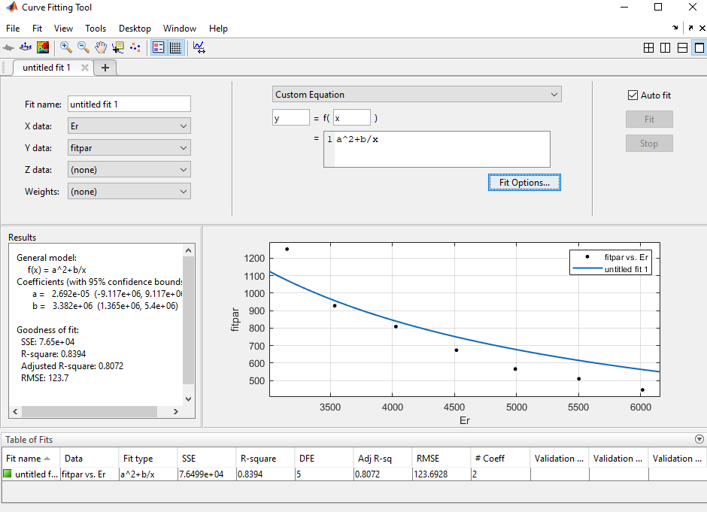
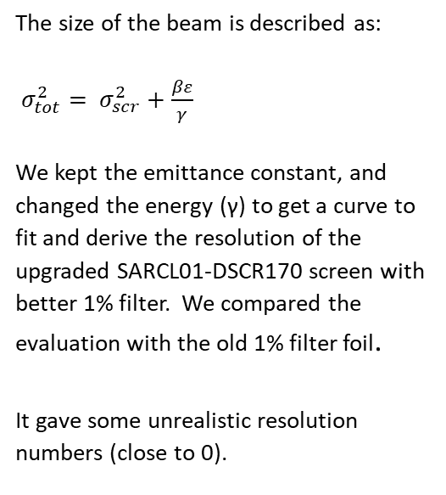
Basic idea
The size of the beam is described as:
$σ_{tot}^{2}= σ_{scr}^{2}+\frac{βε}{γ}$
We kept the emittance constant, and changed the energy (γ) to get a curve to fit and derive the resolution of the upgraded SARCL01-DSCR170 screen with better 1% filter. We compared the evaluation with the old 1% filter foil.
It gave some unrealistic resolution numbers (close to 0).

Slide 3
Is it all wrong? What is even real?
At least, that’s what Eduard started saying when he had the existential crisis. We started suspecting something was wrong with the e-beam energy scaling. And we found the culprit! The S30 quads were all not following the e-beam energy scaling.
We told Didier the e-beam scaling is not working right. He found the bug and fixed it, and we re-did the measurement next MD shift.

Slide 4
Physics works. All is well.
Final results:
Good screen resolution: 14.3 +/- 0.5 um
Good screen emittance*beta function: 2.95 +/- 0.12e-6 m^2
Bad screen resolution: 19.8 +/- 0.4 um
Bad screen emittance*beta function: 3.20 +/- 0.13e-6 m^2
It seems the focusing ability also helped the ‘bad’ filters a bit as well. The resolution improved by about 5 um from the value published in the PRL on emittance measurements.

