Slide 1
Zheqiao Geng :: LLRF Group :: RF Section
Measurement of Beam Loading in the X-band TDS
SPM
28.03.2023

Slide 2
Outline
Motivation
Measurement Setup and Results
Outlook

Slide 3
Motivation

Slide 4
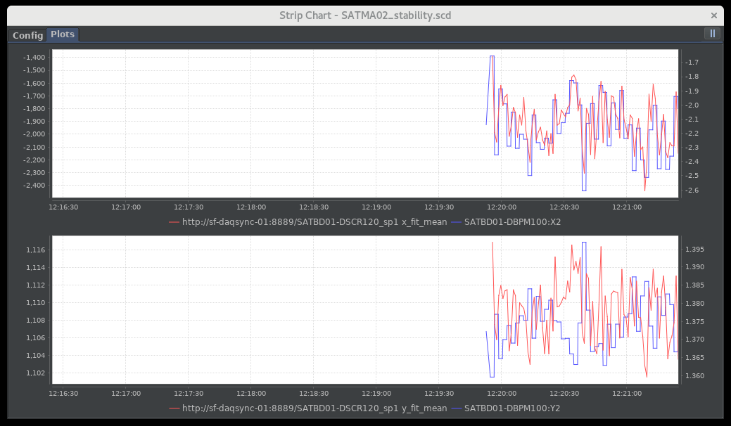
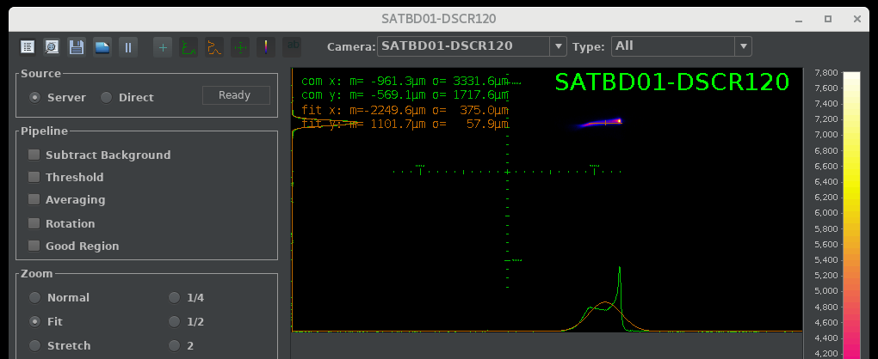
Stability Issue of X-band TDS
Large fluctuation of deflected beam profile on screen (SATBD01-DSCR120) and BPM position (SATBD01-DBPM100:X2)
Large variation of zero-crossing phase for different executions of calibration
Data collection 12:20 – 13:00, 09.09.2022

Slide 5
Stability Issue of X-band TDS (cont.)
Large fluctuation of deflected beam profile on screen (SATBD01-DSCR120) – or BPM position (SATBD01-DBPM100:X2)
Large variation of zero-crossing phase for different executions of calibration
data = {'10:48:00', 243.14;
'10:54:00', 242.83;
'10:59:00', 242.94;
'11:11:00', 242.84;
'11:16:00', 242.78;
'12:07:00', 242.66;
'12:10:00', 242.77;
'12:13:00', 242.69;
'12:16:00', 242.34;
'12:18:00', 242.40;
'12:20:00', 242.32;
'12:22:00', 242.23;
'12:24:00', 242.10;
'14:22:00', 243.26;
'14:24:00', 243.17;
'14:26:00', 243.05;
'14:36:00', 243.19;
'14:38:00', 243.29;
'14:44:00', 243.18;
'15:35:00', 242.98;
'15:37:00', 243.08;
'15:39:00', 243.24};
Zero-crossing Phase during MD Shift (08.09.2022)

Slide 6
Factors Affecting the Stability
Factors affecting the pulse-to-pulse fluctuation:
X-band TDS RF amplitude and phase
Bunch arrival time
Bunch orbit (offset and angle)
Factors affecting the zero-crossing calibration variation:
Pulse-to-pulse fluctuation (above) increases the variance of the zero-crossing phase (viewed as a random variable)
LLRF imperfections:
  LLRF measurement of amplitude/phase has systematic errors (compared to the actual field seen by the beam) dependent on the RF pulse shapes (no accurate model to represent the integrated field seen by the beam based on the measured RF pulse at the input-output of the structure – we even have errors in identifying which part of the pulse interacts with the beam)
  At different deflecting voltage, the RF pulse shape are slightly different
  LLRF actuation has systematic errors (180-degree phase adjustment results in slightly different actual phase change – we rely on feedback to achieve accurate phase change – not fully possible due to measurement systematic errors)

Slide 7
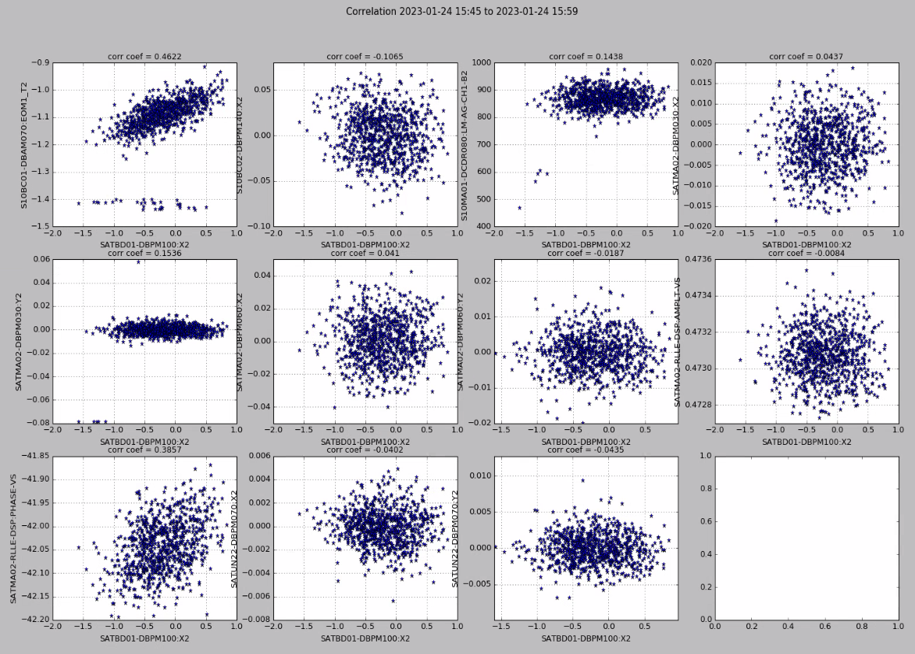
Factors Affecting the Stability (cont.)
Factors affecting the pulse-to-pulse fluctuation
BC2 BAM
BC2 Energy
RF Phase

Slide 8
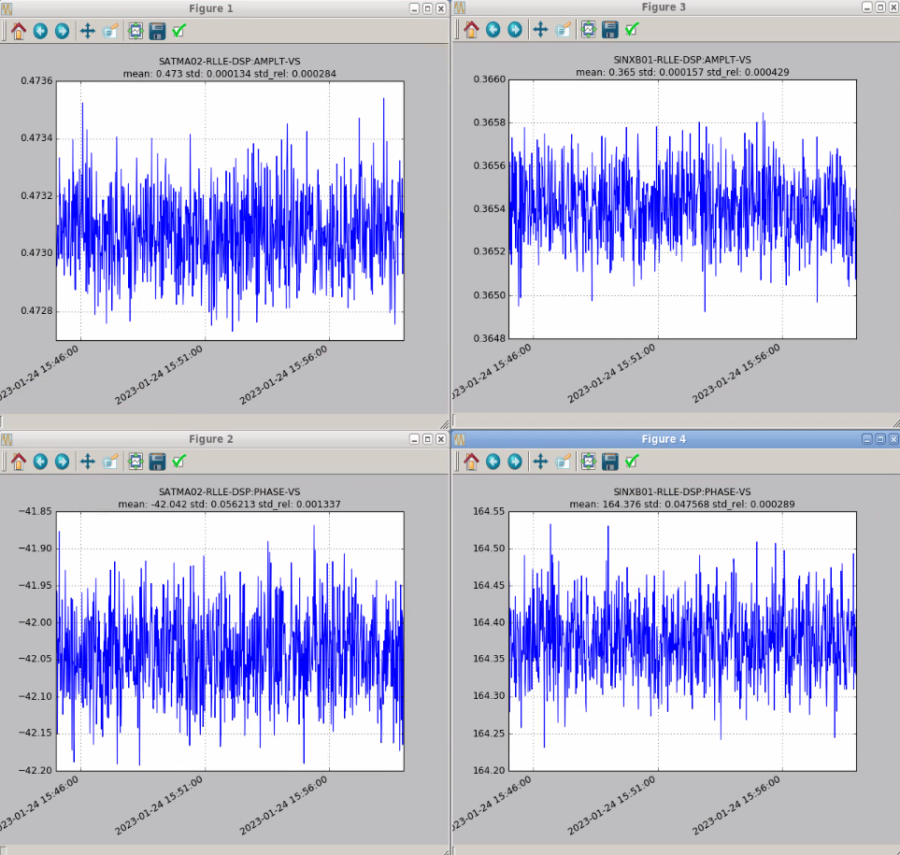
Factors Affecting the Stability (cont.)
Factors affecting the pulse-to-pulse fluctuation
SATMA02 ampl. jitter: 2.84e-4 RMS
SINXB01 ampl. jitter: 4.29e-4 RMS
SATMA02 Phase jitter:
0.056° RMS
SINXB01 Phase jitter:
0.048° RMS

Slide 9
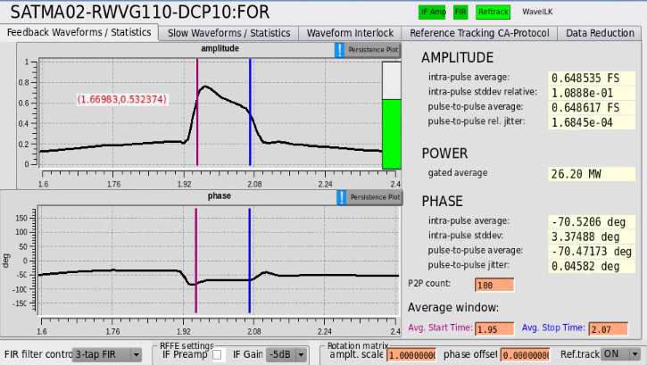
Factors Affecting the Stability (cont.)
Factors affecting the zero-crossing calibration variation:
LLRF uses a simplified model to estimate the RF field seen by the beam by averaging the pulse
This works well for a constant RF pulse shape (slightly differs at different amplitude). That is, LLRF works well for a constant operating point to compensate for drift
At different amplitudes, LLRF feedback stabilizes a measured phase, but may not be the actual phase seen by the beam, causing beam phase errors
It also implies that the phase offset calibration at a RF level will not be fully correct at a different RF power

Slide 10
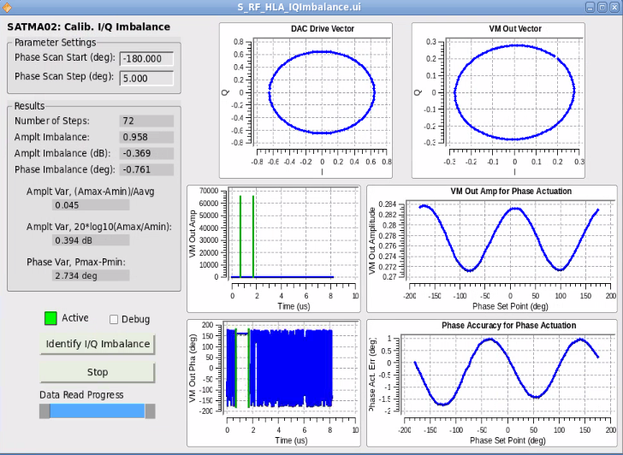
Factors Affecting the Stability (cont.)
Factors affecting the zero-crossing calibration variation:
The open-loop RF actuation error can be up to 2 degree – limited by the hardware
Mostly corrected by feedback – may also be corrected by feedforward (not yet implemented in LLRF)

Slide 11
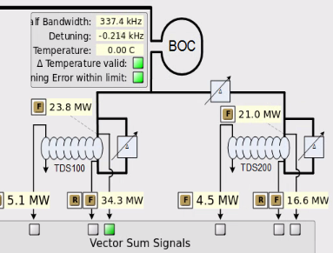
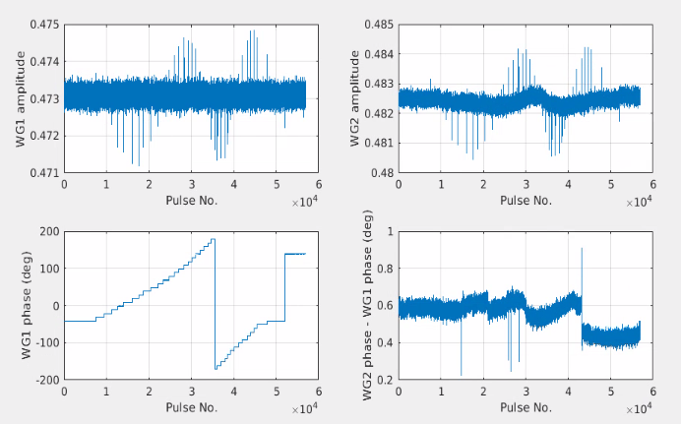
Factors Affecting the Stability (cont.)
Factors affecting the zero-crossing calibration variation:
RF amplitude/phase feedbacks applied for controlling WG1 input. The results show:
Controlling one signal does not control the others with the same accuracy – even more uncertain for the field seen by the beam!
RF feedback can be accurate for fixed-operating-point operation: constant amplitude and phase setpoints!
For tracking the actual RF field to a time-varying setpoints with feedback, we need to know the exact RF-beam interaction model, and the exact model of the structure, WG … - almost not possible for TW structures (standing-wave cavities are more predictable/measurable)

Slide 12
Measurement Setup and Results

Slide 13
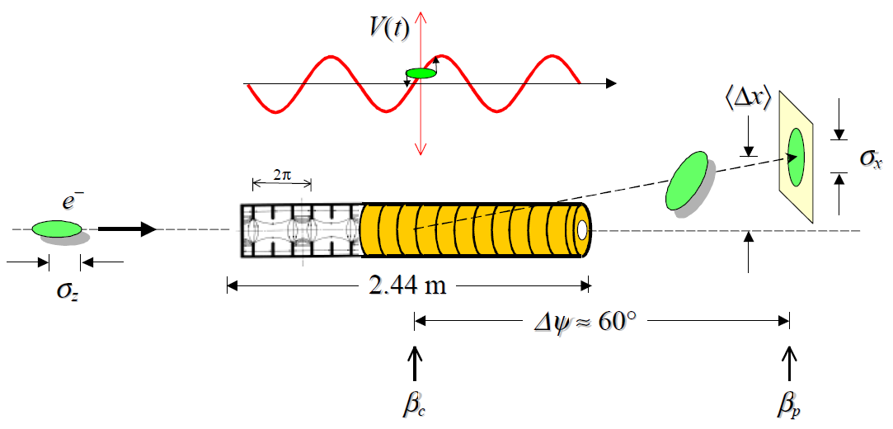
Goals of Test
Evaluate the beam arrival time fluctuation at the X-band TDS by measuring the beam loading signals in the structures
Check the correlation of the beam loading with upstream beam parameters

Slide 14
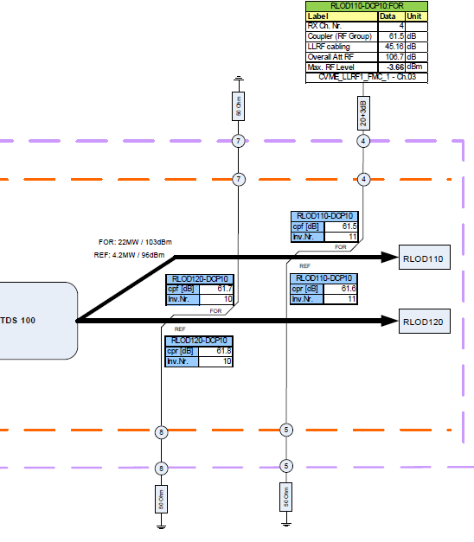
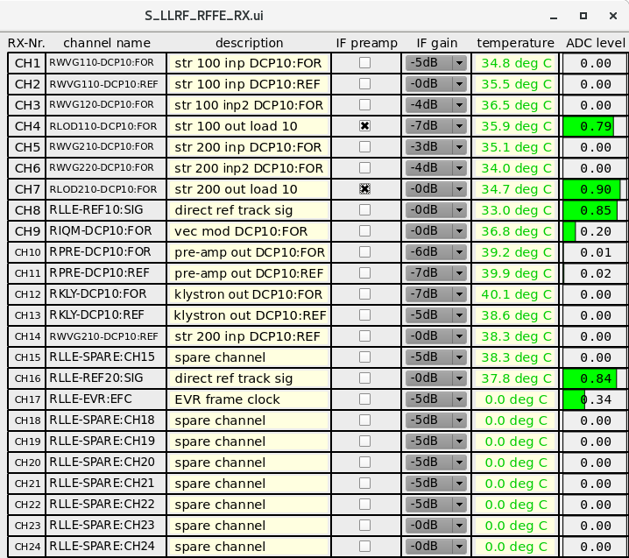
Test Setup
RF attenuators of the structure load signals are removed
IF amplifiers enabled in LLRF receiver channels (IF attenuation is used to adjust the signal level)
Other settings can be found in elog (https://elog-gfa.psi.ch/SwissFEL+RF/6275)

Slide 15
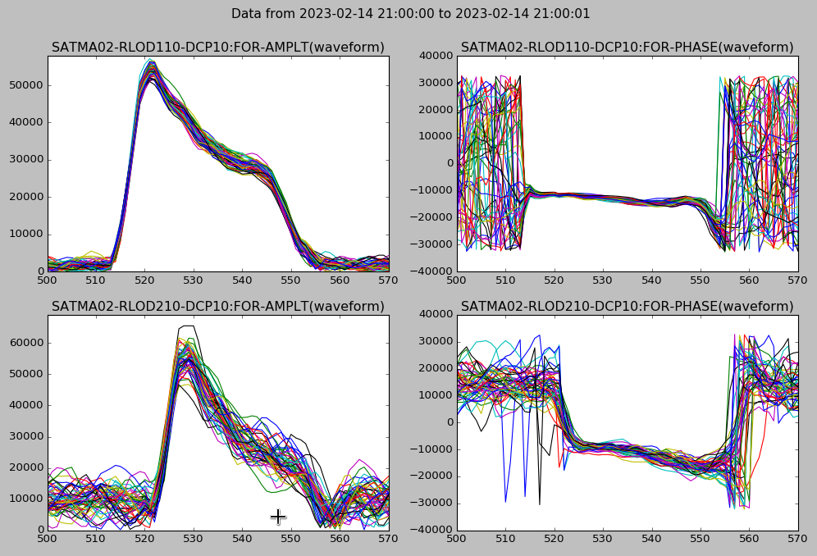
Test Results – Beam Loading Waveforms
The beam loading signal is clearly visible

Slide 16
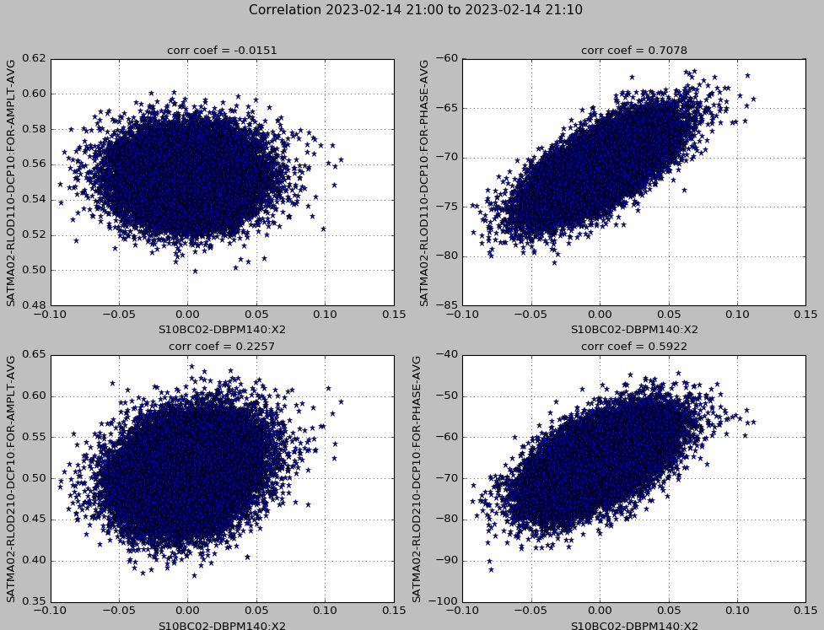
Test Results – Correlation with BC2 Energy
Fluctuation of structure2 beam-loading phase is > 2 times of structure1 phase!

Slide 17
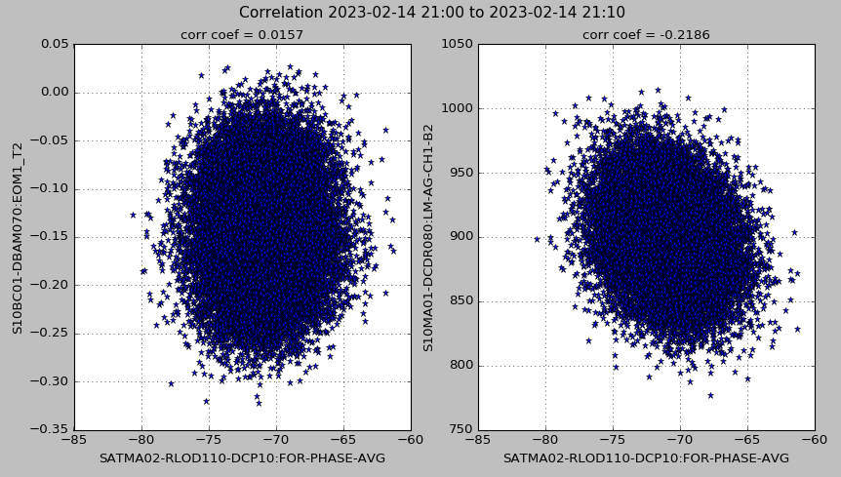
Test Results – Correlation with BC2 Arrival Time & Compression

Slide 18
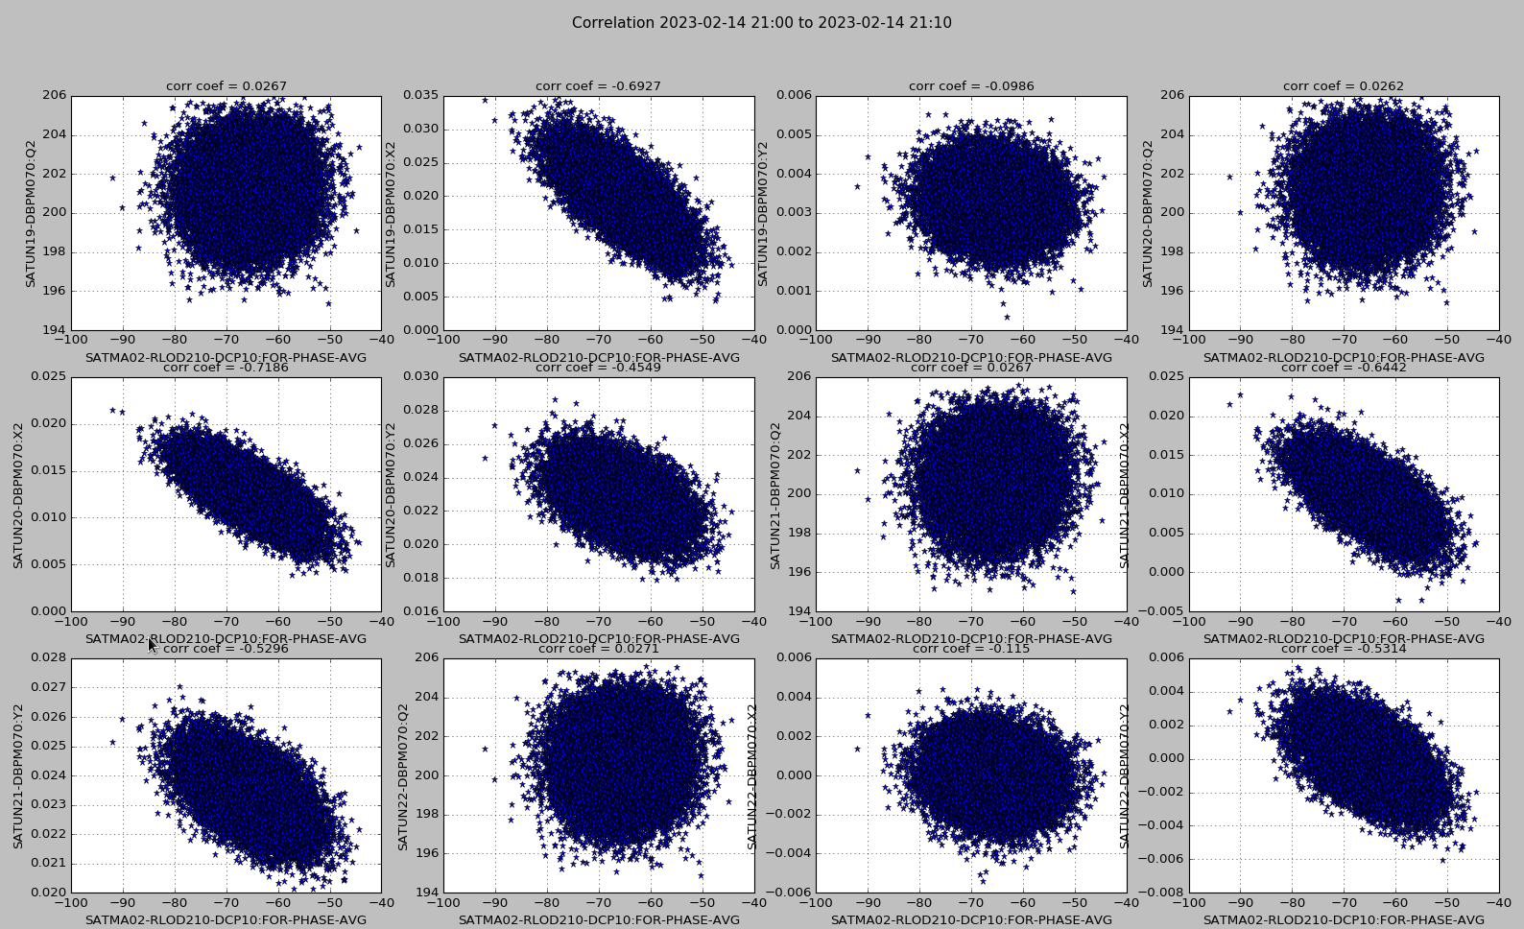
Test Results – Correlation with Undulator BPMs
The beam loading phase has strong correlation with beam orbit in undulators

Slide 19
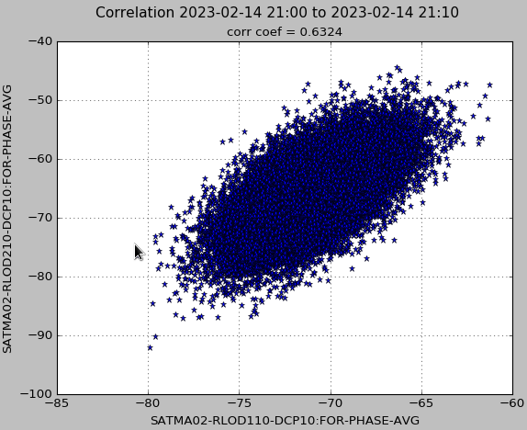
Test Results – Preliminary Explanation
The beam loading phase is determined by both the bunch arrival time and the orbit offset – not easy to separate them. However, the beam arrival time cannot exceed hundreds of fs from experience (RF frequency = 11.9952 GHz => 1 degree = 231.6 fs) → the beam loading phase fluctuation might be mainly caused by the orbit fluctuation
If the beam loading phase is mainly affected by the orbit offset (assume so in our case), the bunch offset in two structures are different – offset in structure2 is much larger → the bunch orbit angle has a fluctuation when passing the structures

Slide 20
Outlook

Slide 21
What can be done next?
Study the bunch arrival time, orbit offset/angle at the X-band TDS for given beam parameters (arrival time, energy, etc.) at BC2 → simulation
Study how the bunch orbit offset affect the beam loading phase (simulation) – compare with the measurement to estimate the orbit offset/angle
Estimate beam-caused fluctuation of deflected beam by subtracting the contribution from the RF amplitude/phase jitter (calibrate the sensitivity of the deflected beam position to RF jitter, assuming the RF jitter is exactly measured by LLRF)
Run the RF station at different phases (with different sensitivity to the final beam jitter), calibrate the actual RF jitter (assume the entry beam jitter is stationary)
Calibration of the I/Q modulator of LLRF to improve the RF actuation accuracy?

Slide 22
Thank you for your attention!

Slide 23
Backup

Slide 24
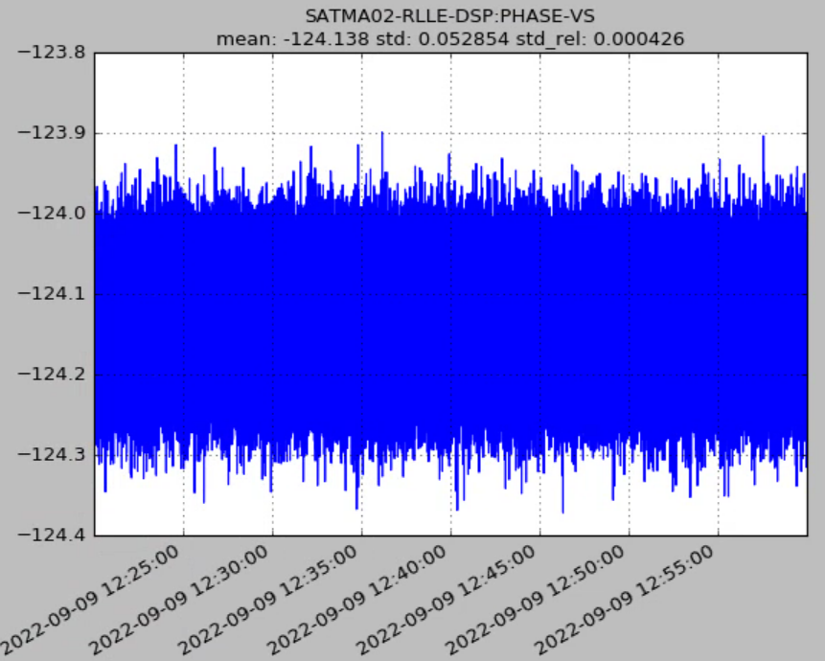
Zero-crossing Phase during MD Shift (cont.)
The peak-to-peak phase fluctuation is up to ±0.2°, agree with the variance of zero-crossing phase obtained at circled period

Slide 25
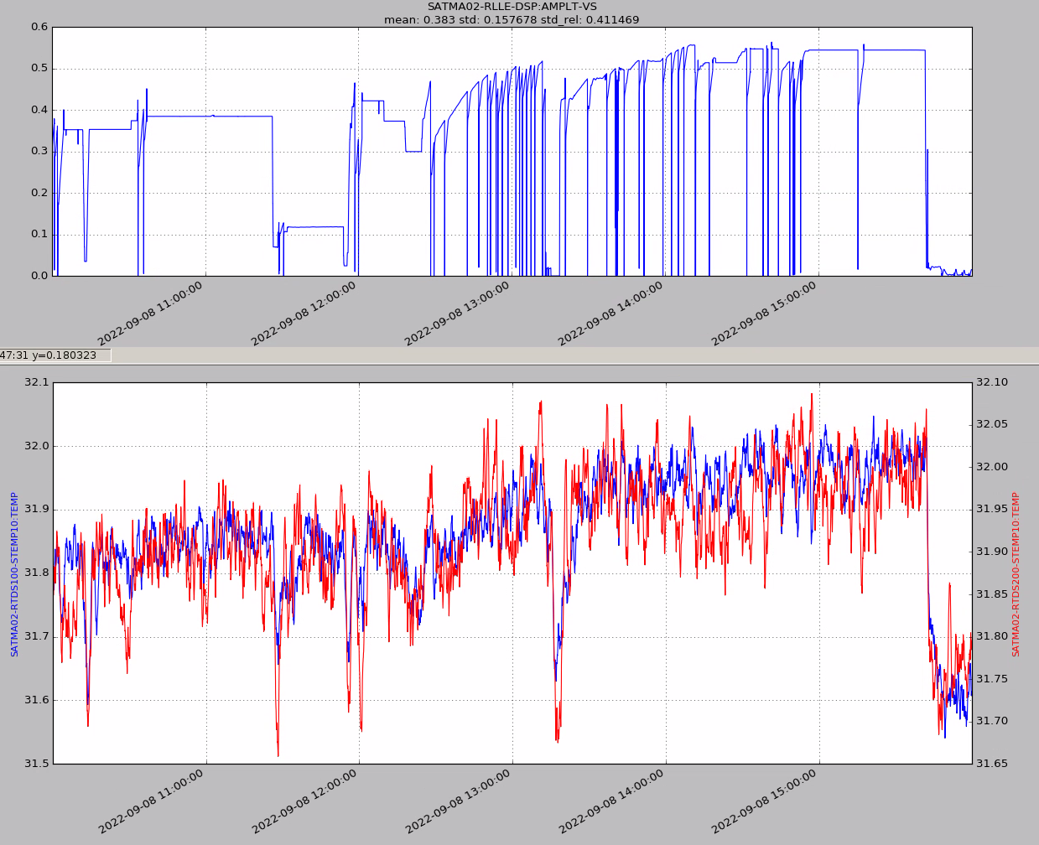
Zero-crossing Phase, RF Amplitude, and Structure Temperature
Structure temperature (even if under regulation) is related to the RF amplitude (heat load)
Zero-crossing phase is related to temperature and RF amplitude
I believe the LLRF system can compensate for the temperature change, but introduce systematic error at different RF amplitudes

Slide 26
Zero-crossing Phase, RF Amplitude, and Structure Temperature
Measuring the exact RF phase seen by the beam in traveling-wave structures is challenging – I haven’t seen successful examples
LLRF uses a simplified model to estimate the RF field seen by the beam by simply averaging the RF pulse
This works well for a constant RF pulse shape (slightly differs at different amplitude). That is, LLRF works well for a constant operating point to compensate for drift
At different amplitudes, LLRF feedback stabilizes a measured phase, but may not be the actual phase seen by the beam, causing beam phase errors. This may explain the zero-crossing phase difference at the highlighted time period
It also implies that the phase offset calibration at a RF level will be not accurate after we change the RF power

