Slide 1
SATMA02 TDS commissioning results
Paolo Craievich, Fabio Marcellini :: Paul Scherrer Institute
Evening shifts 10.02.23 and 10.03.23

Slide 2
Shift goals
Suppress the kick in the plane orthogonal to the streaking plane due to input power unbalance or misaligned phases of the 3 phase shifters.
Verify deflecting voltage vs. input power (TDS efficiency).

Slide 3
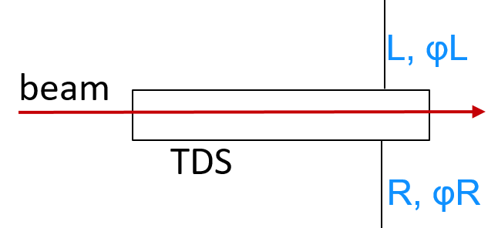
ϕPS
Deflecting field in a PolariX TDS is the combination of two rotating, one clockwise and the other counterclockwise, modes. Direction of rotation depends on the input for the RF power.
In Cartesian coordinates:
Clockwise mode: L cos (ωRFt + φL)x + L sin (ωRFt + φL)y
Counterclockwise mode: R cos (ωRFt + φR)x - R sin (ωRFt + φR)y ^{(*)}
Ideally the amplitudes at the TDS inputs are balanced, L=R, and the polarization plane depends on the phase difference between the inputs φL+φPS-φR, where φPS is the variable phase set through a phase shifter.
(*) from Pau Gonzalez (FlashForward – DESY) thesis

Slide 4
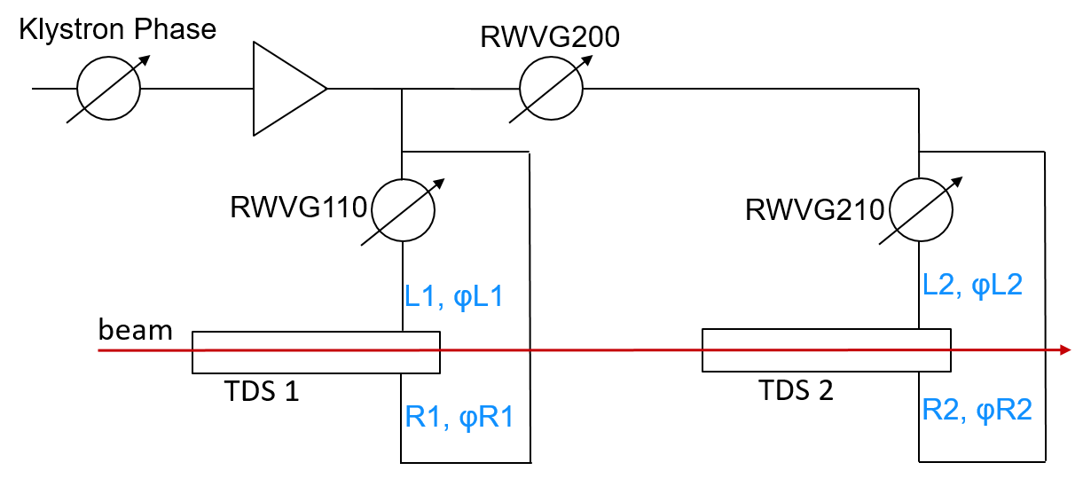
In SATMA02 we use two TDS according to the scheme
Deflection in x and y will be:
Dy=R1*sin(φRF+φR1)-L1*sin(φRF+φRWVG110+φL1)+R2*sin((φRF+φRWVG200+φR2)-L2*sin(φRF+φRWVG200+φRWVG210+φL2)
Dx=R1*cos(φRF+φR1)+L1*cos(φRF+φRWVG110+φL1)+R2*cos((φRF+φRWVG200+φR2)+L2*cos(φ+φRWVG200+φRWVG210+φL2)
φRF is the RF phase, φRWVG are the 3 phase shifters phase that one can set from the panel “Athos RF X-Band Phase Shifters”.
L1, L2, R1, R2, φL1, φL2, φR1 and φR2 are fixed and unknown.
x and y positions measured with a downstream BPM proportional to Dx and Dy.

Slide 5
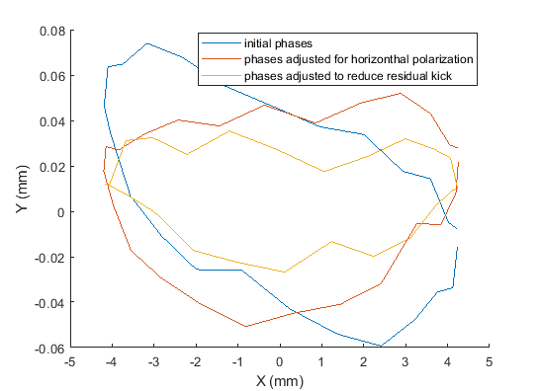
In the february shift, first we validated the idea to reduce the kick in the vertical plane adjusting the phases of the three waveguide phase shifters.
360° RF phase scan:
X and Y positions measured with SATBD01-CBPM020
Vertical kick reduced by about a factor of 2
Then, we saved a number of acquisition readings of the first 3 BPMs downstream the TDSs for many different values of the phases of the 3 waveguide phase shifters.
The goal was to use these data to find the L1, L2, R1, R2, φL1, φL2, φR1 and φR2 values and have a model to predict the optimal set of the 3 variable phases of RWVG110, RWVG200 and RWVG210.

Slide 6
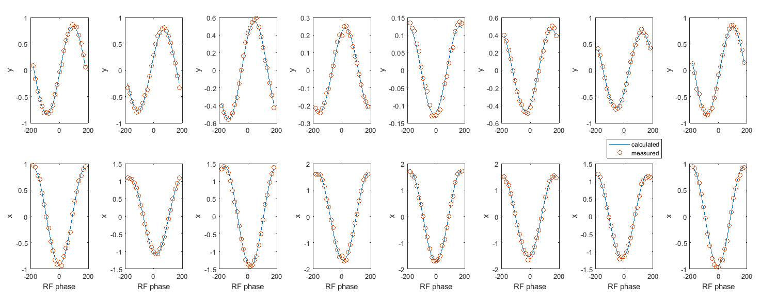
Fitting the measured X and Y positions of the beam, as a function of φRF and for many different values of the phases of the 3 phase shifters, the 8 unkowns have been estimated.
For this measurements we had to reduce as much as possible the TDS input power to take the beam losses below a still acceptable threshold→ BOC detuned, no compressed RF pulse, very low LLRF signal amplitude.
All quads and correctors downstream the TDS switched off → beam moves in a drift after getting kicked by the the TDS.
Example of measured beam positions and fit result

Slide 7
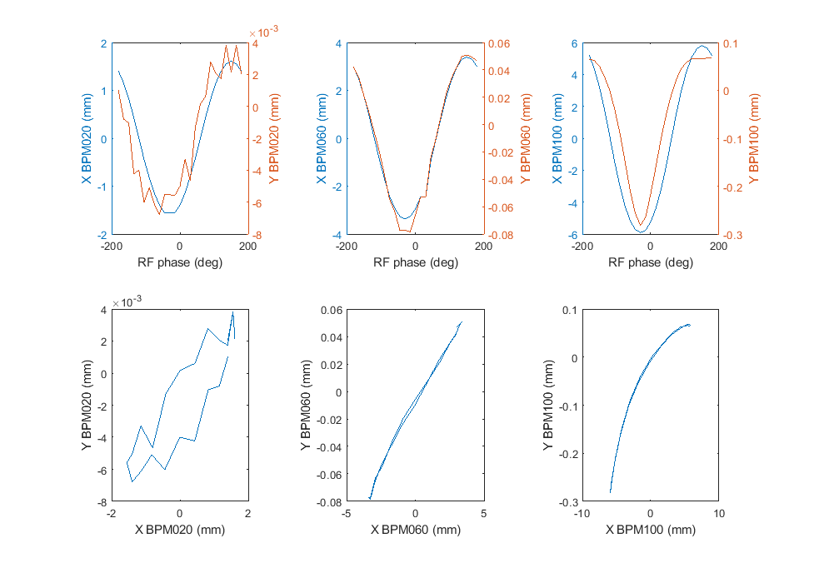
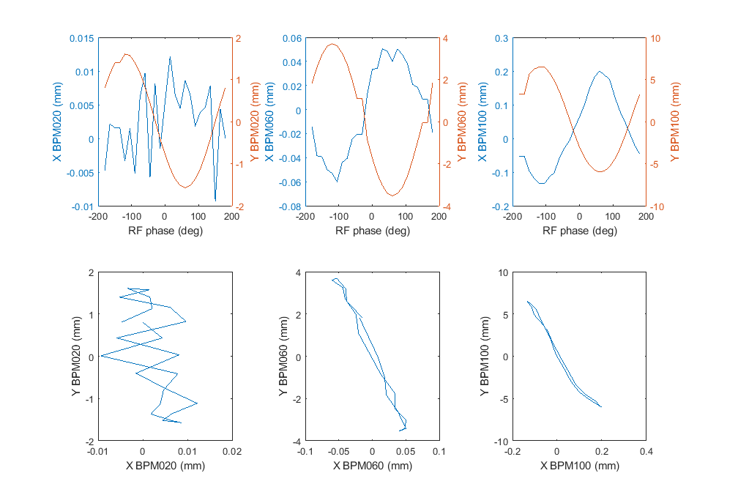
With the values of the 8 unknowns, we were able to calculate a set of 3 phase shifter phases to get beam deflection in one plane only (no more orthogonal kick when streaking in a given plane).
H polarization
V polarization
Kick (and beam size without quadrupoles) was probably too large for a correct beam position measurements with
SATBD01-CBPM060 and SATBD01-CBPM100.

Slide 8
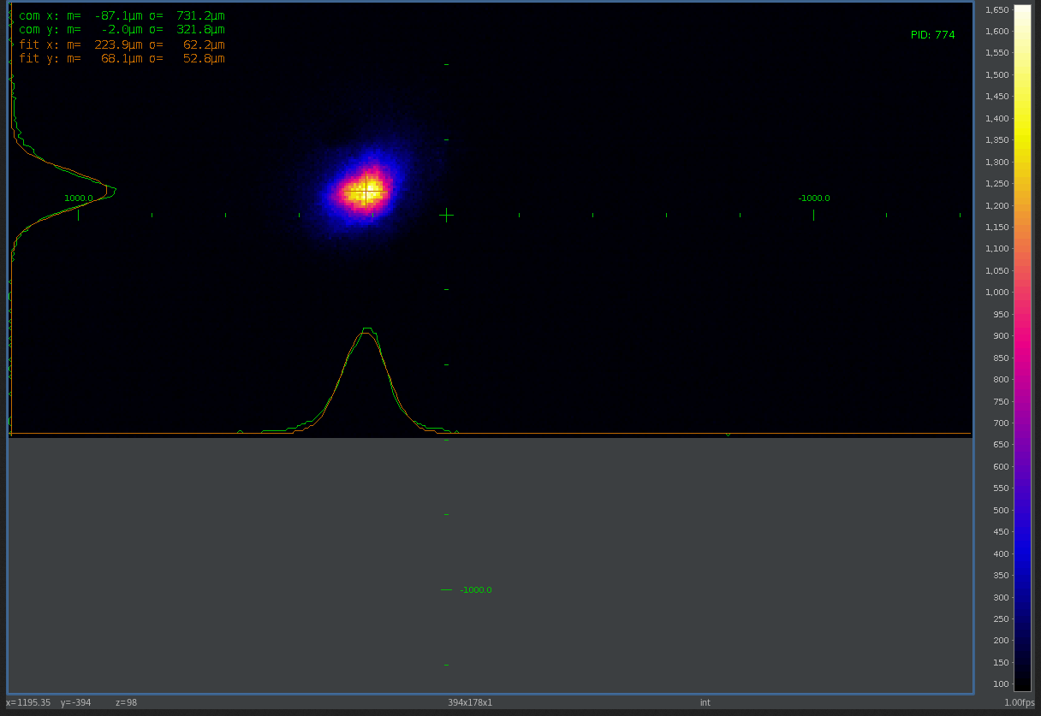
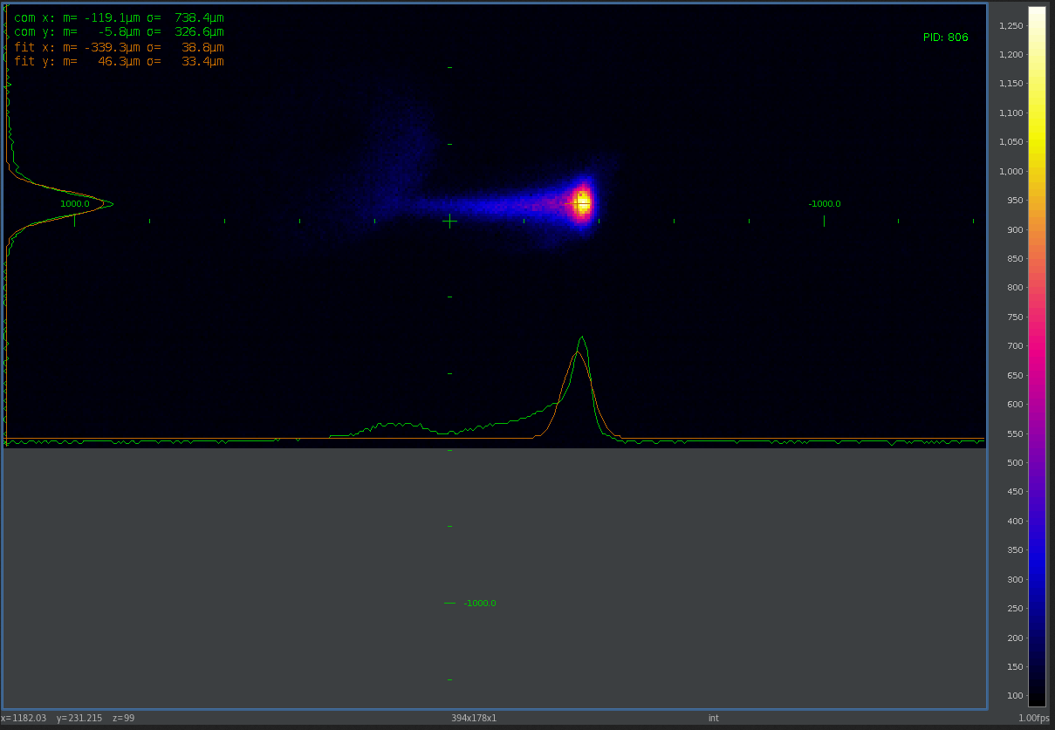


Tuning back the BOC, increasing klystron output power to 24 MW, the beam has been observed on SATBD01-DSCR120.
Horizontal polarization of TDS.
The beam takes a vertical kick giving a displacement of 22um at the screen.
RF OFF
RF ON (streaking)

Slide 9
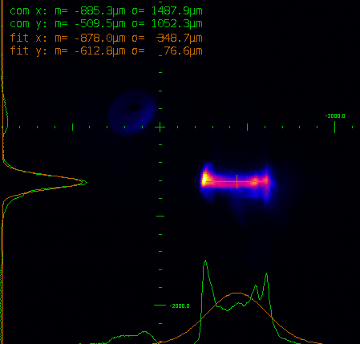
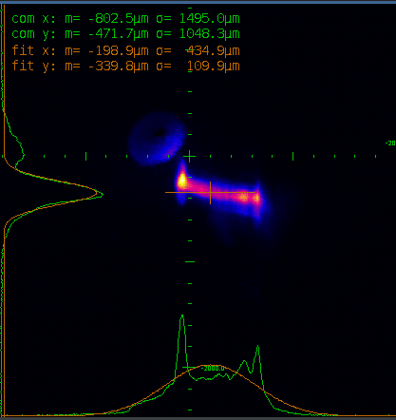
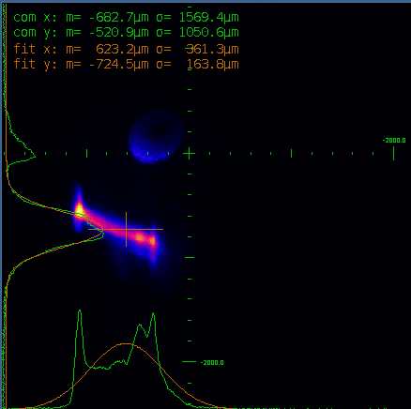
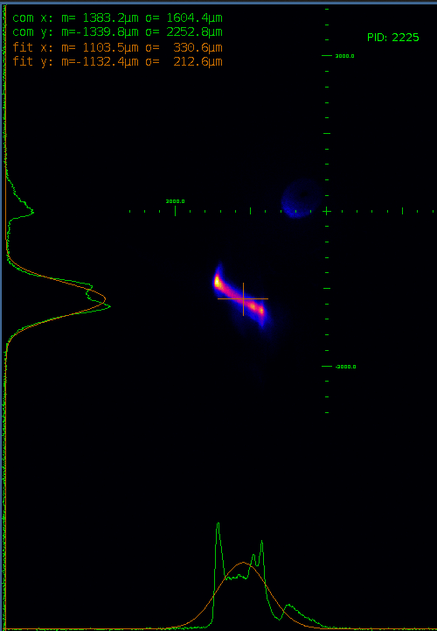
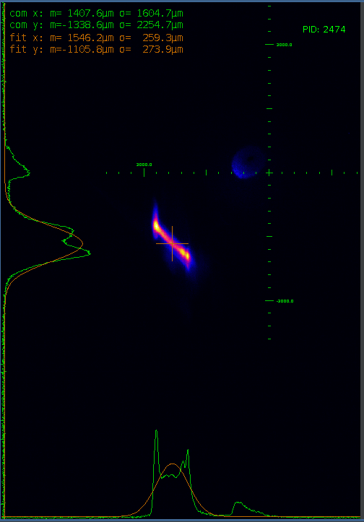
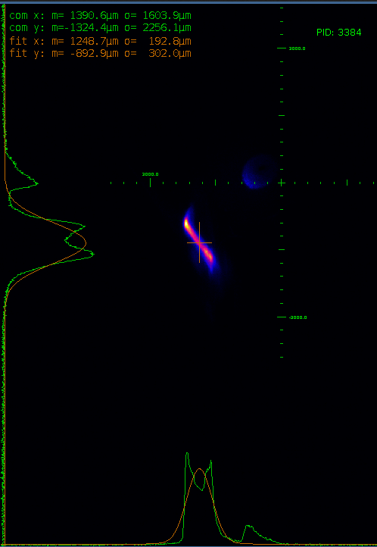
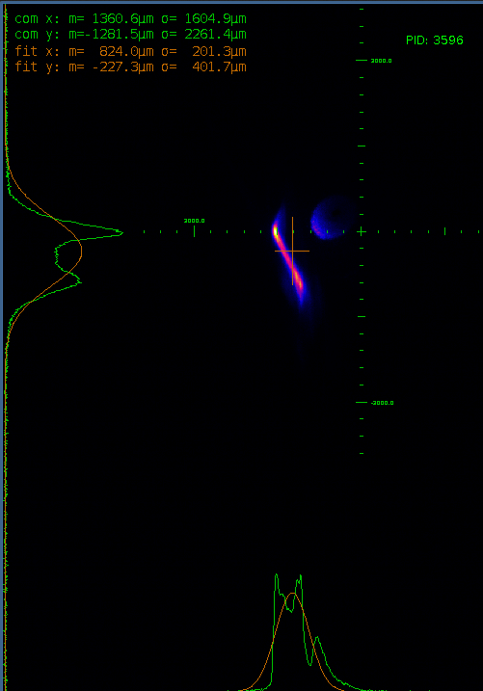
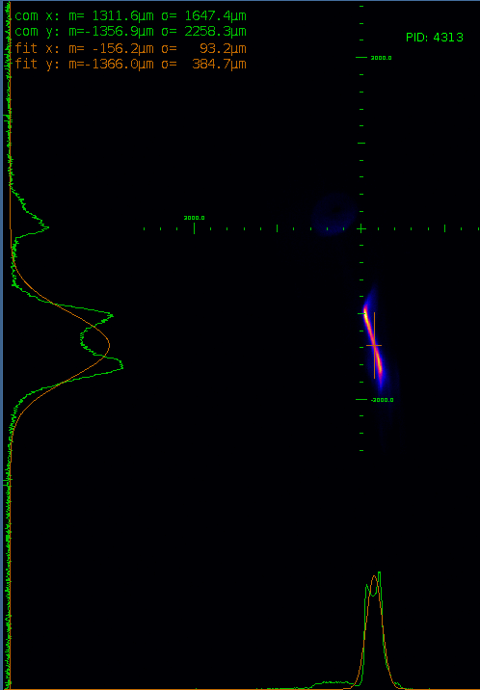
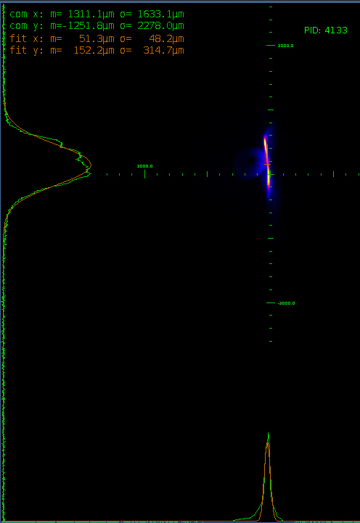
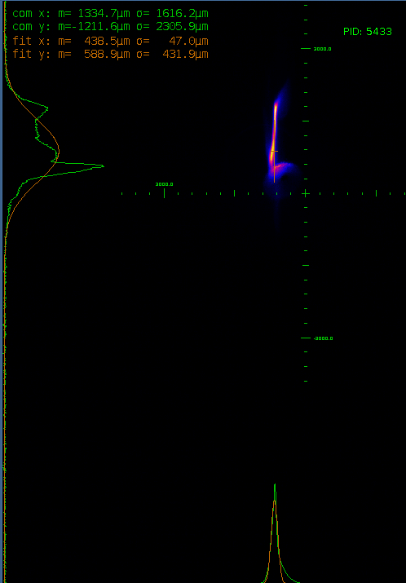
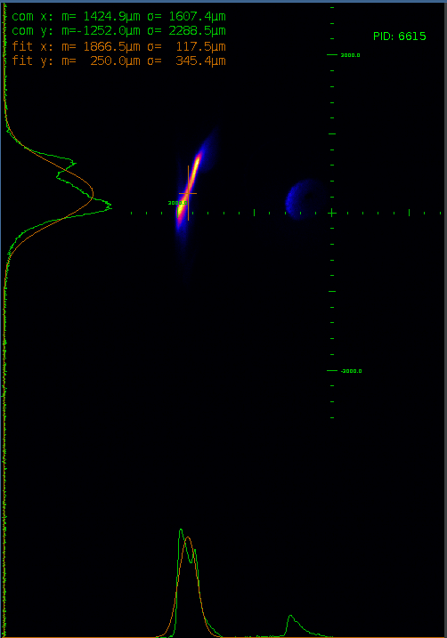
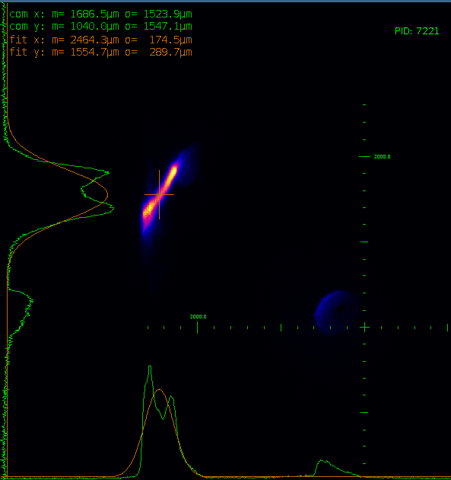
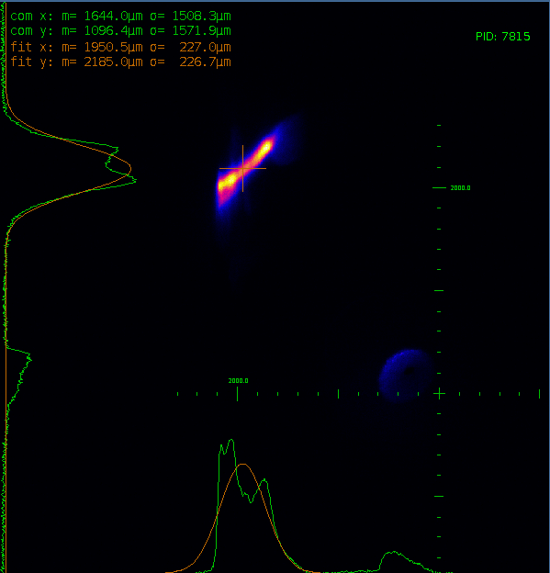
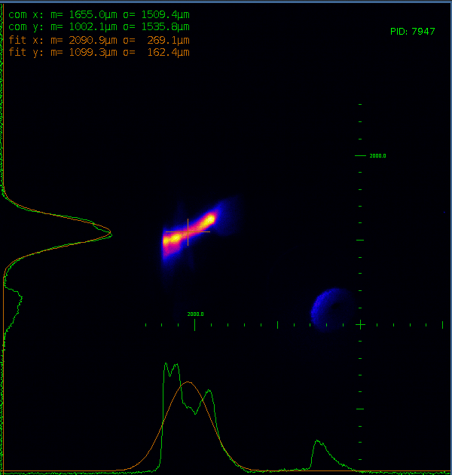
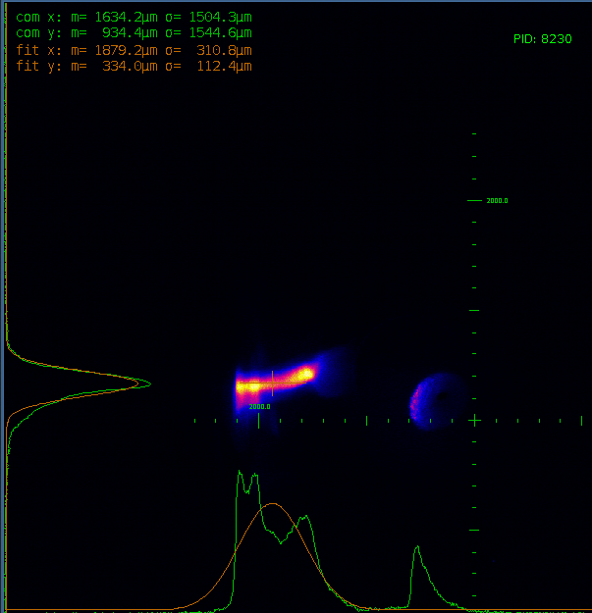
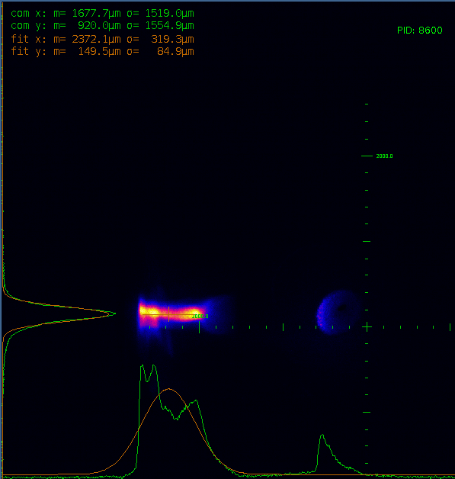
Last measurements past Friday.
Streaking at different polarities.
We did not operate exactly at zero crossing to avoid overlap of beam image with unexplained presence of a halo.
0°
10°
20°
30°
40°
50°
60°
70°
165°
180°
80°
90°
105°
120°
135°
150°

Slide 10
Deflecting voltage
Similar setup as used for suppression of orthogonal kick:
  BOC detuned = +400 kHz
  DAC level = 10
From readout of klystron output power, taking into account the losses of waveguide network we estimated the single TDS input power to be 116kW.
With a scan of the RF phase we measured the max beam deflection 4.2 mm with SATBD01-CBPM020.
Distance between SATBD01-CBPM020 and center of the two TDS is 2.97m.
Beam energy ~3.1 GeV
V_{Ʇ} = 4.2/2970*3100 = 4.38 MV → Power to voltage coefficient = 2.19/sqrt(0.116) = 6.4 MV/sqrt(MW) for a single TDS.
From HFSS simulation we obtained 5.8 MV/sqrt(MW), from the A. Grudiev estimate 6.1 MV/sqrt(MW).
Estimate of both the RF power and the waveguide attenuation done with some degree of approximation. This can explain the discrepancy between nominal and measured coefficient.

Slide 11
Wir schaffen Wissen – heute für morgen
My thanks go to
Christoph Kittel
Eduard Prat
Zheqiao Geng
For their support in setting the machine during the shifts.

