Slide 1
CHIC-Kick correction
Tobias Weilbach & Didier Voulot
SPM 28.03.2023

Slide 2
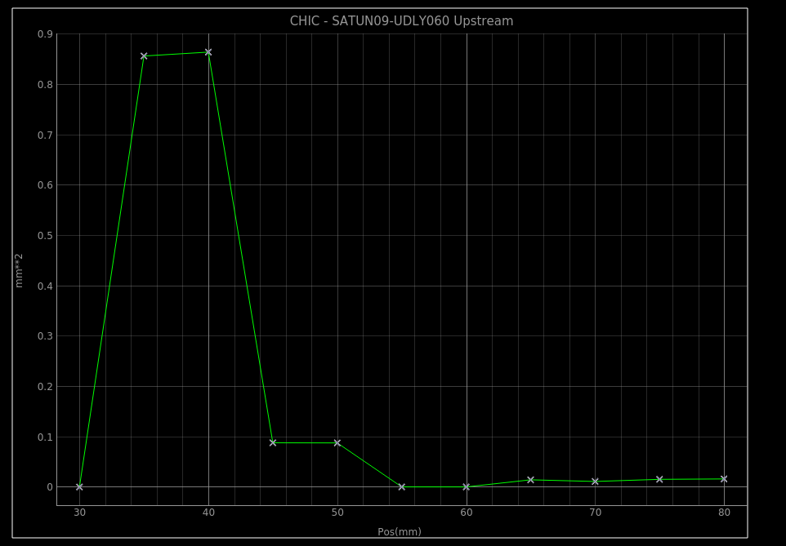
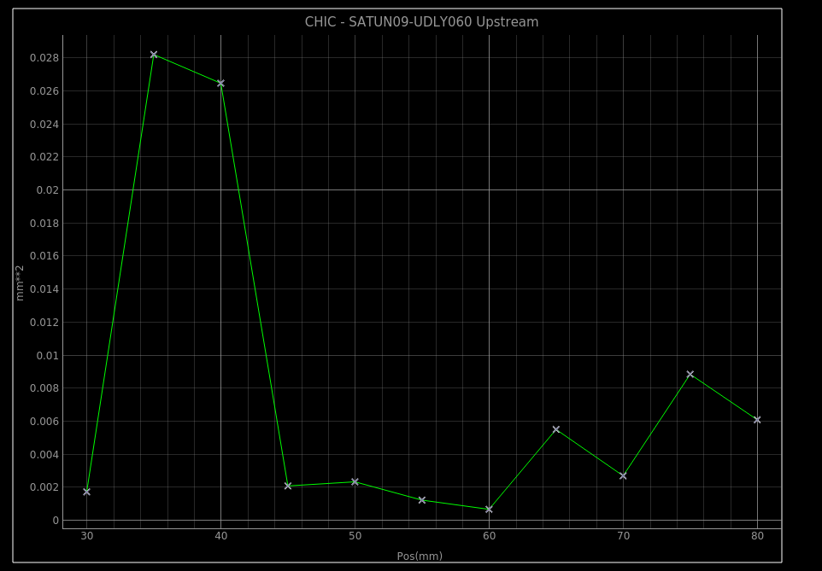
MD shift Report 23.03.2023
Testing CHIC kick compensation with new CHIC server
Enabled CHIC kick compensation (was set to constant value before)
Checked Orbit with and without compensation (BPMs)
SATUN09 scan of both CHIC gaps separately
SATUN09 CHIC scan (30-80mm) without and with kick compensation ()
(Orbit(new)-Orbit(initial))²

Slide 3
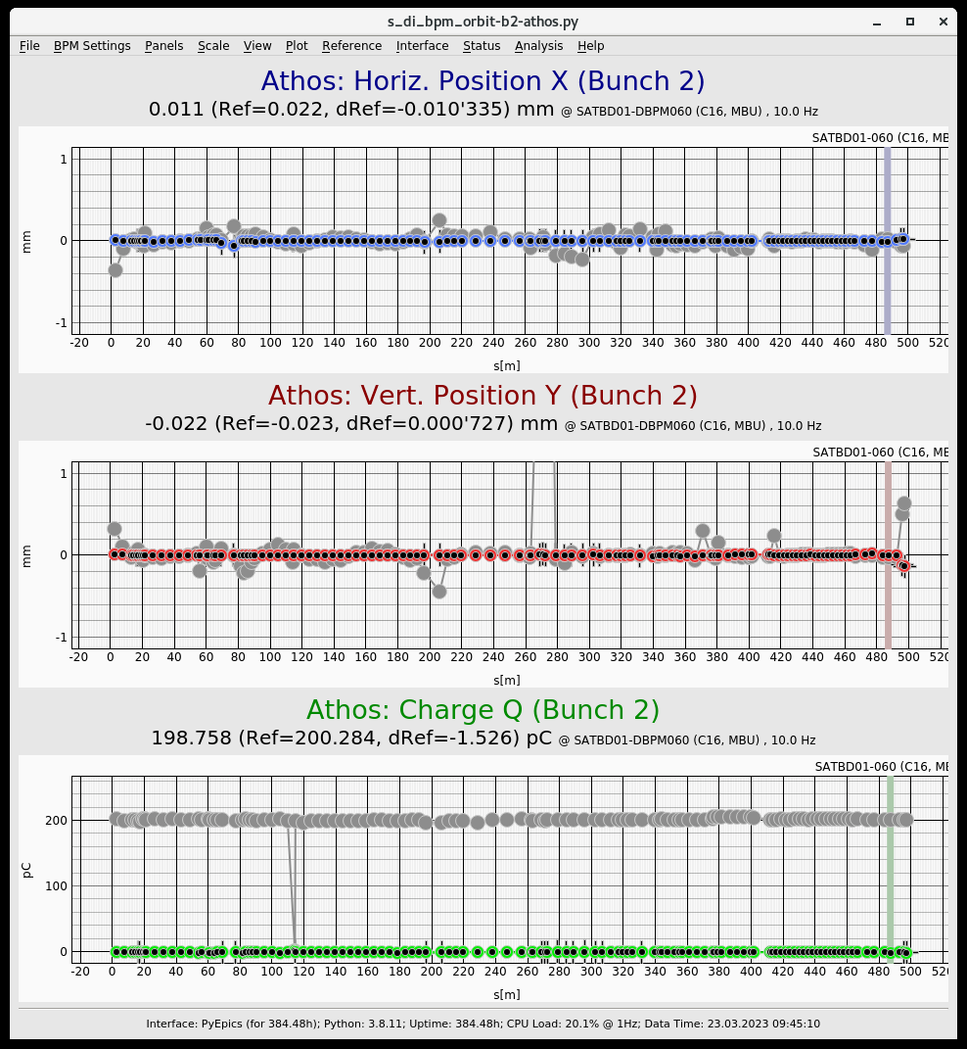
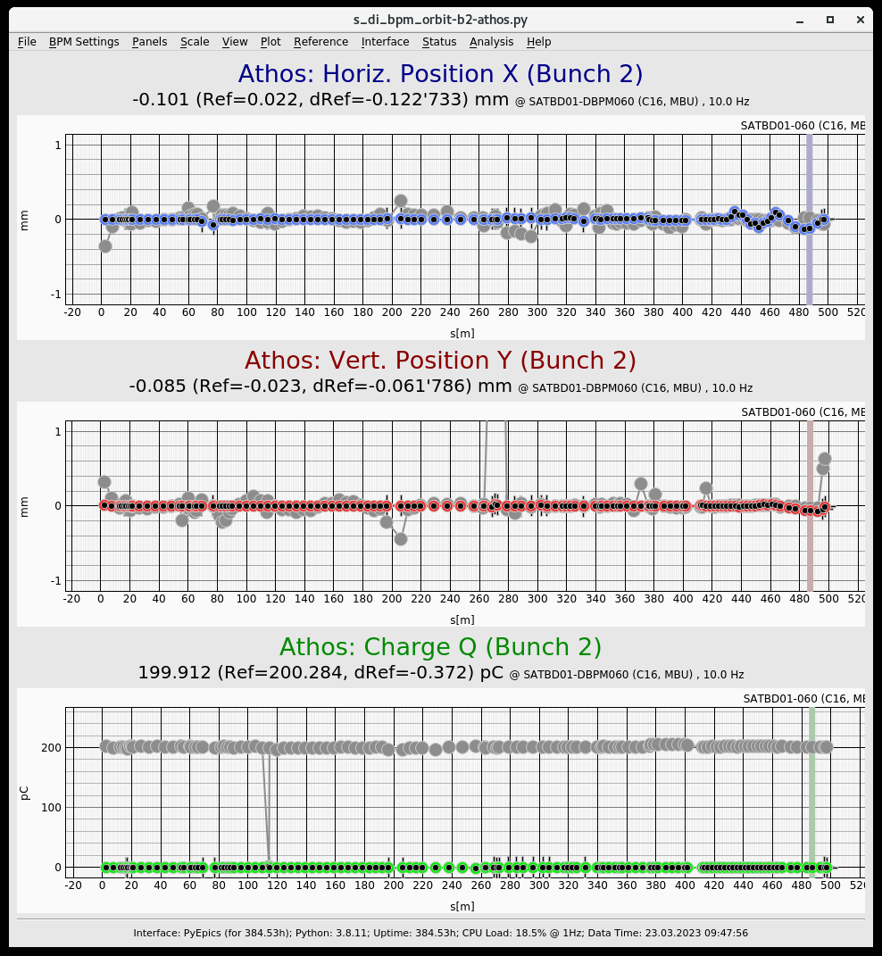
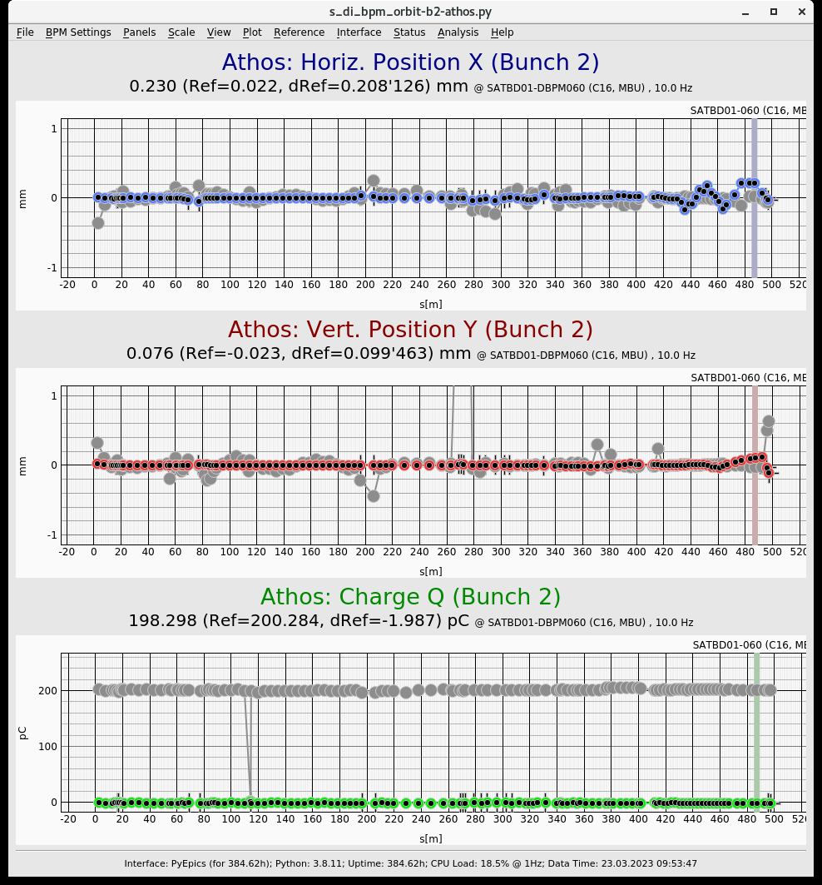
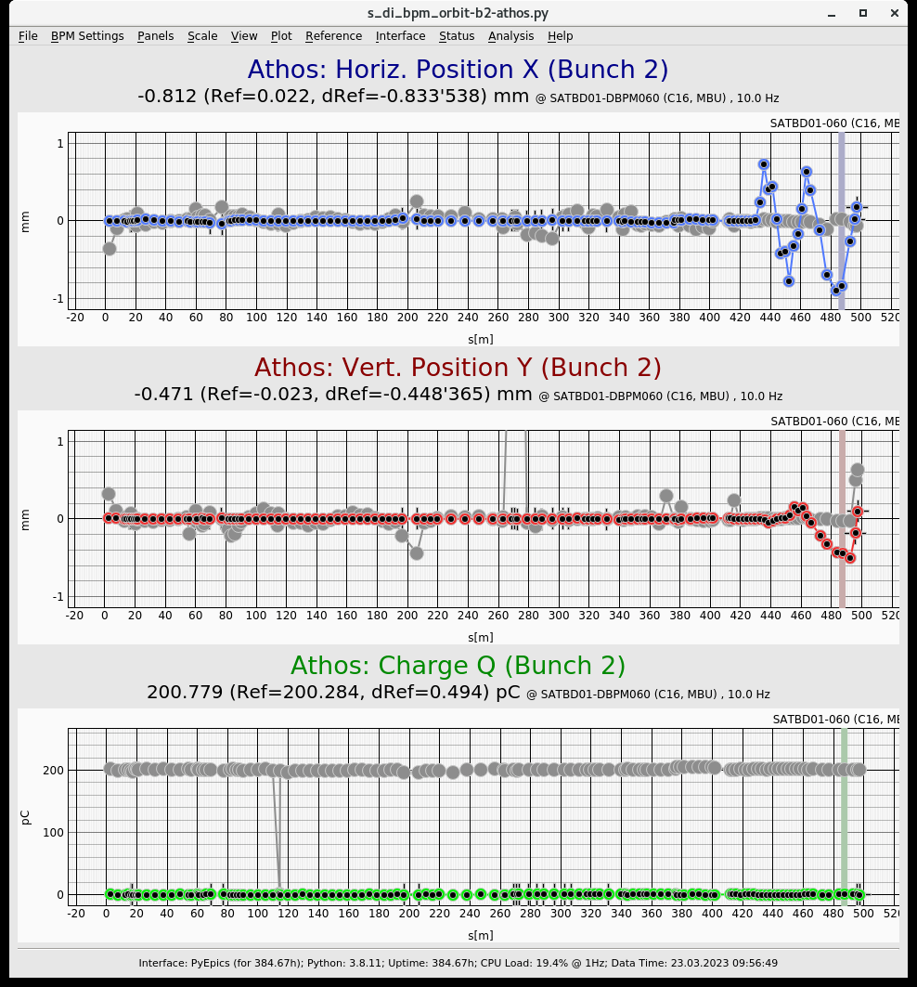
Athos Orbit Measurements for SATUN09
BPM reference
gaps to 85 mm 1.816 A, set BPM reference
gaps to 8 mm 0.031 A, max orbit deviation in x ~0.2 mm
gaps to 85 mm 1.816 A and disable kick calculation
gaps to 25 mm 1.816 A, max x deviation ~0.3 mm
gaps to 8 mm 1.816 A, max x deviation ~1 mm
SATUN09 CHIC Gap 8mm, I-Set 0.031 A, with kick compensation
SATUN09 CHIC Gap 25mm, I-Set 1.816 A, without kick compensation
SATUN09 CHIC Gap 8mm, I-Set 1.816 A, without kick compensation

Slide 4
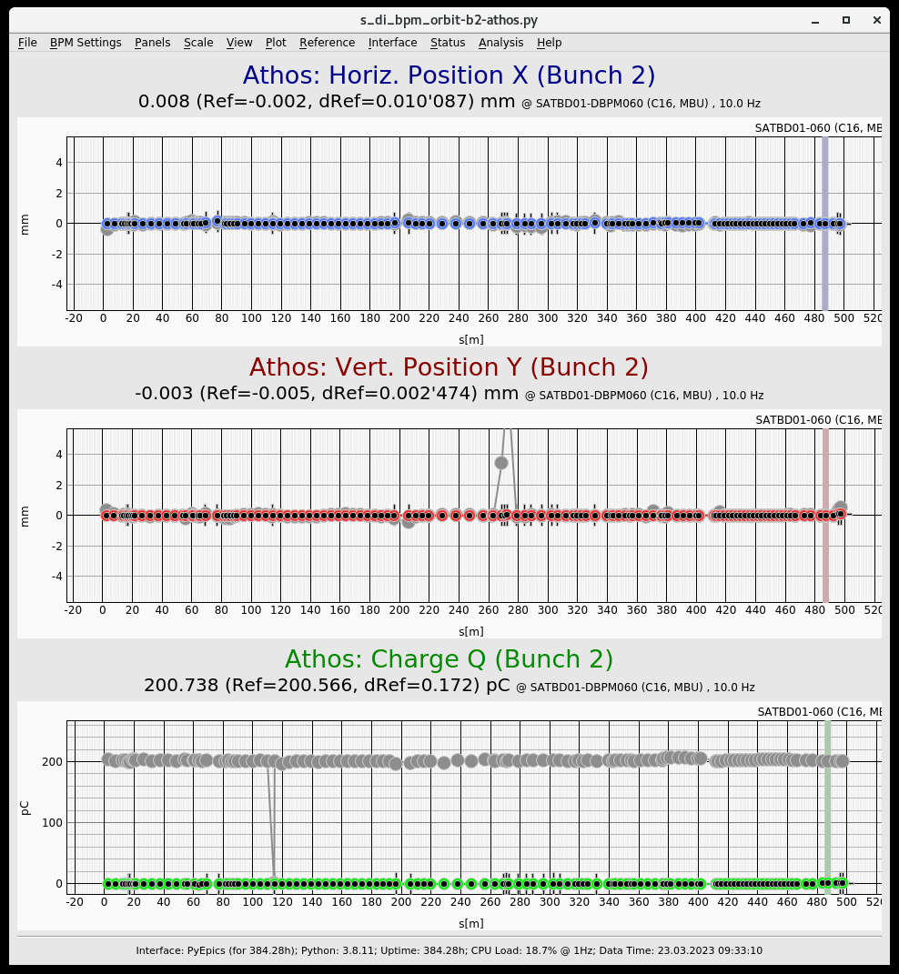
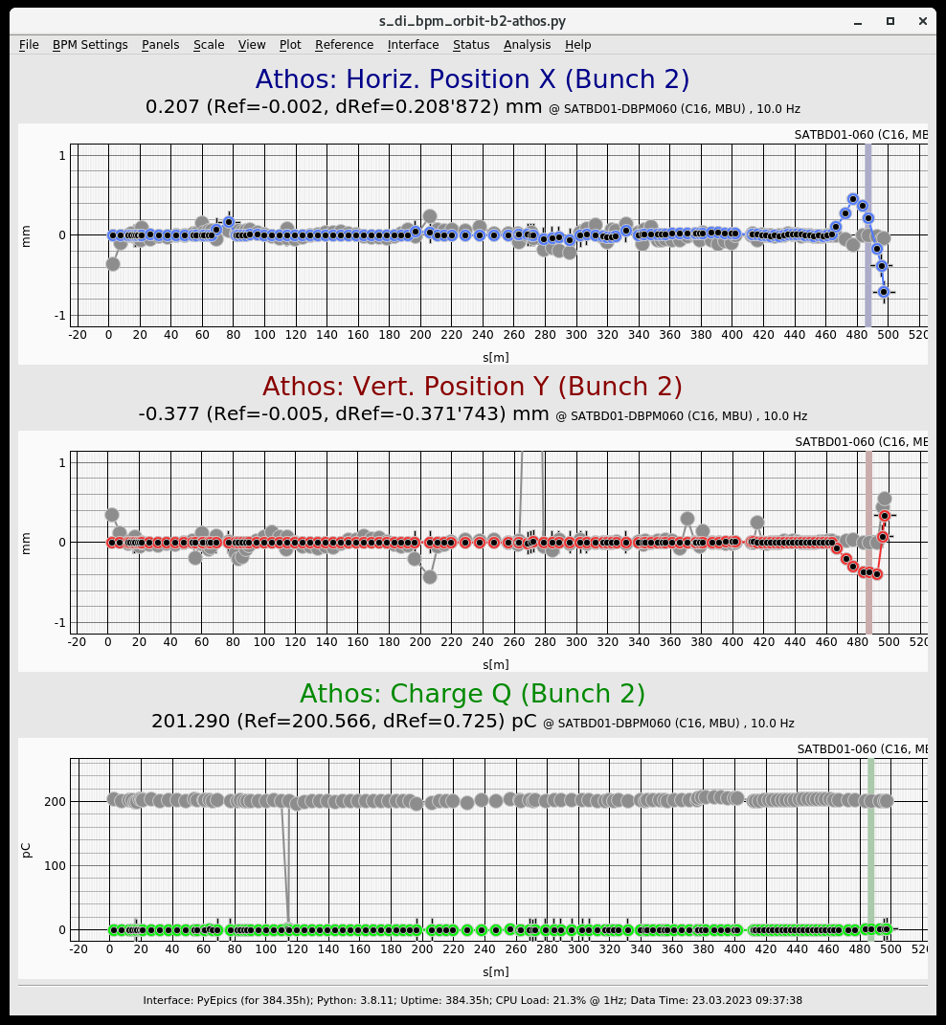
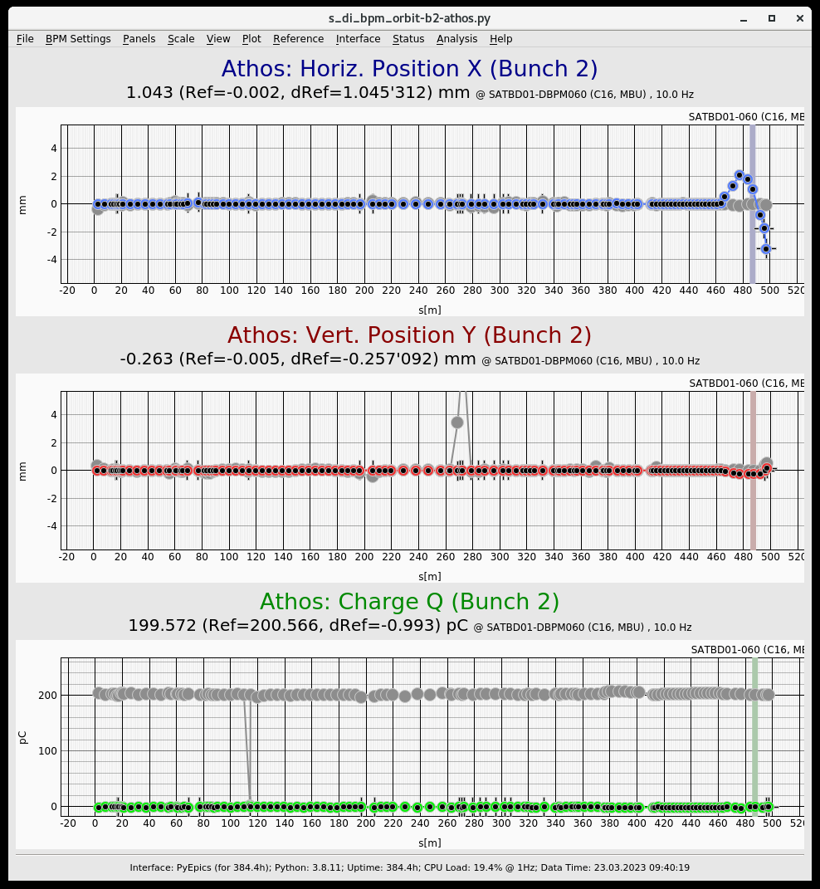
Athos Orbit Measurements for SATUN21
gaps to 85 mm 1.67 A, set BPM reference
gaps to 10 mm -2.43 A, we observe a small kick (~0.5 mm max orbit displacement) in x and y
gaps to 85 mm 1.67 A and disable the kick calculation
gaps to 10 mm 1.67 A, we observe a large kick, up to ~3 mm orbit displacement in x,
SATUN21 CHIC Gap 85mm,
I-Set 1.67 A, BPM reference
SATUN21 CHIC Gap 10mm,
I-Set -2.43 A, with kick correction
SATUN21 CHIC Gap 10mm,
I-Set 1.67 A, without kick correction
Different x-axis

Slide 5
Offset and polarity check
Without kick compensation
  SATUN09 Offset:
upstream gap to 55 mm (we keep downstream gap constant at 78.77 mm) 1.975 A, set BPM reference
scan the upstream gap between 30 and 80 mm without kick compensation
scan the upstream gap between 30 and 80 mm with kick compensation
At 30/78 mm we see 0.2 mm with compensation active (-0.488 A)
At 15/78 mm we see 0.4 mm with compensation active (-4.733 A)
At 8/78 mm we see 0.5 mm with compensation active (-7.868 A), no losses
back to 78/78 (1.979 A) and compensation off (1.979 A)
40/78 mm -> 0.4 mm in x
30/78 mm -> 0.8 mm in x, losses increases
  Check if correction is applied correctly for all CHICS:
  Set upstream gap to 30 mm with orbit feedback off, observe displacement
  apply the compensation -> The displacement is decreasing nicely in all case.
  The correction is not perfect but is clearly helping to prevent losses
With kick compensation
-> After SD run with kick correction (to get experience), check if kick correction is sufficient for BBA

