Slide 1
Progress on Multi Stage fresh-slice Amplification (MSA) in Athos
Guanglei Wang
02.05.2023

Slide 2
Contents
Introduction
Methods for longitudinal phase space (LPS) diagnostics
Experimental results of multi stage fresh slice amplification (MSA)
  2 stages and two color generation
  3 stages MSA results
  4 stages MSA results
  MSA pulse duration control
Single particle imaging in Maloja
Difficulties and outlook
Summary and conclusion

Slide 3
Contents
Introduction
Methods for longitudinal phase space (LPS) diagnostics
Experimental results of multi stage fresh slice amplification (MSA)
  2 stages and two color generation
  3 stages MSA results
  4 stages MSA results
  MSA pulse duration control
Single particle imaging in Maloja
Difficulties and outlook
Summary and conclusion

Slide 4
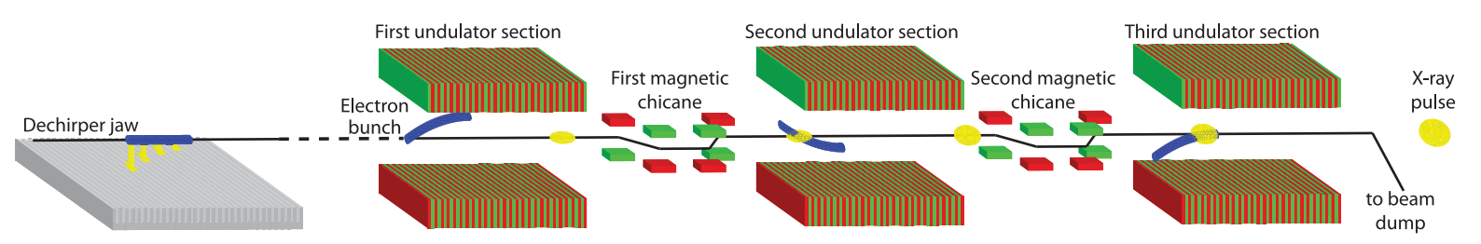
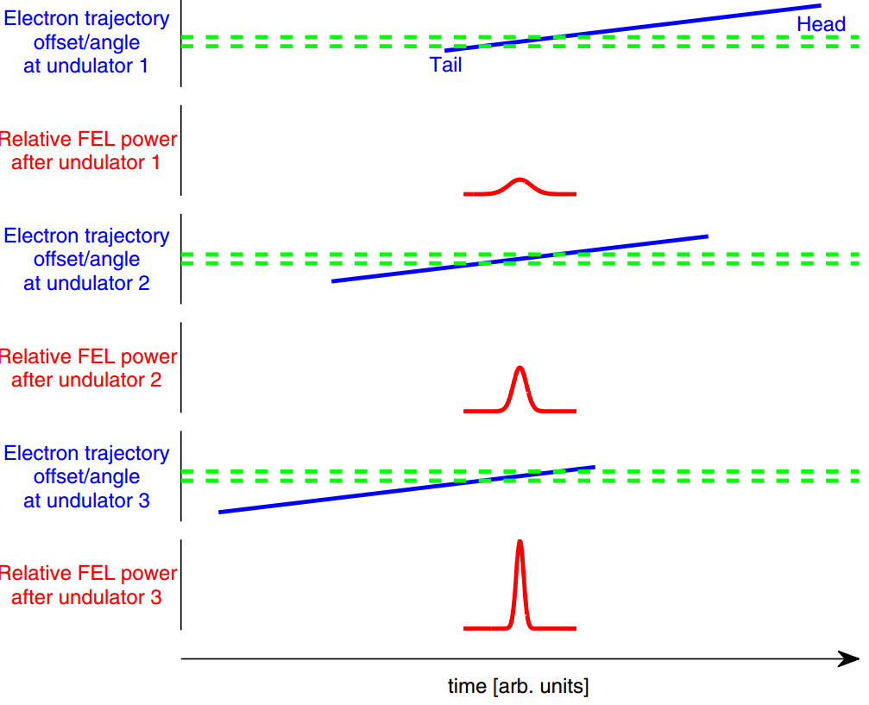
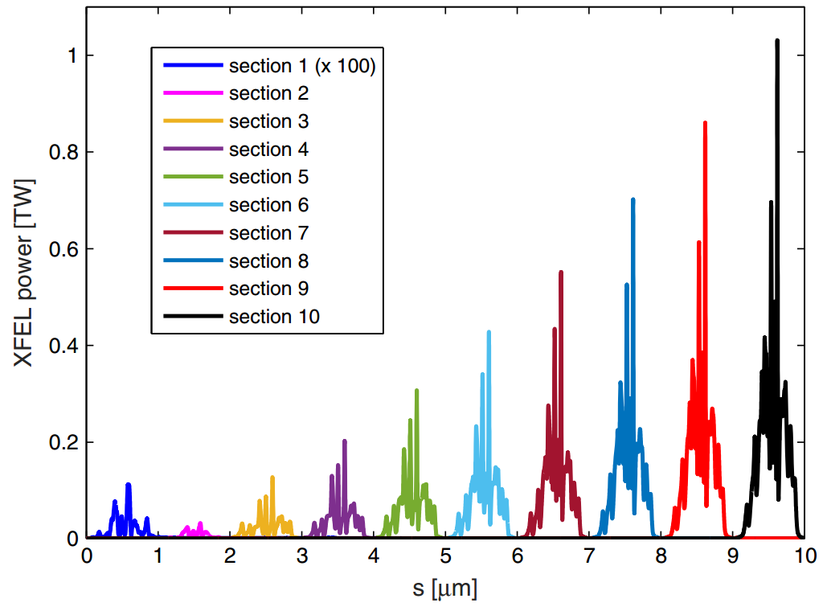
Multi stage fresh slice amplification with tilted beam
Lasing part of e-beam is femtosecond to attosecond, TW level FEL output (simulation).
Experimental demonstration in LCLS: few hundreds of uJ for few fs
Eduard Prat et al., Phys. Rev. ST Accel. Beams 18 (2015) 100701
Alberto A. Lutman et al., Phys. Rev. Lett. 120 (2018) 264801

Slide 5
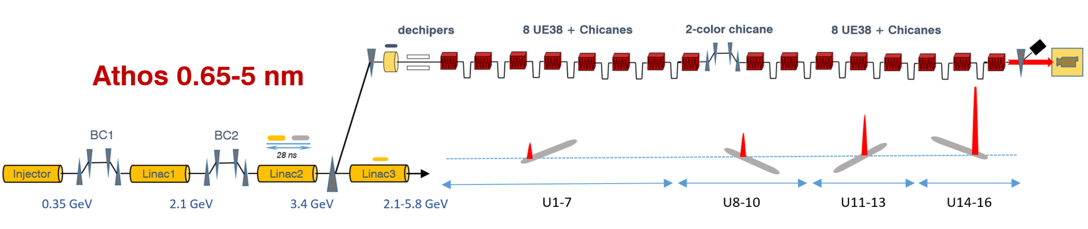
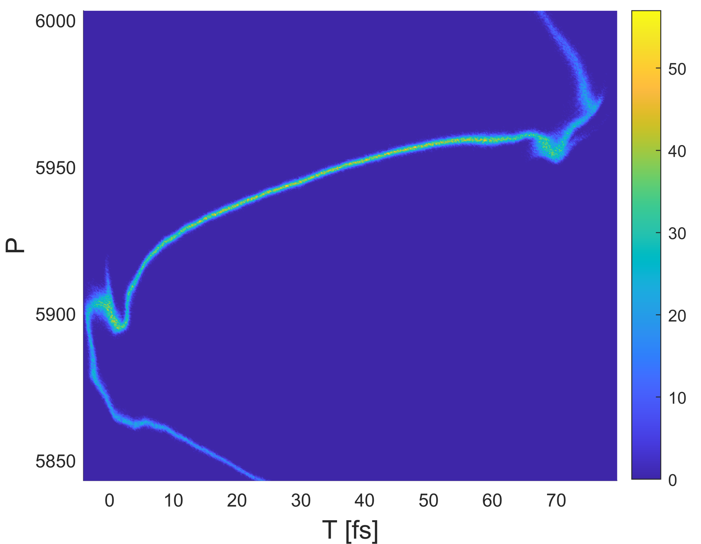
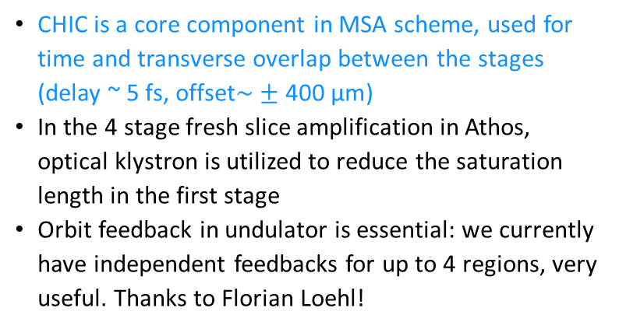
MSA in Athos
Simulation result of e-beam longitudinal phase space (LPS)
16 Apple X undulator +
Chicanes for High power and Improved Coherence
CHIC is a core component in MSA scheme, used for time and transverse overlap between the stages (delay ~ 5 fs, offset$\sim ±\text{400 }\text{μm}$)
In the 4 stage fresh slice amplification in Athos, optical klystron is utilized to reduce the saturation length in the first stage
Orbit feedback in undulator is essential: we currently have independent feedbacks for up to 4 regions, very useful. Thanks to Florian Loehl!
Tilt can be produced in 2 ways:
Dispersion in the switchyard (used method due to linear streaking and less losses)
Dechirper wakefields

Slide 6
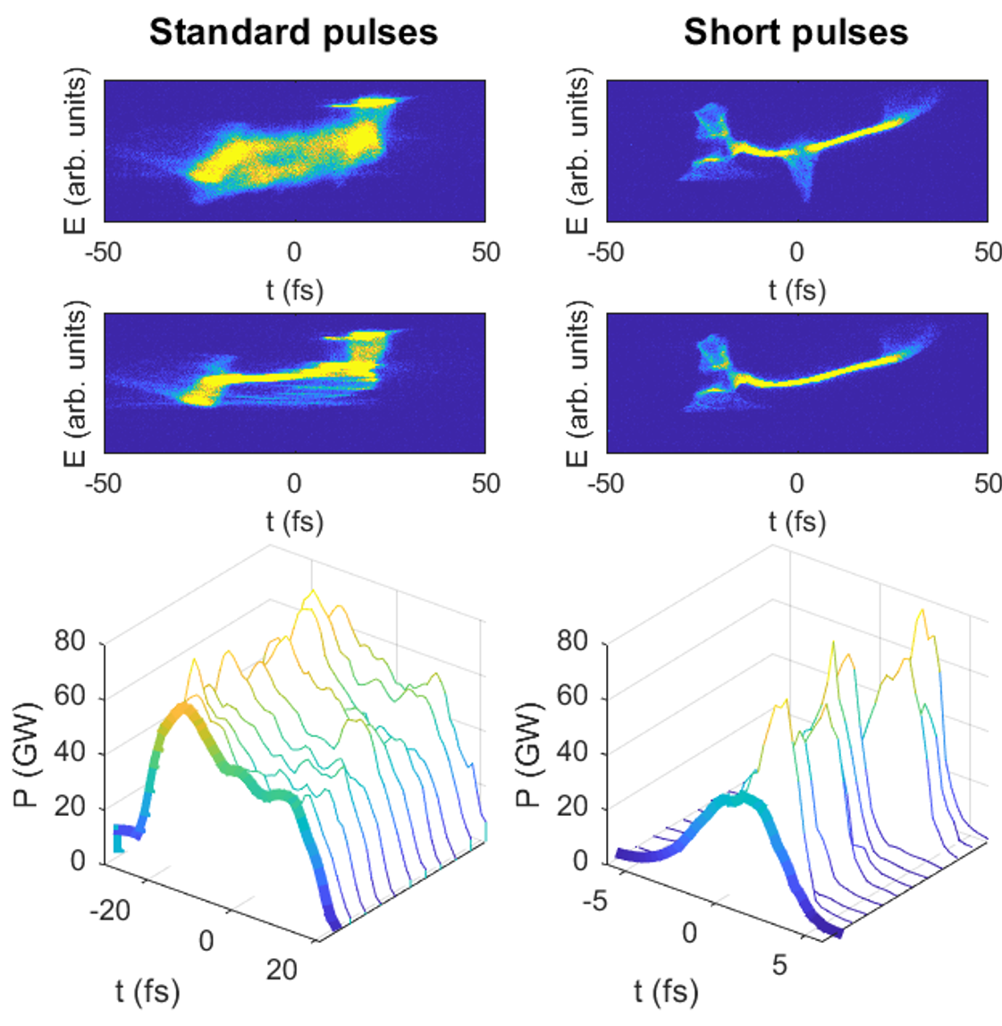
Athos: standard & short pulses with tilted beams
900 eV
Lasing on
Lasing off
Standard short pulses with tilted beam: down to 1.5 fs rms, peak power < 100 GW
More advanced modes with tilted beams:
  Two-color short pulses
  High-power short pulses with MSA

Slide 7
Contents
Introduction
Methods for longitudinal phase space (LPS) diagnostics
Experimental results of multi stage fresh slice amplification (MSA)
  2 stages and two color generation
  3 stages MSA results
  4 stages MSA results
  MSA pulse duration control
Single particle imaging in Maloja
Difficulties and outlook
Summary and conclusion

Slide 8
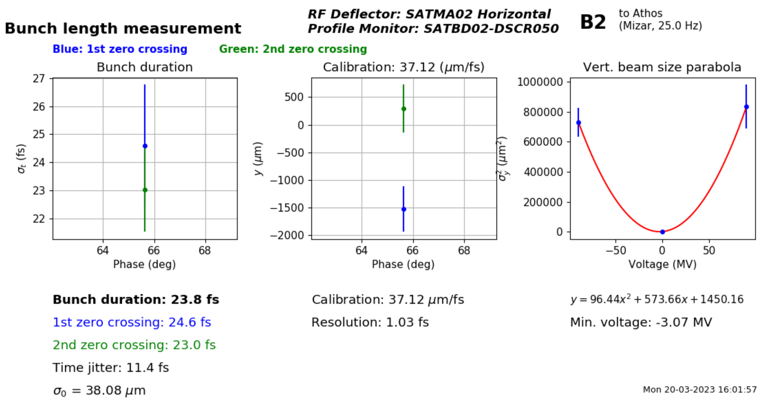
LPS diagnostics
Measurements at the Athos dump (dispersive in Y)
Streaking in X
Comparing lasing on and off conditions → FEL power profile reconstruction
Beam can be streaked after the undulator
  X-band RF (resolution ~ 1 fs)
  dechirper (not used here)
The tilt used for fresh slice mode is added to the post-undulator streaking for enhanced resolution

Slide 9
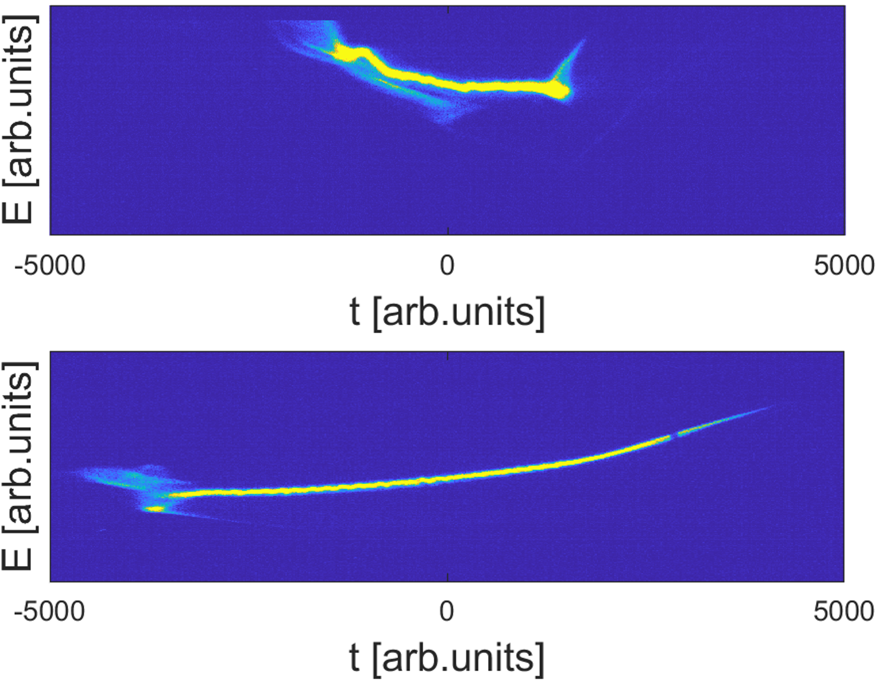
LPS measurements with tilted beams and TDC
TDC
TDC+dispersion tilt
With dispersion, streaking increases by a more than a factor of 2 → resolution < 500 as
This post undulator X-band TDC measurements are fundamental to setup and optimize the MSA scheme
Many thanks to the RF group in SwissFEL!

Slide 10
Contents
Introduction
Methods for longitudinal phase space (LPS) diagnostics
Experimental results of multi stage fresh slice amplification (MSA)
  2 stages and two color generation
  3 stages MSA results
  4 stages MSA results
  MSA pulse duration control
Single particle imaging in Maloja
Difficulties and outlook
Summary and conclusion

Slide 11
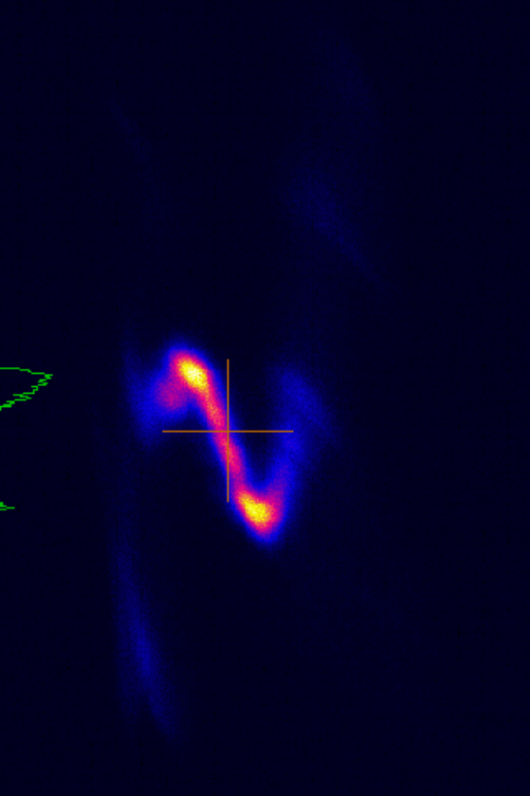
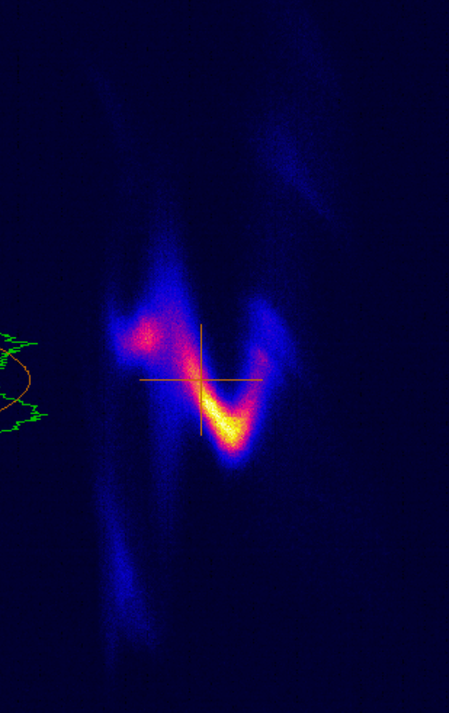
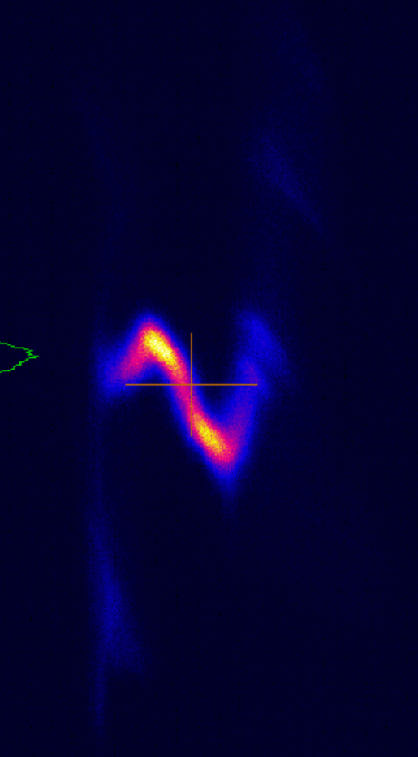
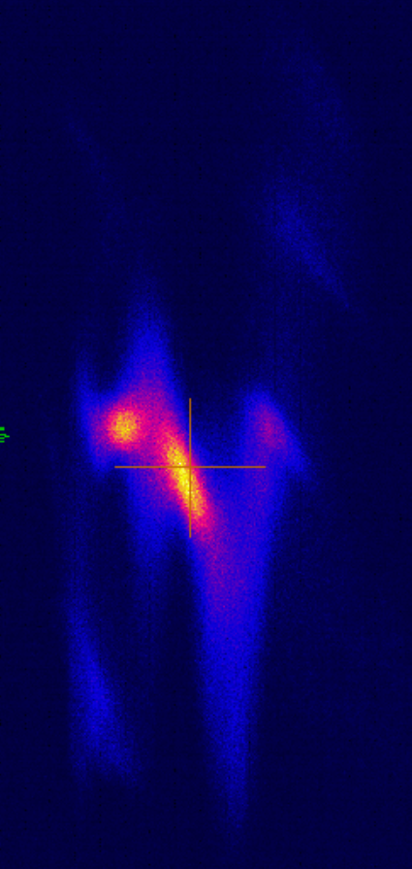
First experimental demonstration at Athos with 2-stages
8+8 undulator modules. Two-color chicane used to overlap two fractions in time. Orbit feedback used for transverse overlap.
FEL pulse energy from 2nd undulator section is amplified by more than 5 times, 20 μJ to about 140 μJ.
FEL pulse duration is about 4 time shorter than normal operation in Athos.
Streaking by dispersion only is used to diagnose FEL beam (X-band not available at that time)
No lasing
tail lasing
head lasing
all lasing
Energy
time
https://elog-gfa.psi.ch/SwissFEL+commissioning/20613

Slide 12
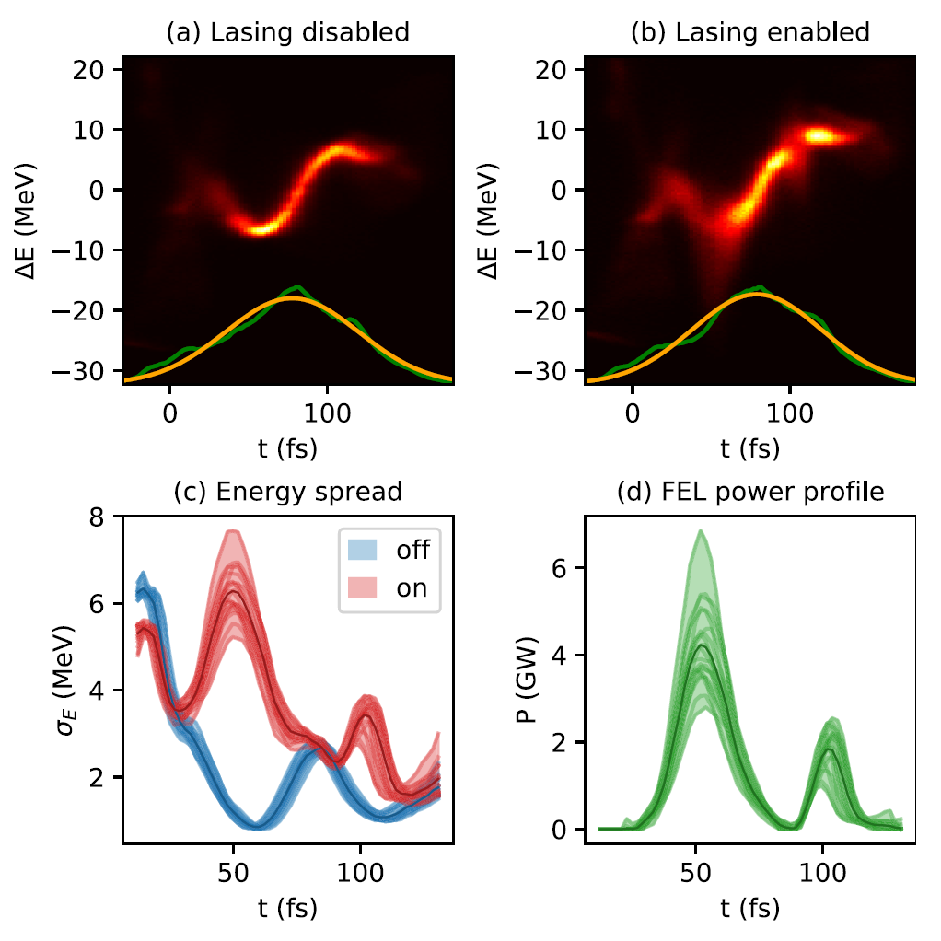
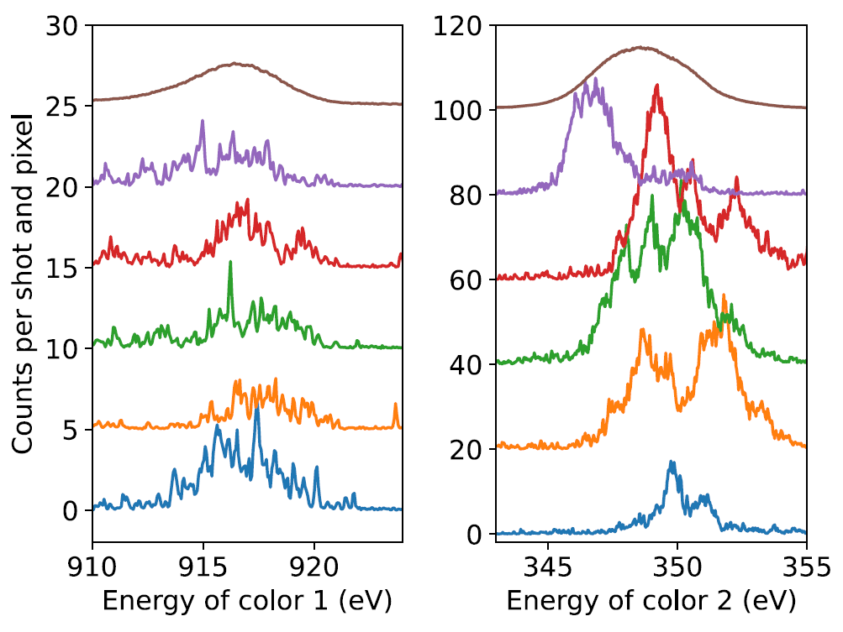
Two-color generation with fresh slice
“2 stage amplification without overlap” → 2 colors in fresh slice mode
2 color chicane used to scan the delay between the 2 pulses, K uses to tune the photon energies
We achieved pulse energies between 10 and 100 μJ for each color by fresh slice method.
The two-color FEL pulse duration could be controlled by the beam tilt quadrupole, down to several femtoseconds.
Mode extensively used in Maloja
Prat, E., et al., Widely tunable two-color x-ray free-electron laser pulses. Physical Review Research, 4(2), L022025 (6 pp.).

Slide 13
Contents
Introduction
Methods for longitudinal phase space (LPS) diagnostics
Experimental results of multi stage fresh slice amplification (MSA)
  2 stages and two color generation
  3 stages MSA results
  4 stages MSA results
  MSA pulse duration control
Single particle imaging in Maloja
Difficulties and outlook
Summary and conclusion

Slide 14
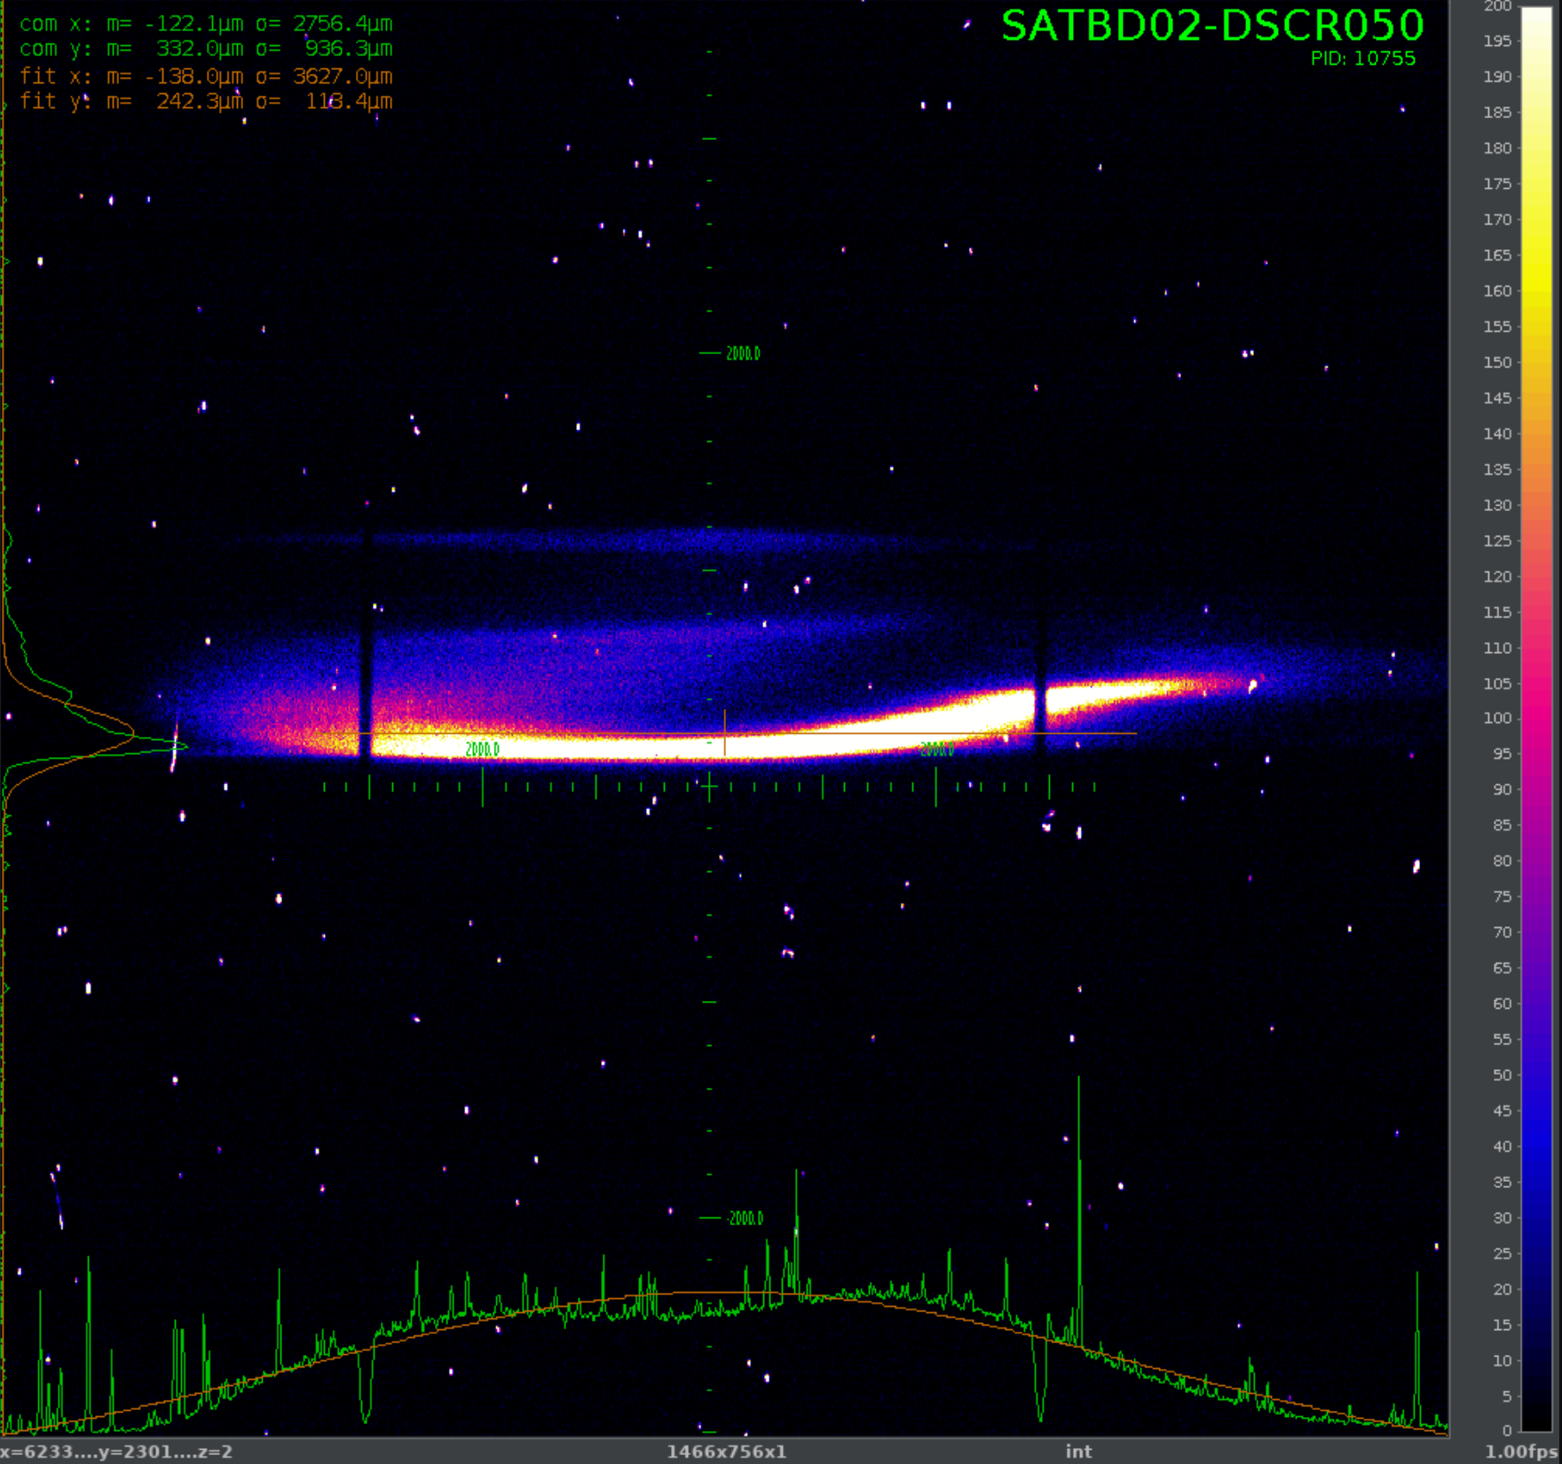
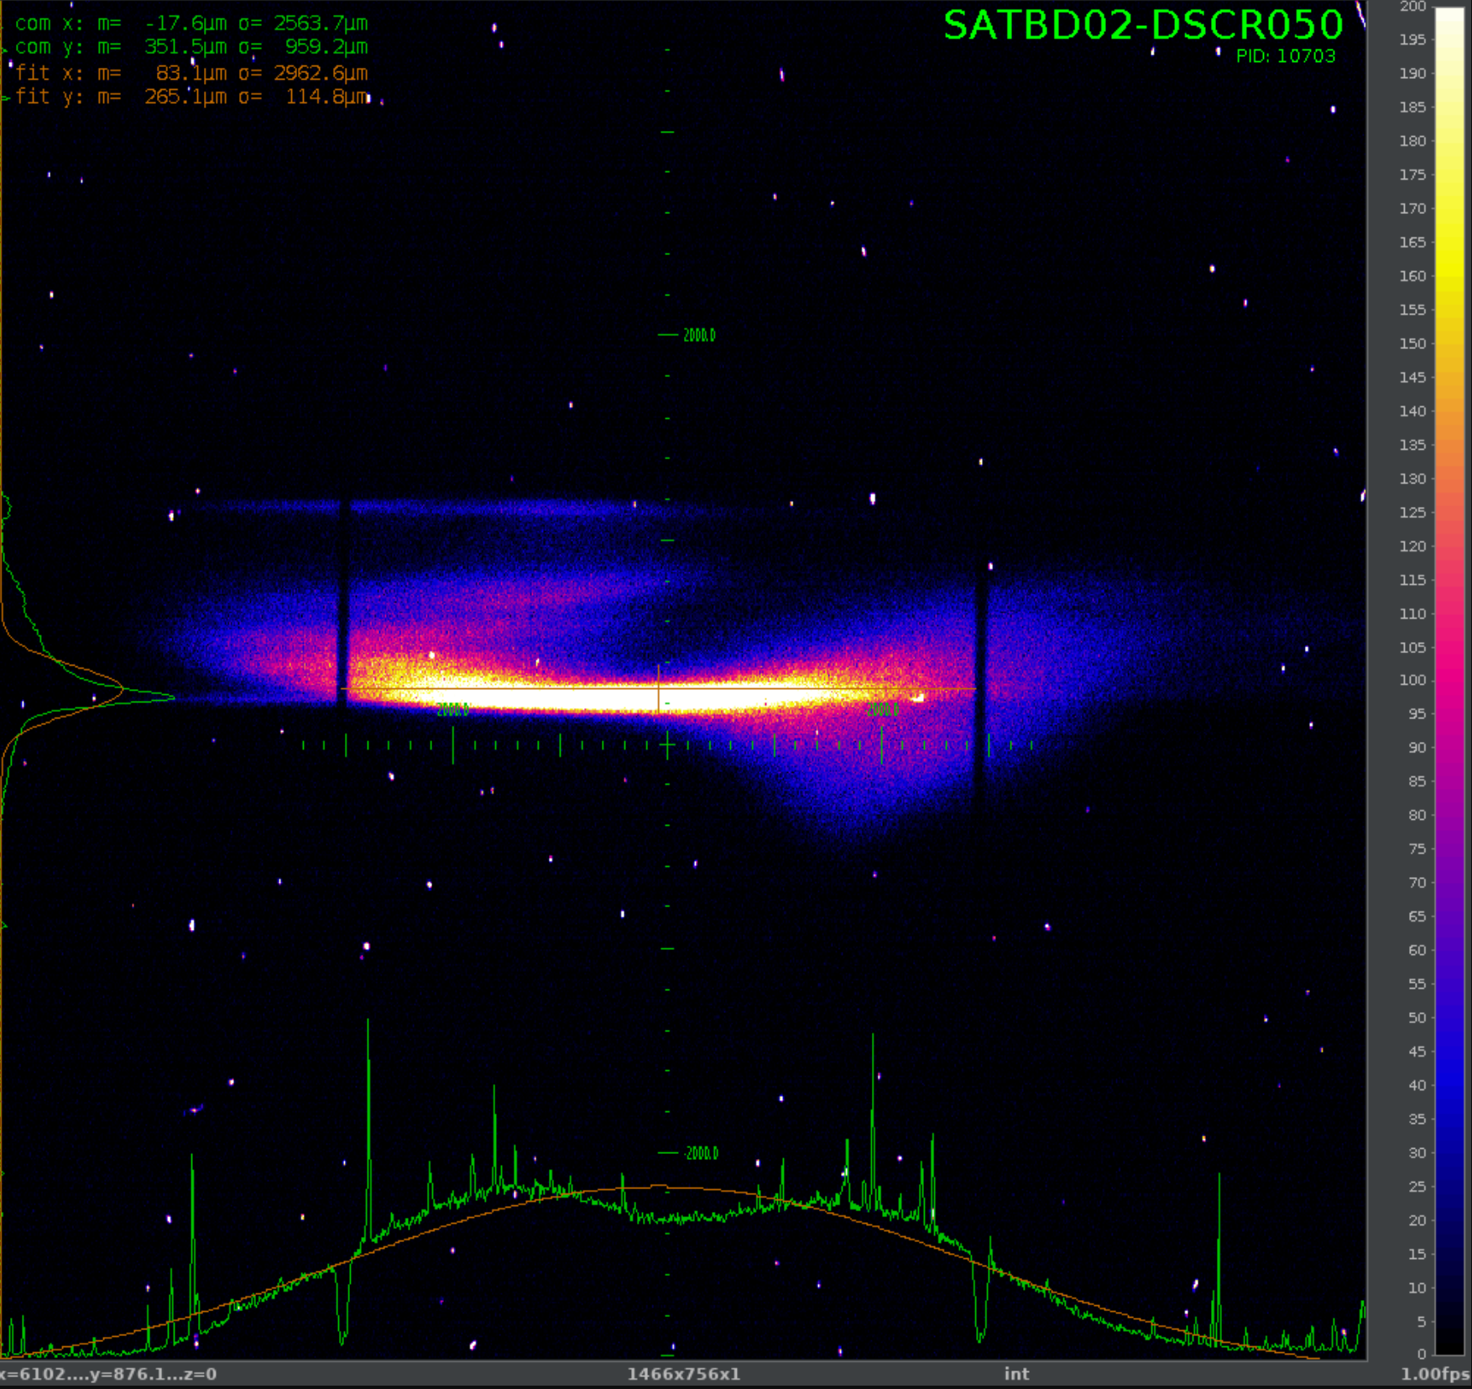
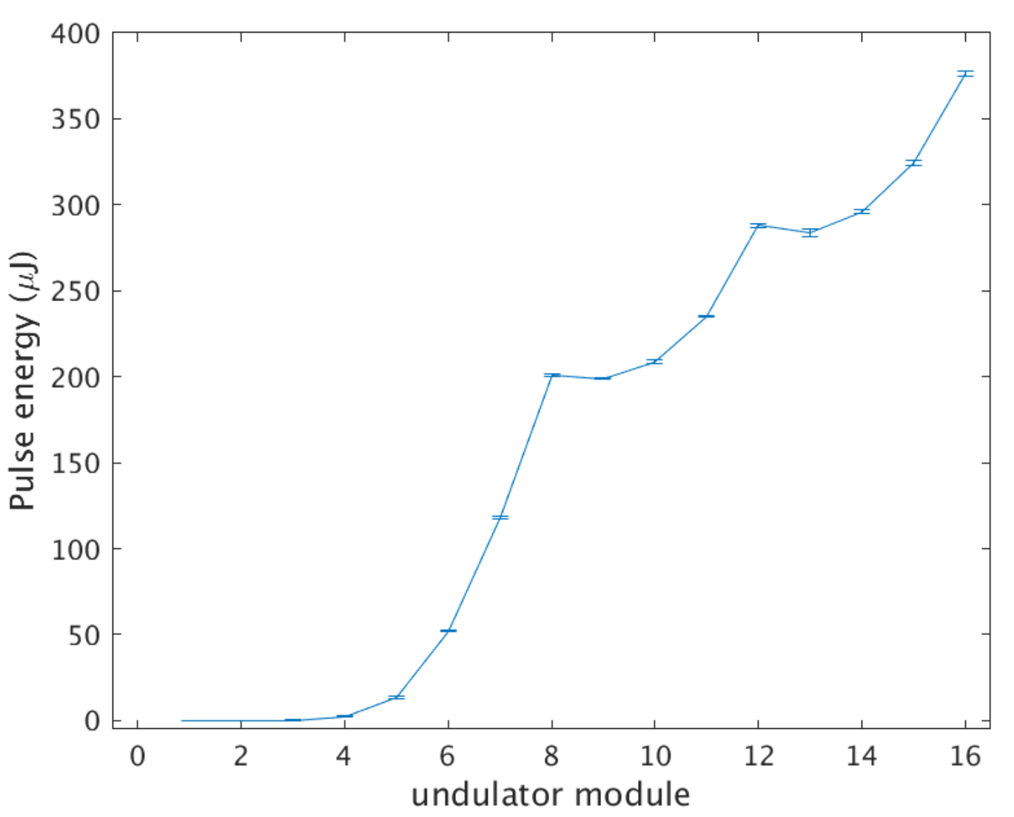
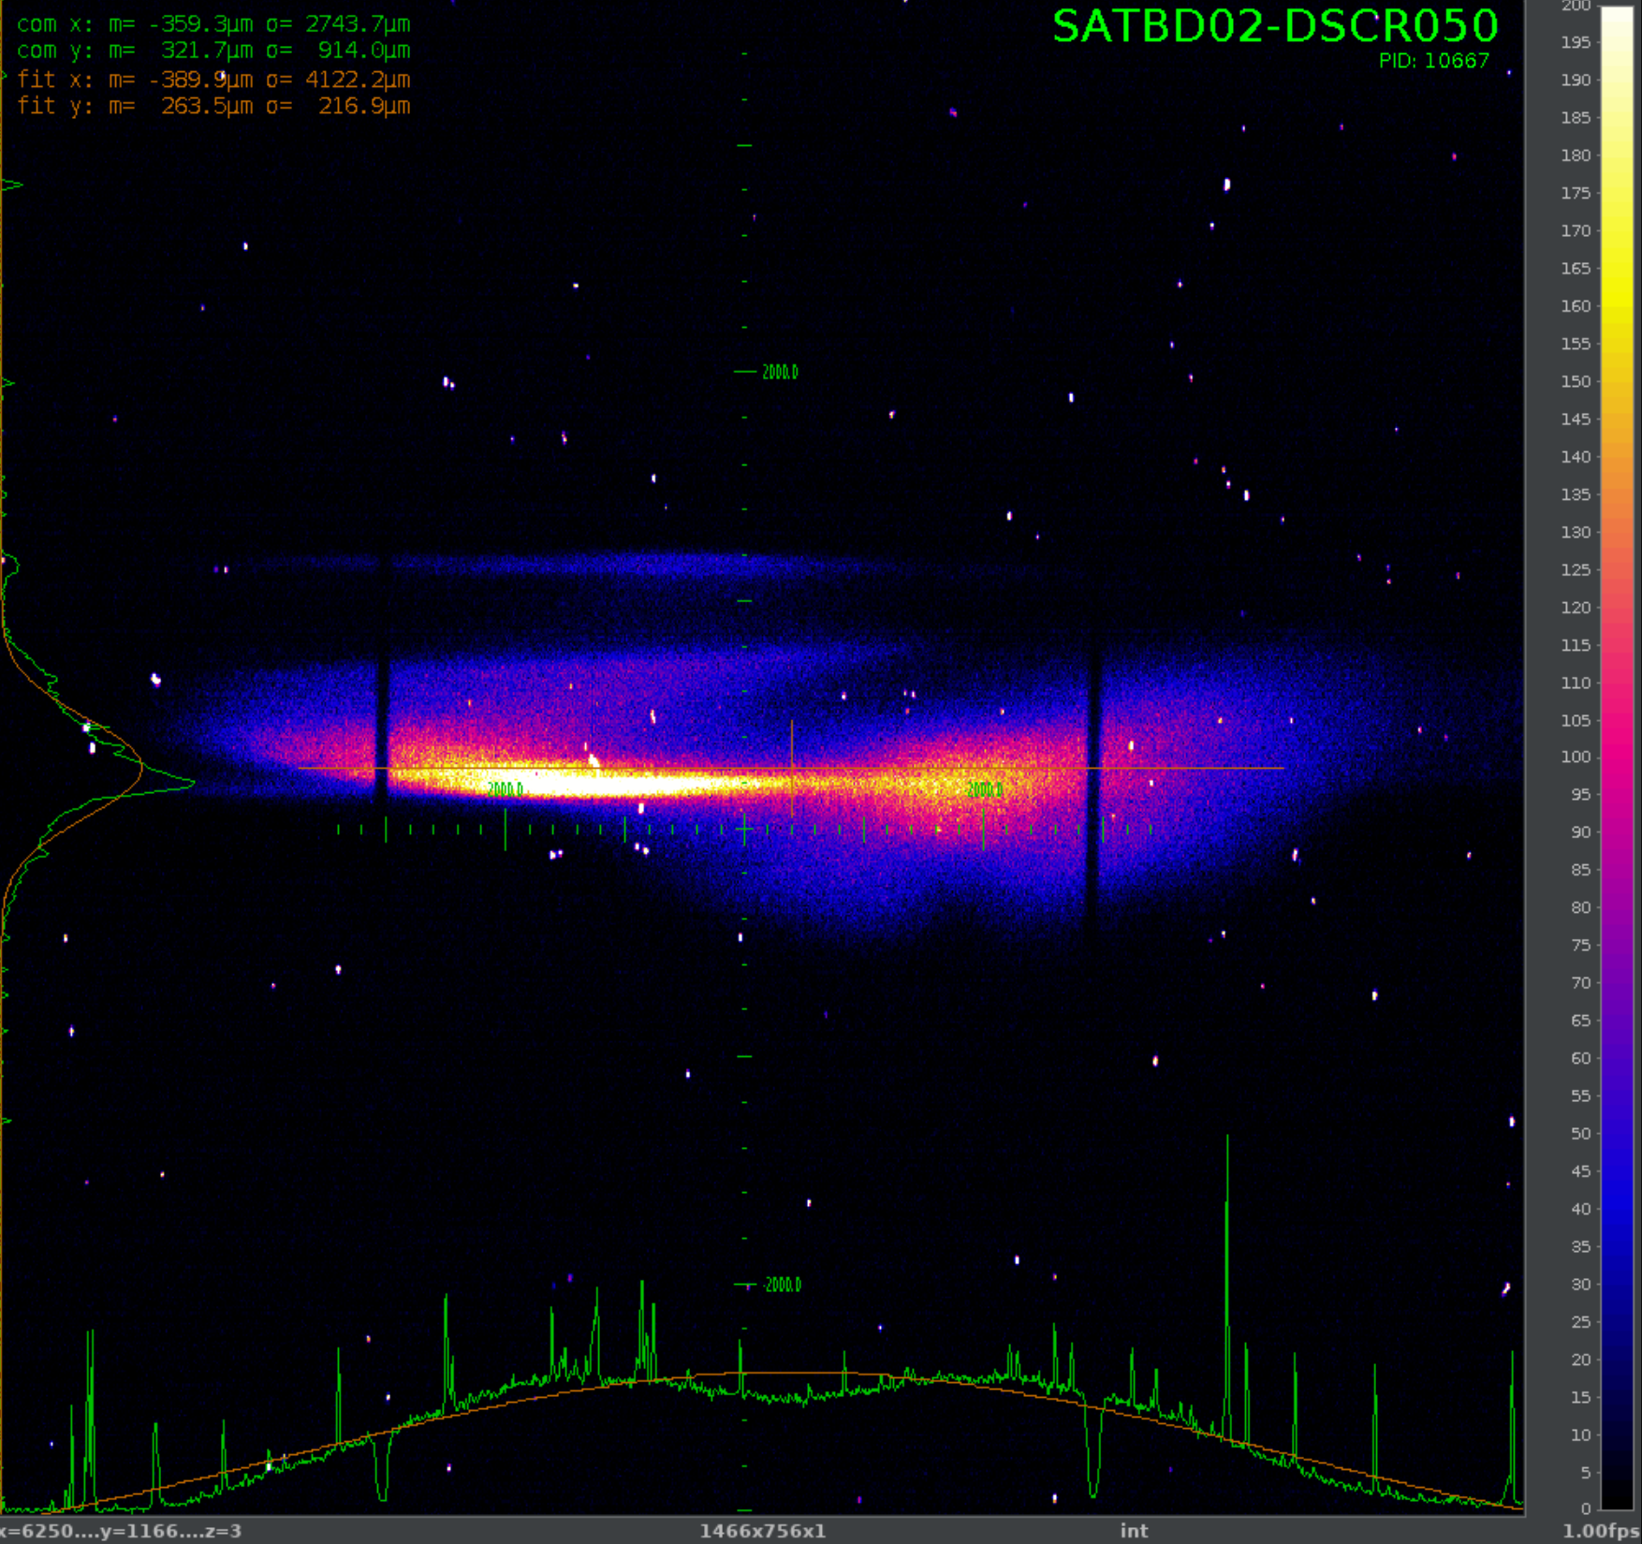
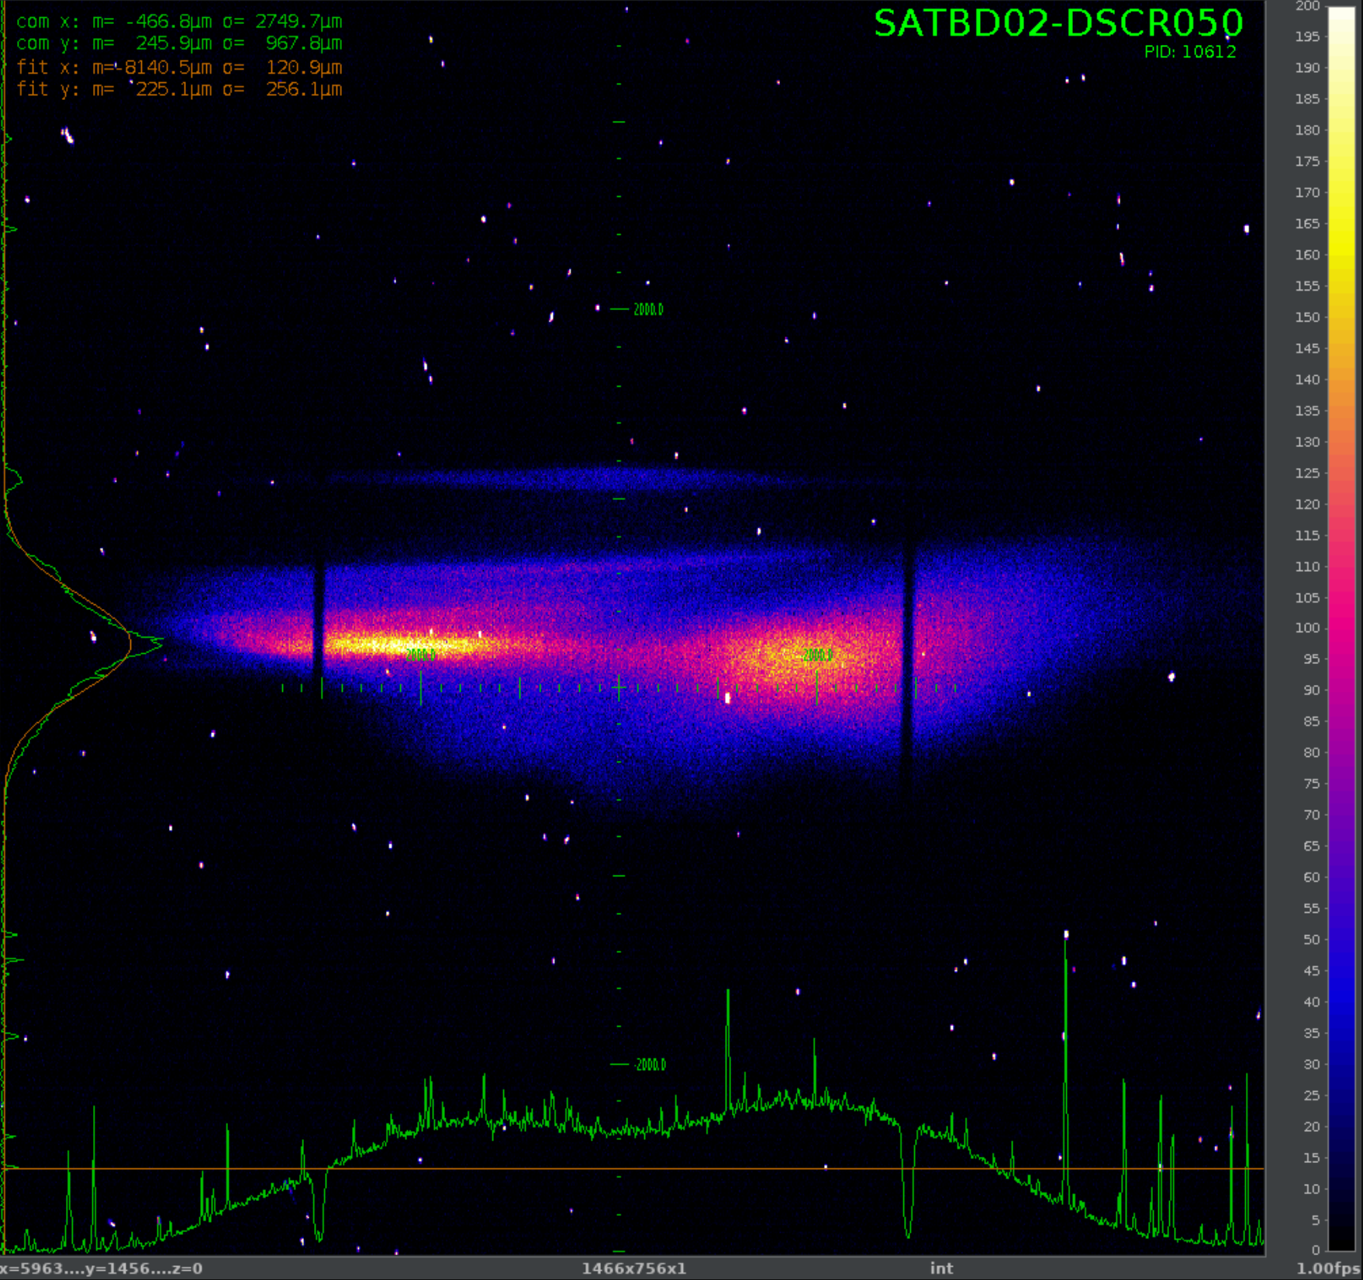
3-stage fresh slice amplification after horn cutting
A very beautiful and flat distribution beam could be achieved after horn cutting in BC 1.
8+4+4 stages. Overlap between the stages achieved with CHIC delay and corrector, and orbit feedback.
The FEL lasing from the first stage is about 200 µJ, amplified to 300 µJ in the second stage, and about 400 µJ after the third stage.
The full length of FEL pulse is estimated to be 6 fs, the FEL peak power is around 150 GW.
Gain curve of 3-stage amplification
no lasing
1st stage
Energy
2nd stage
3rd stage
time
https://elog-gfa.psi.ch/SwissFEL+commissioning/23557

Slide 15
Contents
Introduction
Methods for longitudinal phase space (LPS) diagnostics
Experimental results of multi stage fresh slice amplification (MSA)
  2 stages and two color generation
  3 stages MSA results
  4 stages MSA results
  MSA pulse duration control
Single particle imaging in Maloja
Difficulties and outlook
Summary and conclusion

Slide 16
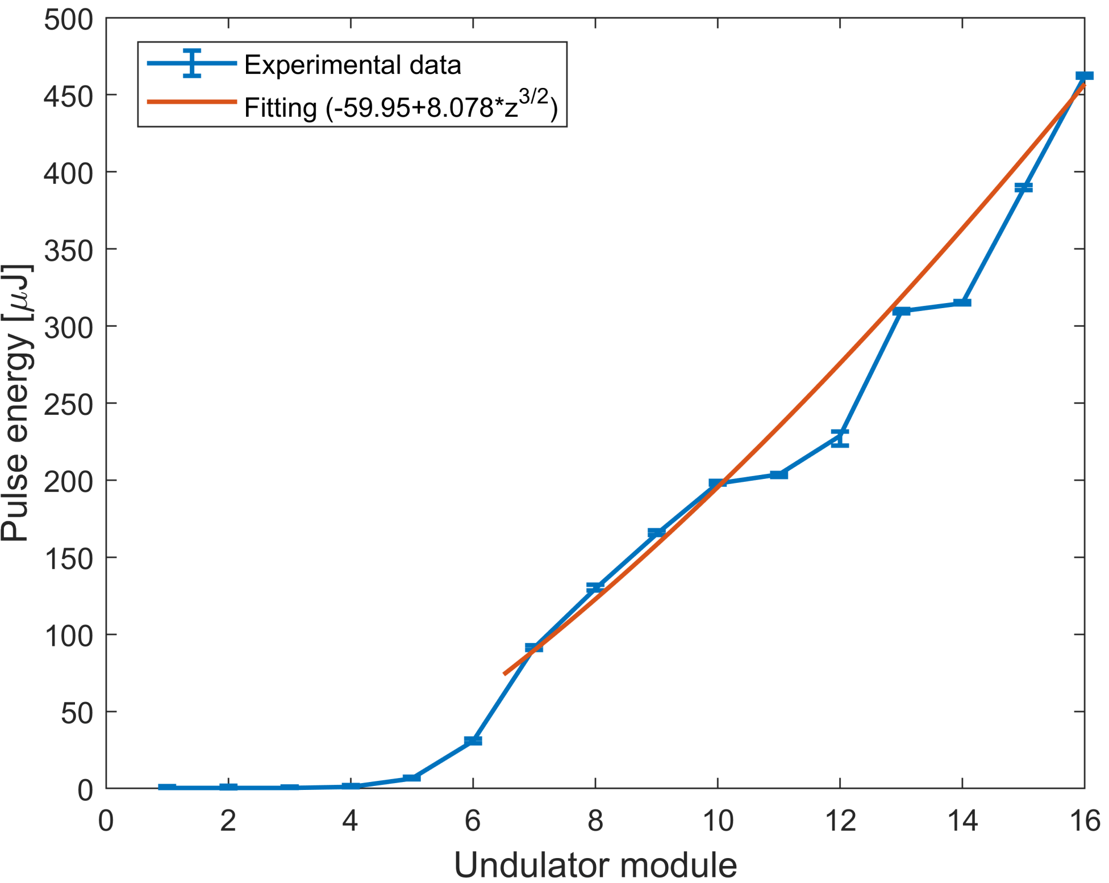
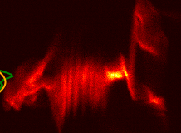
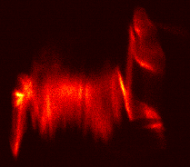
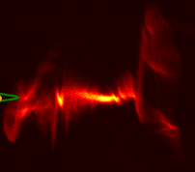
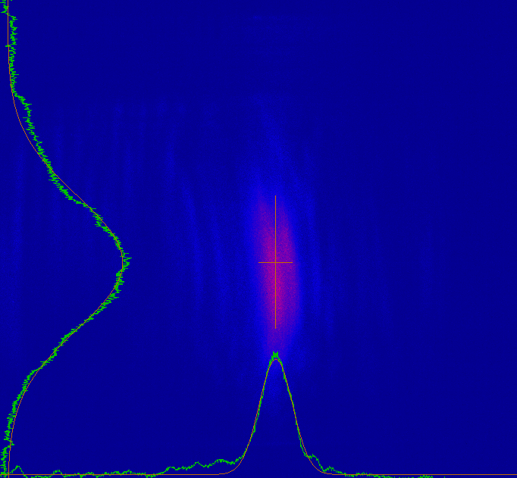
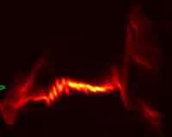
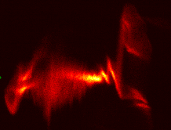
4-stages fresh-slice amplification
3
@500 eV
Tilt with dispersion
4-stages amplification (7+3+3+3)
~500 uJ in few fs
4
1
PMOS spectra with one to few spikes
0
2
~30 fs
Notes:
16

Slide 17
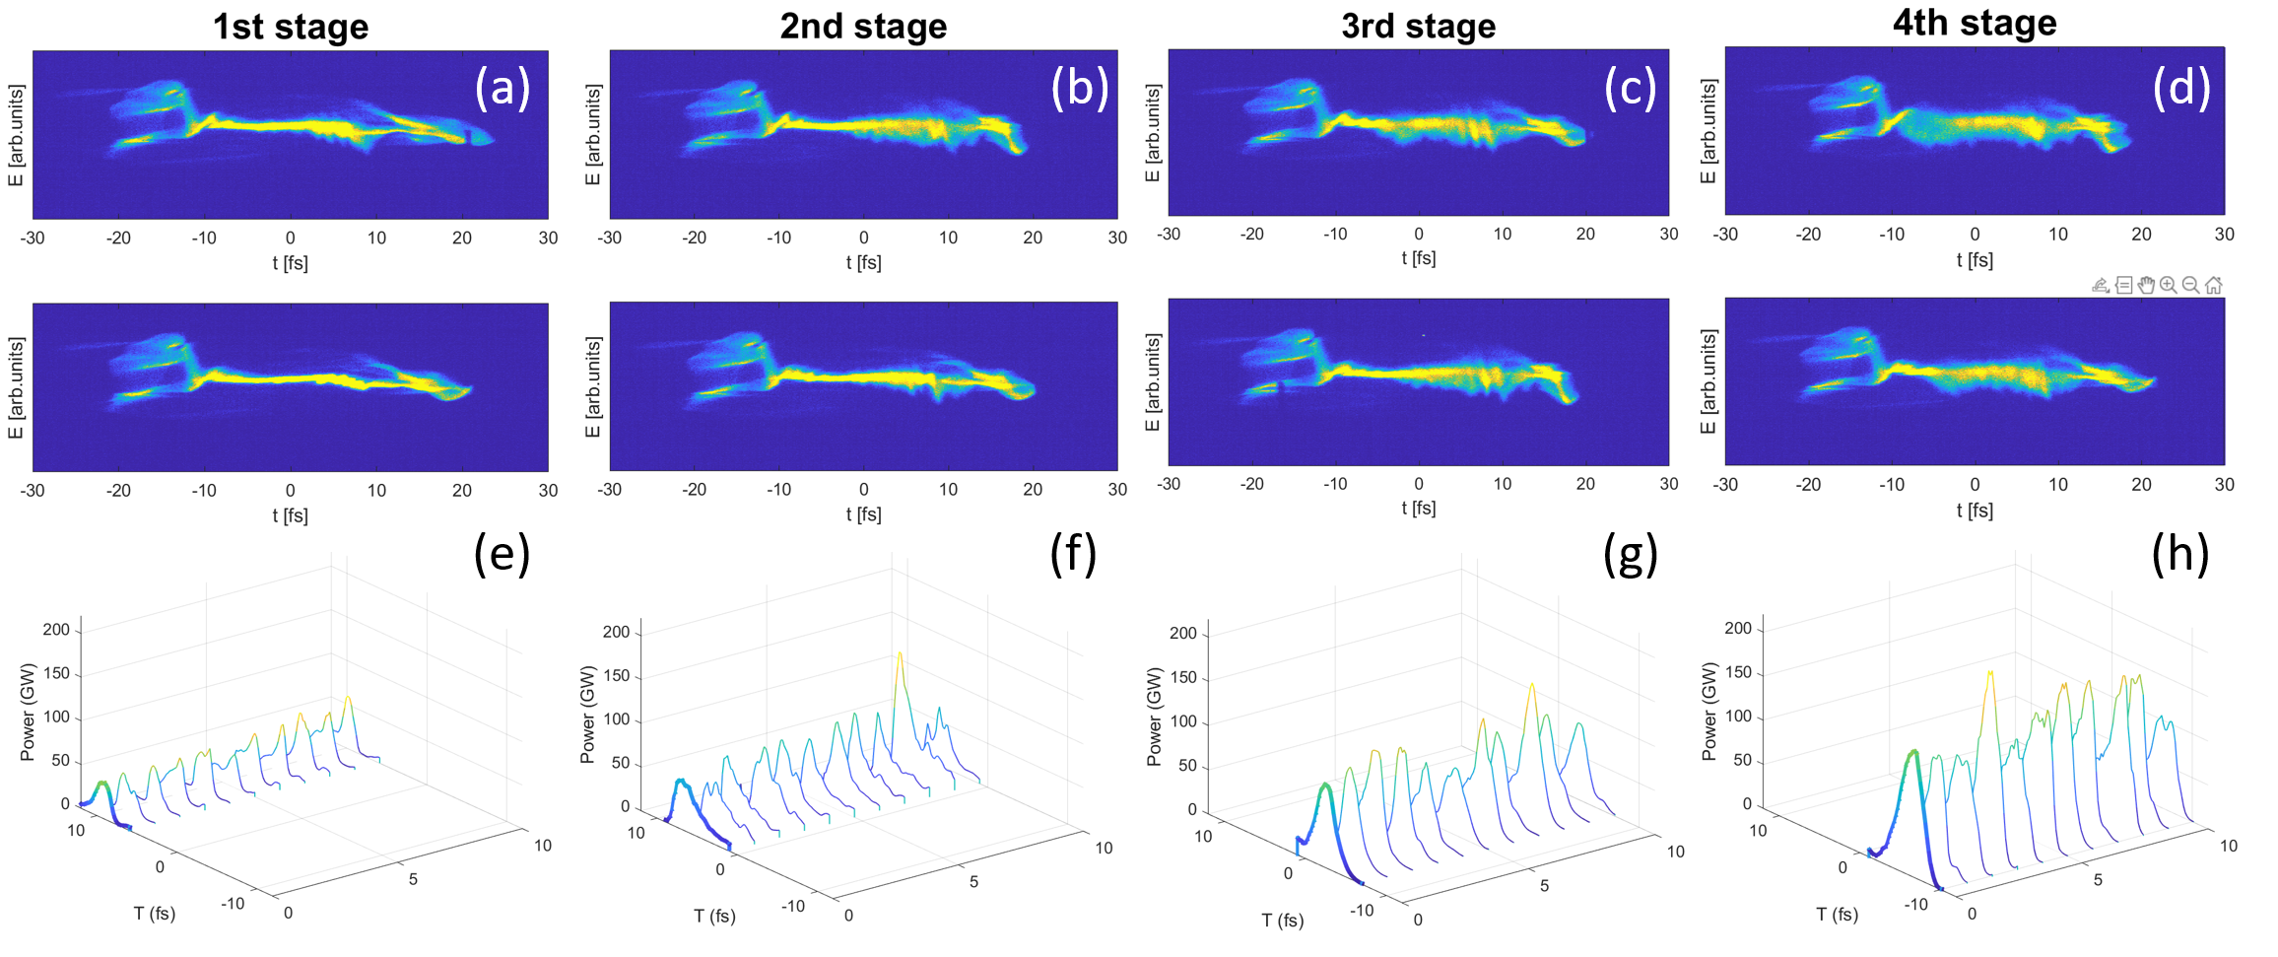
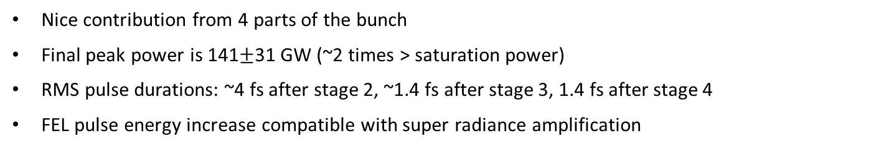
MSA: first 4-stage results @500 eV
Lasing on
Lasing off
FEL power profiles (average in bold & shot to shot)
Nice contribution from 4 parts of the bunch
Final peak power is 141$±$31 GW (~2 times > saturation power)
RMS pulse durations: ~4 fs after stage 2, ~1.4 fs after stage 3, 1.4 fs after stage 4
FEL pulse energy increase compatible with super radiance amplification
https://elog-gfa.psi.ch/SwissFEL+commissioning/25105

Slide 18
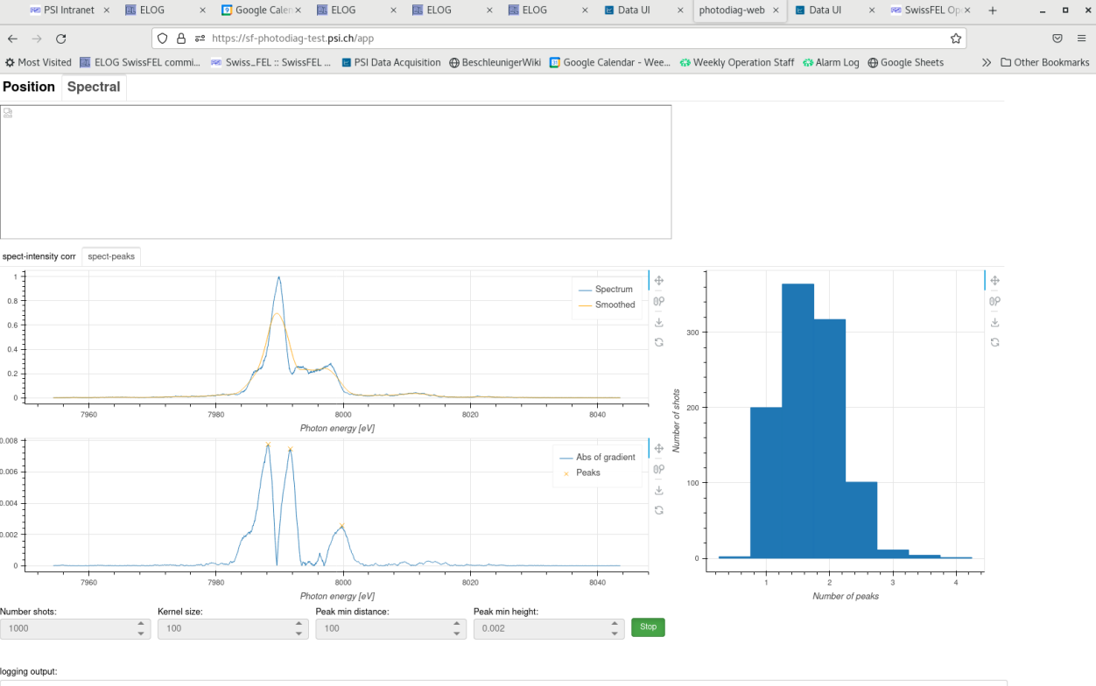
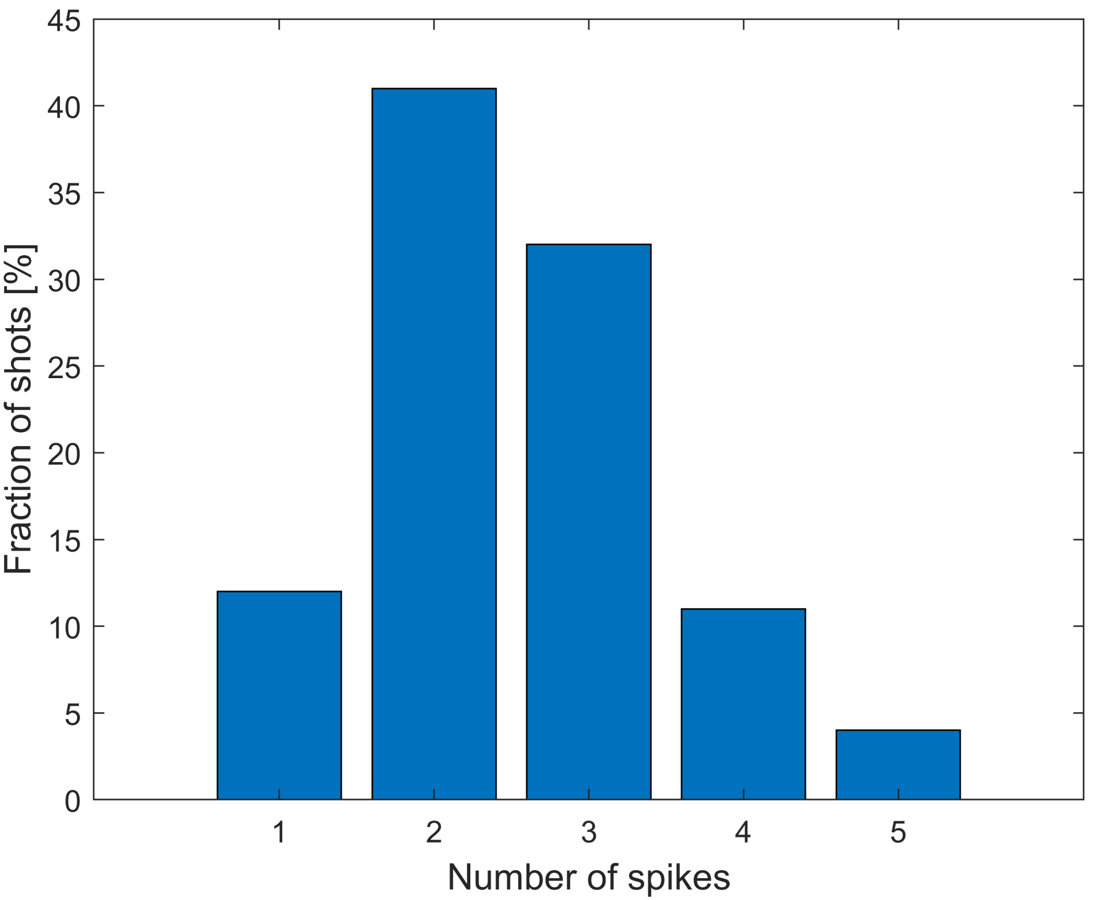
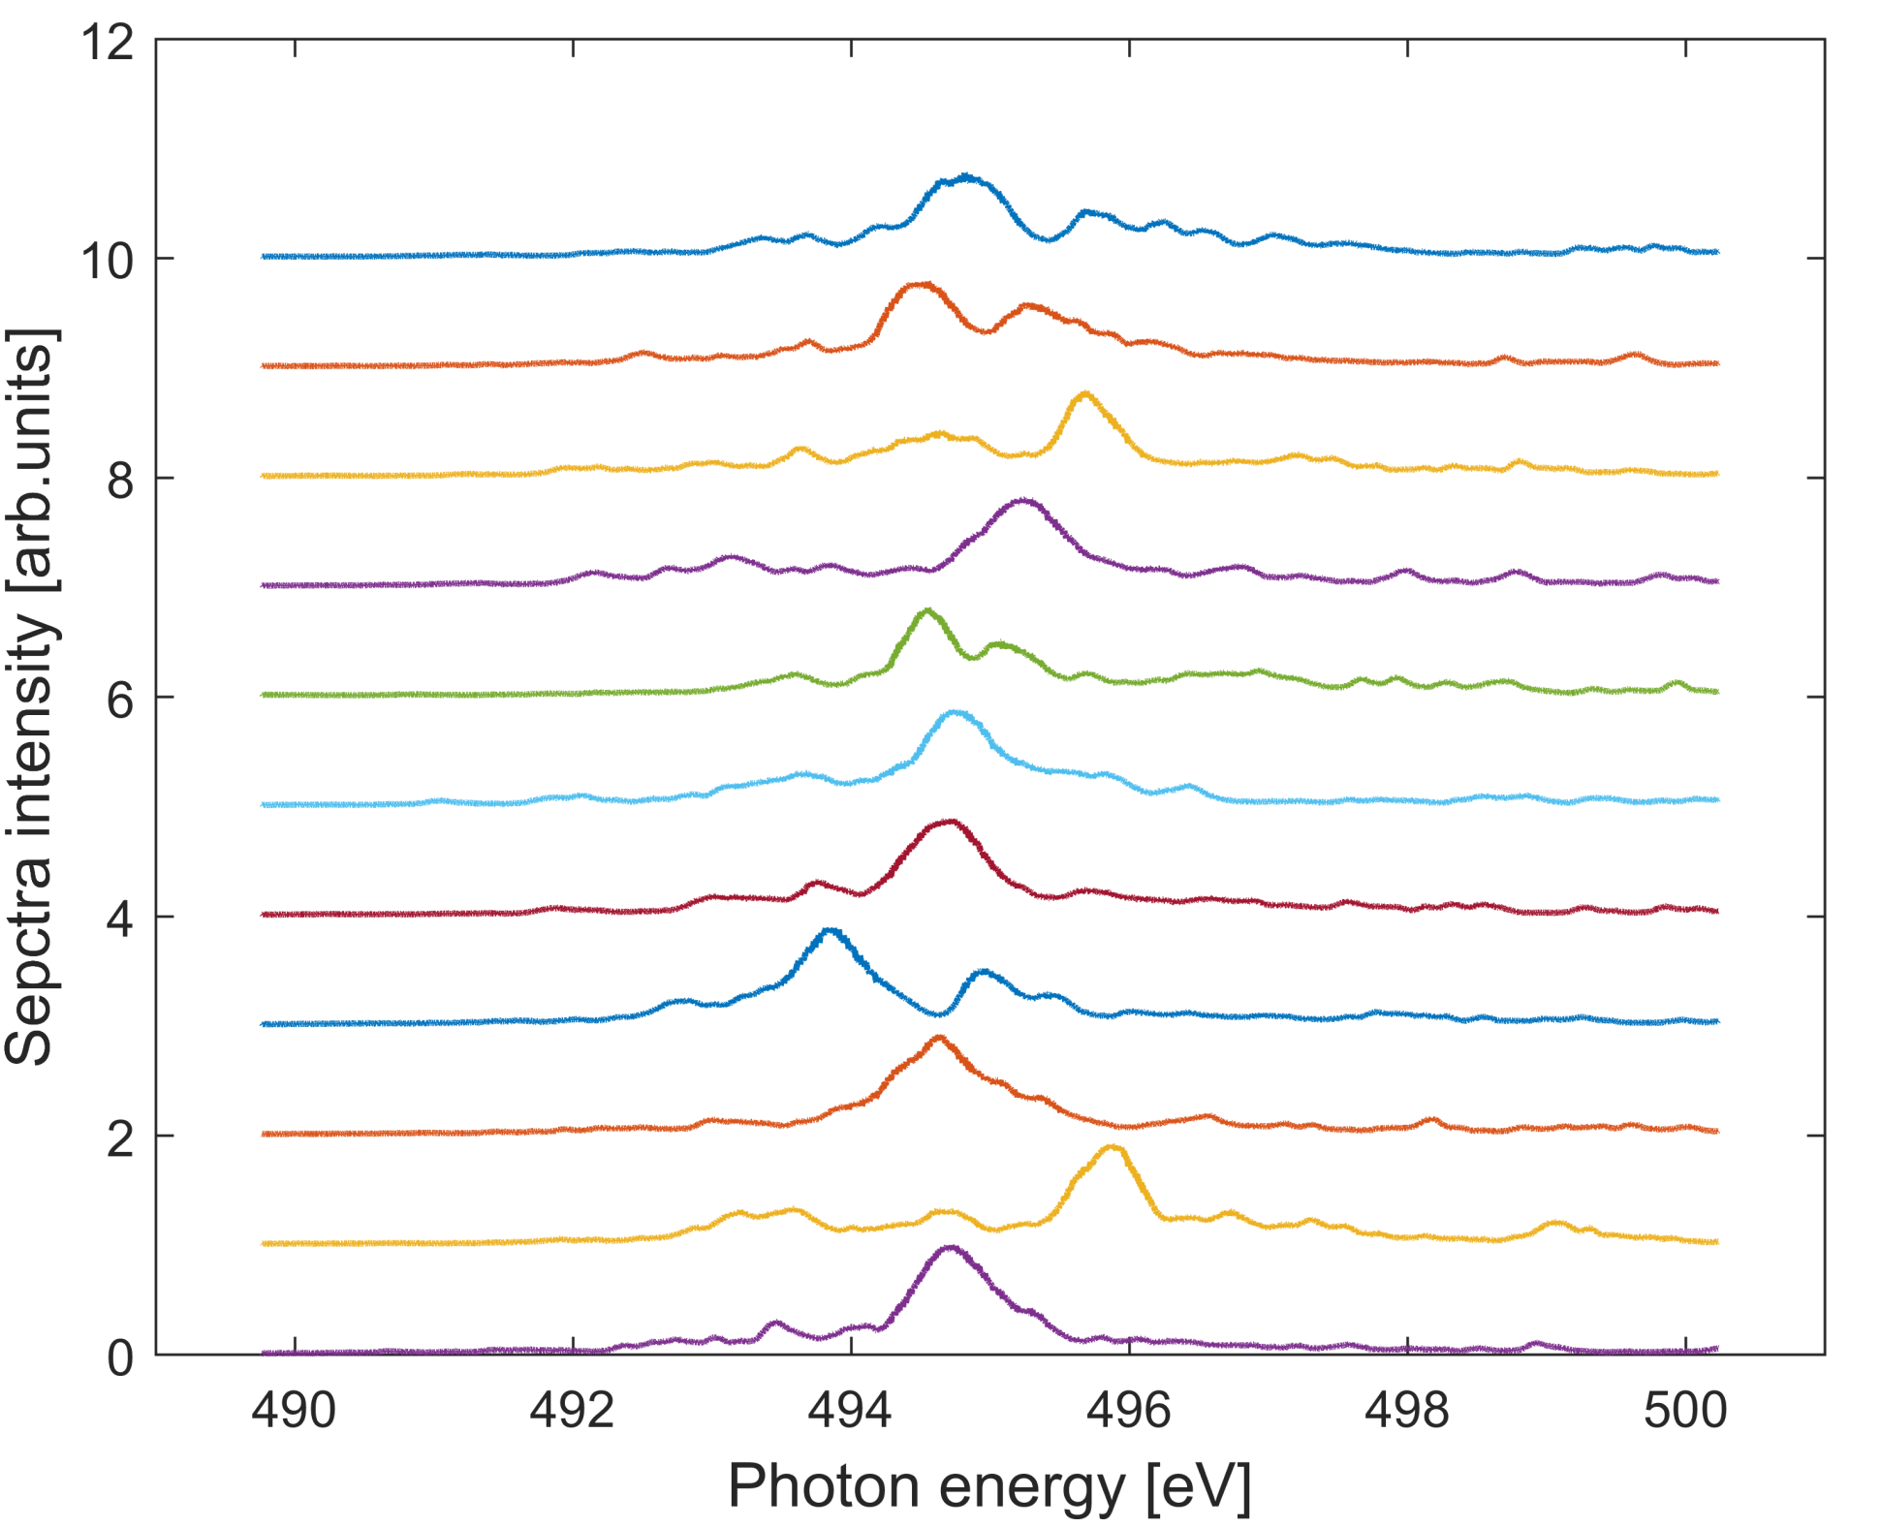
FEL spectrum analysis (4 stages @500 eV)
The FEL pulse duration is 1.3 fs (RMS) from spectrum analysis, which is in good agreement with LPS measurements
Around 50% of the FEL pulses are 1-2 spikes, the estimated FEL bandwidth is about 2-3 times the FTL.
Live histogram of number of spikes → very helpful for setup (thanks to Chris Arrell)
https://elog-gfa.psi.ch/SwissFEL+commissioning/25105

Slide 19
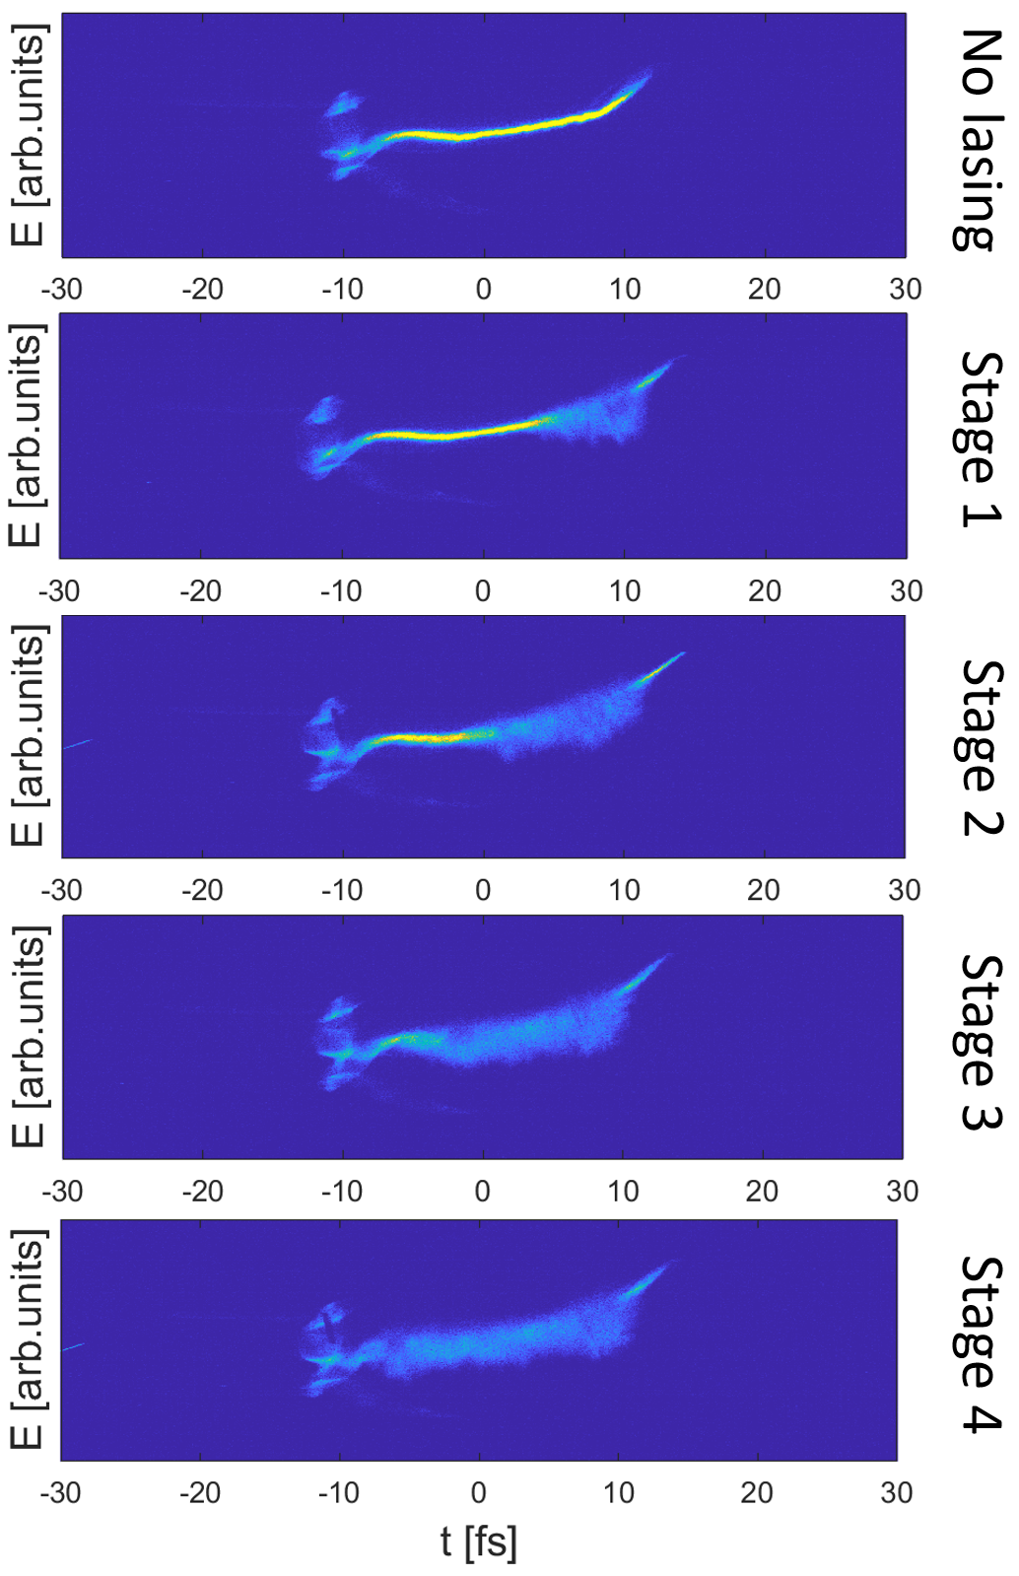
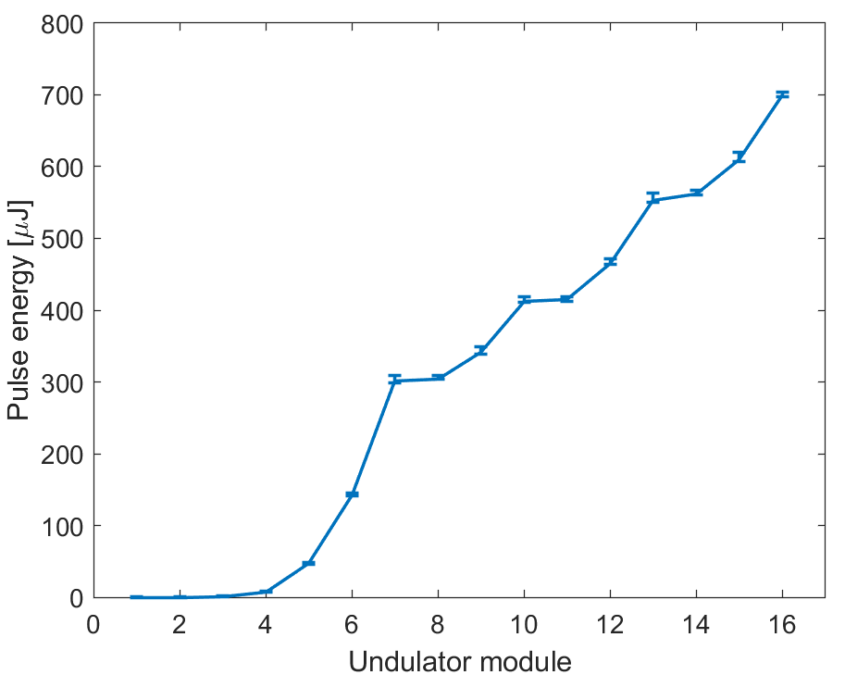
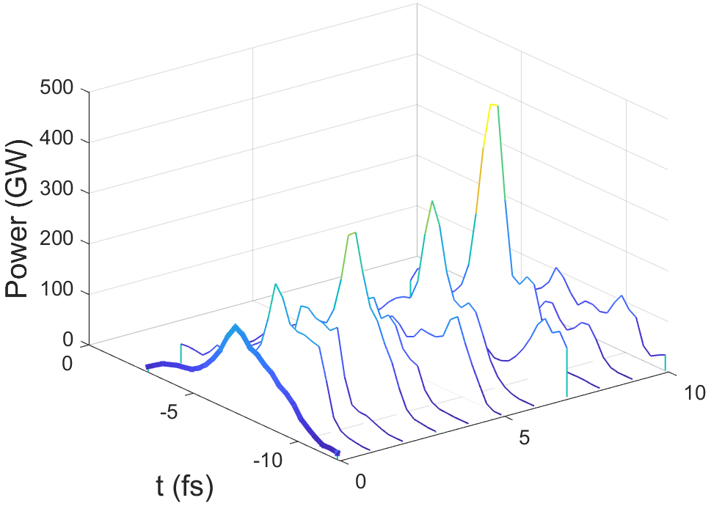
MSA: best results (4 stages @540 eV)
FEL pulse energy follows the tendency of $z^{3/2}$, compatible with FEL superradiance regime
Peak power = 370±129.1 GW, RMS pulse duration =1.13±0.28 fs (best 10 of 20 shots)
https://elog-gfa.psi.ch/SwissFEL+commissioning/27666

Slide 20
Contents
Introduction
Methods for longitudinal phase space (LPS) diagnostics
Experimental results of multi stage fresh slice amplification (MSA)
  2 stages and two color generation
  3 stages MSA results
  4 stages MSA results
  MSA pulse duration control
Single particle imaging in Maloja
Difficulties and outlook
Summary and conclusion

Slide 21
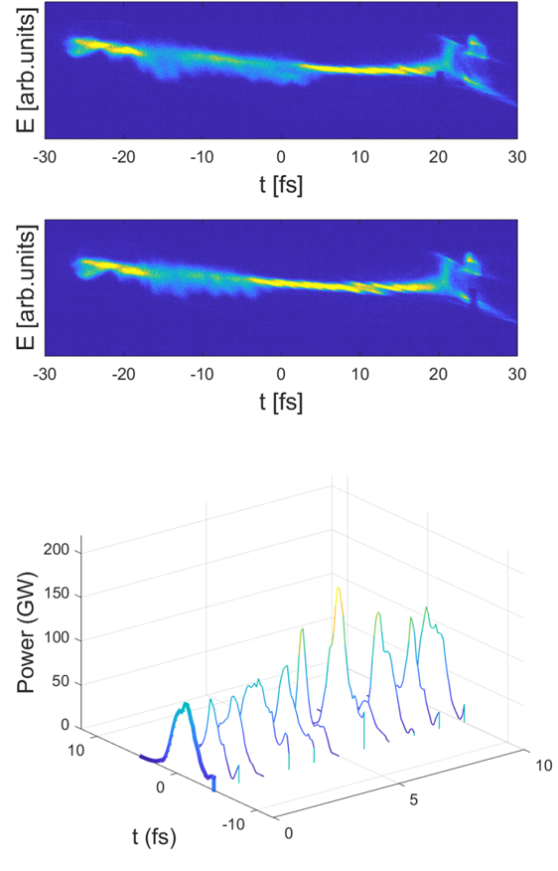
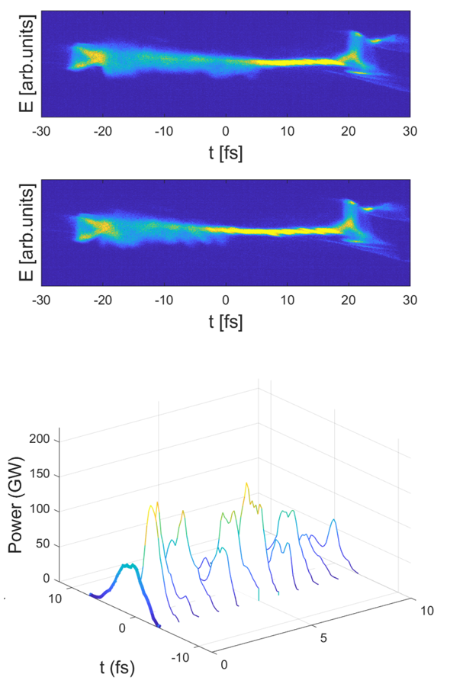
MSA FEL pulse duration control @ 1 keV
Short/1.4 fs
Long/2.1 fs
Lasing on
Lasing off
FEL power profiles (average in bold & shot to shot)
The FEL pulse duration can be controlled by adjusting the tilt amplitude (more tilt less energy but shorter pulse). Results: 1.4 to 2.1 fs, with a pulse energy of 290, 440 uJ.
The peak power for the two different FEL pulse duration is similar at around 100 GW.
The MSA short pulse is delivered to Maloja for the study of double core hole of neon
https://elog-gfa.psi.ch/SwissFEL+commissioning/26323

Slide 22
Contents
Introduction
Methods for longitudinal phase space (LPS) diagnostics
Experimental results of multi stage fresh slice amplification (MSA)
  2 stages and two color generation
  3 stages MSA results
  4 stages MSA results
  MSA pulse duration control
Single particle imaging in Maloja
Difficulties and outlook
Summary and conclusion

Slide 23
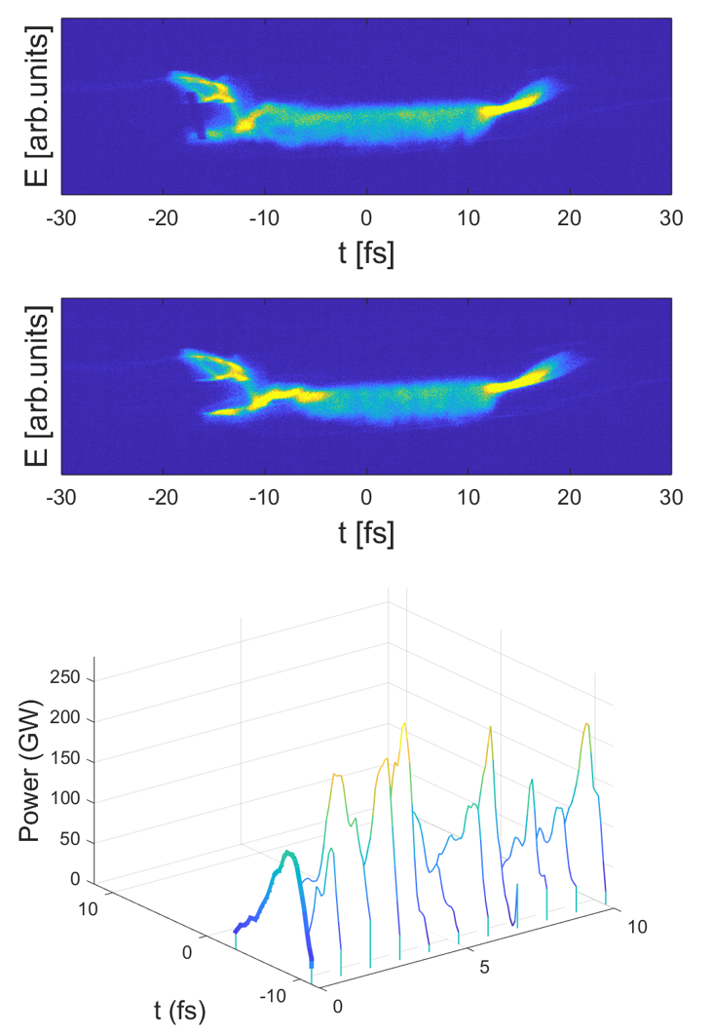
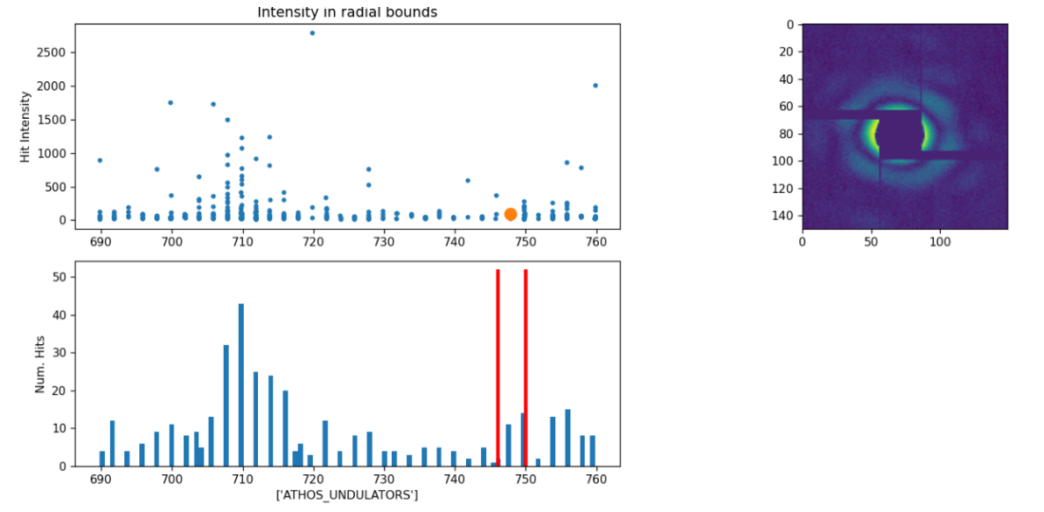
Transient Resonant Single-Particle Imaging
Motivation: Exploring the roles of transient resonances for single-particle imaging with new multistage amplification mode - unique at Athos.
A 4-stage fresh slice beam was delivered to Maloja with 650 uJ, ~2 fs, ~200 GW
Variation! But dominantly from pulse energy variations.
Data need to be analyzed carefully
https://elog-gfa.psi.ch/SwissFEL+commissioning/28147

Slide 24
Contents
Introduction
Methods for longitudinal phase space (LPS) diagnostics
Experimental results of multi stage fresh slice amplification (MSA)
  2 stages and two color generation
  3 stages MSA results
  4 stages MSA results
  MSA pulse duration control
Single particle imaging in Maloja
Difficulties and outlook
Summary and conclusion

Slide 25
Difficulties
MSA performance significantly better than standard short pulse mode: 2-4 times higher than standard.
Nevertheless, we are still a bit far from results expected from simulations (~0.5 TW for 600 eV).
Why?
  Not possible to compress the beam as much as assumed in simulations (6 kA) without significantly degrading the beam
  Not possible to tilt the beam as much as we wanted to better suppress the FEL lasing (losses)
  Transverse coupling in the undulator

Slide 26
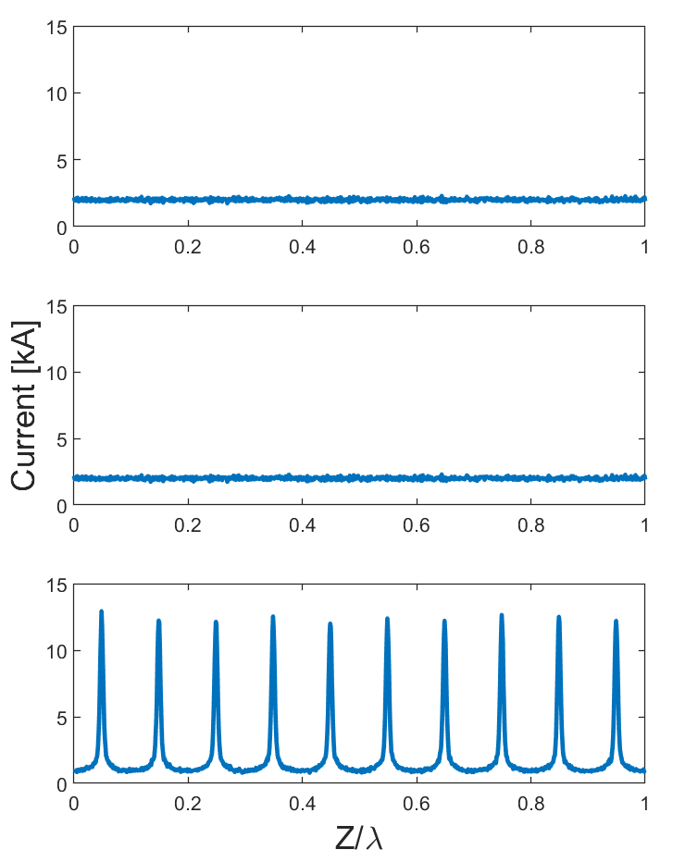
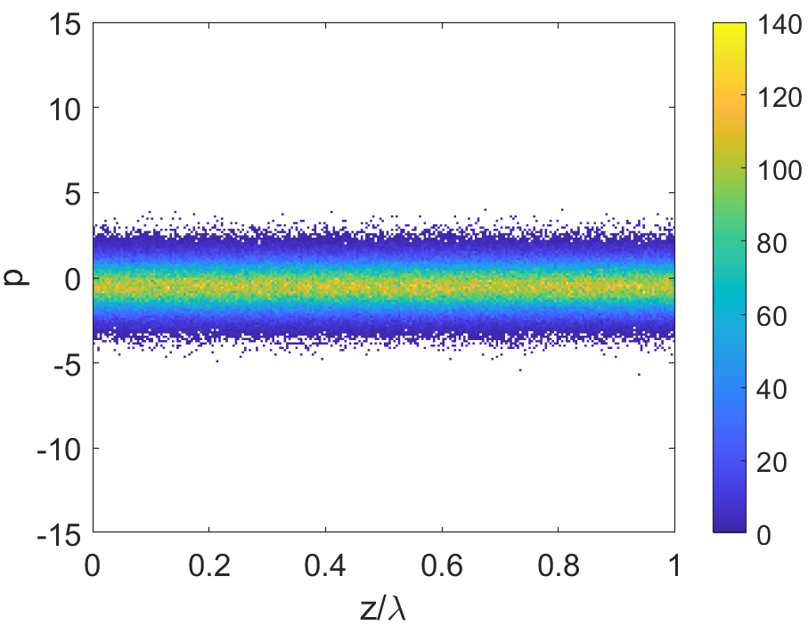
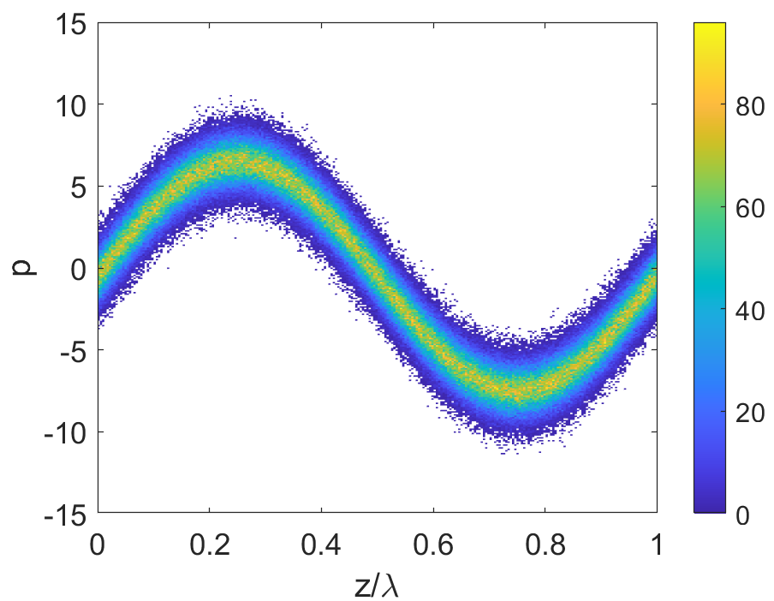
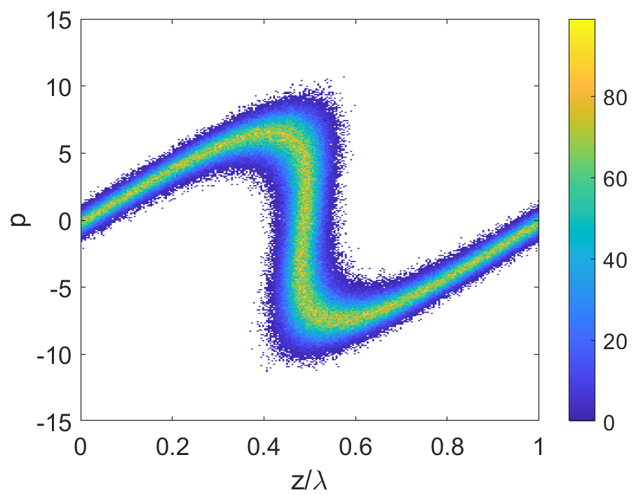
Outlook
MSA based on E-SASE
E-SASE to enhance the local beam current, e.g. 2kA to 12 kA in Athos.
Using beam energy chirp and seed laser chirp to generate unequal separation of current distribution
MSA to enhance the FEL performance, and generate an isolated high power pulse
Current: 2kA to 12 kA
unmodulated
energy modulation
density modulation
1st: simulations and specify laser requirements
2nd: experimental demonstration

Slide 27
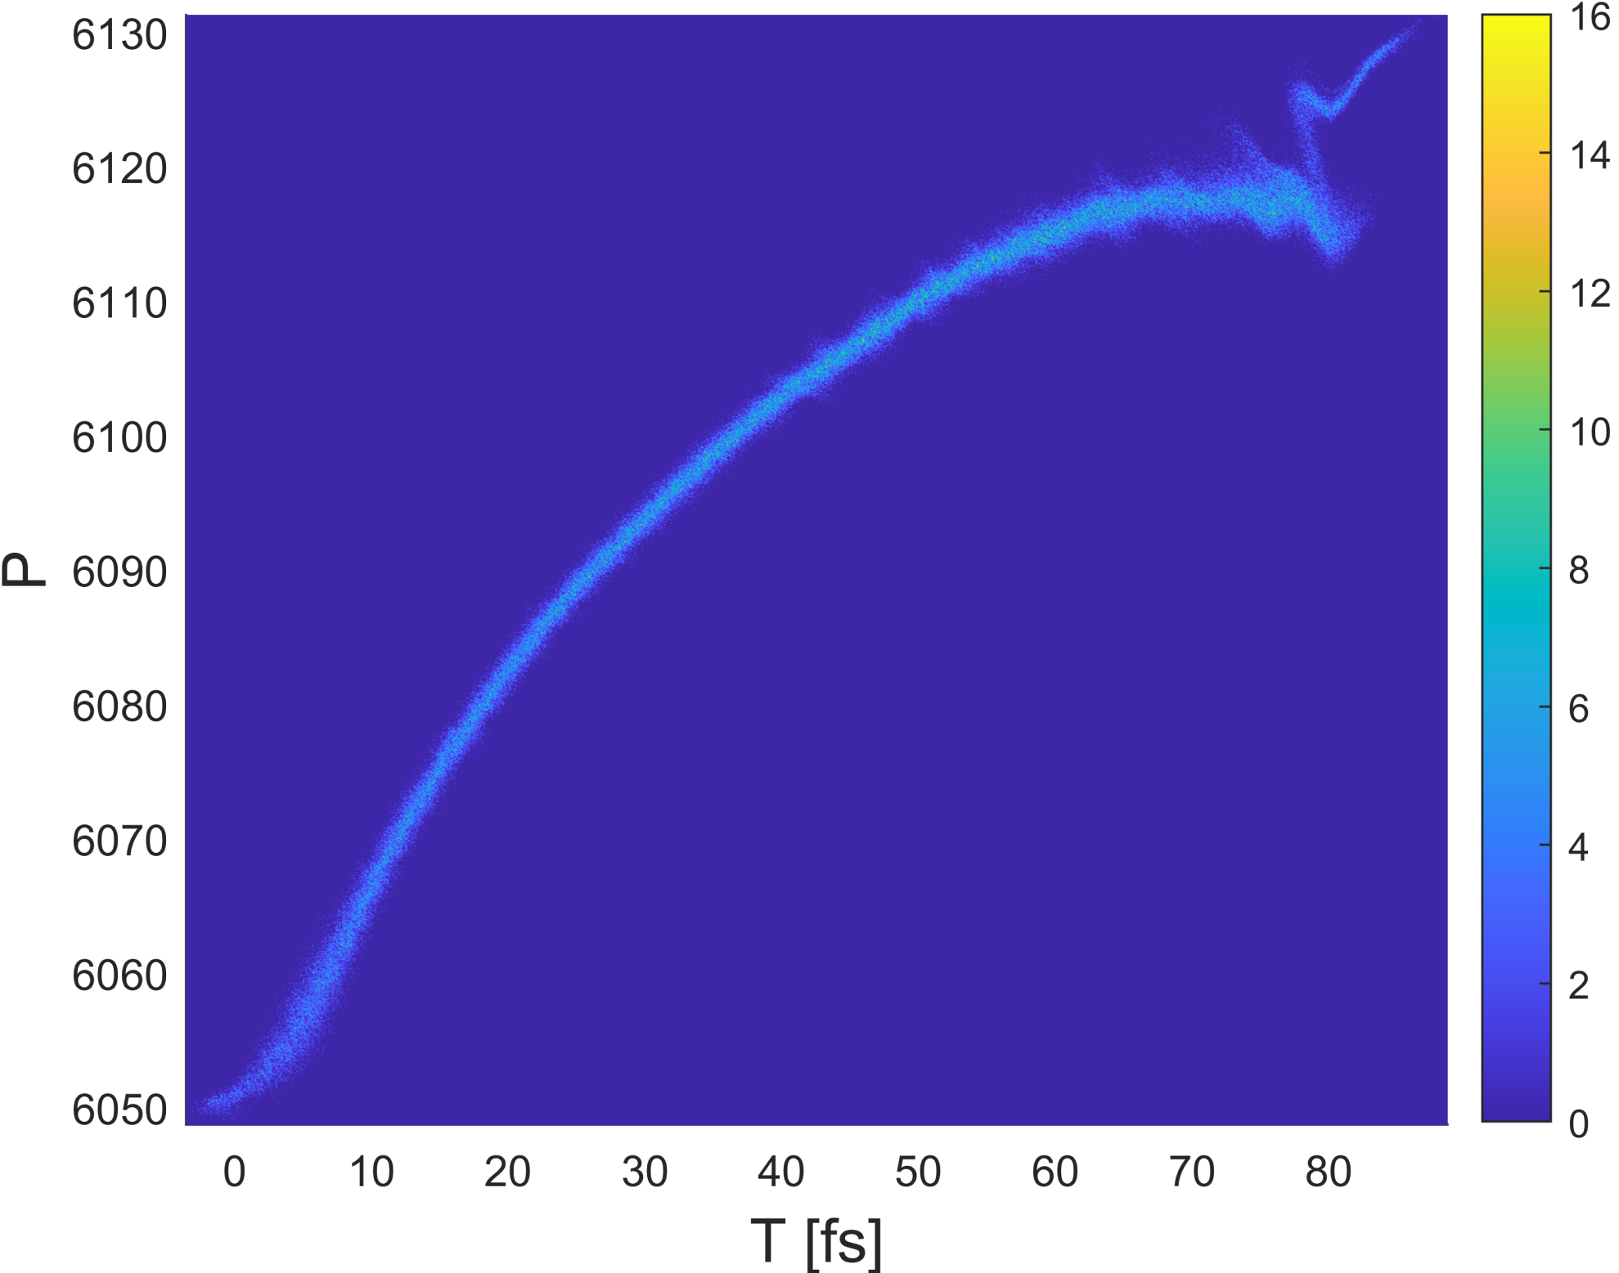
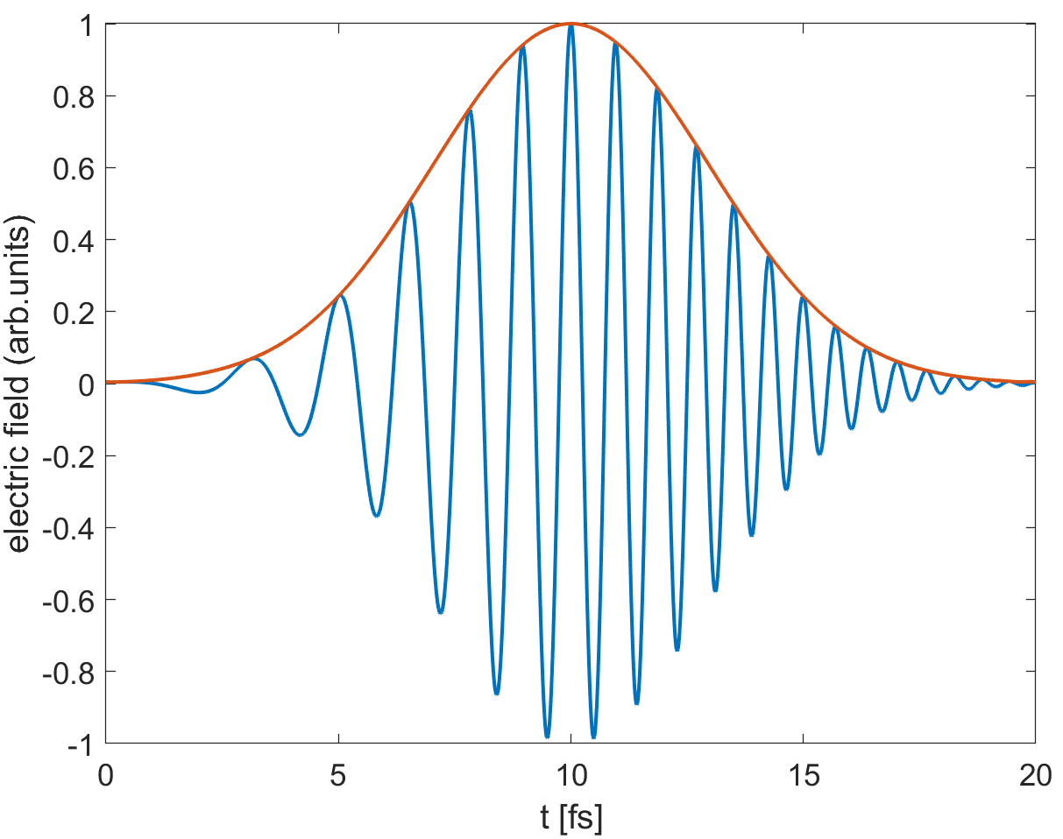
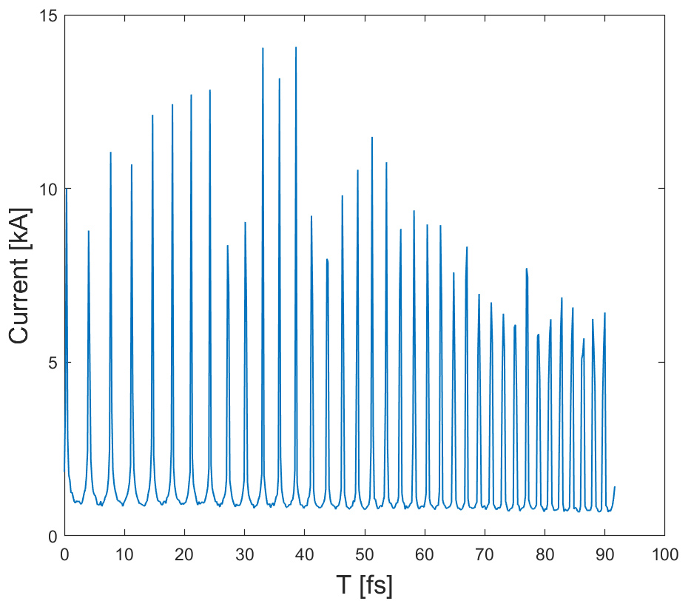
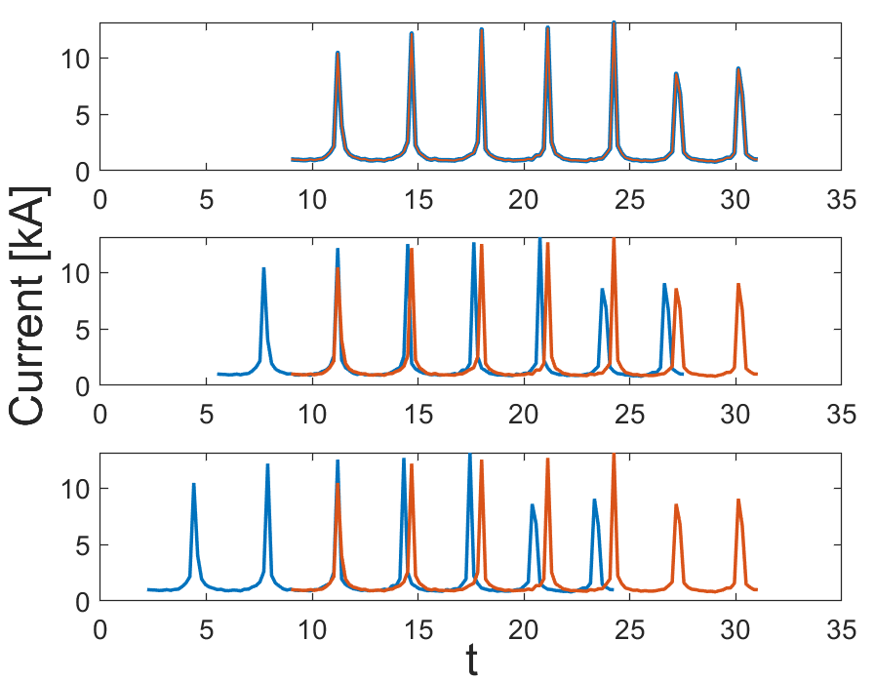
Outlook for MSA in Athos
Using beam energy chirp and seed laser chirp to generate unequal current distribution
Controlling the number of current spikes by dispersion tilt
+
https://indico.psi.ch/event/14437/

Slide 28
Contents
Introduction
Methods for longitudinal phase space (LPS) diagnostics
Experimental results of multi stage fresh slice amplification (MSA)
  2 stages and two color generation
  3 stages MSA results
  4 stages MSA results
  MSA pulse duration control
Single particle imaging in Maloja
Difficulties and outlook
Summary and conclusion

Slide 29
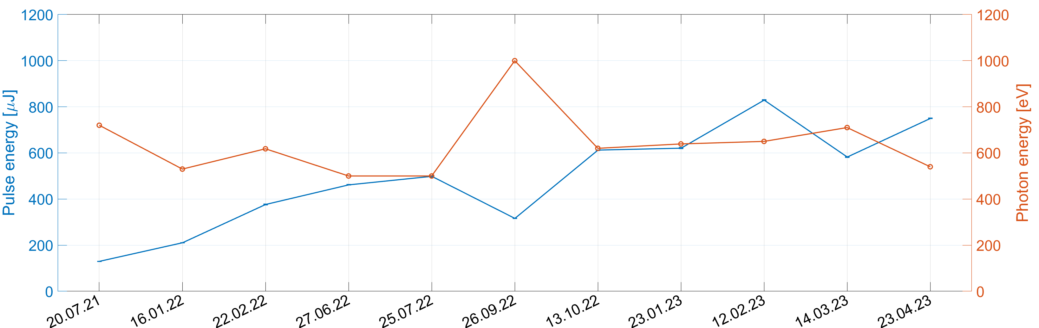
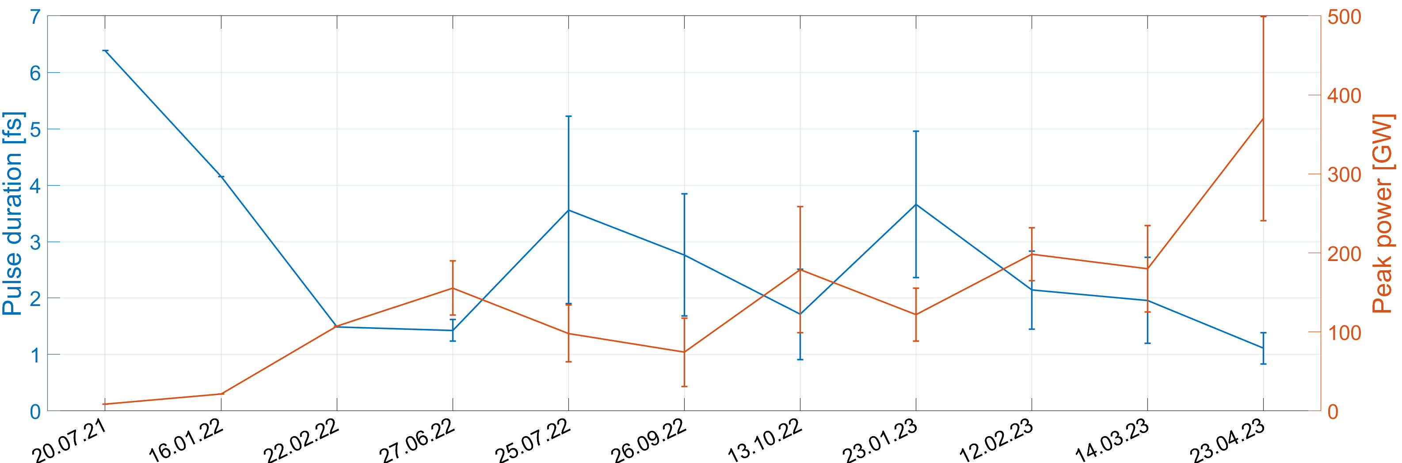
Summary and conclusion
27 MD shifts are applied for the study of MSA in Athos, 11 representative shifts are summarized
The photon range of MSA covers from 500 eV to 1 keV, and the pulse energy increase continuously
The FEL pulse duration is mostly around 1-4 fs (RMS), and could be controlled by the beam tilt
The maximum FEL peak power achieved is over 300 GW, around 5 times of the normal operation

Slide 30
Thanks!

