Slide 1

Multi-physics considerations of NI HTS Solenoid
for PSI Positron Production Experiment
J. Kosse, B. Auchmann, M. Duda, T. Michlmayr, H. Garcia Rodrigues
Bad Zurzach, HTS Modelling Workshop 2024
This work was performed under the auspices of and with support from the Swiss Accelerator Research and Technology (CHART) program

Slide 2
Contents
Motivation
PSI positron production experiment
EM/thermal design
Mechanical design
Conclusion

Slide 3
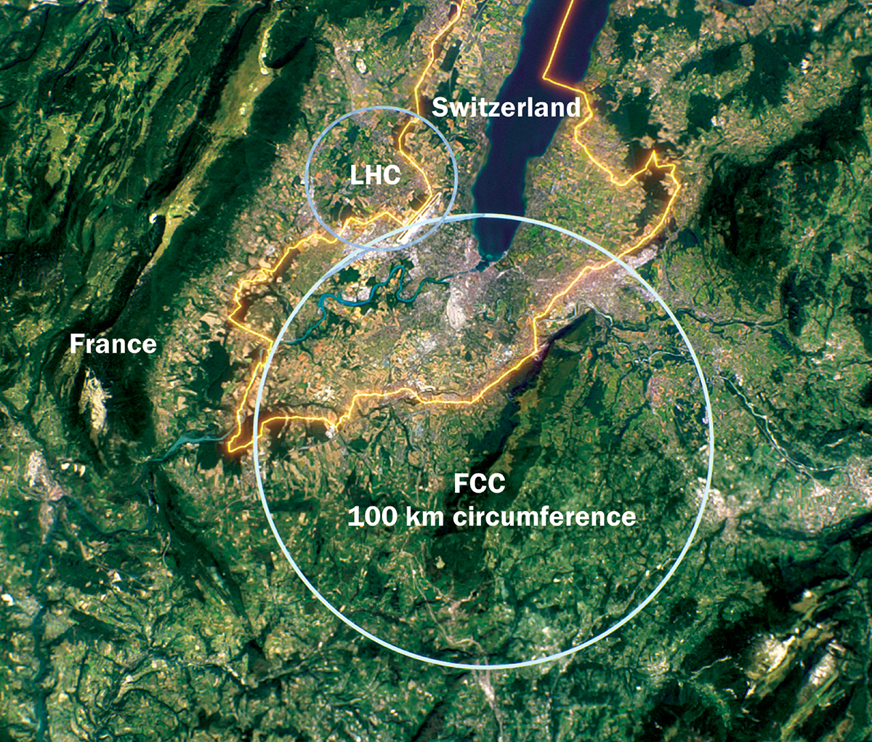
FCC-ee: electron-positron collider
“A 100 km tunnel hosting a circular electron–positron collider as a first stage towards a 100 TeV proton–proton collider would probe new phenomena coupled to the Higgs and electroweak sectors with unparalleled precision.” [1]
[1] https://cerncourier.com/a/fcc-ee-beyond-a-higgs-factory/

Slide 4
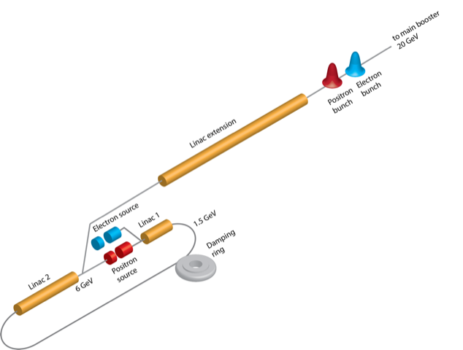
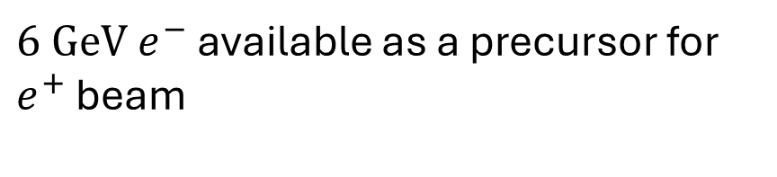

FCC-ee injector
“portions of the same linac are used for multiple purposes” [2]
$6 GeV e^{−}$ available as a precursor for $e^{+}$ beam
$$e^{−}$$
Electrons shot at target produce particles
Charged particles are captured by a magnet
[2] P. Craievich, https://www.psi.ch/en/gfa/fcc-ee-injector-design-and-psi-positron-source-pss-project

Slide 5
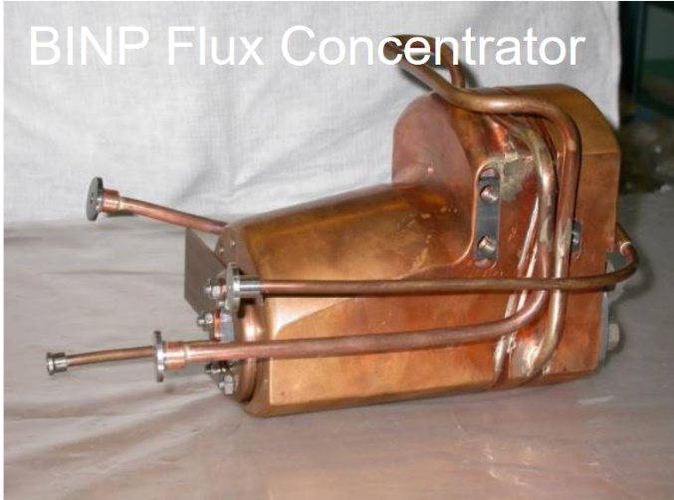
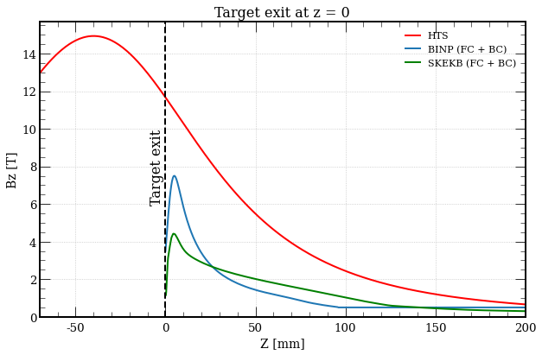


FCC-ee injector
Flux Concentrator (FC)
Pulsed copper device
Yield=$\frac{N_{e^{+}}}{N_{e^{−}}}≈3$[3]
P. Martyshkin, BINP
$$e^{−}$$
Electrons shot at target produce particles
Charged particles are captured by a magnet
We want to do better by using HTS
Yield=$\frac{N_{e^{+}}}{N_{e^{−}}}=7 [3]$
[3] N. Vallis https://doi.org/10.18429/JACoW-LINAC2022-TUPORI16

Slide 6
FCC-ee injector
$$e^{−}$$
Field profile and target location result from
numeric and analytical optimization
Y Zhao. Optimisation of the FCC-ee Positron Source Using a HTS
Solenoid Matching Device, 2022.
Y Zhao. Comparison of Different Matching Device Field Profiles for
the FCC-ee Positron Source, 2021.
R. Chehab et al., “An adiabatic matching device for the Orsay linear positron accelerator”, IEEE Trans. Nucl. Sci., 1983.

Slide 7

PSI Positron Production ($P^{3}$) Experiment @ SwissFEL
Aims to demonstrate high yield positron source in 2026
SwissFEL

Slide 8
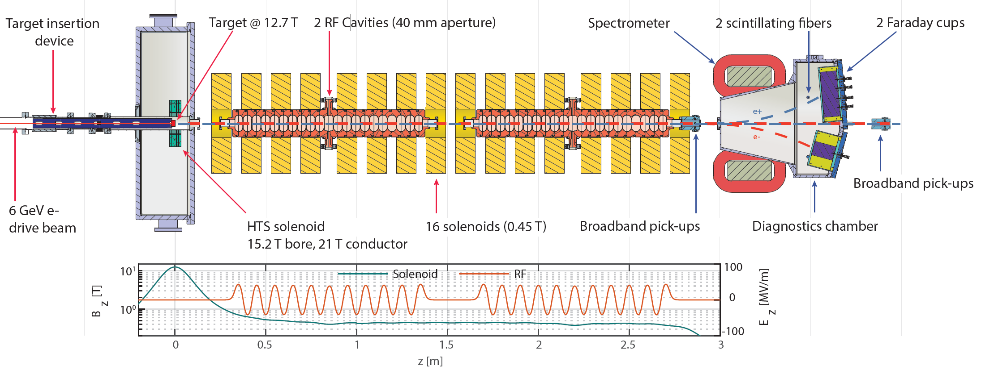
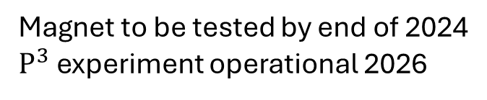
PSI Positron Production ($P^{3}$) Experiment
Aims to demonstrate high yield positron source
Magnet to be tested by end of 2024
$P^{3}$ experiment operational 2026
N. Vallis, https://doi.org/10.1103/PhysRevAccelBeams.27.013401

Slide 9
Solder-potted NI HTS: an attractive option
DC application
Loose magnetic field quality requirement
No risk of insulation radiation damage
Mechanically strong
Good thermal conductivity
Compact

Slide 10
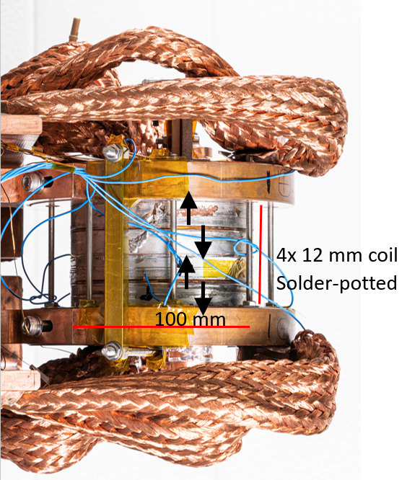


Upscaled version of 18 T PSI NI solenoid
18 T 50 mm cold bore $→$ 15 T 72 mm warm bore
Experimental results of 18 T stack used as $P^{3}$
simulation input
4 coils
Built&tested
5 coils
Under construction
Current injection method
& parts of soldering technology via
licensing agreement with
PSI 18 T solenoid

Slide 11
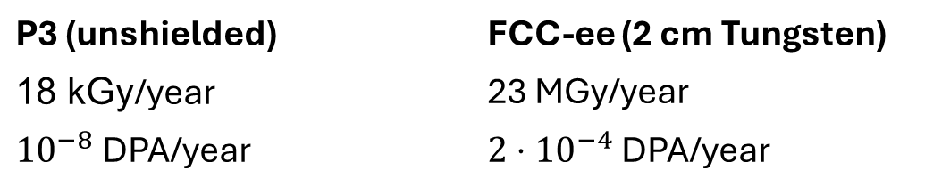
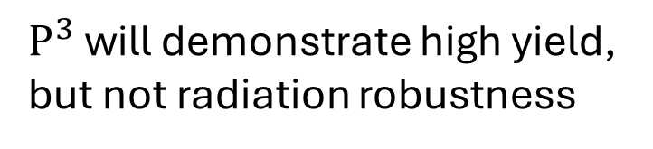
Radiation
$P^{3}$ will demonstrate high yield,
but not radiation robustness
P3 (unshielded) | FCC-ee (2 cm Tungsten)
18 kGy/year | 23 MGy/year
${10}^{−8}$ DPA/year | $2⋅{10}^{−4}$ DPA/year
B. Humann, doi:10.18429/JACoW-IPAC2022-THPOTK048

Slide 12
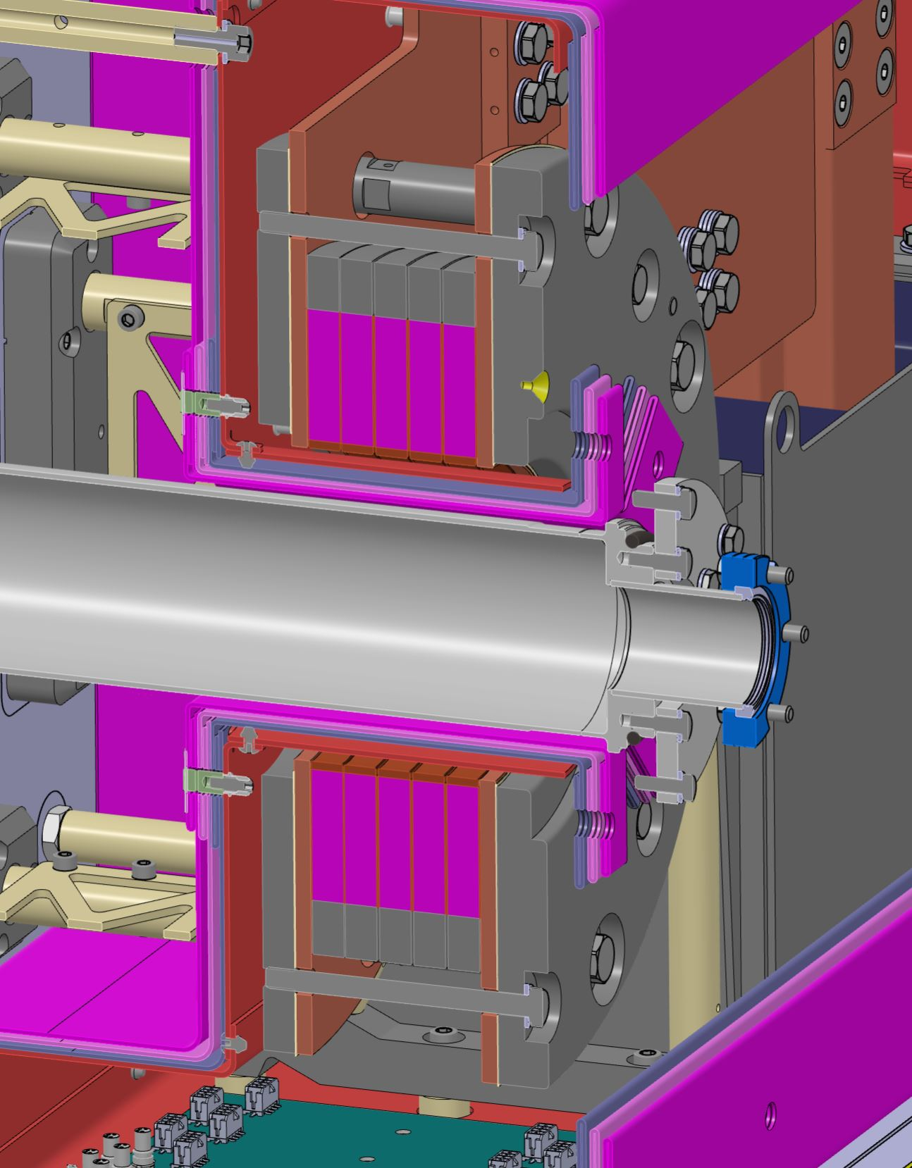
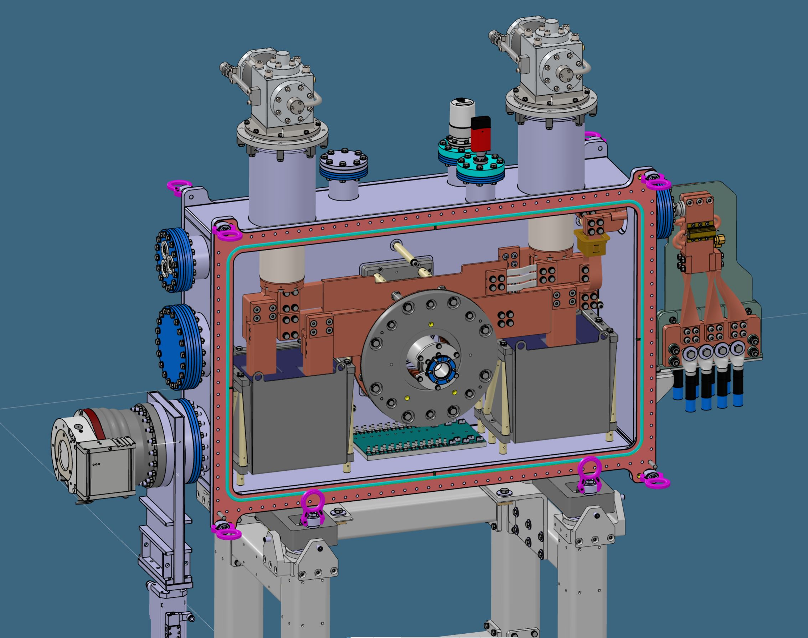

Conduction-cooled system
15 T bore, 20 T conductor @ 1.2 kA, 15 K
G10/SS support
Cryocooler
Current leads
Current terminals
Solenoid stack
HTS coils
72 mm
$$e^{−}$$
Target
1.07 m
Pb mass
Thermal shield
MLI

Slide 13
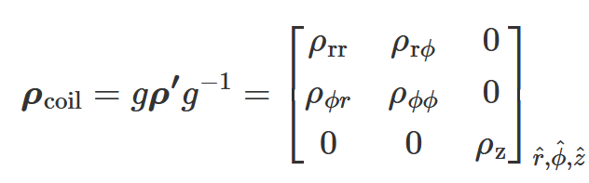
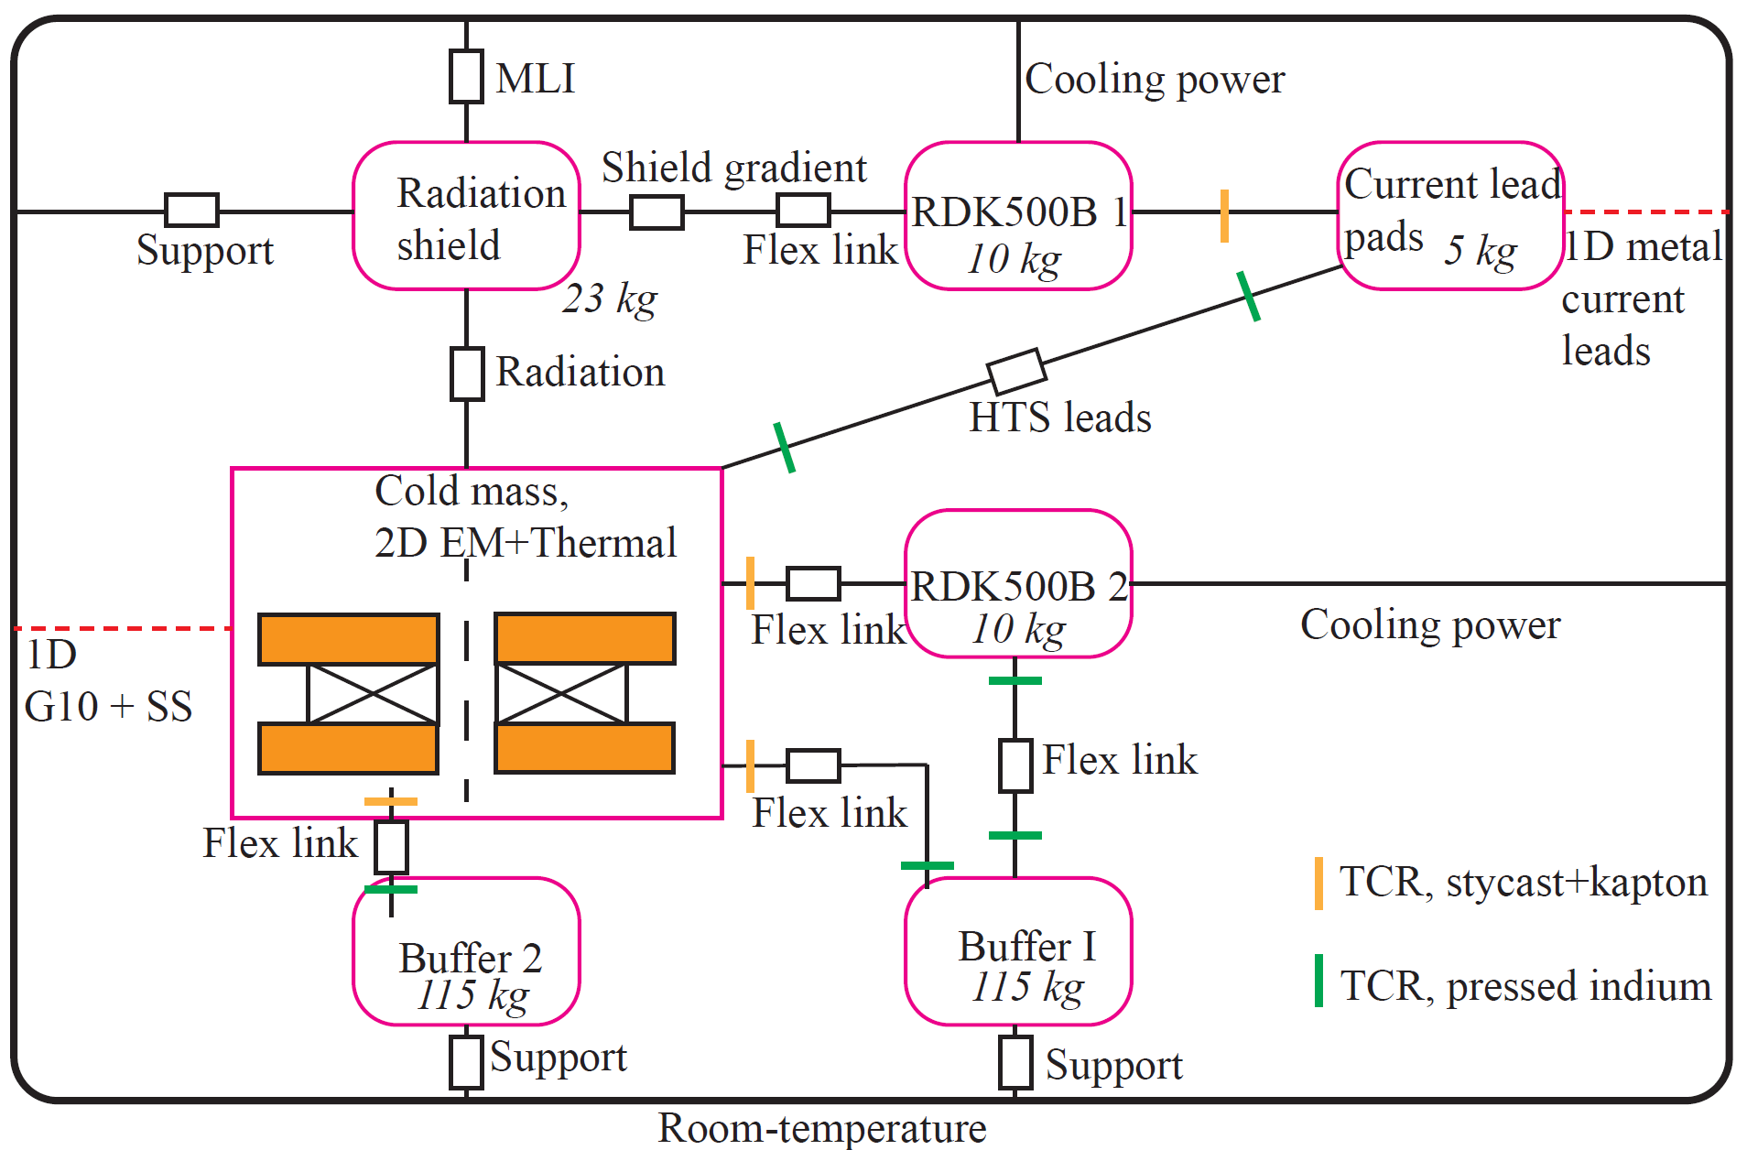
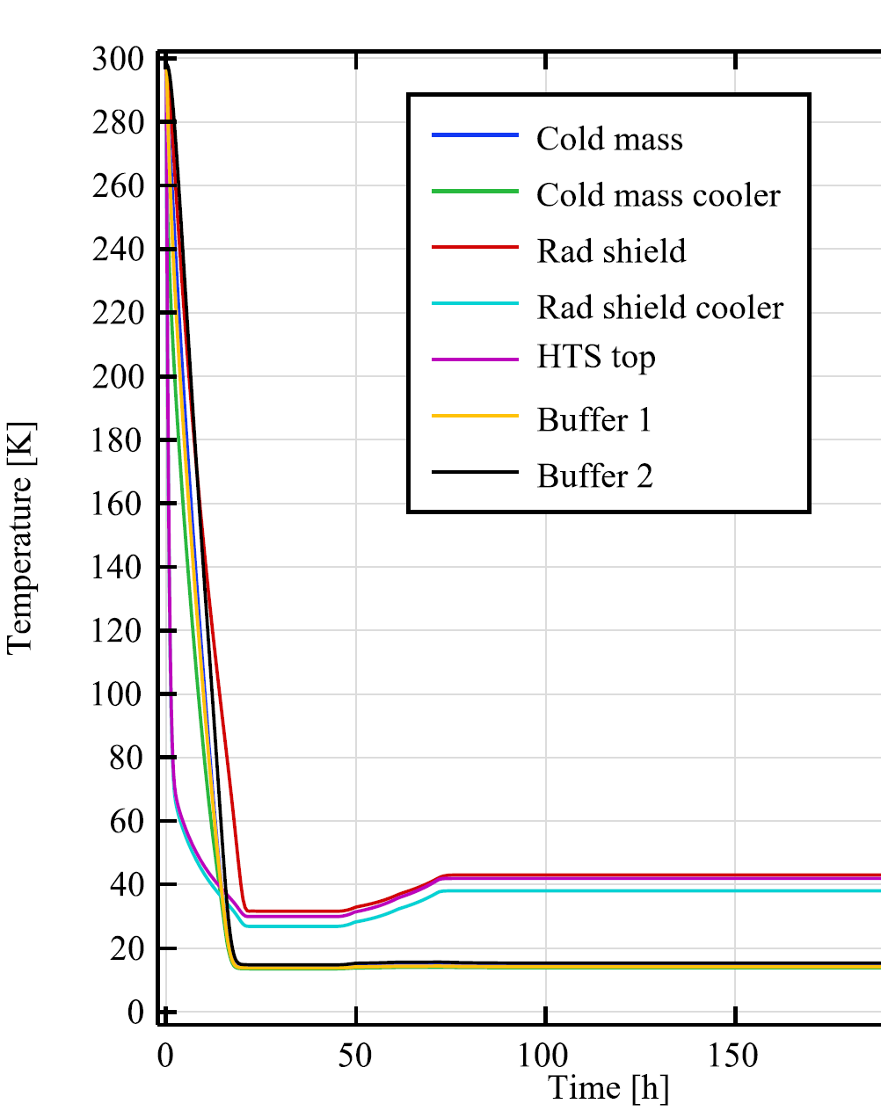

Electromagnet/thermal simulation
2D axisymmetric $H$-formulation,
homogenized winding pack,
Anisotropic resistivity matrix with off-diagonal terms
to account for the spiral nature of the coils [5]
+2D thermal
+ thermal network
[5] R Mateira, DOI 10.1088/1361-6668/ab9688

Slide 14
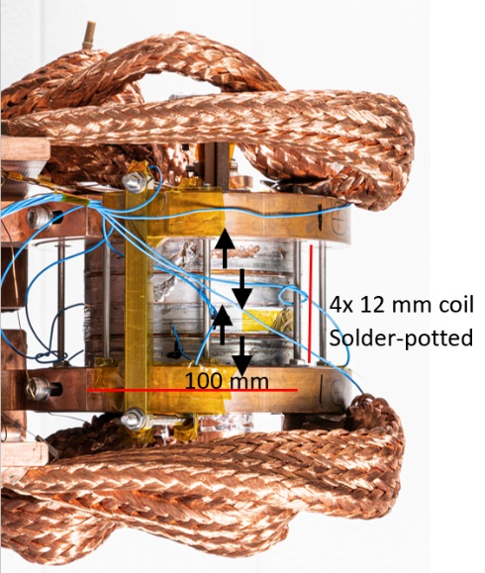
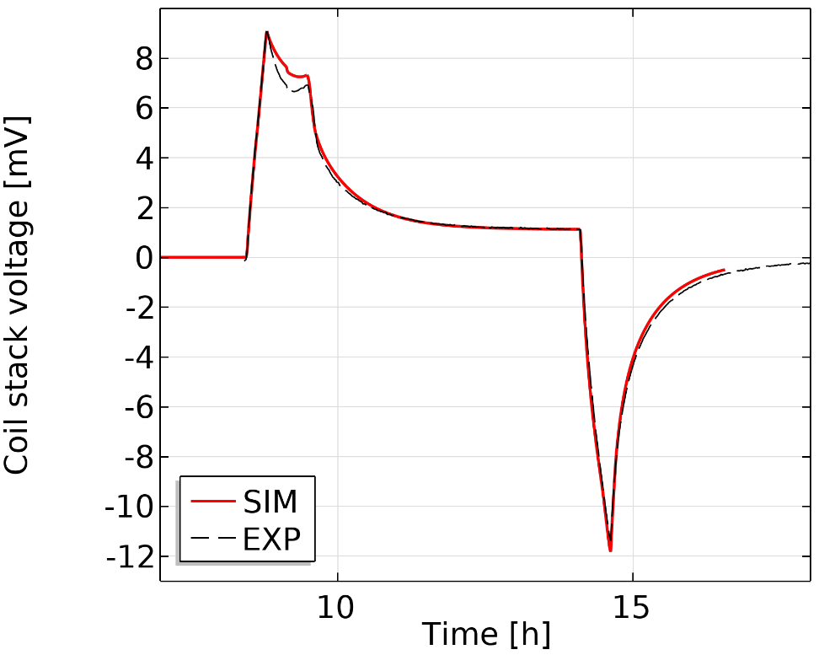
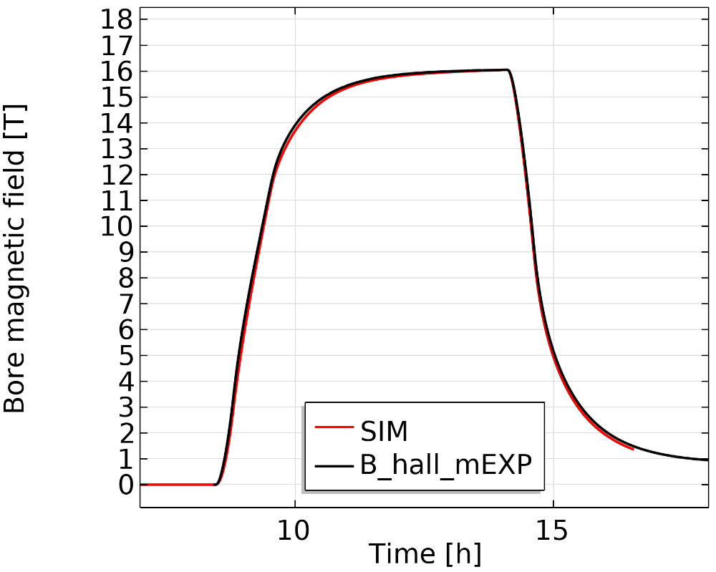
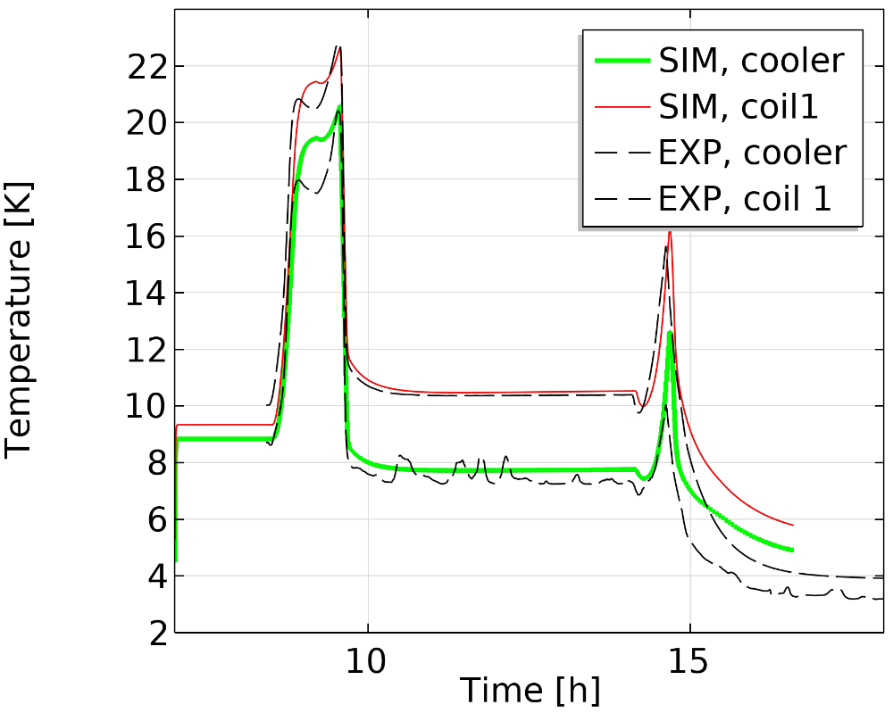

Experiment vs model
Turn-turn resistance used a fitting parameter
$$ρ_{turnturn}∝ρ_{copperRRR20}\left(B,T\right)$$
Works reasonably over a 15-77 K range
Example: 1.8 kA at 15 K in cryogen-free setup

Slide 15
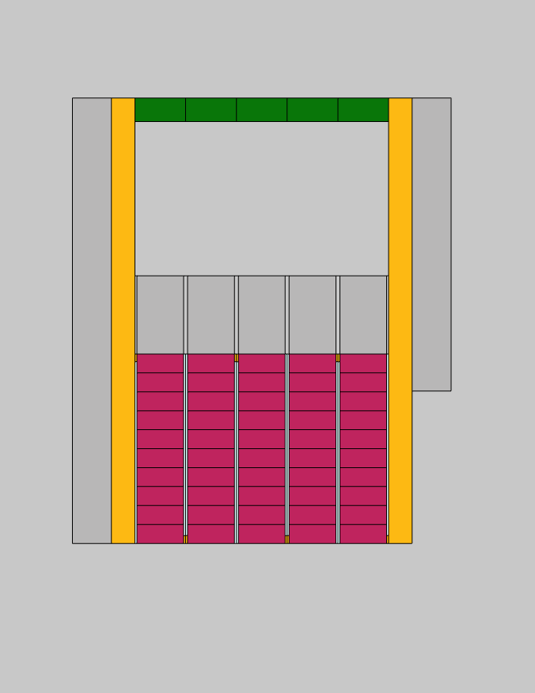

P3 simulation geometry
Current terminals
HTS coils
72 mm
$$e^{−}$$
Target

Slide 16
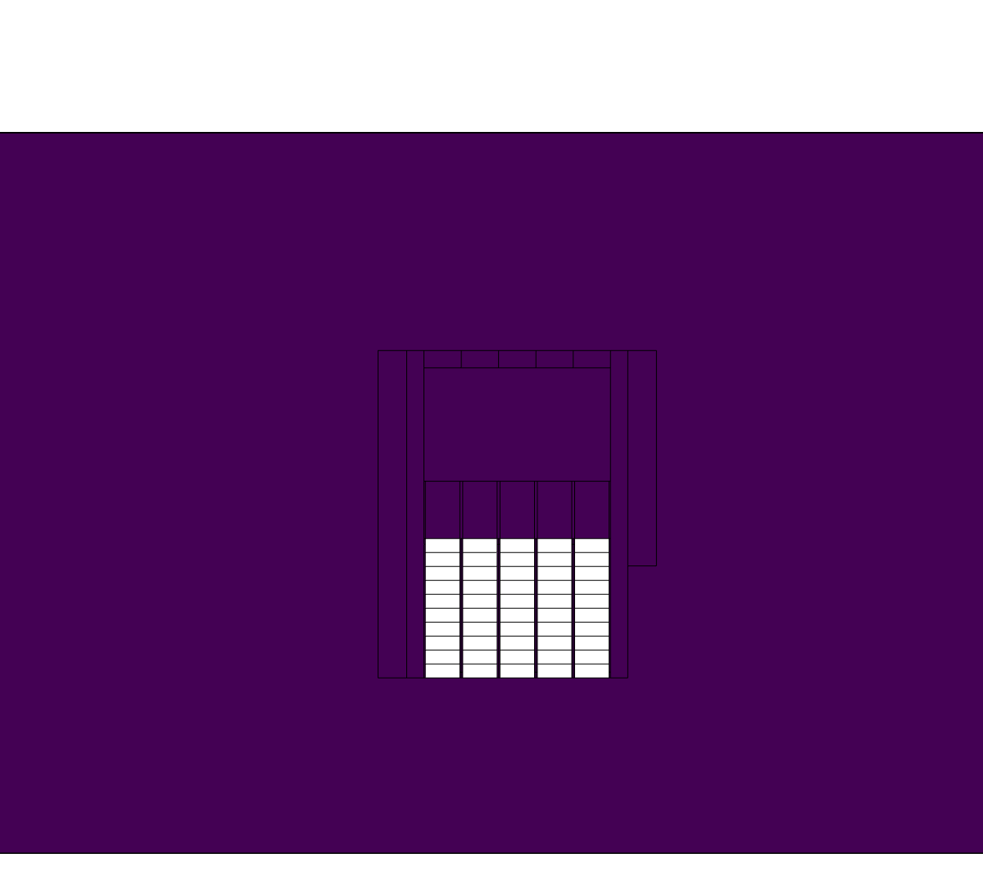
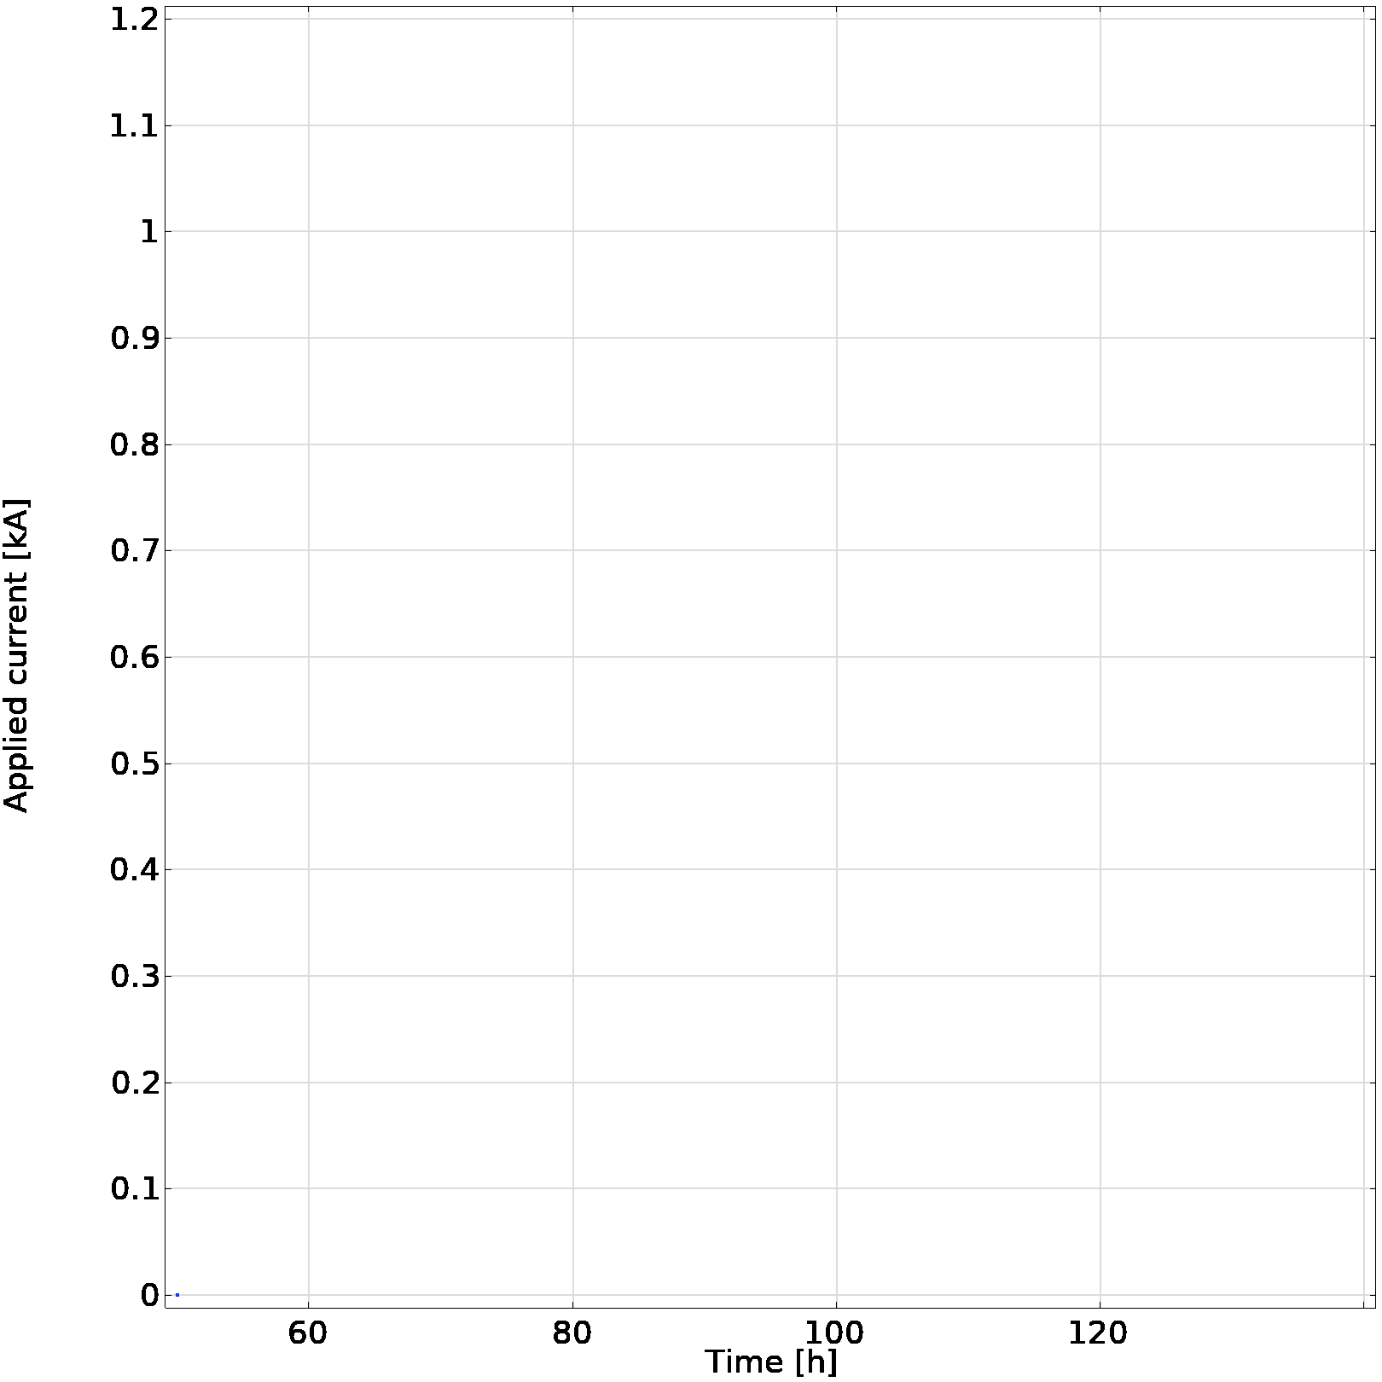
Magnet charging
Applied current [kA]
Time [h]

Slide 17
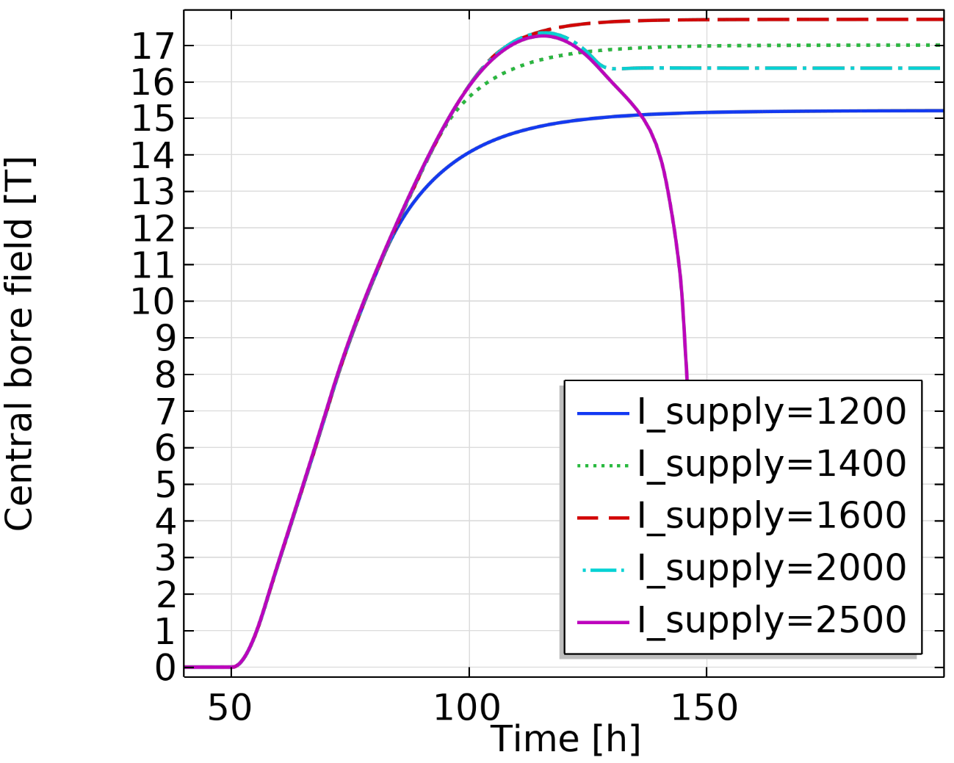
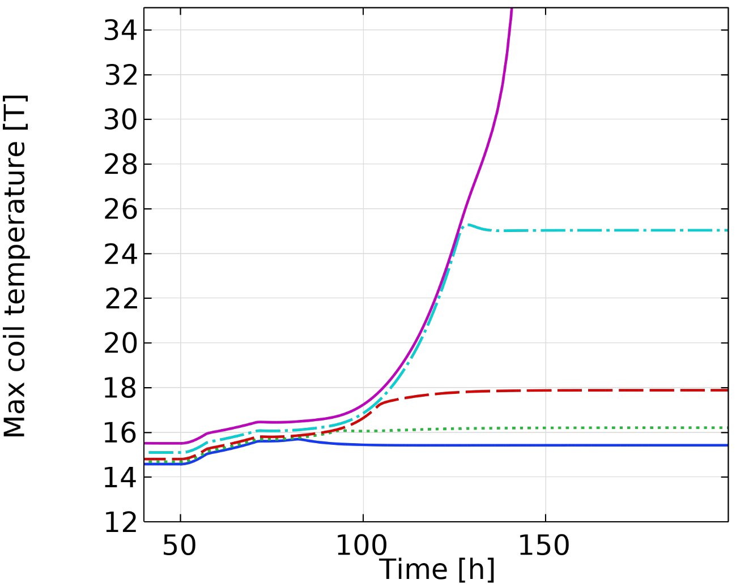
Obtainable field strongly depends on thermal aspects
[K]
17 T reachable*, but magnet at risk of quenching during failure
[5] R Mateira, DOI 10.1088/1361-6668/ab9688
*Not considering mechanical

Slide 18
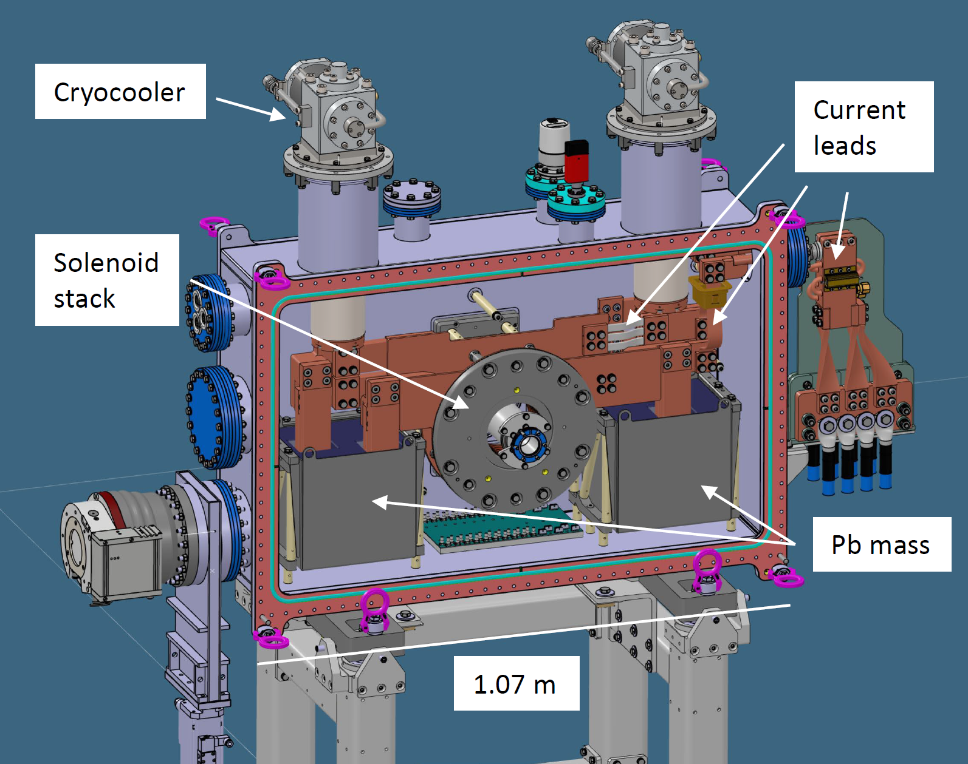
Fault scenario:
Coolers stop
R_turnturn
HTS path
Open circuit
Stored energy gets dissipated
in coils+buffers

Slide 19
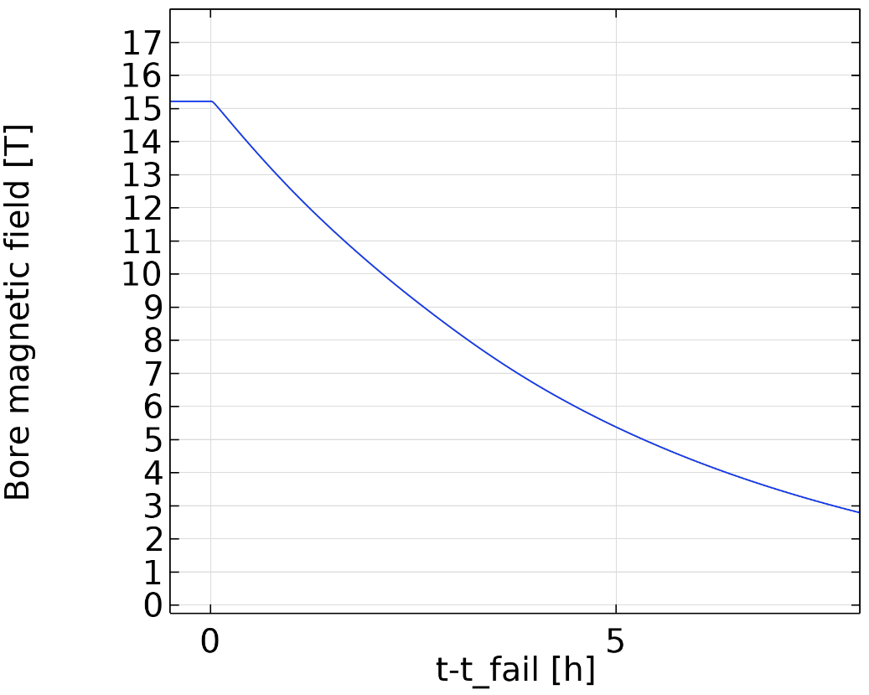
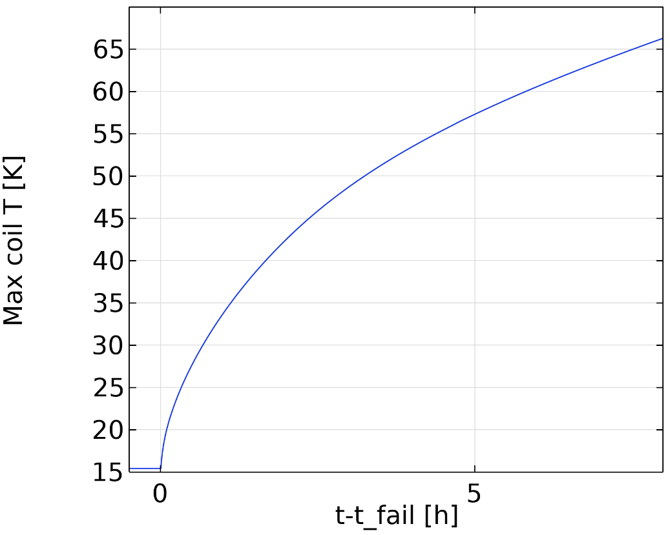
Buffer sizing
Less mass
more mass
Slow ramp-down

Slide 20
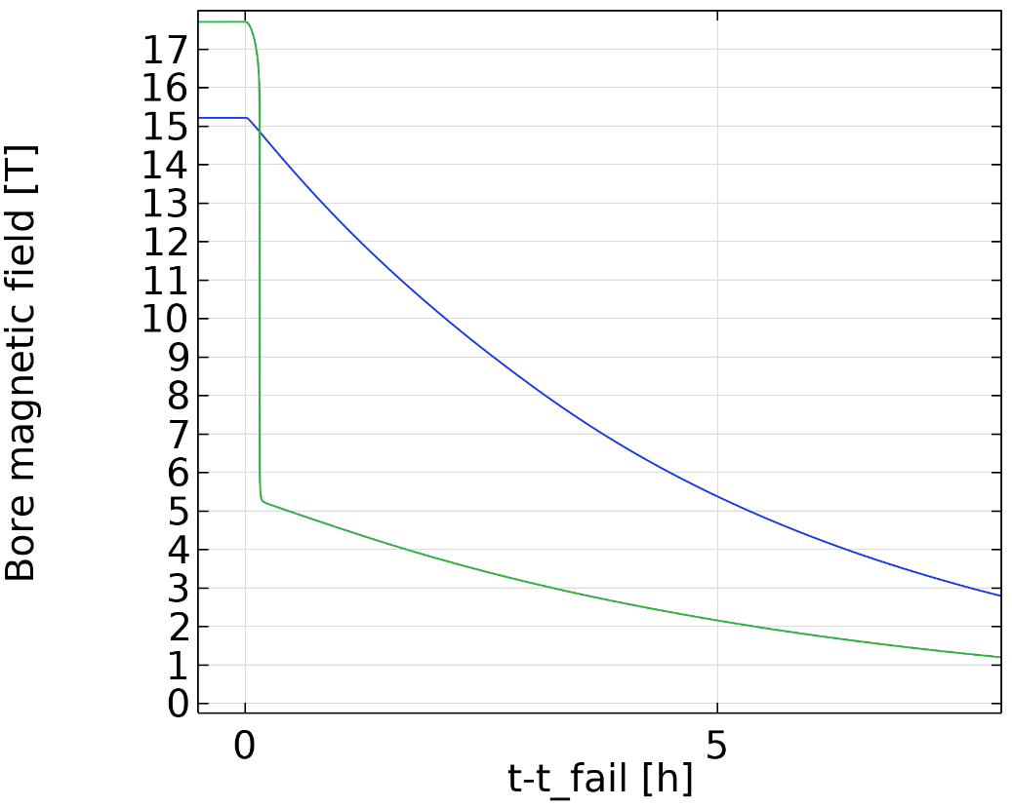
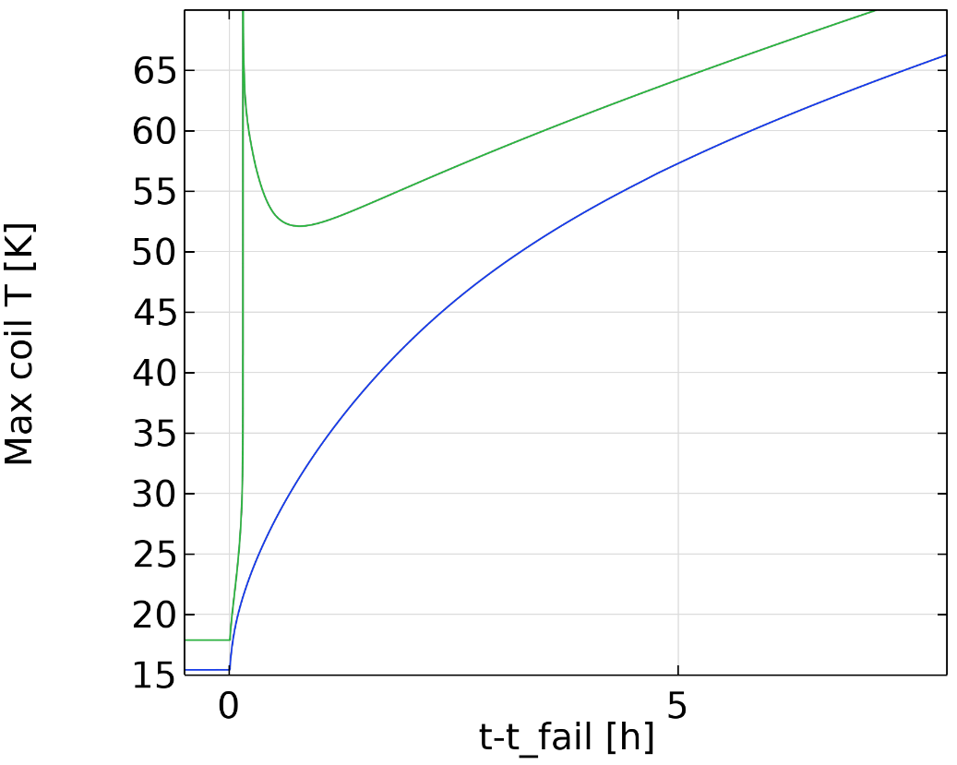
Buffer sizing
Less mass
Quench
more mass
Slow ramp-down

Slide 21
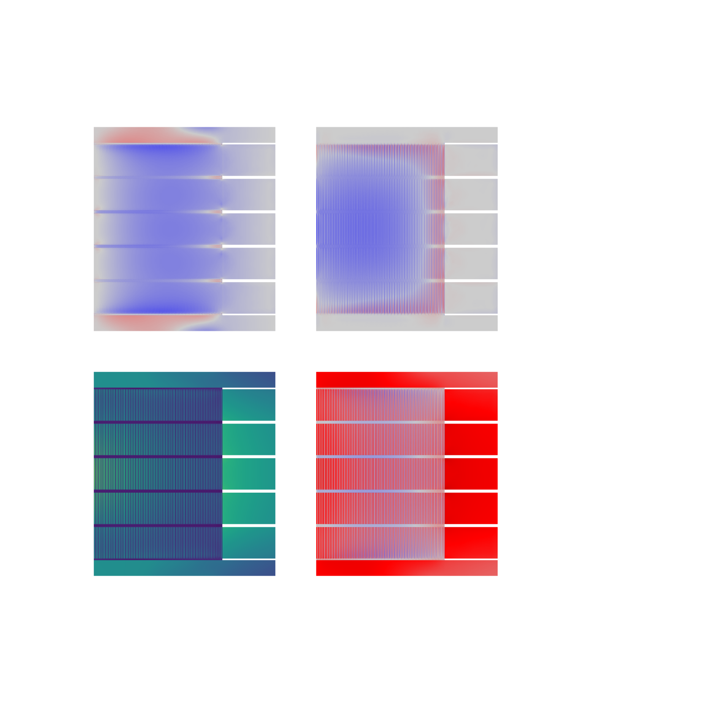
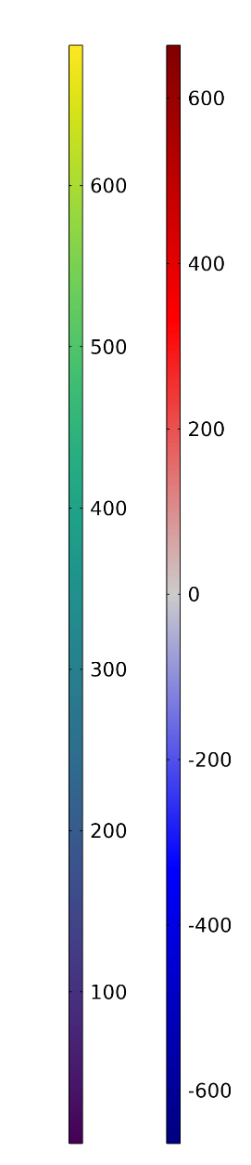
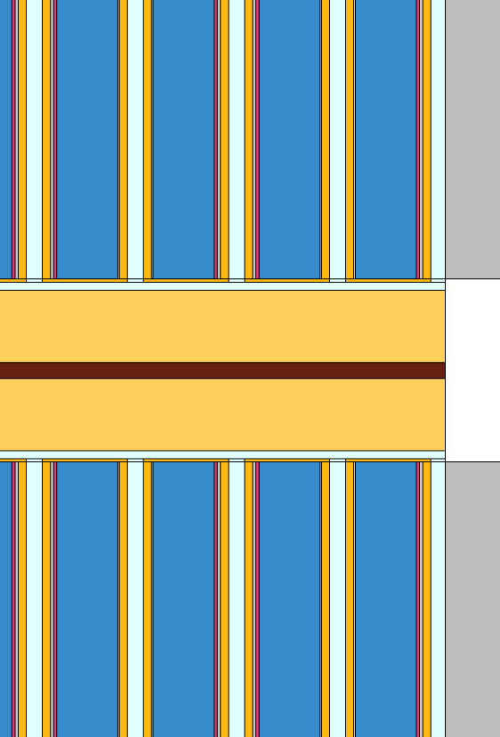
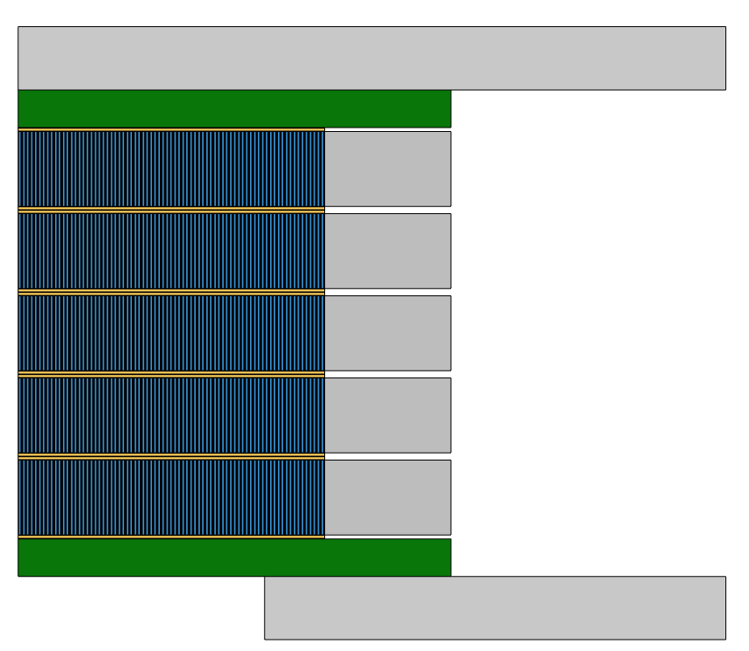


Mechanical
Stress [MPa]
a) Radial
b) Axial
Stainless steel flange
$$z$$
Copper terminal plate
Frictional
interface
$r$
Field’s metal
Stainless steel
overband
Axial plate
HTS tapes
Tape structure explicitly modeled to capture
-differential thermal contraction
-plasticity
c) Mises
d) Hoop
Max radial stress 2 MPa
Min axial stress -150 MPa
Max hoop stress (substrate) 373 MPa

Slide 22
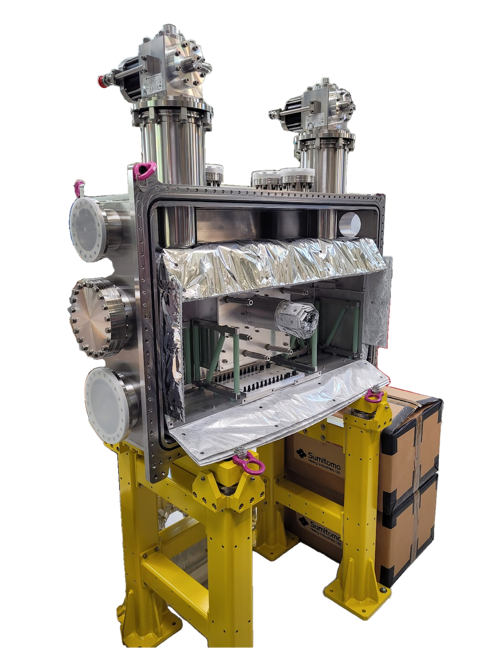
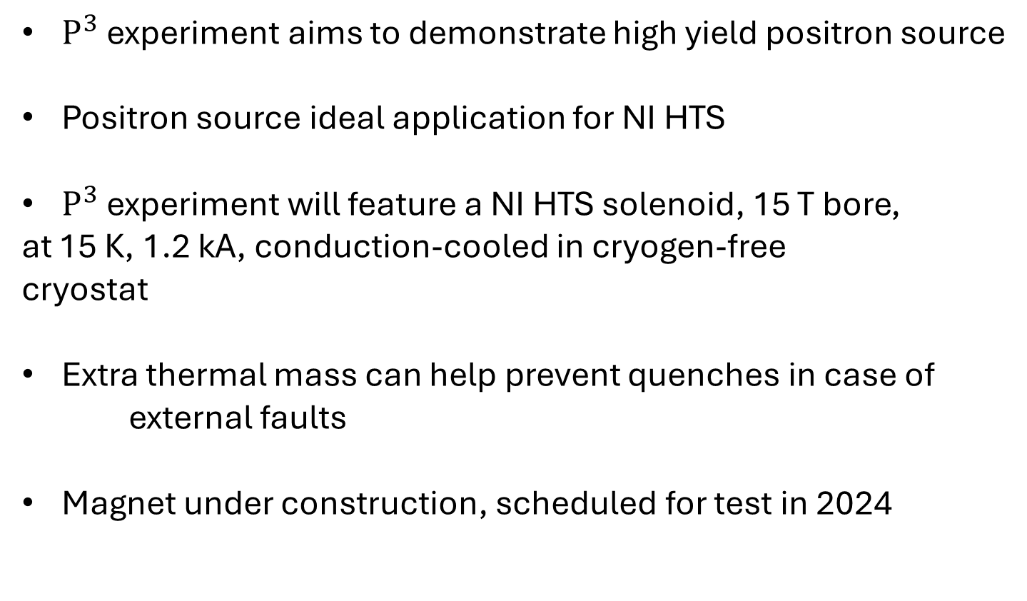
Conclusions
$P^{3}$ experiment aims to demonstrate high yield positron source
Positron source ideal application for NI HTS
$P^{3}$ experiment will feature a NI HTS solenoid, 15 T bore,
at 15 K, 1.2 kA, conduction-cooled in cryogen-free
cryostat
Extra thermal mass can help prevent quenches in case of
external faults
Magnet under construction, scheduled for test in 2024

