Slide 1
Voltage signals on the terminations of an HTS magnet modelled in A-T formulation
F. Gömöry, M. Solovyov
Institute of Electrical Engineering, Slovak Academy of Sciences, Bratislava, Slovakia
Voltage signals on the terminations of an HTS magnet modelled in A-T formulation HTS 2024 Modelling Workshop/ 10-13 June 2024, Bad Zurzach, Switzerland

Slide 2
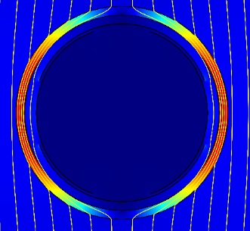
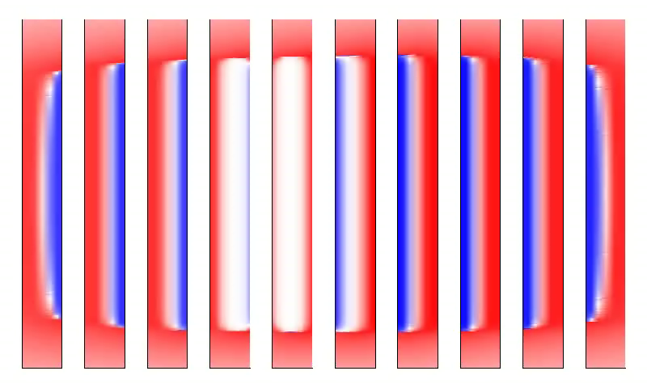
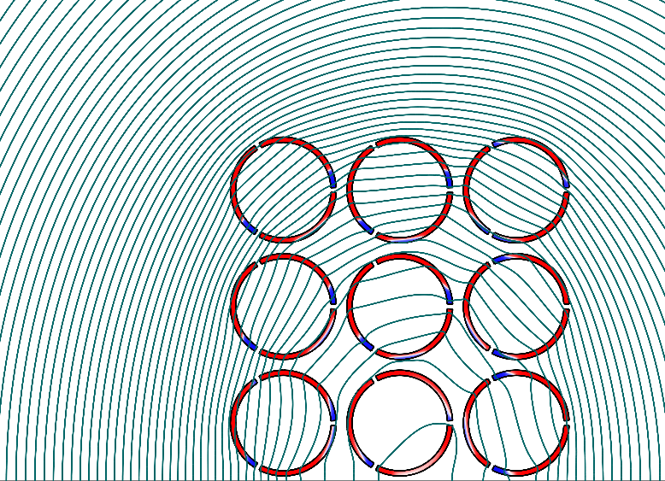
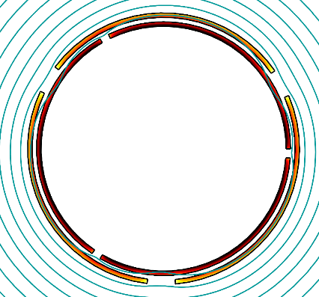
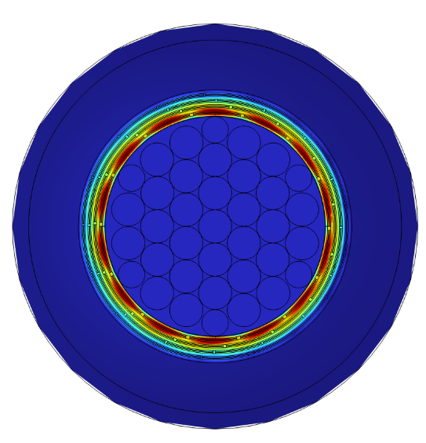
Introductory remarks
Research focus of our group:
Electromagnetic behaviour of devices from CC tapes
mainly AC loss
Methodology: Modelling and experimental verification
using electric masurements
Voltage signals on the terminations of an HTS magnet modelled in A-T formulation HTS 2024 Modelling Workshop/ 10-13 June 2024, Bad Zurzach, Switzerland

Slide 3
Outline
Introduction
Inspiration
Novelty
Application
Voltage signals on the terminations of an HTS magnet modelled in A-T formulation HTS 2024 Modelling Workshop/ 10-13 June 2024, Bad Zurzach, Switzerland

Slide 4
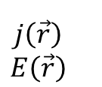
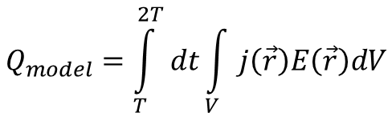
Introduction
Device
(e.g. coil from CC tapes)
Modelling of AC loss
local values
I_{coil}
$$j\left(\vec{r}\right)$$
$$E\left(\vec{r}\right)$$
$$Q_{model}=\int_{T}^{2T}{dt}\int_{V}{j\left(\vec{r}\right)E\left(\vec{r}\right)dV}$$
Voltage signals on the terminations of an HTS magnet modelled in A-T formulation HTS 2024 Modelling Workshop/ 10-13 June 2024, Bad Zurzach, Switzerland

Slide 5
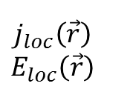
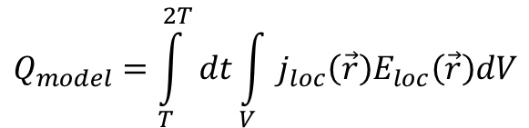
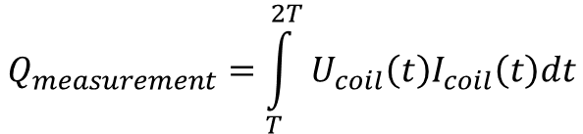
Introduction
Measurement of AC loss
(electric method)
Device
(e.g. coil from CC tapes)
Modelling of AC loss
local values
I_{ps}
I_{coil}
∼
$$j_{loc}\left(\vec{r}\right)$$
$$E_{loc}\left(\vec{r}\right)$$
U_{ps}
U_{coil}
$$Q_{measurement}=\int_{T}^{2T}{U_{coil}\left(t\right)I_{coil}\left(t\right)dt}$$
$$Q_{model}=\int_{T}^{2T}{dt}\int_{V}{j_{loc}\left(\vec{r}\right)E_{loc}\left(\vec{r}\right)dV}$$
derivation of U_{coil} in modelling of AC loss → better comparison with experiment
Voltage signals on the terminations of an HTS magnet modelled in A-T formulation HTS 2024 Modelling Workshop/ 10-13 June 2024, Bad Zurzach, Switzerland

Slide 6



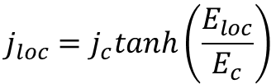
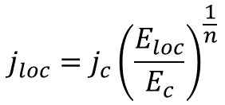
Inspiration
Example of using macroscopic quantities derived from numerical model – transport AC loss in CC tape
Cu top
A-ϕ formulation in 2D
$$∇^{2}A=μ_{0}j_{loc}$$
Ag top
REBCO
buffers
Hastelloy
Ag side
Ag bottom
$$j_{loc}=j_{loc}\left(E_{loc}\right)$$
$$j_{loc}=j_{c}{\left(\frac{E_{loc}}{E_{c}}\right)}^{\frac{1}{n}}$$
superconductor:
Cu bottom
$$j_{loc}=j_{c}tanh\left(\frac{E_{loc}}{E_{c}}\right)$$
metals:
$$j_{loc}=σ_{metal}E_{loc}$$
Voltage signals on the terminations of an HTS magnet modelled in A-T formulation HTS 2024 Modelling Workshop/ 10-13 June 2024, Bad Zurzach, Switzerland

Slide 7
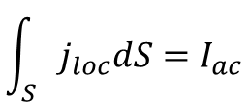





Inspiration
Example of using macroscopic quantities derived from numerical model – transport AC loss in CC tape
Cu top
A-ϕ formulation in 2D
$$∇^{2}A=μ_{0}j_{loc}$$
Ag top
REBCO
buffers
Hastelloy
Ag side
Ag bottom
$$j_{loc}=j_{loc}\left(E_{loc}\right)$$
$$\int_{S}{j_{loc}dS}=I_{ac}$$
Cu bottom
E. Pardo and F. Grilli, F.: Electromagnetic modeling of superconductors. In Numerical modeling of superconducting applications, World Sci Publ. Co. Pte. Ltd., 2023, Chapter 1.1.3
$$E_{loc}=−\frac{∂A}{∂t}−∇φ$$
macroscopic (measurable) quantity:
y
electric field intensity:
$$E_{φ}=−∇φ$$
x
$$I_{ac}=I_{max}sin\left(ωt\right)$$
Voltage signals on the terminations of an HTS magnet modelled in A-T formulation HTS 2024 Modelling Workshop/ 10-13 June 2024, Bad Zurzach, Switzerland

Slide 8
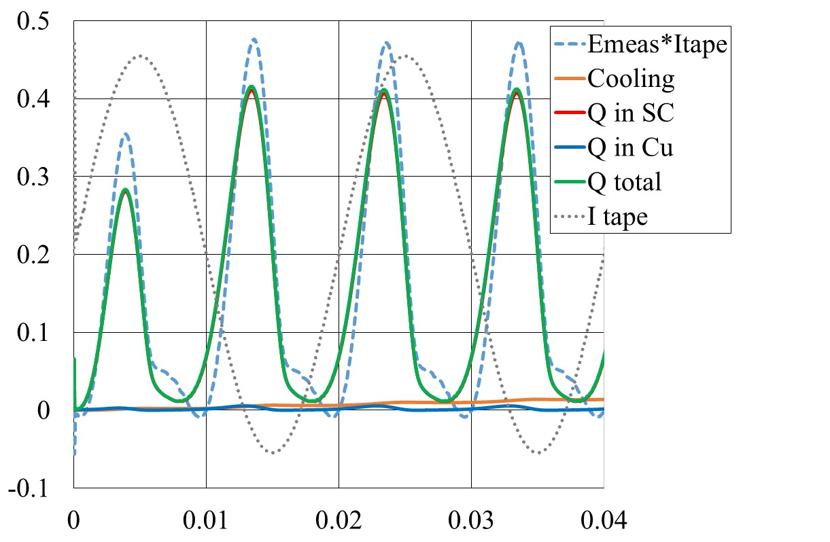
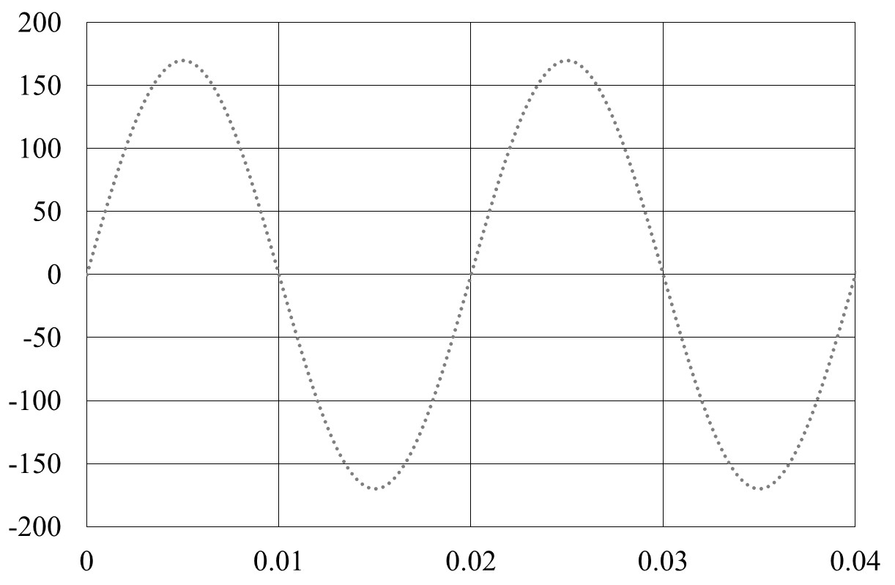
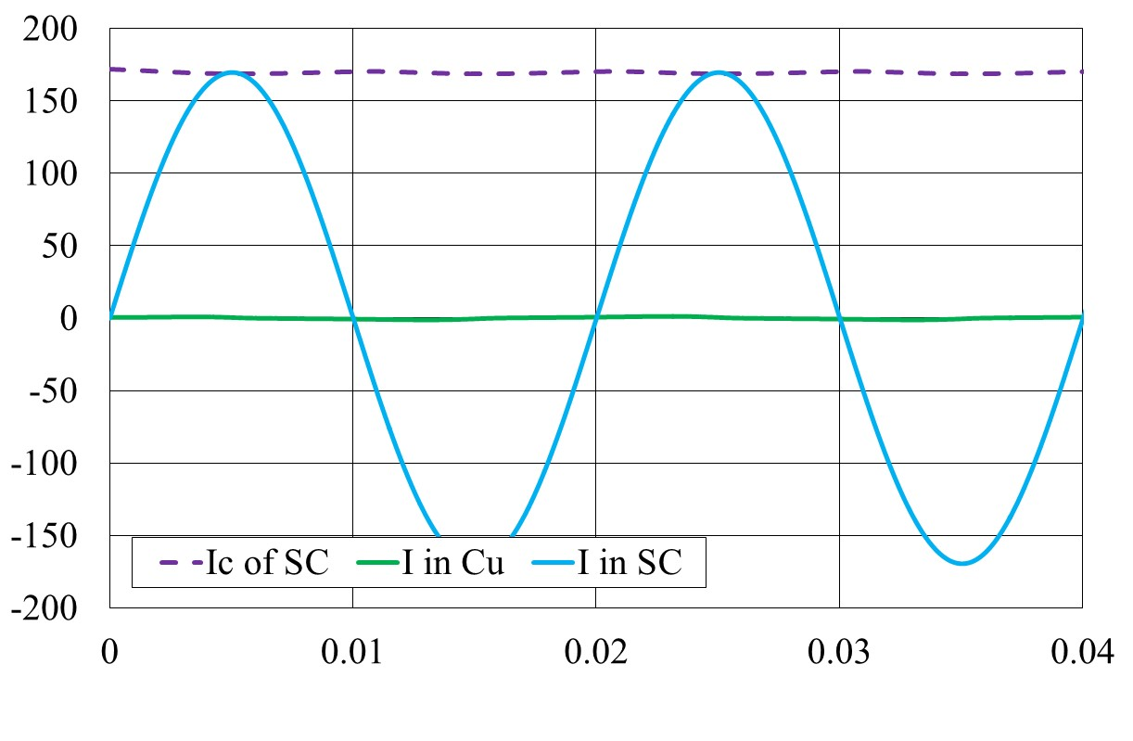


Inspiration
Example of using macroscopic quantities derived from numerical model – transport AC loss in CC tape
Cu top
A-ϕ formulation in 2D
$$∇^{2}A=μ_{0}j_{loc}$$
Ag top
REBCO
buffers
Hastelloy
Ag side
Ag bottom
$$j_{loc}=j_{loc}\left(E_{loc}\right)$$
$$E_{loc}=−\frac{∂A}{∂t}−∇φ$$
$$\int_{S}{j_{loc}dS}=I_{ac}$$
Cu bottom
E_{ϕ,comp}I_{tape}
P [W/m]
I_{tape}
[A]
t [s]
t [s]
t [s]
Voltage signals on the terminations of an HTS magnet modelled in A-T formulation HTS 2024 Modelling Workshop/ 10-13 June 2024, Bad Zurzach, Switzerland

Slide 9

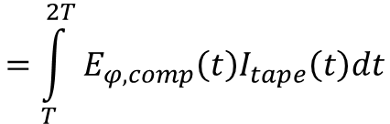
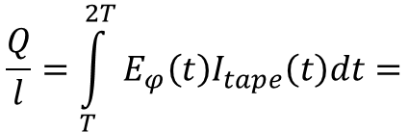
Inspiration
Example of using macroscopic quantities derived from numerical model – transport AC loss in CC tape
Cu top
A-ϕ formulation in 2D
$$∇^{2}A=μ_{0}j_{loc}$$
Ag top
REBCO
buffers
Hastelloy
Ag side
Ag bottom
$$j_{loc}=j_{loc}\left(E_{loc}\right)$$
$$E_{loc}=−\frac{∂A}{∂t}−∇φ$$
$$\int_{S}{j_{loc}dS}=I_{ac}$$
Cu bottom
Removing of purely inductive signal
E_{ϕ,comp}I_{tape}
P [W/m]
$$E_{φ,comp}=−∇φ−L_{aux}\frac{dI}{dt}$$
I_{tape}
[A]
$$\frac{Q}{l}=\int_{T}^{2T}{E_{φ}\left(t\right)I_{tape}\left(t\right)dt=}$$
$$=\int_{T}^{2T}{E_{φ,comp}\left(t\right)I_{tape}\left(t\right)dt}$$
t [s]
t [s]
Voltage signals on the terminations of an HTS magnet modelled in A-T formulation HTS 2024 Modelling Workshop/ 10-13 June 2024, Bad Zurzach, Switzerland

Slide 10
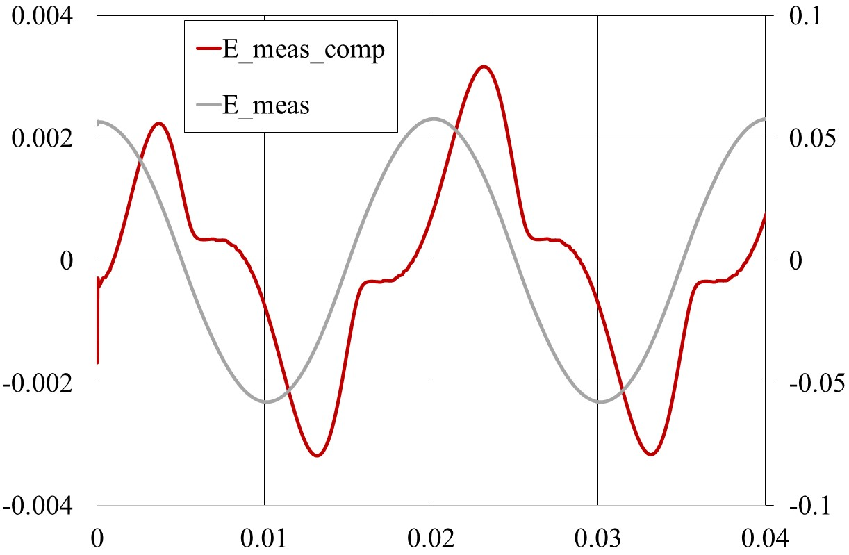

Inspiration
Example of using macroscopic quantities derived from numerical model – transport AC loss in CC tape
Cu top
A-ϕ formulation in 2D
$$∇^{2}A=μ_{0}j_{loc}$$
Ag top
REBCO
buffers
Hastelloy
Ag side
Ag bottom
$$j_{loc}=j_{loc}\left(E_{loc}\right)$$
$$E_{loc}=−\frac{∂A}{∂t}−∇φ$$
$$\int_{S}{j_{loc}dS}=I_{ac}$$
Cu bottom
$$E_{φ,comp}=−∇φ−L_{aux}\frac{dI}{dt}$$
[V/m]
E_{ϕ,comp}I_{tape}
E_{ϕ,comp}
E_{ϕ}
P [W/m]
I_{tape}
[A]
t [s]
t [s]
t [s]
Voltage signals on the terminations of an HTS magnet modelled in A-T formulation HTS 2024 Modelling Workshop/ 10-13 June 2024, Bad Zurzach, Switzerland

Slide 11
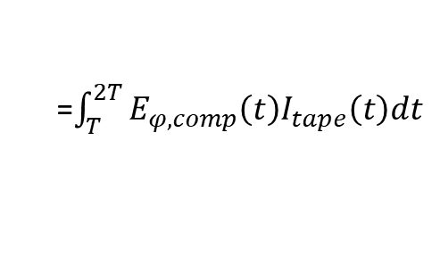
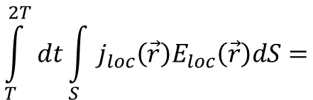
Inspiration
Example of using macroscopic quantities derived from numerical model – transport AC loss in CC tape
Cu top
A-ϕ formulation in 2D
$$∇^{2}A=μ_{0}j_{loc}$$
Ag top
REBCO
buffers
Hastelloy
Ag side
Ag bottom
$$j_{loc}=j_{loc}\left(E_{loc}\right)$$
$$E_{loc}=−\frac{∂A}{∂t}−∇φ$$
$$\int_{S}{j_{loc}dS}=I_{ac}$$
Cu bottom
$$E_{φ,comp}=−∇φ−L_{aux}\frac{dI}{dt}$$
[V/m]
E_{ϕ,comp}I_{tape}
Check of correctness and precision:
E_{ϕ,comp}
E_{ϕ}
P [W/m]
$$\int_{T}^{2T}{dt}\int_{S}{j_{loc}\left(\vec{r}\right)E_{loc}\left(\vec{r}\right)dS=}$$
=$\int_{T}^{2T}{E_{φ,comp}\left(t\right)I_{tape}\left(t\right)dt}$
t [s]
t [s]
Voltage signals on the terminations of an HTS magnet modelled in A-T formulation HTS 2024 Modelling Workshop/ 10-13 June 2024, Bad Zurzach, Switzerland

Slide 12





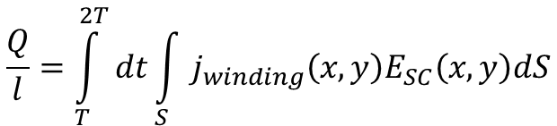


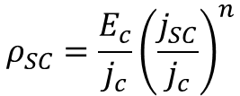

Inspiration – T-A formulation
N = 10 turns, superconductor w_{SC} = 12 mm × t_{SC} = 10 µm, Bean model with I_{c} = 800 A,
$$j_{c}=\frac{I_{c}}{w_{SC}t_{SC}}$$
N, Amemiya, S. I. Murasawa, N. Banno N and K. Miyamoto,”Numerical modelings of superconducting wires for AC loss calculations,” Physica C 310 (1998) 16–29
$$j_{SC}=\frac{∂T}{∂x}$$
$$ρ_{SC}=\frac{E_{c}}{j_{c}}{\left(\frac{j_{SC}}{j_{c}}\right)}^{n}$$
$$E_{SC}=ρ_{SC}j_{SC}$$
T = I_{coil}/t_{SC}
T = 0
y
$$\frac{{∂E}_{SC}}{∂x}=−\frac{{∂B}_{y}}{∂t}$$
z
y
x
x
w_{turn} = w_{SC}
homogenization (not necessary for 10 turns):
$$j_{winding}=j_{SC}\frac{t_{SC}}{t_{turn}}$$
t_{turn} = 1 mm
E. Berrospe-Juarez, V. M. R. Zermeno, F. Triallaud and F. Grilli, “Real-time simulation of large-scale HTS systems: multi-scale and homogeneous models using the T–A formulation,” Supercond. Sci. Technol. 32 (2019) 065003
AC excitation [A]:
Loss density [J/m³]:
Loss per cycle [J/m]:
$$I_{coil}=I_{max}cos\left(2πft\right)$$
$$q_{winding}=j_{winding}E_{SC}$$
$$\frac{Q}{l}=\int_{T}^{2T}{dt}\int_{S}{j_{winding}\left(x,y\right)E_{SC}\left(x,y\right)dS}$$
Voltage signals on the terminations of an HTS magnet modelled in A-T formulation HTS 2024 Modelling Workshop/ 10-13 June 2024, Bad Zurzach, Switzerland

Slide 13
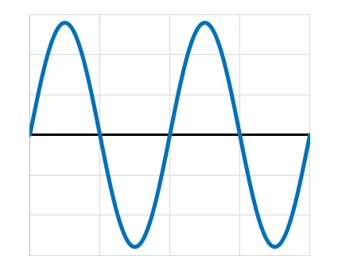
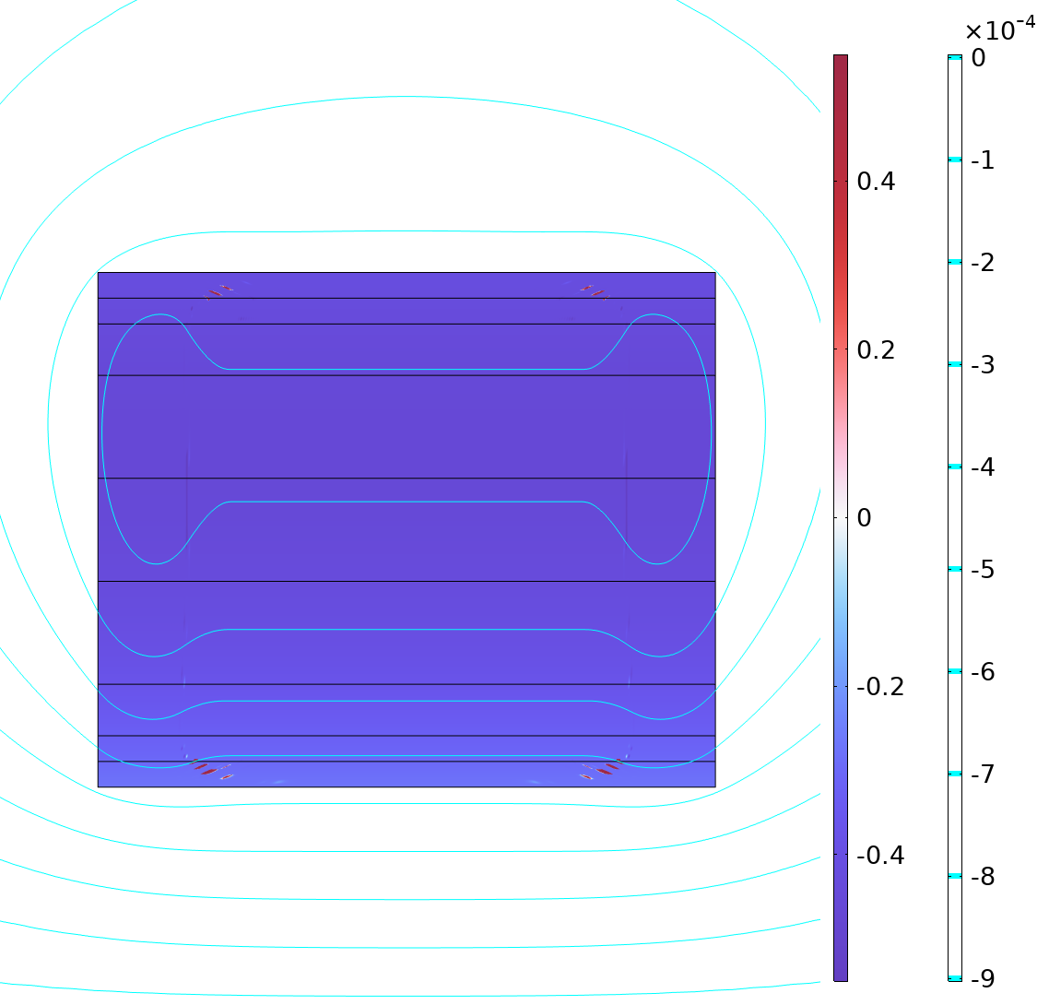
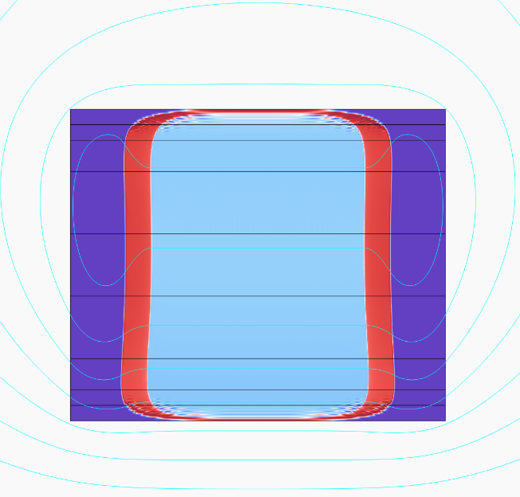
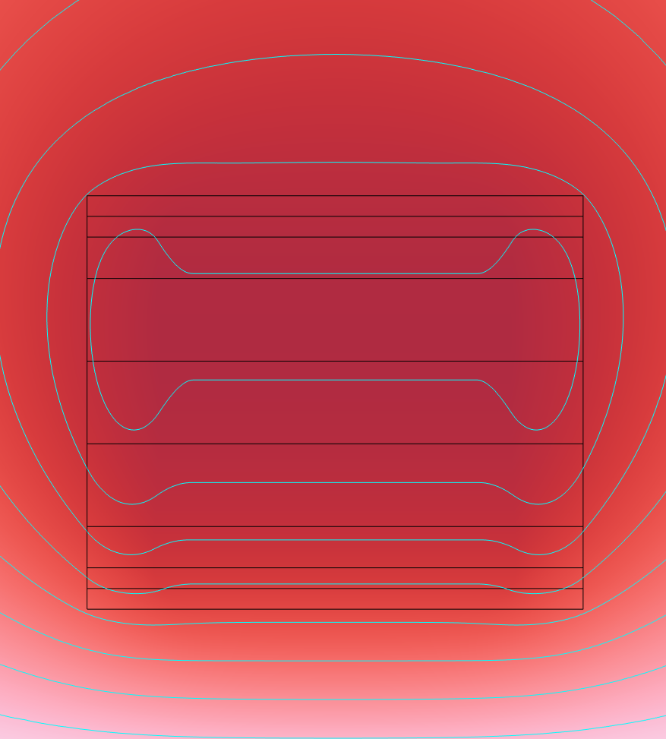
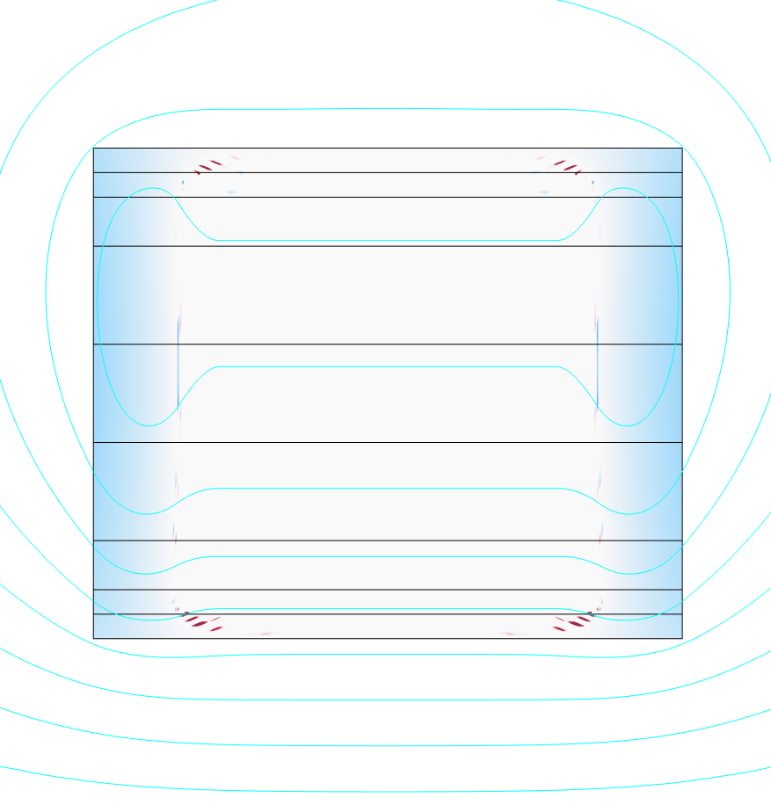






Novelty
how to extract the E_{ϕ} ?
$$E_{SC}=−\frac{∂A}{∂t}−∇φ$$
$${−∇φ=E_{φ}=E}_{SC}+\frac{∂A}{∂t}$$
in ComsolMultiphysics, mf module:
$$j_{SC}=\frac{∂T}{∂x}$$
set as „external current density“,
$$E_{SC}=ρ_{SC}j_{SC}$$
$$\frac{∂A}{∂t}=−E_{z,mf}$$
then:
ωt = 3.74
$$E_{φ}=E_{SC}−E_{z,mf}$$
J_{z}
E_{SC}
E_{z,mf}
E_{ϕ}
Voltage signals on the terminations of an HTS magnet modelled in A-T formulation HTS 2024 Modelling Workshop/ 10-13 June 2024, Bad Zurzach, Switzerland

Slide 14
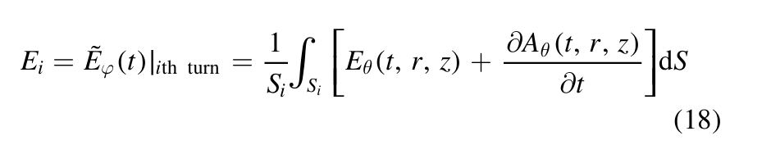


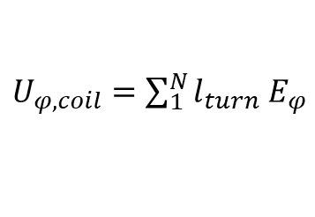
Novelty
E_{ϕ}
$E_{φ}=$ ${E_{SC}−E}_{z,mf}$
is constant in each (fictive) turn
similar approach applicable to H- fomulation:
F. Gömöry and J. Sheng.: Two methods of AC loss calculation in numerical modelling of superconducting coils. Supercond. Sci Technol. 30 (2017) 064005
voltage on coil terminations:
$U_{φ,coil}=\sum_{1}^{N}{l_{turn}}$ $E_{φ}$
averaging over coil cross-section
$$U_{φ,coil}=l_{turn}N\overline{E_{φ}}=l_{turn}N\left(\overline{{E_{SC}−E}_{z,mf}}\right)$$
representative:
$$E_{coil}=\overline{E_{φ}}$$
Voltage signals on the terminations of an HTS magnet modelled in A-T formulation HTS 2024 Modelling Workshop/ 10-13 June 2024, Bad Zurzach, Switzerland

Slide 15
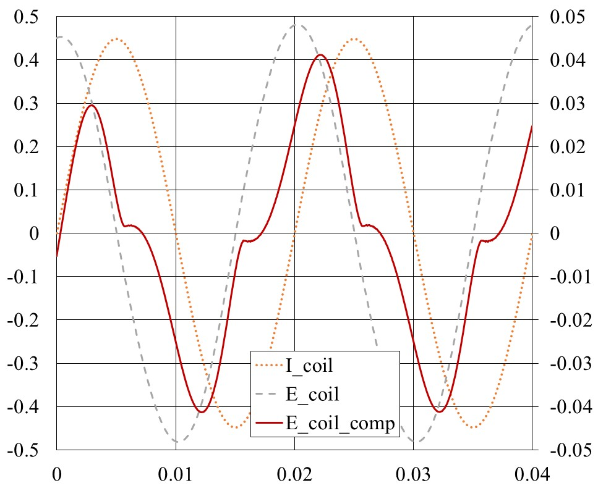
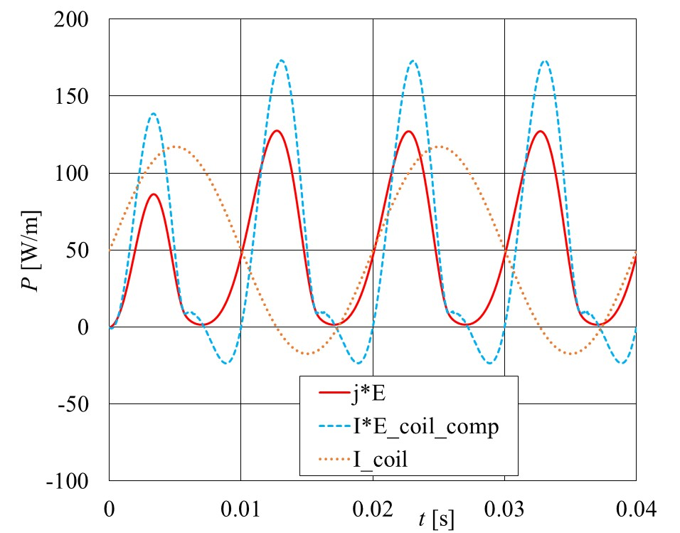
Novelty
results for 50 Hz, I_{max} = 560 A
E_{coil} [V/m]
E_{coil,comp} [V/m]
t [s]
1st cycle:
Q_{loss, j*E} = 0.823 J/m
Q_{loss, I*E} = 0.912 [J/m]
2nd cycle:
Q_{loss, j*E} = 1.06 J/m
Q_{loss, I*E} = 1.07 [J/m]
Voltage signals on the terminations of an HTS magnet modelled in A-T formulation HTS 2024 Modelling Workshop/ 10-13 June 2024, Bad Zurzach, Switzerland

Slide 16
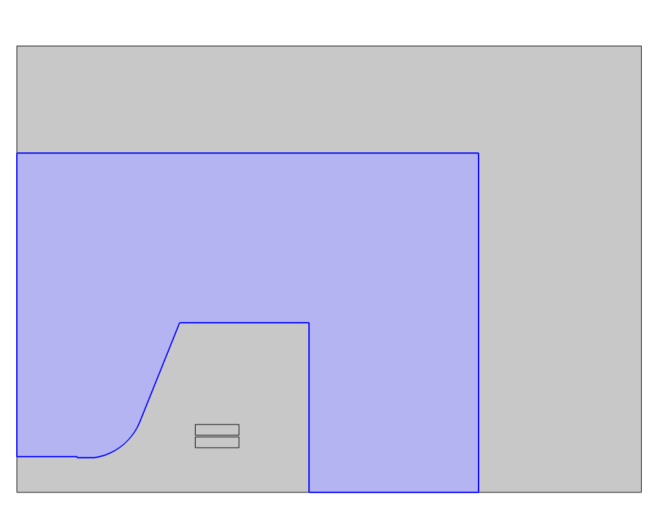
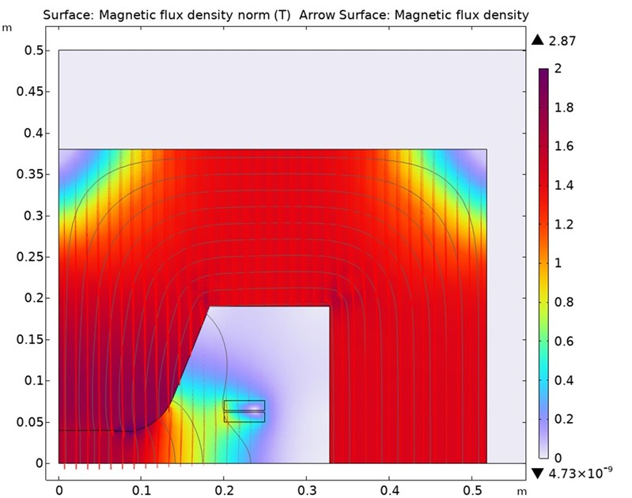
Example of use: superferric accelerator magnet
50 turns in each pancake
(200 turns in total)
Magnet yoke
y
12 mm wide CC tape
generating 1.6 T at
I_{max} = 530 A
Superconducing coil
(upper double pancake)
x
Superconducing coil
(lower double pancake)
Voltage signals on the terminations of an HTS magnet modelled in A-T formulation HTS 2024 Modelling Workshop/ 10-13 June 2024, Bad Zurzach, Switzerland

Slide 17
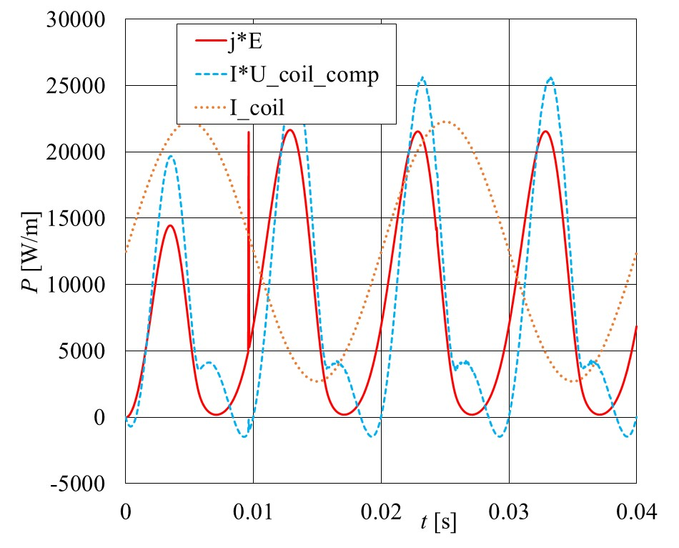
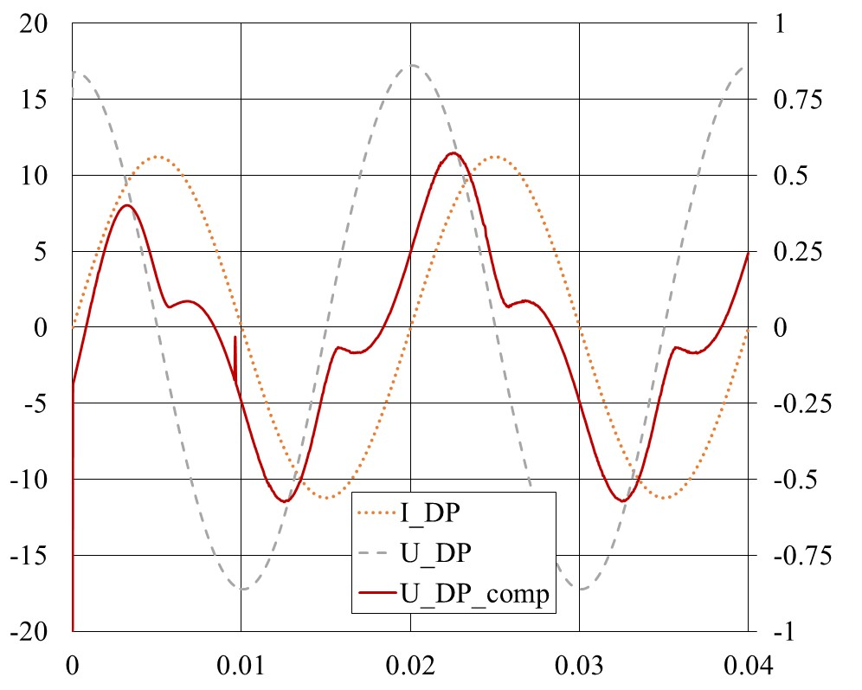

Example of use: superferric accelerator magnet
computations for I_{max} = 560 A, 50 Hz
1) I_{c} = const. = 1350 A, non-magnetic yoke
$$U_{coil}=NE_{coil}$$
Loss per 1 m of winding (100 turns)
U_{coil} [V/m]
U_{coil,comp} [V/m]
t [s]
2nd cycle:
Q_{loss, j*E} = 178 J/m
Q_{loss, I*U} = 181 [J/m]
Voltage signals on the terminations of an HTS magnet modelled in A-T formulation HTS 2024 Modelling Workshop/ 10-13 June 2024, Bad Zurzach, Switzerland

Slide 18
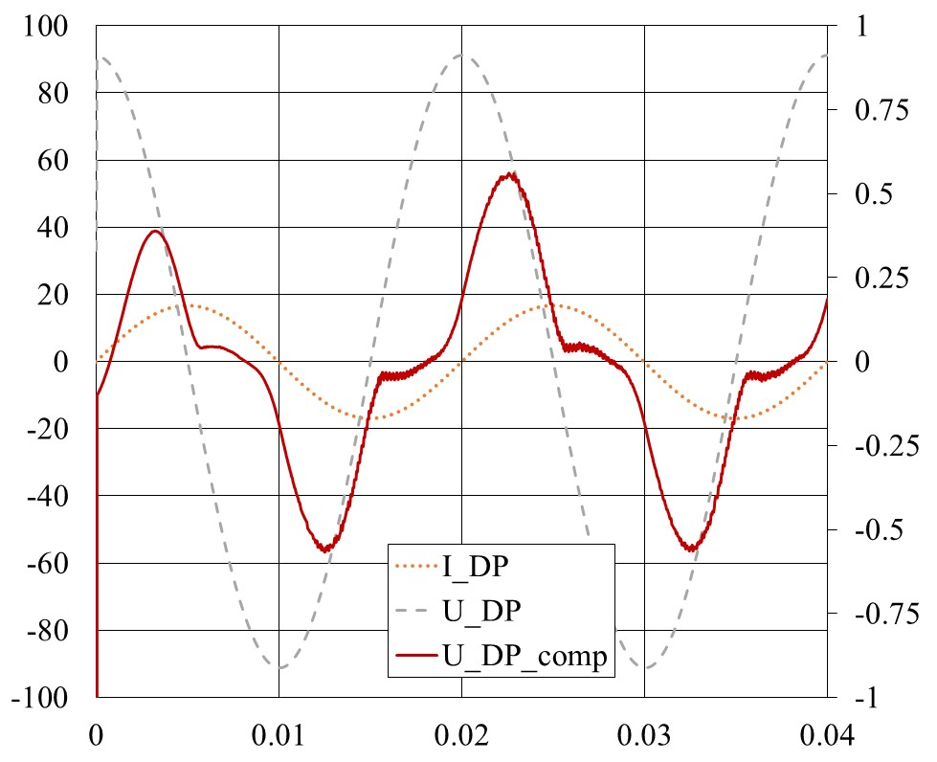
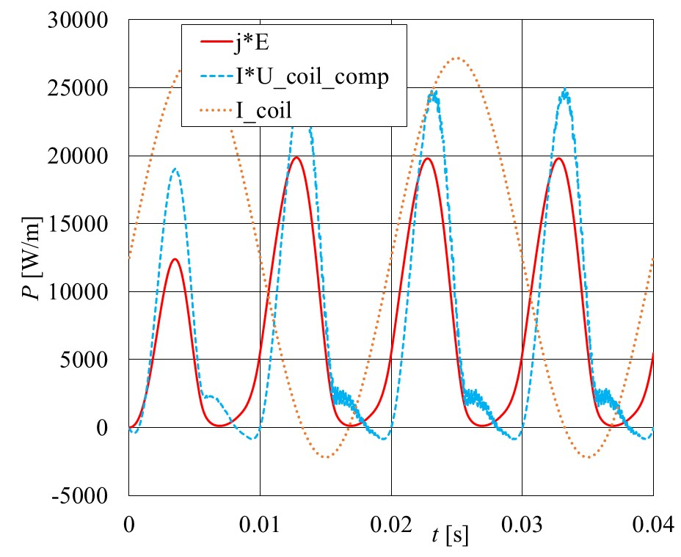
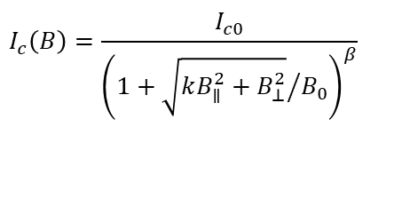
Example of use: superferric accelerator magnet
computations for I_{max} = 560 A, 50 Hz
$$I_{c}\left(B\right)=\frac{I_{c0}}{{\left(1+{\sqrt{kB_{∥}^{2}+B_{⊥}^{2}}}/{B_{0}}\right)}^{β}}$$
2) ; magnetic yoke μ_{r} = 600
U_{coil} [V/m]
U_{coil,comp} [V/m]
t [s]
2nd cycle:
Q_{loss, j*E} = 156 J/m
Q_{loss, I*U} = 162 [J/m]
Voltage signals on the terminations of an HTS magnet modelled in A-T formulation HTS 2024 Modelling Workshop/ 10-13 June 2024, Bad Zurzach, Switzerland

Slide 19
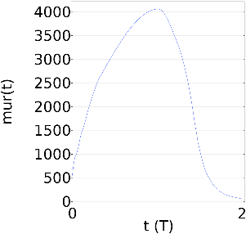
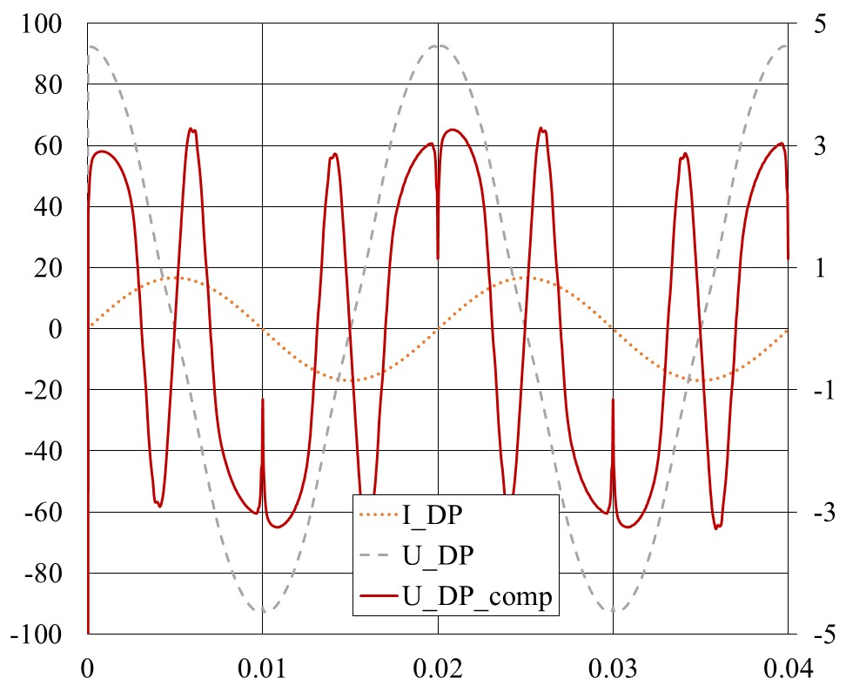
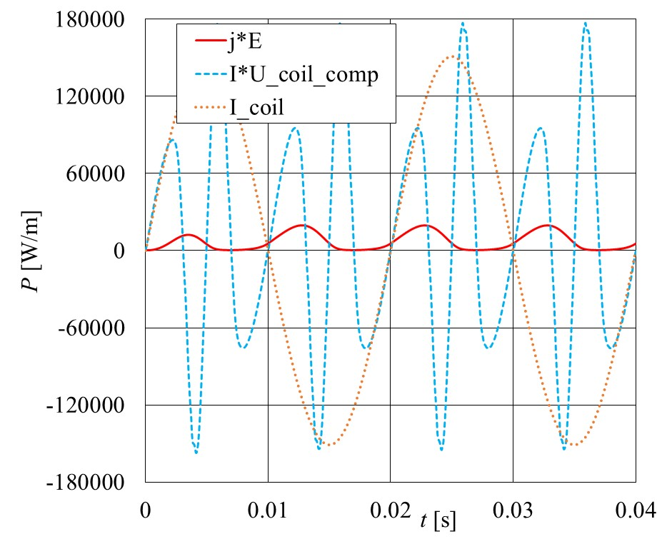
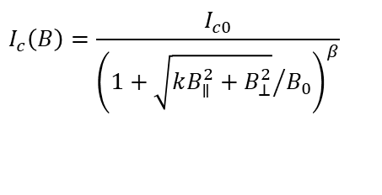
Example of use: superferric accelerator magnet
computations for I_{max} = 560 A, 50 Hz
$$I_{c}\left(B\right)=\frac{I_{c0}}{{\left(1+{\sqrt{kB_{∥}^{2}+B_{⊥}^{2}}}/{B_{0}}\right)}^{β}}$$
3) ; magnetic yoke μ_{r} = μ_{r}(B)
B[T]
U_{coil} [V/m]
U_{coil,comp} [V/m]
t [s]
2nd cycle:
Q_{loss, j*E} = 157 J/m
Q_{loss, I*U} = 163 [J/m]
Voltage signals on the terminations of an HTS magnet modelled in A-T formulation HTS 2024 Modelling Workshop/ 10-13 June 2024, Bad Zurzach, Switzerland

Slide 20
Conclusions
It is possibe to extract the voltage on terminations of a superconducting CC pancake coil in electro-magnetic simulations utilising T-A formulation
Interpretation of the „loss voltage signal“ could provide better insight into coil operation
Thank you
Voltage signals on the terminations of an HTS magnet modelled in A-T formulation HTS 2024 Modelling Workshop/ 10-13 June 2024, Bad Zurzach, Switzerland

Slide 21
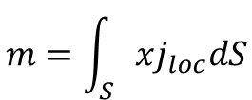



AC-AC case
Example of using macroscopic quantities derived from numerical model – AC loss in CC tape
Cu top
A-ϕ formulation in 2D
$$∇^{2}A=μ_{0}j_{loc}$$
Ag top
REBCO
buffers
Hastelloy
Ag side
Ag bottom
$$j_{loc}=j_{loc}\left(E_{loc}\right)$$
E. Pardo and F. Grilli, F.: Electromagnetic modeling of superconductors. In Numerical modeling of superconducting applications, World Sci Publ. Co. Pte. Ltd., 2023, Chapter 1.1.3
$$E_{loc}=−\frac{∂A}{∂t}−∇φ$$
$$\int_{S}{j_{loc}dS}=I_{ac}$$
Cu bottom
macroscopic (measurable) quantities:
$$B_{ac}=B_{max}sin\left(ωt\right)$$
y
electric field intensity:
$$E_{φ}=−∇φ$$
x
$$m=\int_{S}{xj_{loc}dS}$$
magnetic moment:
$$I_{ac}=I_{max}sin\left(ωt\right)$$
Voltage signals on the terminations of an HTS magnet modelled in A-T formulation HTS 2024 Modelling Workshop/ 10-13 June 2024, Bad Zurzach, Switzerland

Slide 22
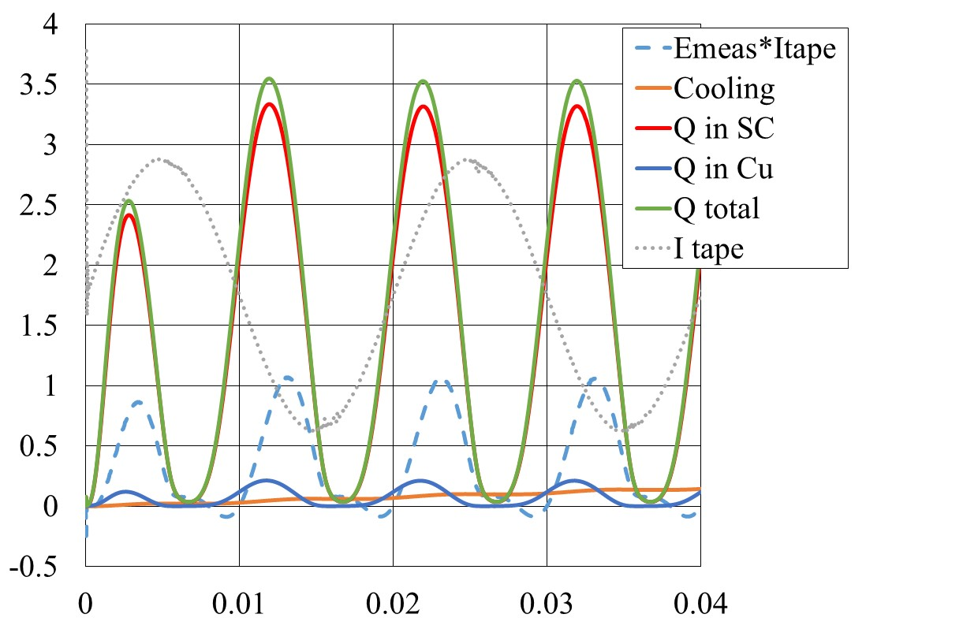
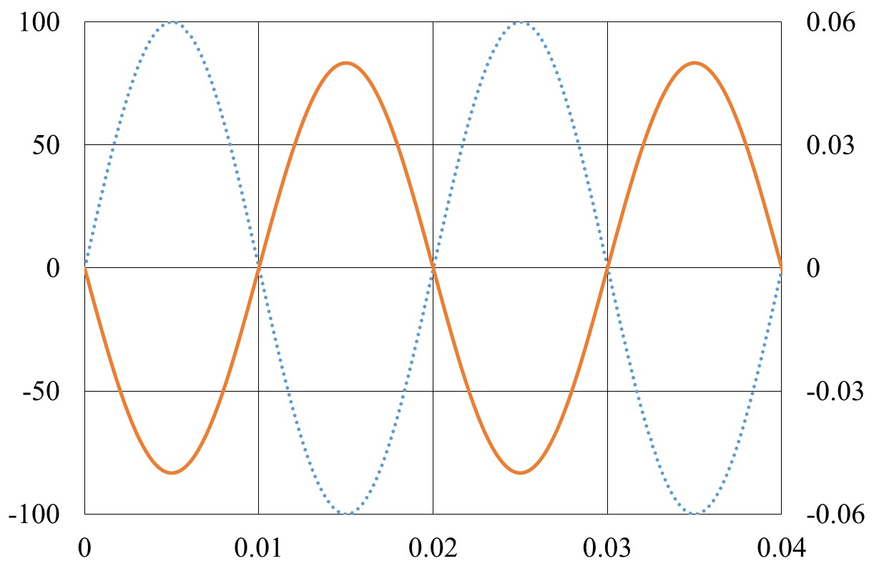
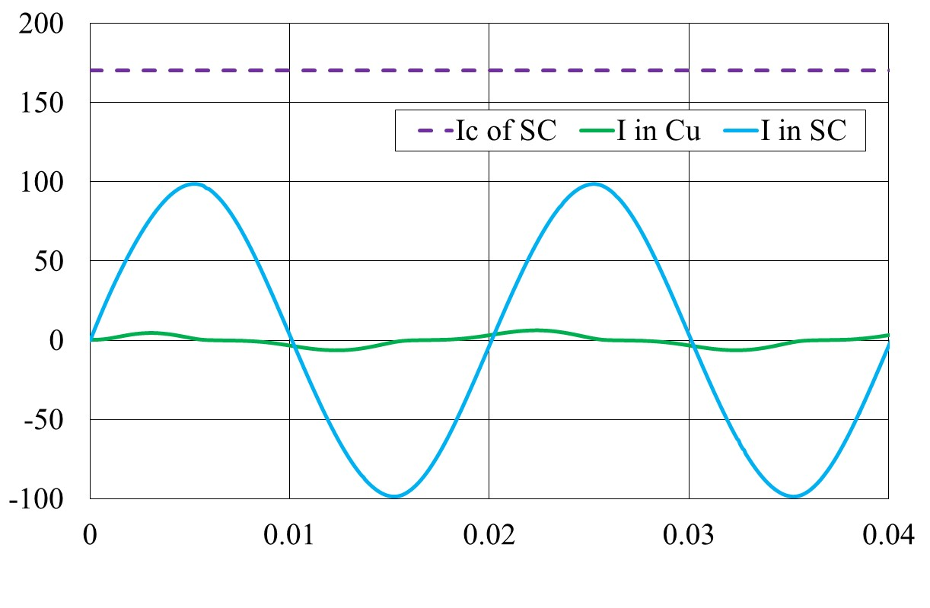
AC-AC case
Example of using macroscopic quantities derived from numerical model – AC loss in CC tape
Cu top
A-ϕ formulation in 2D
$$∇^{2}A=μ_{0}j_{loc}$$
Ag top
REBCO
buffers
Hastelloy
Ag side
Ag bottom
$$j_{loc}=j_{loc}\left(E_{loc}\right)$$
$$E_{loc}=−\frac{∂A}{∂t}−∇φ$$
$$\int_{S}{j_{loc}dS}=I_{ac}$$
Cu bottom
E_{ϕ,comp}I_{tape}
P [W/m]
I_{tape}
[A]
B_{appl}
[T]
t [s]
t [s]
t [s]
Voltage signals on the terminations of an HTS magnet modelled in A-T formulation HTS 2024 Modelling Workshop/ 10-13 June 2024, Bad Zurzach, Switzerland

Slide 23
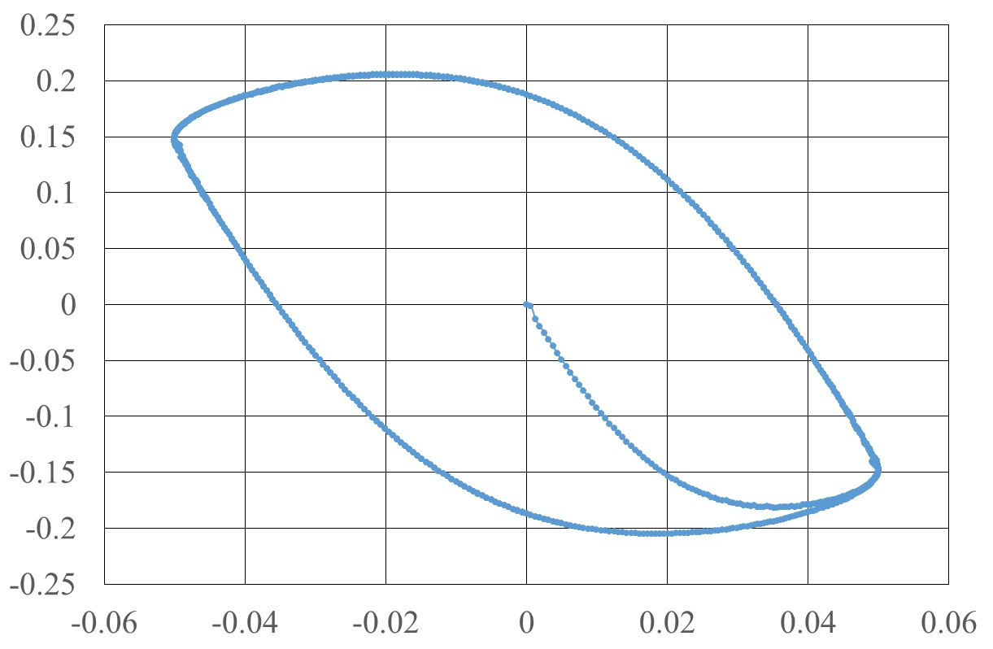
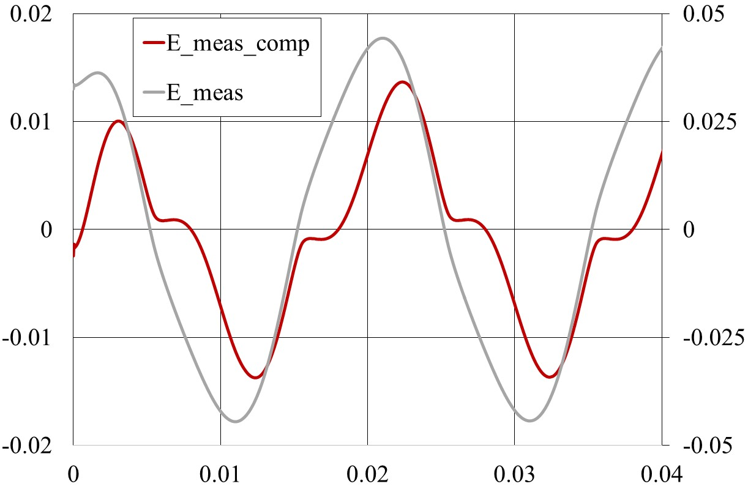



AC-AC case
Example of using macroscopic quantities derived from numerical model – AC loss in CC tape
Cu top
A-ϕ formulation in 2D
$$∇^{2}A=μ_{0}j_{loc}$$
Ag top
REBCO
buffers
Hastelloy
Ag side
Ag bottom
$$j_{loc}=j_{loc}\left(E_{loc}\right)$$
$$E_{loc}=−\frac{∂A}{∂t}−∇φ$$
$$\int_{S}{j_{loc}dS}=I_{ac}$$
Cu bottom
$$E_{φ,comp}=−∇φ−L_{aux}\frac{dI}{dt}$$
[V/m]
E_{ϕ,comp}
E_{ϕ}
Check of correctness and precision:
$$\int_{T}^{2T}{dt}\int_{S}{j_{loc}\left(\vec{r}\right)E_{loc}\left(\vec{r}\right)dS=}$$
m [Am]
32.5 mJ/m
=$\int_{T}^{2T}{E_{φ,comp}\left(t\right)I_{tape}\left(t\right)dt}−\oint{mdB}$
t [s]
7 mJ/m
22.5 mJ/m
B [T
Voltage signals on the terminations of an HTS magnet modelled in A-T formulation HTS 2024 Modelling Workshop/ 10-13 June 2024, Bad Zurzach, Switzerland

