Slide 1
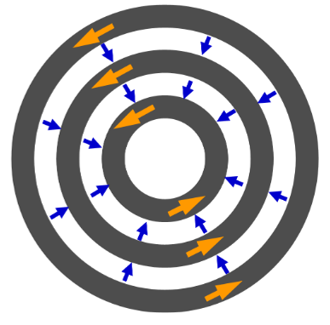
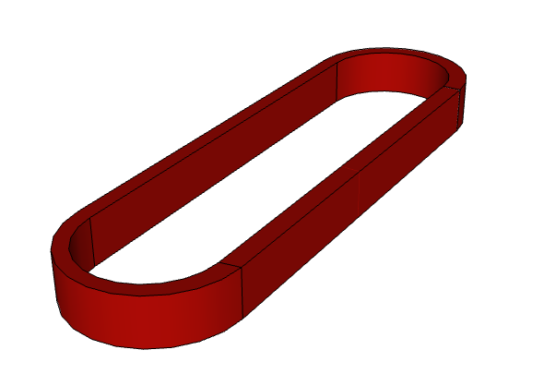
Electrothermal modeling of HTS coils
using homogenization and different formulations
A. Dadhichª, F. Grilli^{b}, K. Berger^{c}, G. Hajiri^{c}, F. Trillaud Pighi^{d}, D. Sotnikov^{e}, T. Salmi^{f},
G. dos Santos^{g}, B. M. O. Santos^{g}, F. G. R. Martins^{h}, T. Benkel^{i}, A. Hussainª, E. Pardoª
  a Institute of Electrical Engineering, Slovak Academy of Sciences, Bratislava, SLOVAKIA
  b Karlsruhe Institute of Technology, Karlsruhe, GERMANY
  c Université de Lorraine, GREEN, Nancy, FRANCE
  d Instituto de Ingeniería, UNAM, Mexico City, MEXICO
  e Paul Scherrer Institut PSI, Villigen, SWITZERLAND
  f Tampere University, Tampere, FINLAND
  g Rio de Janeiro State University, Rio de Janeiro, BRAZIL
  h Universidade Federal Fluminense, Rio de Janeiro, BRAZIL
  i Atled Engineering, Oxford, UK

Slide 2
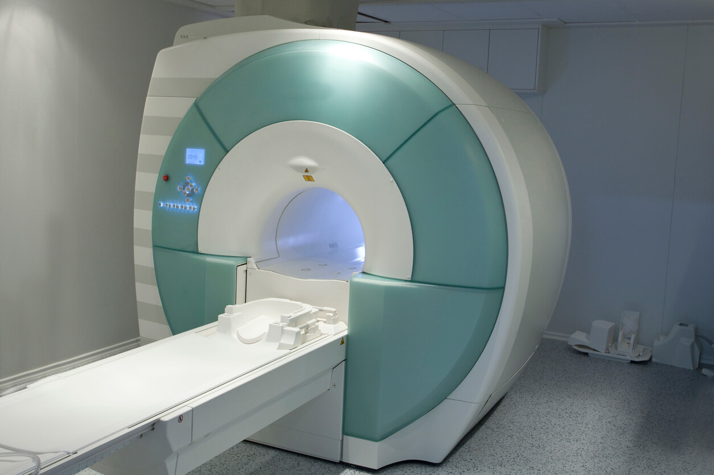
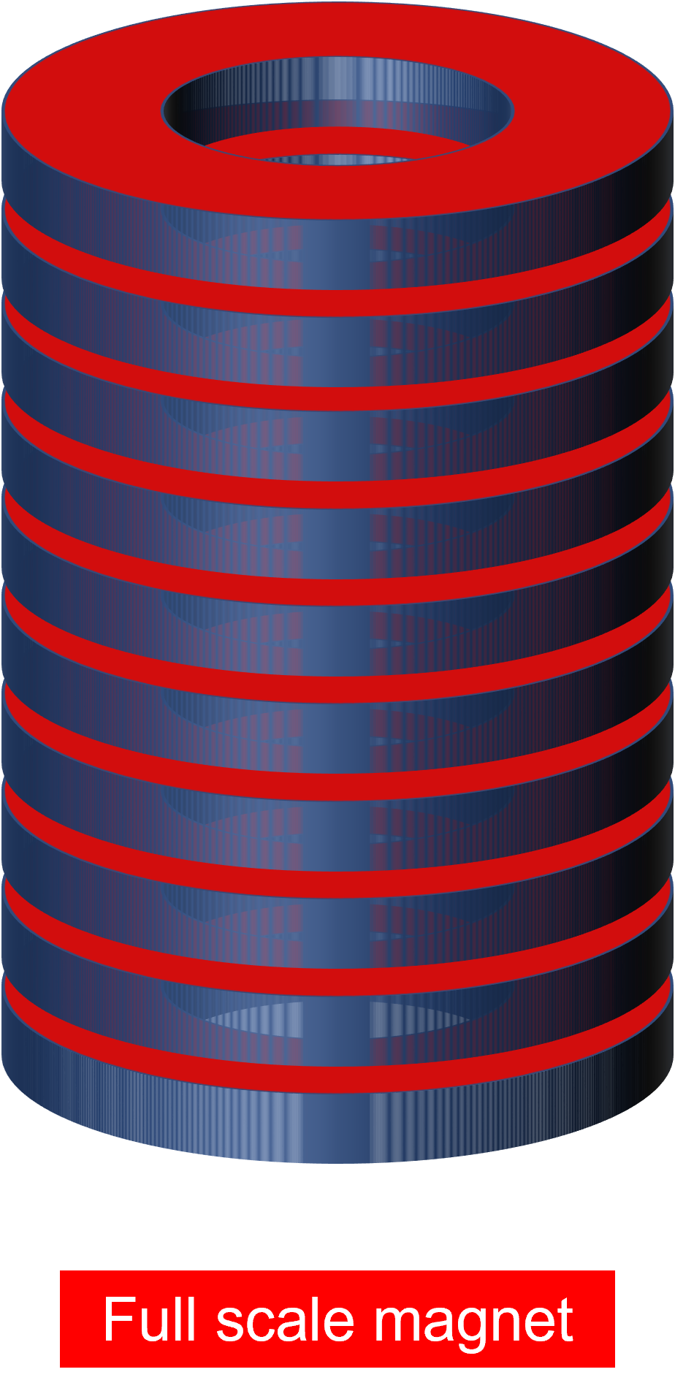


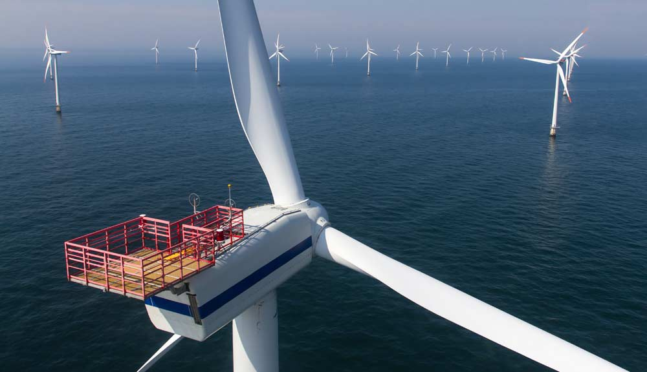
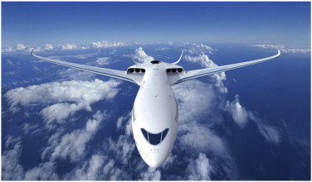
Current applications
MRI machines
High field magnets
Particle accelerators
Ship Propulsion
Wind generator
Electric aircraft
Notes:
Ship: https://global.kawasaki.com/en/corp/newsroom/news/detail/?f=20130529_1100
Wind:
https://www.theva.com/applications/
Hyperloop:
https://zeleros.com/2019/06/19/zeleros-and-siemens-cooperate-to-develop-technology-for-the-hyperloop/

Slide 3
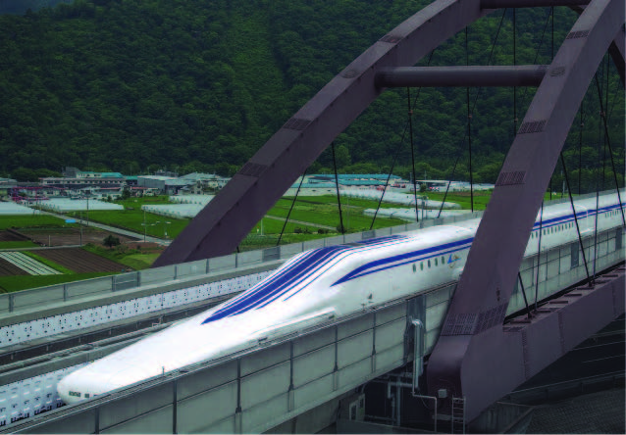
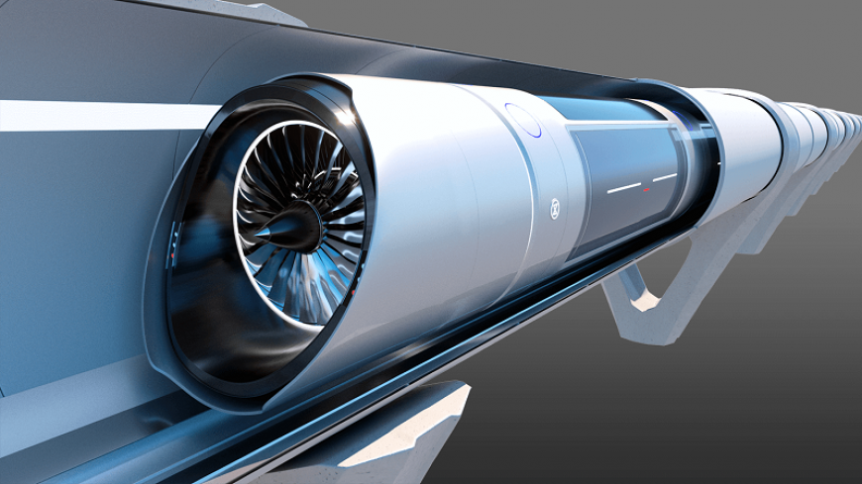
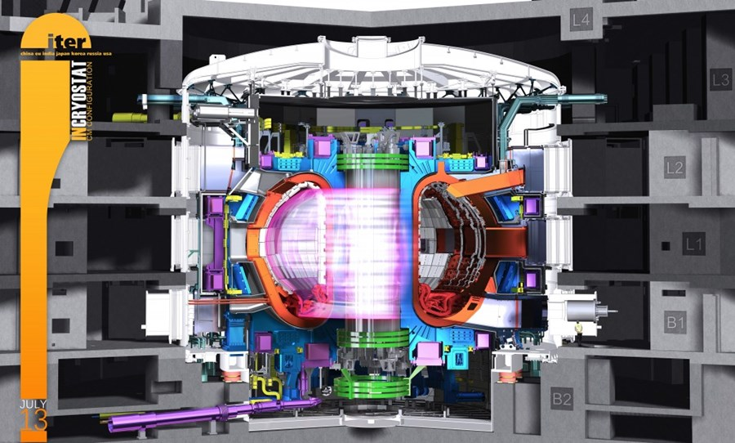
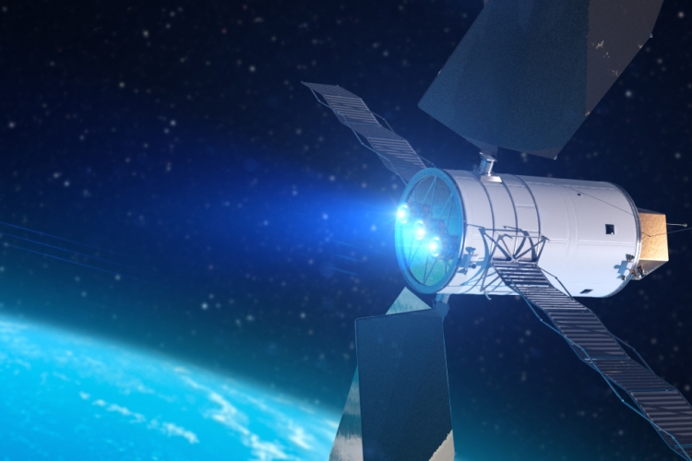
Future applications
Maglev trains
Hyperloop
Fusion
Space propulsion
Notes:
Ship: https://global.kawasaki.com/en/corp/newsroom/news/detail/?f=20130529_1100
Wind:
https://www.theva.com/applications/
Hyperloop:
https://zeleros.com/2019/06/19/zeleros-and-siemens-cooperate-to-develop-technology-for-the-hyperloop/

Slide 4
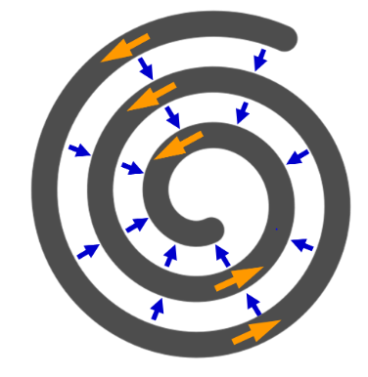
Racetrack coil
Pancake coil
Application: Rotating machines, high field magnets

Slide 5
Motivation
Modeling superconductors is tough and time consuming
Complicated non-linear multiphysics (specially for quench analysis)
Need for a fast and efficient method
Developed a novel and fast homogenization method!
Development and benchmark of various numerical models
14 models or combinations for different cases!
Collaboration between research teams within superconductor community
8 countries, 9 institutes!

Slide 6
Electrothermal modeling of HTS coils
using homogenization and different formulations
A. Dadhichª, F. Grilli^{b}, K. Berger^{c}, G. Hajiri^{c}, F. Trillaud Pighi^{d}, D. Sotnikov^{e}, T. Salmi^{f},
G. dos Santos^{g}, B. M. O. Santos^{g}, F. G. R. Martins^{h}, T. Benkel^{i}, A. Hussainª, E. Pardoª
  a Institute of Electrical Engineering, Slovak Academy of Sciences, Bratislava, SLOVAKIA
  b Karlsruhe Institute of Technology, Karlsruhe, GERMANY
  c Université de Lorraine, GREEN, Nancy, FRANCE
  d Instituto de Ingeniería, UNAM, Mexico City, MEXICO
  e Paul Scherrer Institut PSI, Villigen, SWITZERLAND
  f Tampere University, Tampere, FINLAND
  g Rio de Janeiro State University, Rio de Janeiro, BRAZIL
  h Universidade Federal Fluminense, Rio de Janeiro, BRAZIL
  i Atled Engineering, Oxford, UK

Slide 7



Institute of Electrical Engineering,
Slovak Academy of Sciences
Bratislava, Slovakia

Slide 8
Problem statements
Material properties
Numerical models
Benchmark results

Slide 9
Problem statements
Material properties
Numerical models
Benchmark results

Slide 10
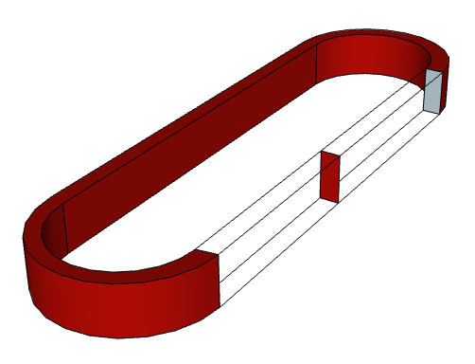
Racetrack coil
2D cross section
Application: Rotating machines

Slide 11
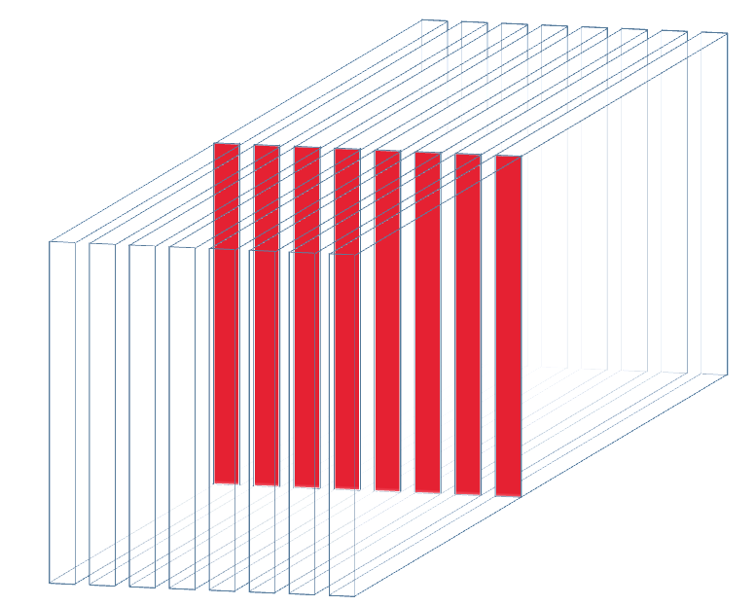
We consider infinitely long half-coil for benchmark
Many turns/tapes
in cross section

Slide 12
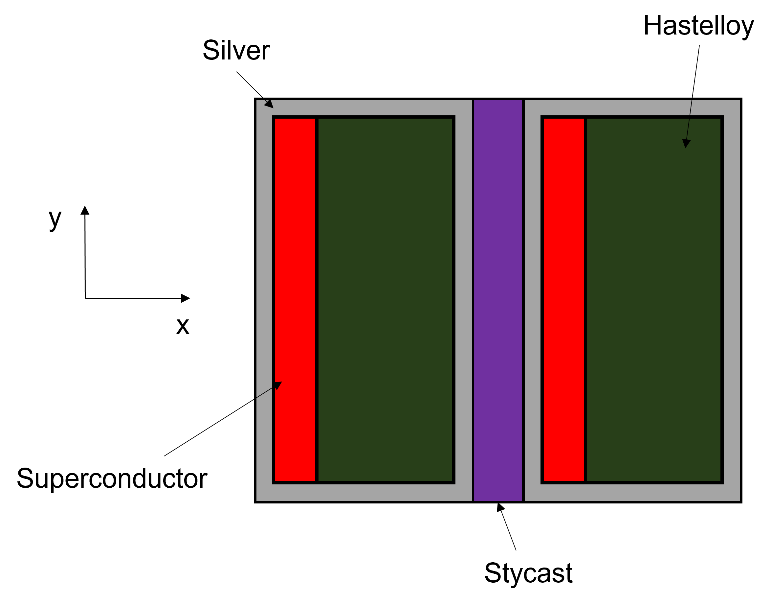
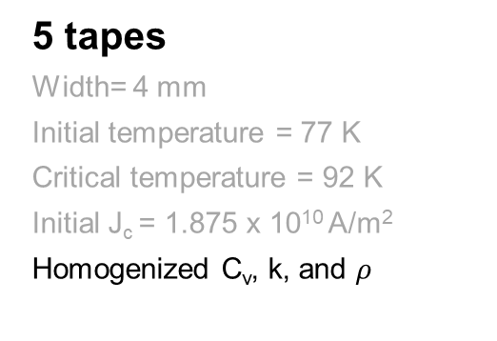
Tape geometry
5 tapes
Width= 4 mm
Initial temperature = 77 K
Critical temperature = 92 K
Initial J_{c} = 1.875 x 10¹⁰ A/m²
Homogenized C_{v}, k, and $ρ$
Electrical insulation between turns via Stycast

Slide 13
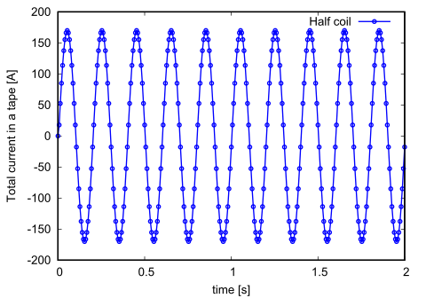
Input : AC current (170 A and more, 5 Hz)
I_{c} = 150 A

Slide 14
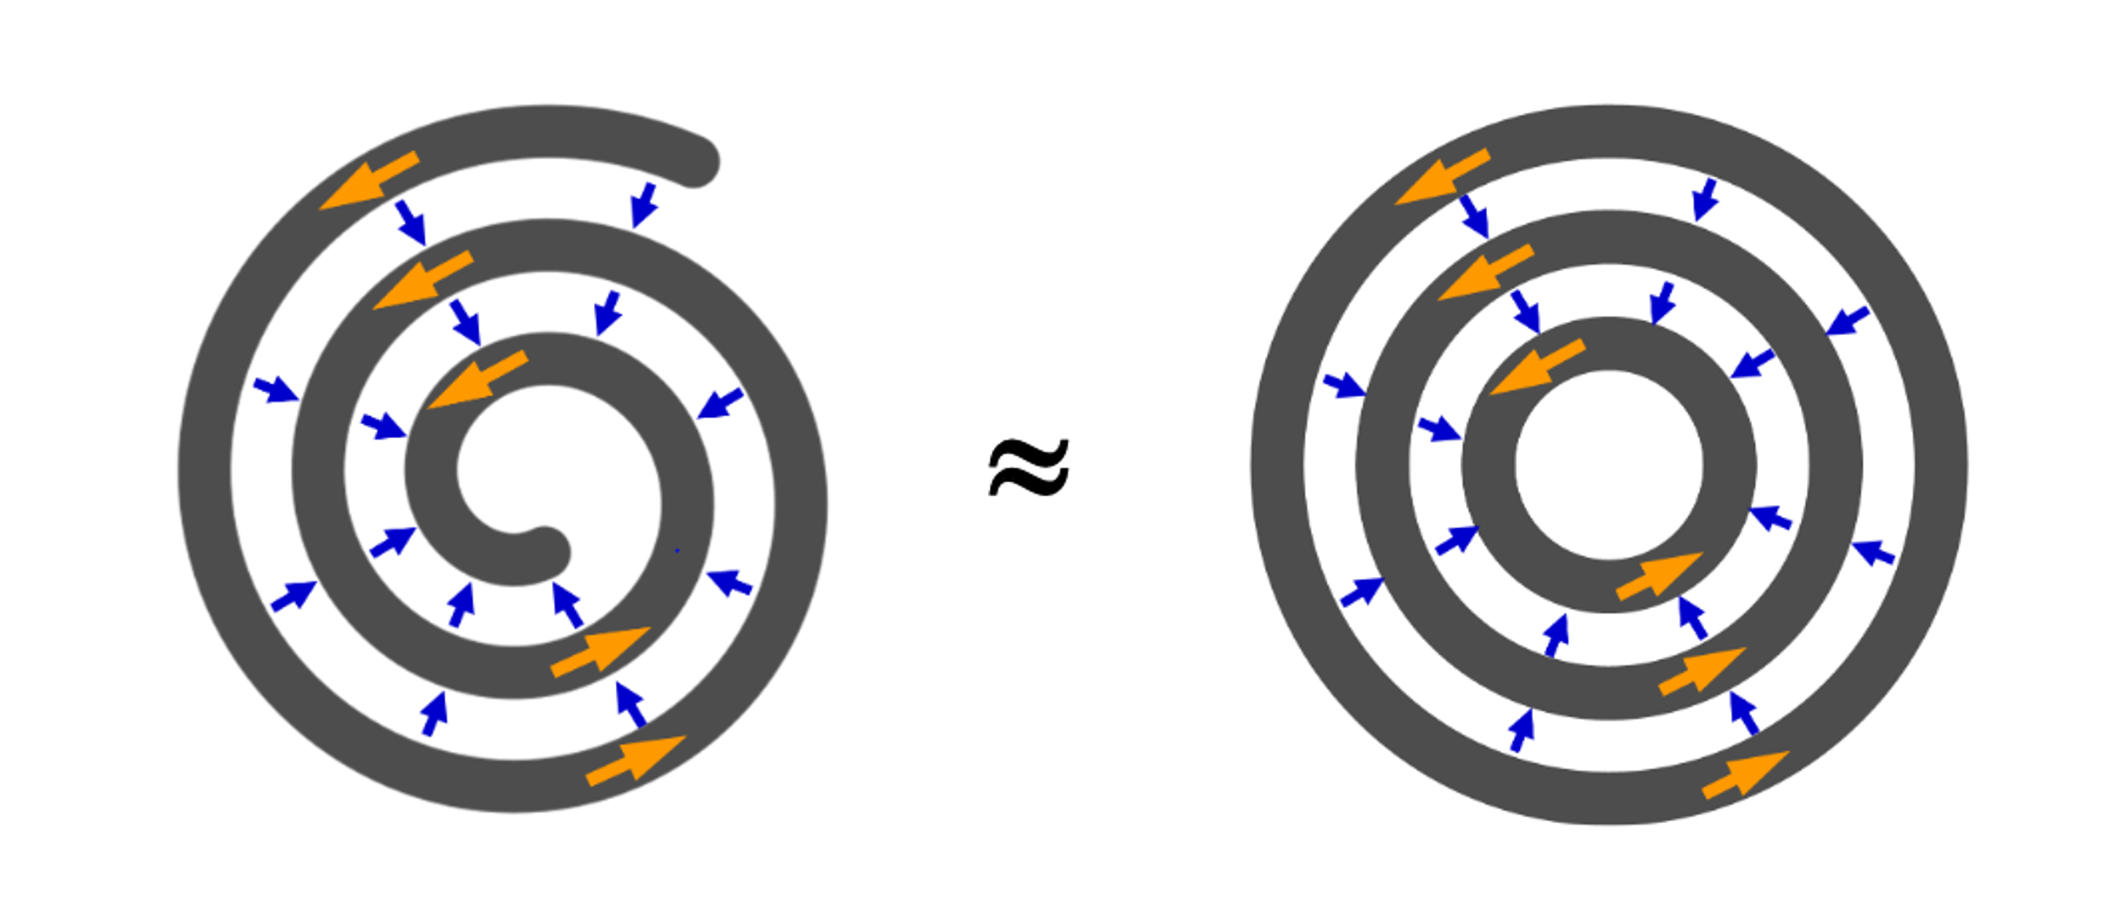
Pancake coil
(axisymmetric assumption)
Application: High field magnets

Slide 15
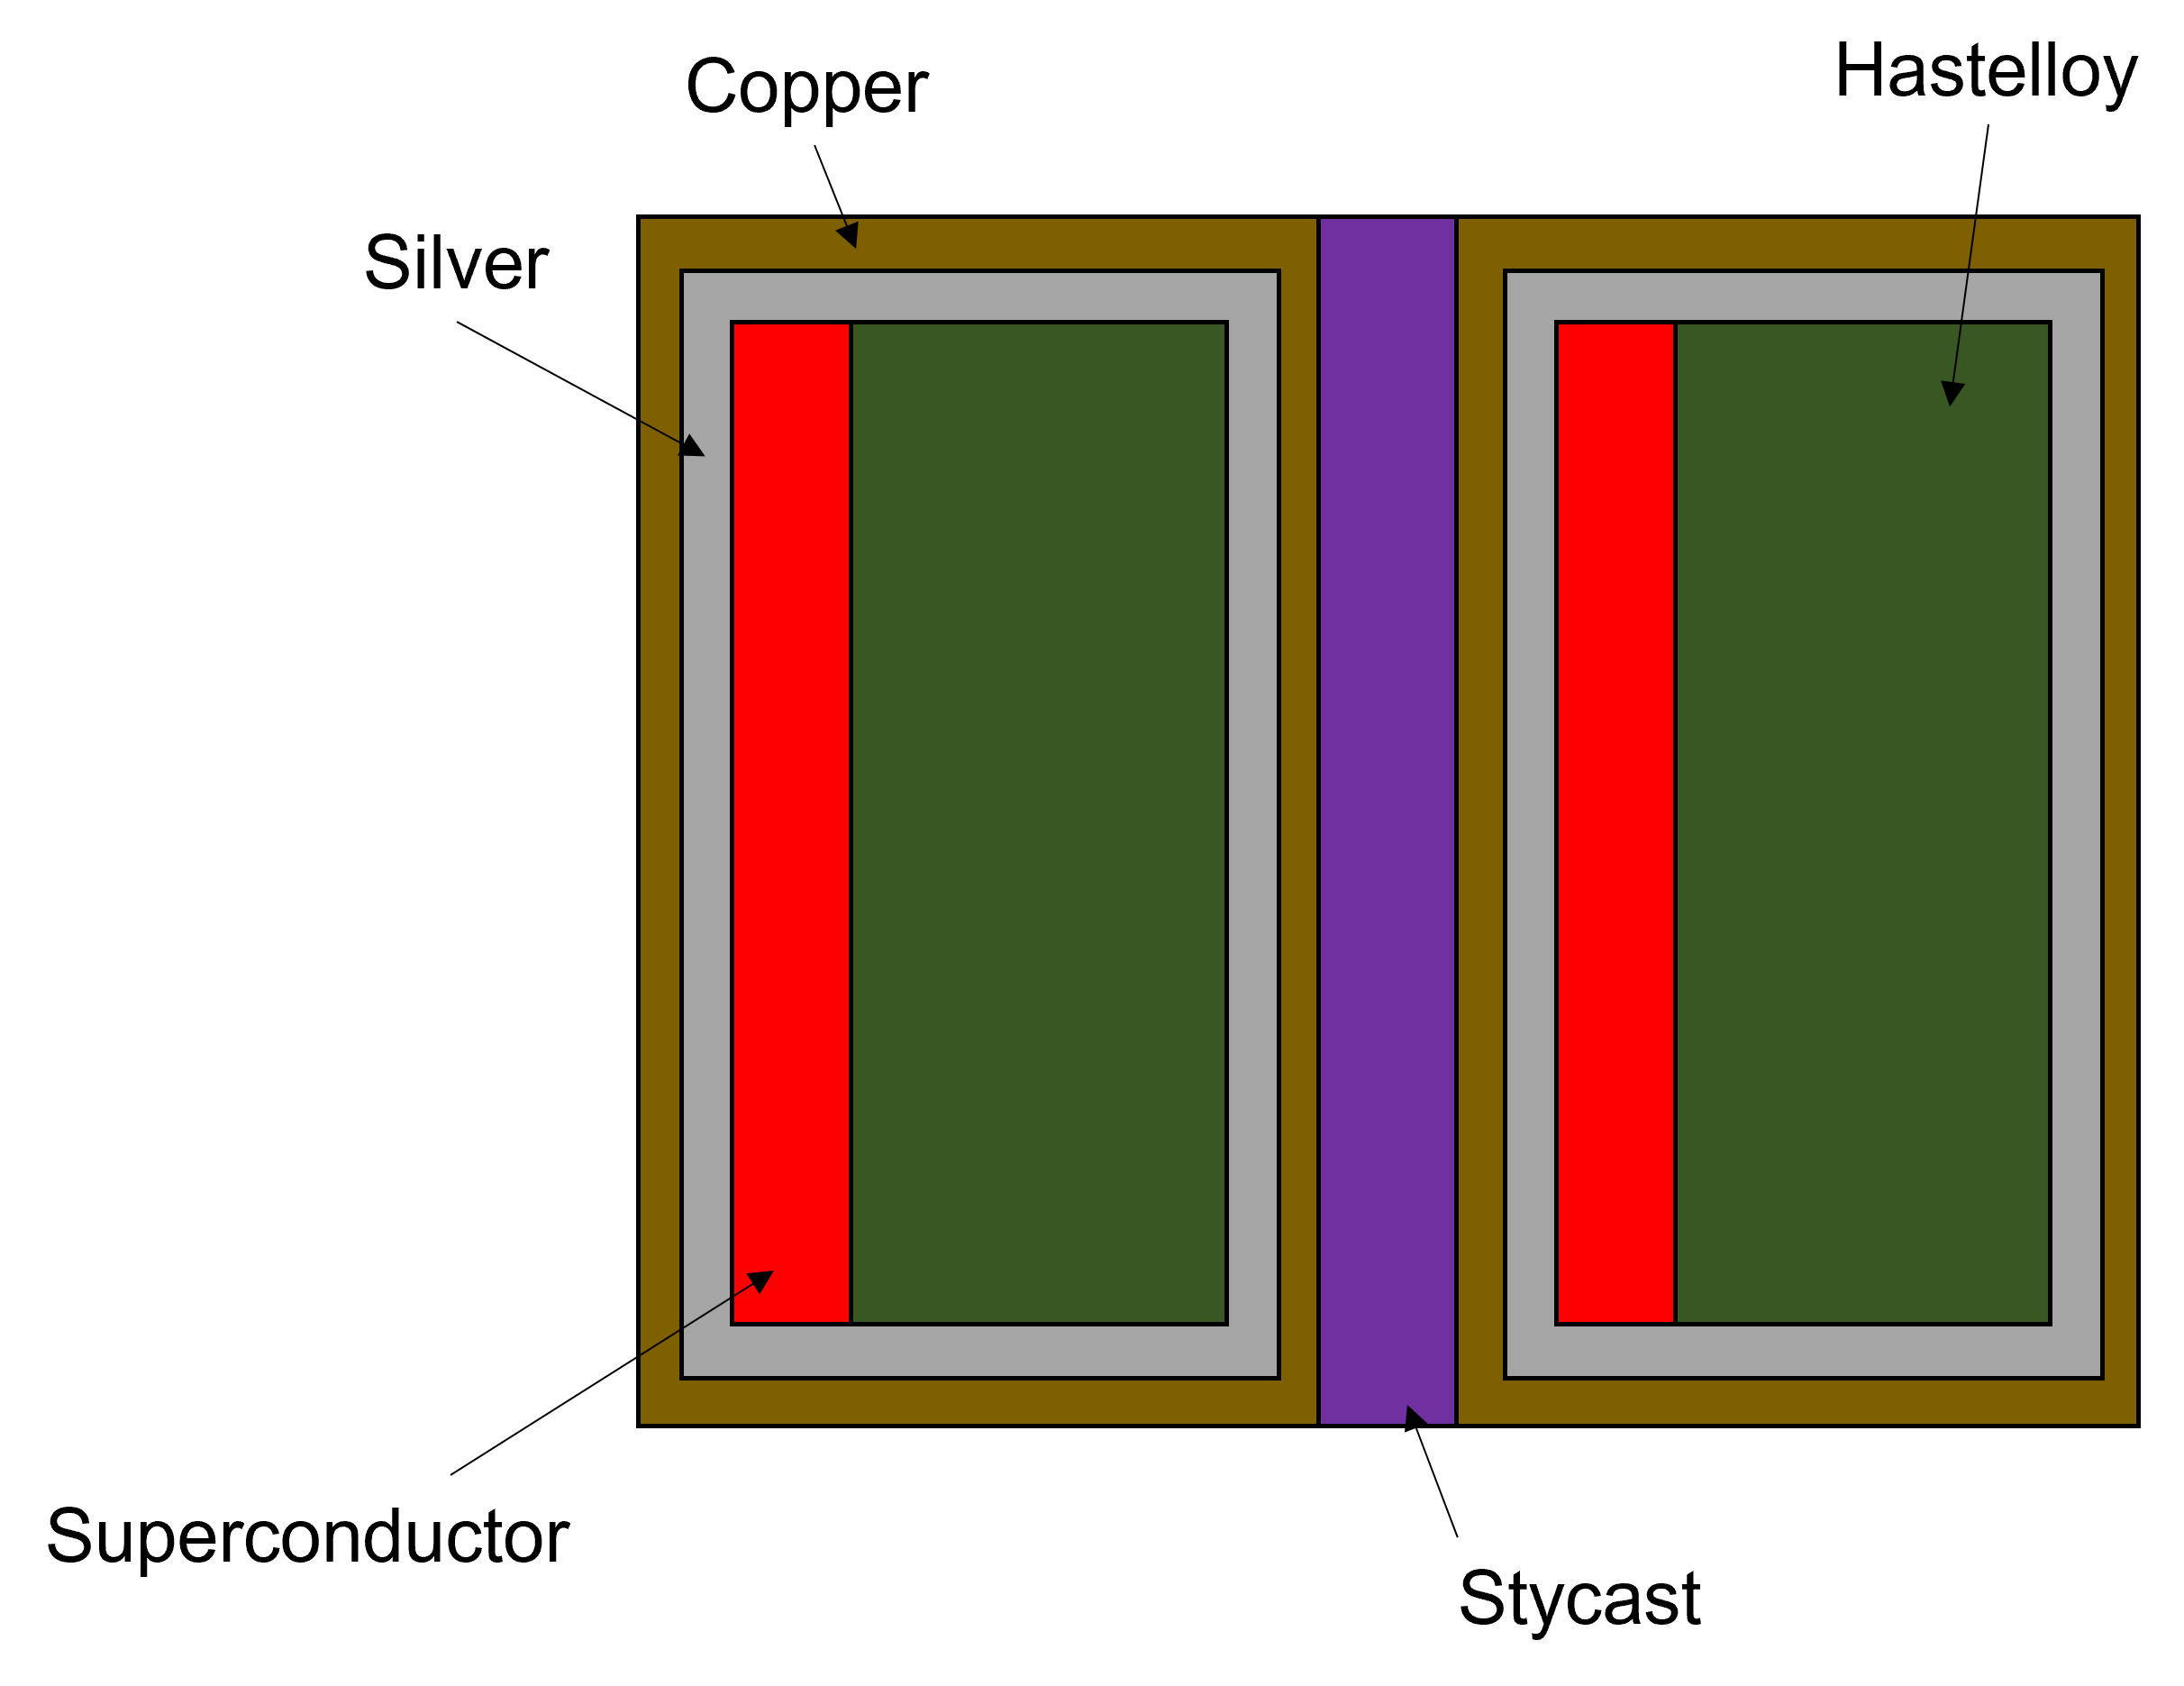
Tape geometry
5 tapes
Width= 4 mm
Initial temperature = 77 K
Critical temperature = 92 K
Initial J_{c} = 1.875 x 10¹⁰ A/m²
Homogenized C_{v}, k, and $ρ$
Electrical insulation between turns via Stycast

Slide 16
Input : Current ramp (1 A/s) up to 160 A and more
I_{c} = 150 A

Slide 17
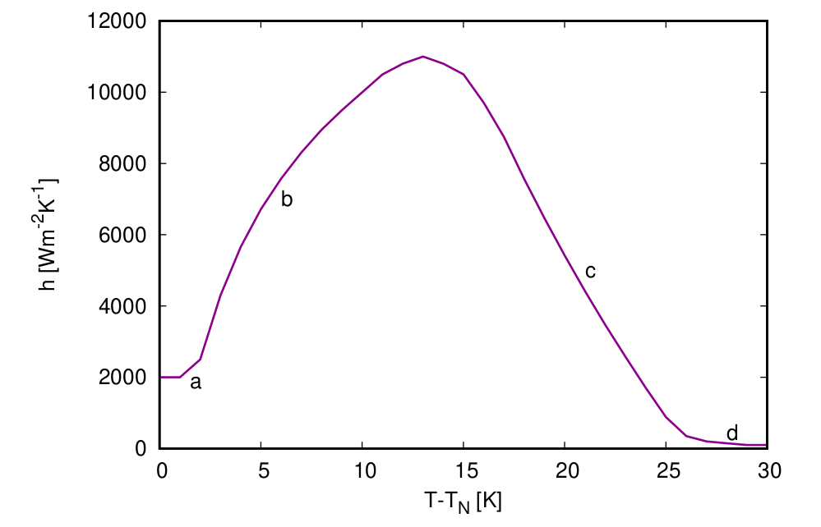
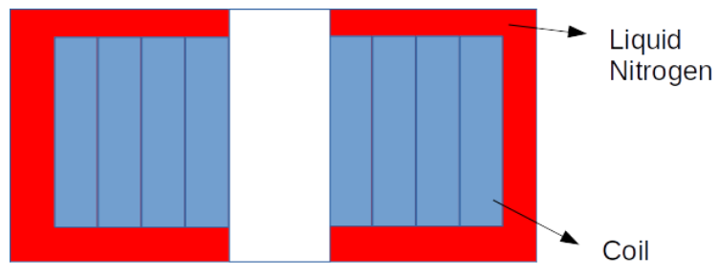
Cooling
By Dr. Frederic Sirois
Polytechnique Montreal

Slide 18
Problem statements
Material properties
Homogenization
Numerical models
Benchmark results

Slide 19
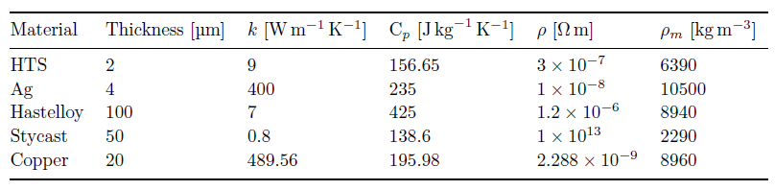
Electrical and thermal properties
Considered constant for simplification

Slide 20
Problem statements
Material properties
Homogenization
Numerical models
Benchmark results

Slide 21
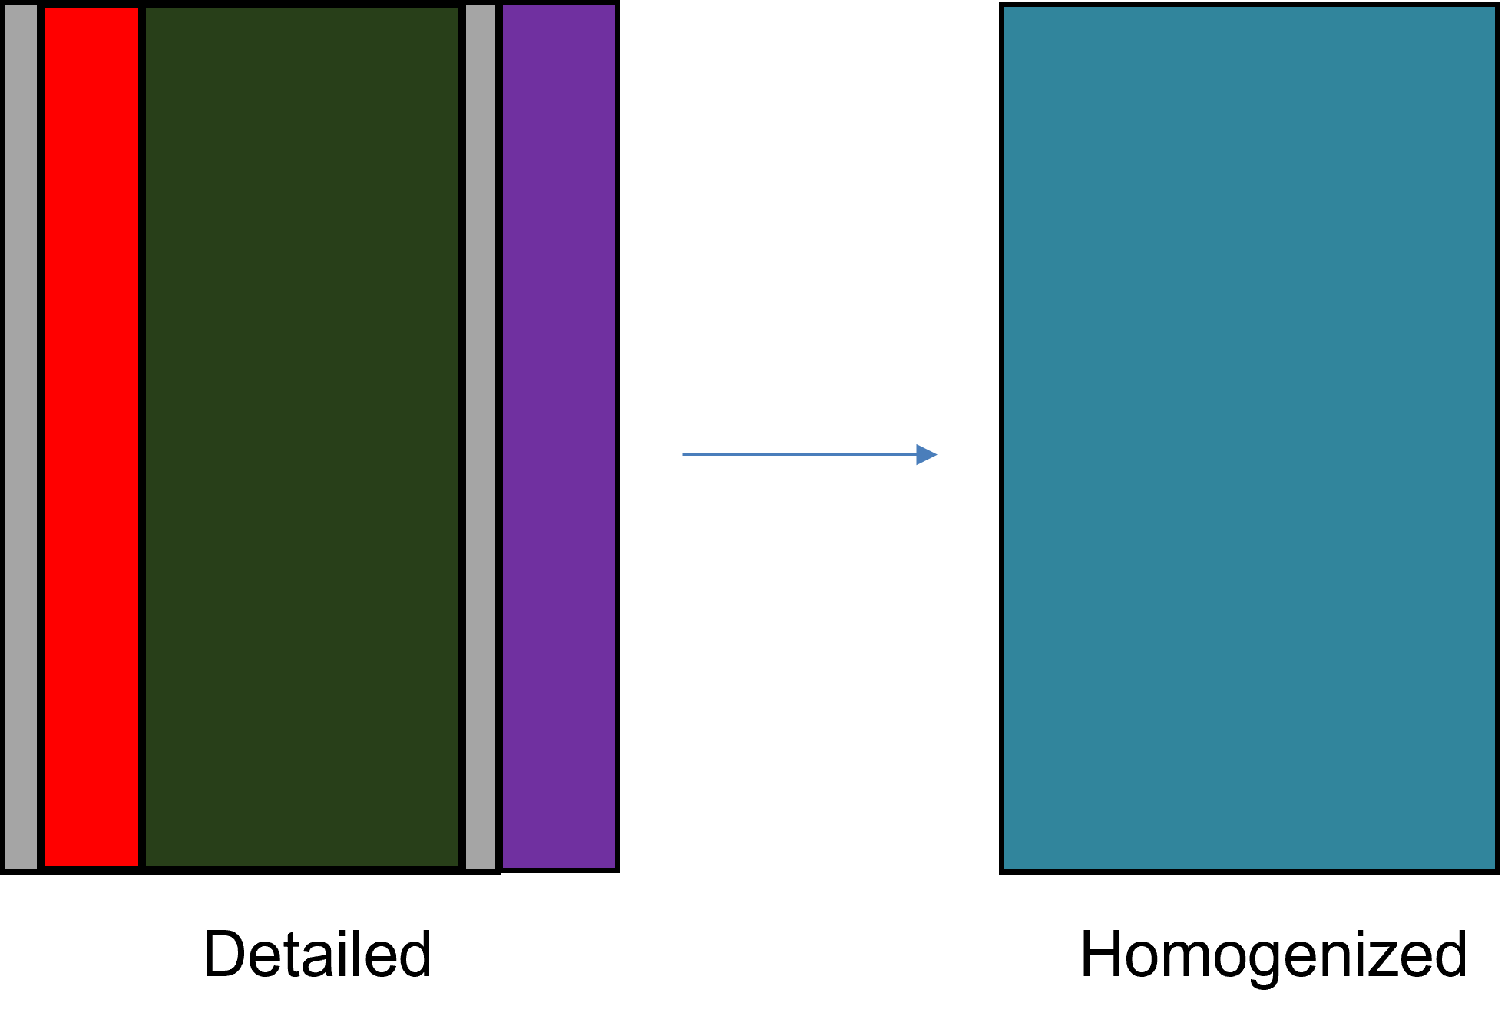
Homogenization of layers
Include Stycast or not?
Stycast

Slide 22



Homogenized electrical properties
Total thickness
Normal conductivity
Parallel resistivity
Comes from power law
(Electric field)

Slide 23


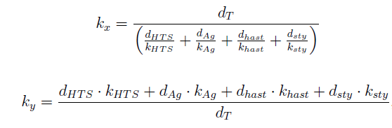
Homogenized thermal properties
Thermal capacity
C_{p}= C_{v}/ρ_{m}
Mass density
Anisotropic conductivity

Slide 24
Problem statements
Material properties
Numerical models
Benchmark results

Slide 25
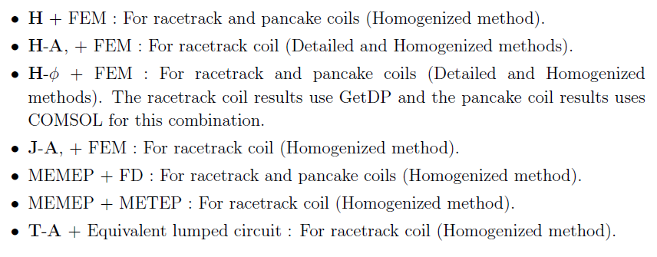
Different formulations and combinations

Slide 26
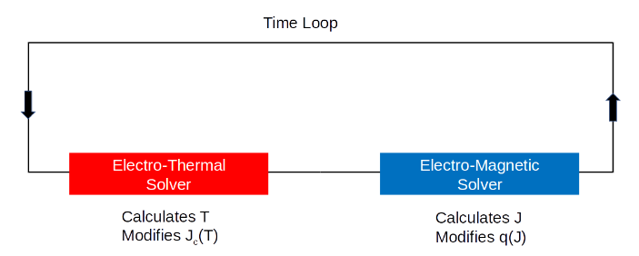

Coupling
q(J) = E(J).J(T)

Slide 27
Standard mesh and inputs
Mesh elements in tape thickness: 1
Mesh elements in tape width: 50
Time step per cycle: 200 (racetrack)
Time step per second: 20 (pancake)

Slide 28
Problem statements
Material properties
Numerical models
Benchmark results
Racetrack coil (Detailed vs Homogenized models)
Racetrack coil (Homogenized models)
Pancake coil (Detailed vs Homogenized models)

Slide 29
Racetrack coil

Slide 30
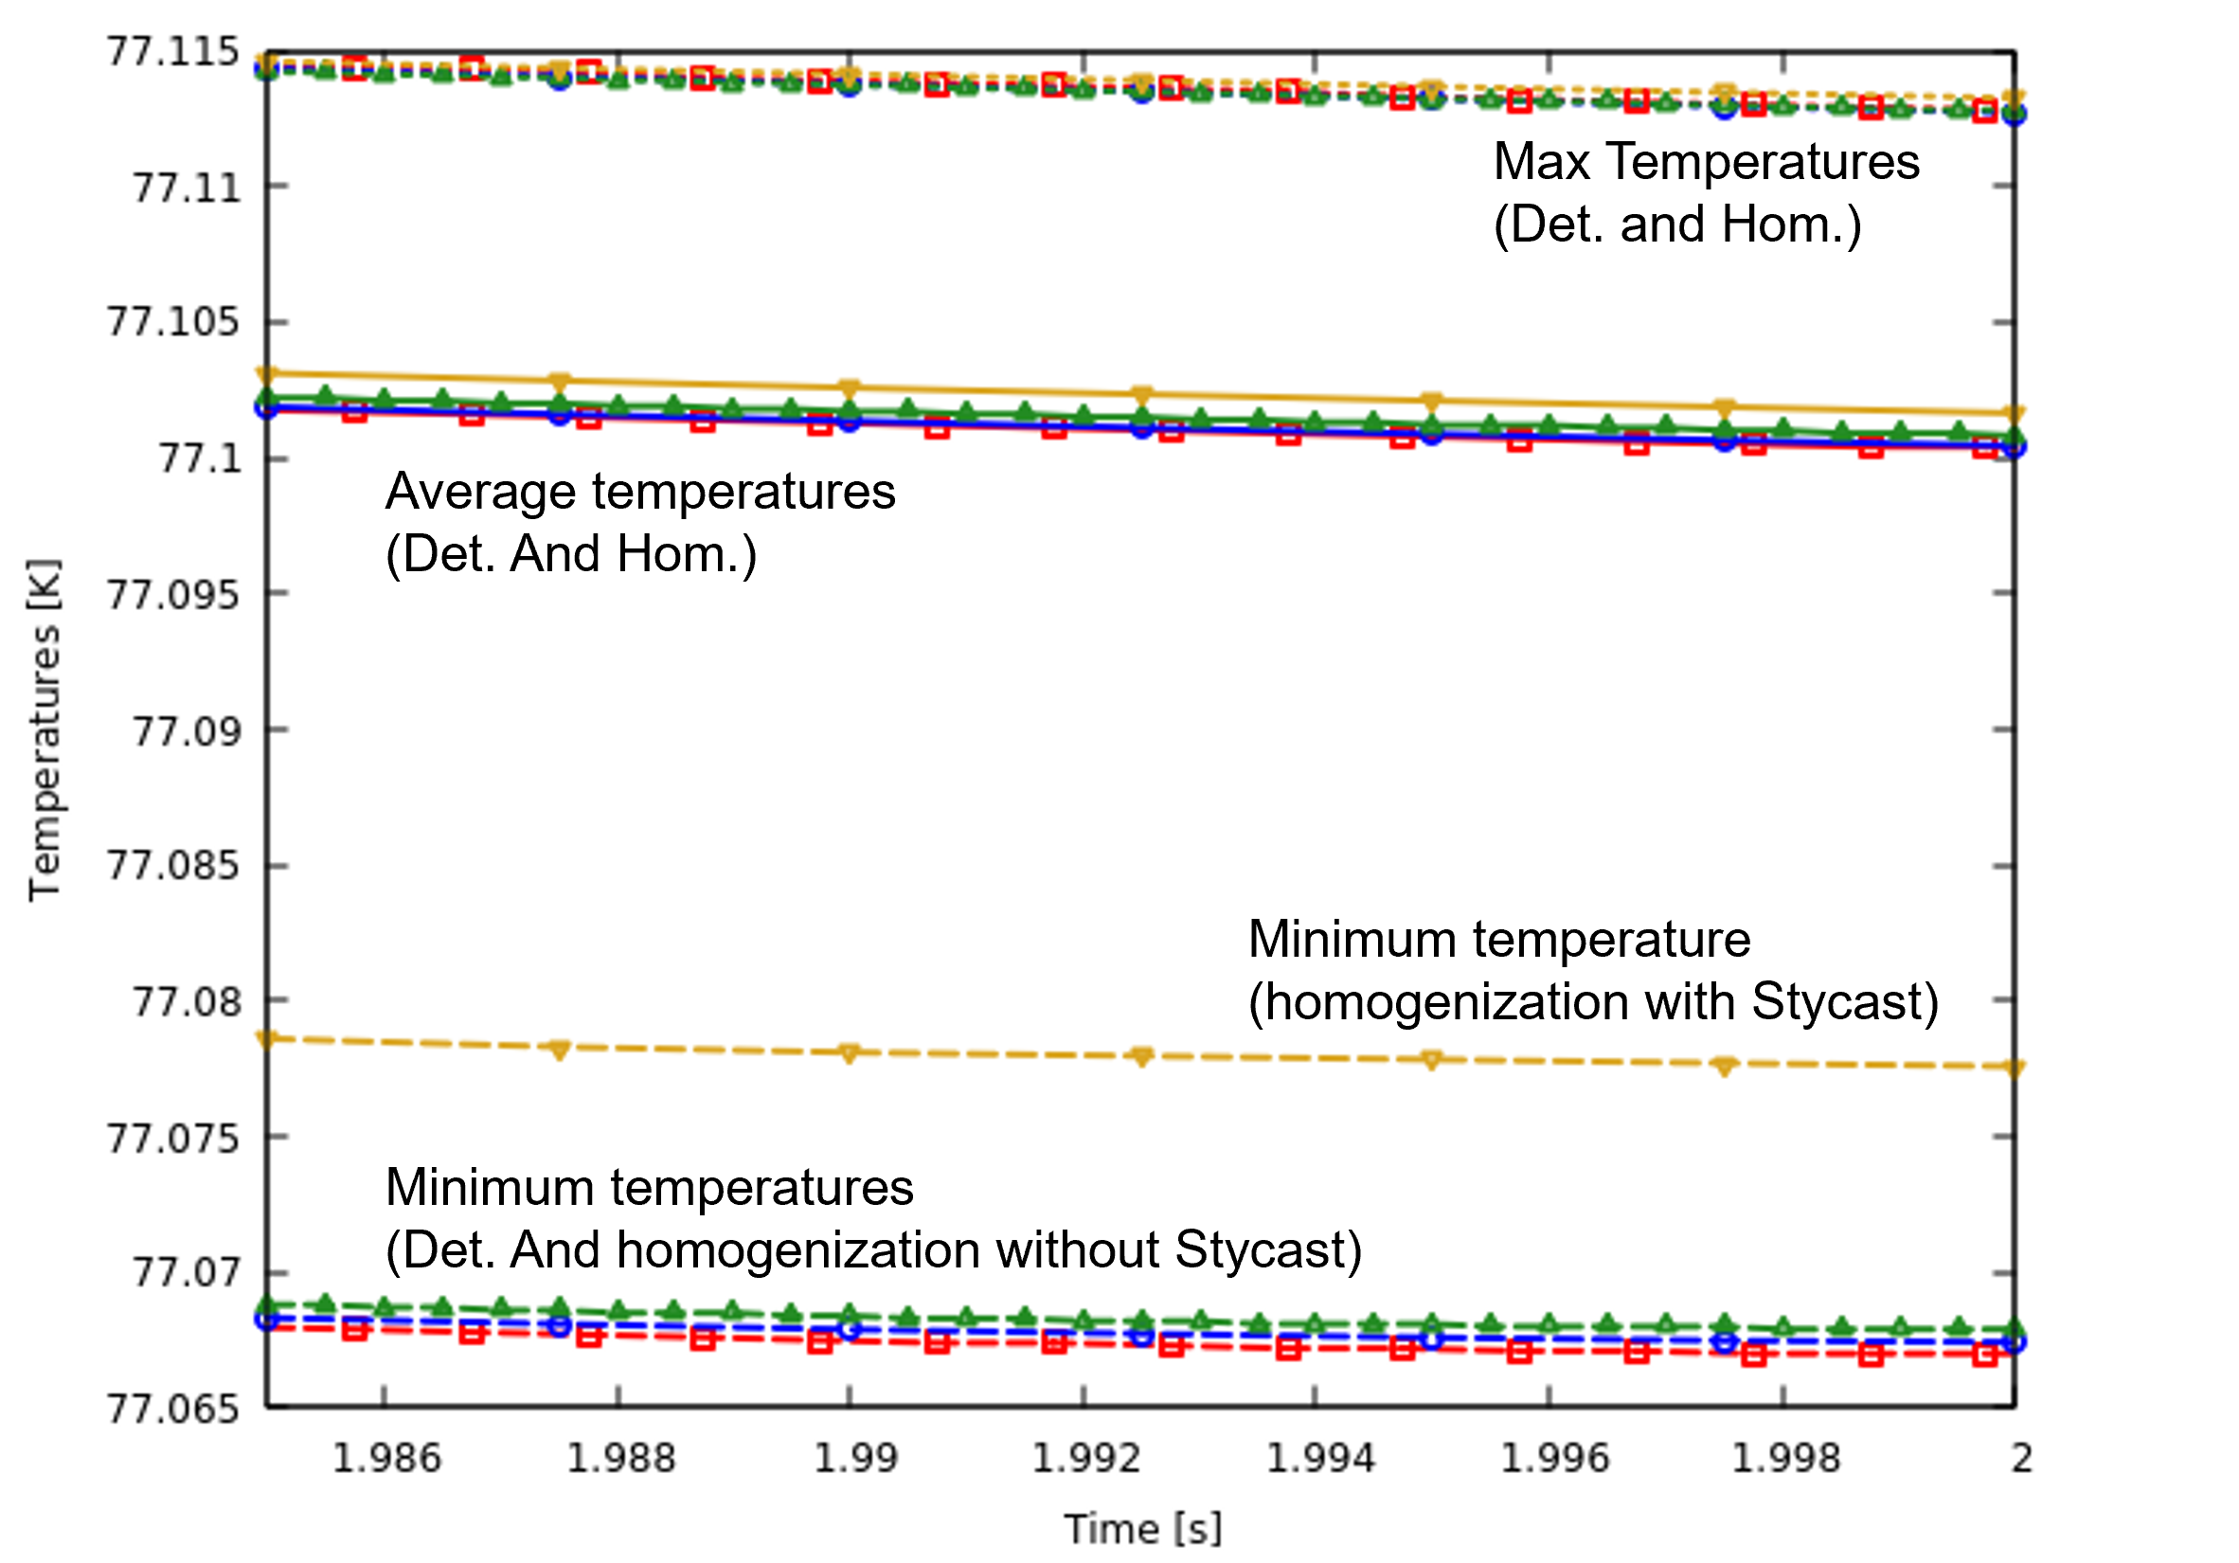
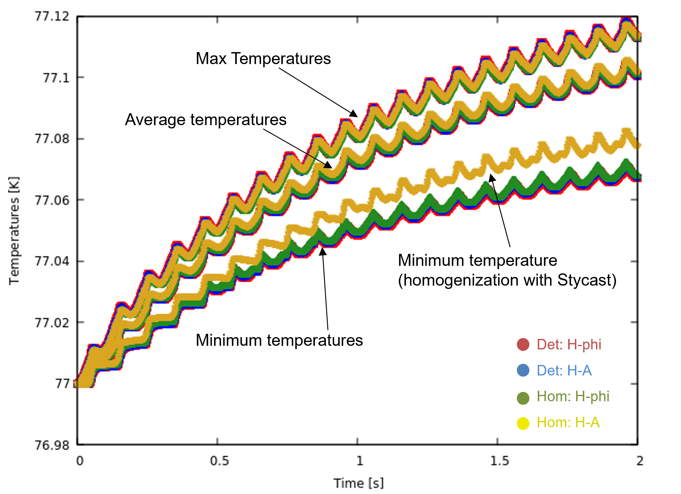
170 A
Only minimum temperature is affected
with Stycast in homogenization
Very good agreement in maximum and average temperatures

Slide 31
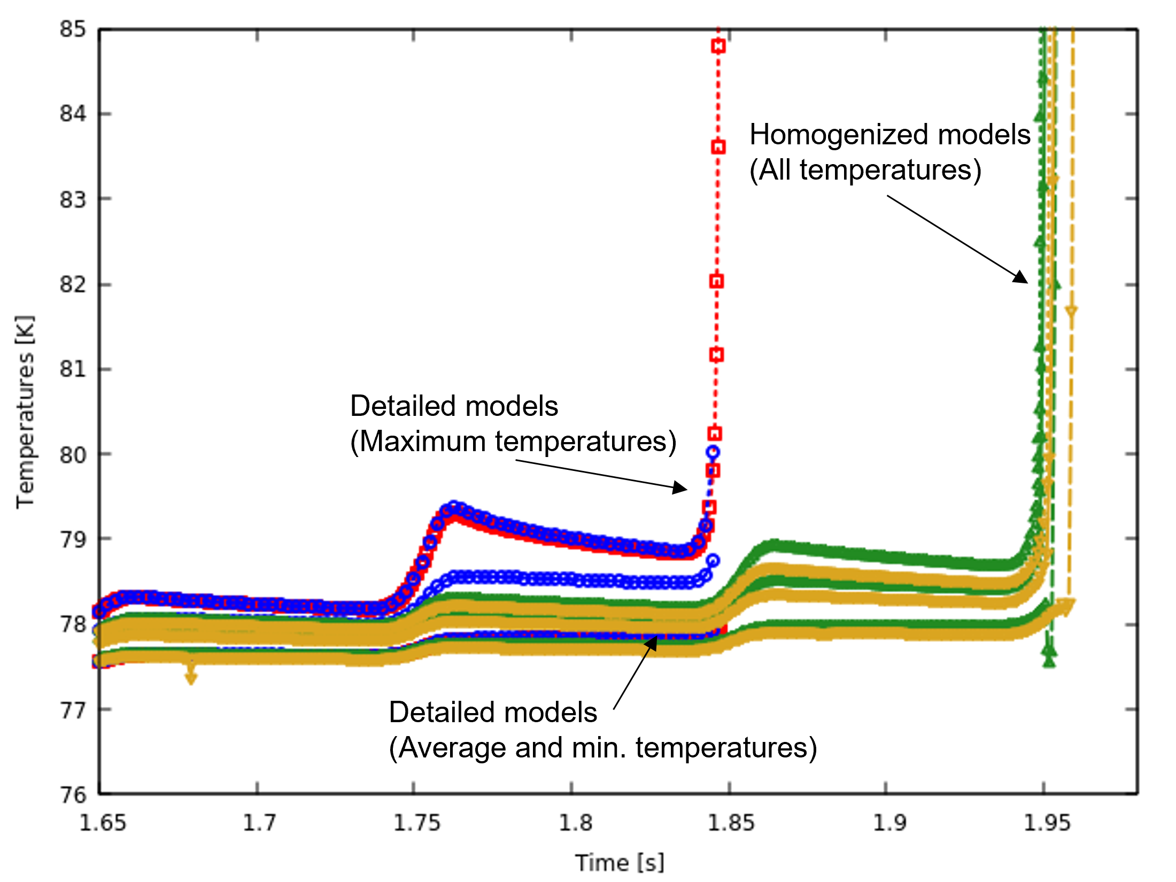
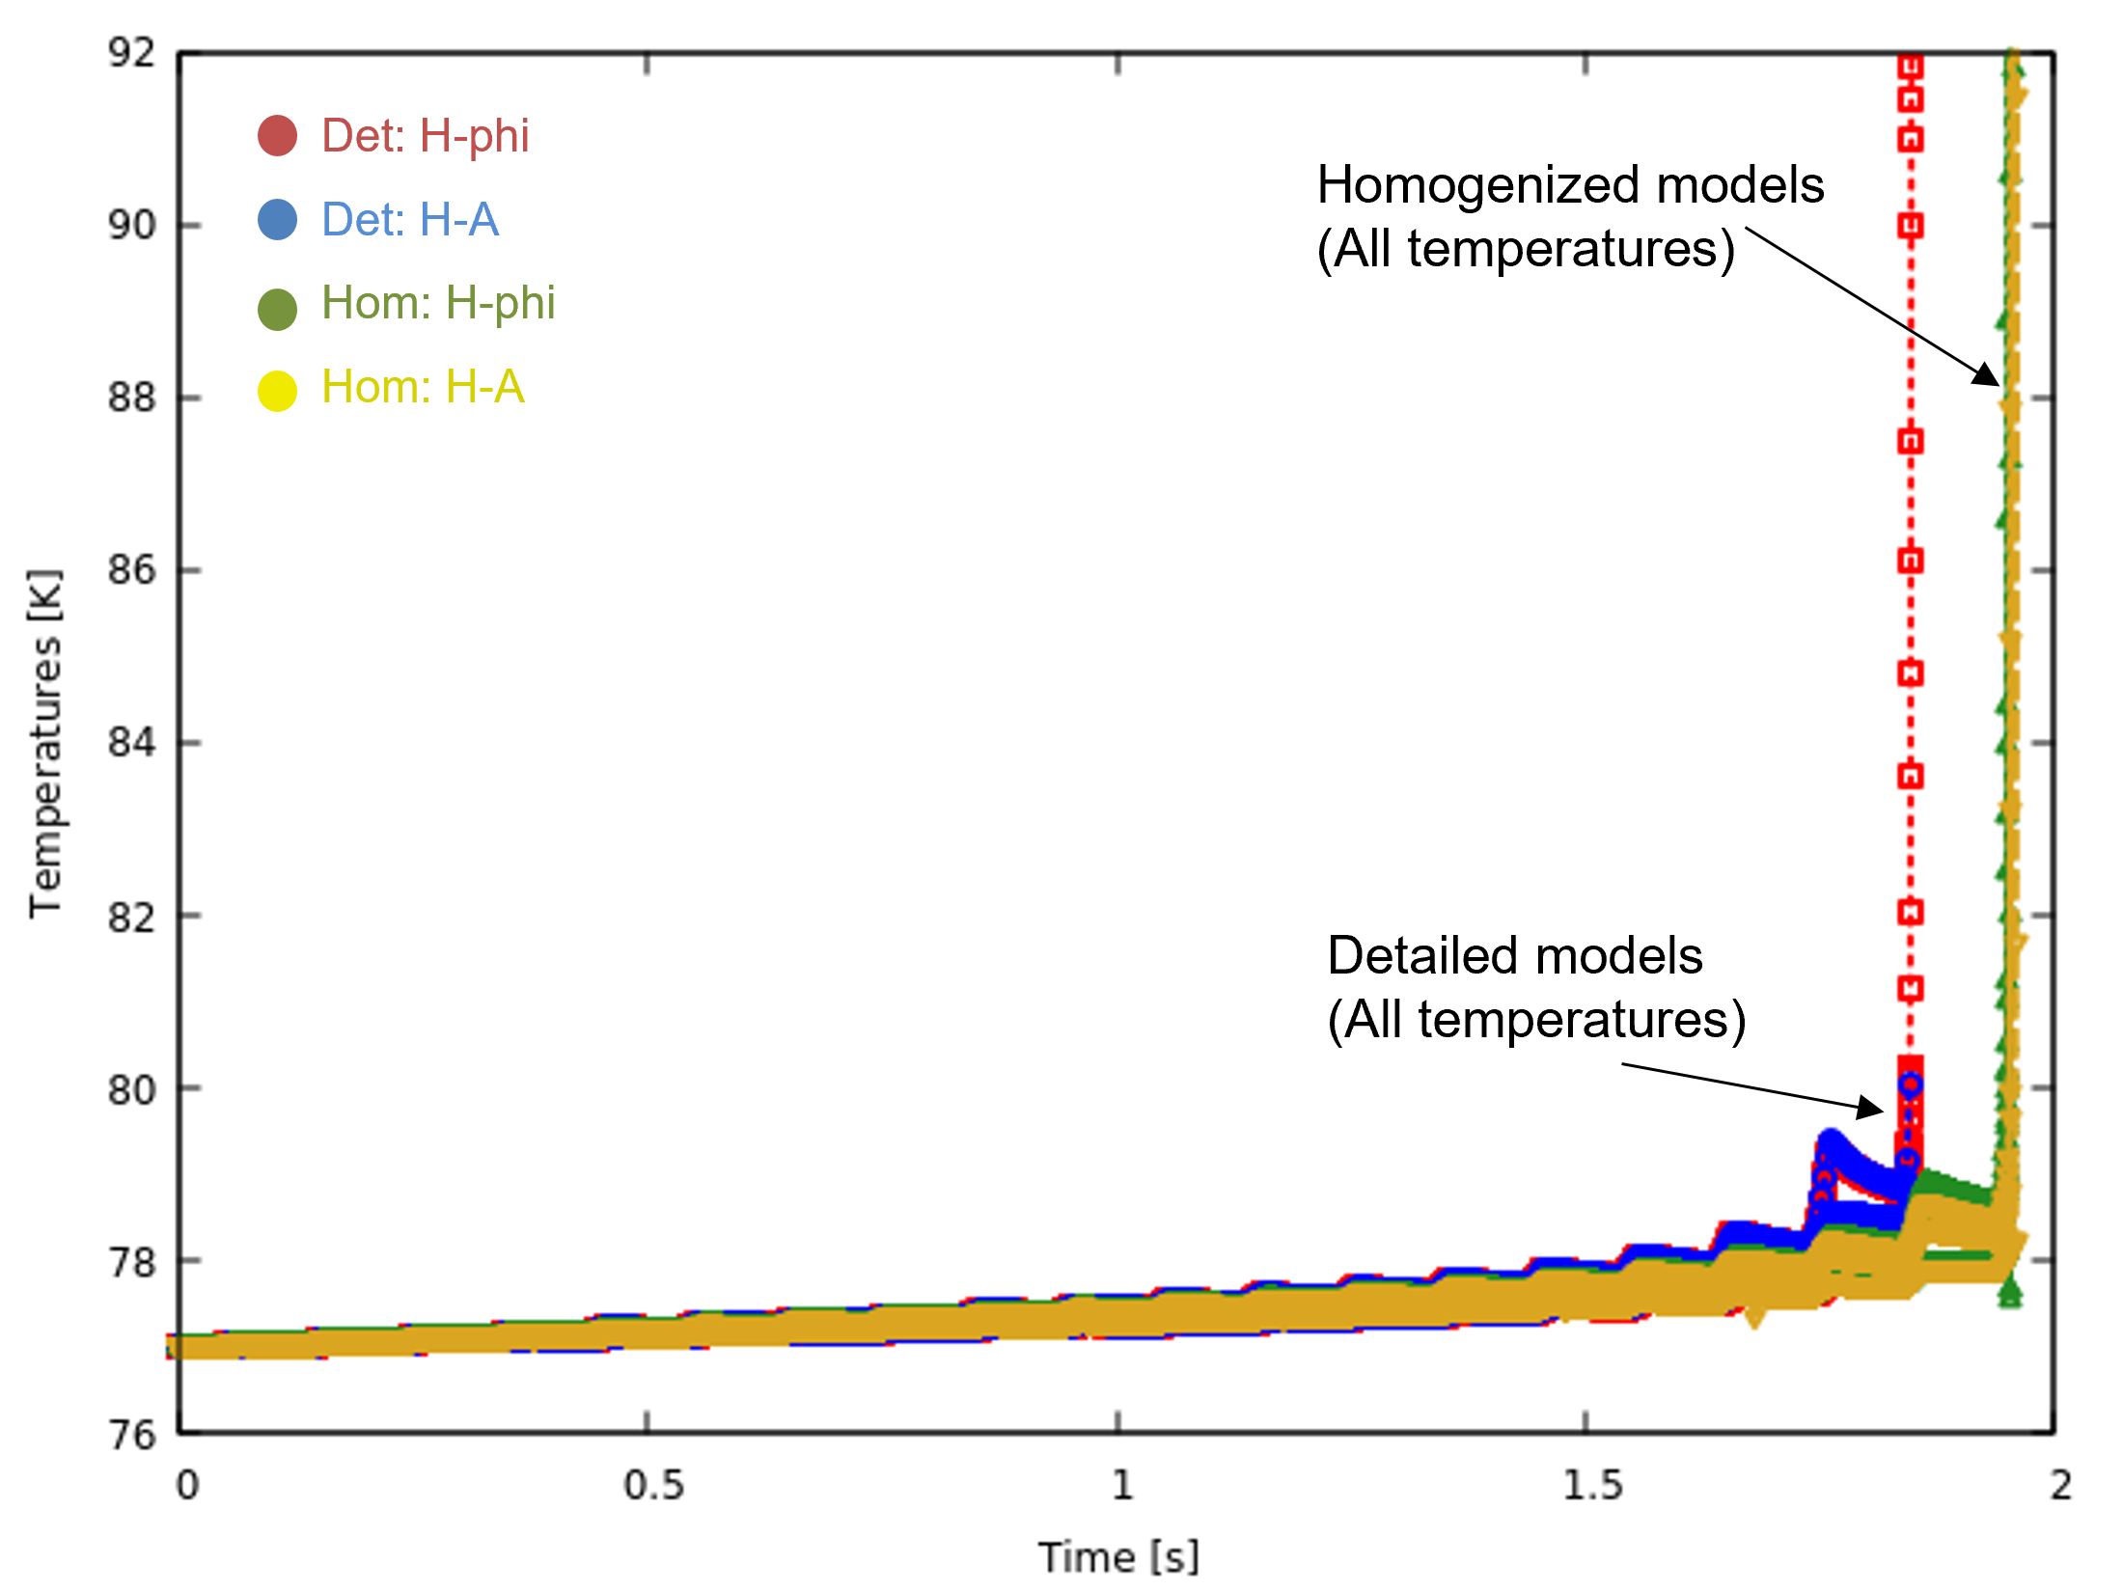
180 A
Maximum temperature matters for studies like quench
Detailed model predicts quench slightly earlier?

Slide 32
Problem statements
Material properties
Numerical models
Benchmark results
Racetrack coil (Detailed vs Homogenized models)
Racetrack coil (Homogenized models)
Pancake coil (Detailed vs Homogenized models)

Slide 33
170 A (adiabatic)
Very good agreement!

Slide 34
170 A (cooling)
Very good agreement!

Slide 35
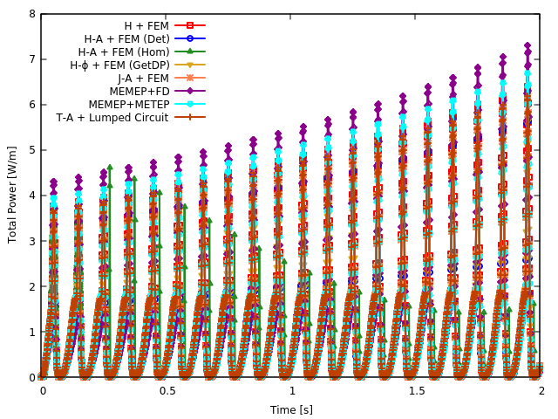
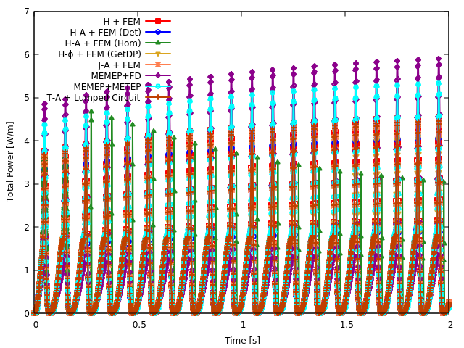
Total Power
170 A (adiabatic)
170 A (cooling)

Slide 36
180 A (adiabatic)
Minor difference due to mesh
Good agreement!

Slide 37
180 A (cooling)
Some homogenized models also predict quench at 1.85 s, like detailed models!
Differences arise between models
But why?

Slide 38
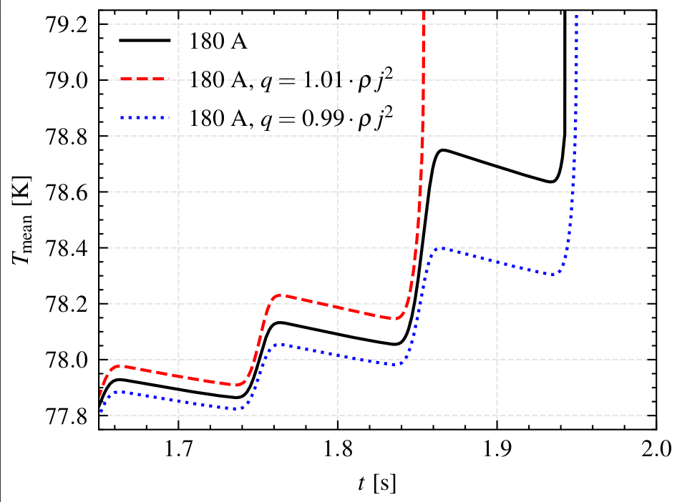
1 % difference in power accuracy
initiates quench differently
By H-phi + FEM

Slide 39
1 % difference in power accuracy
initiates quench differently
Even a very small difference in models can be important for some cases!
Total power
Average temperature

Slide 40
190 A (cooling)
Very good agreement!

Slide 41
Problem statements
Material properties
Numerical models
Benchmark results
Racetrack coil (Detailed vs Homogenized models)
Racetrack coil (Homogenized models)
Pancake coil (Detailed vs Homogenized models)

Slide 42
Pancake coil

Slide 43
Adiabatic case
Quench is initiated faster due to tougher conditions
(even after including copper!)
Very good agreement!

Slide 44
Cooling case
Quench is predicted slightly earlier than detailed model
Very good agreement!

Slide 45
Conclusion

Slide 46
Various models are benchmarked for homogenized method
      Very good agreement with detailed method
      Very good agreement between each other
Including Stycast in homogenization only affects minimum temperature
Even 1-2% difference between models can affect quench prediction

Slide 47
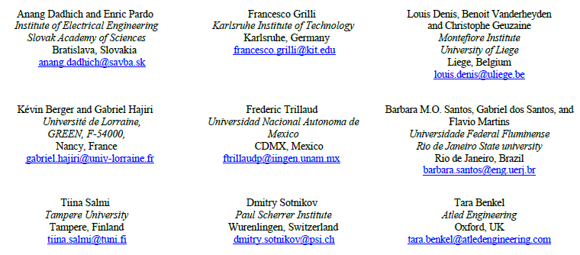
Future work
More development of models and comparison with experiments
Publication of paper (stay tuned!)
Join our collaboration or questions? Contact: ☺

Slide 48

Thank you!

Slide 49
Questions?

Slide 50
Extras

Slide 51
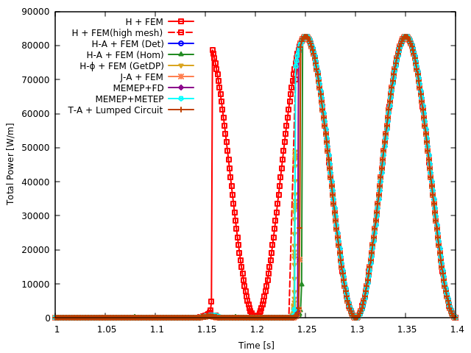
180 adia total power

