Slide 1


A physics-guided recurrent machine learning model for long-time prediction of quench dynamics
N. Breault, J.-H. Fournier-Lupien, C. Lacroix, F. Sirois
June 12th, 2024
Laboratory of Superconductivity and Magnetism (LSM)
Polytechnique Montréal, Montréal, QC, Canada

Slide 2
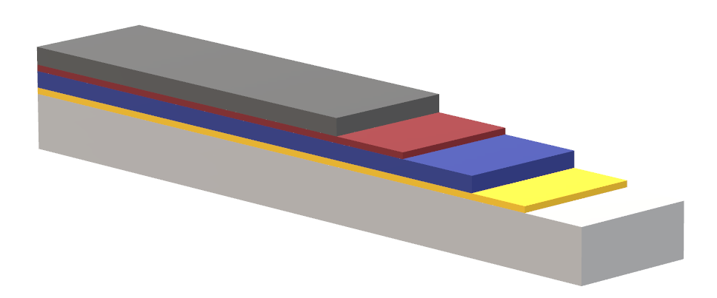
Problematic: High computational cost for 3D simulations
Main problems with FEM:
Simulation time: Several hours
Numerical instabilities
Few meters tape simulation: Impratical
y
z
x
Silver
Interfacial Resistance
Modelling approach:
Electrothermal (FEM)
Nonlinear E-J relation
Local defect in HTS (quench)
Solve for T(x,y,z,t) and V(x,y,z,t)
HTS
Buffer
Local defect
Substrate
length
width
Exemple of HTS architecture
(not to scale)
A continuation of J.-H. Fournier-Lupien’s work. Heat problem only.
Notes:
Critical phenomena must be taken into account

Slide 3
How to SPEED UP simulation: the main idea
y
x
2D or 3D Problem (side view)
Dimension Reduction
Silver
1D Problem
A
HTS
A’
A
A’
Local defect
length
Substrate
Low Computational cost
length
In practice: length ~ m, width ~ mm, and heigth ~ µm
How to maintain accuracy?
Solution inside the HTS (thin layers)
T(x,t) and V(x,t)
Machine learning: Learn physics & Dimension reduction impacts
Notes:
Critical phenomena must be taken into account

Slide 4
Overview: workflow AND SPEED UP
2D or 3D Quench Simulations
(FEM solver)
Data Generation
Time-consuming
Training set
Test set
Classical 1D models for quench dynamics
Fast
Physics-Guided Machine Learning Model
Solution
T(x,t) & V(x,t)
Machine learning techniques
Notes:
Critical phenomena must be taken into account

Slide 5

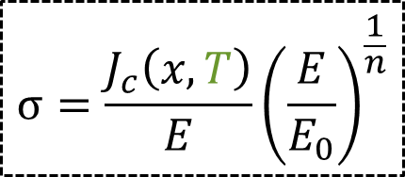


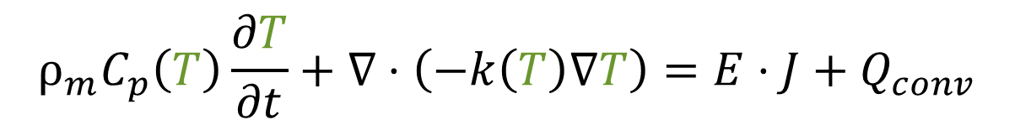
Problem definition for data generation
Silver
HTS
Substrate
2-D Problem to solve with FEM:
Electrical: Current continuity equation
$$∇⋅\left(−σ\left(T,V\right)∇V\right)=0$$
$$ρ_{m}C_{p}\left(T\right)\frac{∂T}{∂t}+∇⋅\left(−k\left(T\right)∇T\right)=E⋅J+Q_{conv}$$
Thermal: Heat Equation
$$J=σ\left(T,V\right)E$$
$$E = − ∇V$$
Coupled and nonlinear system
$$σ=\frac{J_{c}\left(x,T\right)}{E}{\left(\frac{E}{E_{0}}\right)}^{\frac{1}{n}}$$
Notes:
Critical phenomena must be taken into account

Slide 6
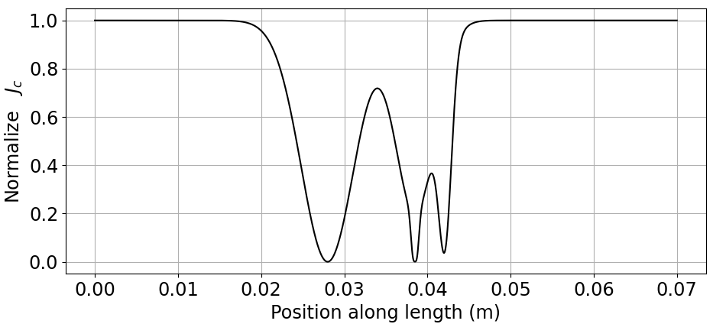
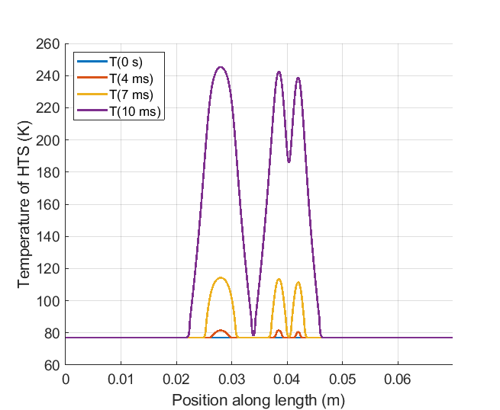
DATA GENERAtion: randomness & parameters
Random inhomogeneities in critical current:
Position
Numbers
Amplitude
Width
Tape Architecture:
Width : 0.04m
Height : 2 µm (HTS, ag) & 50 µm hastelloy
Rinter : 1 µΩcm²
FEM Model information:
Δx = 58 µm, Nx = 1201
Δt = 8 µs, Nt = 1201
Simulation time ~ 1h30min
Example of 2-D FEM solution
Notes:
Critical phenomena must be taken into account

Slide 7


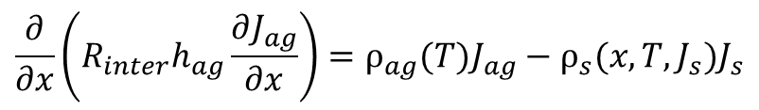









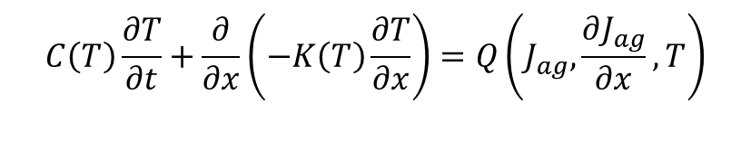


Classical FDM 1D model
2-D problem (Silver, YBCO & Hastelloy layers) represented as 1-D problem:
G.A Levin., K.A. Novak and P.N. Barnes. “The effects of superconductor-stabilizer interfacial resistance on the quench of a current-carrying coated conductor”, Supercond. Sci. Technol., 23(1), p. 014021, 2010.
Current sharing
equation
$$\frac{∂}{∂x}\left(R_{inter}h_{ag}\frac{∂J_{ag}}{∂x}\right)=ρ_{ag}(T)J_{ag}−ρ_{s}{(x,T,J_{s})J}_{s}$$
Newton-Raphson method
$$C\left(T\right)\frac{∂T}{∂t}+\frac{∂}{∂x}\left(−K\left(T\right)\frac{∂T}{∂x}\right)=Q\left(J_{ag},\frac{∂J_{ag}}{∂x},T\right)$$
Dufort-Frankel
discretization scheme
Heat equation
Homogenization
: Our Implementation
Sequential decoupled resolution:
$t^{n}\left(s\right)$:
$$0$$
$$Δt$$
$$2Δt$$
$$3Δt$$
Current density inside HTS
$${\vec{J}}_{0}$$
$${\vec{J}}_{1}$$
$${\vec{J}}_{2}$$
$${\vec{J}}_{3}$$
$${\vec{T}}_{0}$$
$${\vec{T}}_{1}$$
$${\vec{T}}_{2}$$
$${\vec{T}}_{3}$$
…
Temperature inside HTS
Notes:
Critical phenomena must be taken into account

Slide 8

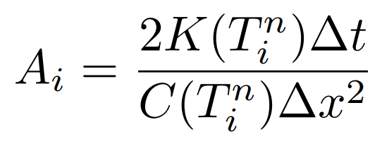
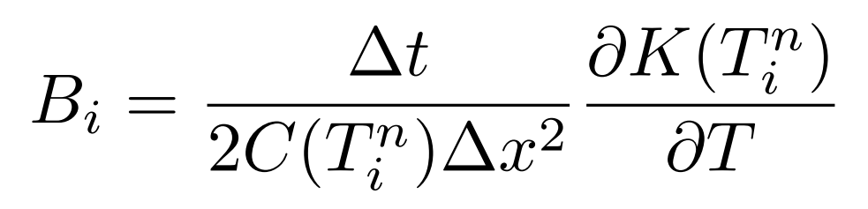
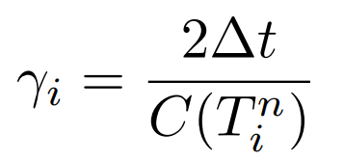


Physics-guided machine learning model
Dufort-Frankel discretization:
Heat equation
Function of T
Incorporation of Machine learning:
Machine learning: Only for heat equation
Let’s re-define:
Prefactors : Functions learned during training!
Notes:
Critical phenomena must be taken into account

Slide 9
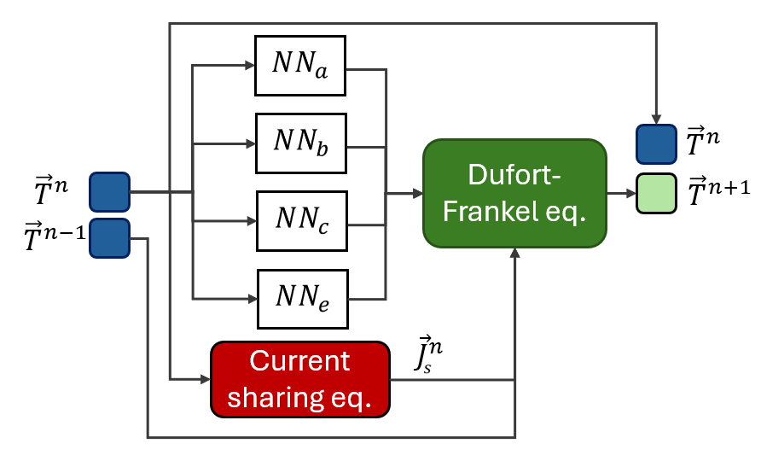


schematic view of the model
Physics-Guided Recurrent Machine Learning (PGRML) model
$NN :$Neural Network
${\vec{T}}^{n−1}$, ${\vec{T}}^{n}$
Outputs
PGRML cell
Inside the cell
Inputs
Key attributes:
General for any initial states
Independant of tape length (for a given architecture)
Only dependant on temperature seen in training
Notes:
Critical phenomena must be taken into account

Slide 10
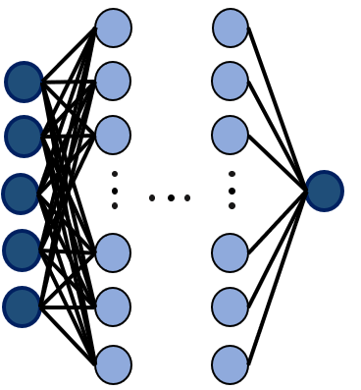





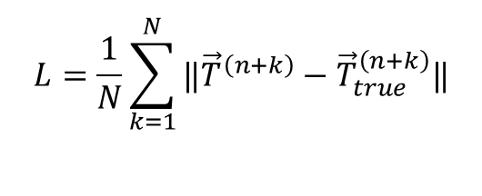


Model size & related information
$$x_{i}$$
Training time: ~12h
Activation function: ReLU
Dropout for hidden layers
MinMax Normalization
Not a fine tuned model
For each NN:
$$T_{i+2}^{n}$$
$$T_{i+1}^{n}$$
[5,60,60,60,1]
$$T_{i}^{n}$$
$$T_{i−1}^{n}$$
31 simulations:
23 training
1 validation
7 test
$$T_{i−2}^{n}$$
Loss function & recurrent predictions:
k times
Optimization with respect to T !
PGRML cell
$$L=\frac{1}{N}\sum_{k=1}^{N}{‖{\vec{T}}^{\left(n+k\right)}−{\vec{T}}_{true}^{\left(n+k\right)}‖}$$
$${\vec{T}}^{\left(n+1\right)},{\vec{T}}^{\left(n+2\right)}... {\vec{T}}^{\left(n+k\right)}$$
Notes:
Critical phenomena must be taken into account

Slide 11
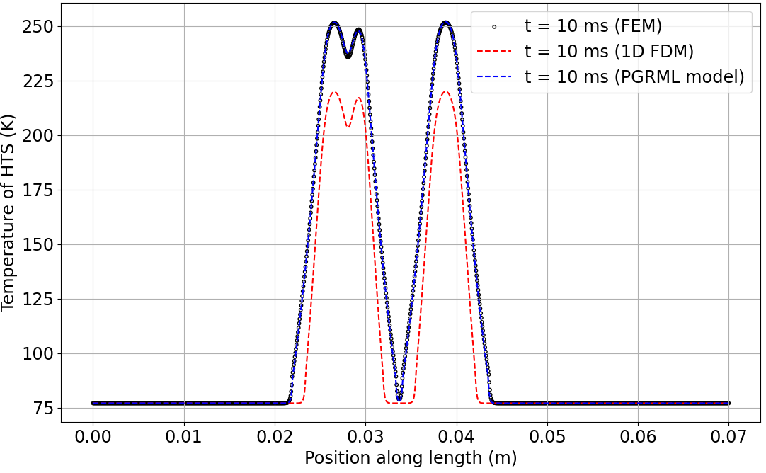
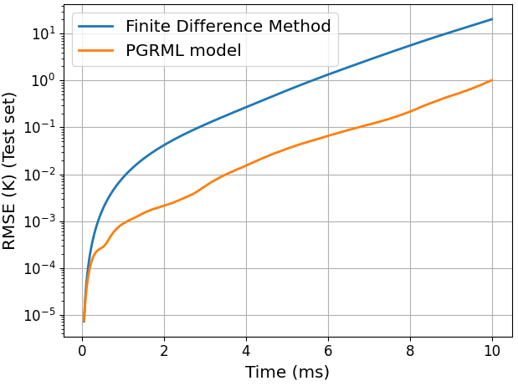
Solution on test set: PGRML vs FDM
FDM: not accurate
FEM ~ 1h30min : (Δx , Δt) = (58 µm, 8 µs)
PGRML ~ 45s : (Δx , Δt) = (58 µm, 25 µs)
Notes:
Critical phenomena must be taken into account

Slide 12

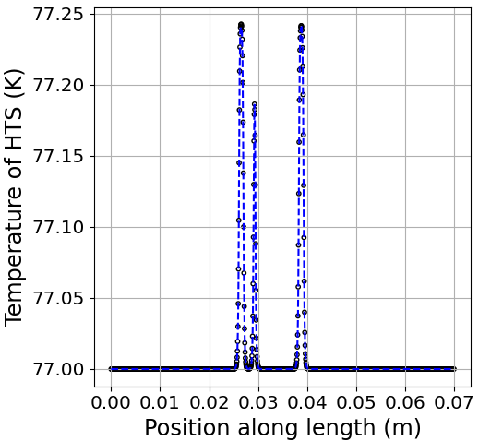
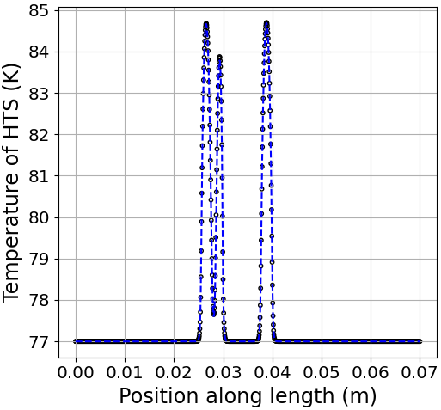
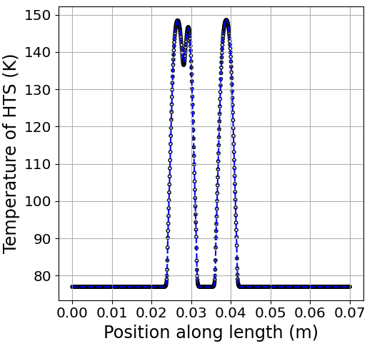
solution on test set: PGRML over time
t = 1.2 ms
t = 4.0 ms
t = 8.0 ms
Notes:
Critical phenomena must be taken into account

Slide 13
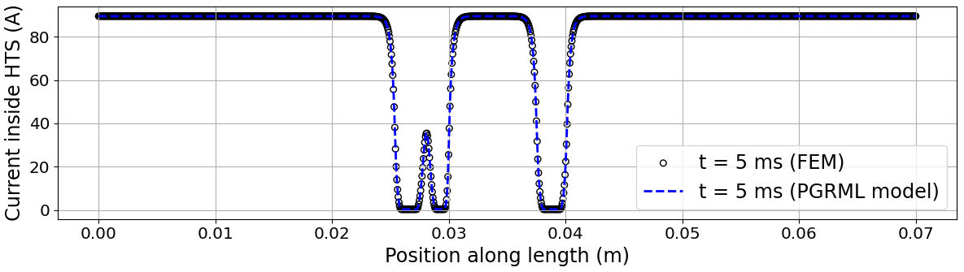
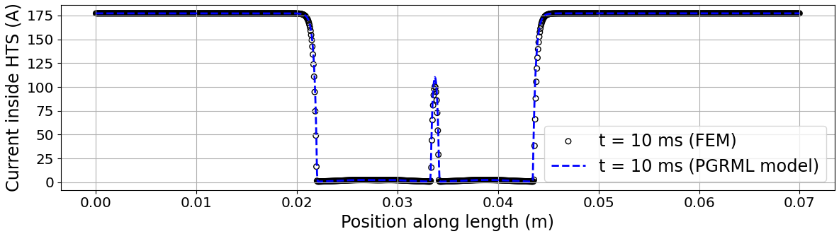
solution on test set: Current sharing
I = 89.5 A
PGRML model is not trained on the current profile!
I = 177.3 A
Notes:
Critical phenomena must be taken into account

Slide 14
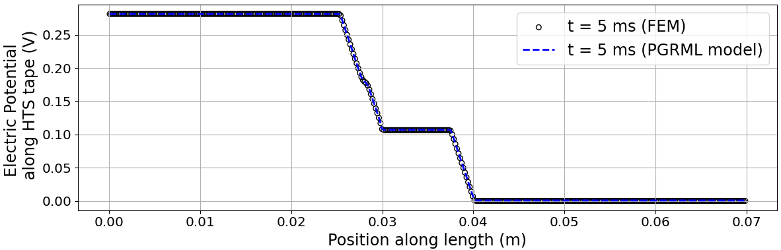
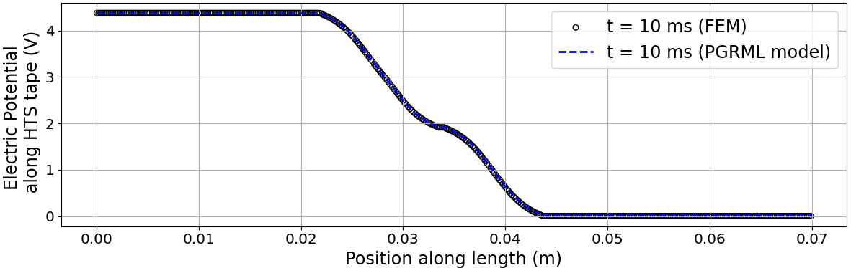
solution on test set: Electric potential profile
I = 89.5 A
PGRML model is not trained on the electrical potential !
I = 177.3 A
Notes:
Critical phenomena must be taken into account

Slide 15
Long tape prediction with solution: METHODOLOGY
Test set
10x
2-D simulations
Spatial
Concatenation
Simu. 1
Simu. 2
Simu. 3
…
Simu. 10
0
L
2L
10L
x
Position along length
PGRML prediction as a whole:
1 initial condition, 1 simulation
0
10L
x
Position along length
Notes:
Critical phenomena must be taken into account

Slide 16
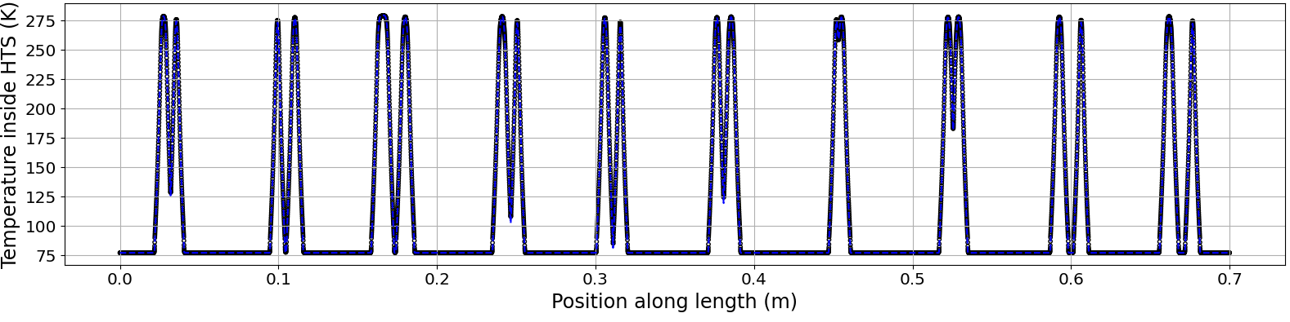

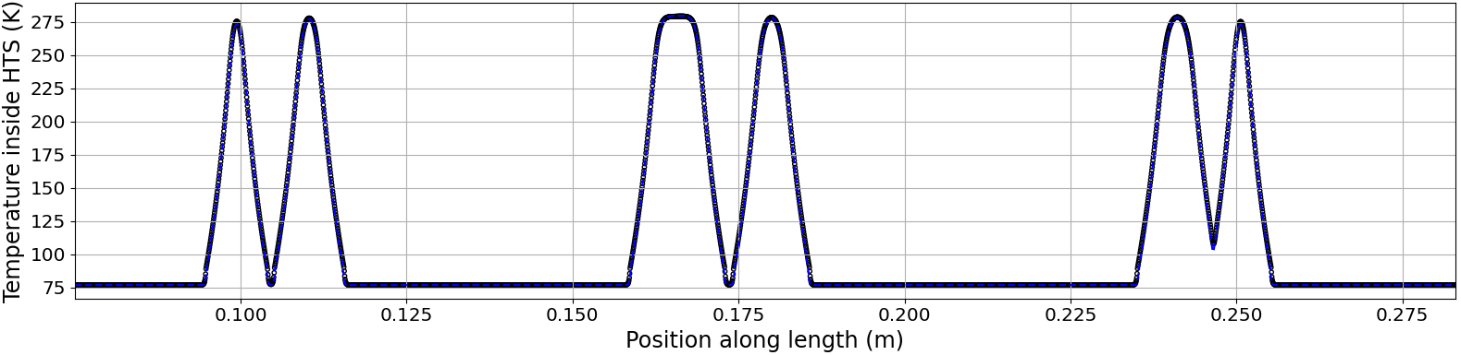
Long tape prediction with solution: Temperature
Simulation time:
FEM : 10x 1h30 = 15h
PGRML: 10min
90x Faster !
Notes:
Critical phenomena must be taken into account

Slide 17
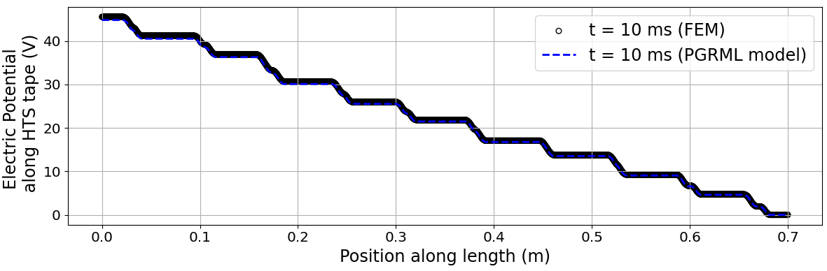
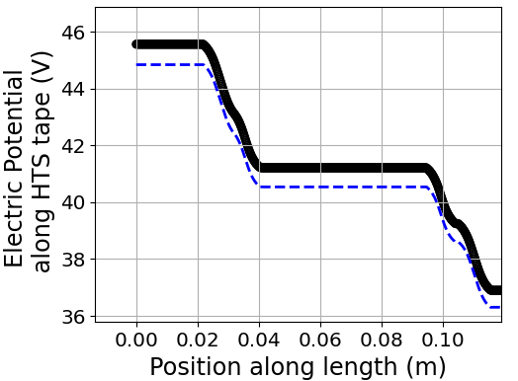

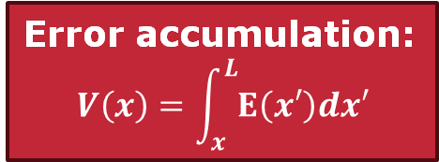
Long tape prediction with solution: electric potential
$$max\left(\frac{\left|V_{FEM}−V_{PGRML}\right|}{V_{FEM}}\right)≈1.6\%$$
Error accumulation:
$$V\left(x\right)=\int_{x}^{L}{E\left(x′\right)dx′}$$
Notes:
Critical phenomena must be taken into account

Slide 18

Conclusion
Highlights:
Model based on a reduction in physical dimensionality & Machine learning
General for any initial state
No re-training required for length changes given an architecture
90x times faster than FEM
What’s next:
Complete cooling after hot spots appear
Variable interfacial resistance
Real critical current density distribution
3-D simulations and CFD architecture
Notes:
Critical phenomena must be taken into account

Slide 19
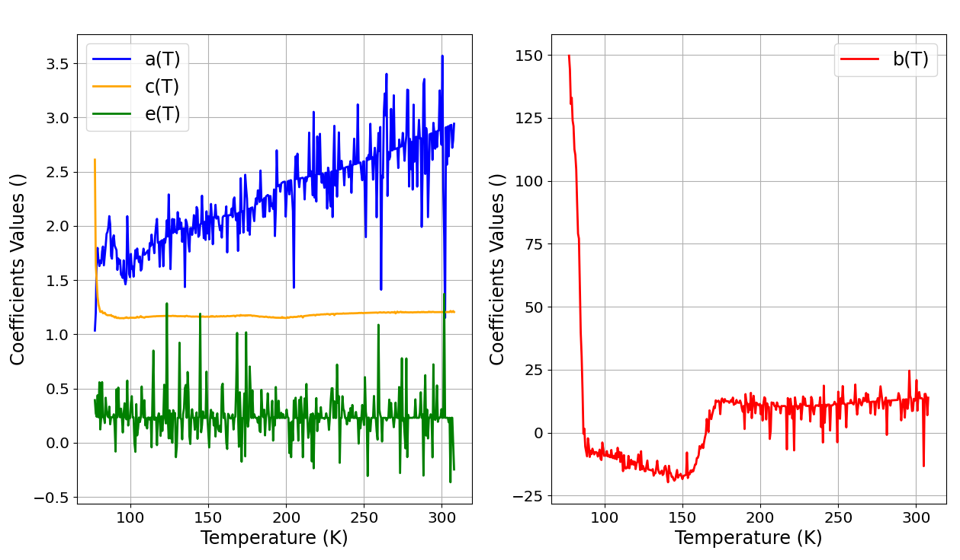





Neural networks outputs values
5 inputs function!
$$T$$
$T$+ 0.5
$T$+ 1
$T$+ 1.5
$T$+ 2
T = [77, 320]
Notes:
Critical phenomena must be taken into account

