Slide 1

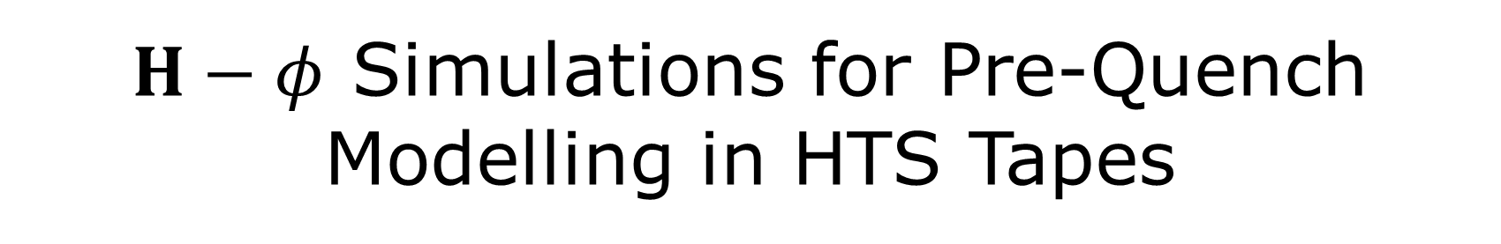
$H−φ$ Simulations for Pre-Quench Modelling in HTS Tapes
Gregory Giard, Christian Lacroix, Haifa Ben Saad, Benjamin Poupart-Raîche, Simon-Mathieu Bergeron-Hartman and Frédéric Sirois
Laboratory of Superconductivity and Magnetism, Polytechnique Montreal
  June 11th 2024

Slide 2
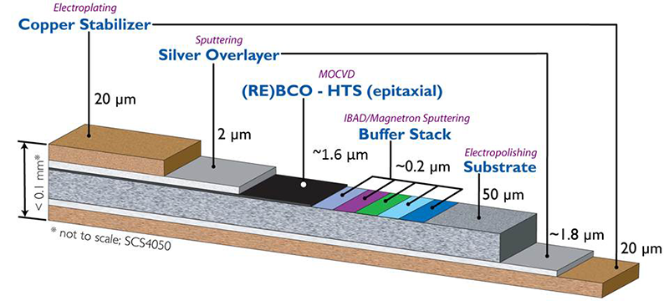
Introduction
HTS modelling can be extremely challenging
  Multiphysics often required
  Highly non-linear and inter-dependent material laws
  High-aspect ratio mesh
➔ lead to sensitive simulations when it comes to predicting quench nucleation and propagation

Slide 3
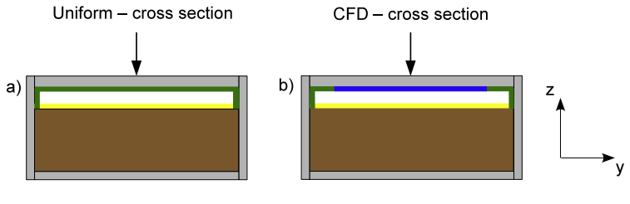
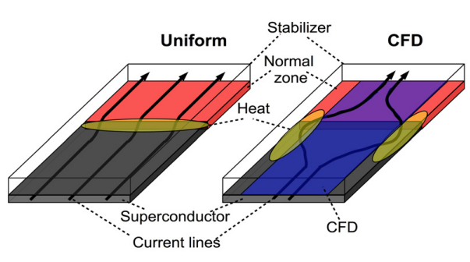
Introduction
Our goals in this work are to accurately:
Compare different electromagnetic formulations, E-J characteristics and tape architectures, especially the Current Flow Diverter (CFD) tapes (3-D problems)
Predict the hot-spot nucleation and propagation with temperature and voltage
Investigate the “pre-quench” regime
NZPV enhancement (6-7 times faster!)
C. Lacroix and F. Sirois, SuST. 27(3), 035003 (2014)

Slide 4
Overview
Introduction
Electromagnetic Formulations
E-J Characteristic in HTS
Simulation results
Summary and Outlook

Slide 5
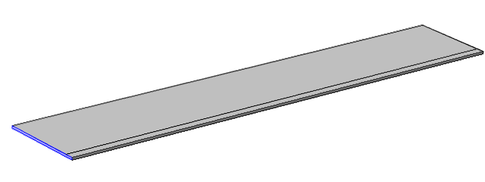
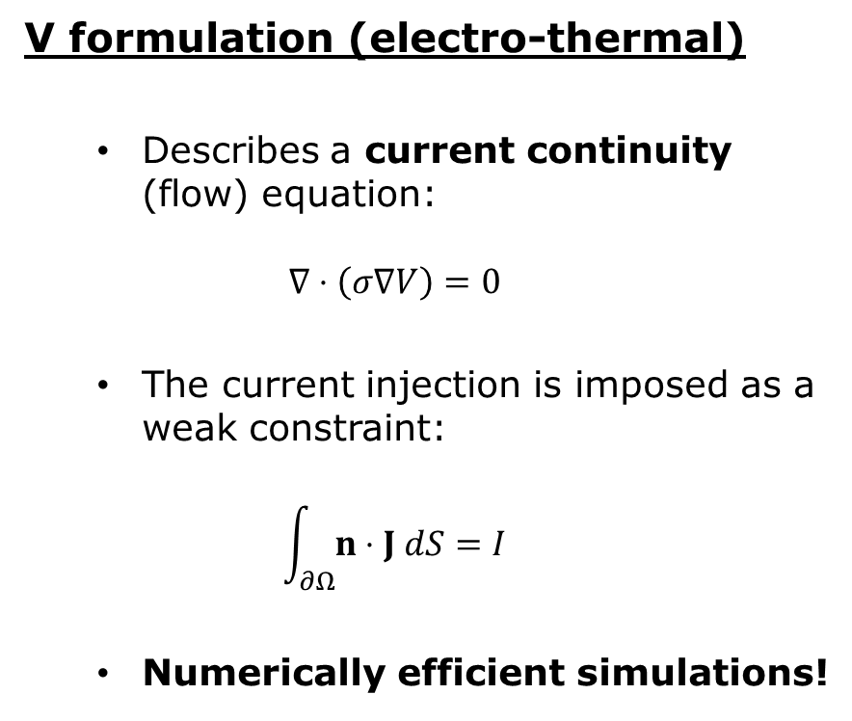
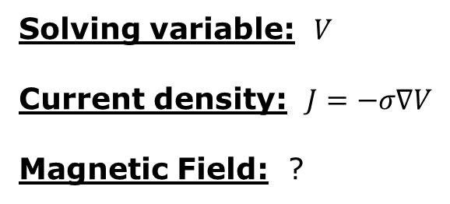
Electromagnetic Formulations
V formulation (electro-thermal)
  Describes a current continuity (flow) equation:
  $$∇⋅\left(σ∇V\right)=0$$
  The current injection is imposed as a weak constraint:
  $$\int_{∂Ω}{n⋅J dS}=I$$
  Numerically efficient simulations!
Solving variable: $V$
Current density: $J=−σ∇V$
Magnetic Field: ?

Slide 6
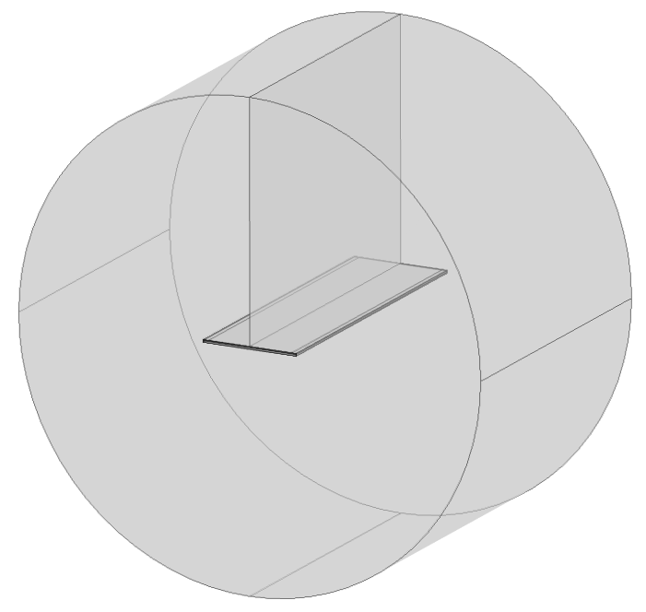
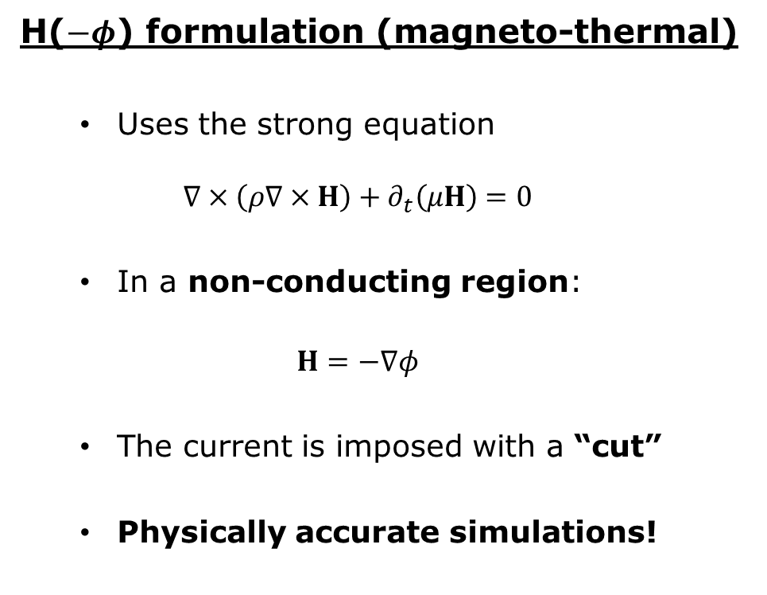
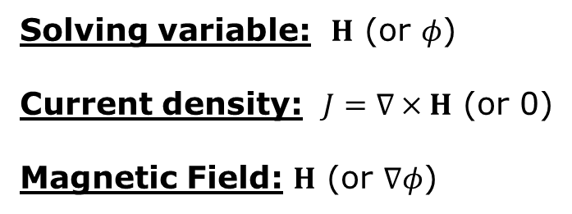
Electromagnetic Formulations
H($−φ$) formulation (magneto-thermal)
  Uses the strong equation
  $$∇×\left(ρ∇×H\right)+∂_{t}\left(μH\right)=0$$
  In a non-conducting region:
  $$H=−∇φ$$
  The current is imposed with a “cut”
  Physically accurate simulations!
Solving variable: $H$ (or $φ$)
Current density: $J=∇×H$ (or 0)
Magnetic Field: $H$ (or $∇φ$)

Slide 7
Overview
Introduction
Electromagnetic Formulations
E-J Characteristic in HTS
Simulation results
Summary and Outlook

Slide 8
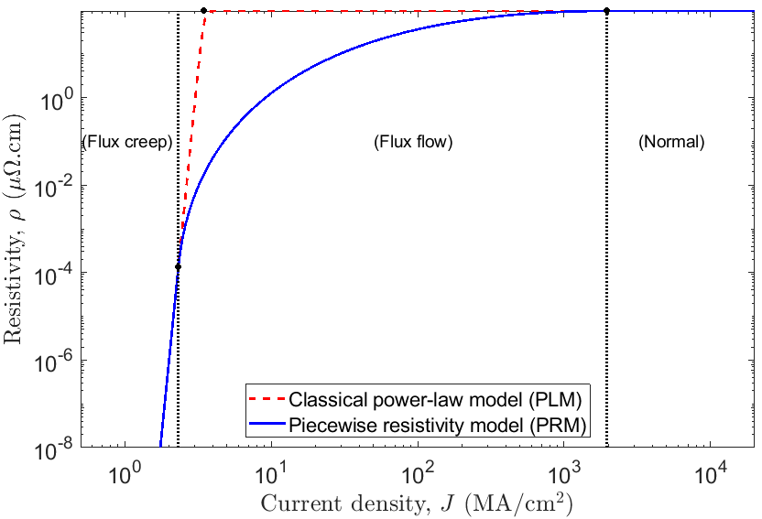
E-J Characteristic
Very often, we observe that the classical power-law generates a hot-spot too early in simulations (N. Riva, et al., SuST. 33(11), 27, 114008, 2020)
Power-law model (PLM) vs. piecewise resistivity model (PRM)
  PLM: Simple, but overshoots the voltage during flux flow
  PRM: Better represents experimental results
Bezier control points

Slide 9
Overview
Introduction
Electromagnetic Formulations
E-J Characteristic in HTS
Simulation results
Summary and Outlook

Slide 10
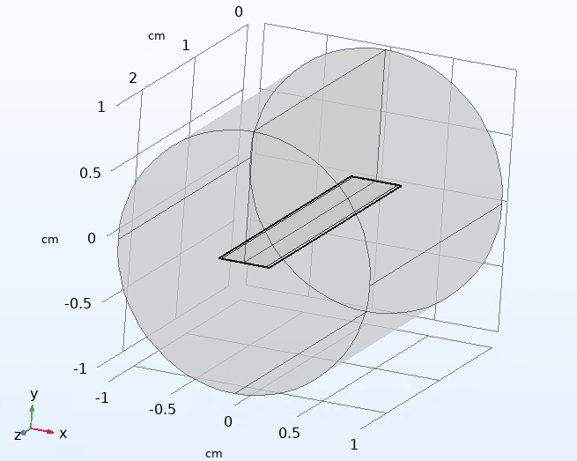
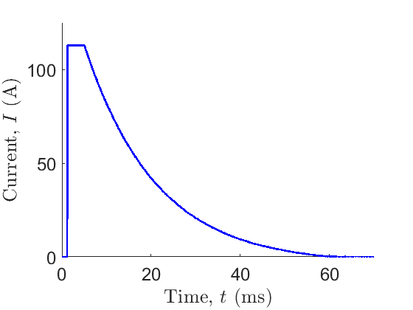


Results
Simulated benchmark (COMSOL, 3-D)
  Multilayered tapes (silver, interface, REBCO, buffer, Hastelloy and copper)
  Quench generated by a magnet (local drop of $I_{c}$)
  Experimental data available
50% drop of $J_{c}$
Thin-cut

Slide 11
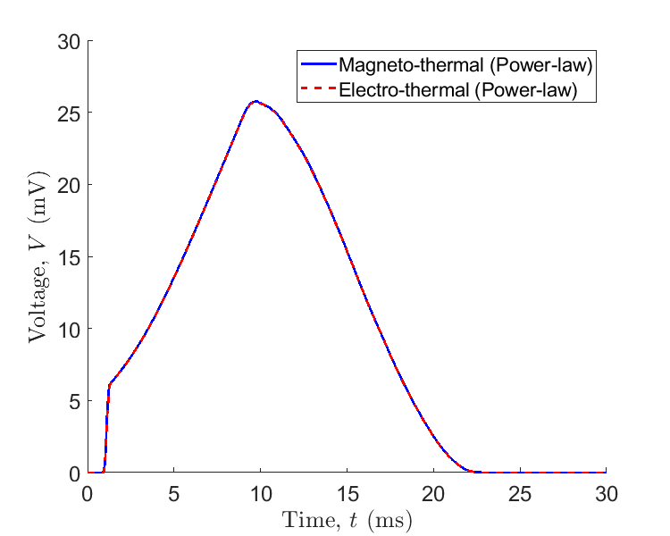
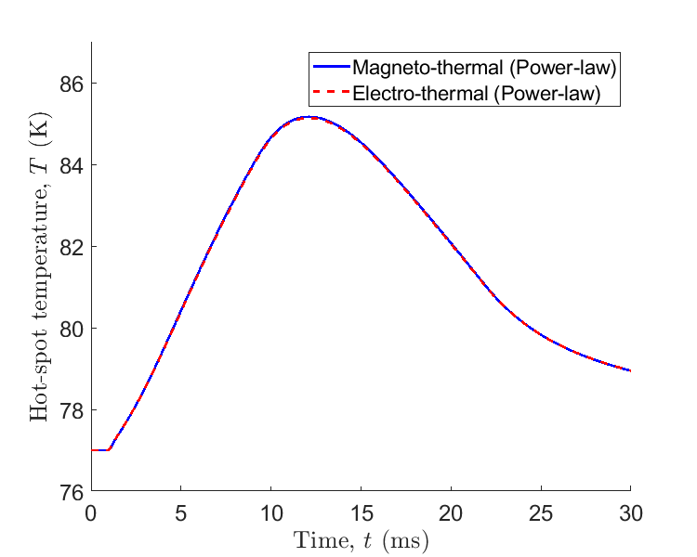
Results
Commercial tape:
Electro-thermal simulations vs. Magneto-thermal simulations (power-law)
The model used has very little to no effect on the simulation for commercial tape!

Slide 12
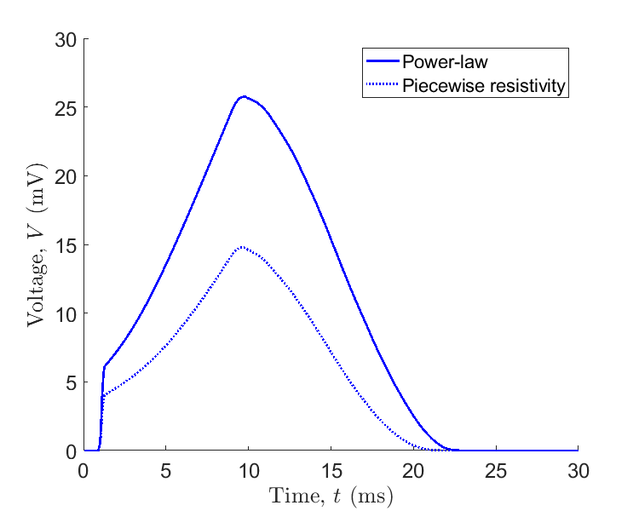
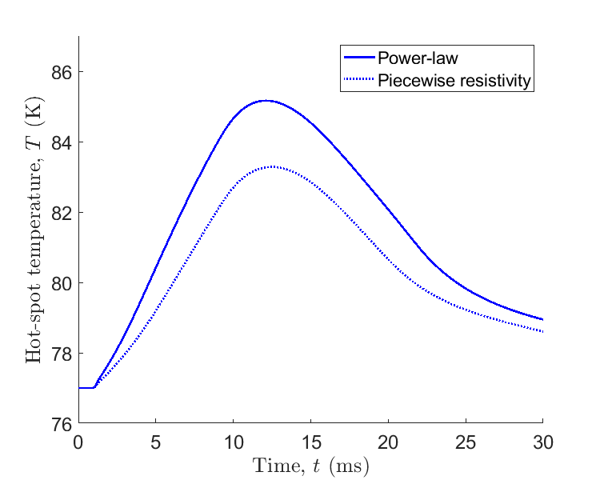
Results
Commercial tape:
Power-law vs. piecewise resistivity (magneto-thermal)

Slide 13
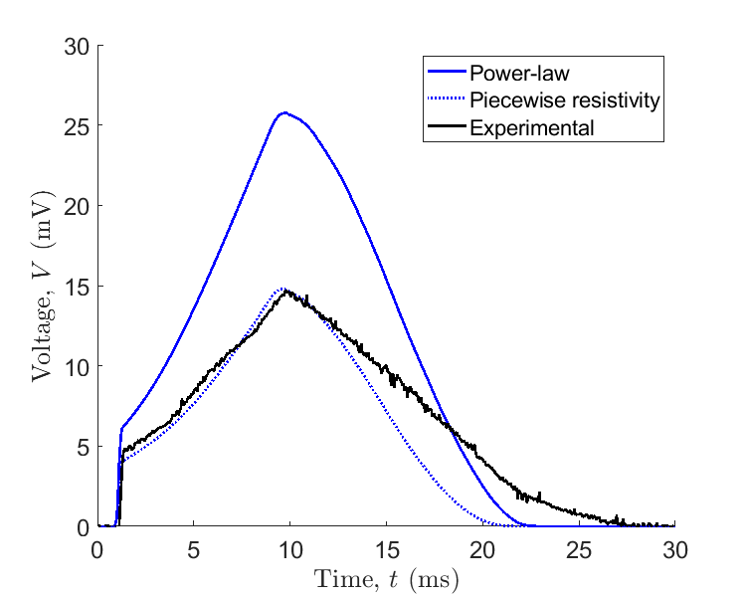
Results
Commercial tape:
Comparing with experimental data
The voltage drop, not as much…
The voltage rise much better represented with the piecewise resistivity

Slide 14
Results
Remarks for the commercial tape
  Electro-thermal simulations are probably good enough for commercial tapes (when magnetodynamic effects are negligible)
  During the quench propagation, both models also give similar results
  Flux flow regime is important to consider in resistivity model

Slide 15
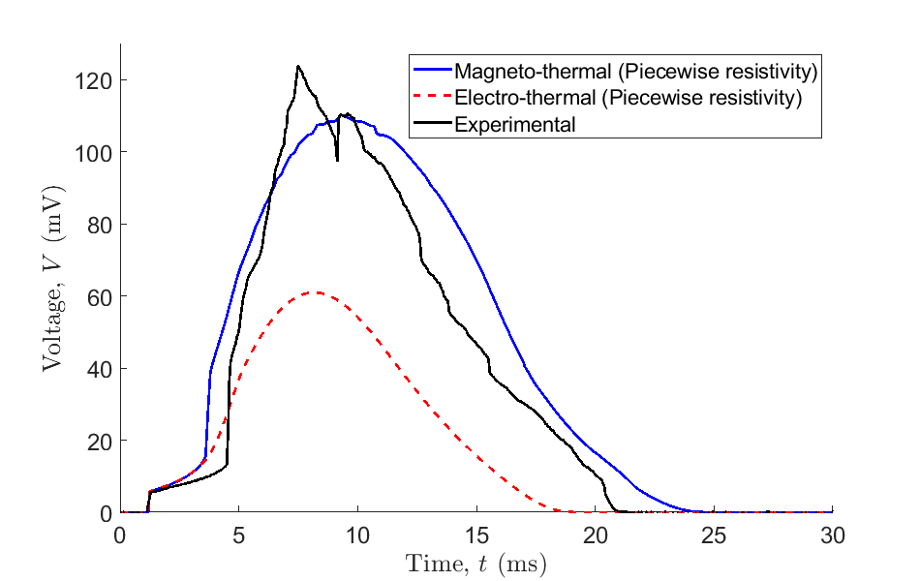
Results
CFD tape:
Let’s compare the electro-thermal and magneto-thermal model (piecewise resistivity)
The magneto-thermal simulation better represents the voltage rise and peak
Initially, both models give very similar results

Slide 16
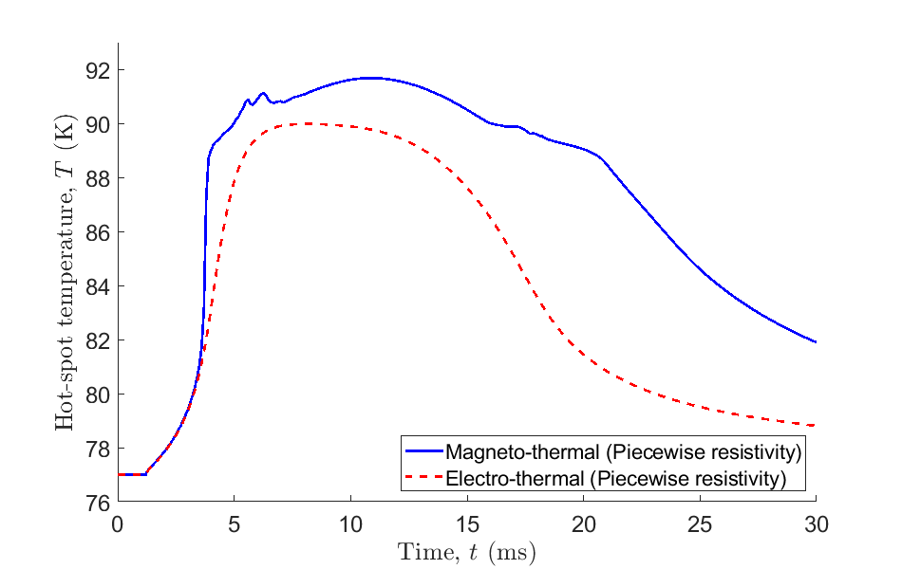
Results
CFD tape:
And what about the temperature?

Slide 17
Results
Remarks for the CFD tape
  Power-law not shown for CFD tapes, but still overshoots the voltage as expected
  The idea of CFD architecture is to count on current transfer on the sides of the tapes ➔ magnetodynamic effects are not negligible
  CFD simulations are prone to a lot of convergence issues!

Slide 18
Overview
Introduction
Electromagnetic Formulations
E-J Characteristic in HTS
Simulation results
Summary and Outlook

Slide 19
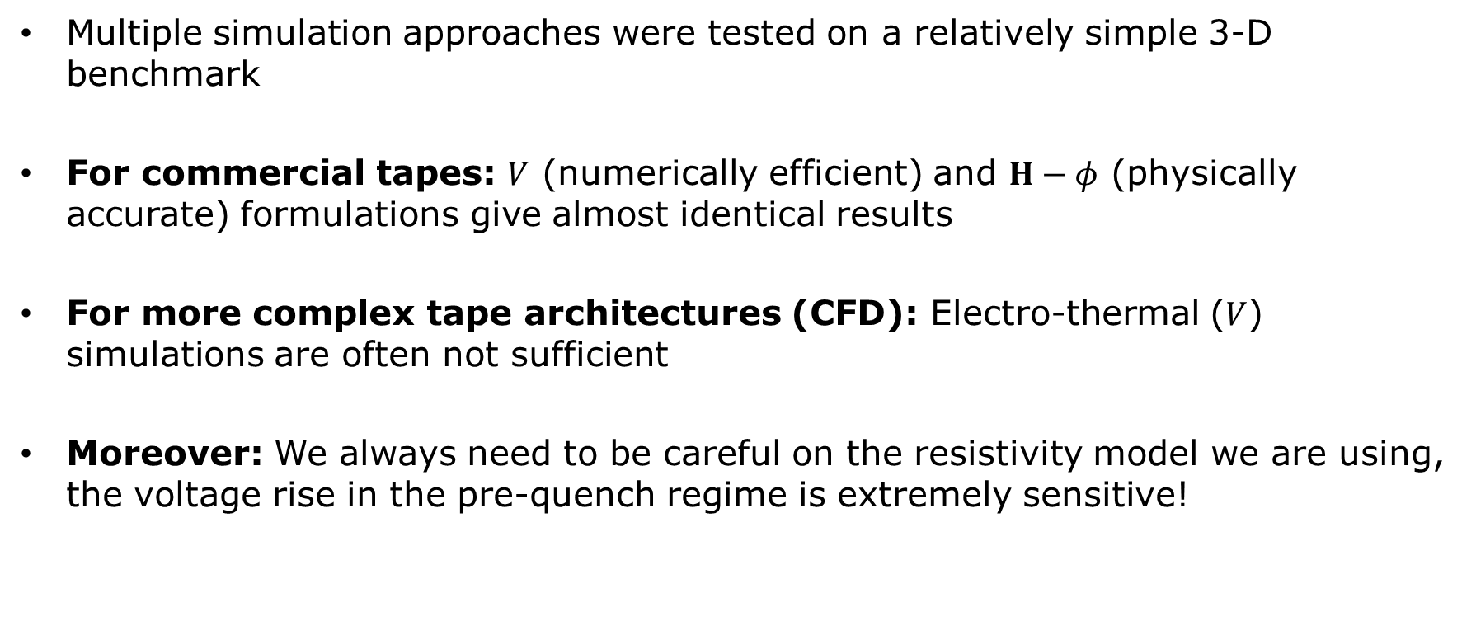
Summary And Outlook
Multiple simulation approaches were tested on a relatively simple 3-D benchmark
For commercial tapes: $V$ (numerically efficient) and $H−φ$ (physically accurate) formulations give almost identical results
For more complex tape architectures (CFD): Electro-thermal ($V$) simulations are often not sufficient
Moreover: We always need to be careful on the resistivity model we are using, the voltage rise in the pre-quench regime is extremely sensitive!

Slide 20
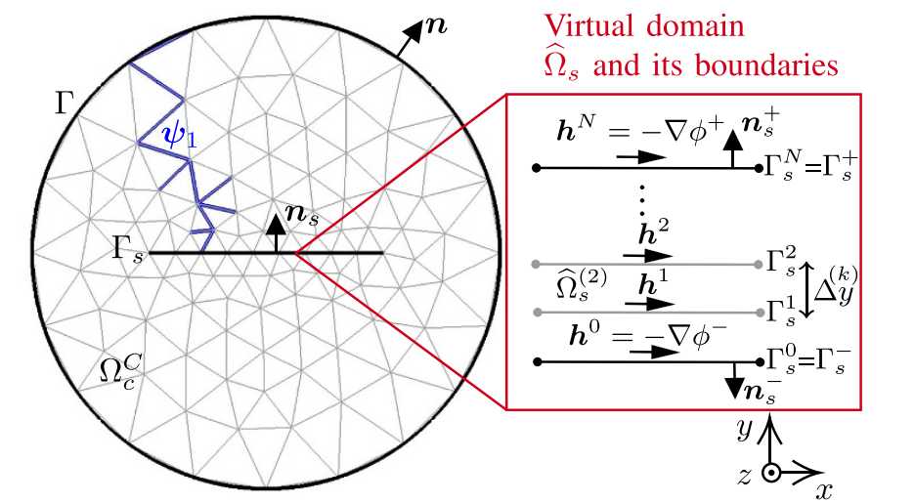

Summary And Outlook
Next steps
  Calibrate the piecewise resistivity with measurements (this summer)
  Compute the minimum quench energy with $H−φ$
  Implement the benchmark in BELFEM
B. De Sousa Alves et al., SuST 35 (2), 024001 (2021)

Slide 21





Acknowledgement

