Slide 1


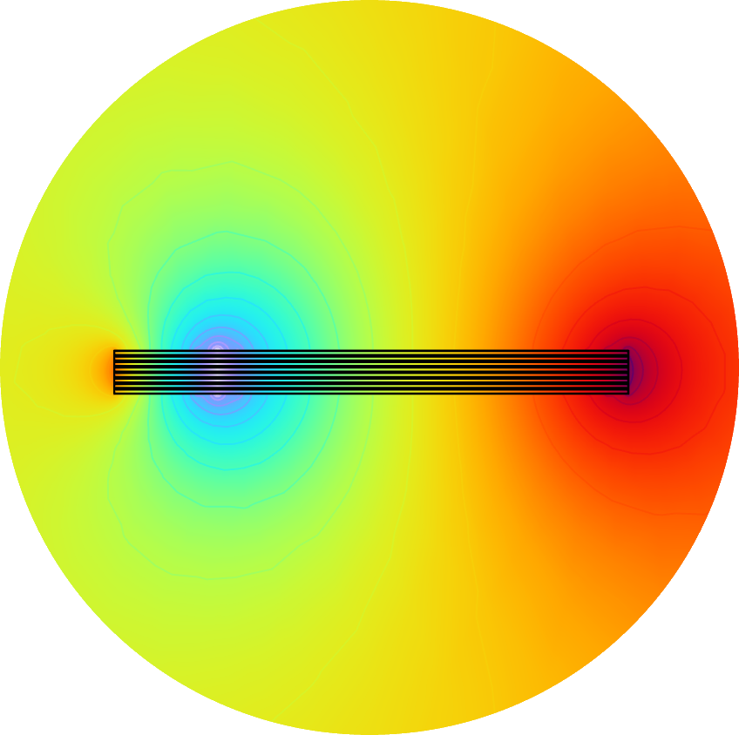
2D FEM electro-magnetic modelling of straight soldered ReBCO stack cable in high magnetic field
M. D. Araujo , B. Auchmann , A. Brem , M. Duda , H. Garcia , J. Kosse , D. Sotnikov :: PSI
9th International Workshop on Numerical Modelling of High Temperature Superconductors - HTS 2024, Bad Zurzach, 13 June 2024
This work was performed under the auspices of and with support from the Swiss Accelerator Research and Technology (CHART) program

Slide 2
Agenda
Preview
Initial data
Computation model
FEM modelling
Data analysis and validation
Conclusion

Slide 3
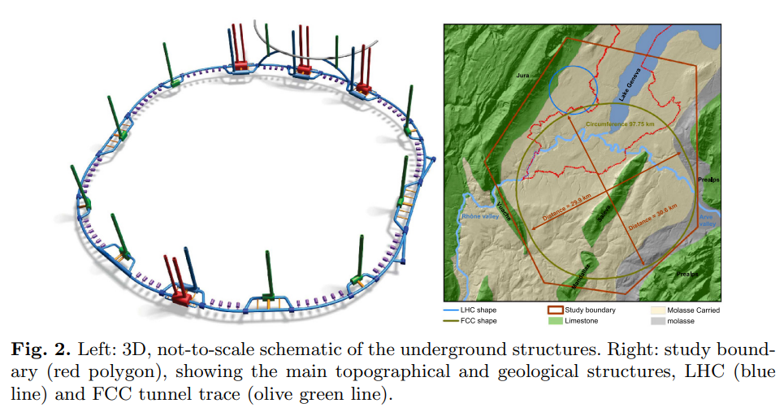
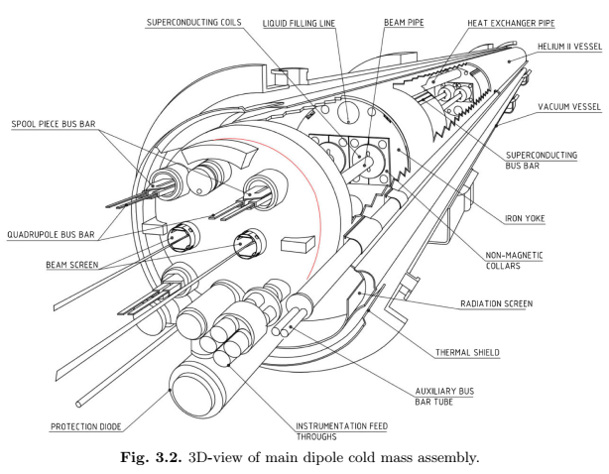
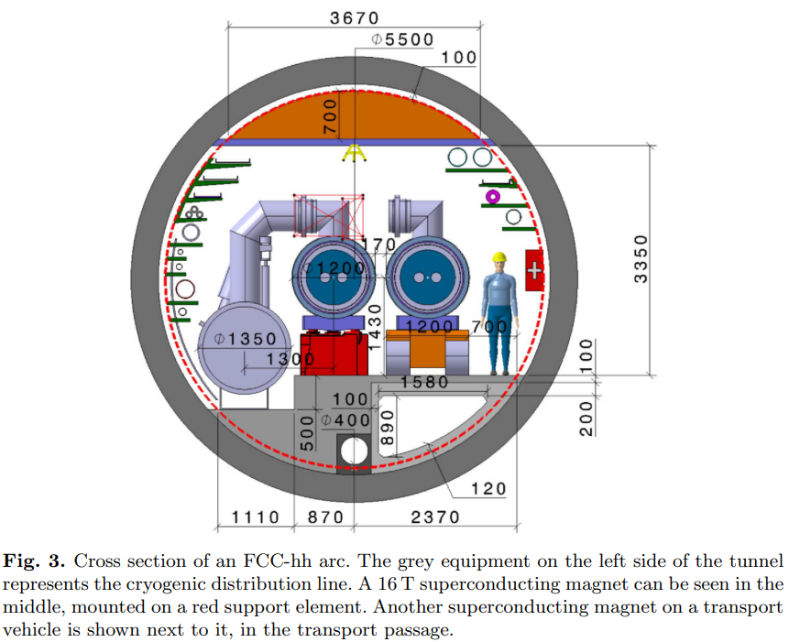
Preview – Magnet requirements
CDR dipole magnet for FCC-hh project expectations and requirements:
Critical current density at 16 T (at 4.2 K): 1,500 A/mm^2
Magnetization losses for full cycle (two apertures): 10 kJ/m
Distance between apertures: 250 mm
Coil physical aperture: 50 mm
Operating temperature: 1.9 K
Length of magnet: 15 m
Cable material: Nb3Sn
Criteria:
AC losses
Field quality
[1] A. Abada et al., FCC-hh: The Hadron Collider. Future Circular Collider Conceptual Design Report Volume 3,
The European Physical Journal Special Topics volume 228, pages755–1107 (2019)

Slide 4
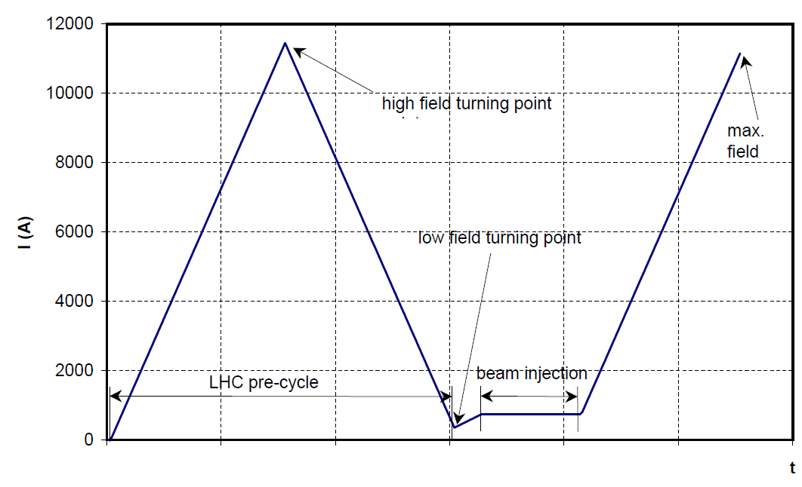
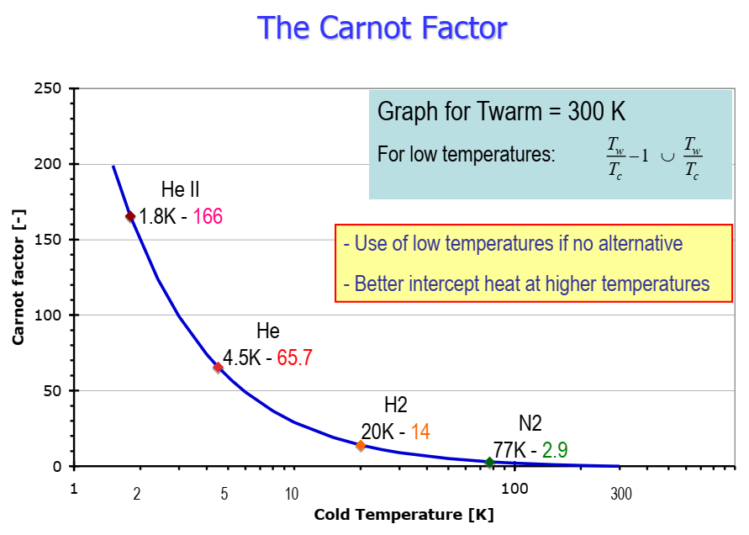
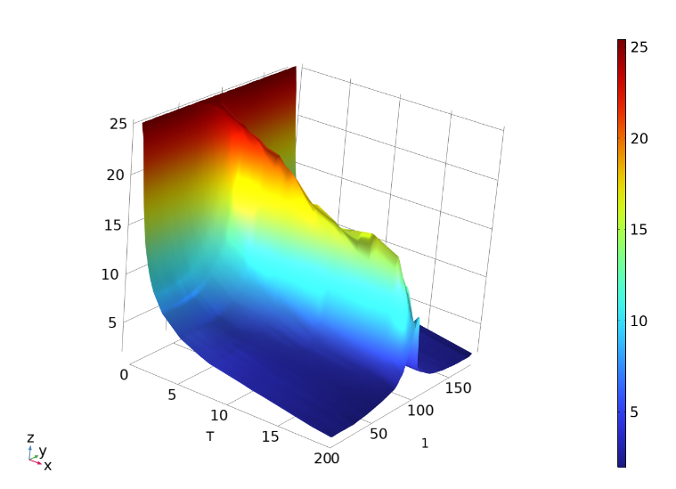
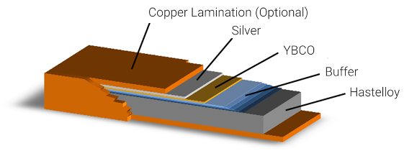
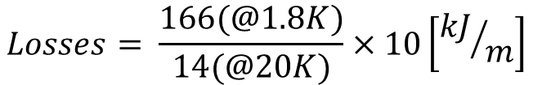
Initial data – HTS tape properties
The goal is to design a dipole magnet that fulfills FCC-hh requirements. Computation used interpolation of experimental data Jc(B) from [2] and [3].
Applied current is DC. For simplification used only linear ramping up.
Parameter name | Values
Temperature | 20 K
Maximal current | 10 kA
Current ramp | Linear
HTS tape width | 4, 12
HTS tape structure | FFJ
External magnetic field | up to 20 T
Time range | 1,500 s
Ramp rate | 10 A/s
AC losses @20K | 120 kJ/m
$$Losses= \frac{166(@1.8K)}{14(@20K)}×10\left[{kJ}/m\right]$$
[2] https://htsdb.wimbush.eu/
[3] https://www.faradaygroup.com/
[4] https://www.metoxtech.com/
[5] Christine Völlinger, Superconductor Magnetization Modeling for the Numerical Calculation of Field Errors in Accelerator Magnets, Doctor Dissertation, Berlin 2003

Slide 5
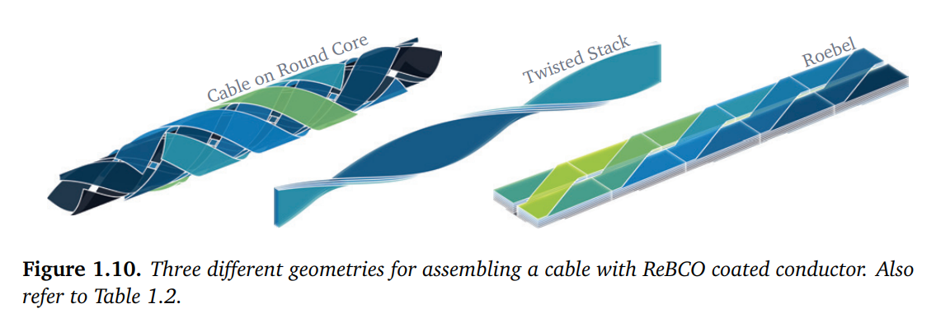
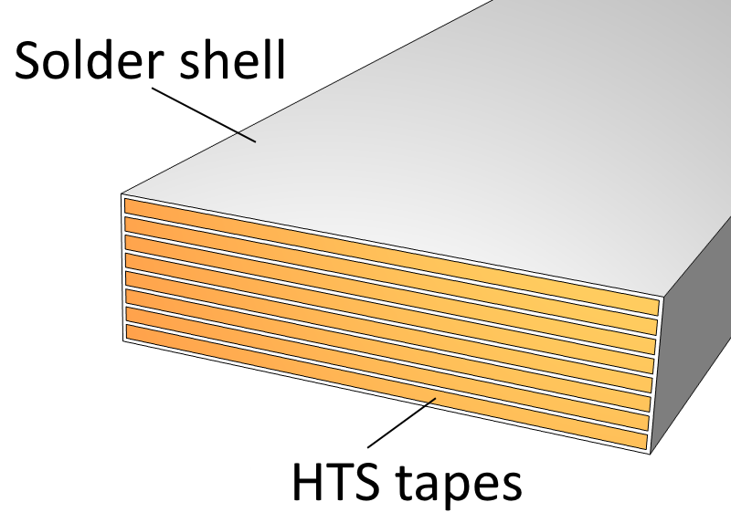
Initial data – HTS straight soldered stack cable
HTS wires are thin tapes (typically 4 and 12 mm width) with strong anisotropy of critical current to magnetic field direction.
Straight soldered stack cable:
Pros:
Shape fits to racetrack design
Fits to Block-coil and Common coil
Highest packing factor
Highest oriented critical current
Cons:
AC losses (not known)
Anisotropy Jc (B)
Field quality
Cables:
Roebel
TSTC
CORC
CroCo
CICC
STAR
Insulated Stack
others
[6] J. van Nugteren, “High temperature superconductor accelerator magnets,” Ph.D. dissertation, Energy Materials Syst., Univ. Twente, Enschede, The Netherlands, 2016.

Slide 6
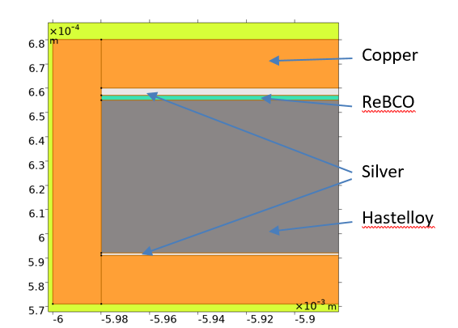
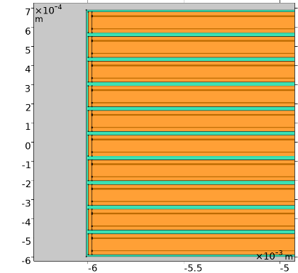
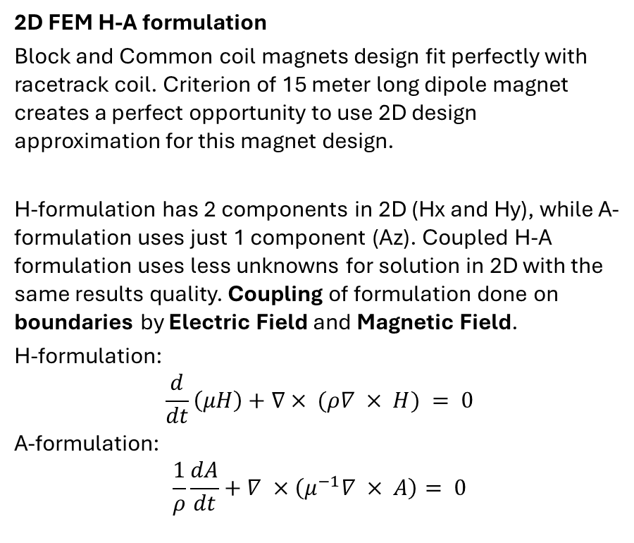
Computation model
2D FEM H-A formulation
Block and Common coil magnets design fit perfectly with racetrack coil. Criterion of 15 meter long dipole magnet creates a perfect opportunity to use 2D design approximation for this magnet design.
H-formulation has 2 components in 2D (Hx and Hy), while A-formulation uses just 1 component (Az). Coupled H-A formulation uses less unknowns for solution in 2D with the same results quality. Coupling of formulation done on boundaries by Electric Field and Magnetic Field.
H-formulation:
$$\frac{d}{dt}\left(μH\right)+∇× (ρ∇ × H) = 0$$
A-formulation:
$$\frac{1}{ρ}\frac{dA}{dt}+∇ ×\left(μ^{−1}∇ × A\right)= 0$$
Stack structure and mesh selection
Purpose of this work is to define as accurate results as we can. Only detailed model (all layers of HTS tape) applied to this computation.
The first analysis done on 10 tapes in a stack.
ReBCO layer presented as 1 element by thickness (strip).
[7] Lorenzo Bortot, et al., A coupled a–h formulation for magneto-thermal transients in high-temperature superconducting magnets,
IEEE Transactions on Applied Superconductivity, 30(5):1–11, 2020
[8] https://www.comsol.com/

Slide 7
FEM modelling - Losses computation - plan
Most of the presented AC loss results for HTS stacks in literature are for AC current or AC field cases. In the case of a dipole magnet, both the current applied to the coil and the external magnetic field applied to the coil are DC with a low ramp rate (about 10 A/s).
Agenda for single HTS straight soldered stack cable in external magnetic field computation:
AC losses dependence on perpendicular magnetic field magnitude
AC losses dependence on magnetic field direction at 16 T
AC losses dependence on HTS tapes width
Full cross-section 16 T dipole

Slide 8
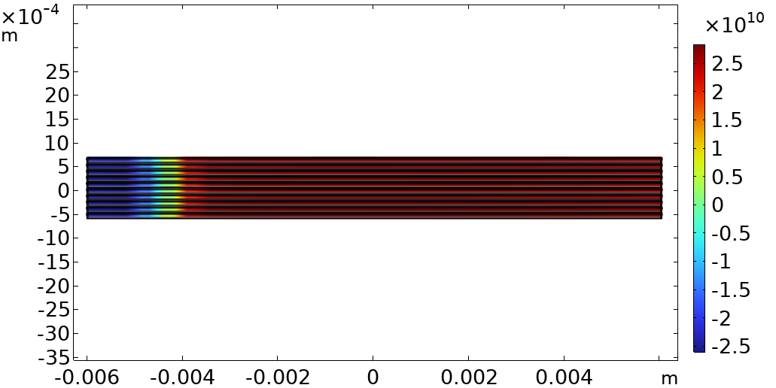
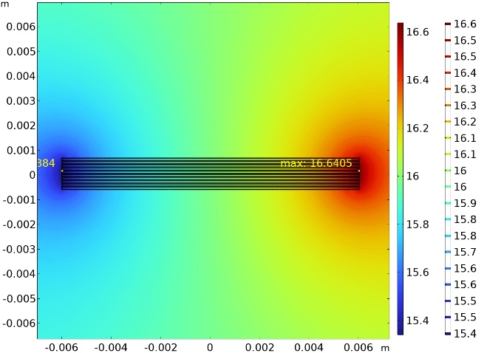
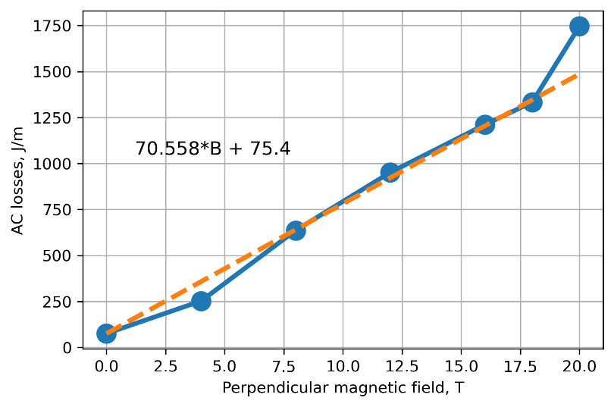
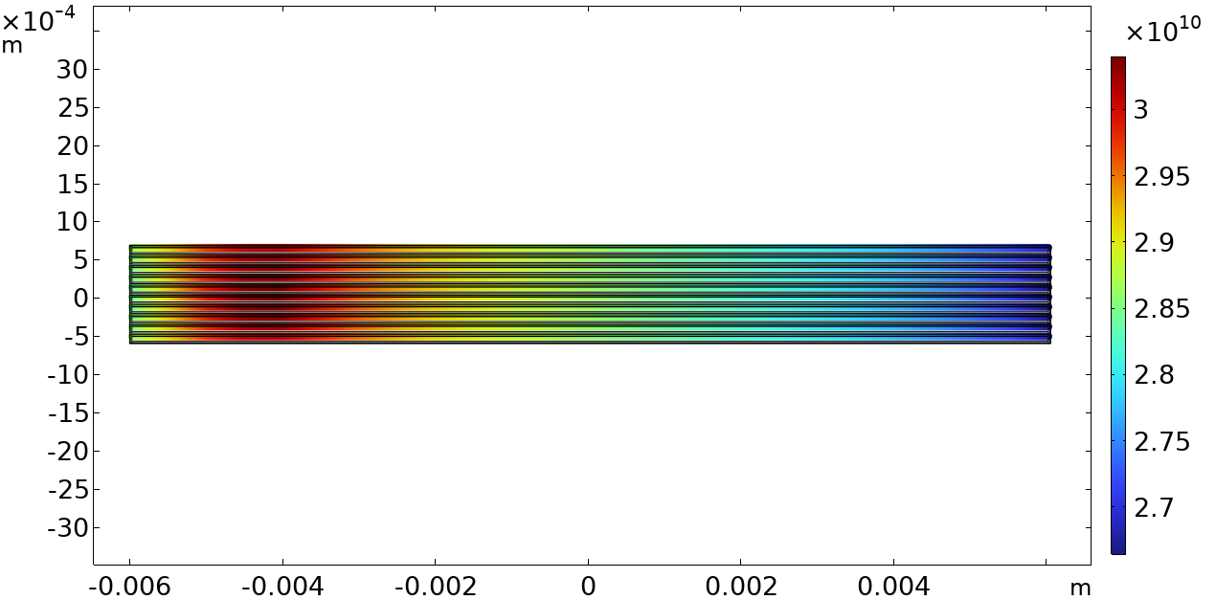
FEM modelling - Losses computation - field magnitude
Critical current of single tape dependence on magnetic field amplitude is a very well known experimental data published in many papers. It returns simple criterion for stack of insulated tapes, but it is different for soldered tape stack, where current can flow from almost transferred to normal state tape to others.
Jc distribution across the stack
HTS tape stack in 16 T external magnetic field with 10 kA applied current
AC losses of HTS tape stack cable dependence on perpendicular magnetic field magnitude
Jz distribution across the stack

Slide 9
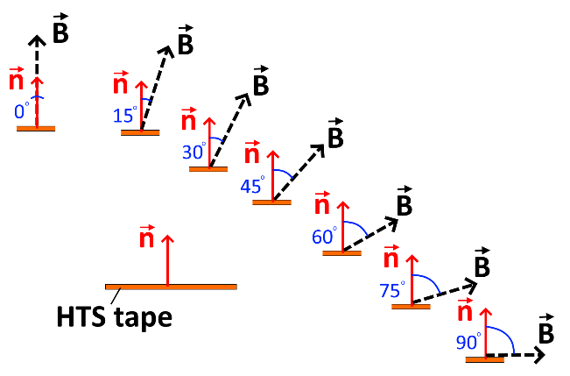
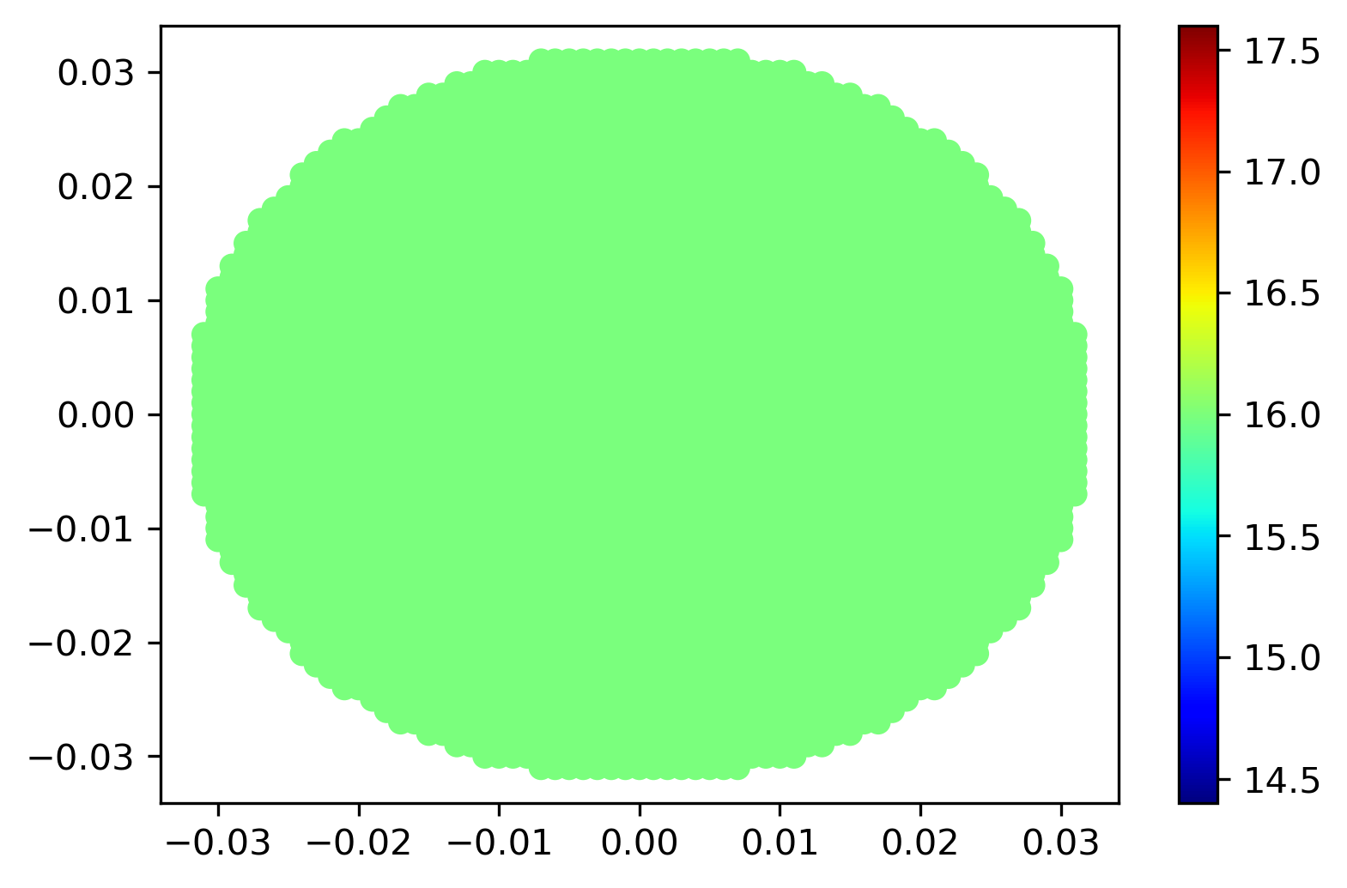
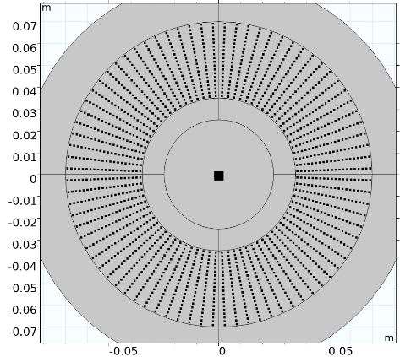
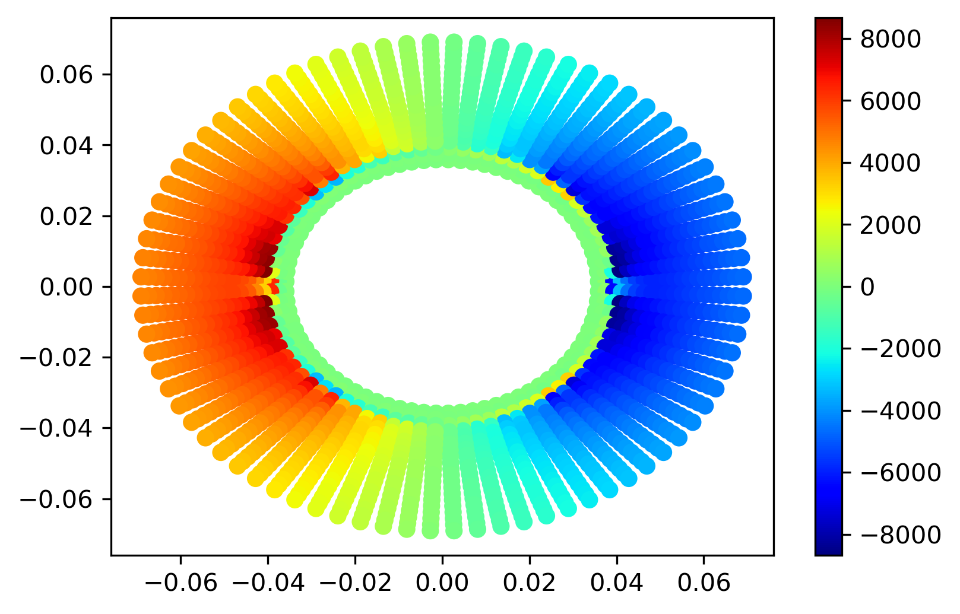
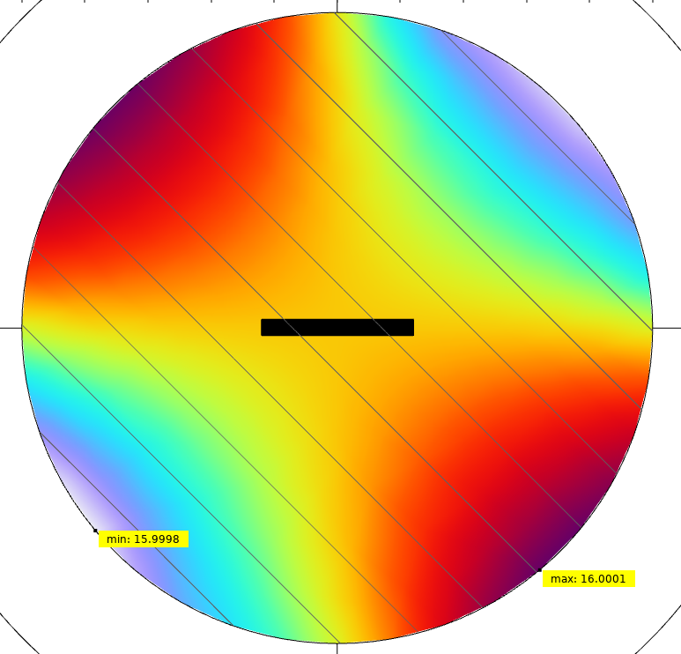
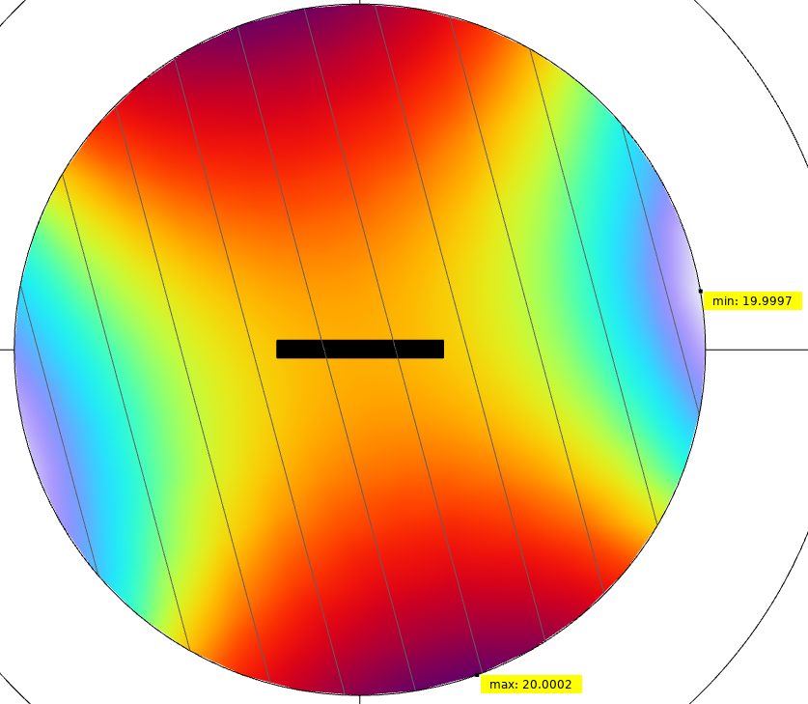
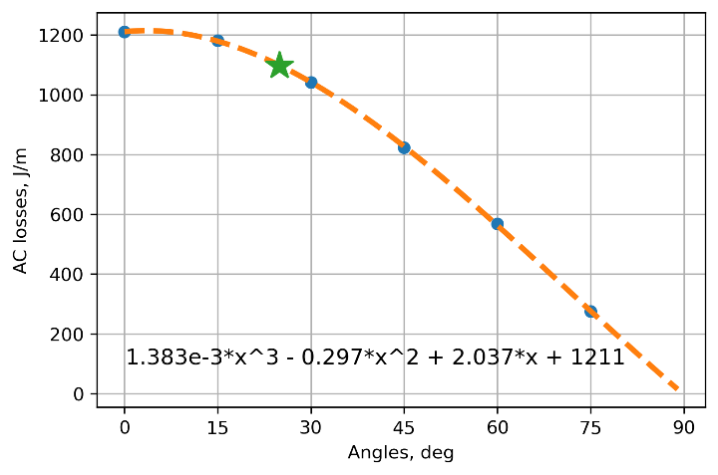
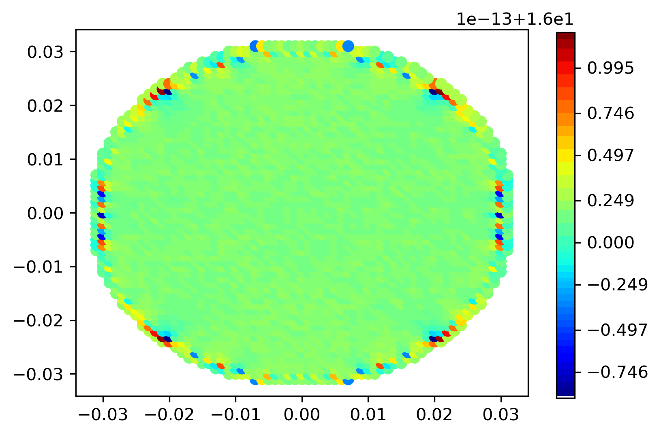
FEM modelling - Losses computation – field angular dependence
Current sharing between tapes could affect on critical current dependence on external magnetic field direction. It could be not so dramatic for perpendicular magnetic field as single tape is.
Required By
Linear current distribution
16 T and 45 deg
20 T and 15 deg
AC losses vs Angle
Returned By

Slide 10
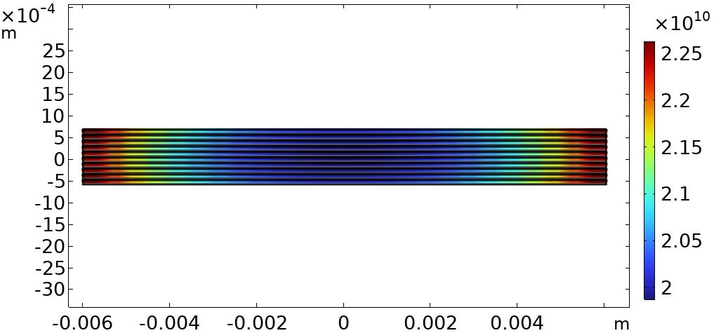
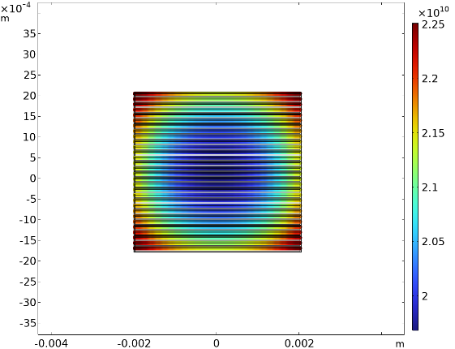
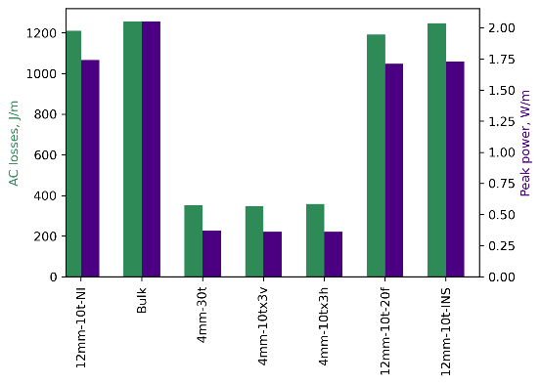
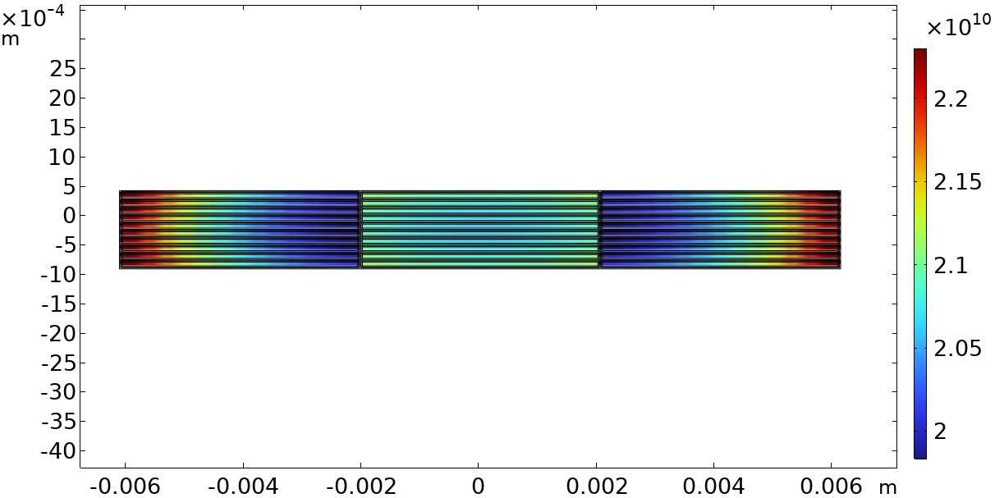
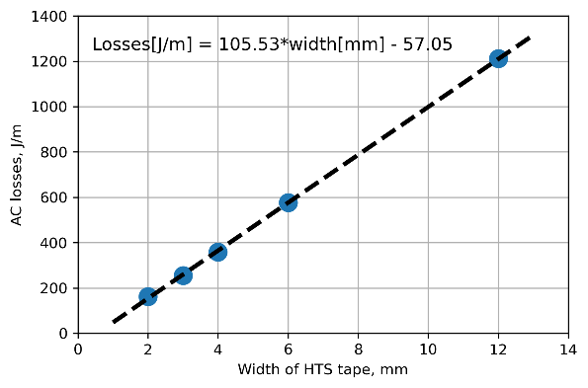
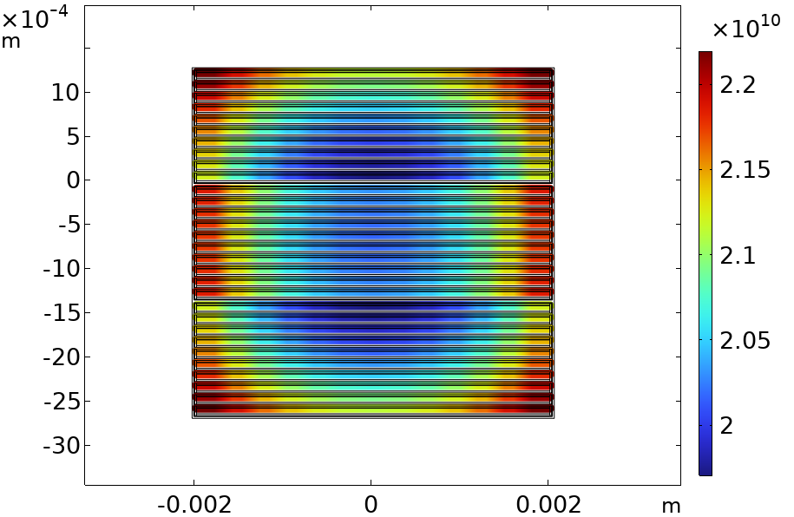
FEM modelling - Losses computation – tape width
It is well-known that narrower ReBCO tape has lower AC losses. Proper cable configuration can further reduce AC losses in the magnet.
Jz distribution across the stacks of different configurations
AC losses of different stack configurations
AC losses vs Width of tapes in stack

Slide 11
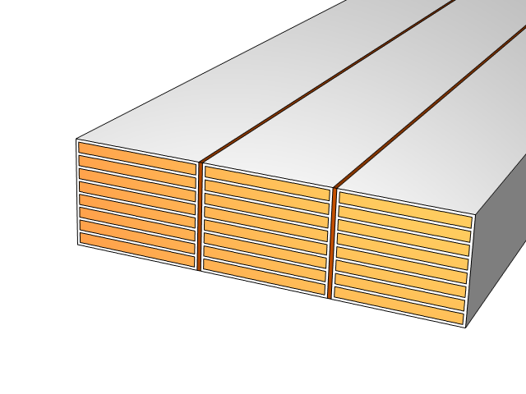
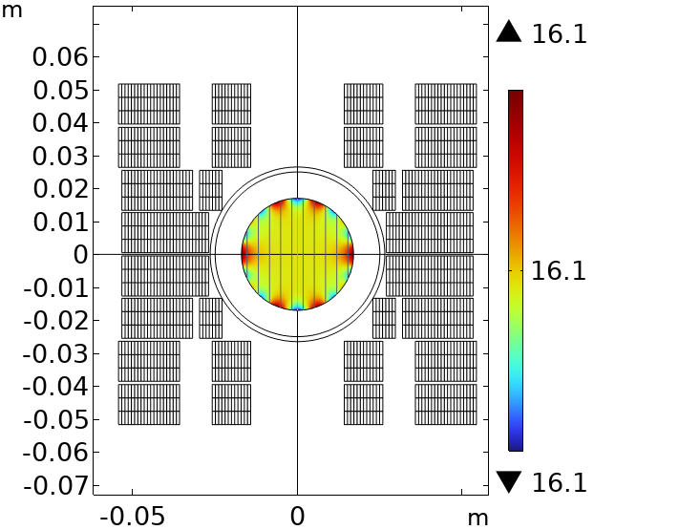
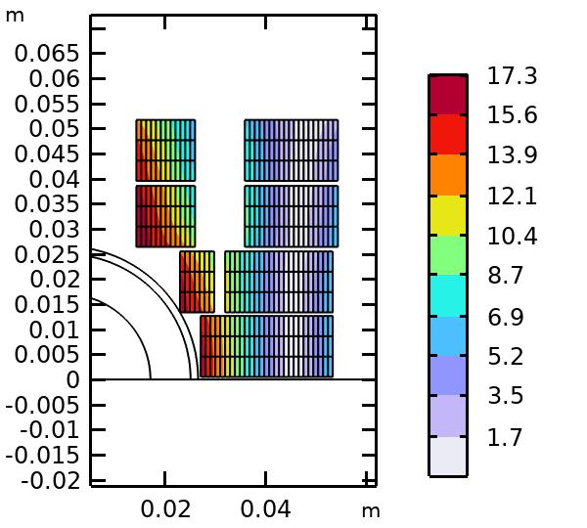
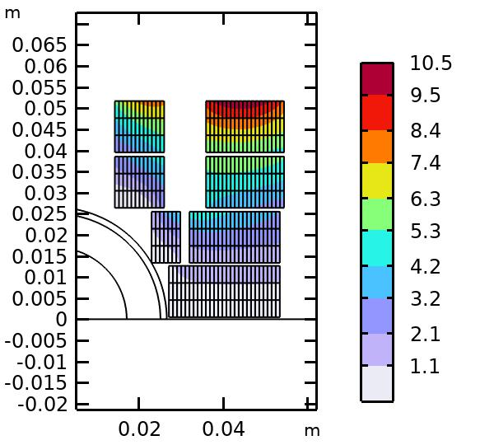
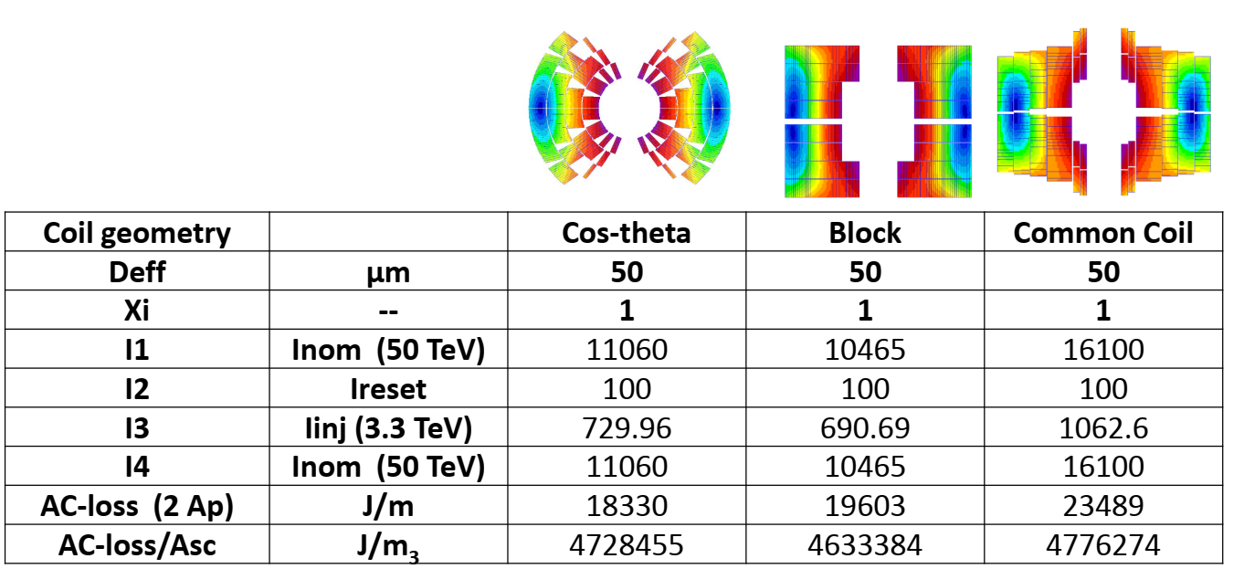
FEM modelling - Losses computation – 16 T dipole
Based on previous analysis, for the first draft of the 16 T dipole magnet, we selected a block-type magnet (where the magnetic field is mostly parallel to the cable surface near the aperture) with 3 parallel stacks of 4-mm tapes, each stack containing 8 tapes. This design is based only on electromagnetic computations and does not account for the protectability of the coil.
Parallel
Parameter | Value
Magnetic field in center | 16.120 T
b3 | 0.0067340
b5 | 0.44438
b7 | 0.78468
b9 | -0.30249
Perpendicular
224 [kJ/m](@20K) ↔19[kJ/m](@1.8K)

Slide 12
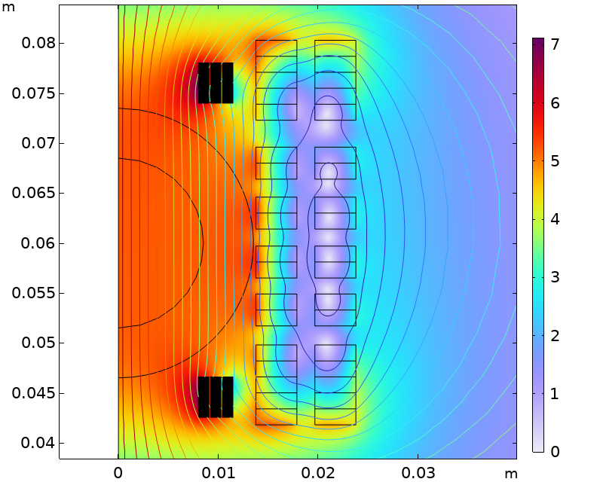
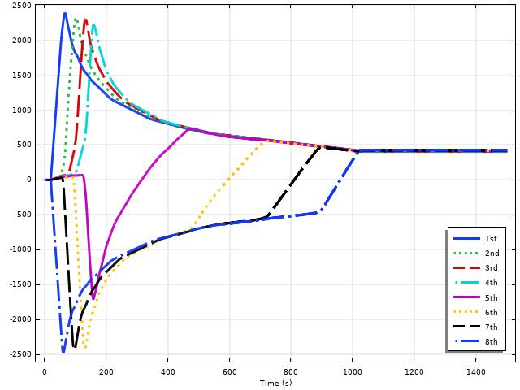
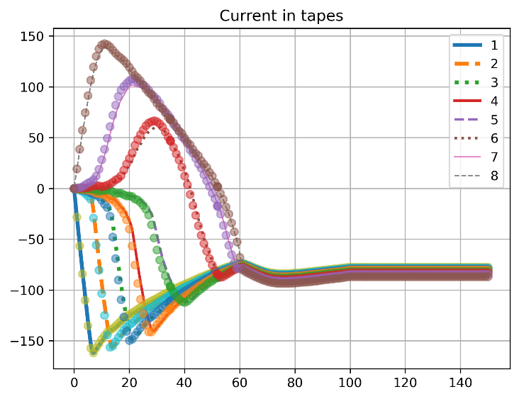
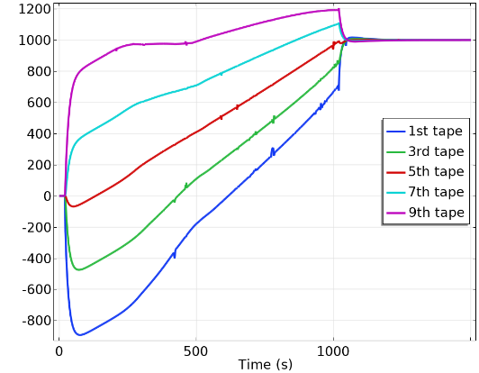
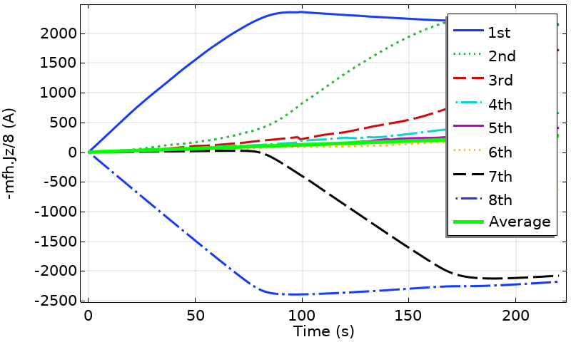

FEM modelling - Current sharing
Current sharing in tapes of HTS straight soldered stack has mutual direction during DC ramping up.
Current sharing in 8 tapes stack of one of cables in 16 T dipole
Current sharing in 8 tapes stack
Current sharing in stack in 16 T field at 75 degrees
Designed by M.D.Araujo
circles – Comsol Multiphysics
lines – Quanscent AllSolve
Acknowledgement to J. Ruuskanen & M. Lyly

Slide 13
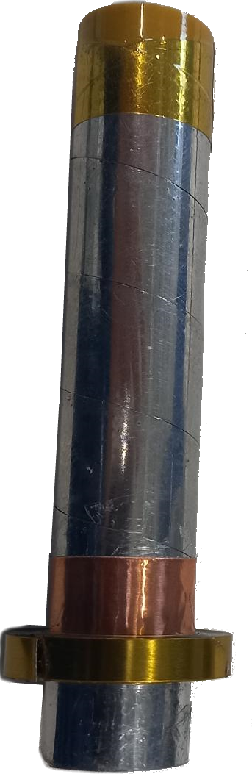
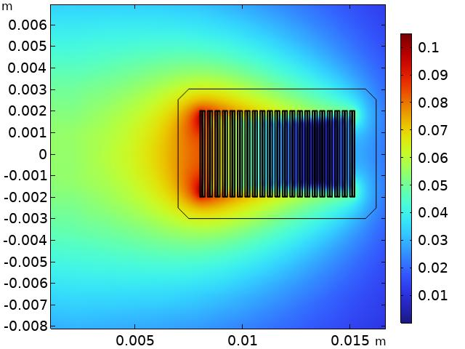
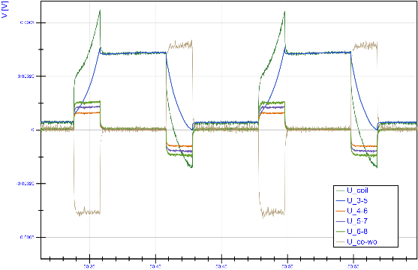
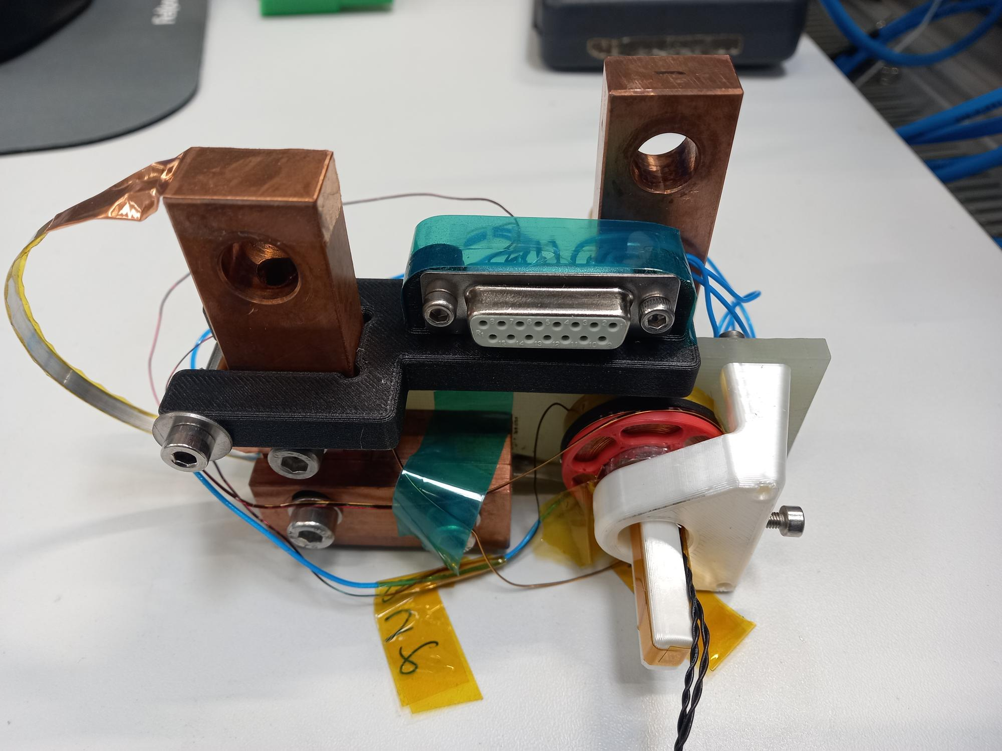
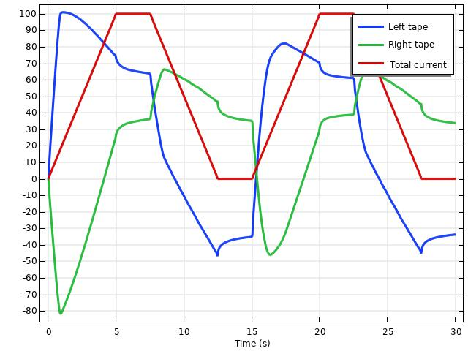
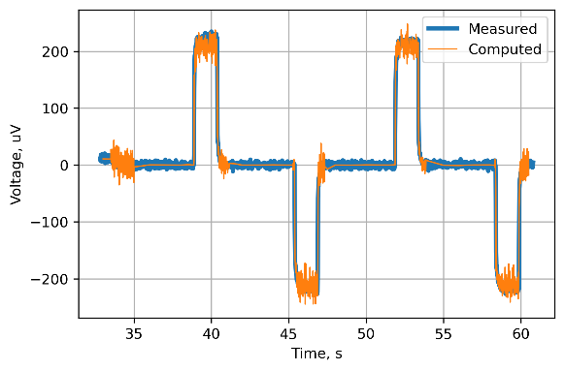
Data analysis and validation - Experimental approval of Losses
We plan to validate the AC losses of a small pancake coil made from 4-mm soldered face-to-face HTS tape from FFJ. This experiment will be conducted both in our lab and at Twente University. The production and testing process is ongoing with advice from A. Kario and S. Otten at Twente.
HTS tapes
Solder
Left
Right
Courtesy by M.Duda
Courtesy by H.Garcia
ReBCO layers

Slide 14
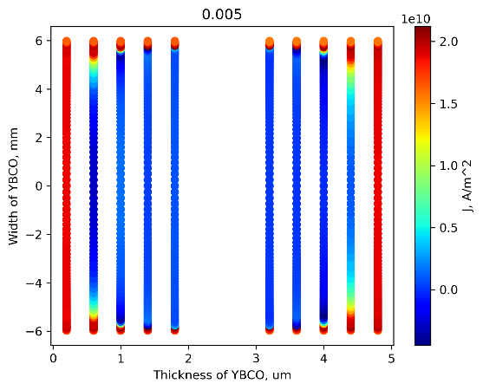
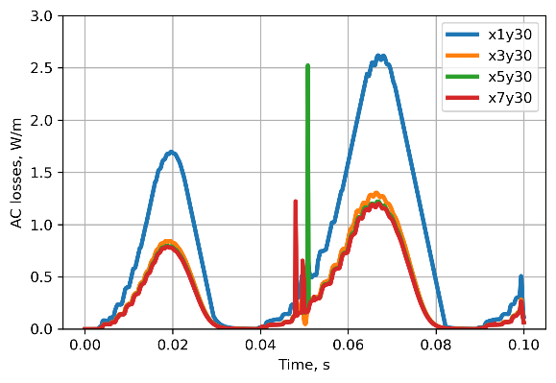





Data analysis and validation - Mesh quality
During computation for the experimental pancake, mesh quality significantly impacted AC losses in the face-to-face 2-tape stack.
AC losses from number of elements by thickness ReBCO layer
AC losses from exponential ratio of distribution by width
YBCO layer Left
YBCO layer Right
Current distribution by width half of tape for linear (blue) and exponential (orange)
AC losses from number of elements by width ReBCO layer
Best fit: 5 elements by thickness
and more than 20 elements by width

Slide 15


Data analysis and validation - Losses computation – 16 T dipole – different meshes
Computation results for two cycles of the magnet ramping up and down for homogenized mesh.
Two different meshes of the same geometry for homogenized models returned different AC loss dependences.

Slide 16


Data analysis and validation - Losses computation – 16 T dipole – different meshes
The previous model of the 16 T dipole magnet required an update after new requirements for mesh quality were established. AC losses for the more detailed model (blue line) are significantly lower than those for the strip layer model (red line). This model solves 4 mln DoF.
Best fit: 5 elements by thickness
and more than 20 elements by width
Steady computation at 0.1 s time step.
Estimated time of computation: 120 days

Slide 17



Plans
Finish AC losses validation measurements.
Try to measure current distribution in the pancake coil using Hall probes.
Modelling (including 3D), production and test of racetrack coil based on HTS straight soldered stack cable for pole coils of the Subscale Hybrid magnet.
Improve computation speed by using alternative computation software.
Enhance the design of the 16 T dipole magnet according to new computations.
Courtesy by H.Garcia

Slide 18
Conclusion
Selection of the correct geometry of the magnet, design optimization, and number of tapes in HTS straight soldered stack cable optimization can make this type of cable reliable for high-field magnets.
The shape of the cable allows for 2D computations of very detailed structures. Computation of each cable is sufficient, as computation of the whole magnet takes too long.
Next steps are the validation of the computation model and speeding up computations.

