Slide 1




Impact of porosity on trapped magnetic field and mechanical stresses in HTS bulks during PFM
9th International Workshop on Numerical Modelling of High Temperature Superconductors
Santiago Guijosa G.¹, Kévin Berger¹, Frederic Trillaud^{1,2}, Melika Hinaje¹
¹ Université de Lorraine, GREEN, F-54000 Nancy, France
² Instituto de Ingeniería, Universidad Nacional Autónoma de México, 04350 CDMX, México
June 11, 2024

Slide 2
Contents
Introduction: HTS bulks as cryo-permanent magnets
Background and motivation of research
Multiphysics model: a porosity first approach
Results and discussion
Summary
Santiago Guijosa G.

Slide 3
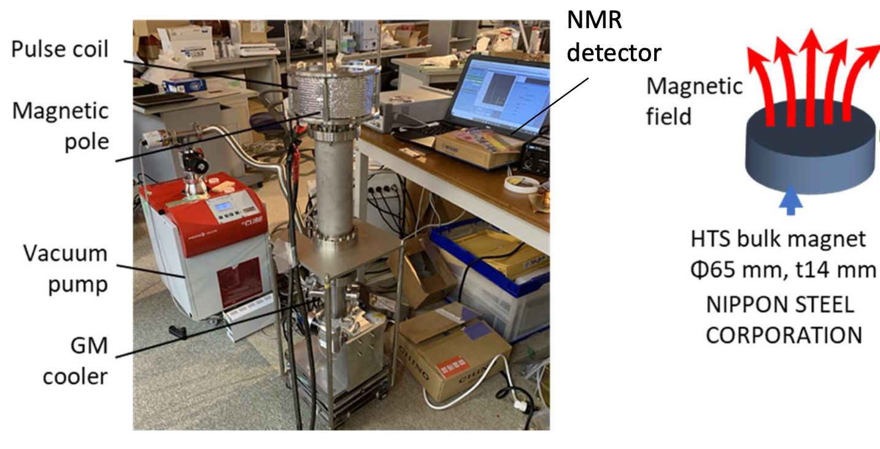
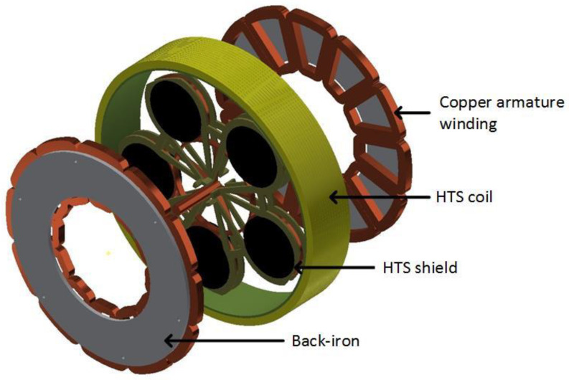

Introduction: HTS bulks as magnets
HTS bulks can act as cryo-permanent magnets after magnetization.
The circulation of induced persistent electrical current J_{sc} generates a “trapped” magnetic field $B_{z}≈R Jc$ (T_{o} < T_{c}).
Magnetic fields up to 10 times higher than conventional magnets can be achieved (1-17 T at low temperatures).
NMR Magnet. M. Takahashi et al., IEEE Trans. Appl. Supercond., 32(6) 2022
Axial flux HTS motor. Rémi Dorget et al Materials 2021, 14, 2847
Santiago Guijosa G.

Slide 4
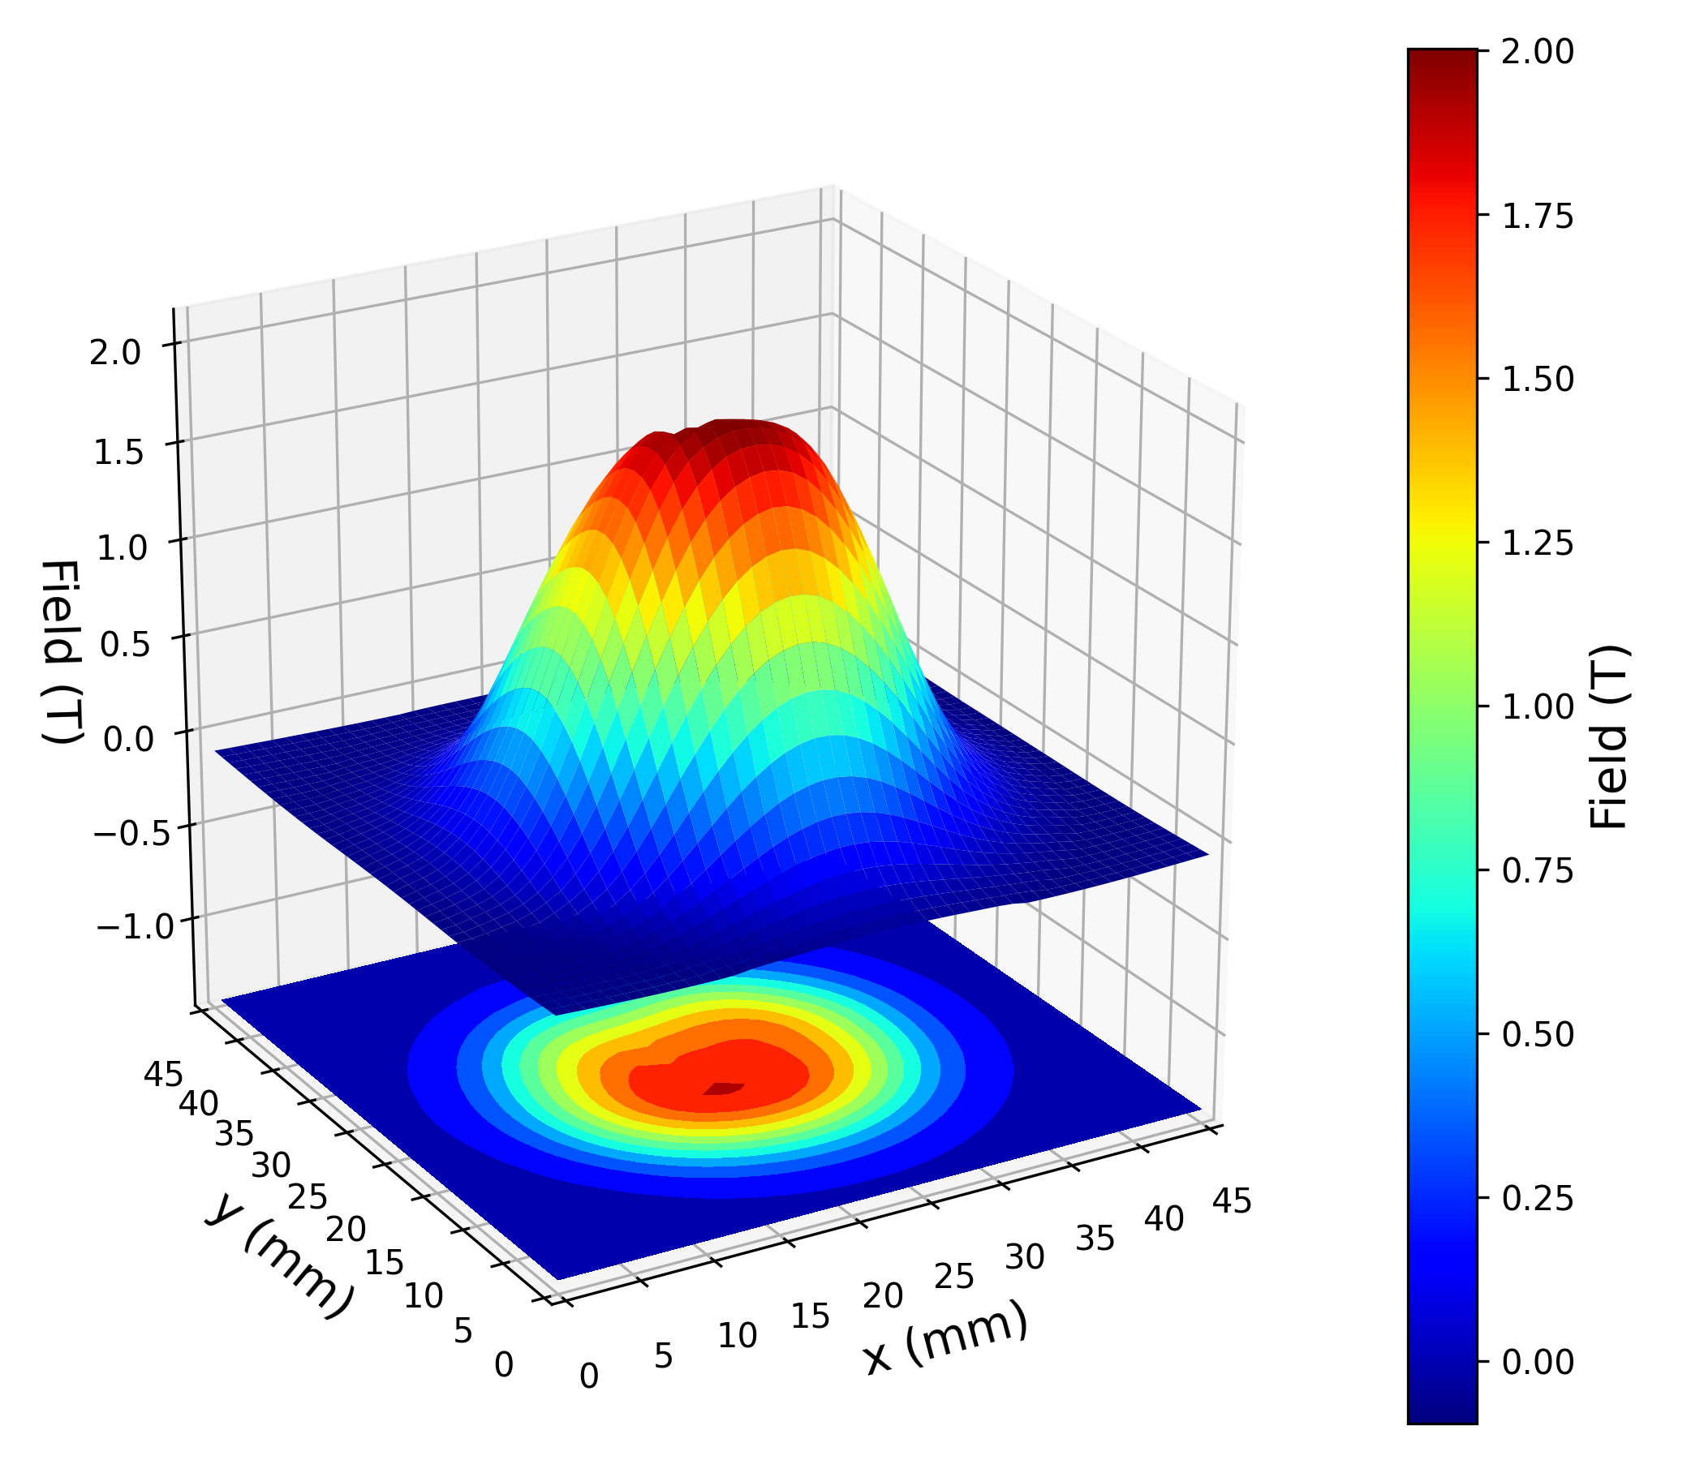
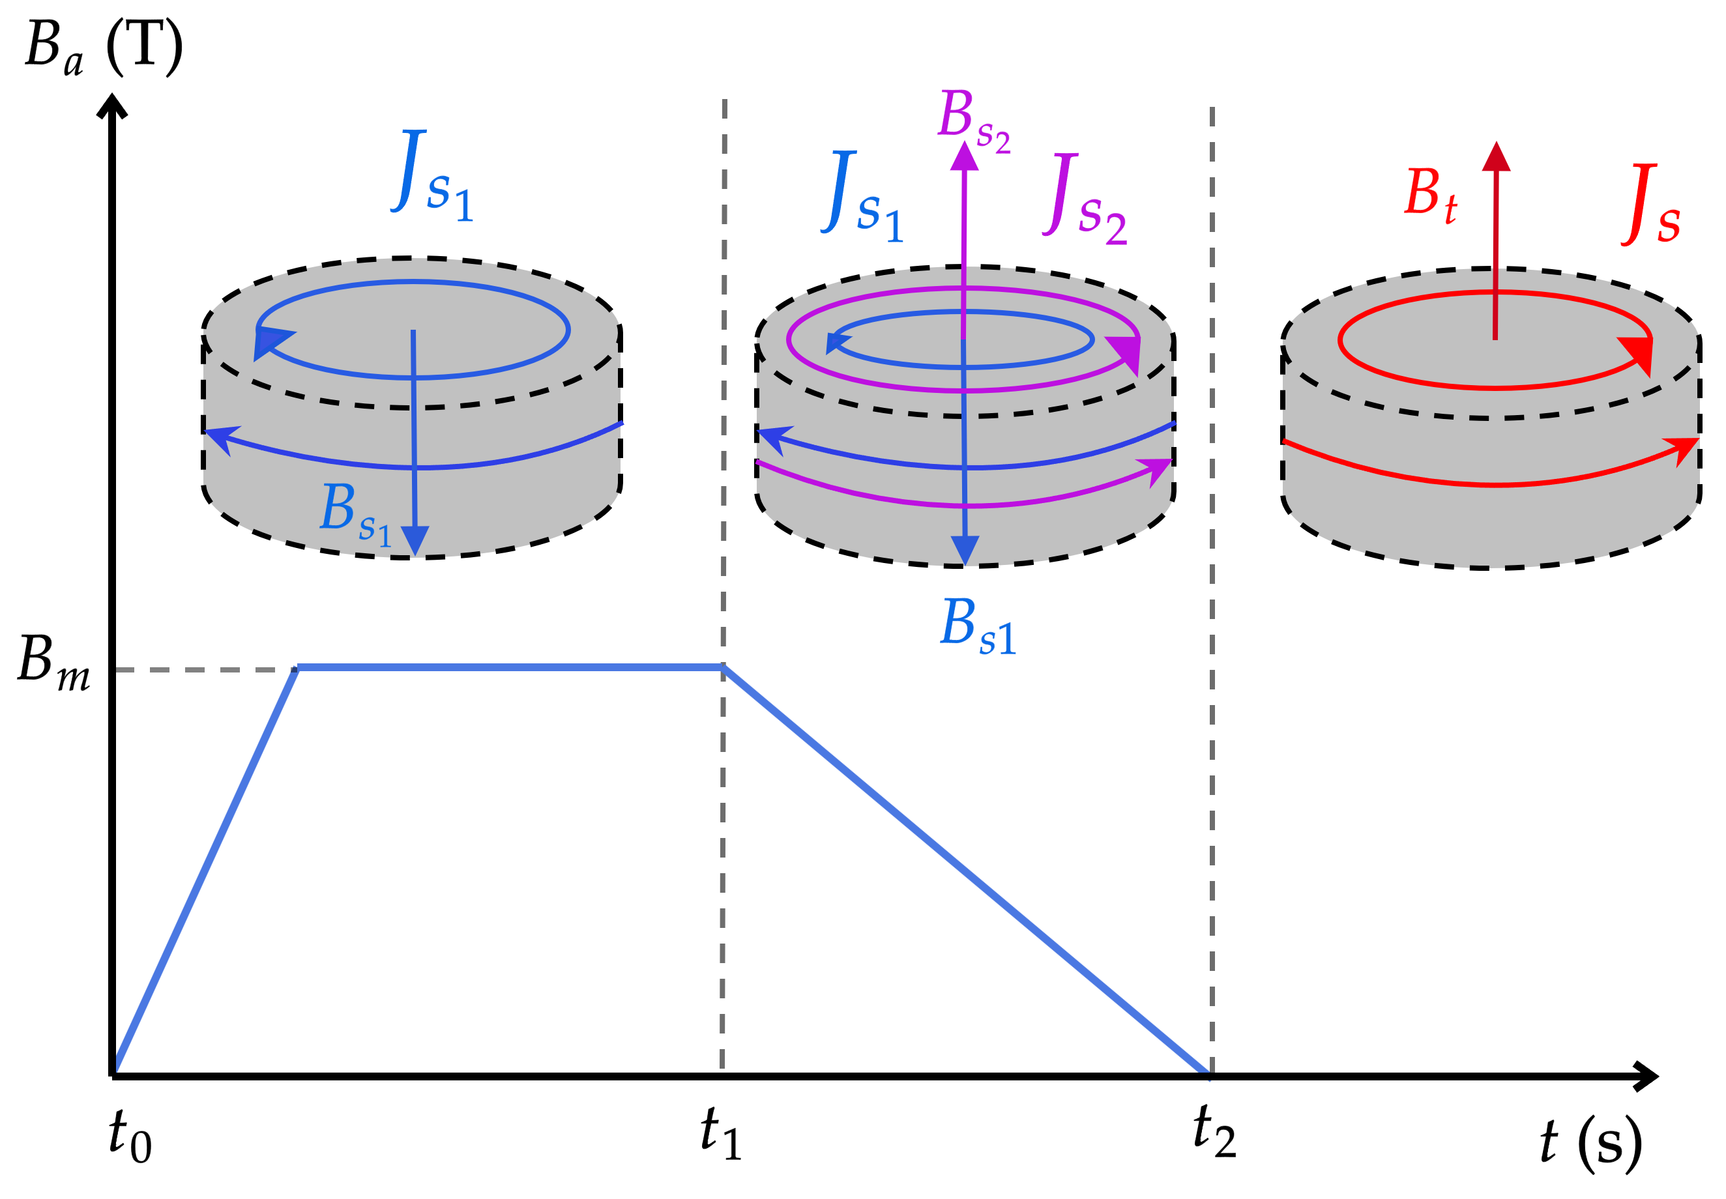
Introduction: magnetization of bulks
Example of magnetization of a HTS bulk.
Trapped field measurement of a HTS bulk.
Santiago Guijosa G.

Slide 5
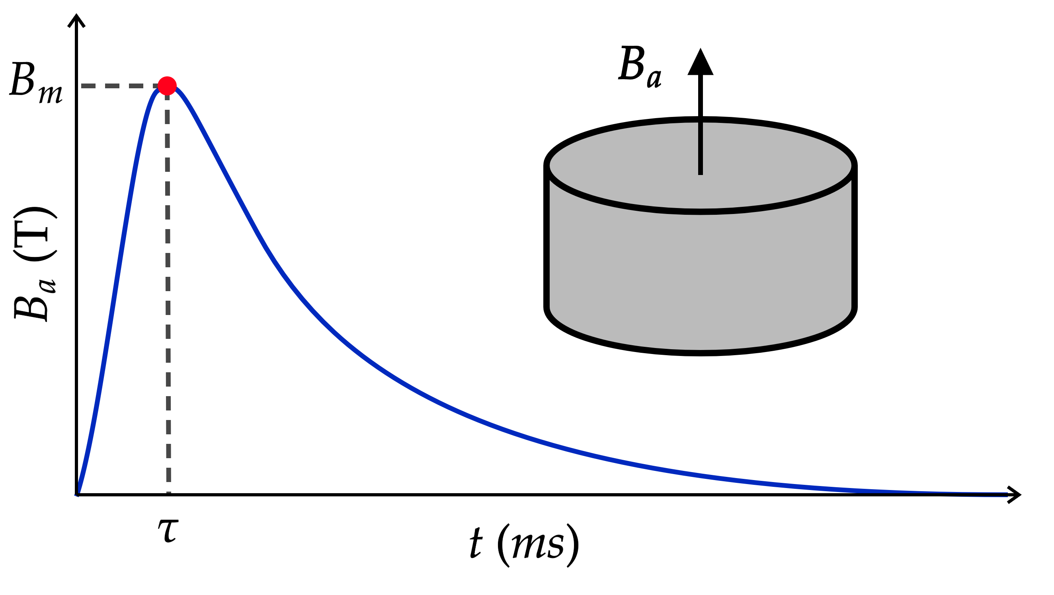
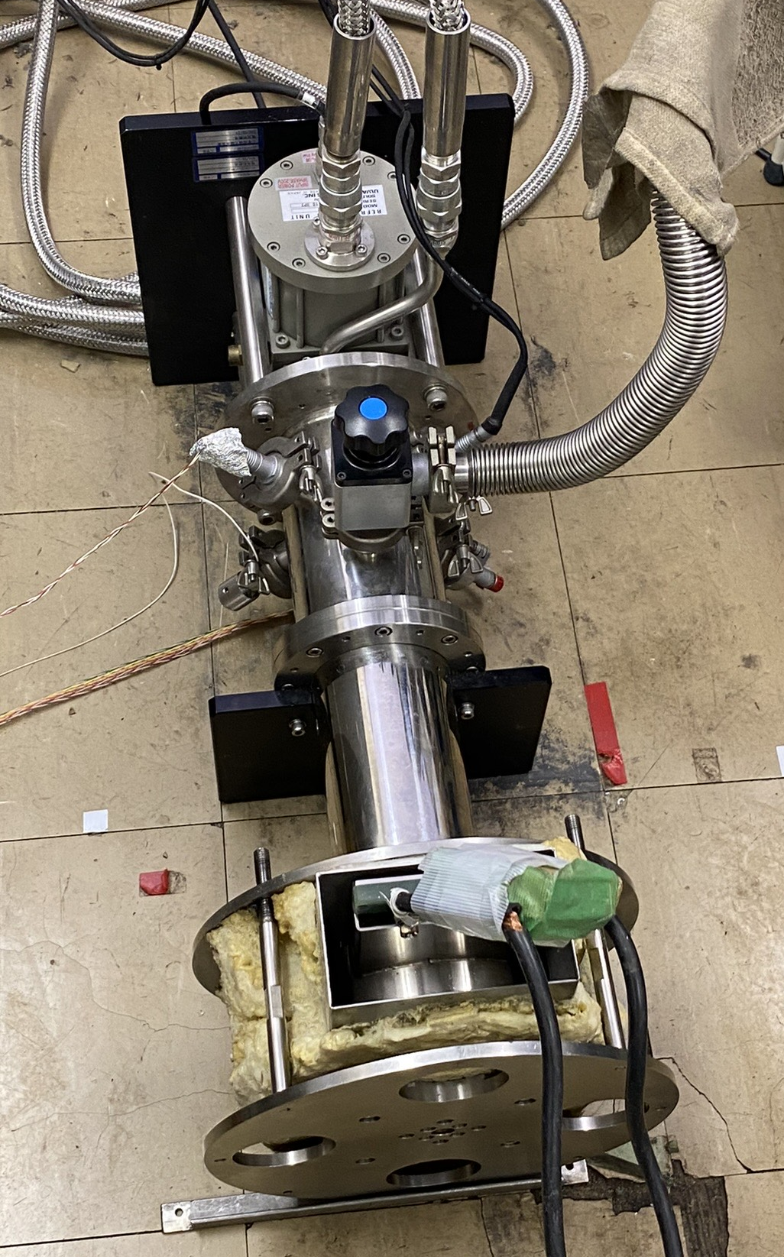
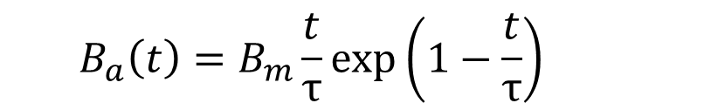
Pulsed field magnetization (PFM)
Pros:
  Compact
  Fast
  In situ magnetization
  Multi-PFM
Cons:
  Low trapped fields compared to ZFC/FC (Max. ≈ 5 T @ 29K)
  Large heat generation due to rapid flux motion
  For larger applied fields or bulks, larger capacitor banks are needed
  $$B_{a}\left(t\right)=B_{m}\frac{t}{τ}exp\left(1−\frac{t}{τ}\right)$$
T. Oka, K. Yokoyama, Ashikaga University, Japan
Santiago Guijosa G.

Slide 6
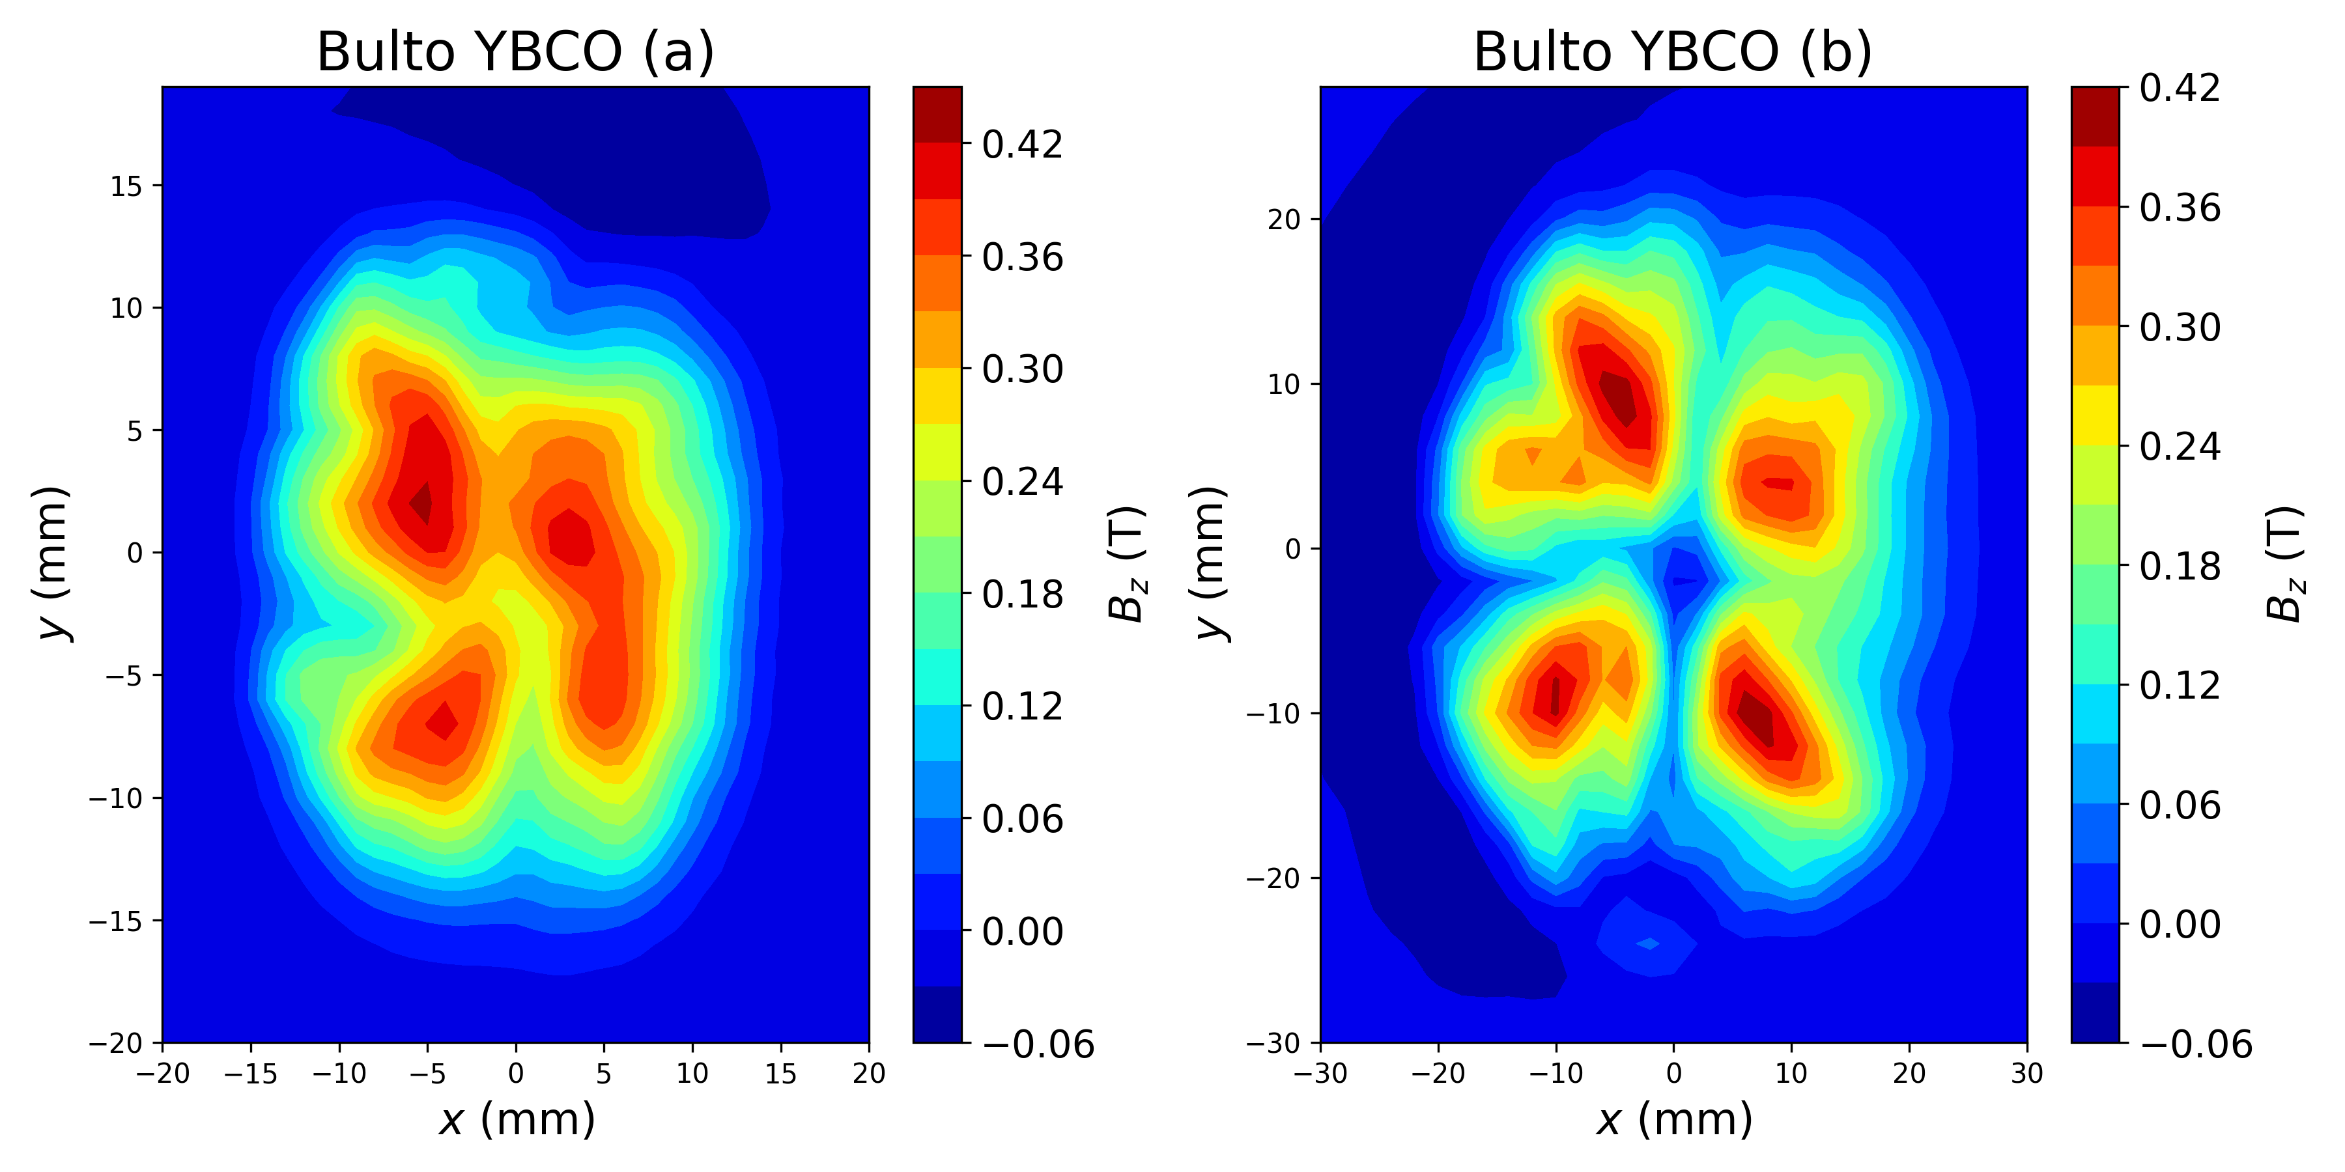
Problems
Inhomogeneous magnetization
Ideal magnetization
ATZ YBCO bulks, PFM 77 K, 2.5 T
Origins:
Cracks, pores (addressed here) and inhomogeneous J_{c}?
Mechanical crack before and during PFM or influence of Growth Section Boundaries?
Nippon steel GdBCO, PFM 5 T, 40 K
Santiago Guijosa G.

Slide 7
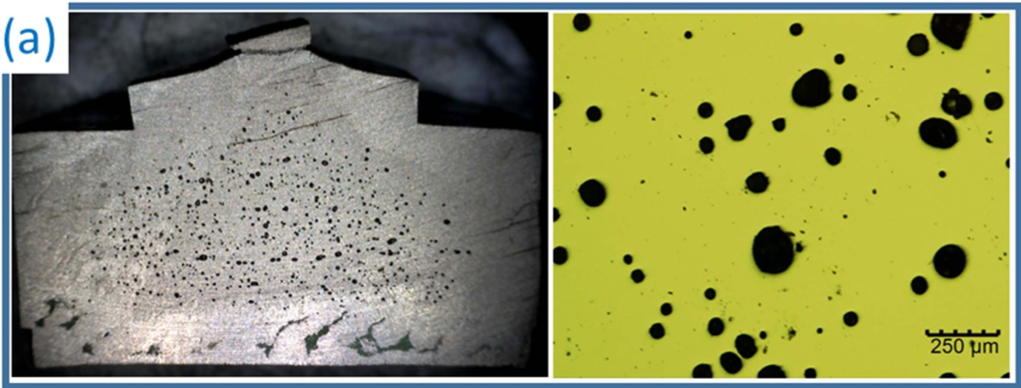
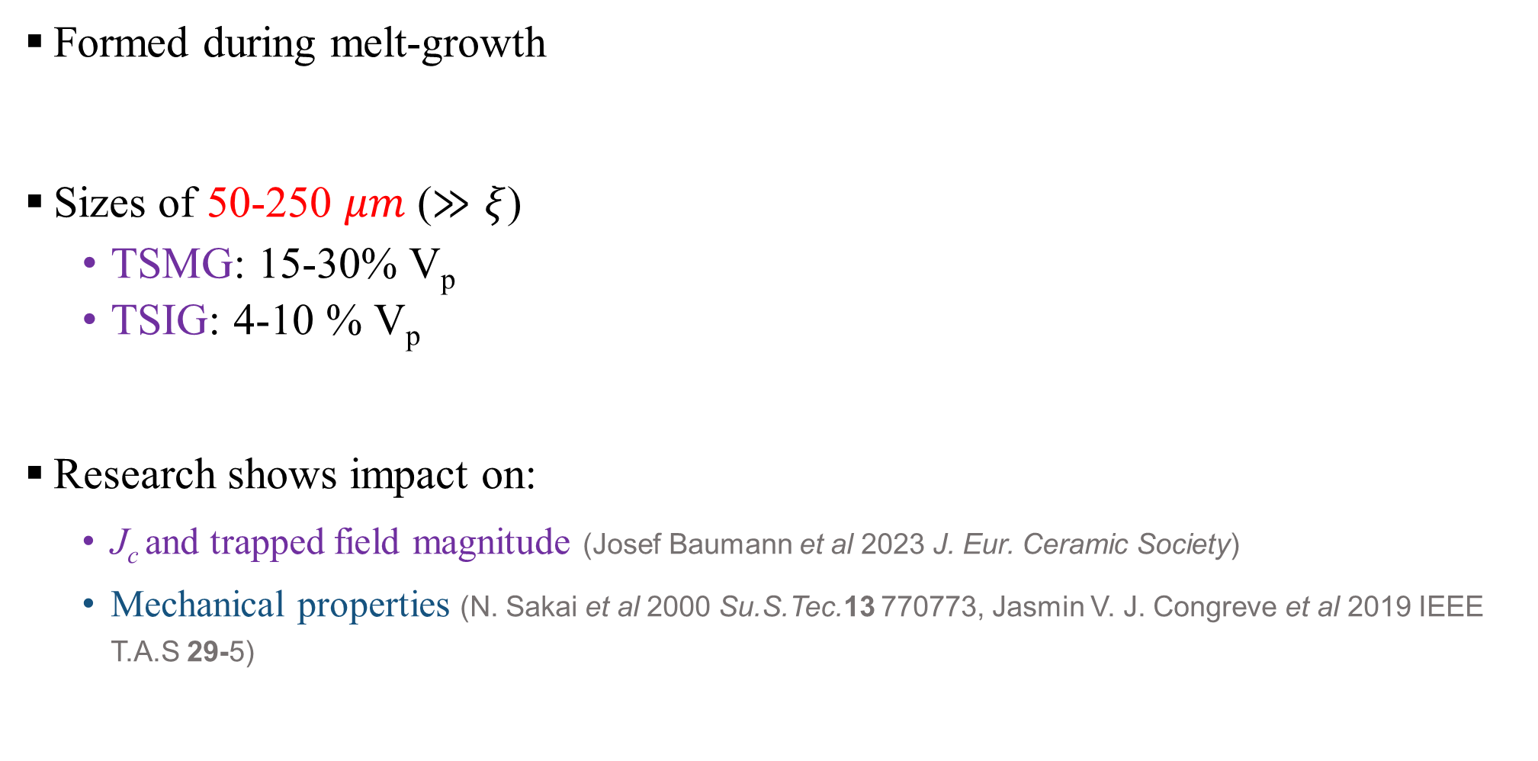
Porosity in HTS bulks
Formed during melt-growth
Sizes of 50-250 $μm$ ($≫ξ$)
  TSMG: 15-30% V_{p}
  TSIG: 4-10 % V_{p}
Research shows impact on:
  J_{c} and trapped field magnitude (Josef Baumann et al 2023 J. Eur. Ceramic Society)
  Mechanical properties (N. Sakai et al 2000 Su.S.Tec.13 770773, Jasmin V. J. Congreve et al 2019 IEEE T.A.S 29-5)
Devendra K Namburi et al 2021 Supercond. Sci. Technol. 34 053002
Santiago Guijosa G.

Slide 8
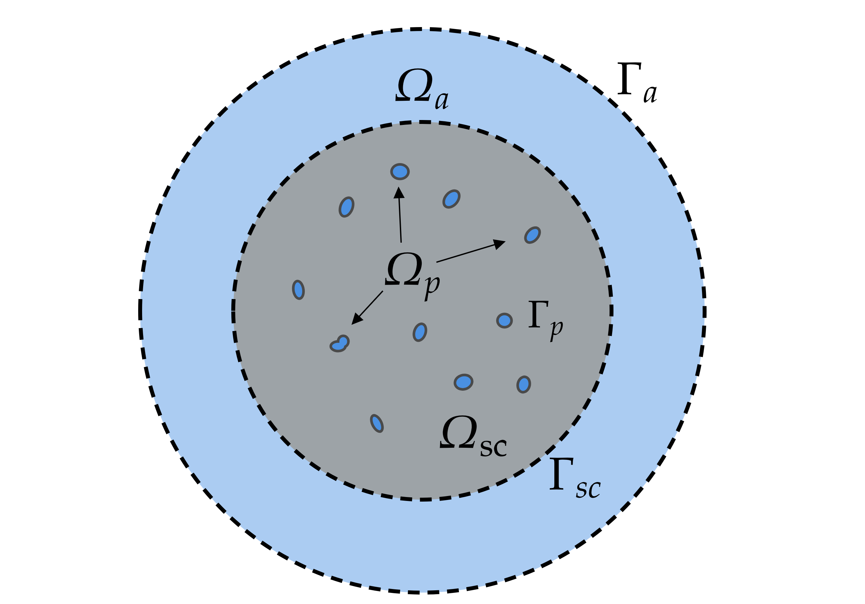


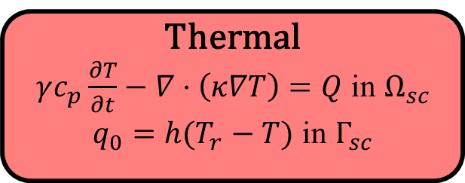
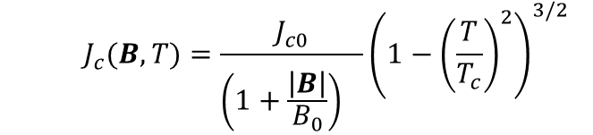



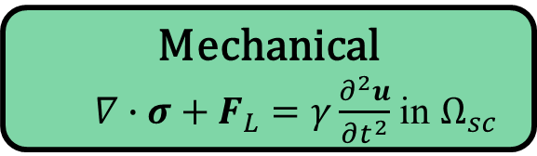

Multiphysics model in COMSOL
$$B_{a}\left(t\right)=B_{m}\frac{t}{τ}exp\left(1−\frac{t}{τ}\right)$$
Electromagnetic
$μ_{0}\frac{∂H}{∂t}+∇×\left(ρ∇×H\right)=0$ in $Ω_{}$
$ρ_{sc}=\frac{E_{c}}{J_{c}}{\left(\frac{\left| J\right|}{J_{c}}\right)}^{n−1}$in $Ω_{sc}$
  $$J_{c}(B,T)=\frac{J_{c0}}{{\left(1+\frac{\left|B\right|}{B_{0}}\right)}^{}}{\left(1−{\left(\frac{T}{T_{c}}\right)}^{2}\right)}^{3/2}$$
$$F_{L}=J×B$$
  $Q={ρJ}^{2}$
$$σ=c\{\left(ε_{L}\left(u\right)+ε_{T}\left(\text{Δ}\text{T} \right)\right\}$$
Mechanical
$∇∙σ+F_{L}=γ\frac{∂^{2}u}{∂t^{2}}$ in $Ω_{sc}$
$$J_{c}\left(B, T\right)$$
ΔT
Thermal
$γc_{p}\frac{∂T}{∂t}−∇⋅\left(κ∇T\right)=Q$ in $Ω_{sc}$
$q_{0}=h(T_{r}−T)$ in $Γ_{sc}$
Schematic drawing of domains and boundaries
Santiago Guijosa G.

Slide 9
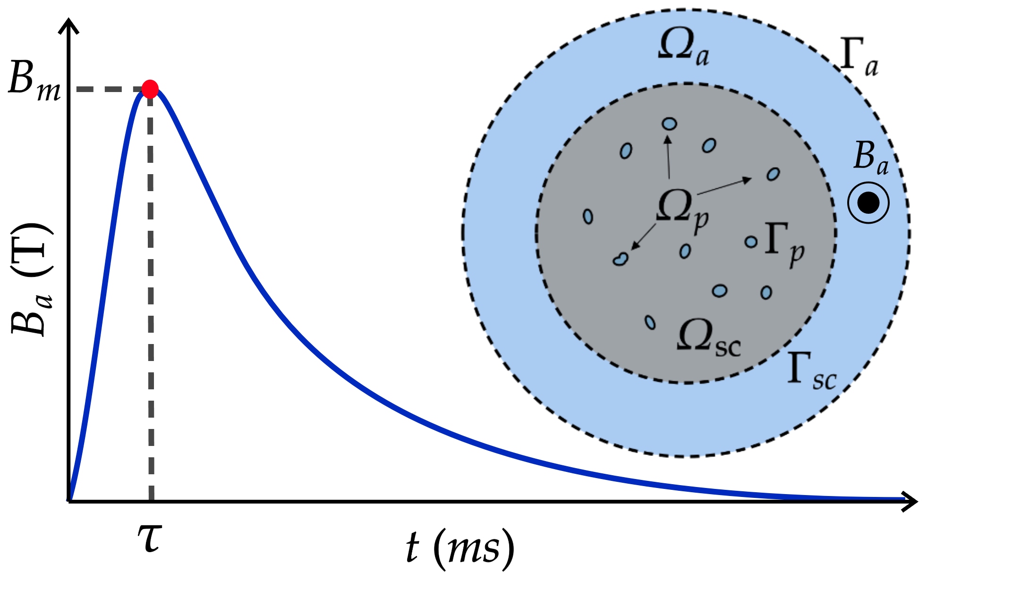
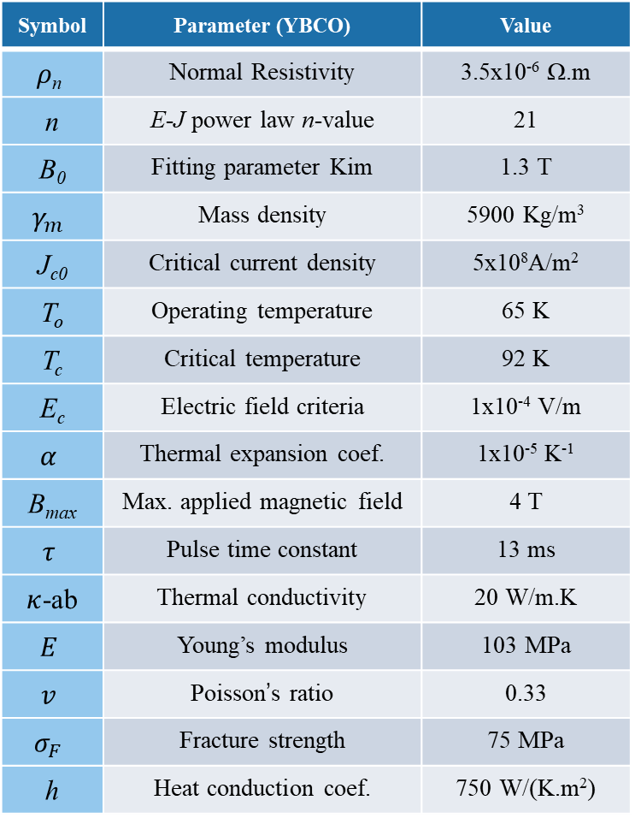

Multiphysics model in COMSOL
Case study:
  2D Infinitely long cylinder approx.
  YBCO bulk 1% porosity
Given porosity surface area (S_{p}%):
  Random a-b axis of ellipse [125-250 $μ$m]
  Randomly distributed inside bulk
Symbol | Parameter (YBCO) | Value
$$ρ\text{n}$$ | Normal Resistivity | 3.5x10⁻⁶ Ω.m
n | E-J power law n-value | 21
B₀ | Fitting parameter Kim | 1.3 T
$$γ_{m}$$ | Mass density | 5900 Kg/m³
J_{c0} | Critical current density | 5x10⁸A/m²
T_{o} | Operating temperature | 65 K
T_{c} | Critical temperature | 92 K
E_{c} | Electric field criteria | 1x10⁻⁴ V/m
$$α$$ | Thermal expansion coef. | 1x10⁻⁵ K⁻¹
B_{max} | Max. applied magnetic field | 4 T
$$τ$$ | Pulse time constant | 13 ms
$κ$-ab | Thermal conductivity | 20 W/m.K
$$E$$ | Young’s modulus | 103 MPa
$$v$$ | Poisson’s ratio | 0.33
$$σ_{F}$$ | Fracture strength | 75 MPa
h | Heat conduction coef. | 750 W/(K.m²)
Santiago Guijosa G.
Devendra K Namburi et al 2020 Supercond. Sci. Technol. 33 115012

Slide 10
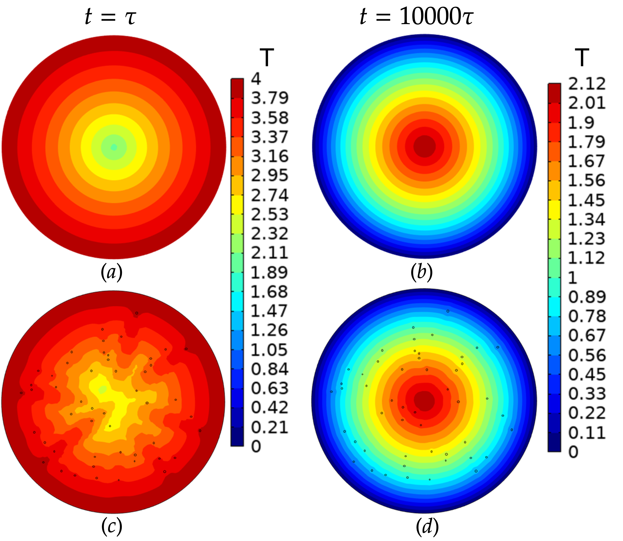
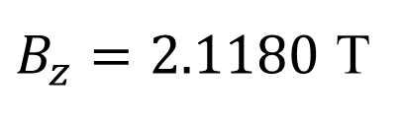
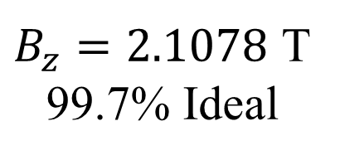
Results: Magnetic flux density
Magnetic flux density distribution
At 130 s
center of bulk:
Ideal
$B_{z}=2.1180$ T
$B_{z}=2.1078$ T
99.7% Ideal
1% Porosity
Santiago Guijosa G.

Slide 11
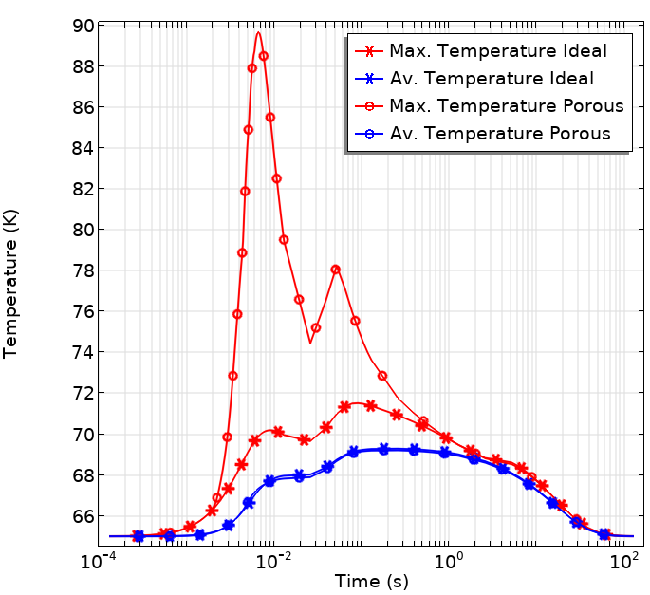
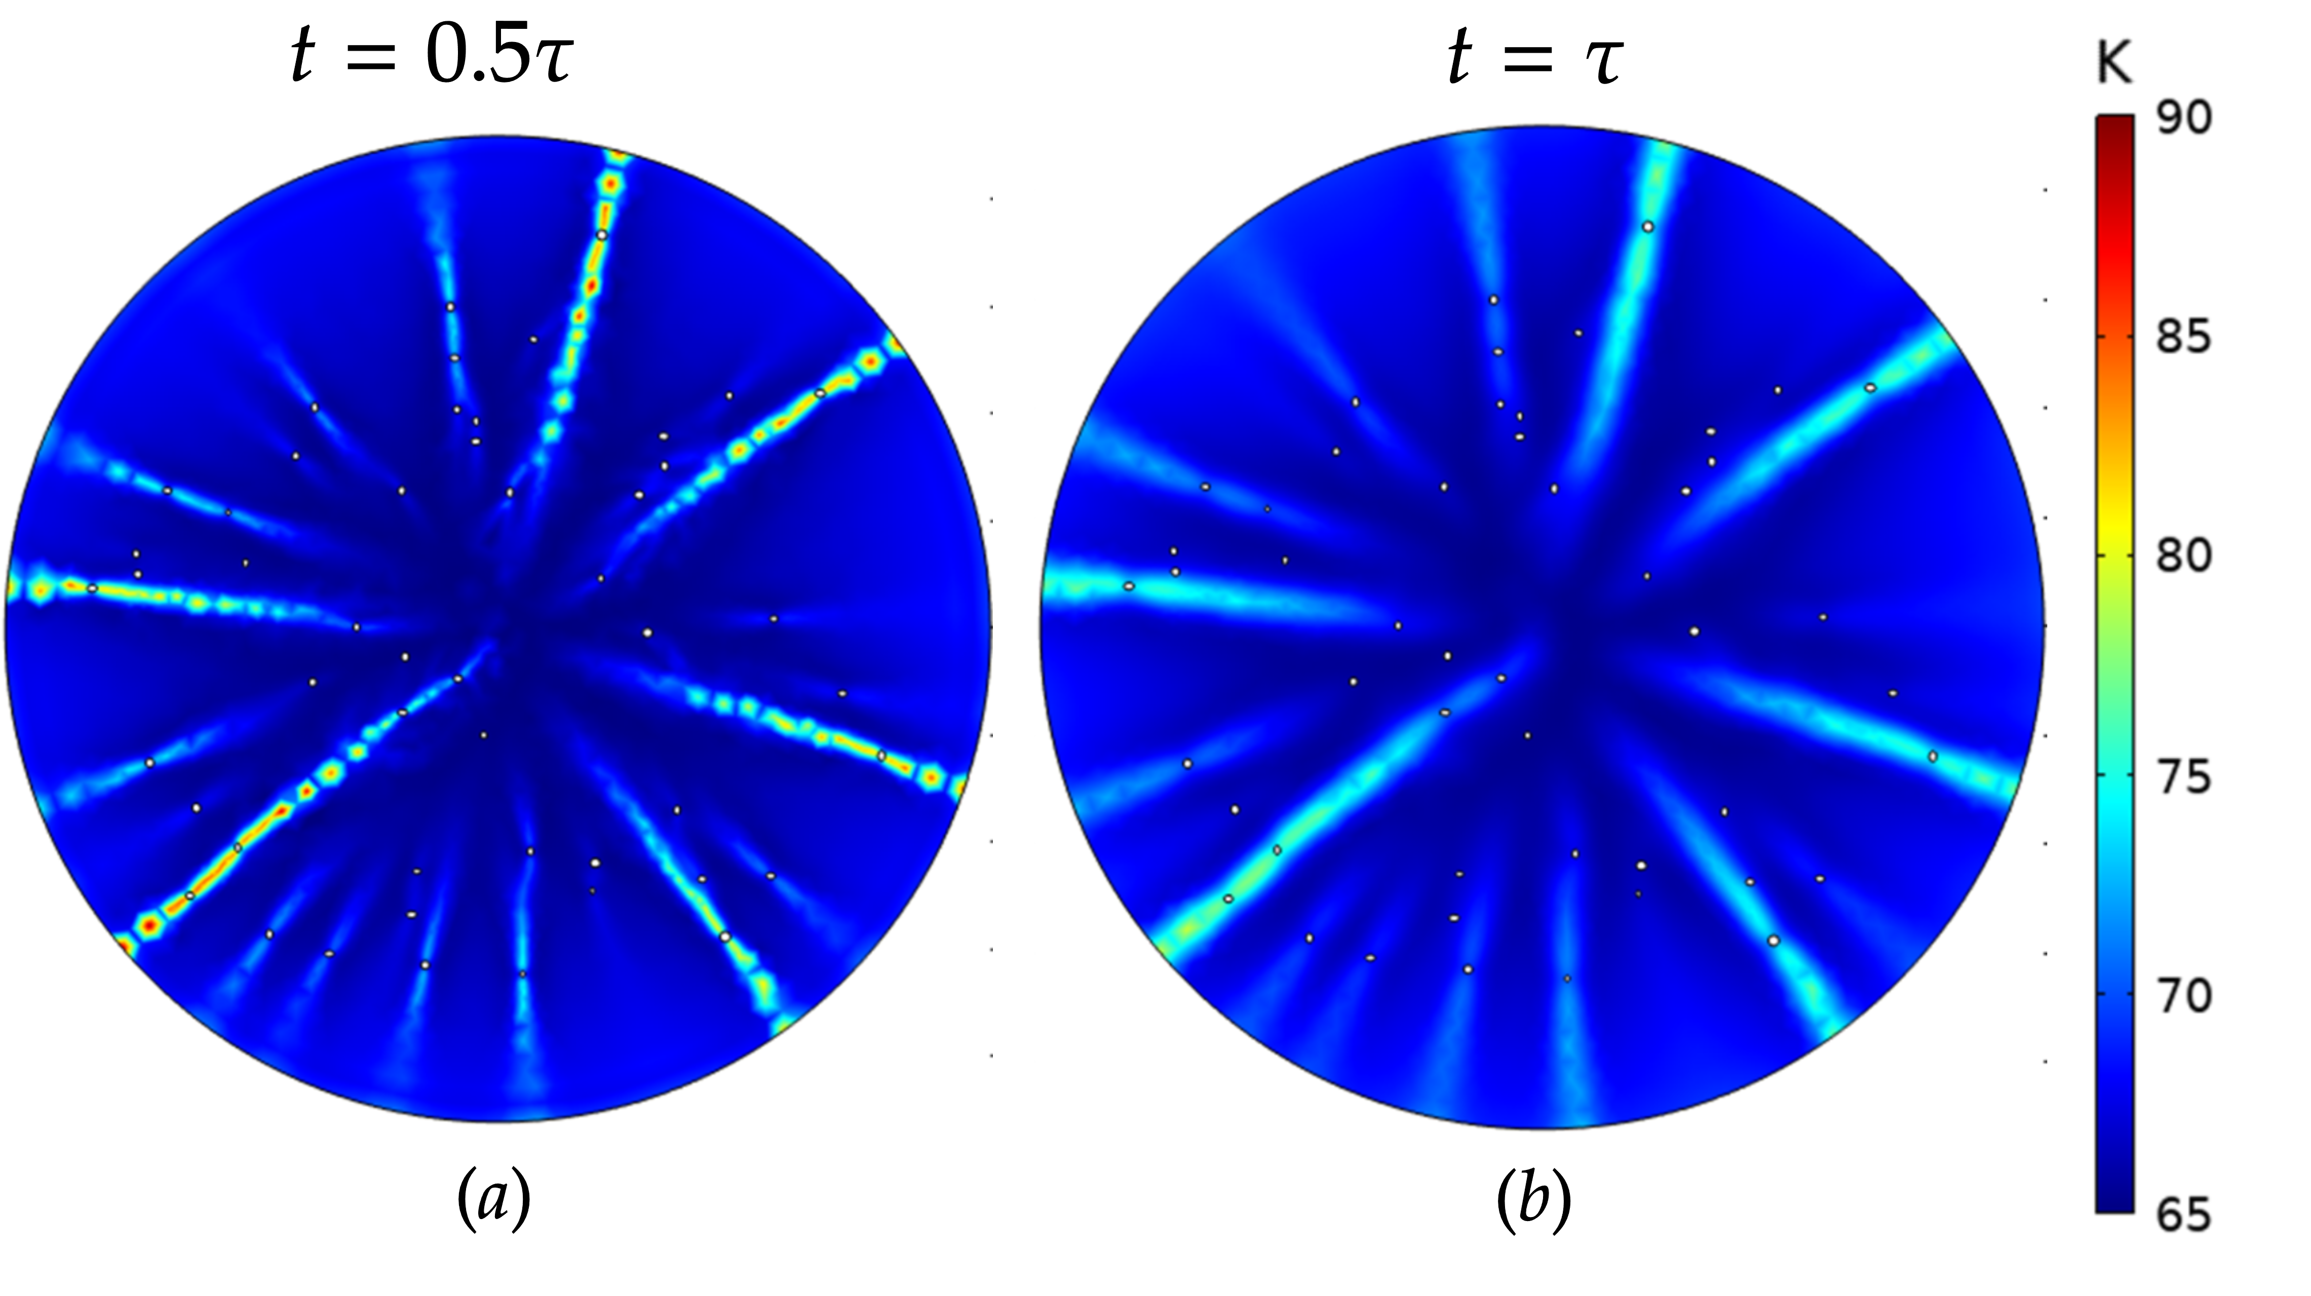

Results: Thermal impact
Temperature evolution
Temperature distribution
$∆T=25 K$ in < 6 ms
Ze Jing and Mark D Ainslie 2020 Supercond. Sci. Technol. 33 084006
Santiago Guijosa G.

Slide 12
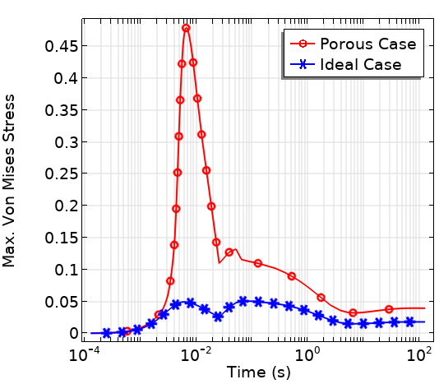
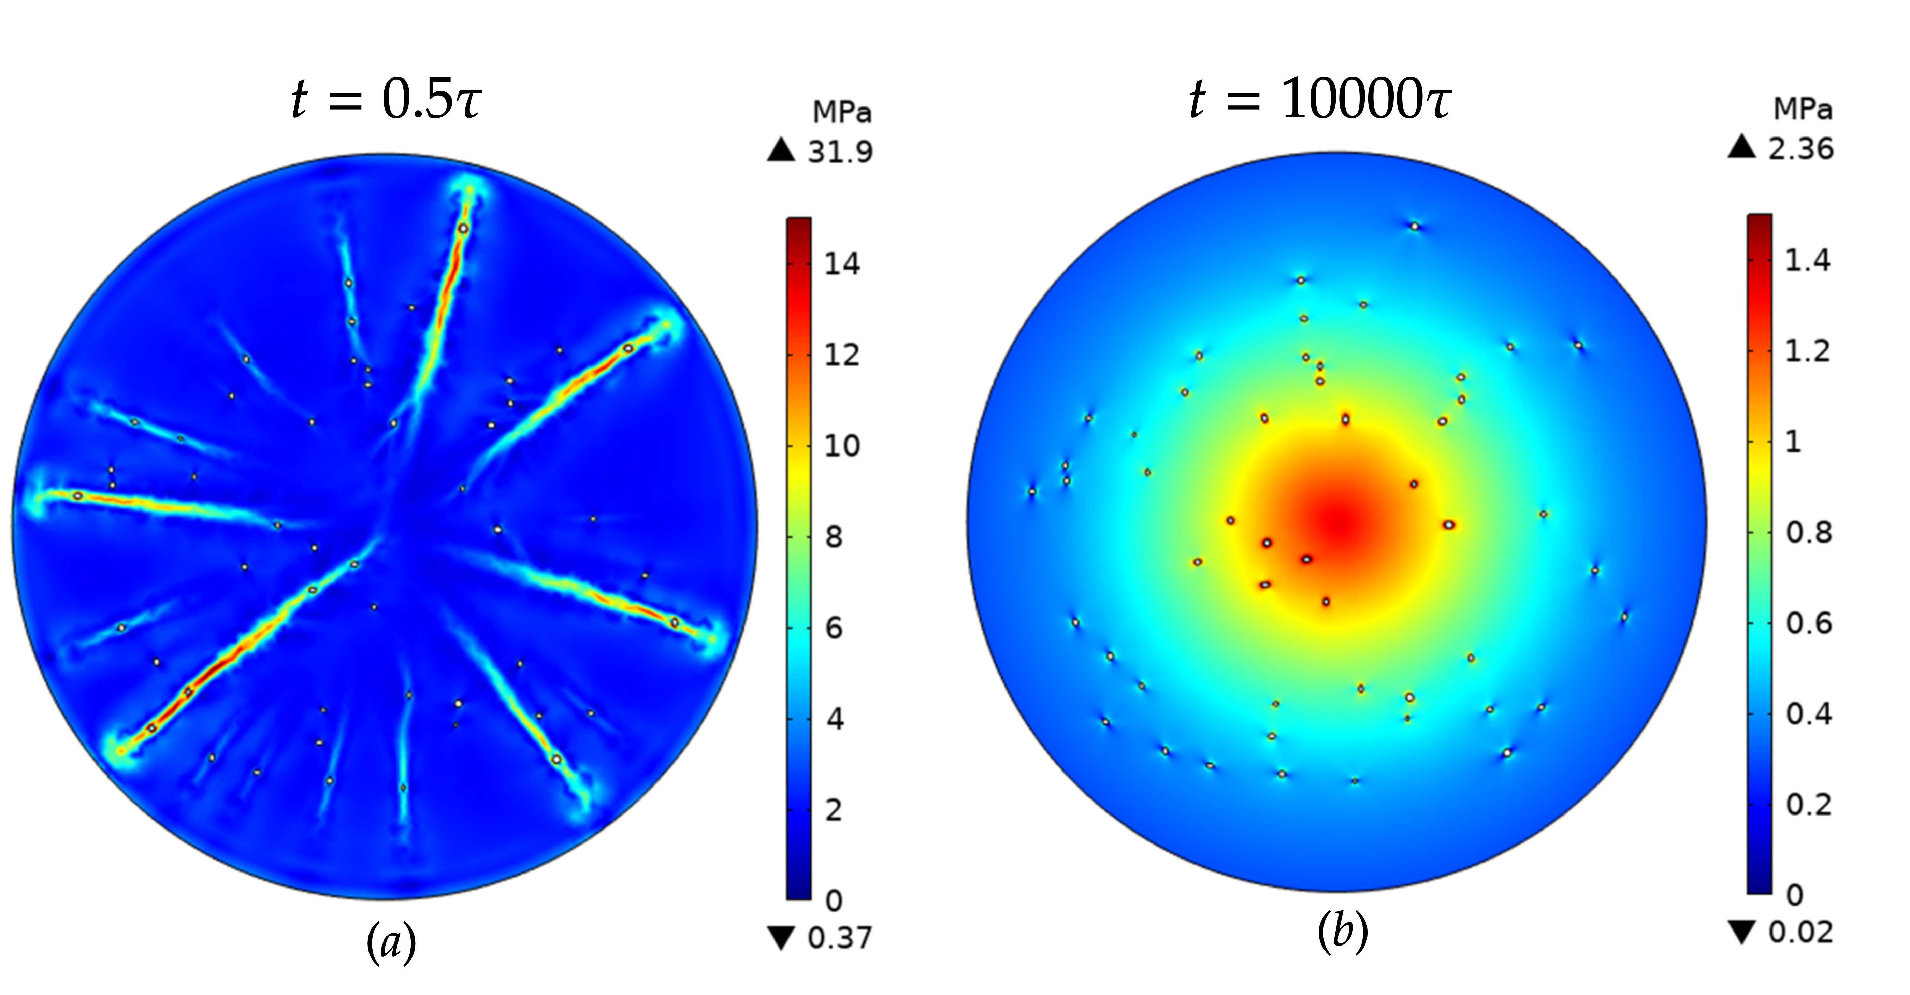
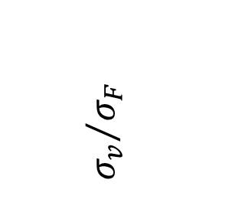
Results: Mechanical impact
Fracture stress comparison
Von mises stress distribution
$${σ_{v}}/{σ_{F}}$$
50% of fracture strength
Santiago Guijosa G.

Slide 13
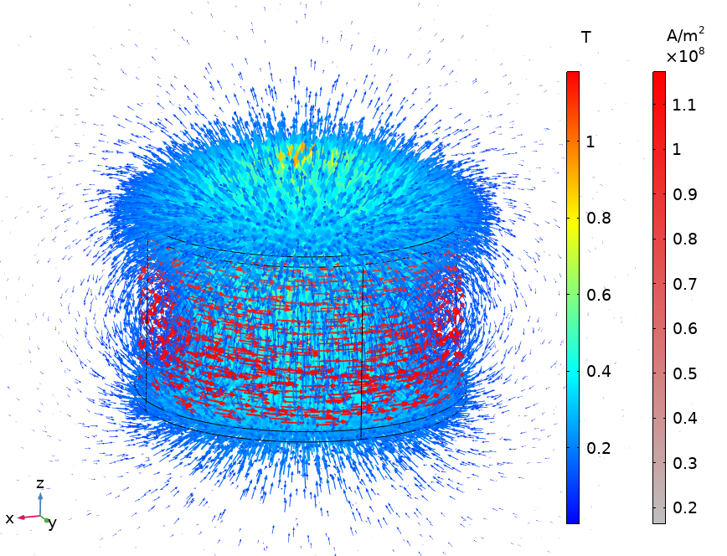
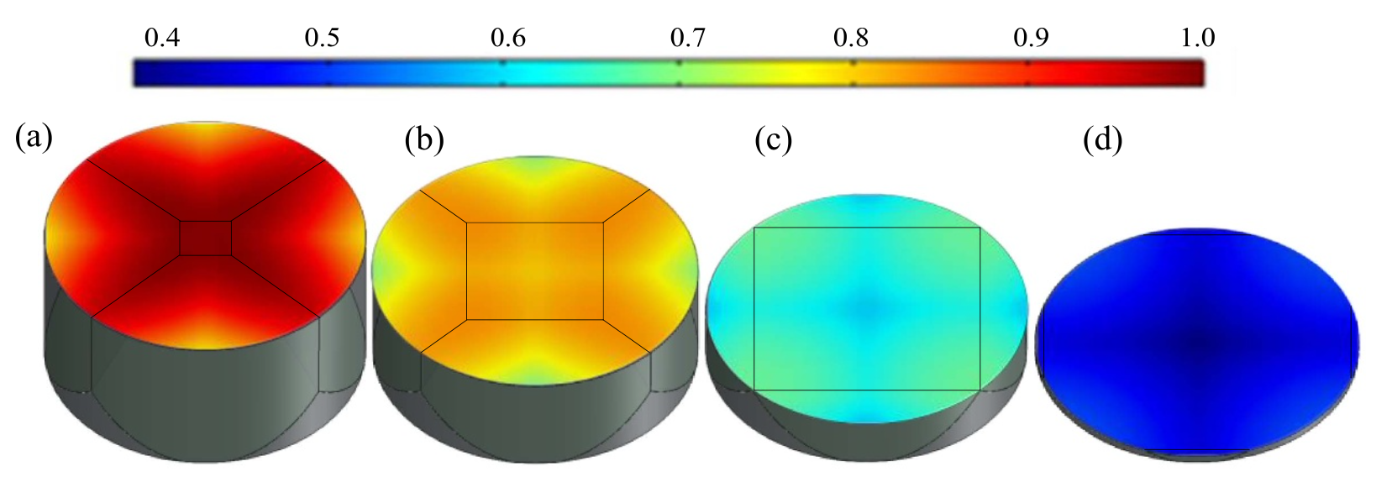
Summary
A 2D numerical model is proposed as a first approach to study the impact of porosity in the magnetization of bulk HTS by PFM.
Porosity shows an impact during PFM in:
  Trapped field distribution
  Local and abrupt temperature rise
  High mechanical tensile stresses (possible fracture)
Future work:
  Studying the current paths around pores and related rise of temperature
  3D model (2D could overestimate the increase in temperature)
  Investigation on mechanical and thermal stresses contributions
Yanxing Cheng et al 2021 Supercond. Sci. Technol. 34 125017
Santiago Guijosa G.

Slide 14
Thank you for your attention!
Contact: sguijosa278@gmail.com
Santiago Guijosa G.

