Slide 1
Critical current numerical characterization of 6-layers CORC® cables
Sofia Viarengo^{1,2}, Fabio Freschi^{1,3}, Laura Savoldi^{1,4}

Slide 2
Outline
Framework
Aim of the work
Electromagnetic-thermal model
Model set-up
Results
Conclusions and perspectives

Slide 3
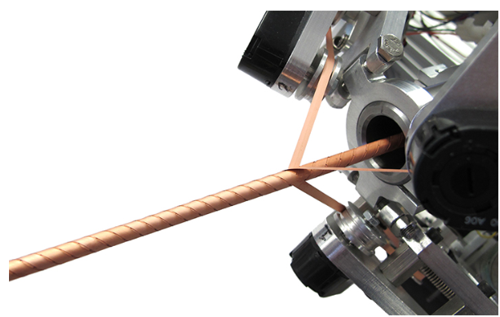
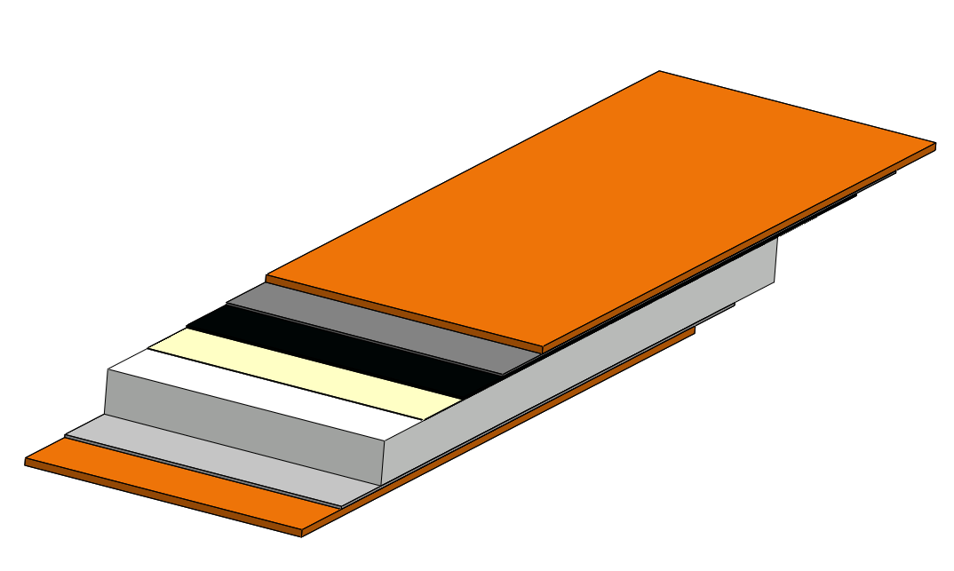




ReBCO tapes and CORC® cables
ReBCO tape
Conductor-on-Round-Core (CORC®)
Copper stabilizer
Silver layer
ReBCO
1.6 μm
100 - 40 μm
Buffer zone
Substrate
2 - 4 mm
[From D.C. Van der Laan et al, 2019]
High working temperature
High Jc
High field achievable
Compact layout
High flexibility
Electric and mechanical isotropy
High thermal stability
Strain sensitive
Anisotropic properties
Complex geometry
Icon from: https://www.flaticon.com

Slide 4
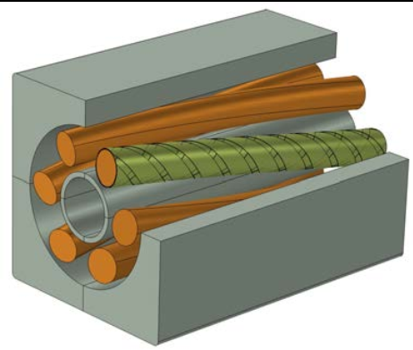
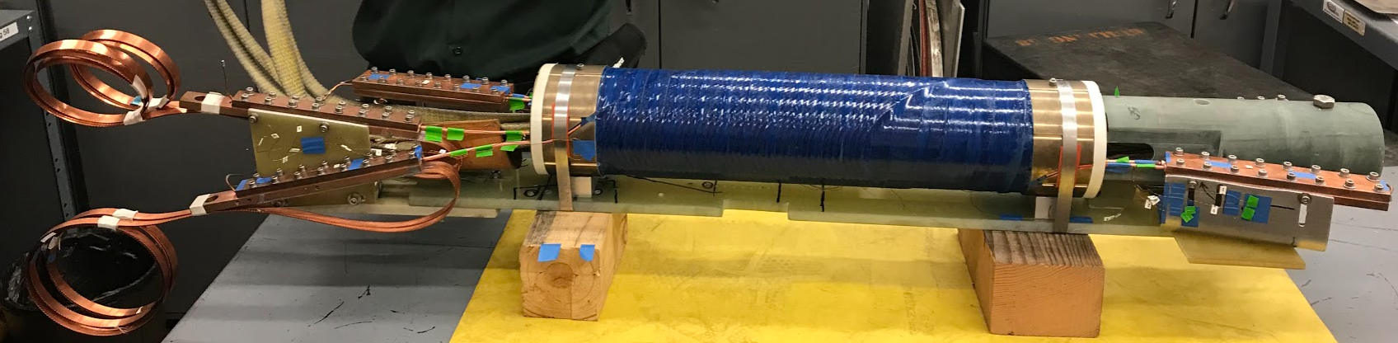
CORC® for high field applications
BEST Central Solenoid coil
[Courtesy of EUROFusion]
CORC® cables are insert in a cable-in conduit conductor or in grooves
Considering them as macro-strands and we need to lump its electric/mechanical/thermal behaviour
Lack of data for a scaling law for Ic(B,T,ε) for the CORC®s
Canted-cosine theta (CCT) Accelerator
C2 wire layout [Courtesy of LBL]

Slide 5
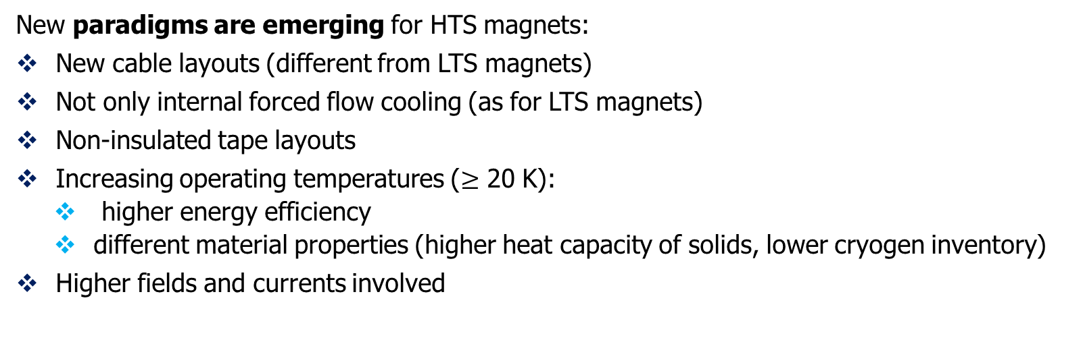
Modeling HTS cables
New paradigms are emerging for HTS magnets:
New cable layouts (different from LTS magnets)
Not only internal forced flow cooling (as for LTS magnets)
Non-insulated tape layouts
Increasing operating temperatures ($≥$ 20 K):
  higher energy efficiency
  different material properties (higher heat capacity of solids, lower cryogen inventory)
Higher fields and currents involved
[From IREF23, L. Savoldi, M. Breschi, L. Bottura, follow-up at ASC24]
There are new challenges to consider for modelling and design next generation of magnets based on HTS material!

Slide 6
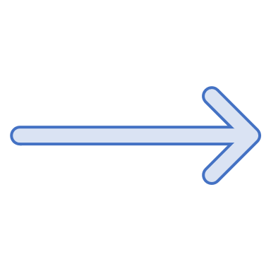
Modeling CORC® cables
What aboout CORC® cables? Which are the issues to tackle?
Only round geometry HTS cable
No insulation between tapes
Tape and layers are electrically, thermally and mechanically coupled
Multiphysics model needed
Electromagnetism
Heat transfer
Strain evaluation
Terminations strongly affects the VI curves
Non-uniform current distribution among tapes and layers
→ We need new model for a proper description of the cable and prediction of Ic

Slide 7


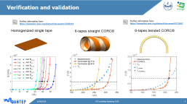
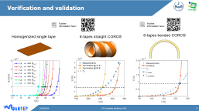
Aim of the work
Tape assumed as a homogeneous and single material
$J_{c}$ scaled on operating conditions $(B$, $T$ and $ε)$
Full 3D multiphysics model aims at the evalutation of the critical current Ic, with a self-consistent current redistribution.
Current redistribution among tapes and layers
Coupling with the thermal module which properly considered the cooling of the cable and analytical definition of strain map
Validated and verified for tapes, simpler geometries CORC® geometries (straight and bended)

Slide 8



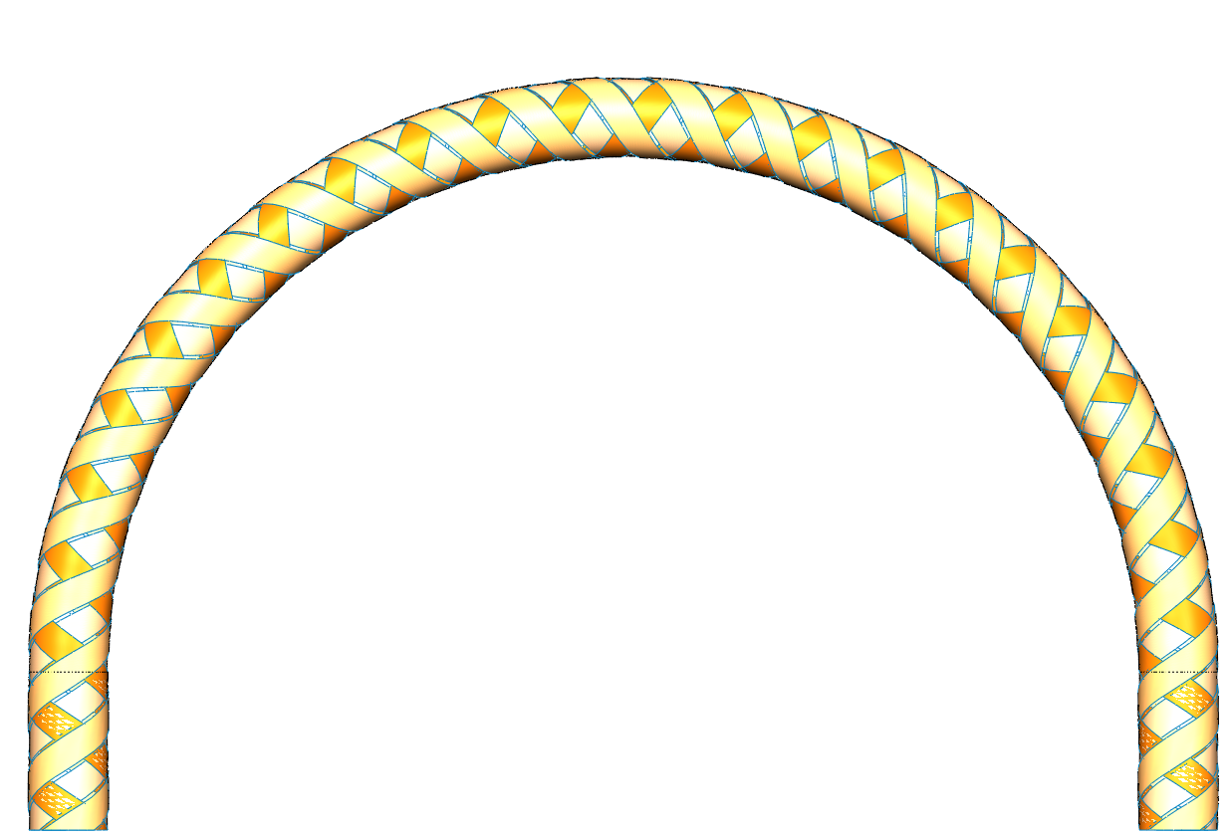
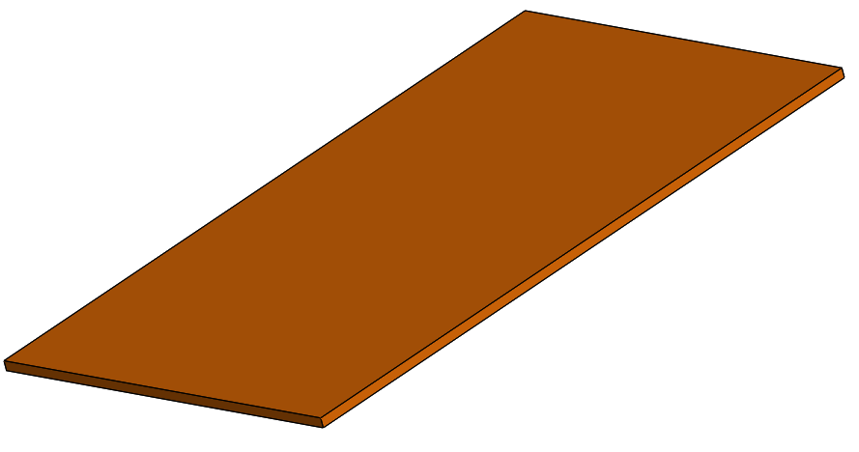
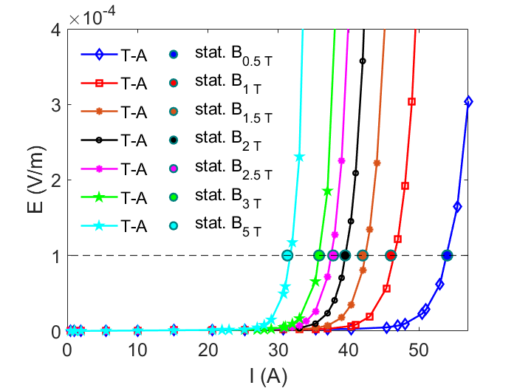
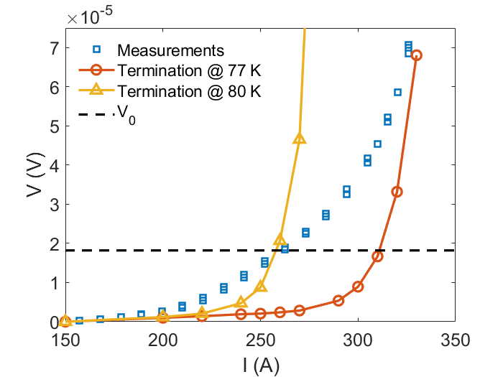
Verification and validation
Further information here:
Further information here:
Homogenized single tape
6-tapes straight CORC®
6-tapes bended CORC®

Slide 9
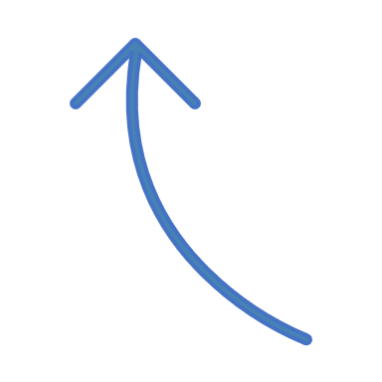
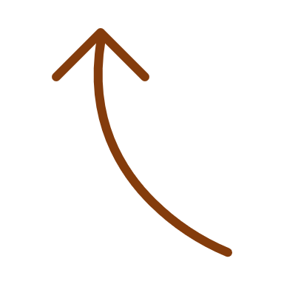





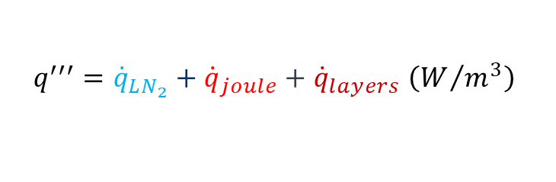

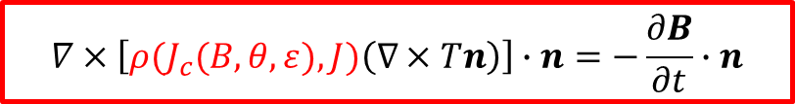
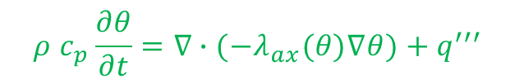


Numerical multiphysics model based on T-A formulation
Air domain
Thin shell approximation
Homogenized properties weigthed on the cross section or on the mass
$${\dot{q}}_{LN_{2}}$$
$$\frac{dB}{dt}$$
$$J$$
Heat conduction equation (SC domain)
$$q^{′′′}$$
$$ρ{ c}_{p}\frac{∂θ}{∂t}=∇∙(−λ_{ax}(θ)∇θ)+q^{′′′}$$
CORC®
$$q^{′′′}={\dot{q}}_{LN_{2}}+{\dot{q}}_{joule}+{\dot{q}}_{layers} \left(W/{m^{3}}\right)$$
Free convection
Conduction among tapes
A-formulation (Whole domain)
T-formulation (SC domain)
$∇ ×E=−\frac{∂B}{∂t}$
Joule Losses
$$B=∇×A$$
$∇ ×H=J$
$$J=∇×T$$
$$∇×\left[ρ(J_{c}(B,θ, ε),J)\left(∇×Tn\right)\right]∙n=−\frac{∂B}{∂t}∙n$$

Slide 10
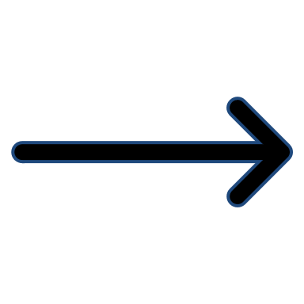

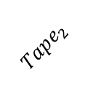






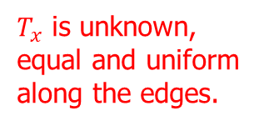


Current-sharing boundary condition
Self-consistent condition in strong form!
$$T_{x}$$
Further information here:
$$Tape_{1}$$
$$PBC$$
$$T_{0}=0$$
$$PBC$$
$$T_{x}$$
$$I_{1}=\left(T_{0}−T_{x}\right)t_{tape}$$
$$Tape_{2}$$
$$I_{2}=\left(T_{x}−T_{2}\right)t_{tape}$$
$T_{x}$is unknown, equal and uniform along the edges.
$$T_{2}=I_{tot}/t_{tape}$$
Minimum domain: a CORC® pitch
Periodic boundary conditions (PBC) avoid edge effects!
Total current imposed in the last boundary
Self-consistente current sharing condition!

Slide 11
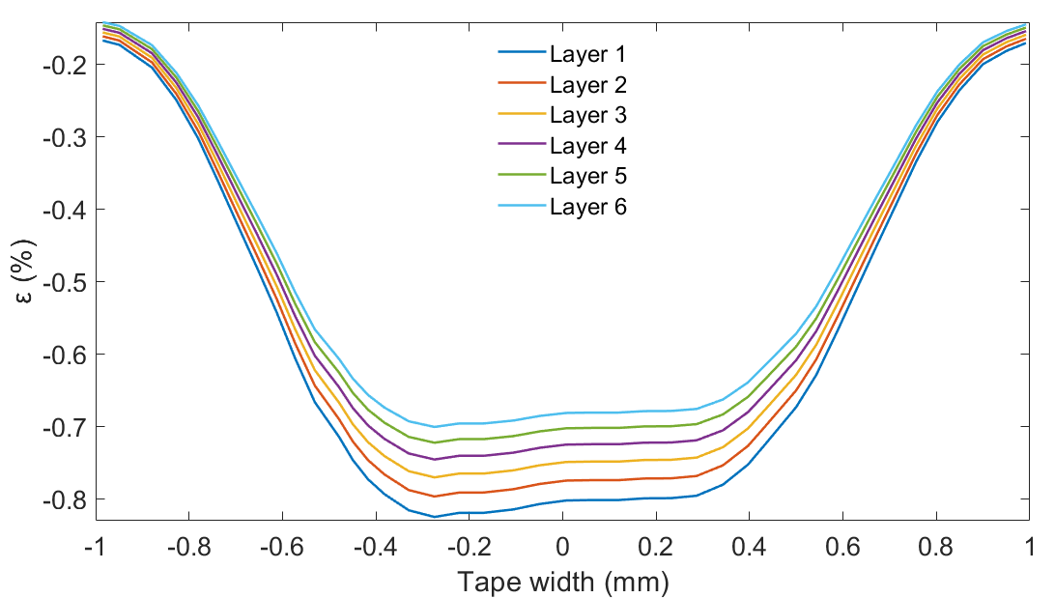
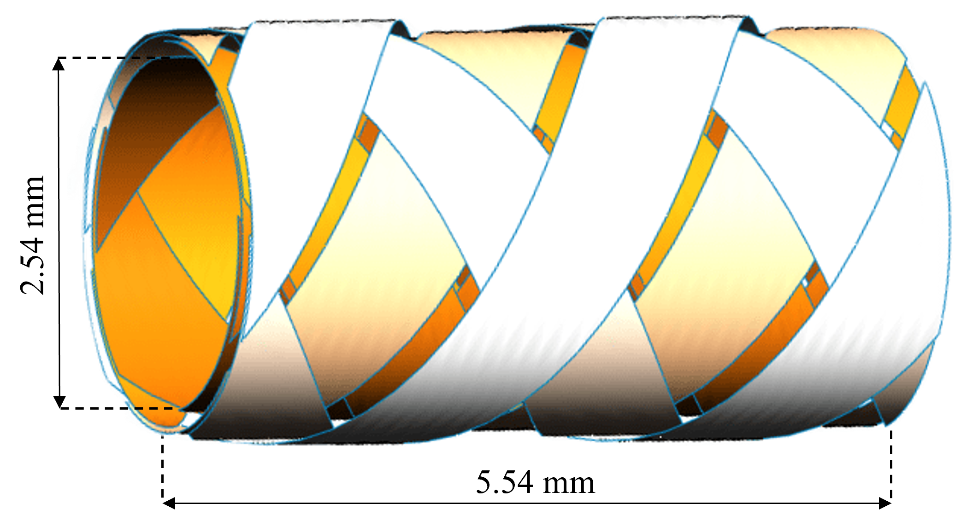


Model set-up
Geometry 12-tapes CORC®
Strain map
$ε_{w}$: intrisic strain due to the tape winding on the copper core.
$$42.5 μm$$
$$2 mm$$
[Bending of corc® cables and wires: Finite element parametric study and experimental validation, Anvar V.A., at el. SUST, 2018]

Slide 12
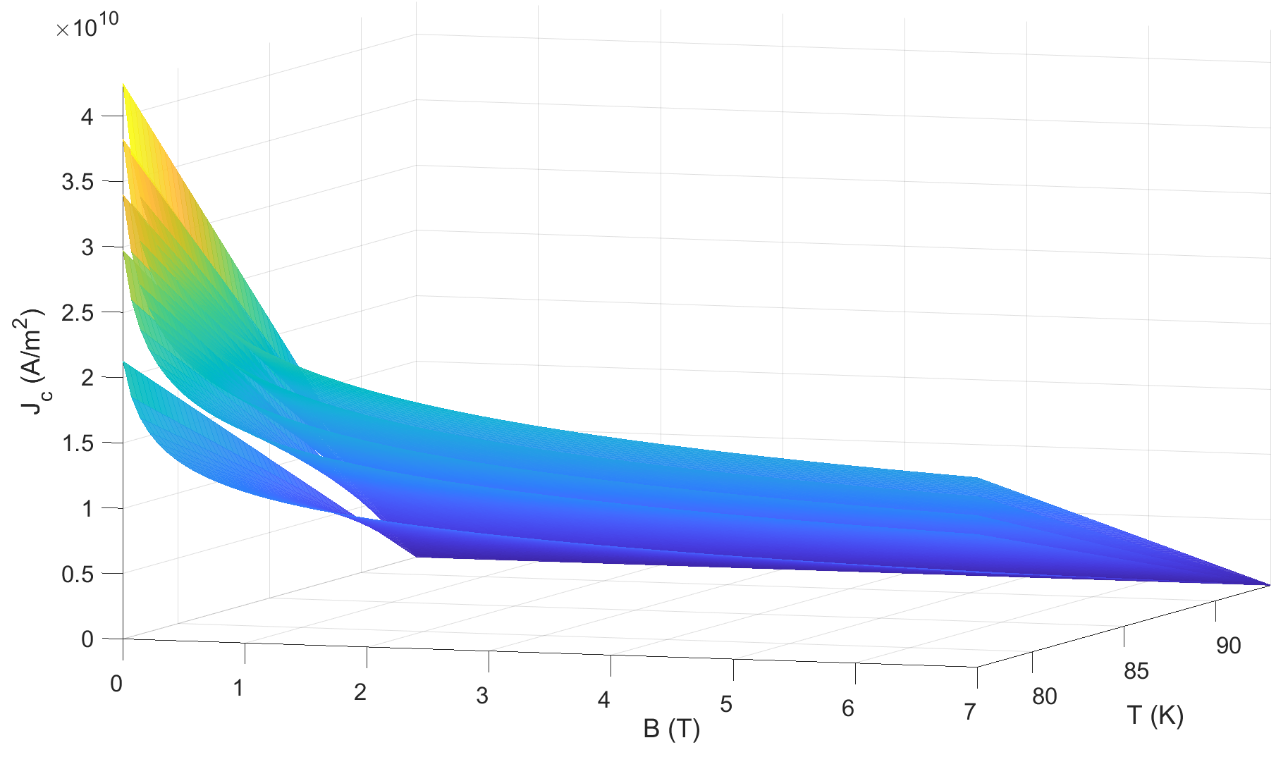
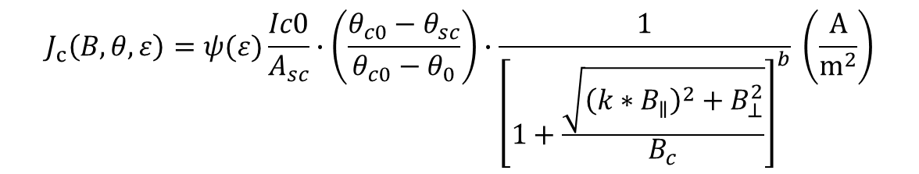
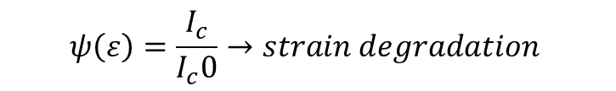
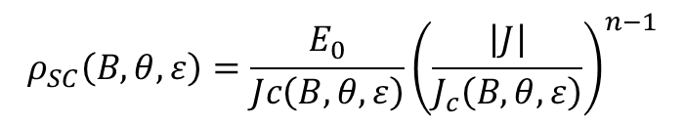
Critical current scaling
$$J_{c}\left(B,θ,ε\right)=ψ(ε)\frac{Ic0}{A_{sc}}∙\left(\frac{θ_{c0}−θ_{sc}}{θ_{c0}−θ_{0}}\right)∙\frac{1}{{\left[1+\frac{\sqrt{{\left(k∗B_{∥}\right)}^{2}+B_{⊥}^{2}}}{B_{c}}\right]}^{b}} \left(\frac{A}{m^{2}}\right)$$
$$ψ\left(ε\right)=\frac{I_{c}}{I_{c}0}→strain degradation$$
[2] From D.C. Van der Laan et al, 2019
Power Law
$$ρ_{SC}\left(B,θ,ε\right)=\frac{E_{0}}{Jc\left(B,θ,ε\right)}{\left(\frac{\left|J\right|}{J_{c}\left(B,θ,ε\right)}\right)}^{n−1}$$

Slide 13
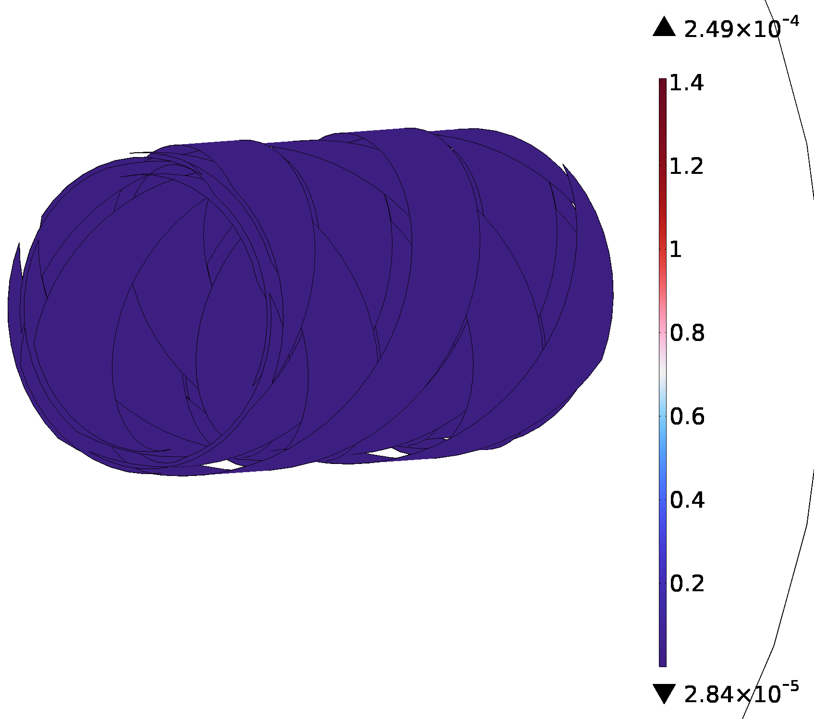
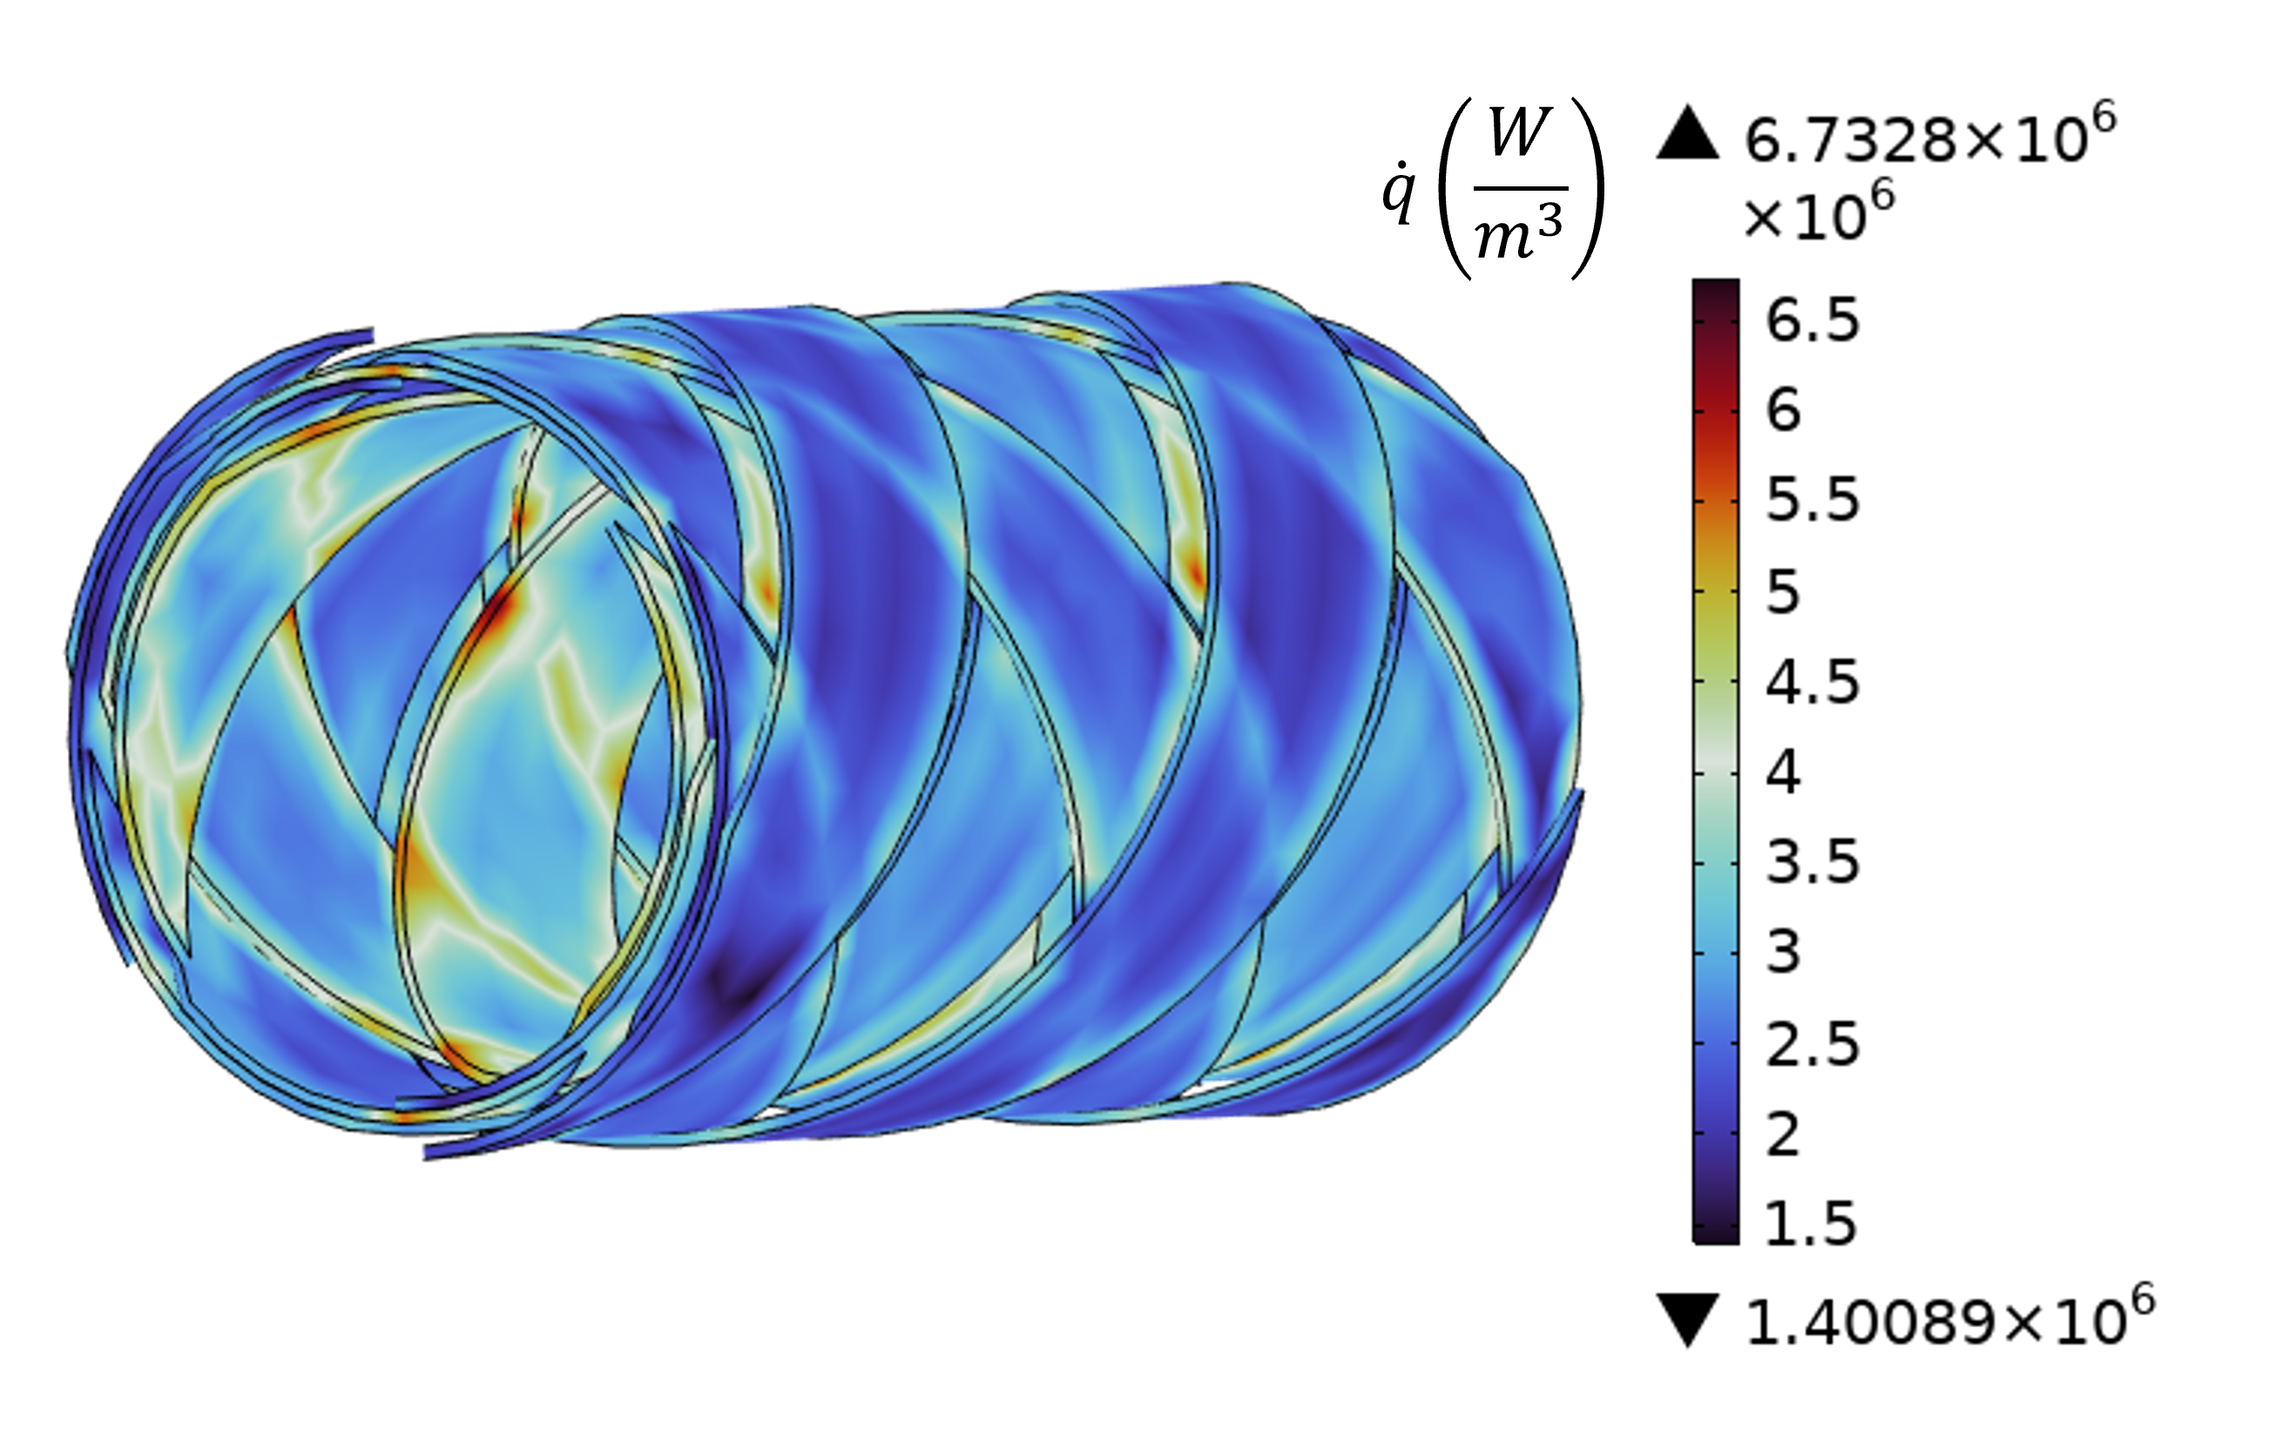
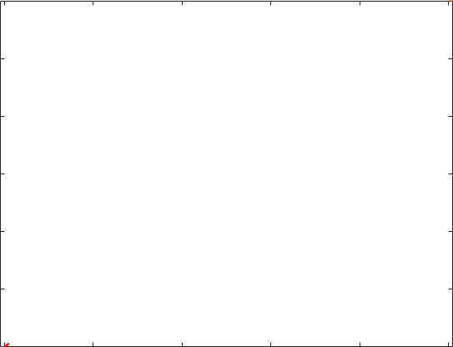



Results: current distribution
$$J_{norm}/J_{crit} (−)$$
$$I_{op}=450 A \left(<I_{c}\right)→superconductive state$$
Joule power not relevant before the transition!

Slide 14
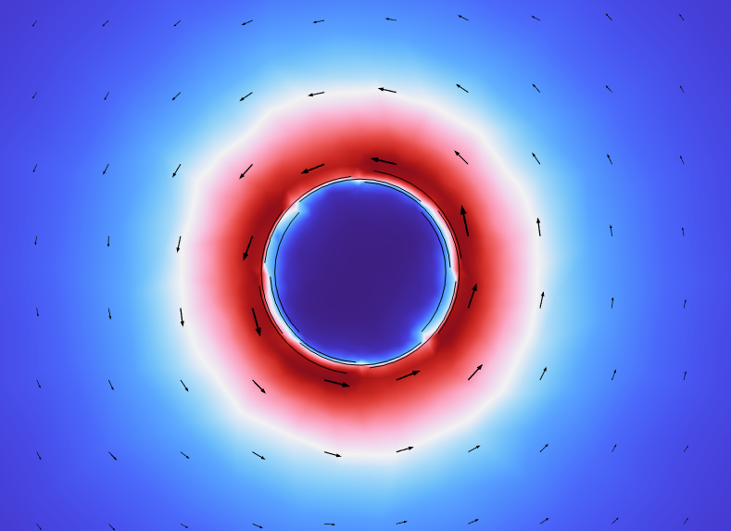
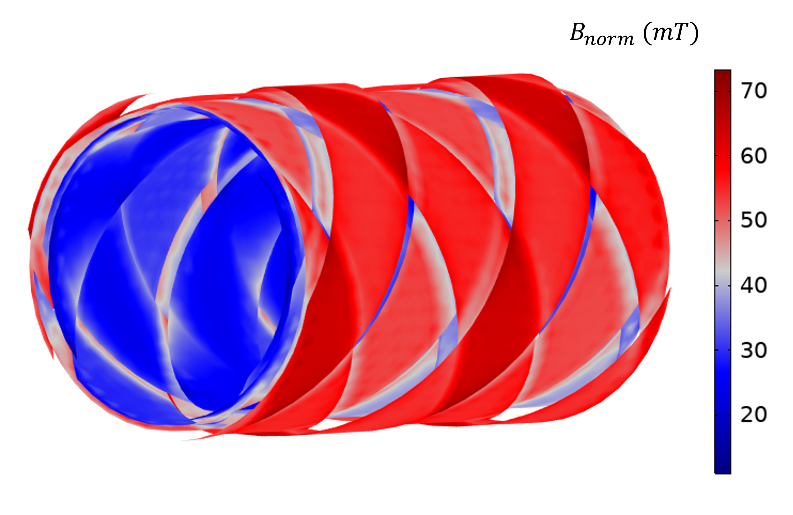
Results: magnetic field distribution
Outermost layers shield the inner ones!
$$I_{op}=450 A \left(<I_{c}\right)→superconductive state$$

Slide 15
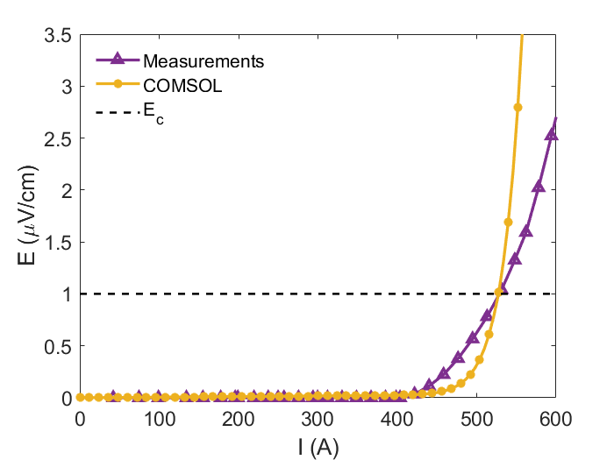
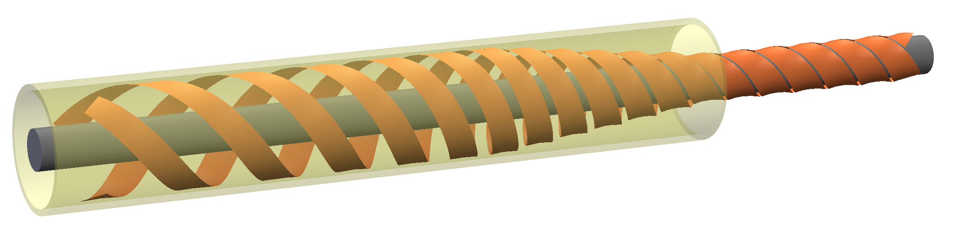
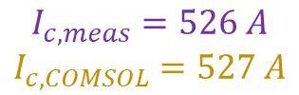


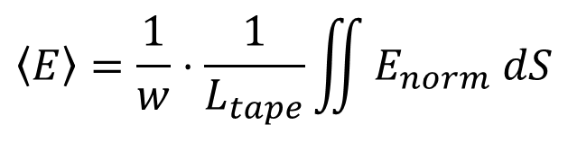
Results: VI curve comparison
Electric field computation:
$$I_{c,meas}=526 A$$
$$I_{c,COMSOL}=527 A$$
$$\left\langle E\right\rangle =\frac{1}{w}⋅\frac{1}{L_{tape}}\iint{E_{norm} dS}$$
Where $w=2 mm$and $L_{tape}=9.83 mm$
$$!$$
N-value largely overestimated,
Termination effect
[Ref: Weiss J., at el. SUST, 2017]

Slide 16
Conclusion and future perspectives
Full 3D multiphysics model for CORC® cables based on T-A formulation has been developed in COMSOL Multiphysics
Implementation of a new boundary condition for the current distribution among tapes and geometrical strain consideration
Extend to more than 3 layers CORC®
Ic well-capture, overestimation of the n-value related to the terminations
In perspective:
Replicate the termination effect
Coupling with a mechanical module

Slide 17
THANK YOU FOR YOUR ATTENTION!

Slide 18
Back-up slides

Slide 19
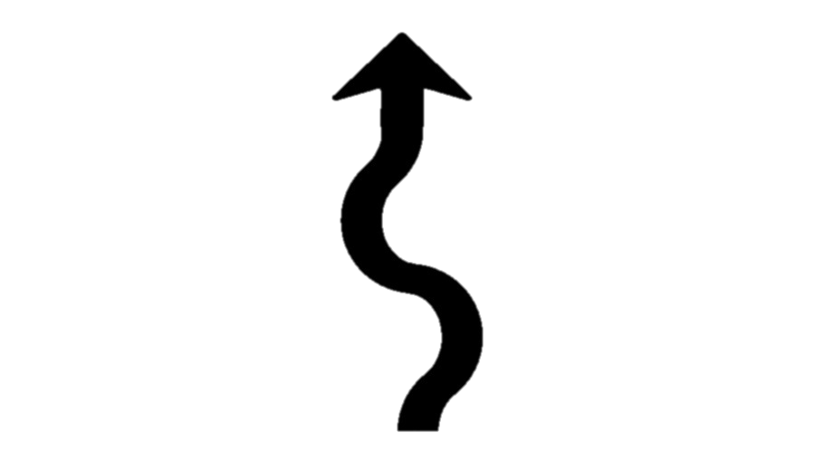
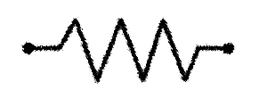
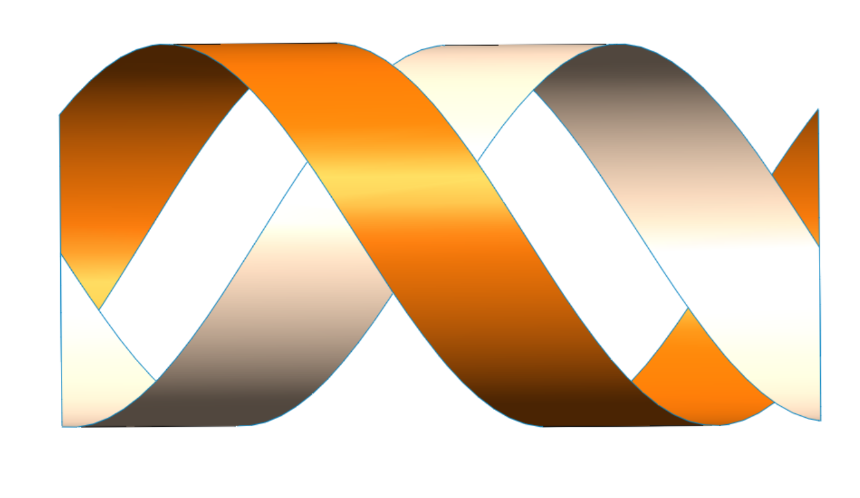






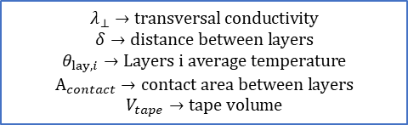

Appendix A: Thermal model for CORC®
Thermal model
$$ρ∙c_{p}∙\frac{∂θ}{∂t}=∇∙\left(−λ_{ax}\left(θ\right)∙∇θ\right)+{\dot{q}}_{joule}+{\dot{q}}_{LN_{2}}+{\dot{q}}_{layers}\left[\frac{W}{m^{3}}\right]$$
$${\overline{θ}}_{lay1}$$
$$\frac{λ_{⊥}}{δ}$$
$${\dot{q}}_{LN_{2}}$$
$${\dot{q}}_{layers}=\frac{\frac{λ_{⊥}}{δ}\left({\overline{θ}}_{lay1}−{\overline{θ}}_{lay2}\right)∙A_{contact}}{V_{tape}}$$
$${\overline{θ}}_{lay2}$$
$${\dot{q}}_{layers}$$
$${\dot{q}}_{joule}$$
$$λ_{⊥}→transversal conductivity$$
$$δ→distance between layers$$
$$θ_{lay,i}→Layers i average temperature$$
$$A_{contact}→contact area between layers$$
$$V_{tape}→tape volume$$

