Slide 1
HTS2024
Welcome - Introductory Remarks
11-13 June 2024, Bad Zurzach & PSI
Stéphane Sanfilippo Paul Scherrer Institute

Slide 2
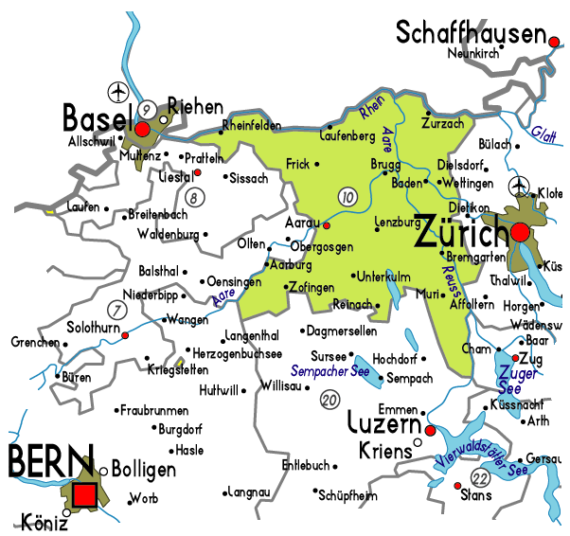
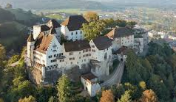
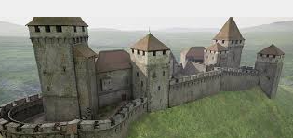
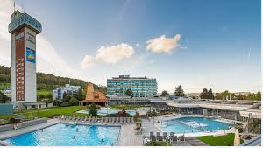
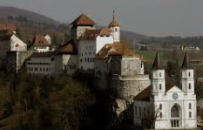
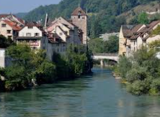
Welcome to HTS2024 workshop
Argovia : Rivers & wellness & and castles
Committee
Kévin Berger (President) – [University of Lorraine – France]
Remi Dorget – [Safran Techn. – France]
Wescley T. B. de Sousa – [Karlsruhe Institute of Technology – Germany]
João Murta Pina – [New University of Lisbon – Portugal]
Nicolo Riva – [Proxima Fusion-Germany]
Stéphane Sanfilippo – [Paul Scherrer Institut – Switzerland]
Frederic Trillaud – [Universidad Nacional Autonoma de Mexico – Mexico]
Min Zhang – [University of Strathclyde – Scotland]
Local committee (PSI)
Stéphane Sanfilippo (Chair)
Silvia Bacher (Organisation)
Ciro Calzolaio
Stefan Keller (Finance)
Jaap Kosse
Rebecca Riccioli
Notes:
Canton Aargau, located in the northern part of Switzerland, is known for its picturesque landscapes, rich history, and diverse tourist attractions. Here’s an overview of what makes Aargau a compelling destination
Castles and Historical Sites
Habsburg Castle: The ancestral seat of the Habsburg dynasty, this medieval castle offers insights into European history and panoramic views of the surrounding countryside.
Lenzburg Castle: One of Switzerland’s oldest and most significant castles, Lenzburg boasts a museum and hosts cultural events throughout the year.
Wildegg Castle: A well-preserved baroque castle with beautifully landscaped gardens and interactive exhibits showcasing 18th-century life.
Thermal Baths and Wellness
Bad Zurzach: Famous for its thermal baths, Bad Zurzach offers a relaxing retreat with modern spa facilities and therapeutic waters.
Baden: Known for its healing thermal springs since Roman times, Baden combines wellness with cultural attractions, including theaters and galleries.

Slide 3
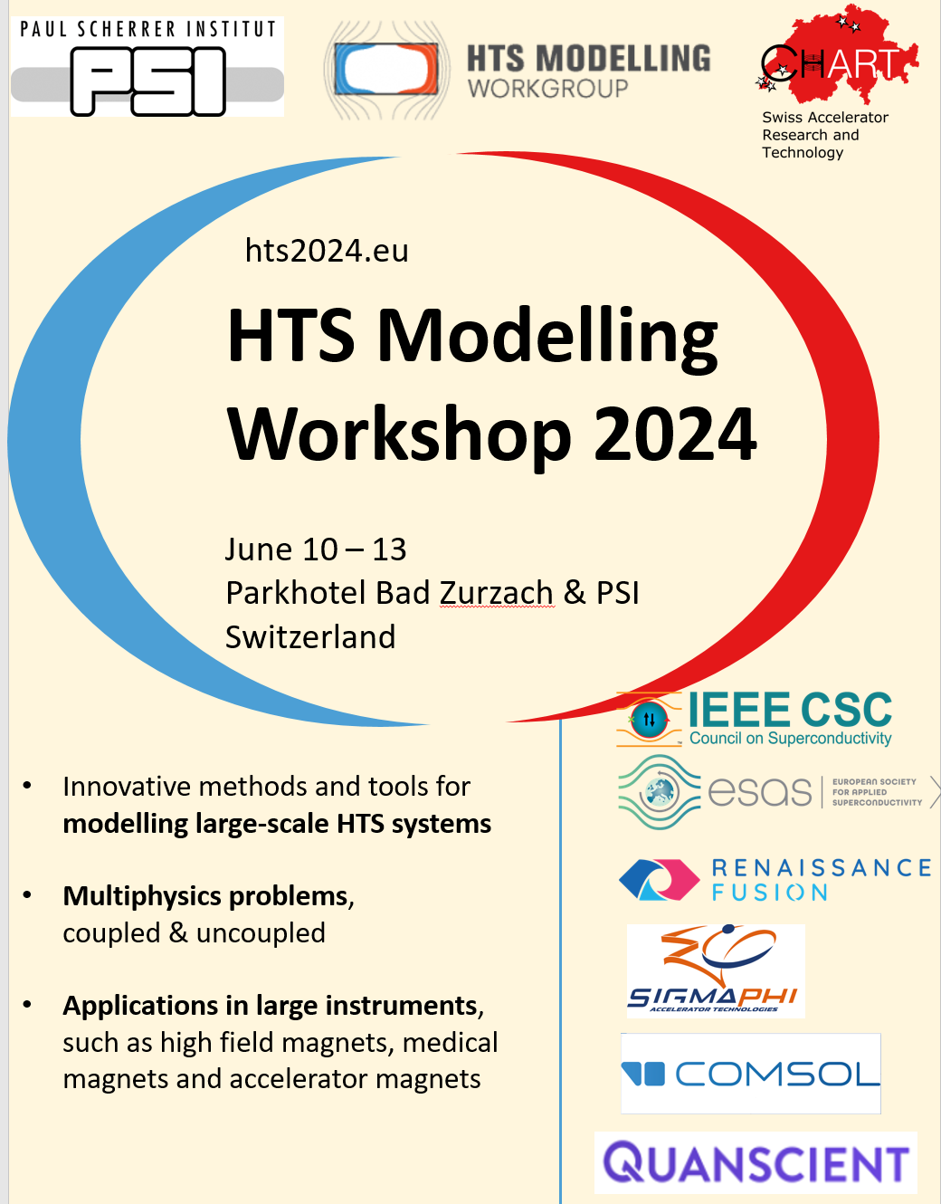
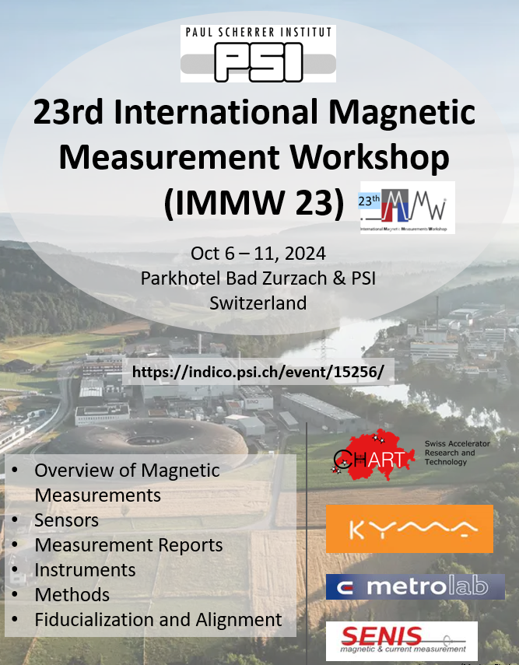
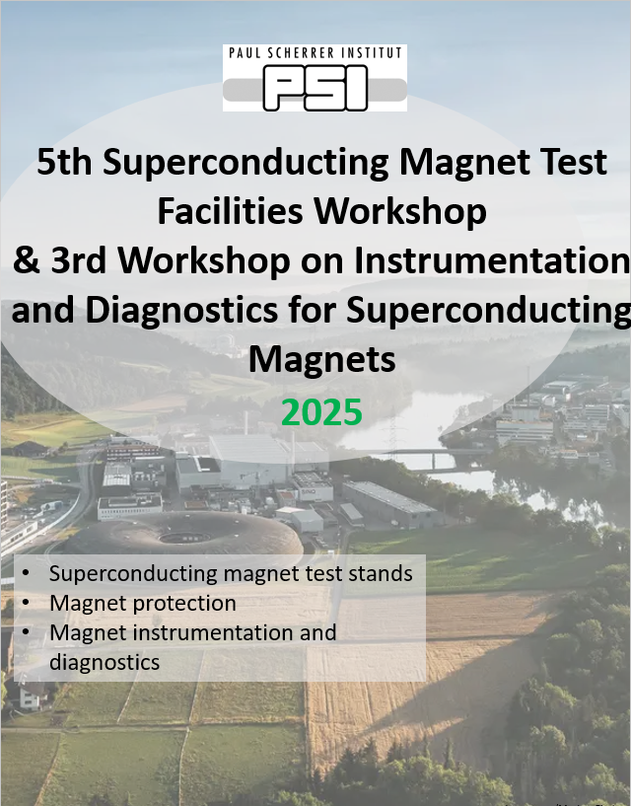
First workshop at PSI of a triptych dedicated to magnet modeling and magnet tests
10/06-13/06/2024
06/10-11/10/2024
(registration open)
Spring 2025

Slide 4

Objectives/ topics
Exchange among researchers in HTS modeling on :
Innovative methods and tools for modelling large-scale HTS systems
Improvements in fundamental numerical methods to simulate superconducting materials, including HTS, MgB₂ and iron-based materials.
Innovative methods and tools for design and simulation of HTS materials.
Original, novel application of commercial numerical software packages,
Open access modelling and simulation resources for teaching, training and research.
Coupled & uncoupled multiphysics problems
Computation of AC losses under distinct regimes.
Thermal modelling (coupled and uncoupled).
Mechanical modelling (coupled and uncoupled).
Applications in large instruments (high-field magnets, medical magnets and accelerator magnets….)
Design and optimization tools for HTS devices for power/transportation applications [Topics include energy storage, including SMES and flywheels; fault current limiters; power cables; transformers; wind generators; stacked tape machines; and others],
Development of tools for integration with power grid software simulators,
Novel applications of HTS materials
https://www.htsmodelling.com/

Slide 5
Time plan of the event
10 June 24 (Monday)-13 June 24 (Thursday)
Monday evening : Welcome reception & apéro, (Park Hotel)
Tuesday : Workshop day 1 (presentations)-Park Hotel
Wednesday
  Transfert to PSI (Villigen)
  Morning : Sponsor session +Poster session
  12 : 00 End of the vote: election of the two new members of the HTS modeling board
  Afternoon : PSI Presentation (auditorium) Oral Session + Lab tour
  Evening : Social Dinner (Habsburg Castle) – Transfer back to Zurzach
Thursday
  Morning : Workshop Day 2 (presentations) - Park Hotel
  End of the workshop : Thursday Midday

Slide 6
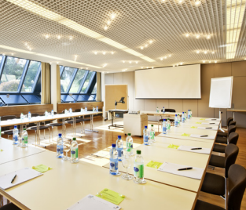
Conference Room for the
oral sessions (Park Hotel)
Plenum room 150 m²
Concert layout 100 persons (without table)
  beamer with screen
  2 flipcharts
  2 pinboards
  moderation material
Coffee breaks just outside the room
Booth from sponsors outside the room
No hybrid sessions

Slide 7


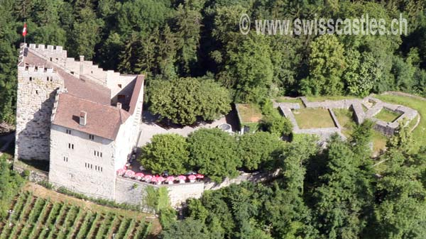





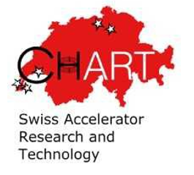
Many thanks to our sponsors !!!!
Many thanks to the sponsors for contribution and support
Workshop dinner:
Habsburg castle (1020)
Reduced fee for
the early career scientists participants (32)
+
Dedicated session on Wednesday
Morning at PSI
Booth at the conference room entrance

Slide 8
Participants
79 participants (thank you for your interest !)
18 countries - An authentic international workshop

Slide 9
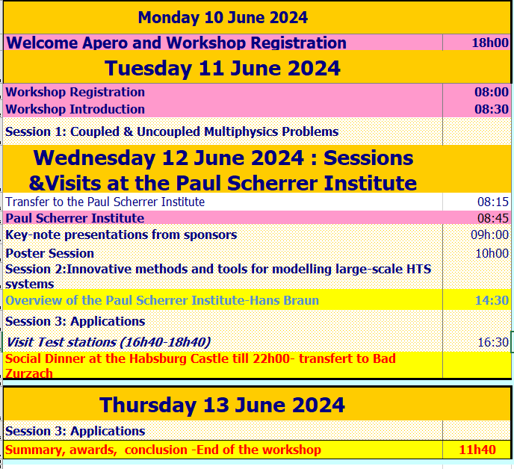
Program of the workshop
Abstract : 50 abstracts
Submitted on indico
Committee’s classification
6 invited talks (25+5 min)
19 contributed talks (20+5 min)
25 Posters
3 sessions
Coupled and uncoupled Multiphysics problems
Innovative methods and tools
Applications
Posters session of 1h30 at PSI Wednesday morning (preparation during a long coffee break ~30 min)
Awards for the 3 best contribution of Early Career Scientist at the end of the workshop

Slide 10
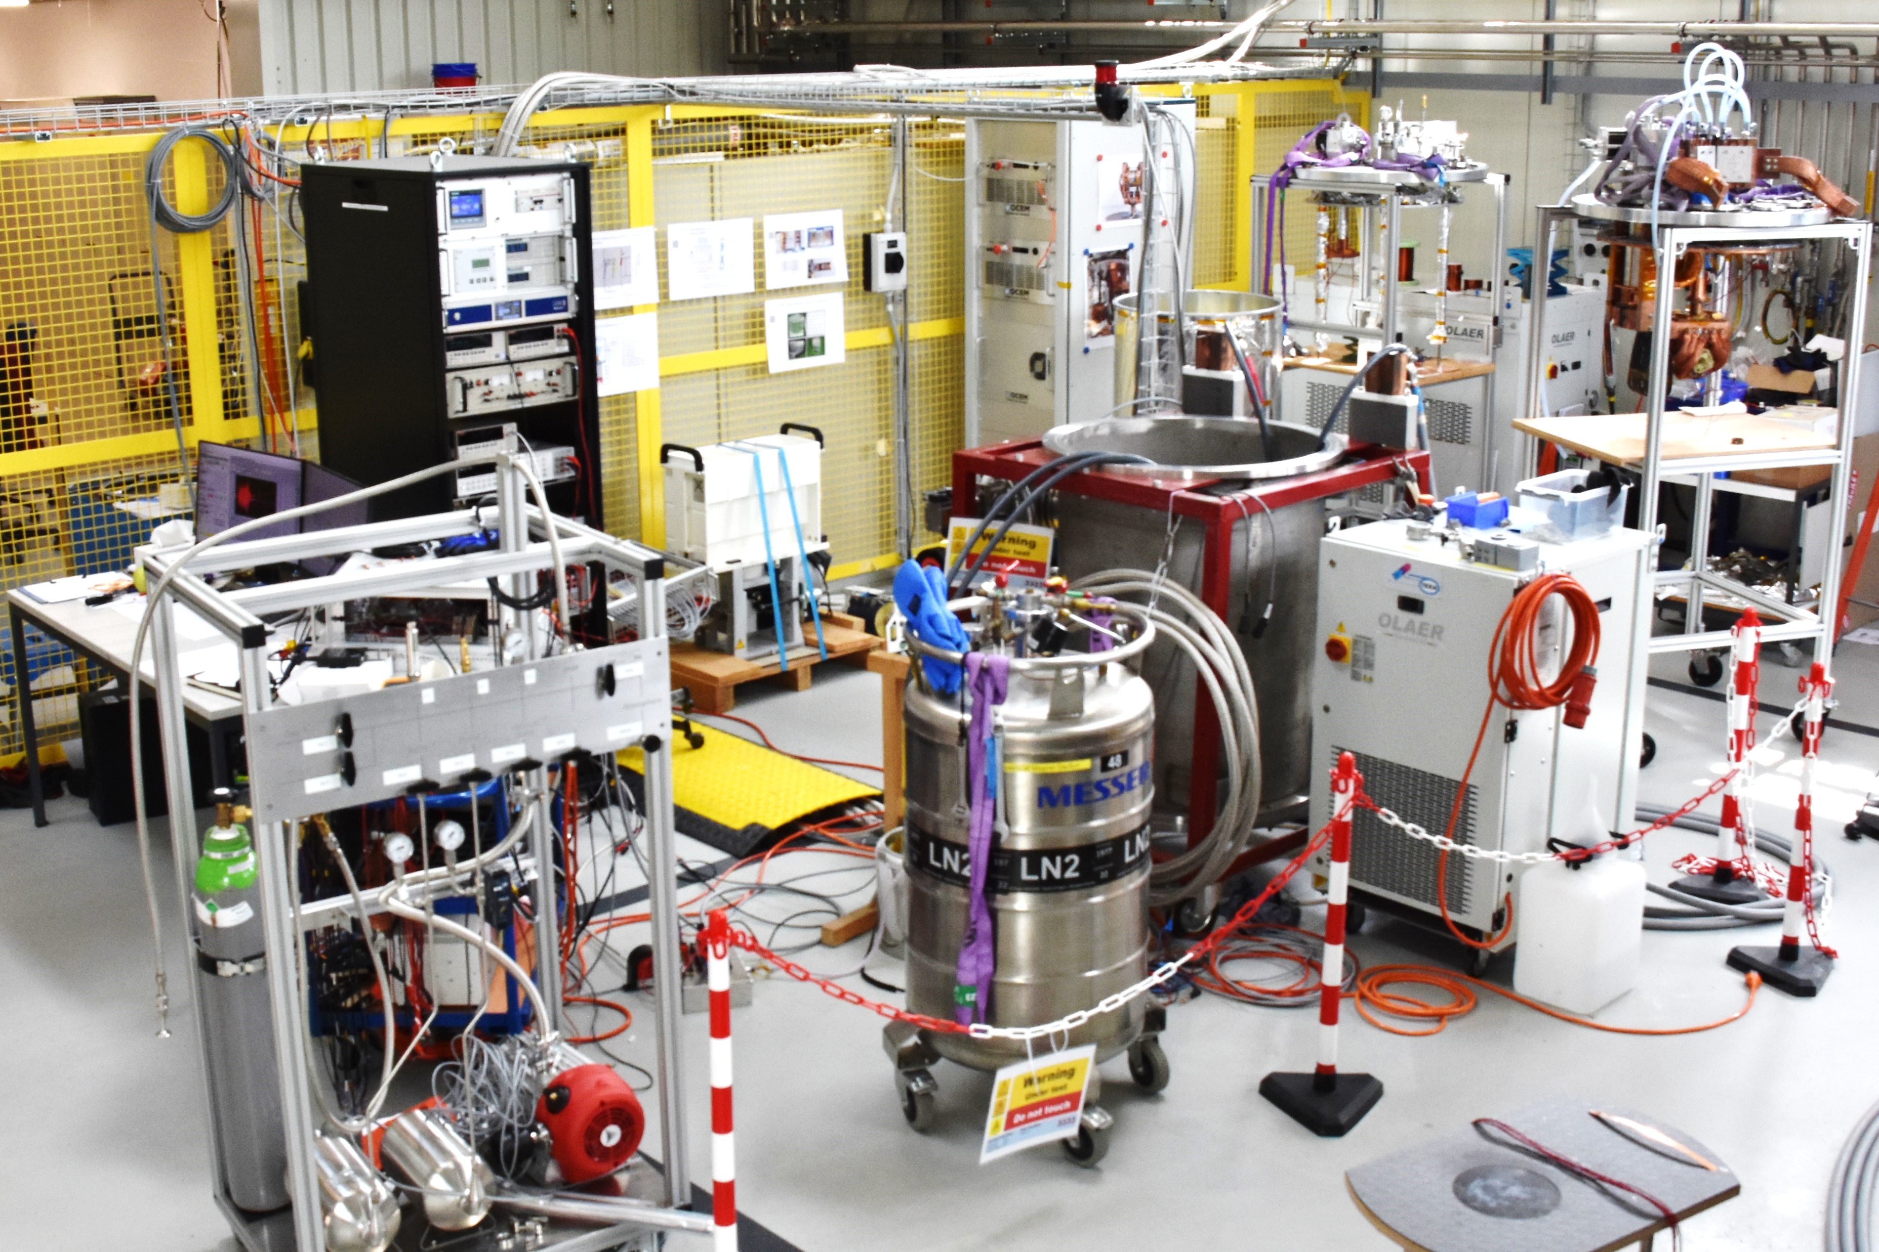
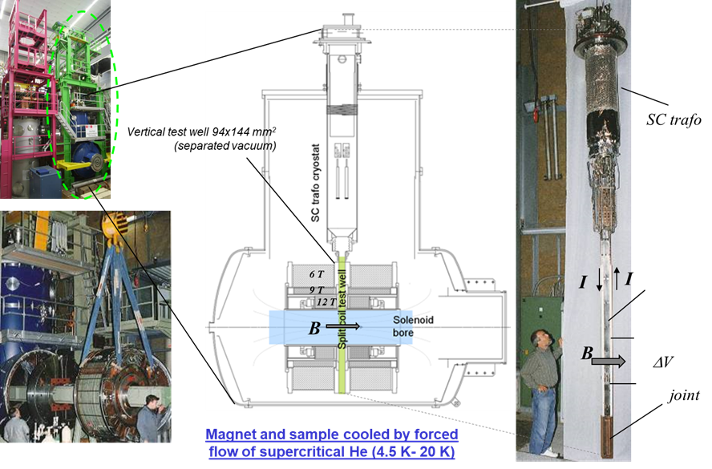
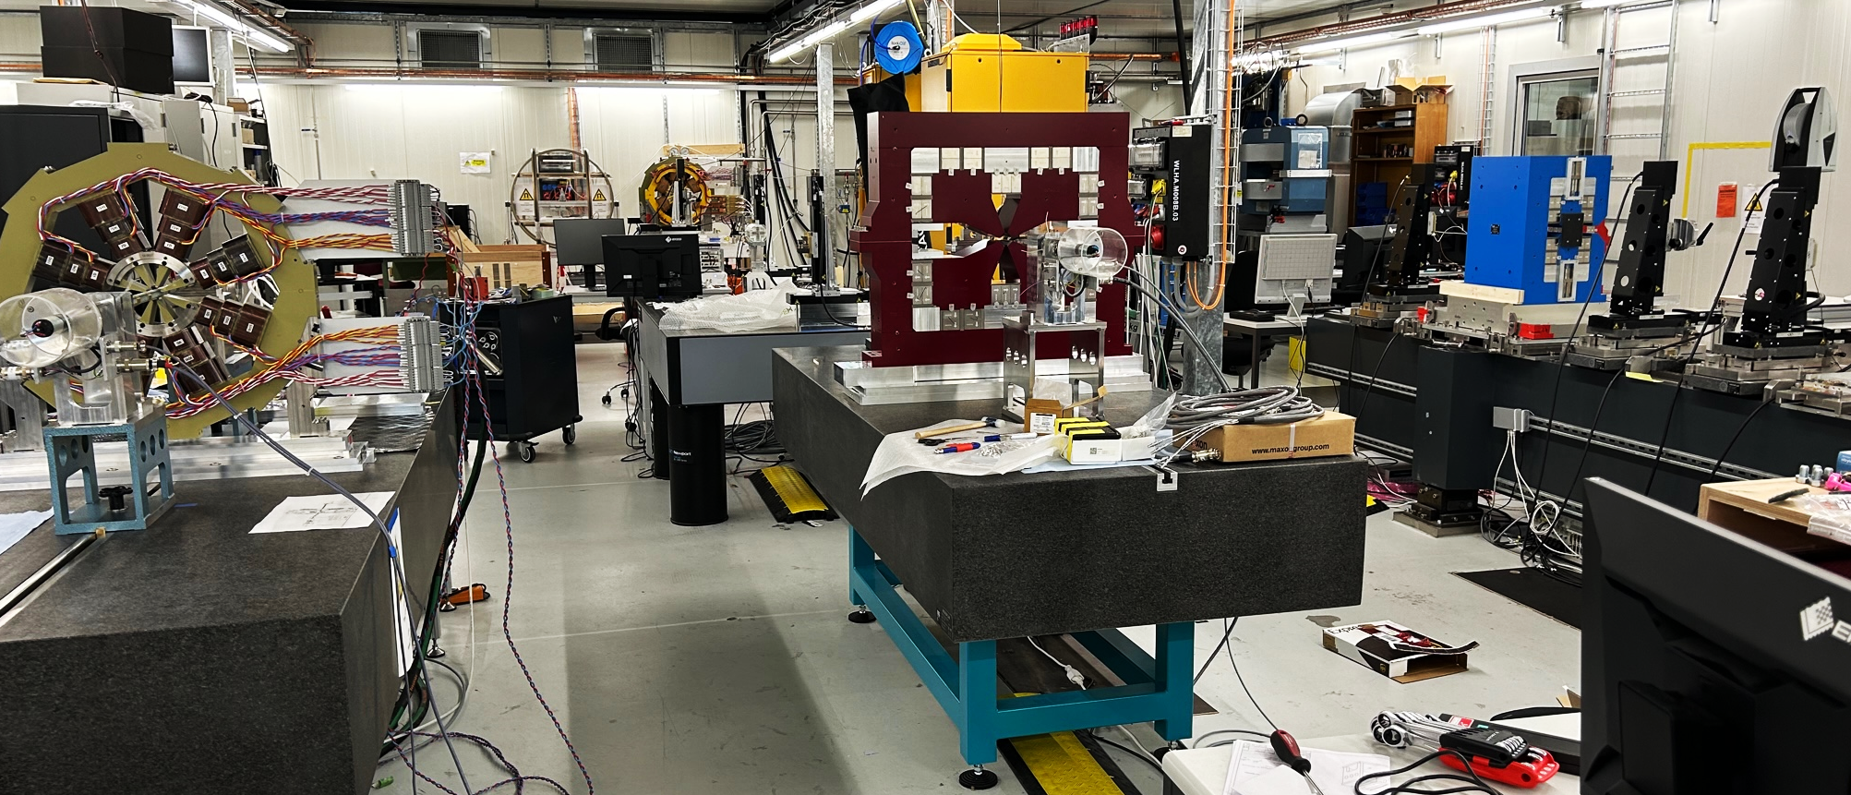
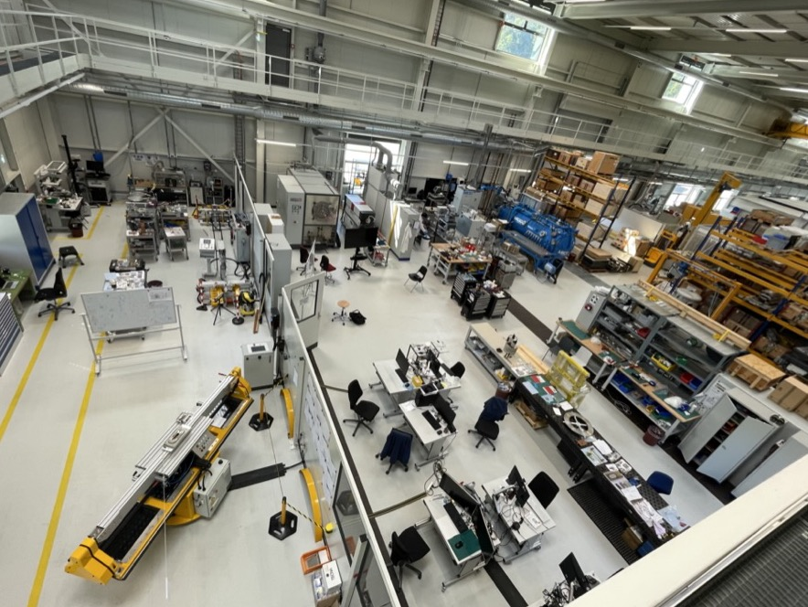
Visits at the Paul Scherrer Institut
SULTAN (Swiss Plasma Center-EPFL)
Cryogenic test stand
SC Magnet lab (CHARTMagDev)
Magnetic measurement lab
4 stations
4 groups of 20 persons
Visit : 2 hours

Slide 11
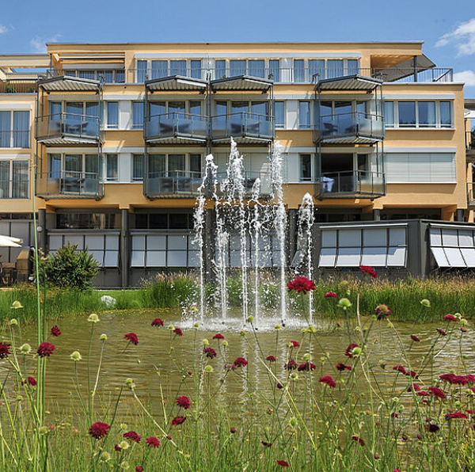
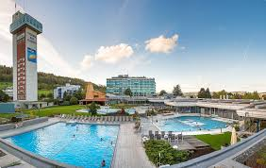
Welcome to the Dorint Parkhotel Bad Zurzach
Public WLAN – WiFi at Dorint Parkhotel Bad Zurzach
Free SMS login (valid 6 months)
Network: Park_Hotel Bad Zurzach
Browser: www.pwlan.ch
Password via SMS
Lunch and Dinner
Following meals are included in the registration fee:
Tuesday: 12:00 lunch and 19:00 dinner
Wednesday: lunch and conference dinner (see PSI day)
Thursday after the event: Sandwich lunch
Parkhotel will provide a form at the HTS registration desk with 3 meal options:
▪ Meat ▪ Fish ▪ Vegetarian
Please mark your preference every day before the morning coffee break
Group photo : on Thursday morning during the coffee break
Hot springs (Thermalbad)
If you booked hotel accommodation at Parkhotel you can enter the hot springs free of charge

Slide 12
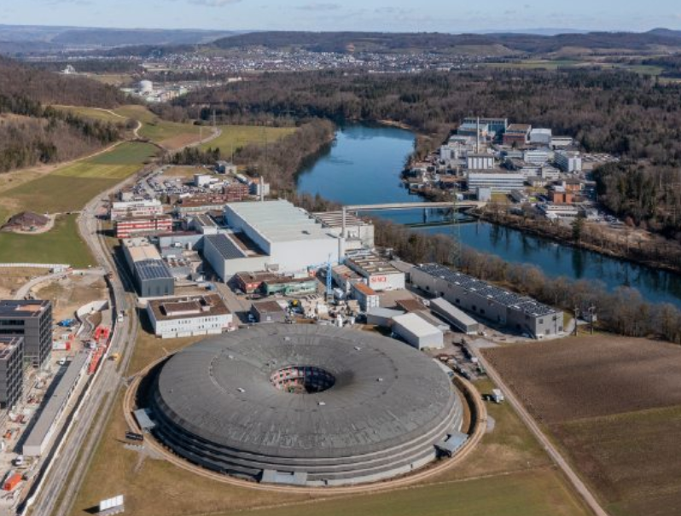
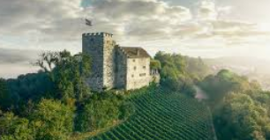
PSI day on Wednesday, June 12th 2024
08:10 Departure by bus in front of the Parkhotel to PSI
Presentations and breaks in the morning and afternoon
10:30 Poster Session: Please bring your posters!
16:40 PSI Lab visits: Please wear flat shoes (no heels).
Please contact Stéphane or Silvia if you apply to one of the following categories, as access to areas may be forbidden:
Pregnant women; persons equipped with pacemaker, defibrillator, electronic medicine dispenser, hearing aid or metal implant, person with reduced mobility or otherwise incapacitated, minors under the age of 16.
18:30 Departure in front of the PSI auditorium for the conference dinner at Habsburg castle
22:00 Departure from Habsburg to Parkhotel Bad Zurzach
For questions/assistance please contact:
Silvia Bacher or Stephane Sanfilippo

Slide 13
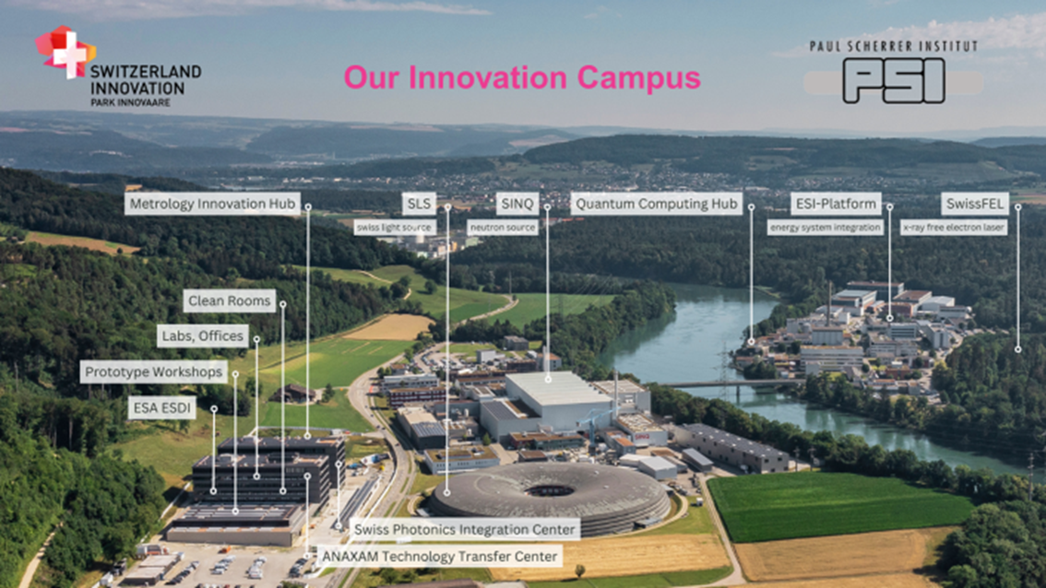
Enjoy HTS2024

