Slide 1
RC Report Week 20/2023
Tobias Weilbach
SEM 22.05.2023

Slide 2
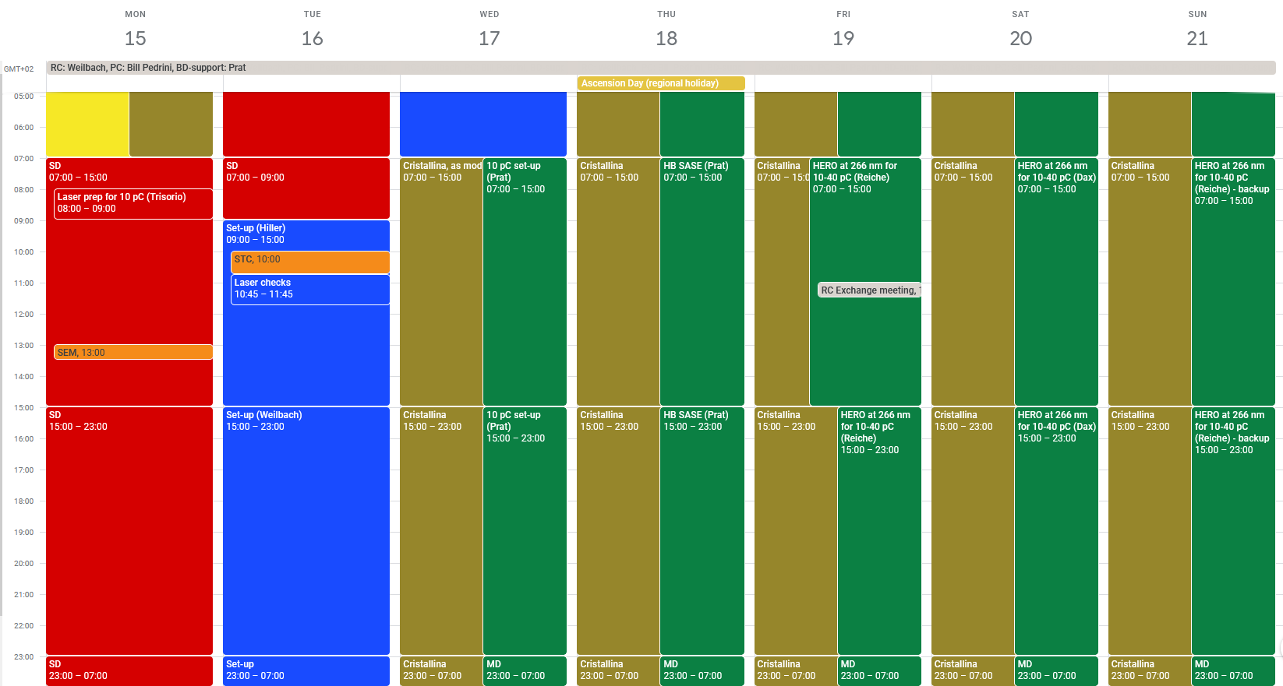
RC Report 2023 week 16 17.-23.04.2023
SwissFEL Start-up, Set-up and MD (preparations for beam ready week)

Slide 3
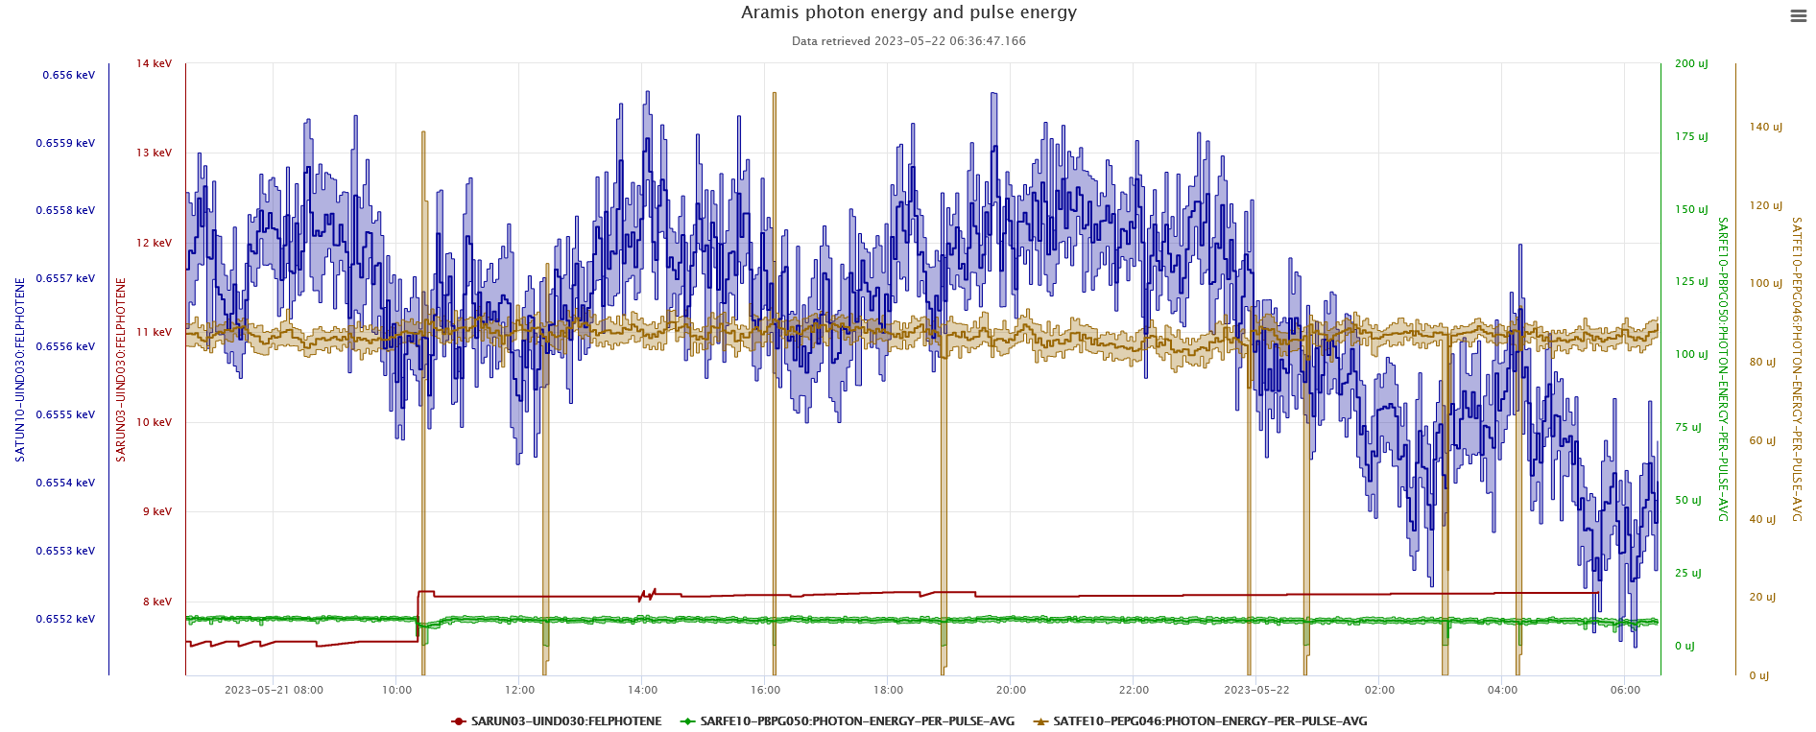
The week

Slide 4
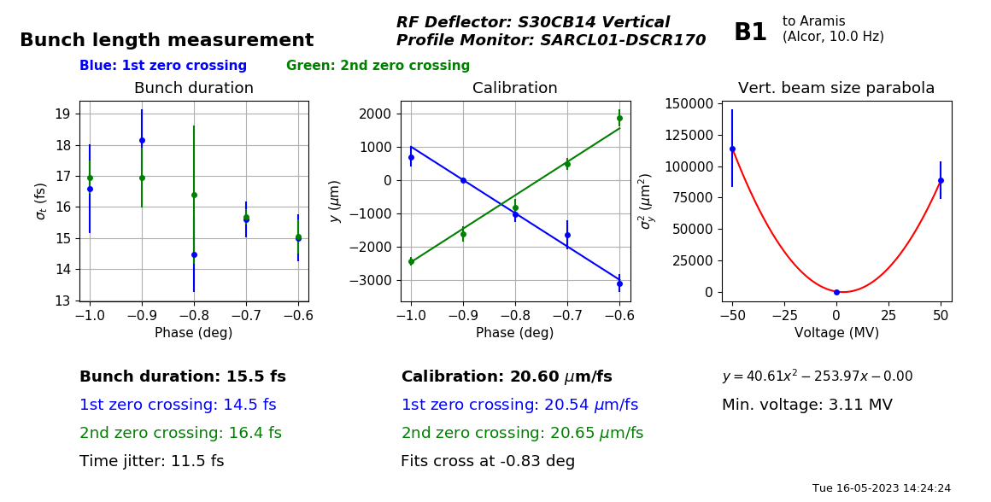
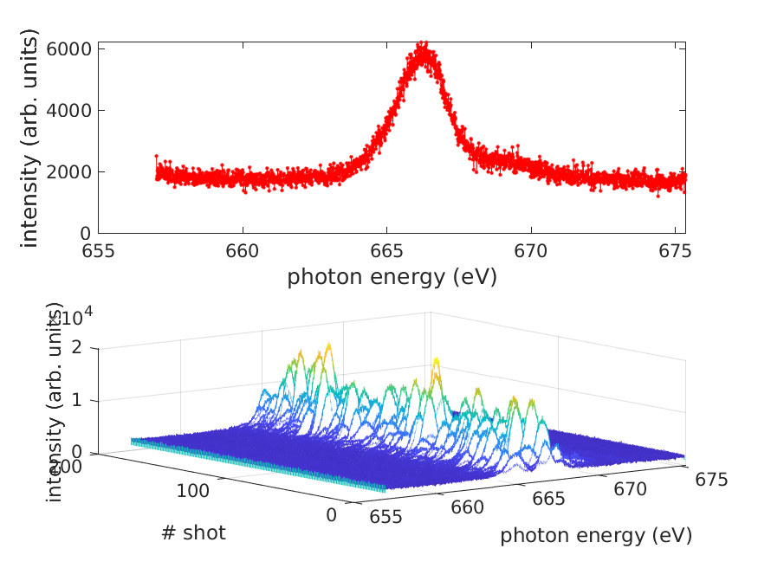
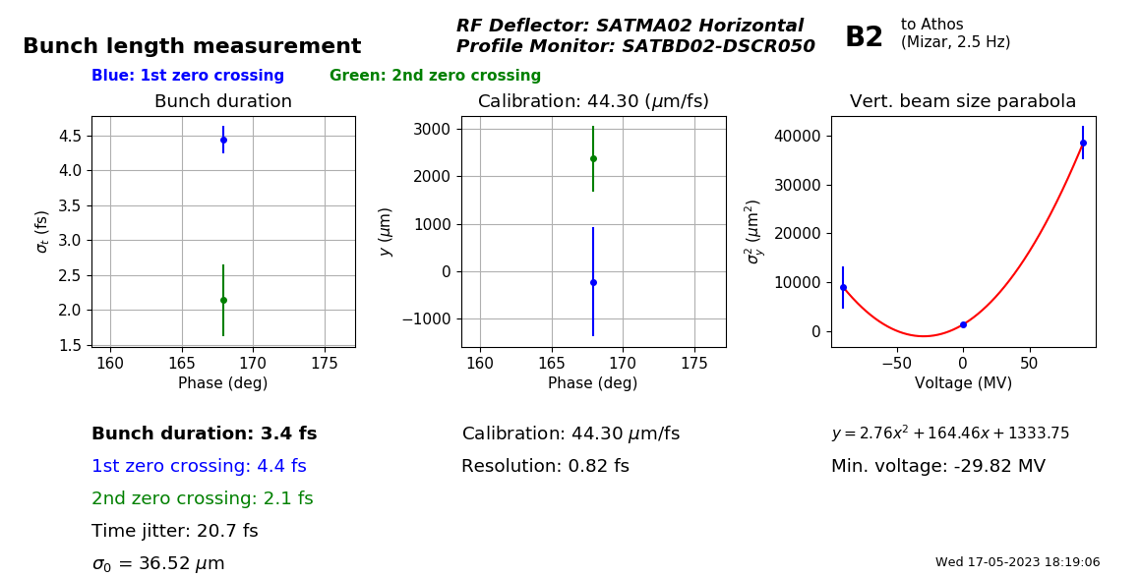
The Start-up/MD
  Tuesday 9:00 Tunnel was searched and closed
    Aramis: Cristallina, as mode 7.5 and 8.1 keV
    Athos: MD, HB-SASE and 266nm HERO
  Athos MD
    HB-SASE

Slide 5
Issues last week
  Start-up:
  SARCL-DSCR280 raw image shows only half of the screen, restart of camera server, adjustment of ROI and refocusing for 100% transmission solves the issue
  During cycling and after MPS event Athos beam is set to 10Hz independent of what it was before (even switched off) -> needs further investigation
  SATUN22 got stuck -> power cycle on site
  During user beam time:
  SATMA02: Thursday modulator problem (electronics were replaced), Friday a short circuit in the modulator, repair postponed to today
  Friday: Huge losses during 266nm HERO operation, seems to be photo effect in SATCB01 when the HERO laser is in the right phase -> increased the BLM limits and adjusted Orbit FB (removed BPMS which see a second bunch due to photo effect) -> changes were reverted on Saturday after HERO measurements were done
  SARUN01-DBLM065 and SARUN030DBLM030 raw values fluctuate strongly but no losses visible -> to be looked at today
  Saturday: spontaneous reboot of BPM IOC

Slide 6
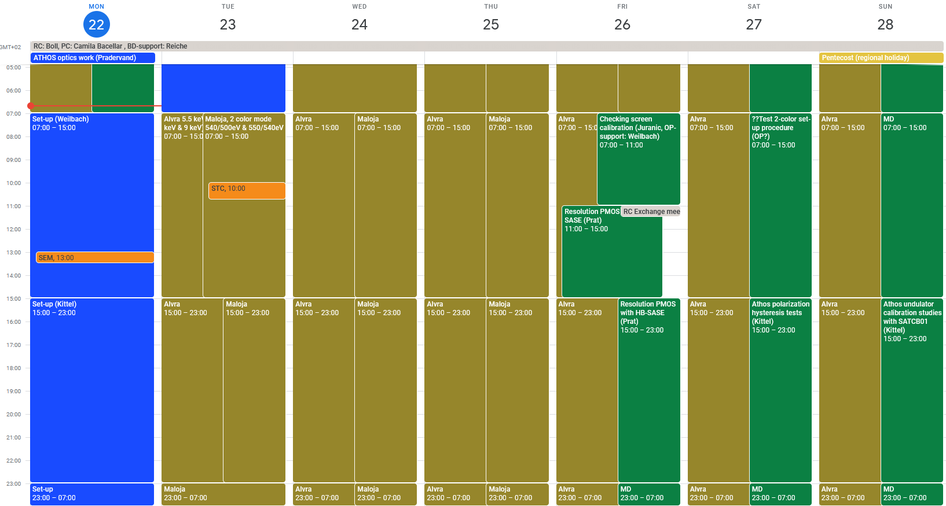
Preview week 17 24.-30.04.2023

