Slide 1
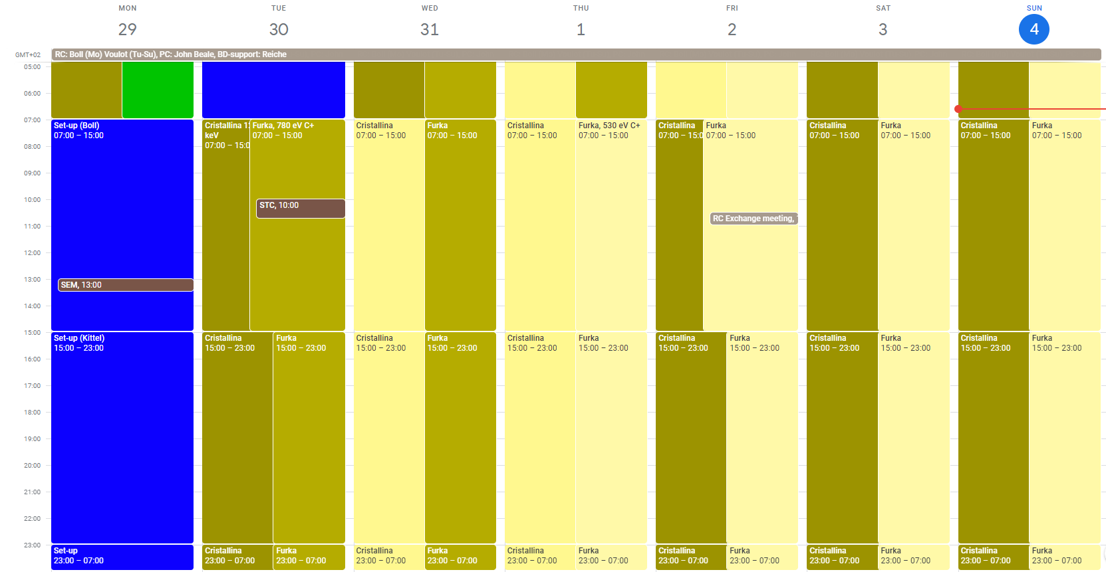
Aramis: Cristallina 12.4 keV
Athos: Furka 780/530 eV C+

Slide 2
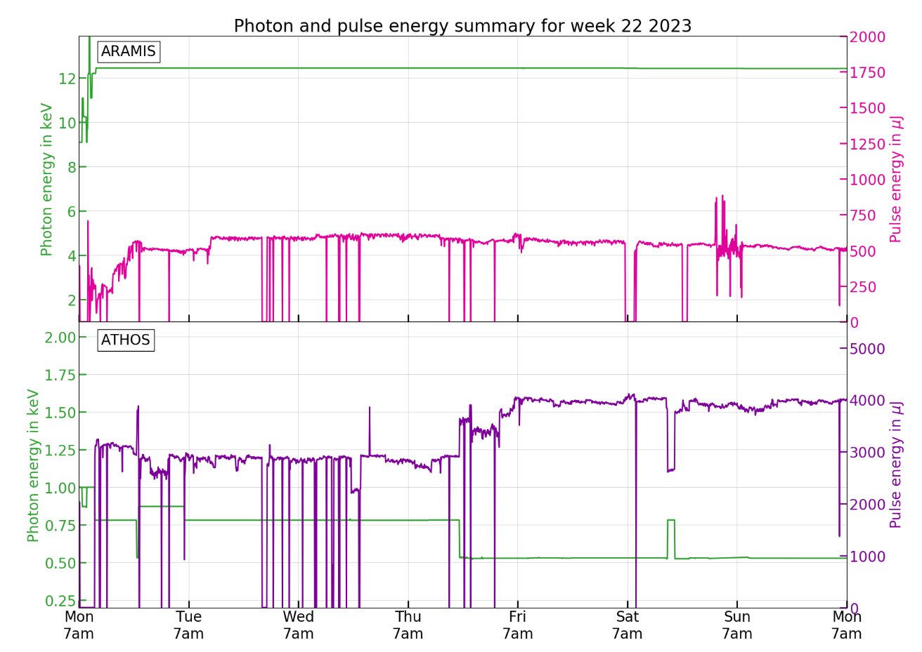

Slide 3
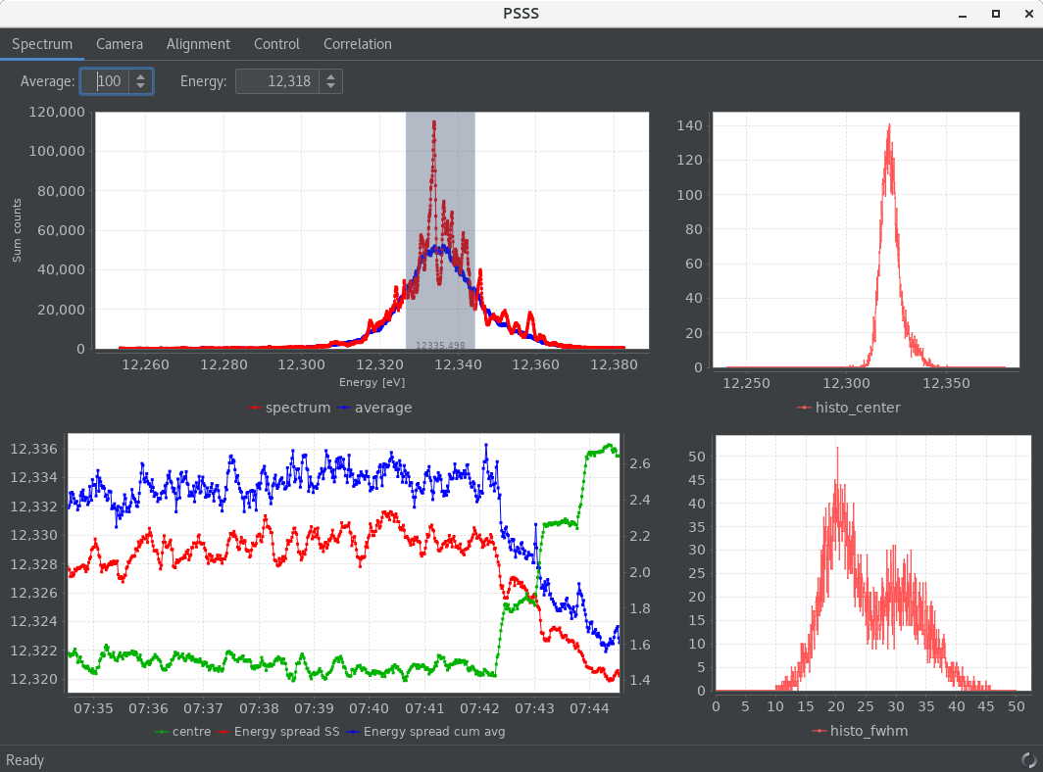
Set-up and performances
Aramis
  12.4 keV 500-600 uJ, good but not a record (900 uJ)
  BW optimization 0.15% at best, re-optimized several times during the week to get rid of side bands
  Optimize Alcor alignment on Tuesday, needs less laser power and more pulse energy
  Some instability during the week, periodic retuning of compression and X-band amplitude
Athos
  780 eV 3.5 mJ / 530 eV 4 mJ
  Energy change on Thursday (and Saturday), 780<->530 eV
  some energy scans lead to a large drop in pulse energy, restored settings and scaling with OP tools worked well, maybe something is wrong with ES script?

Slide 4
Technical problems
Problems causing downtime
DRPS, detector 1204 failed (1h, Tuesday)
Athos gas attenuator not working (40 min in total, Wednesday)
S30CB02, LLRF controls (2h, Saturday)
S30CB05, connection(?) problem (1h, Saturday)
Other problems
SATMA02 down (not needed during the week)
SINSB01 has not enough margin for regulation (already at the limit, change working point?)
Laser Heater in the wrong position: the momentum calculation is unreliable (it depends on the beam-pipe position which is not reproducible) this leads to wrong settings being loaded, we will use the current reading from now on
Resonant kicker briefly stopped (Wednesday)
Aramis gas detector, unreliable, large noise on slow signal (Sunday)

