Slide 1
Requests for week of 19.6.2023-26.6.2023
Requests at week’s begin:
Aramis:
  Cristallina gets beam between 11-12 keV on Monday, no major specifications on pulse energy or pulse duration.
  Alvra gets the beam the rest of the week. Needs 5.5 keV and 9 keV beam, with and without dechirper. Each photon energy should have a ~30 fs and ~20 fs pulse duration mode that is accessed by inserting and removing the dechirper.
  Futhre request from DUO meeting for multiple pulse durations.
Athos:
  Furka pilot phase work, needing 780 eV photon energy with C+ and C- polarization, with a back-up of 530 eV with C+ polarization.
Additional requests:
Aramis (Alvra):
  Requested compression changes to the electron beam to have more pulse duration options on Friday.
  Multiple requests to improve performance during the weekend due to poor lasing.

Slide 2
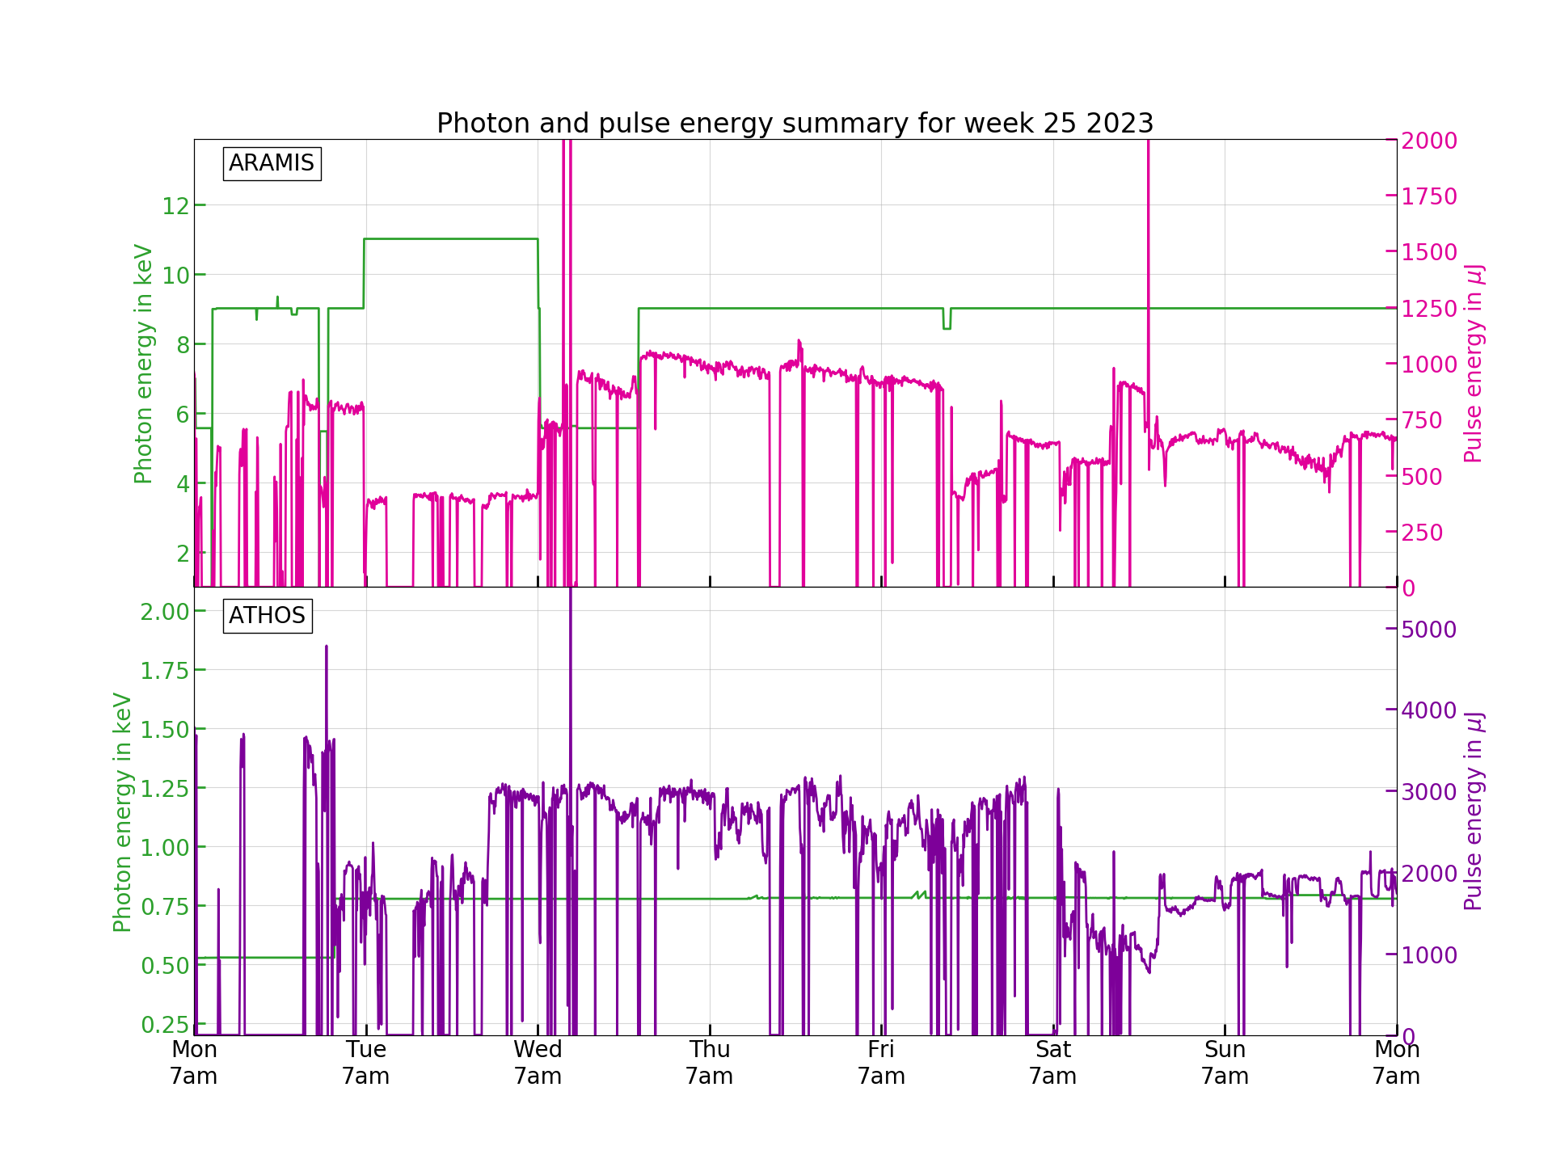
Performance
We had fairly unstable performance in both Aramis and Athos with multiple systems failing through the week causing downtime. Other issues conspired to degrade the FEL performance, though did not cause downtimes.

Slide 3
Down time
Monday:
  ~ 6 hours: Klystron power supply SINSB01 failure. The replacement also had a failure. This delayed setup of the beam modes.
Tuesday:
  ~3 hours: PSYS CPU died, causing the machine to go down. The CPU was exchanged and a full tunnel search had to be done. There was an issue with keys for the tunnel access with the PSYS down.
Thursday:
  ~2 hours: Issue with SATUN10 not moving. Tunnel access needed to exchange the motor-drive control card and to clear the mechanical issue. It was discovered that the SATUN10 bottom left array scrapes the alignment quadrupole under some conditions. Access tripped the PSYS alarm for the door being open too long, so a tunnel search had to be done again.
Friday:
  ~1 hour: SINSB03 failure and DRPS hit the hard limit during a bunch length measurement.

Slide 4
Degraded performance
Issues with feedback throughout the week for multiple sytems, with the whole system crashing on Thursday.
  Florian Lohl got it back to a running state, despite being on vacation. Thank you very much.
Athos pulse power unstable throughout the week. Cause is not fully understood.
BC1 compression seemed to have issues.
Laser had issues that prevented the feedback from working.
PSSS had issues with panel accessibility.
Slow degradation of performance in both Aramis and Athos over several hours, likely due to all of the causes from above.

Slide 5
Plan for next week
Aramis:
  Cristallina gets beam between at 12.4 keV for the whole week, standard pulse duration and pulse energy.
Athos:
  Maloja requests standard modes and multiple 2-color modes:
    Standard operation (single color) > 1mJ and pulse duration is not critical: 400eV Linear horizontal polarization, 535eV Linear horizontal polarization, 620eV Linear horizontal polarization
    Two color modes: as short pulses as possible with stability maintained. Both colors are linear horizontal polarization: C1:400eV // C2:620eV (priority), C1:400eV//C2:500eV (nice to have), C1:400eV//C2:390eV (nice to have), C1:534eV //C2:620eV (priority), C1:534eV//C2:500eV (nice to have), C1:534eV//C2:390eV (nice to have).

Slide 6
Special thanks to
All of the piketts and responsible people who kept fixing problems as they kept popping up (PSYS, Vacuum, RF, Undulators, etc).
Florian Loehl, who helped fixed the feedback system crash on Wednesday while on holiday.
Didier Voulot, who tried to help us on Friday while on holiday.
Eduard Prat, who tried to helps us on Friday while on holiday.
Nicole Hiller and Tobias Weibach, who came early and left late for their weekend night shifts to help the machine perform better, and sent us instructions with little sleep how to restore decent performance on Saturday.
Andreas Dax, who helped us on Sunday outside of the regular laser pikett times.
Christoph Kittel, who took over Thursday from me due to me being on holiday that day.
The machine operators, who kept me updated and tried to accommodate the end-station users to the best of their ability.

