Slide 1


Run Coordinator Report 2023/26
Rasmus Ischebeck
Midjourney: /imagine a peaceful evening in the SwissFEL control room

Slide 2

Operation
Continued operation in Aramis
2-Color mode in Athos
  Pointing of the two colors took a while waiting for feedbacks to stabilize
  Snapshots were prepared by experts
  Snapshots could be loaded by operators
Rasmus Ischebeck

Slide 3
Summary
Rasmus Ischebeck

Slide 4
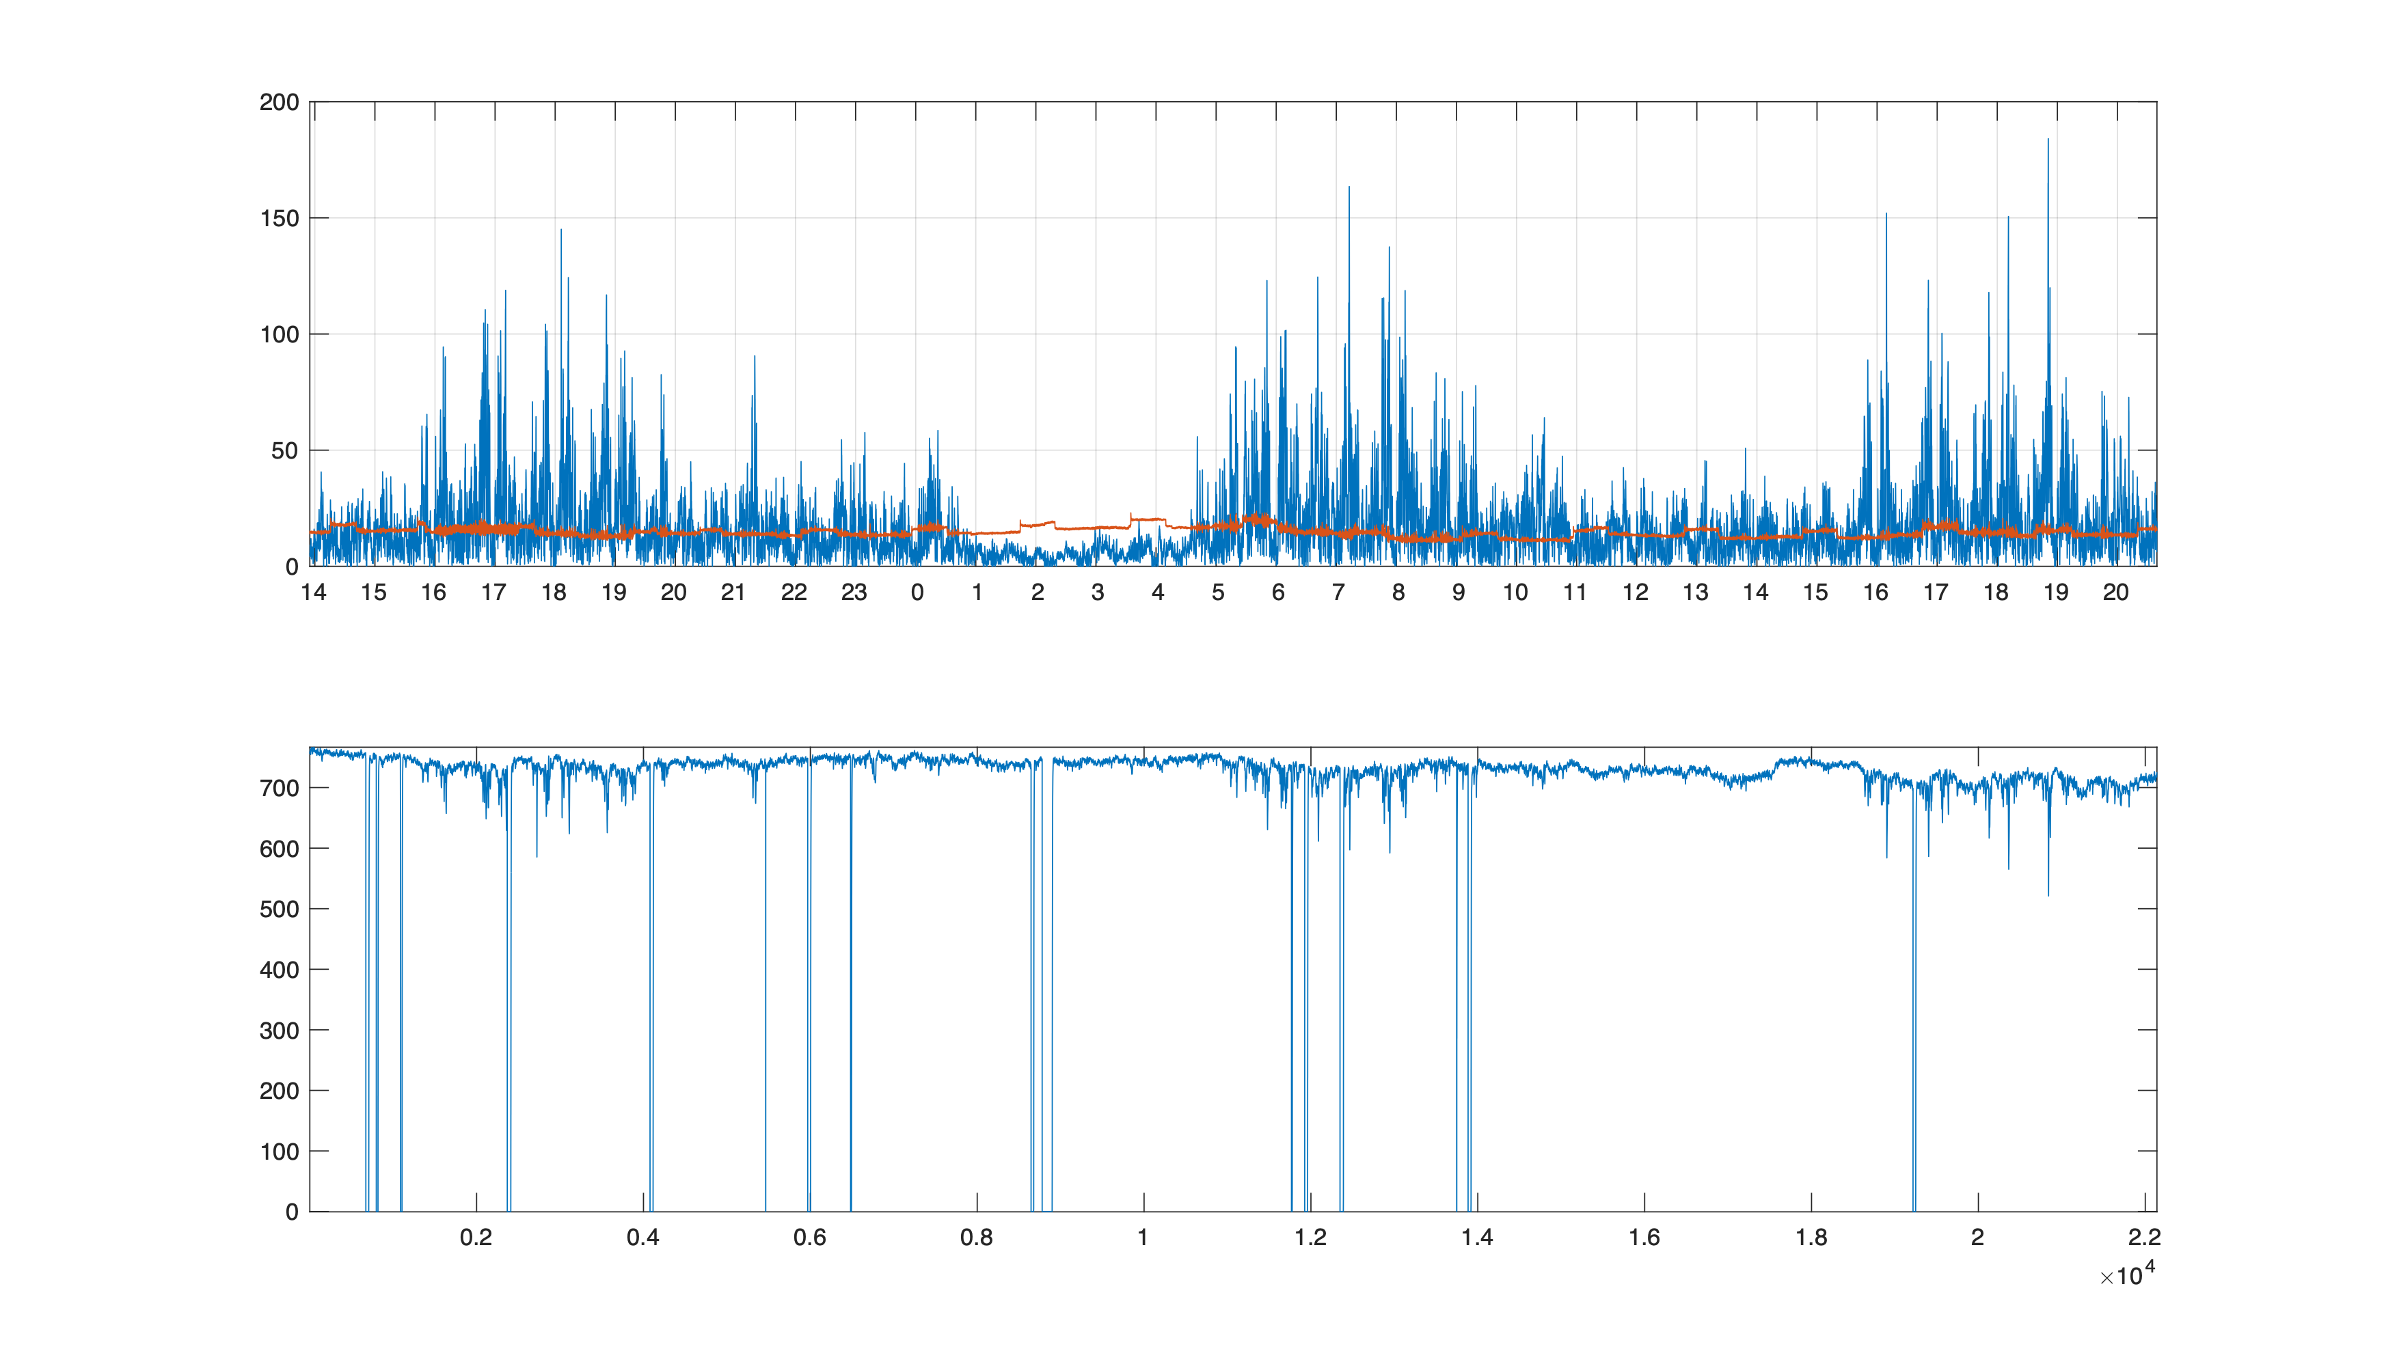
Electromagnetic Fields
rms magnetic field / nT
— 50 Hz
—16.7 Hz
2023-06-28
2023-06-29
Aramis pulse energy / µJ
Rasmus Ischebeck

Slide 5
Small Issues during the week
Feedback server crash, with subsequently caused BAM to loose its zero crossing
Undulator movement failure
Pointing adjustment took a few hours (always waiting for feedback to stabilize beam after adjustment)
Klystron failure in S20CB02
Power glitch caused magnet power supplies to switch off
Loose cable in S30CB07 — Aramis downtime of 2 hours
Feedback servers needed restarting
Rasmus Ischebeck

Slide 6
All in all a good week
Thank you to everyone involved!
Rasmus Ischebeck

