Slide 1
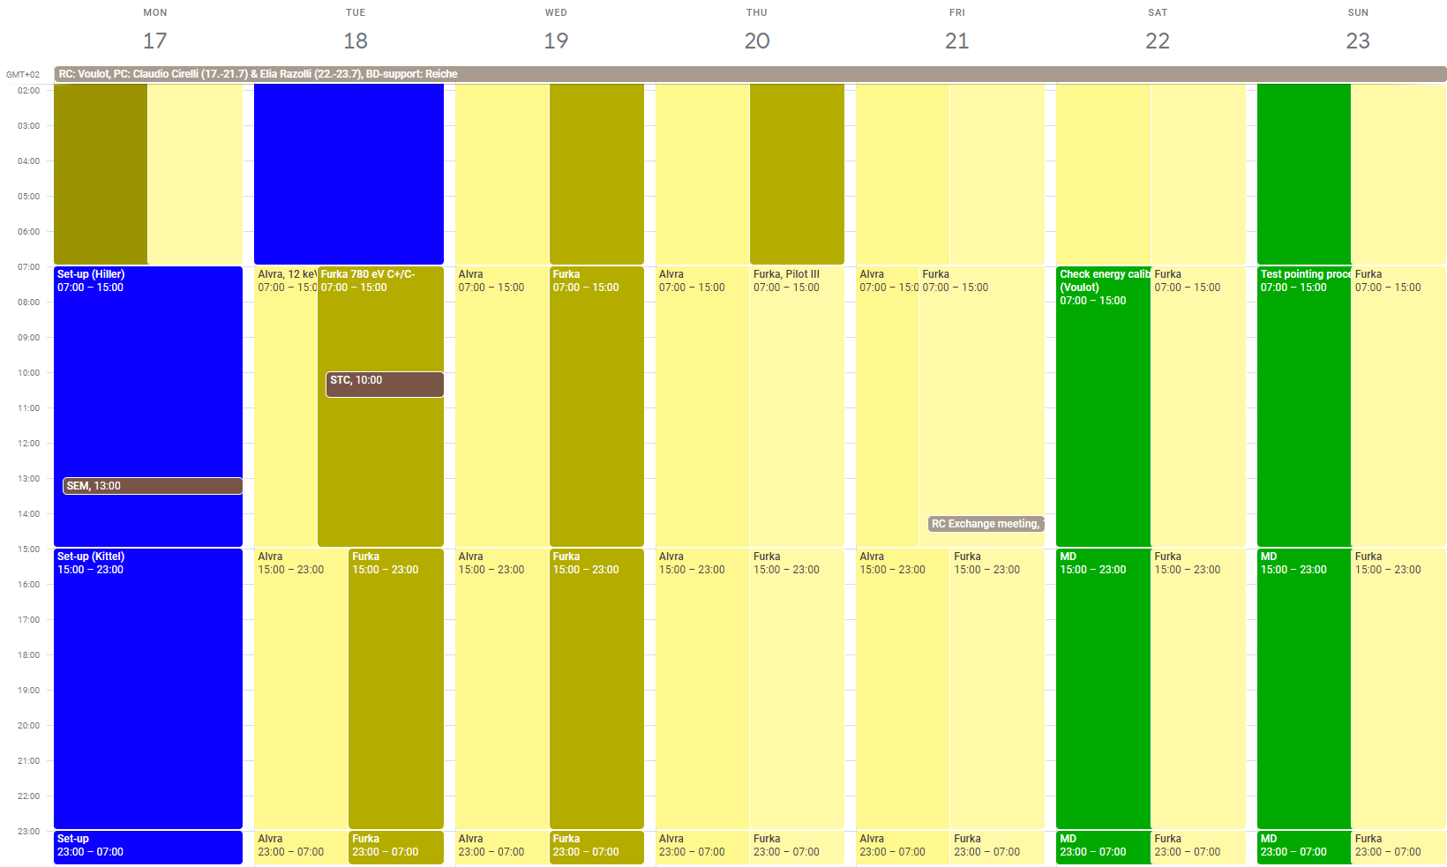
Aramis: Alvra 12 keV
Athos: Furka 780 eV C+/C-

Slide 2
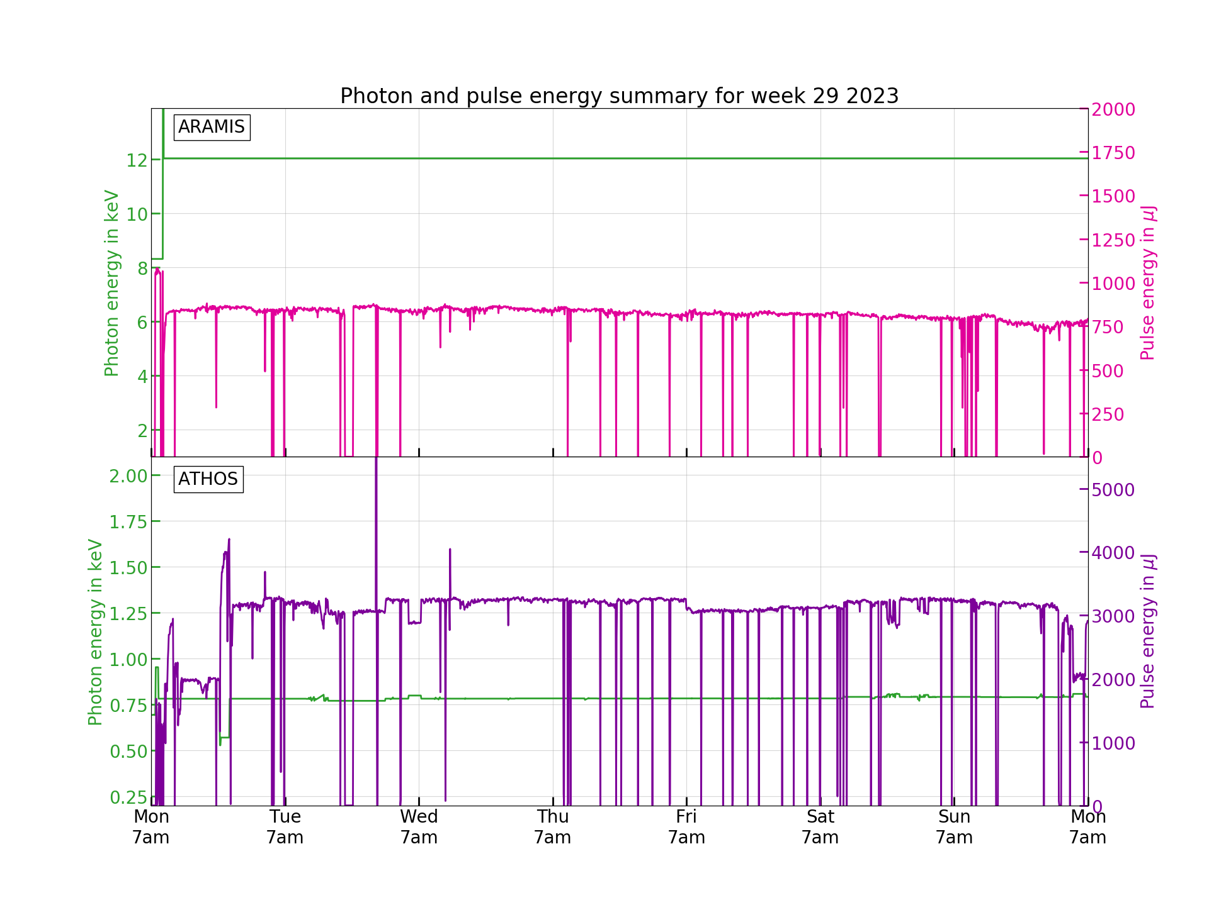

Slide 3
Technical problems
Problems causing downtime
Tu: DRPS failure (1h30)
Su: Mizar synchronization failure, ioc needed reboot (0h15)
Other problems
Bunch2 BC2 compression feedback is giving problems after RF trips, the CDR signal is not coming back after the trip causing losses and requiring manual intervention-> need software improvement
A mishap happened on Sunday night with the Athos orbit feedback, all actuator weights were set to zero. Problem it is difficult to see it. Fortunately the machine was still lasing sufficiently without orbit feedback!
MD/Athos: Aramis MD in parallel with Athos beam delivery is not great, there are not many things that can be done without perturbing the experiment

