Slide 1
Rafael Abela

Slide 2
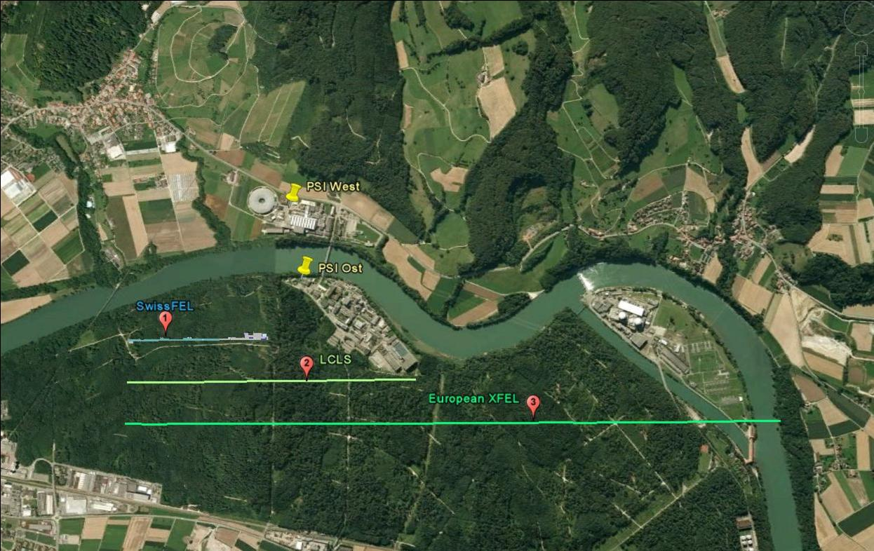
Selected site

Slide 3
Univ. Uppsala, Univ. Stockholm, Royal Institute of Technology
PSI EPFL
Institute of Physics, Chinese Academy of Science (CAS)
Scientific and Technology Facility Council (STFC)

Slide 4
project leaders
Accelerator
Hans Braun
Photonics
Rafael Abela
B & I
Gerry Janzi
→Ueli Schaer
sub project leaders
Injector
Marco Pedrozzi
Main Linac
a.i. Hans Braun
Transfer &
Undulator Lines
Romain Ganter
Beam Design
Sven Reiche
Photon Beamlines
& Instrumentation
Luc Patthey
Science Program
Bruce Batterson
Ch. Rüegg : Head of the Laboratory for Neutron Scattering PSI
Ch. Milne Laboratory of Untrafast Spectroscopy EPFL
Ch. Hauri PSI
R. Ischebeck PSI

