Slide 1

CHART MagAM
Principal Investigator: Prof. Dr. Mirko Meboldt
Dr. Julian Ferchow, Aurel Schüpbach, Patrick Beutler

Slide 2
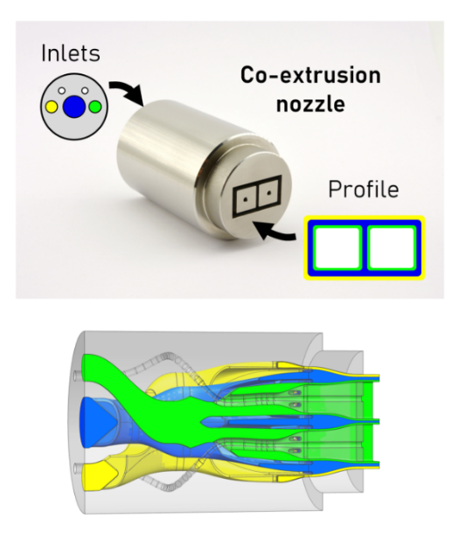
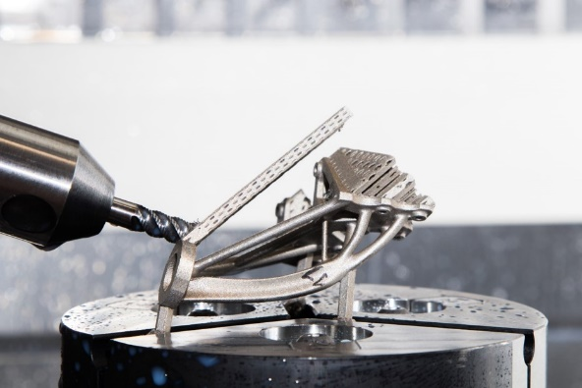
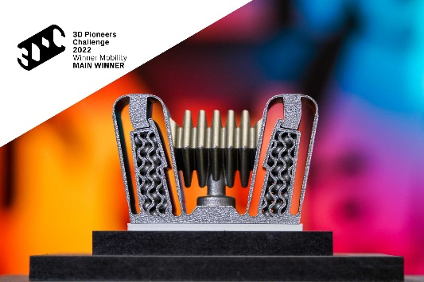
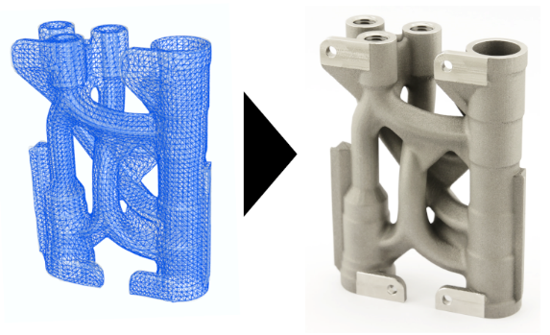
Need for research in additive manufacturing
Innovative applications
with
increased
complexity
End-to-end digital
process chains
including geometry capture, design, fabrication, and
supply chain
Digital design for individualization and configuration of parts
and products for
specific requirements
Combination of AM
with conventional
techniques (e.g. machining, casting)
for complex
manufacturing routes

Slide 3
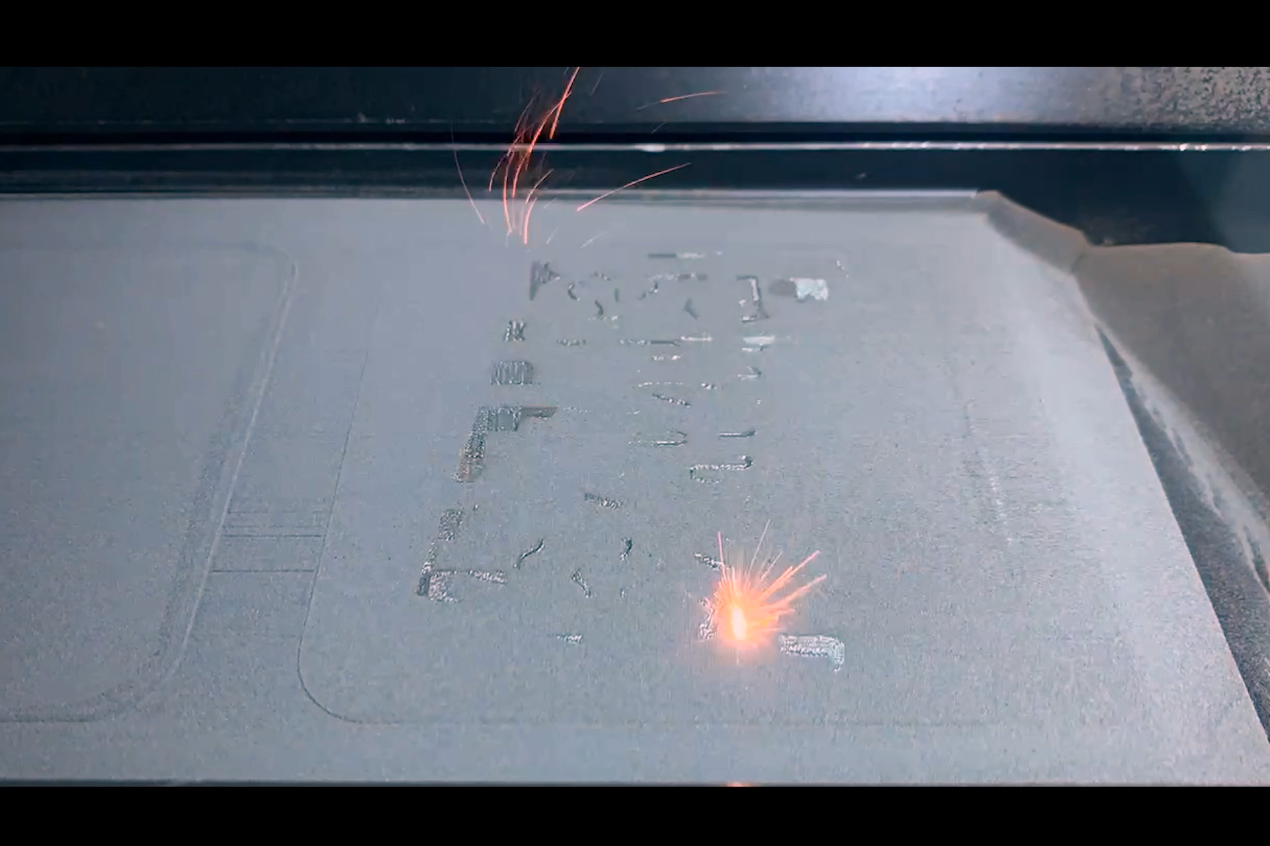
Goal of CHART MagAM
Use the design freedom of additive manufacturing to improve structural components in superconducting coils.
Hofmann et al, 2022, 3D Pioneers Challenge

Slide 4
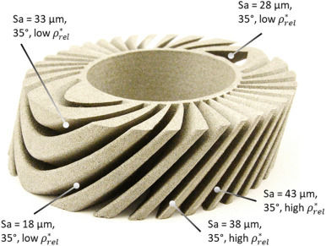
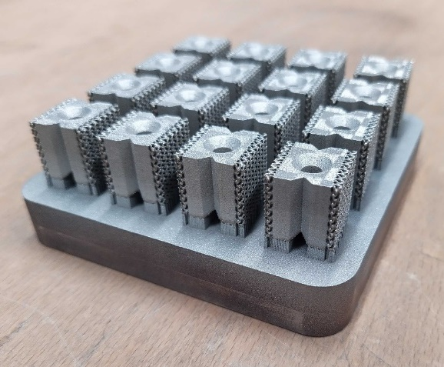
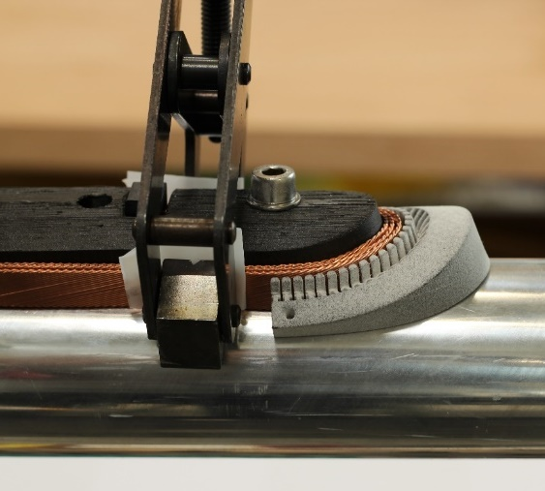
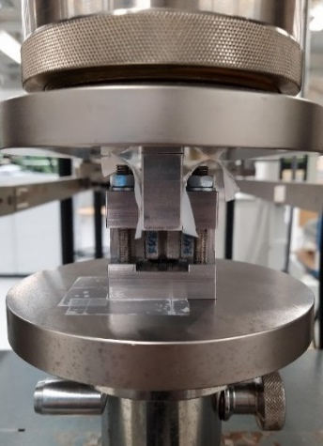
Past Work Packages - CHART MagAM
Use additive manufacturing to improve structural components in superconducting coils.
Manufacturability
Functional Interfaces
Compliance
CCT Segment
Adhesion Interfaces
Shape Adaptive Endspacers

Slide 5
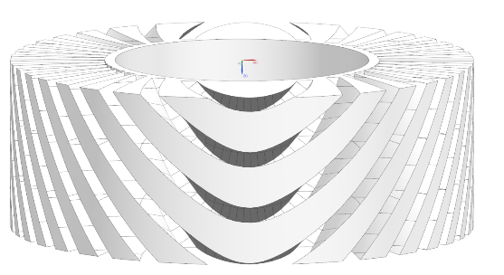
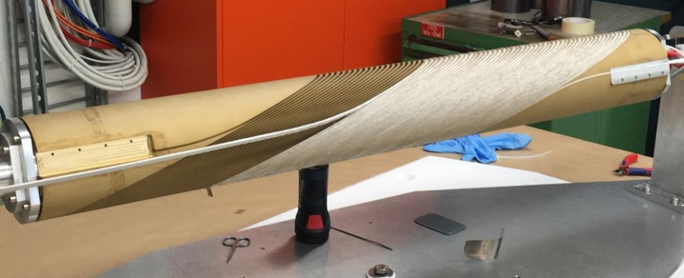
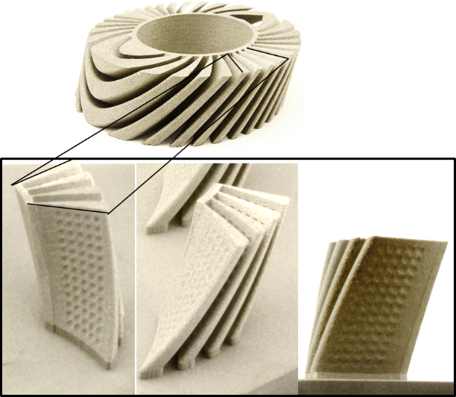
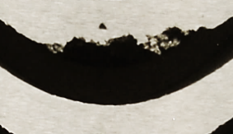
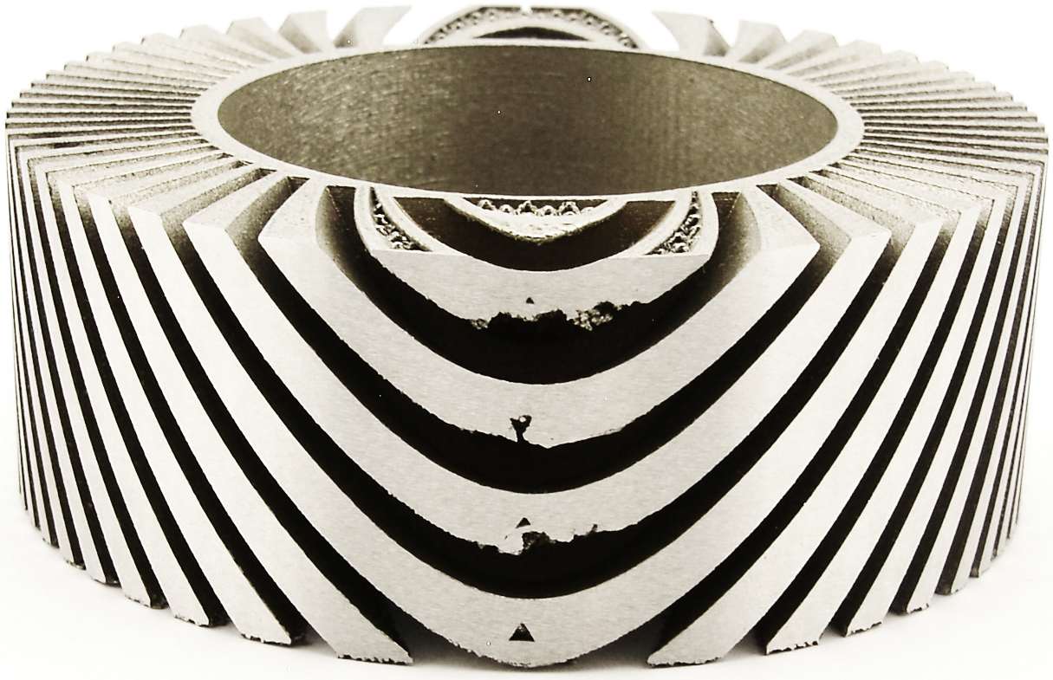
CCT Segment
No support structure
Superconducting solenoid coil
→ A new parameter model was found to extend the current state of the Art
Winding former
Dross formation
Impregnated cables
Complicated to manufacture traditionally
Only limited post processing possible using additive manufacturing
Large overhangs generate dross formation
Adaption of form is limited
Support is not accessible
Julian Ferchow, Manuel Biedermann, Pascal Müller, Bernhard Auchmann, André Brem, Mirko Meboldt; Harnessing manufacturing elements to select local process parameters for metal additive manufacturing: A case study on a superconducting solenoid coil; Additive Manufacturing Journal, 2021
https://doi.org/10.1016/j.addma.2021.102140
B. Auchmann, et al. “On the CCT Option for the FCC-hh Main Dipole Magnet”, MT-28, submitted to IEEE Applied Superconductivity, 2023

Slide 6
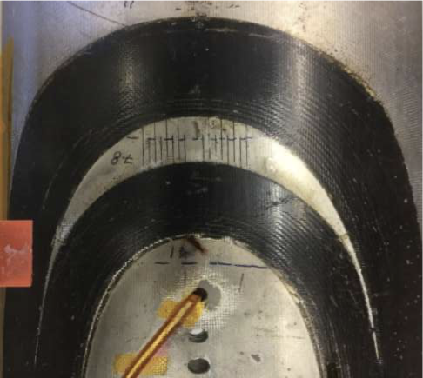
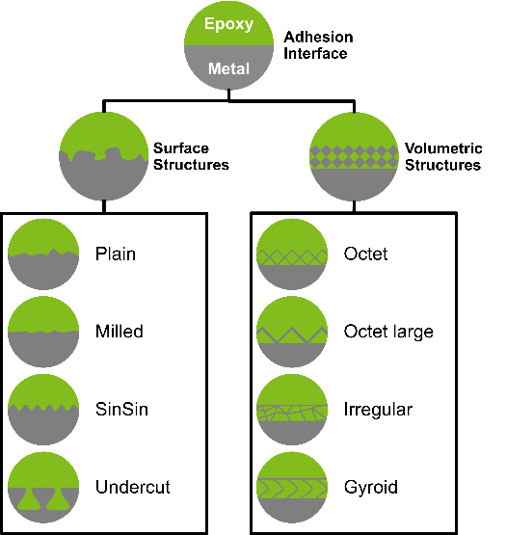
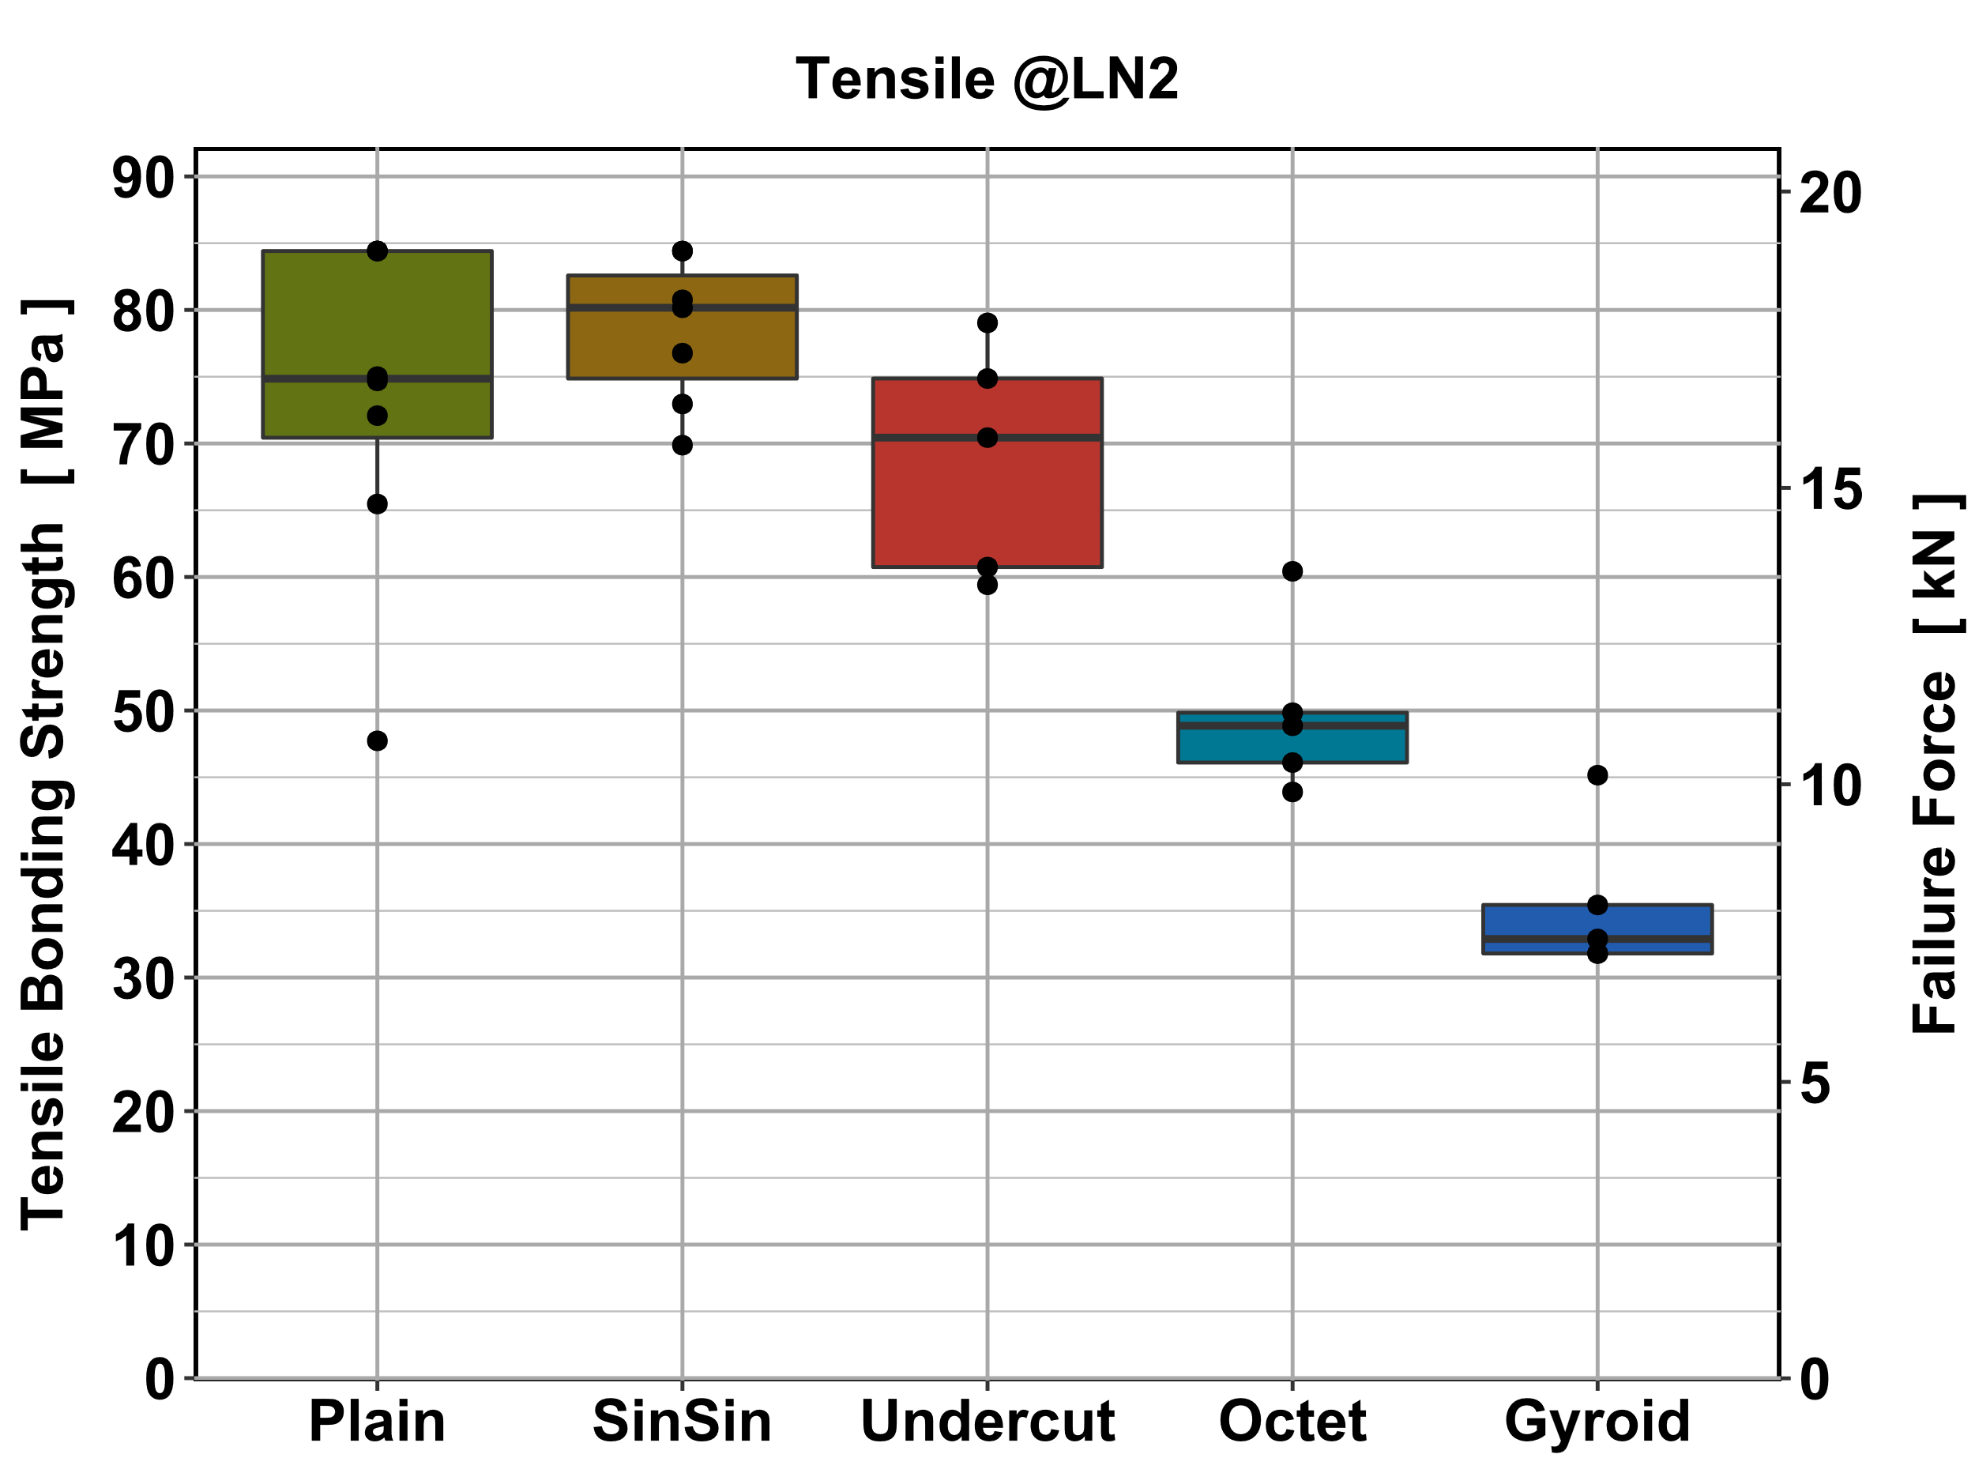
Adhesion Interfaces
Challenge
Adhesion Interface
Simplified tests
with geometrically designed surface structures
F
F
Epoxy Resin
F
GFK Sleeve
Superconducting
Cable
Metal Structure

Slide 7
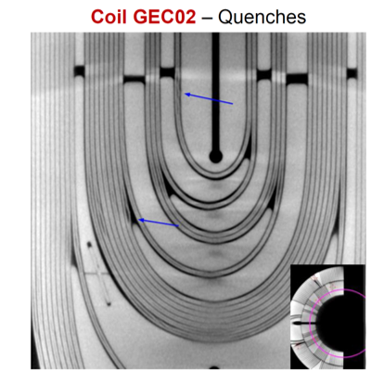

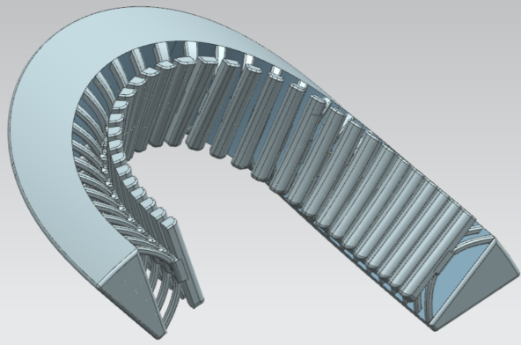
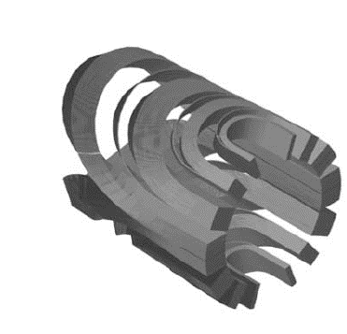
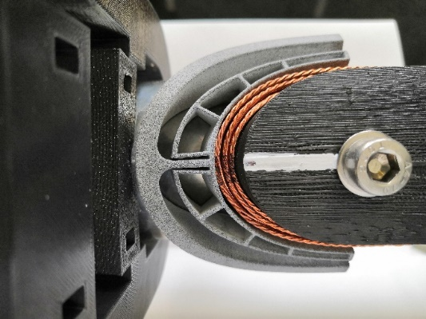
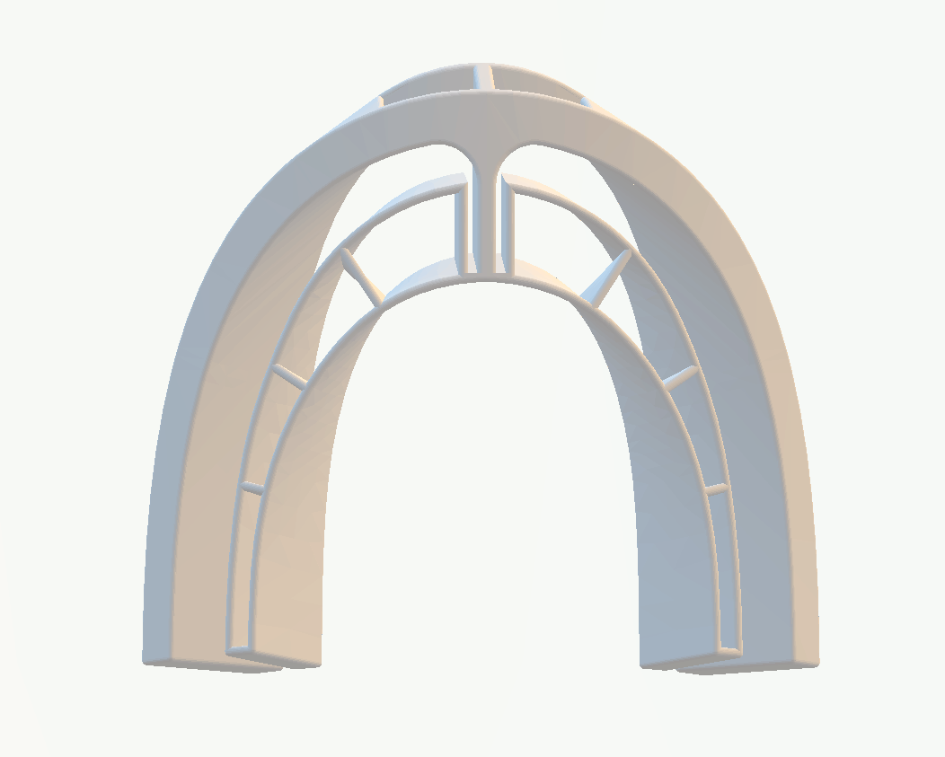
Shape Adaptive Endspacers
Potential quenching source
Locations where large areas with pure epoxy are concentrated. → Cracks
Approach
Development of new Endspacers which can adapt to the winding.
Notes:
Problem:
The endspacers used for the winding of Cosine Theta Magnets have a complicated shape. To allow for assembly of the coils and to correct for the heat expansion coefficients, soild endspacers can’t follow the shape of the coils completely. This results in locations, where pure epoxy is concentrated. During initial tests, it was found, that such regions are prone to cracks and induced quenches.
Here the approach of using compliant structures was used, to improve the fit of the endspacers with the coils.
One solution was to use flexible elements, that softly grip the coils and reduce the distance between the coils.
The other solution was to use compliant elements, that allow for a change of geometry of the endspacers during assembly. This allows to tightly follow the form of the coils, without damaging the coils and the isolating coating of the coils during the assembly steps. Prototypes were built and verified out of MJF and Powder Bed Fusion.

Slide 8
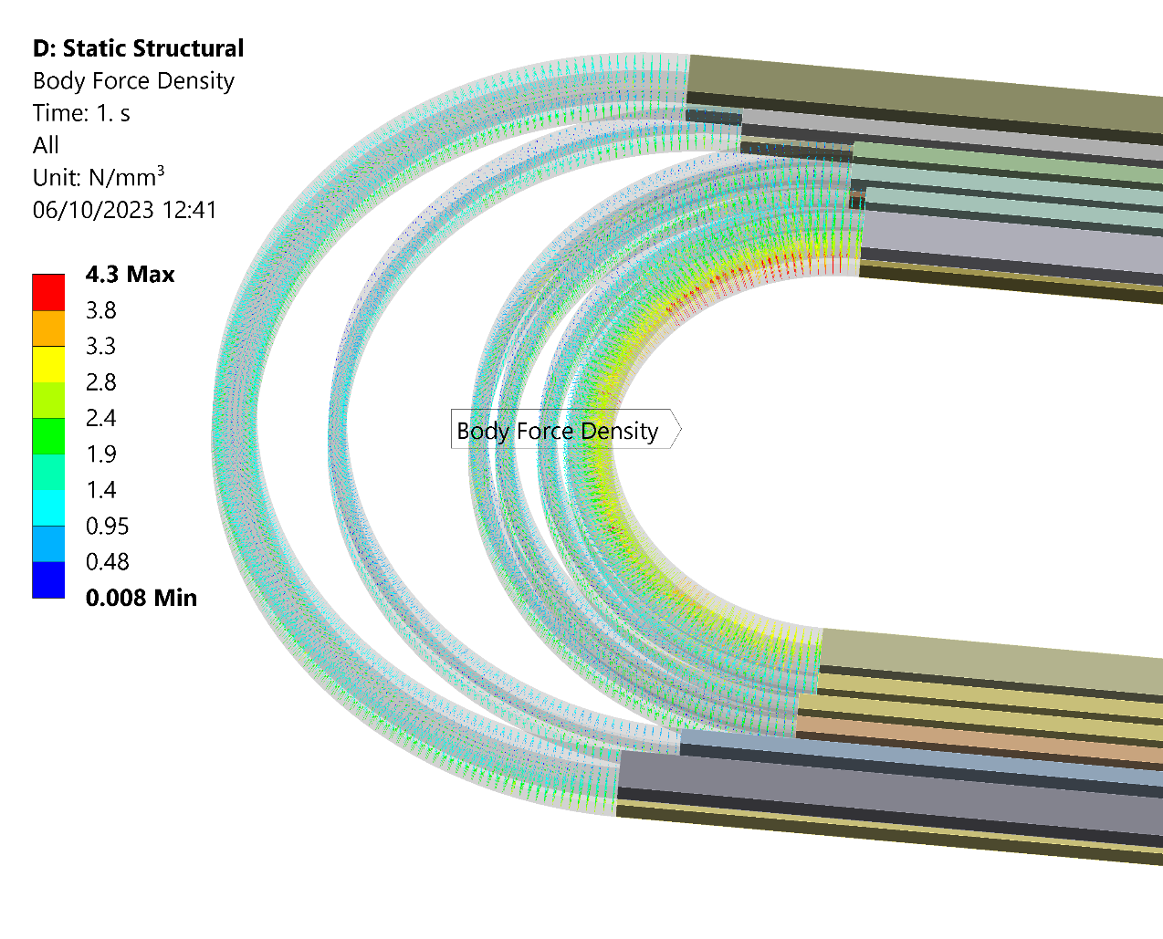
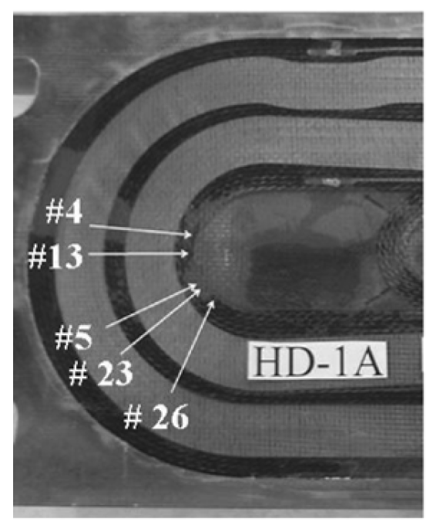
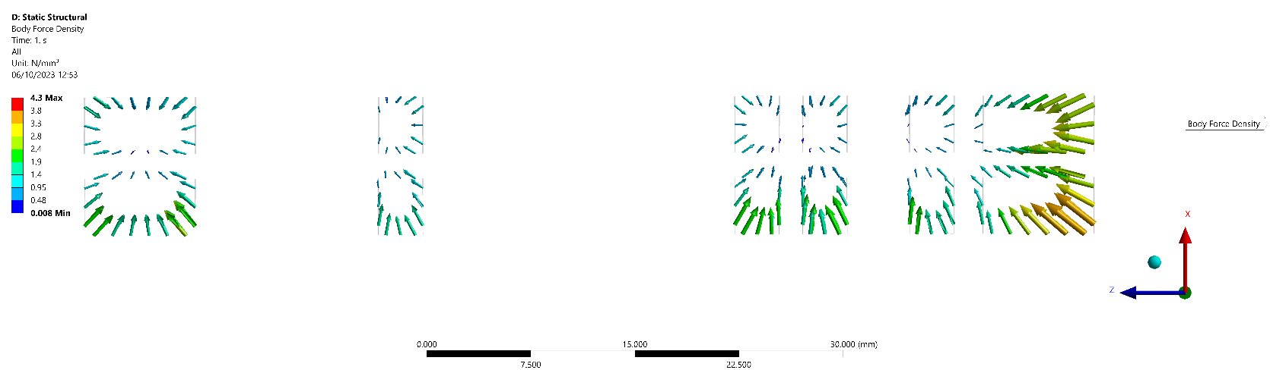
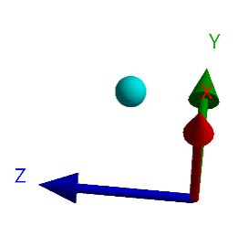
Stress reduction in Dipole Magnets through compliant structures
In racetrack coils, high axial Lorentz Forces occur in the End Sections
These regions are likely to induce quenches
Performance Analysis of HD1: A 16 Tesla Nb3Sn Dipole Magnet, S. Mattafirri et al, 2005

Slide 9
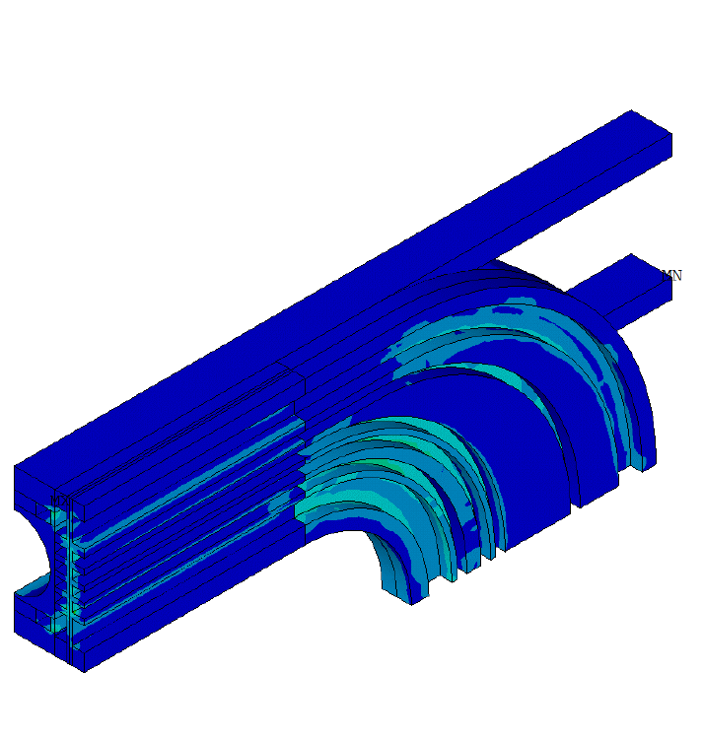
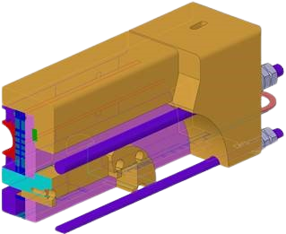
Stress reduction in Dipole Magnets through compliant structures
Current solutions include pretension rods and subdividing the coils
But it’s difficult to pretension the inner coil sections
Pre-Stress
D. M. Araujo, et al. “Subscale Stress-Managed Common Coil Design”, MT-28, submitted to IEEE Applied Superconductivity, 2023.

Slide 10
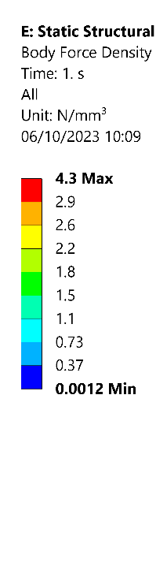
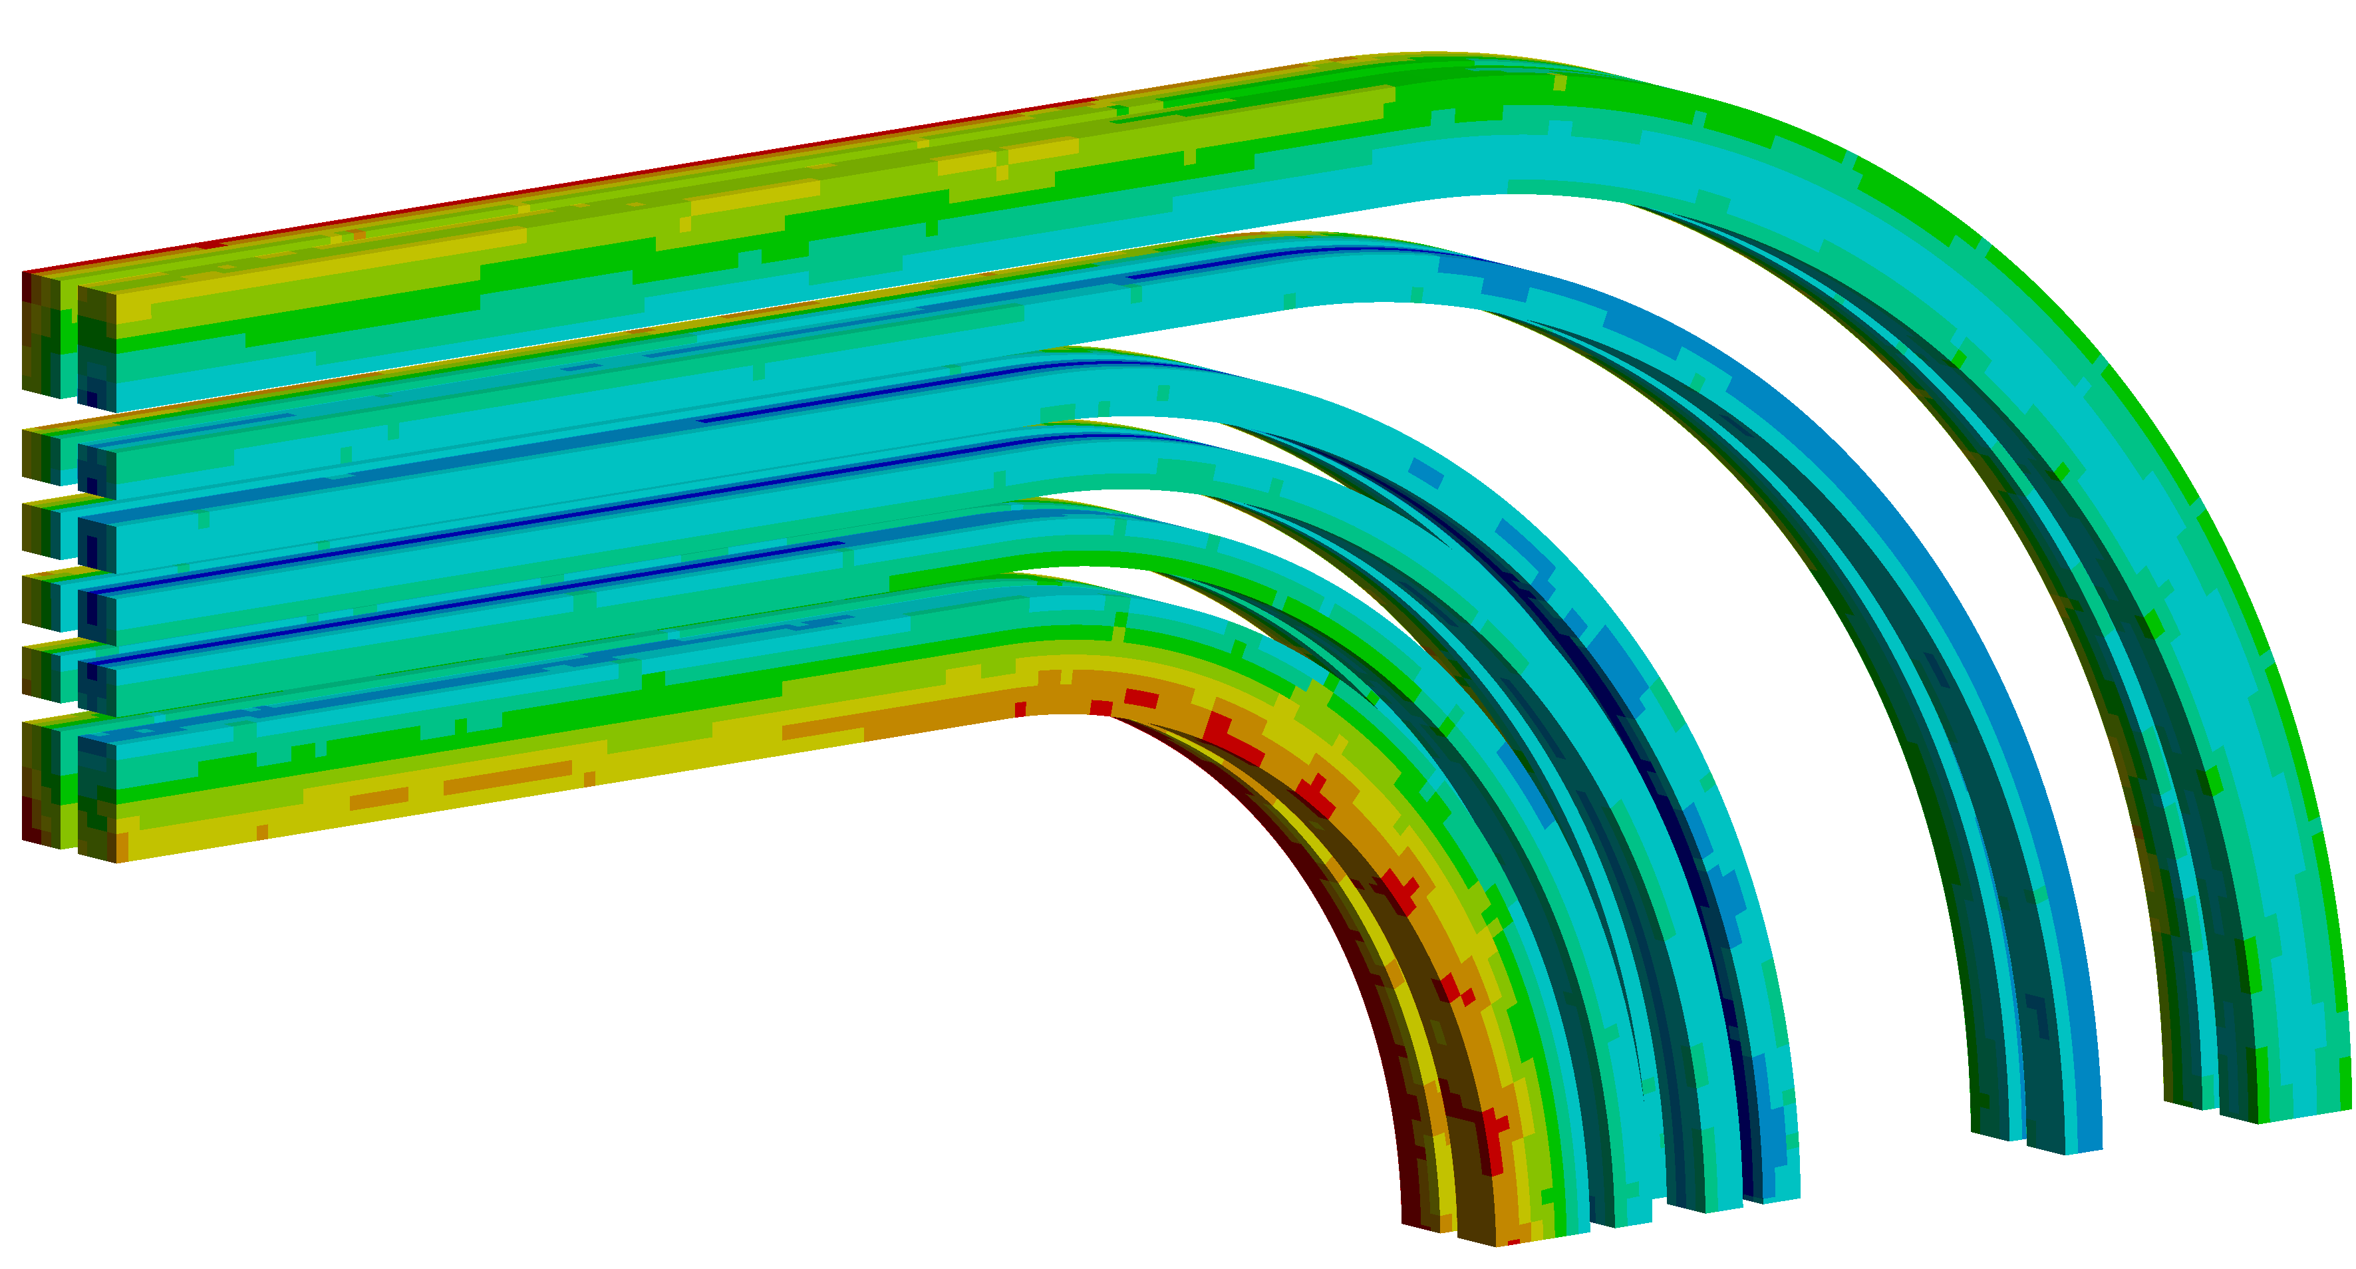

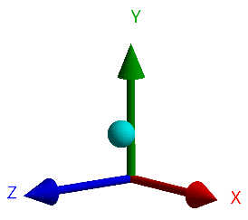
Stress reduction in Dipole Magnets through compliant structures
Coil 1
Coil 2
Coil 3
Metal Support Structure

Slide 11
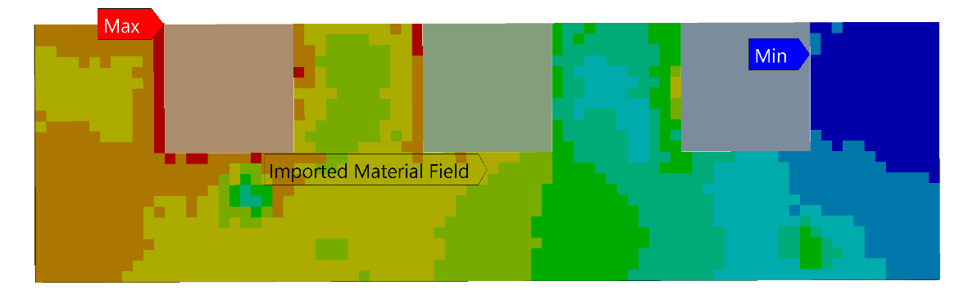

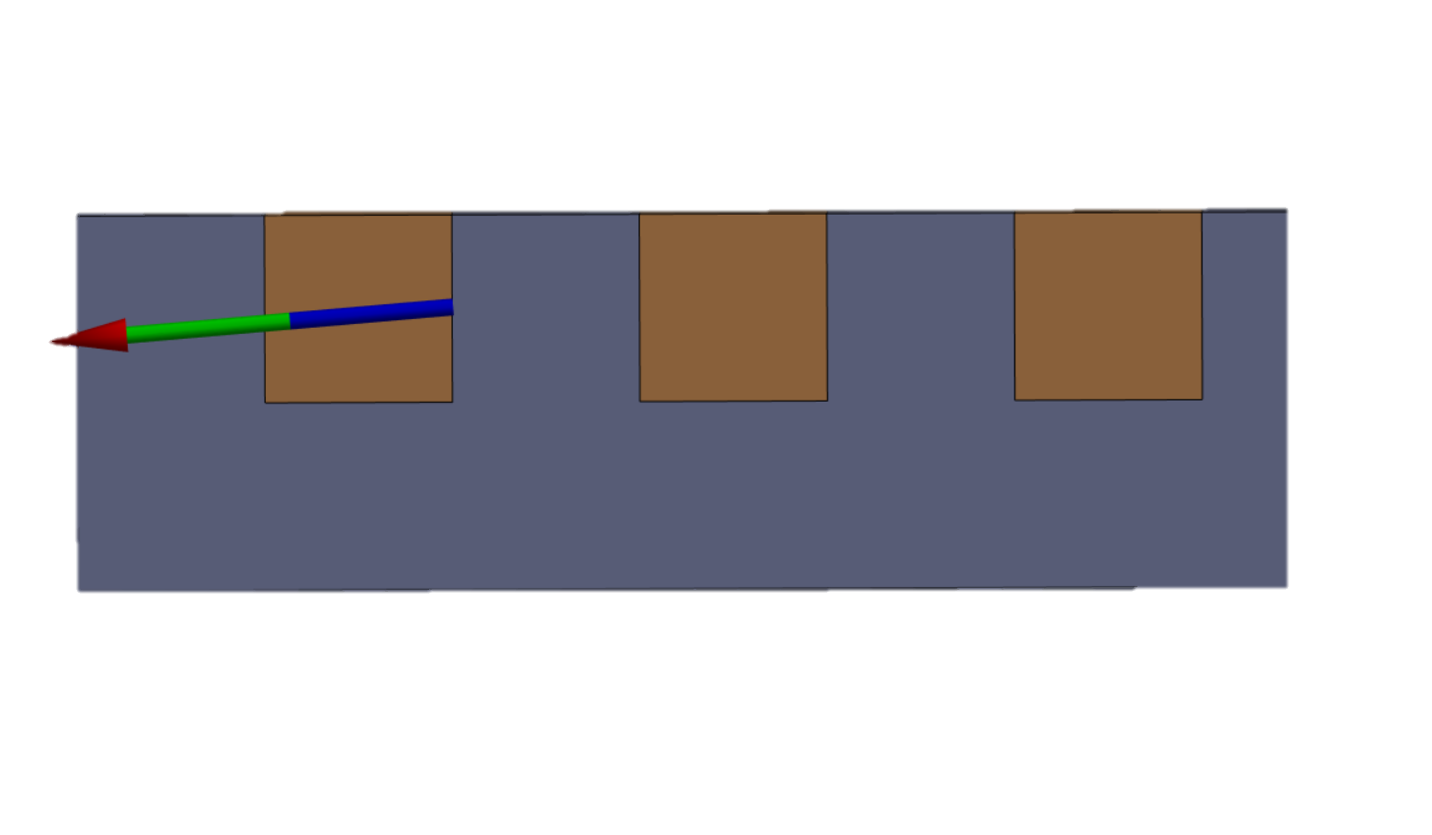
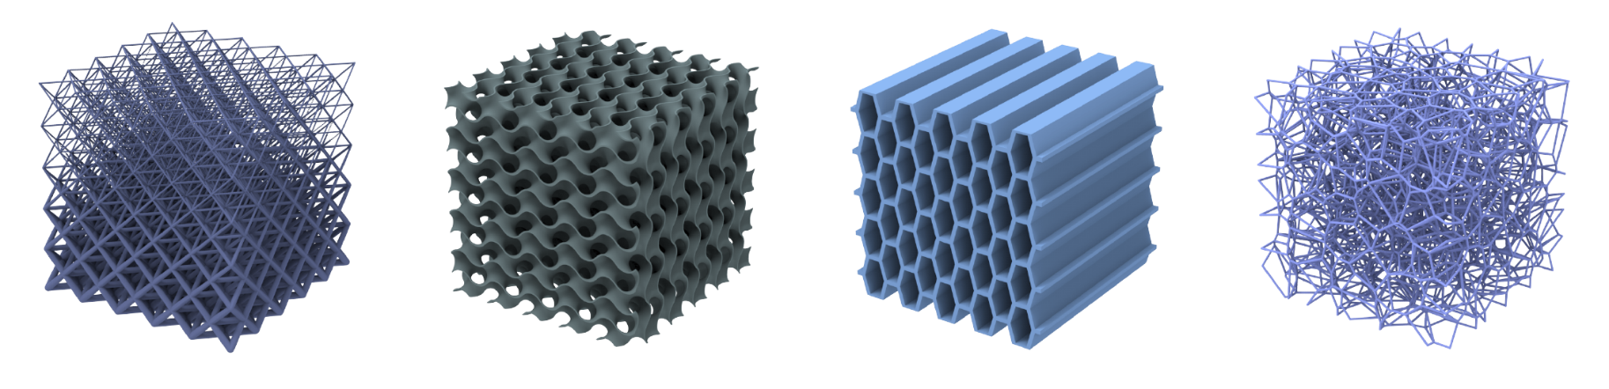
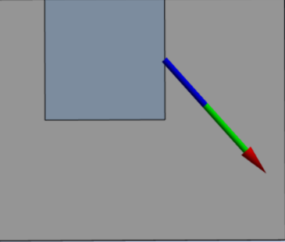
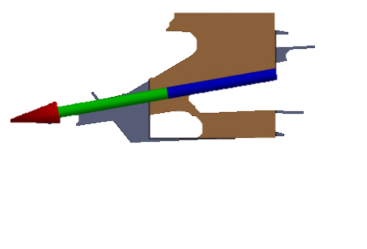
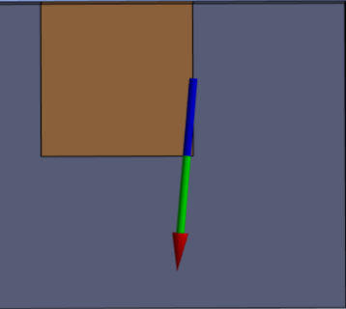
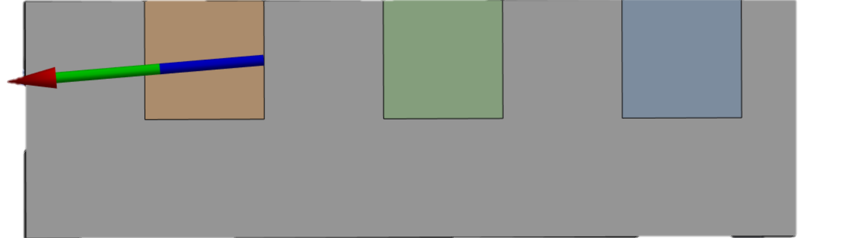
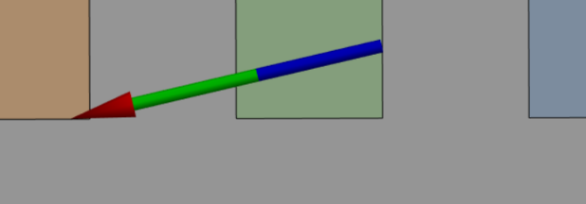
Tuning compliance through material grading
solid Material
Stainless Steel, 200 GPa
graded Material
Stainless Steel, 200 - 30 GPa
Prestress
2 kN
E-Modulus
[GPa]
200
130
Lorentz Forces
75
30
force reaction of bonds
force reaction of bonds
Tune Compliance through:
Pore Size
Wall thickness
Axial distortion
Process Parameters
Compressive Stress
Tensile stress

Slide 12
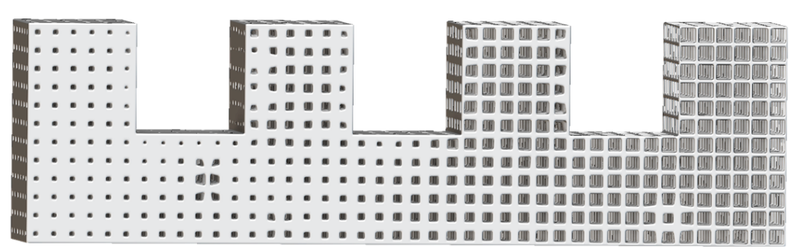
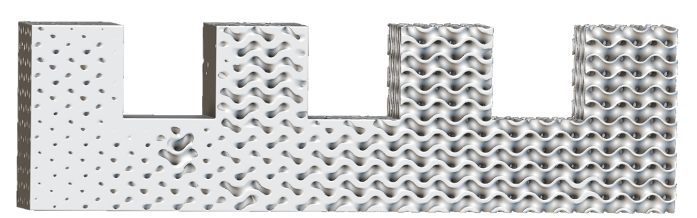
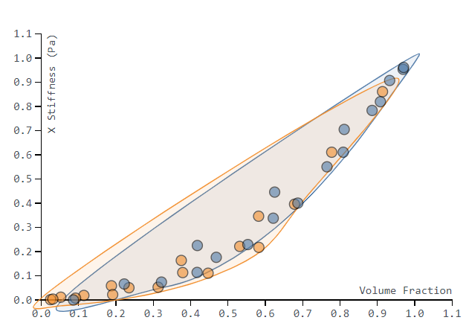
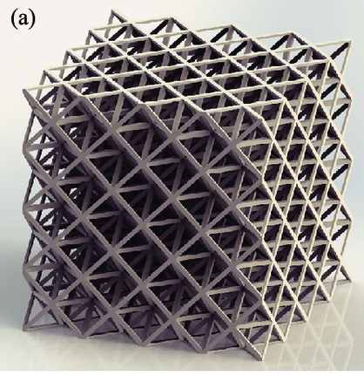
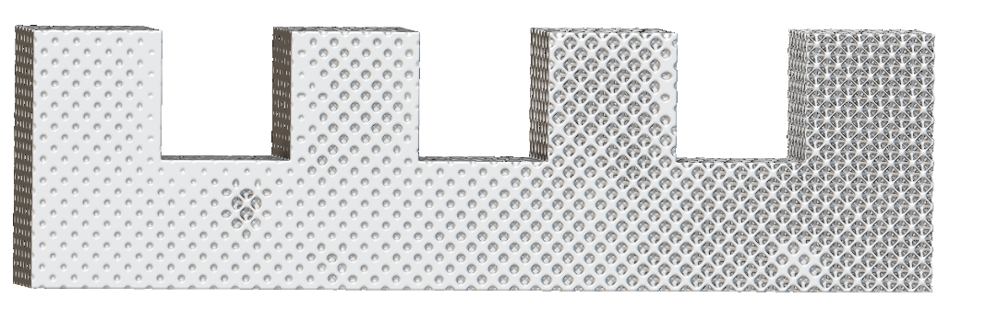
Tuning compliance through material grading
Box Lattice
Functional Grading can be achieved by leveraging additively manufactured lattices
Local tuning of stiffness can be coupled with simulation results of Lorentz Forces
Gyroid Structure
X-Stiffness
Octet Lattice
Volume Fraction
Octet Lattice

Slide 13

Outlook & next Steps
Explore different graded techniques
Compare the different approaches through simulation and experiments
Increase the dimensionality to tackle
3-Dimensional Prestress problems
Add more load cases like thermal stresses
to the problem set

Slide 14
Thank you for your attention!
Aurel Schüpbach
Aurel.Schuepbach@inspire.ch
Prof. Dr. Mirko Meboldt (PI)
meboldtm@ethz.ch
Dr. Julian Ferchow
Julian.Ferchow@inspire.ch
Patrick Beutler
Patrick.Beutler@inspire.ch

Slide 15
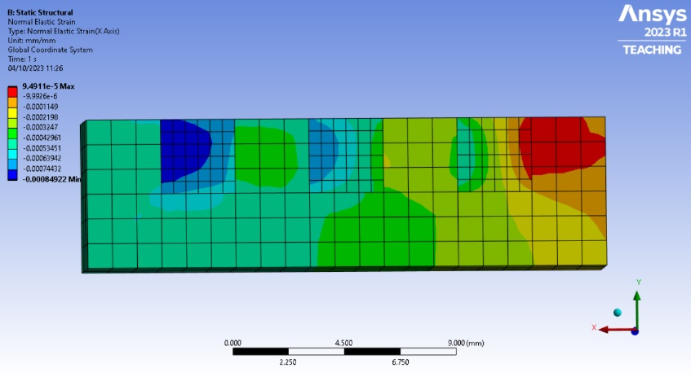
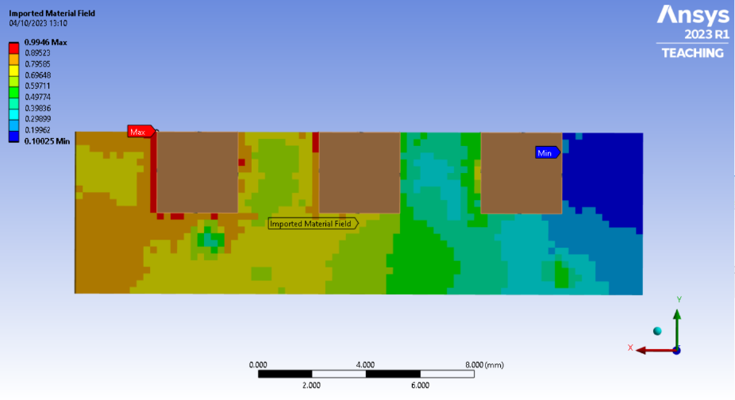
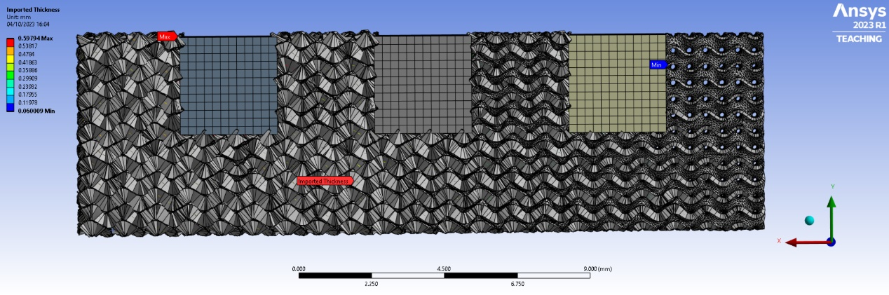
Creation of the “Grading Field”
Elastic strain regions should be minimized
Inversion of the strains creates stiffness regions
Stiffness is mapped to thickness of the gyroid lattices

Slide 16
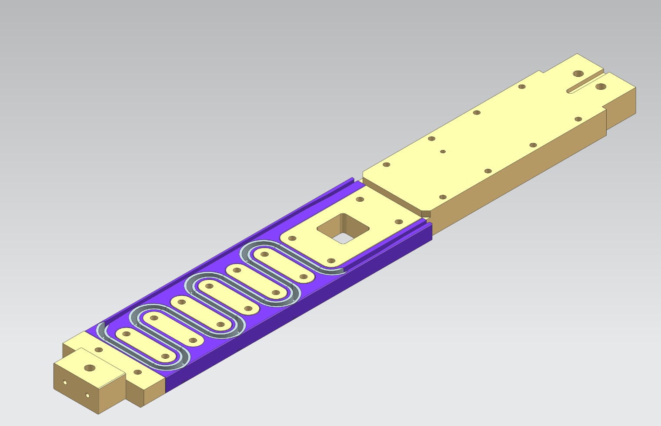
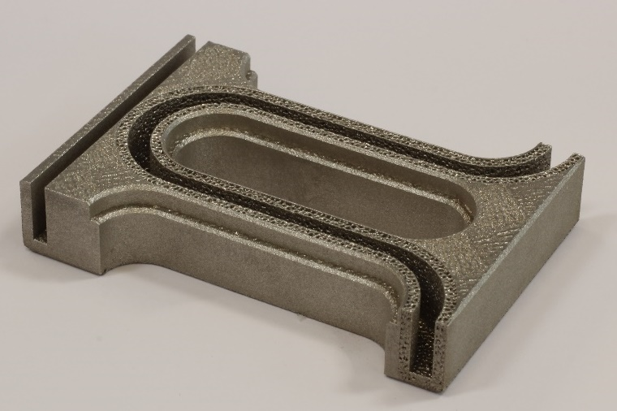
Adhesion Interfaces: Transfer to BOX
Test the irregular design within an adapted version of the BOX sample:
  Yellow: milled part
  Violet: AM bulk
  Grey: AM IPL
Challenging to manufacture for supplier due to small design features.
Structure shows capillary action → potential to improve the impregnation process

Slide 17
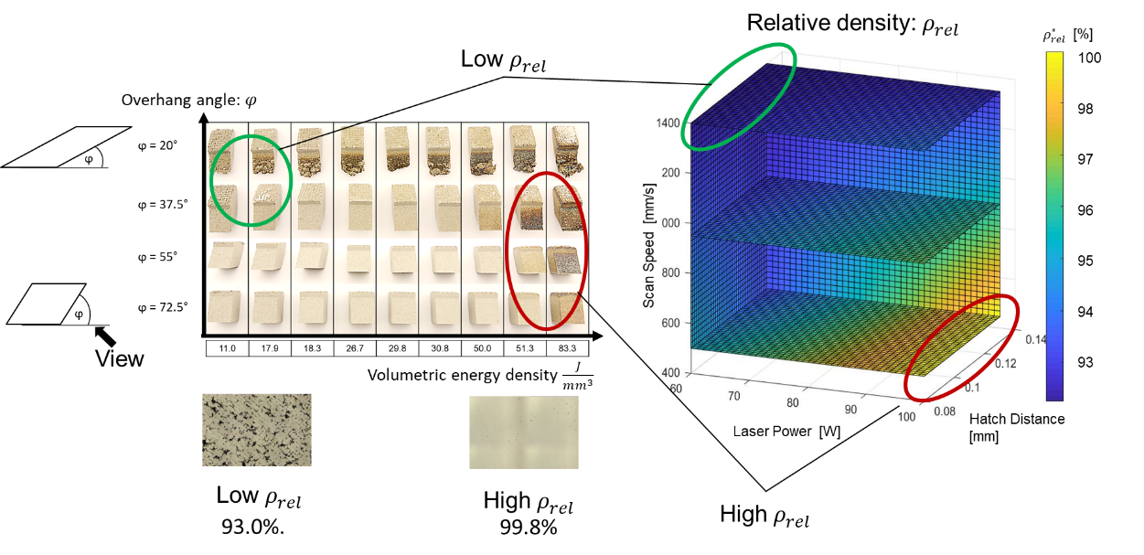




CCT Segment
Parameter Model:
Segmentation:
Final part:
High $ρ_{rel}$
Low $ρ_{rel}$
Support structure reduction
Increase of design freedom
Integration of surface texturing
Julian Ferchow, Manuel Biedermann, Pascal Müller, Bernhard Auchmann, André Brem, Mirko Meboldt; Harnessing manufacturing elements to select local process parameters for metal additive manufacturing: A case study on a superconducting solenoid coil; Additive Manufacturing Journal, 2021
https://doi.org/10.1016/j.addma.2021.102140

Slide 18




Adhesion Interfaces: Explorative Study
Three Approaches: increased mechanical interlocking, reduced material stiffness and enlarged contact area between adhesive and adherend.
Overall adhesive strength is higher in LN2 than at RT
IPL Structures perform worse in LN2 than at RT → Epoxy properties also change
Shear RT → interesting behavior of IPL structures → no abrupt fracture (yielding)
Plain Design performs very good overall

Slide 19

Adhesion Interfaces
Investigations:
Explorative Study
Which surface structures on the adherend could improve adhesive strength?
Load: Shear & Tensile, Temperature: RT & LN2, Designs: B,C,D,E,G
Size of Metal Structures
What’s the effect of the size of metal structures within IPL designs?
Load: Shear, Temperature RT & LN2, Designs: B,H,E,F
Surface Roughness
What’s the effect of surface roughness on the adherend on adhesive strength?
Load: Shear, Temperature: RT & LN2, Designs: A,B
Pollution
What’s the effect of pollution on the adherend on adhesive strength?
Load: Shear, Temperature: LN2, Designs: B,C,E
Designs:
A) Milled, B) Plain, C) SinSin, D) Undercut, E) Octet who, F) Octet woh large, G) Gyroid, H) Irregular

Slide 20



Adhesion Interfaces
Size of Metal Structures
  Effect in LN2, but: must not be the main cause
  Alternative explanation: AM manufacturing defects
Surface Roughness
  Better performance at LN2 & RT with higher surface roughness
  Rough surfaces already promote mechanical interlocking on micro-scale
Pollution
  Pollution reduces adhesive strength by 18-25% for all designs tested
  Small reduction for Octet design.
  Desirable to get rid of pollution during manufacturing process.

Slide 21


Shape Adaptive Endspacers
Multiple design iterations for both design concepts with the goal to reach a good adaptation of the compliant interfaces on a simplified test setup.
Current State: First versions → a lot of potential improvements
Compliant Element Concept
  3 design iterations towards more compliance
Gripper Concept
  2 design iterations

