Slide 1
FCC-ee Injector Baseline and P³ Experiment
Mattia Schaer on behalf of the FCC-ee Injector Collaboration :: Paul Scherrer Institute
CHART Workshop, PSI, 11.10.2023

Slide 2
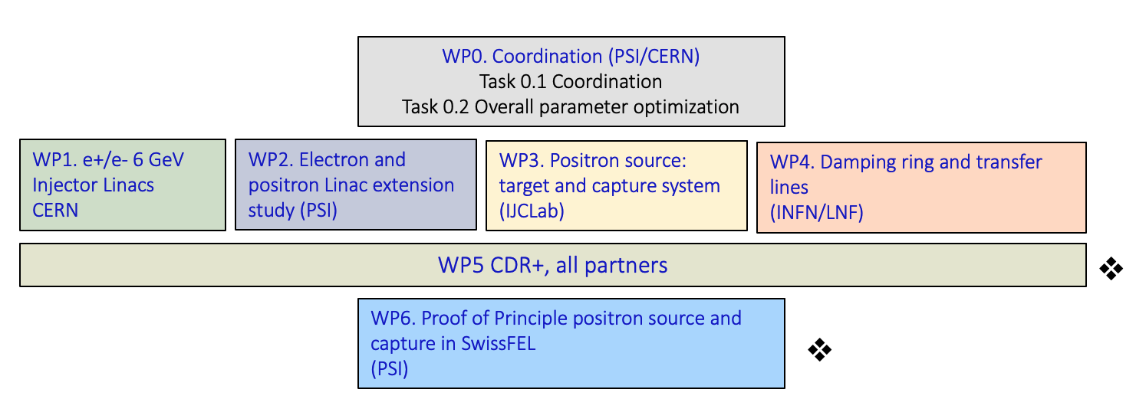
FCC-ee Injector Study
Collaboration between PSI and CERN with external partners:
CNRS-IJCLab (Orsay); INFN-LNF (Frascati); SuperKEKB – as observer, also interested in the P³ experiment; INFN-Ferrara – radiation from crystal
CDR+ and
cost estimate
P³ experiment

Slide 3
CDR+ and Cost Estimate for FCC-ee Injector
CDR+ and
cost estimate
P³ experiment

Slide 4
Schematic Layout of Proposed Injector Complex
Result of:
Beam dynamics sim.
RF design
RF system optim.
Magnet design
Target design
Radiation protection sim.
Overall layout optim.

Slide 5
FCC-ee Injector Study, Status and Outlook
Baseline injector layout ready
→ Fulfilling the latest requirements of the collider rings
Corresponding cost estimate for the hardware ready
FCC Feasibility Study: mid-term review on 16.10.2023 will provide feedback
  Confirm/change overall machine parameters (collider)
  Is SPS still an option as a pre-booster?
Revise injector layout or
write CDR+ based on presented baseline layout

Slide 6
PSI Positron Production (P³) at SwissFEL (PSI)
CDR+ and
cost estimate
P³ experiment

Slide 7
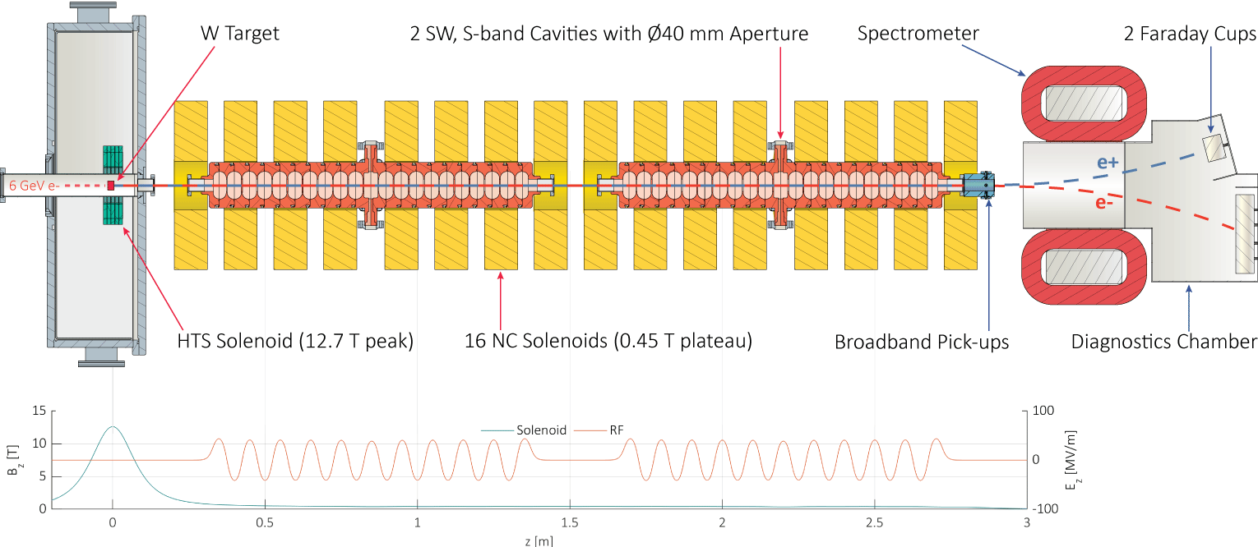
The P³ Experiment in a Nutshell

Slide 8
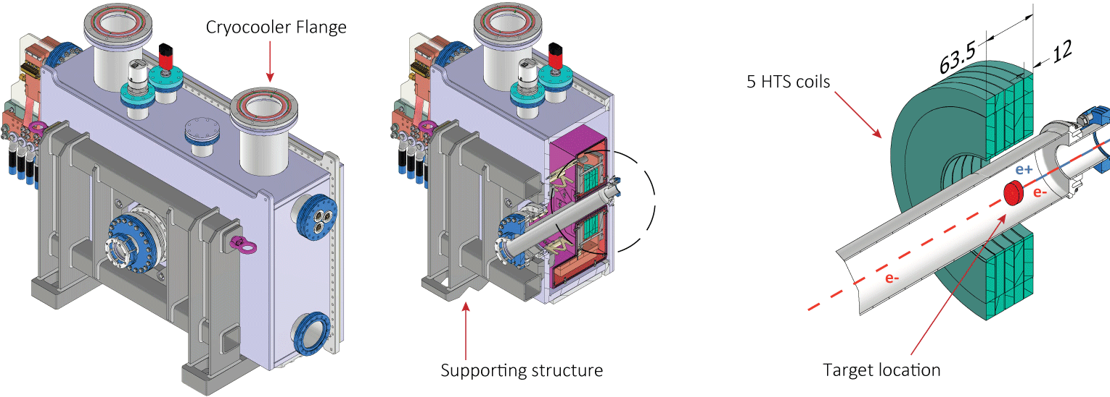
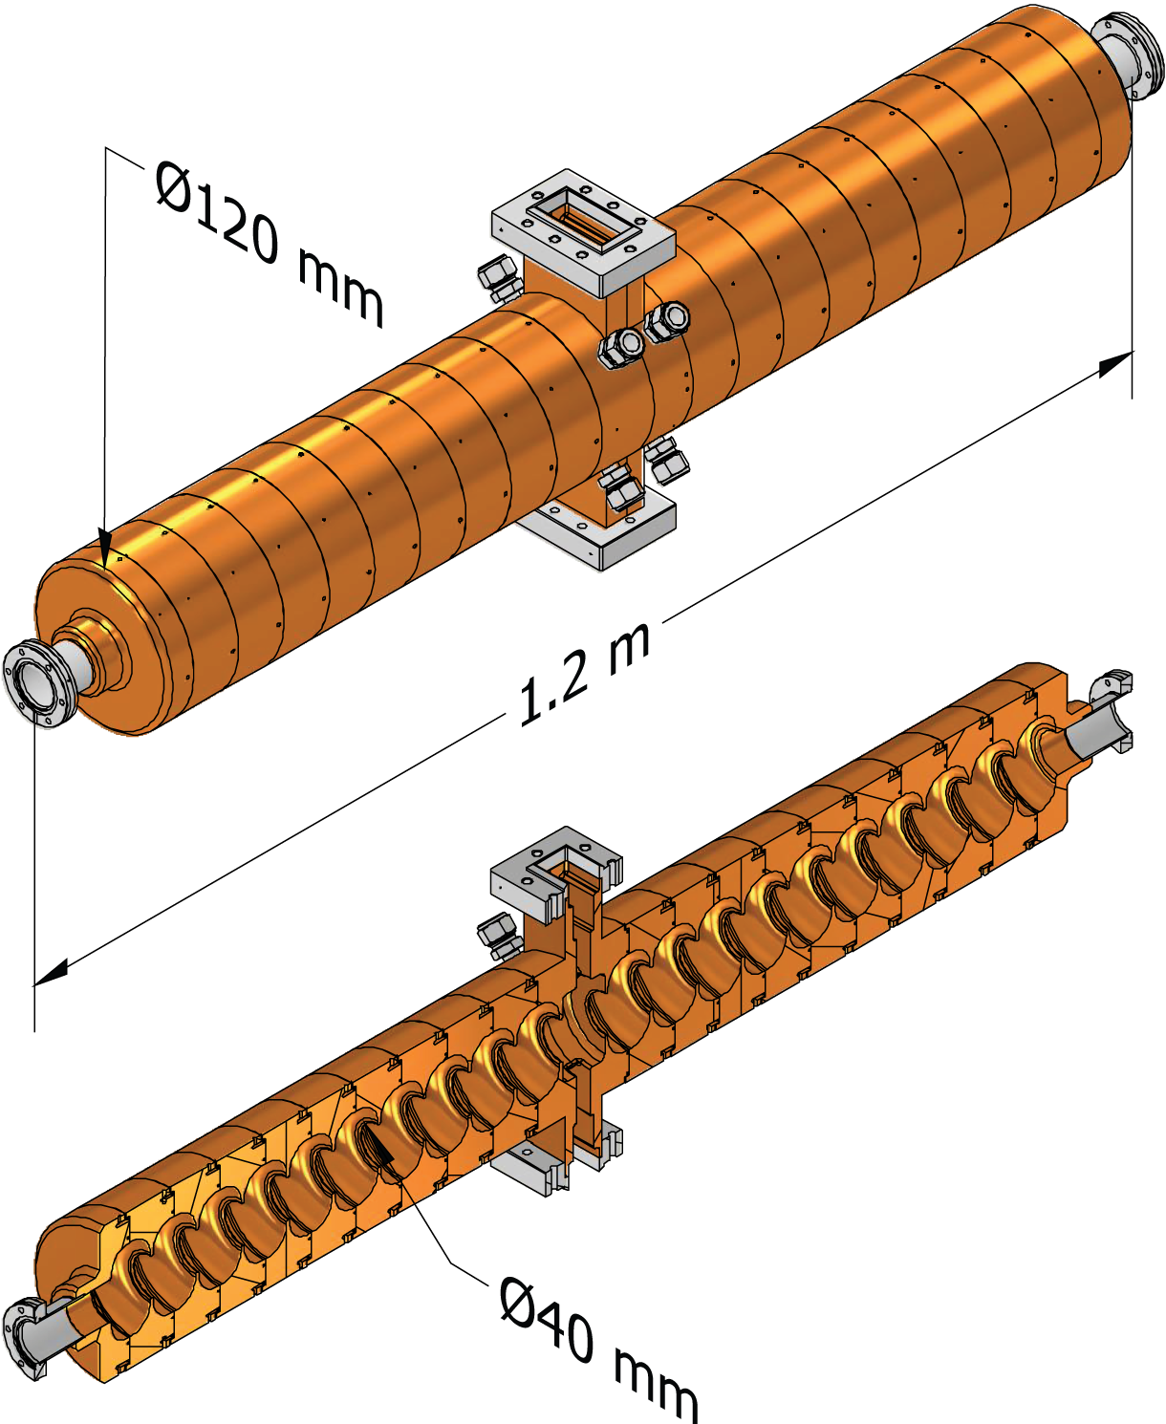
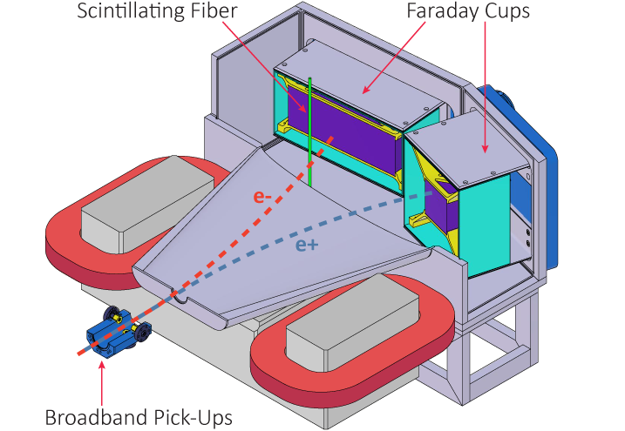
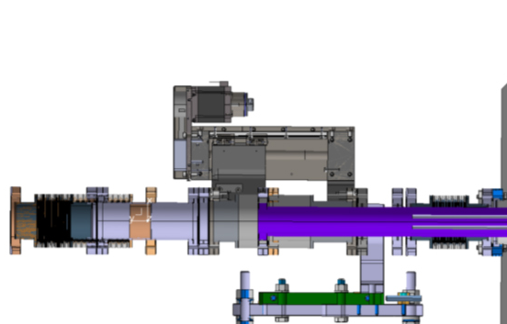

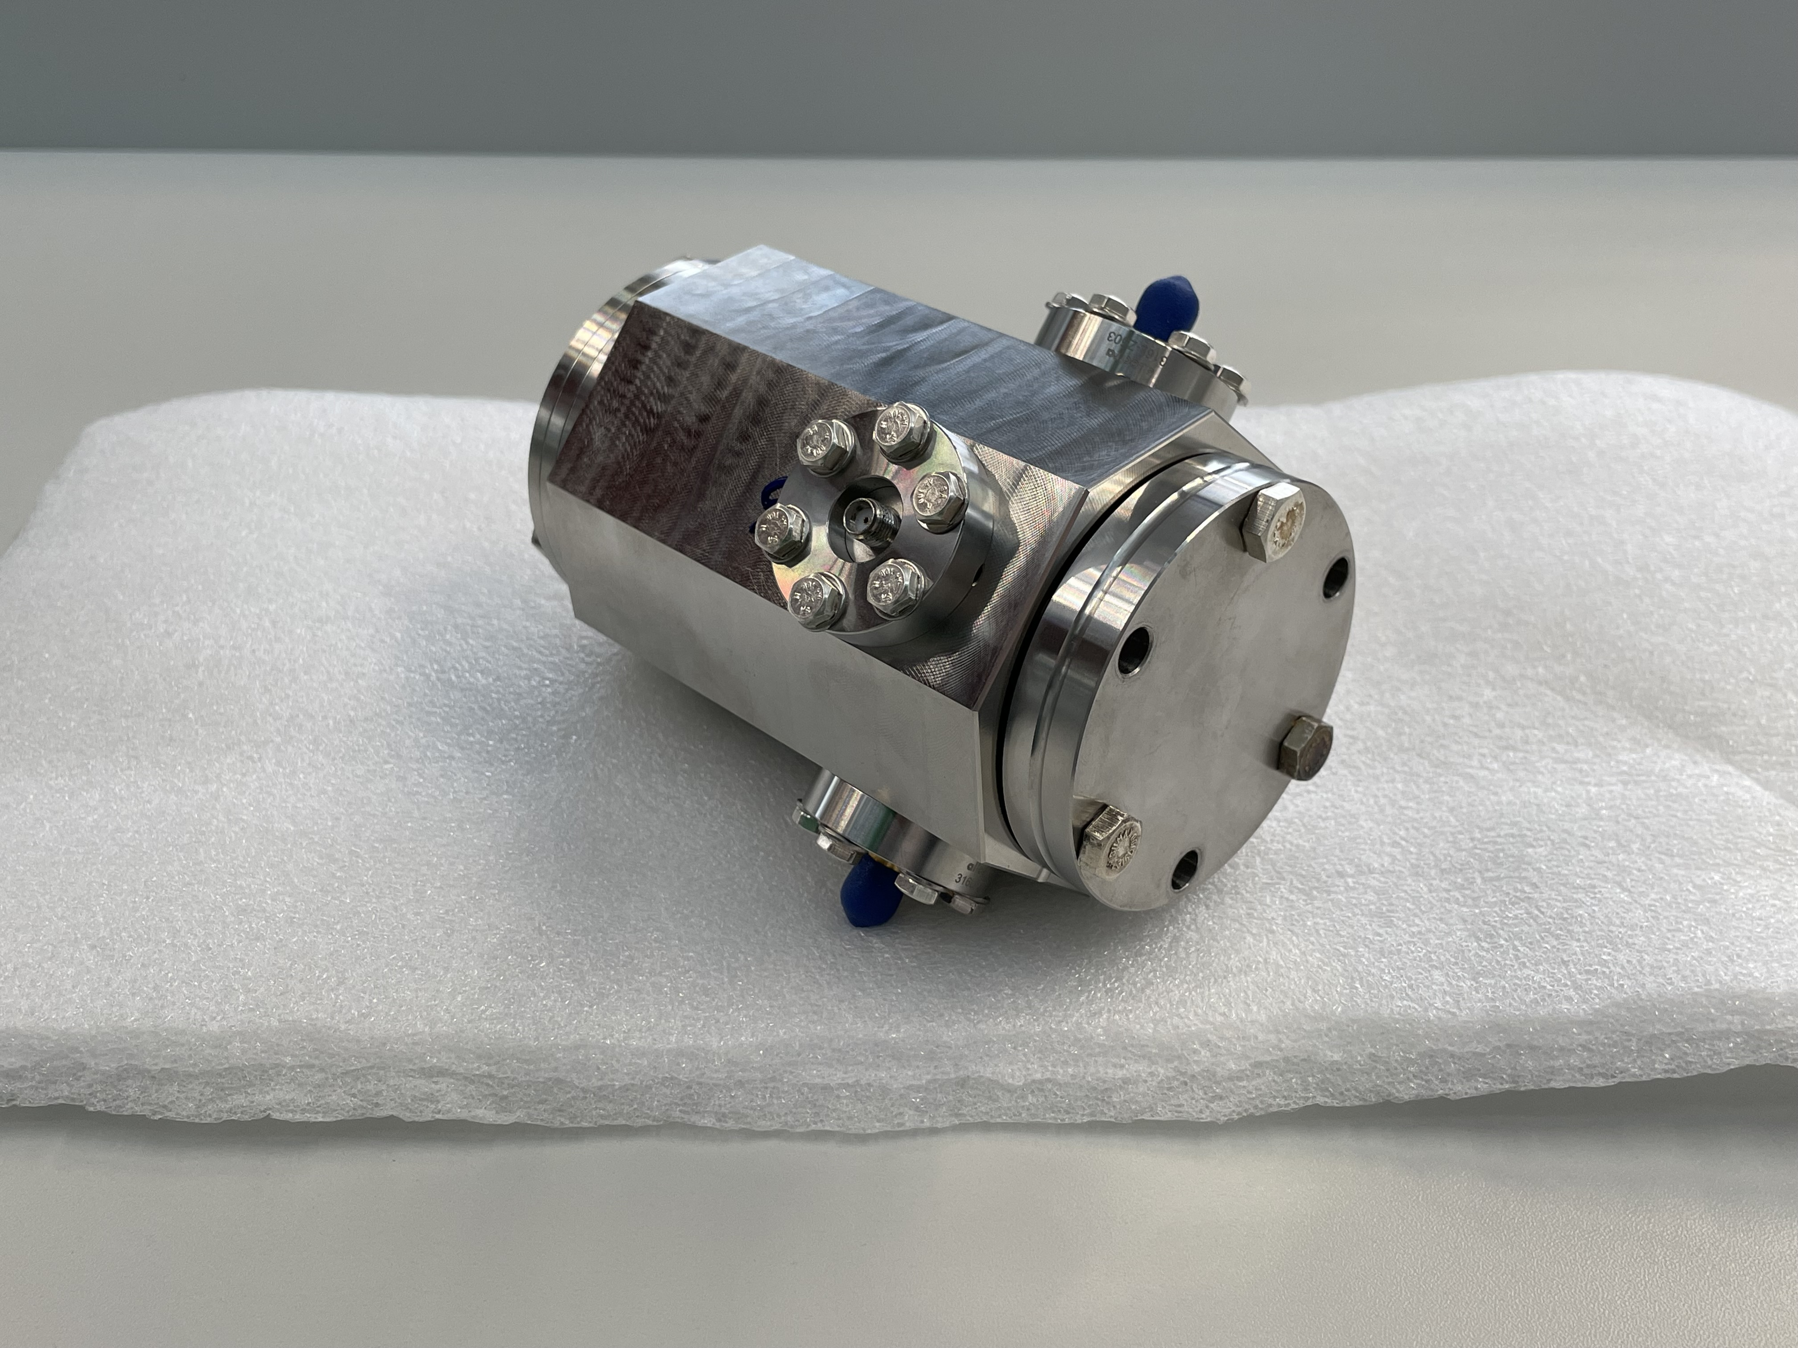
Novel Components under Development at PSI
HTS solenoid ReBCO, 15 K, 2 kA, 12.7 T on-axis
RF S-band SW cavities
40 mm aperture (d)
central double feeder
18 MV/m, 14 MΩ/m
Diagnostic chamber
Target device
Δz = +/- 50 mm
27 and 65 GHz pick-ups

Slide 9
P³ Status
Concept design
Engineering in progress
Ready for Order
Delivered
Physics Studies | Parameter Optimization | Complete
 | Conical Targets Study | In progress
Capture Section | HTS Solenoids | Design complete, components ordered
 | 2 RF Cavities | Ordered, cups partially delivered
 | 16 NC Solenoids | Design complete, waiting for offers
Diagnostics | Broadband Pick-ups | Assembled at PSI, tests with beam at CLEAR (CERN) Nov. 23
 | Faraday Cups | Mechanical design in progress
 | Scintillating Fibers | Location defined, technical design to be developed
 | Diagnostics Chamber | Mechanical design in progress, to be reviewed with diagnostics team
 | Spectrometer | Mechanical design for complete, ready for modification
Installation at SwissFEL | Klystron-Modulator system | Procurement of key components in progress
 | Waveguide Network | Waveguide network layout complete, most waveguide components borrowed from CERN
 | Porthos Switchyard | Design complete, most components ordered and delivered, preliminary installation works
 | Radiation Protection | Study advanced, to be discussed with BAG

Slide 10
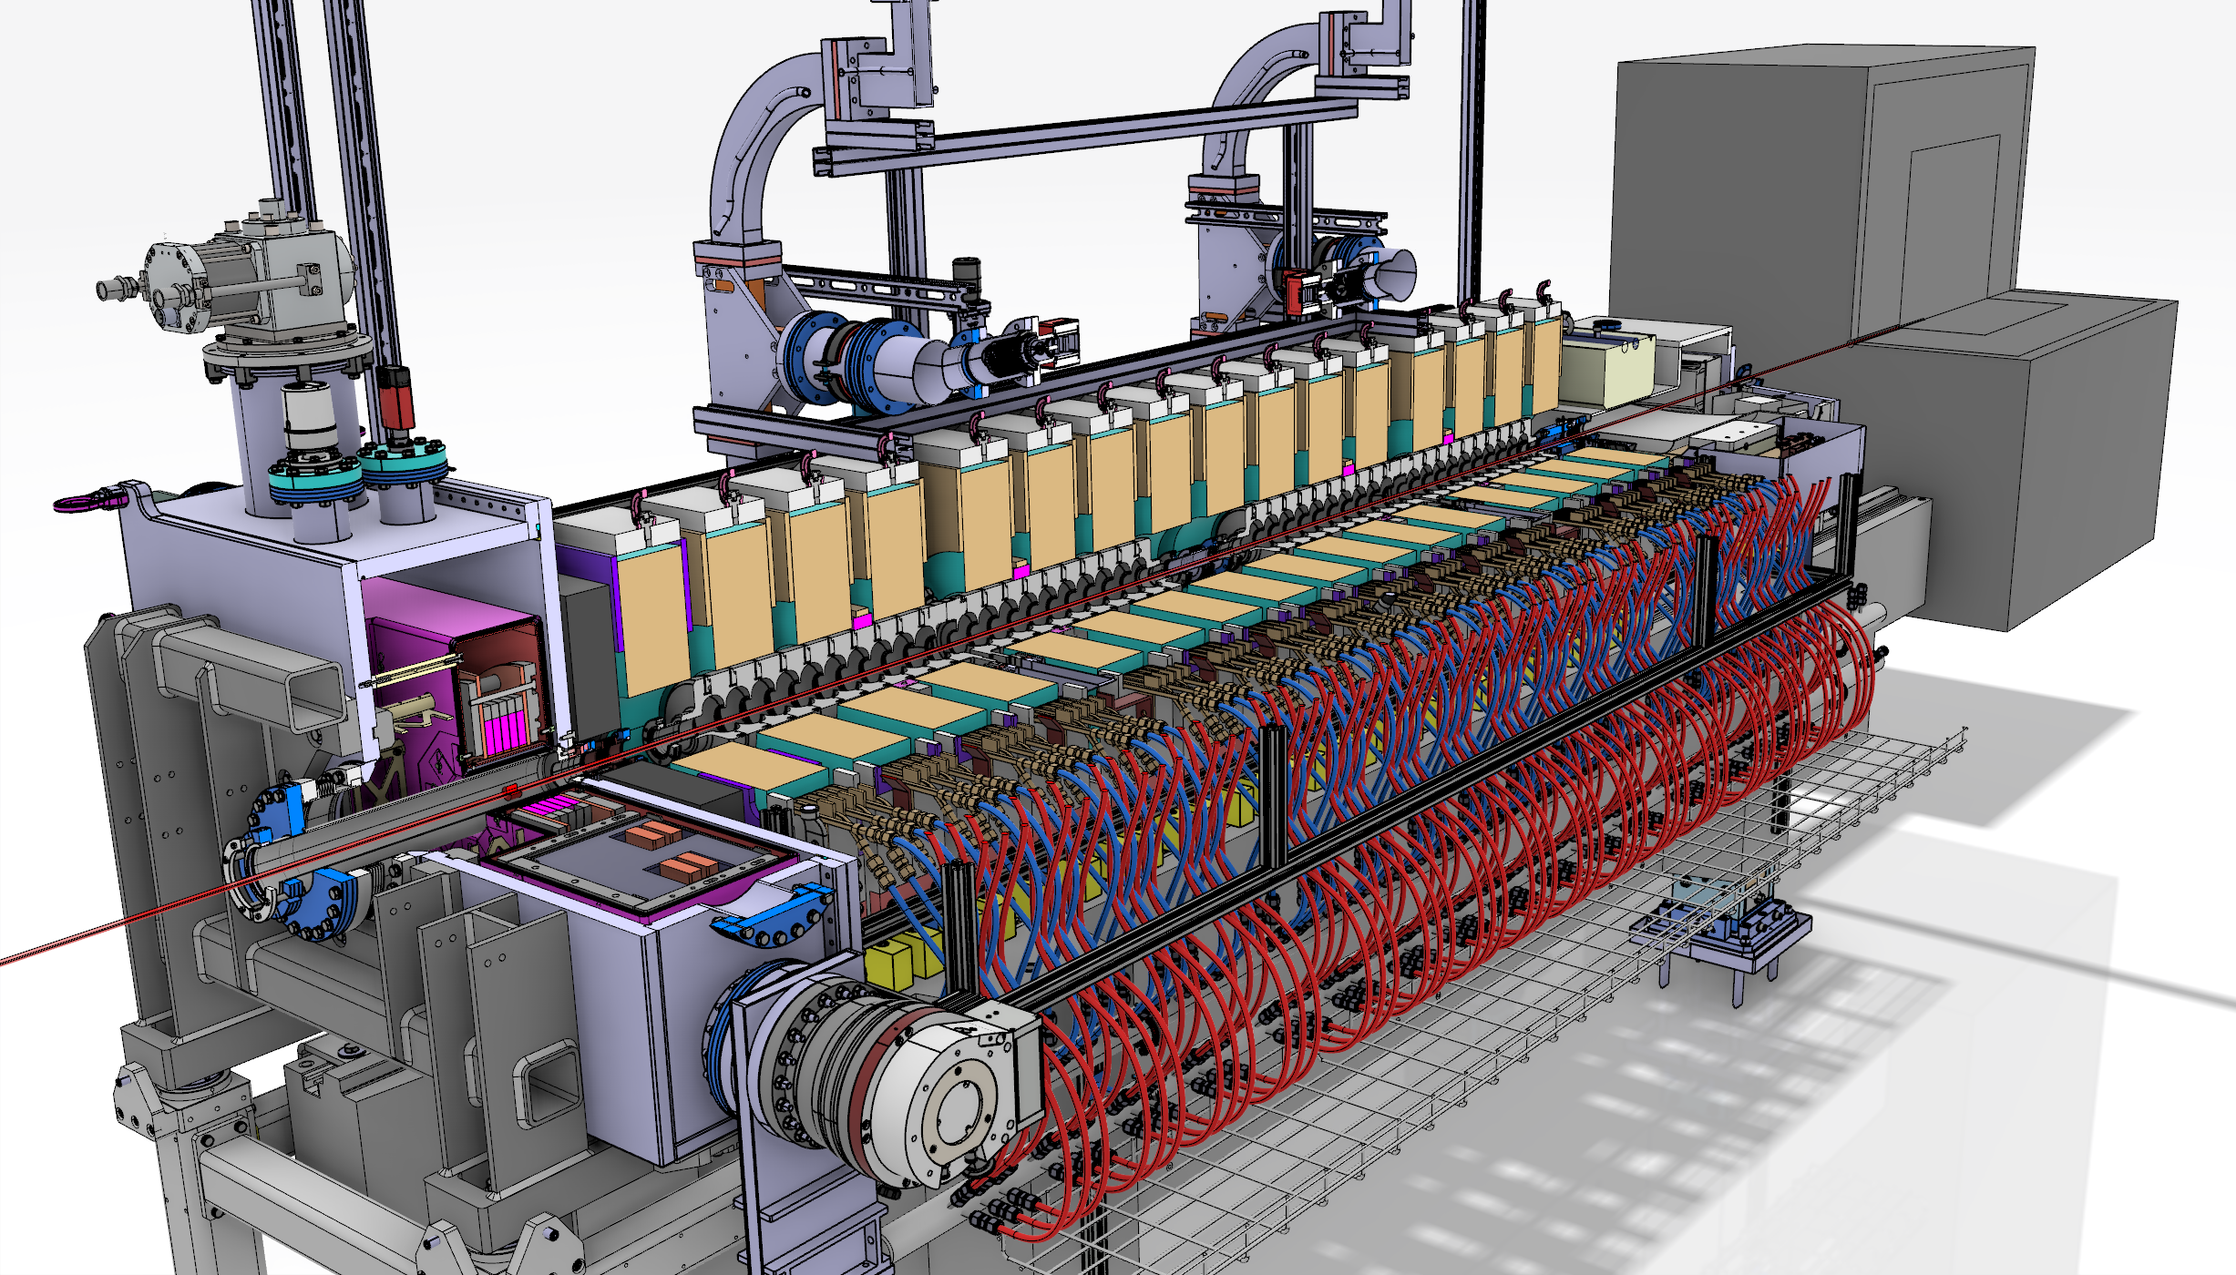
P³ Outlook
Next milestone: Pre-assembly of the girder by the end of 2024

Slide 11
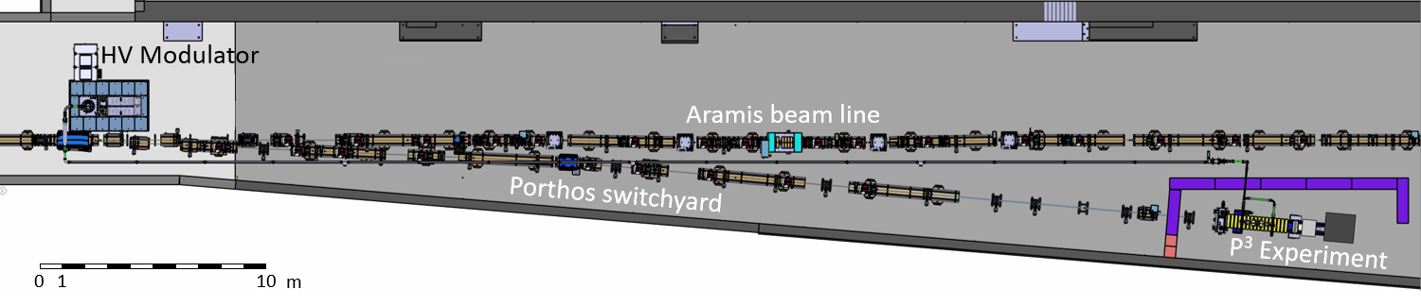
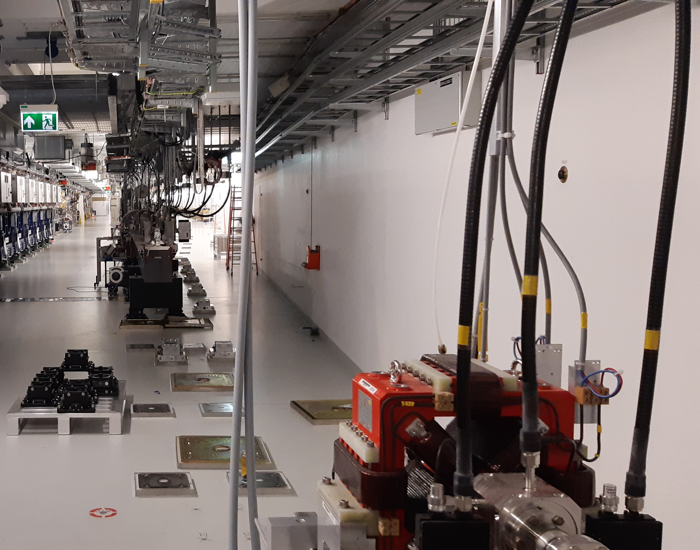
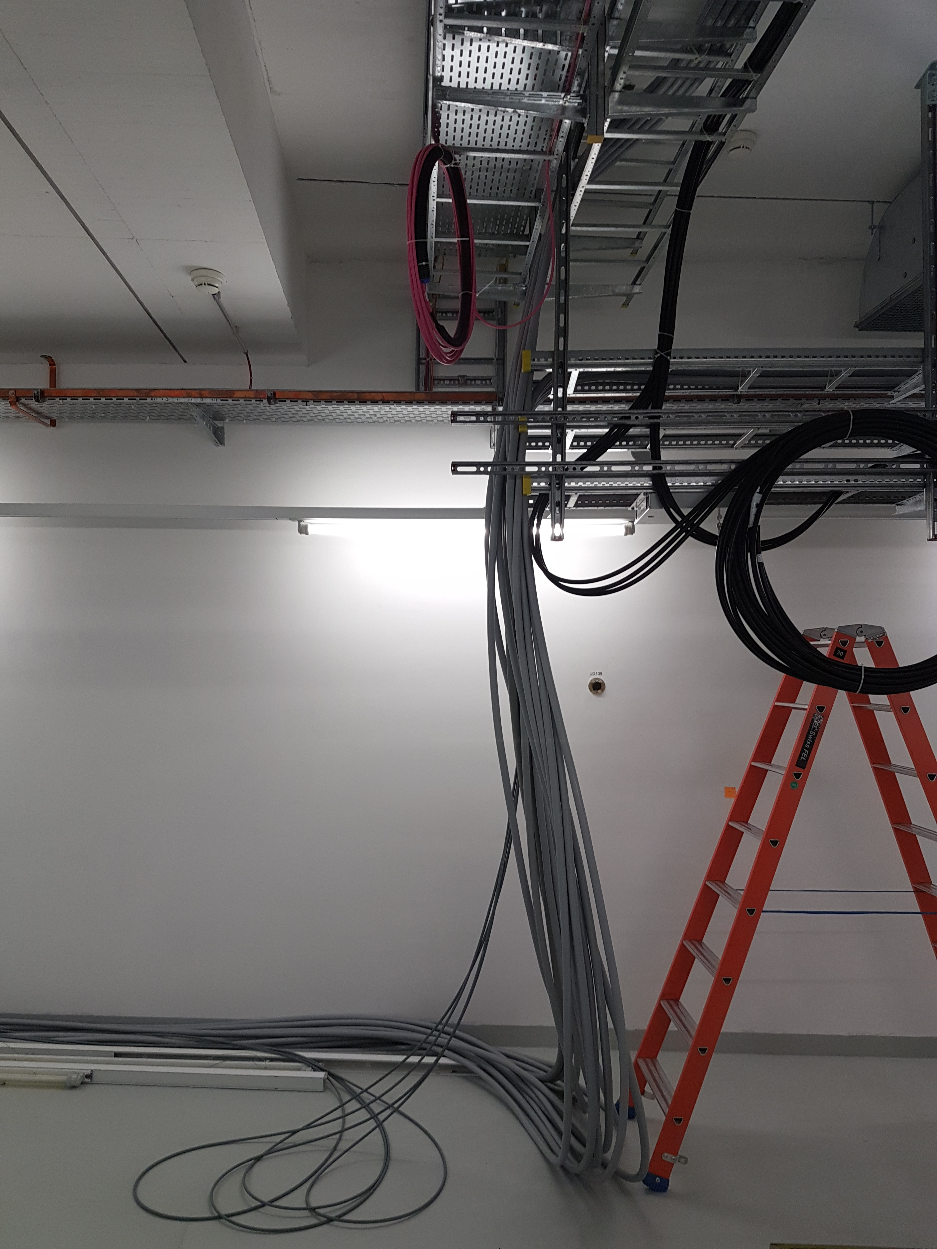
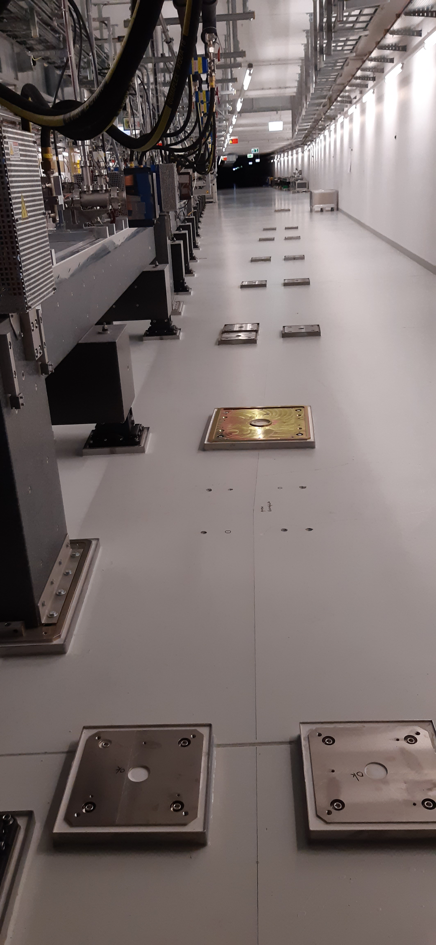
Porthos Switchyard and P³ Installation
Target at z = 480 m
Status:
    Technical design Porthos switchyard complete
    Most beamline components delivered
    All girder footplates installed
    Cables for magnets and BPMs installed
Next steps:
    Q4 2023: Start pre-assembly of Porthos girders
    Spring Shutdown 2024: Aramis modification complete
    Summer Shutdown 2024: Start Porthos installation

Slide 12


Credits
PSI: R. Zennaro, M. Schaer, N. Vallis, B. Auchmann, I. Besana, S. Bettoni, H. Braun, M. Duda, R. Fortunati,
H. Garcia-Rodrigues, D. Hauenstein, E. Hohmann, R. Ischebeck, P. Juranic, J. Kosse, F. Marcellini,
T. Michlmayr, G. L. Orlandi, M. Pedrozzi, J.-Y. Raguin, S. Reiche, R. Rotundo, M. Seidel, S. Sanfilippo,
N. Strohmaier, M. Zykova and all technical groups involved in the P³ exp.
IJCLab: I. Chaikovska, F. Alharthi, V. Mytrochenko, R. Chehab
CERN: R. Mena Andrade, W. Bartmann, H. Bartosik, M. Benedikt, T. Brezina, M. Calviani, S. Doebert,
Y. Duthell, J.L. Grenard, A. Grudiev, B. Humann, J.-L. Grenard, A. Latina, A. Lechner, A. Marcone,
K. Oide, Z. Vostrel, Y. Zhao, F. Zimmermann
INFN-LNF: C. Milardi, A. De Santis, O. Etisken, S. Spampinati, P. Raimondi
SLAC T. Raubenheimen
KEK: Y. Enomoto, K. Furukawa
INFN/Ferrara L. Bandiera, M. Soldani, A. Sytov
INFN/Milano A. Bacci, M. Rossetti Conti
This work was done under the auspices of CHART (Swiss Accelerator Research and Technology) Collaboration, https://chart.ch - CHART Scientific Report 2022: https://chart.ch/reports/
FCCIS: 'This project has received funding from the European Union's Horizon 2020 research and innovation programme under the European Union's Horizon 2020 research and innovation programme under grant agreement No 951754.'

Slide 13
