Slide 1

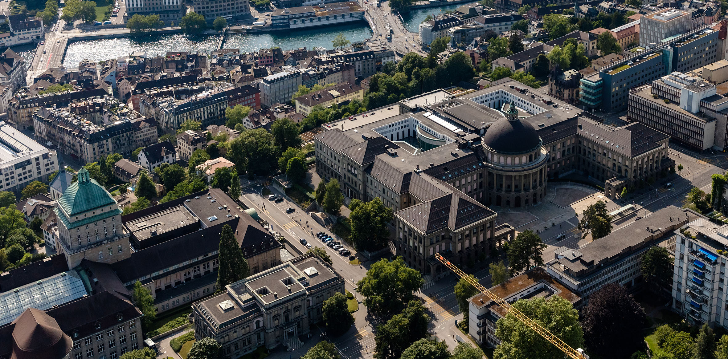

Mechanical modelling and failure identification of impregnated Nb₃Sn Rutherford cable stacks
Xiang Kong¹, Theo A. Tervoort¹, Andre Brem², Douglas Martin Araujo², Michael Daly², Bernhard Auchmann^{2,3}
Department of Materials, ETH Zürich, Switzerland
Paul Scherrer Institution (PSI), Villigen, Switzerland
CERN, Geneva, Switzerland
11.10.2023
CHART Workshop 2023

Slide 2

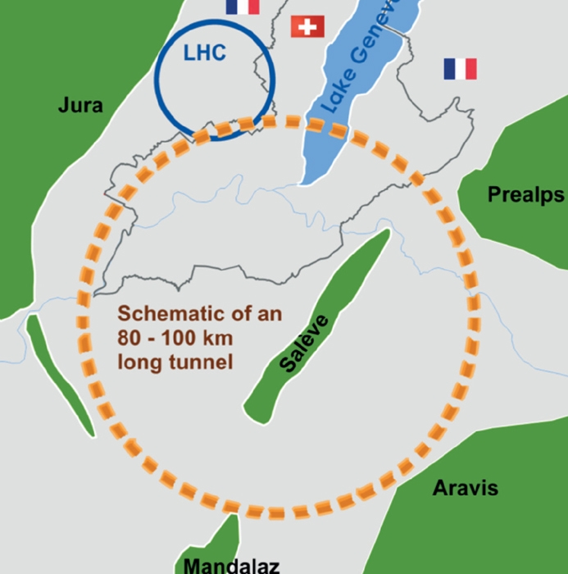
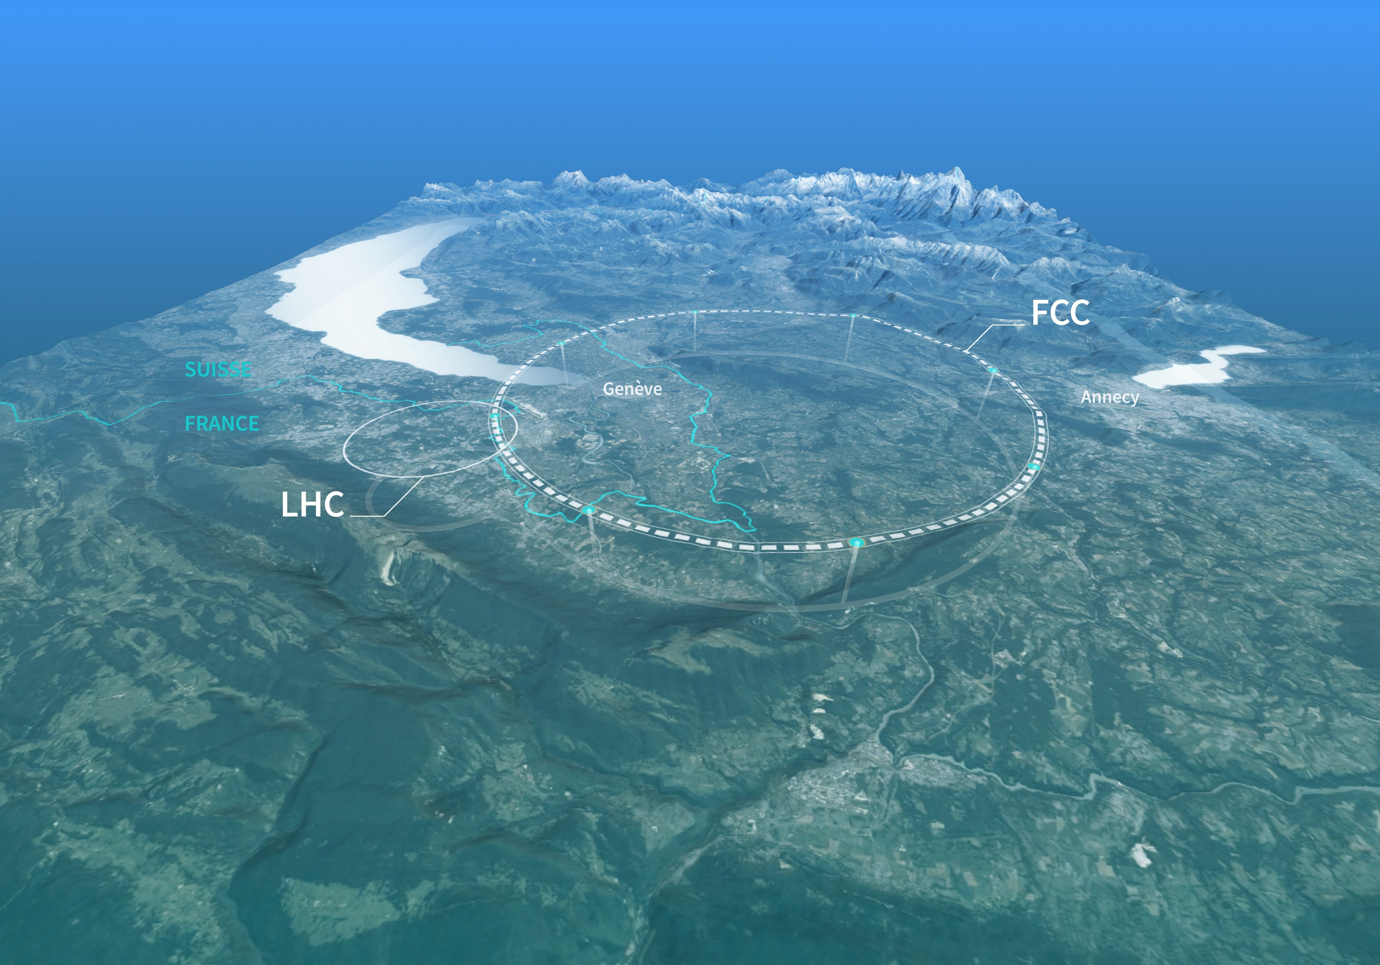
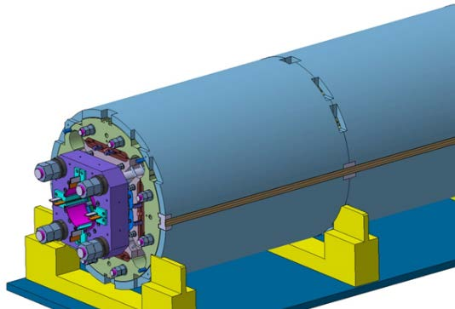
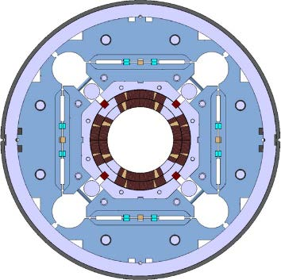
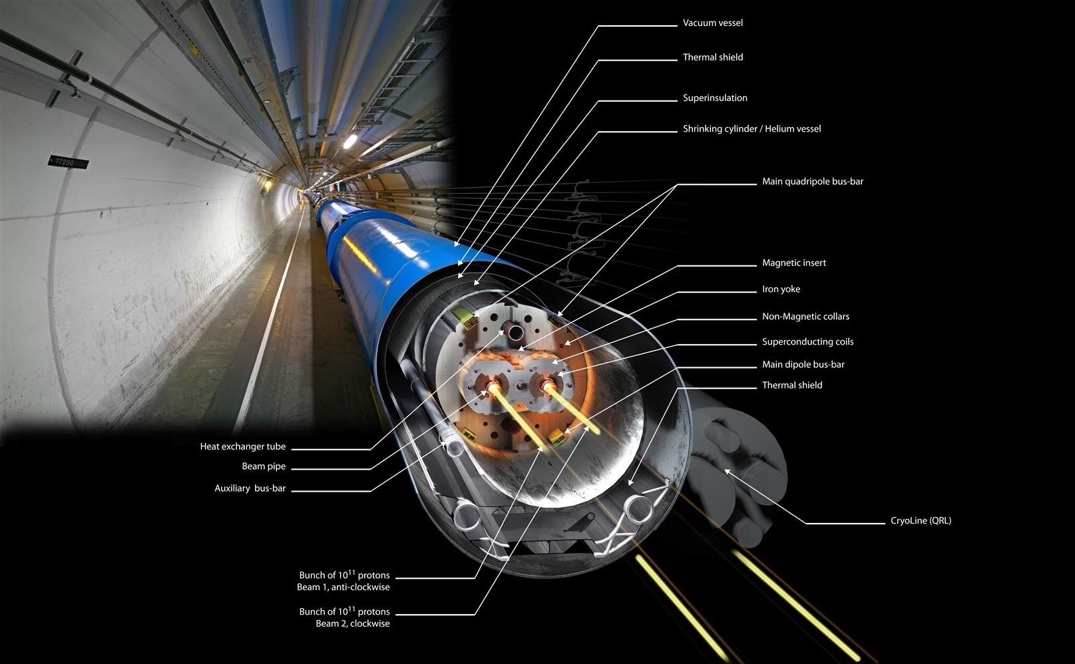
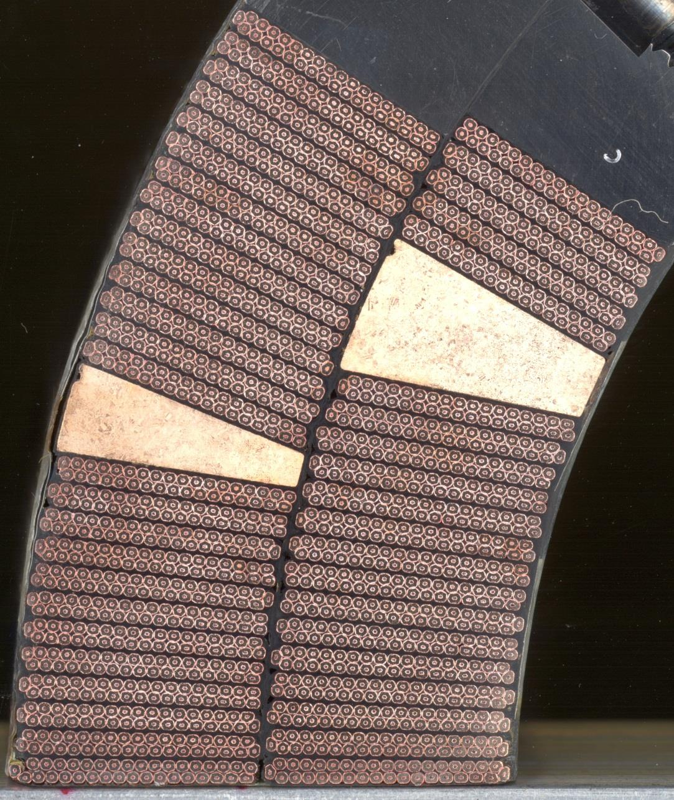
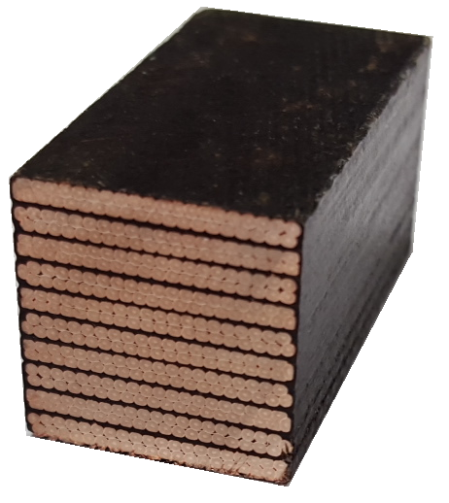
Introduction
Future Circular Collider (FCC)
Ferracin et al. 2015
CHART project
15 mm
15 mm
Transverse
20 mm
Radial
Axial
Daly et al. 2018
CERN website
Ferracin et al. 2015 Transactions on Applied Superconductivity (Volume: 26, Issue: 4, June 2016)
Daly et al. 2018 Transactions on Applied Superconductivity (Volume: 28, Issue: 3, April 2018)
Notes:
CERN-FCC → CHART → scale to 10-stack

Slide 3
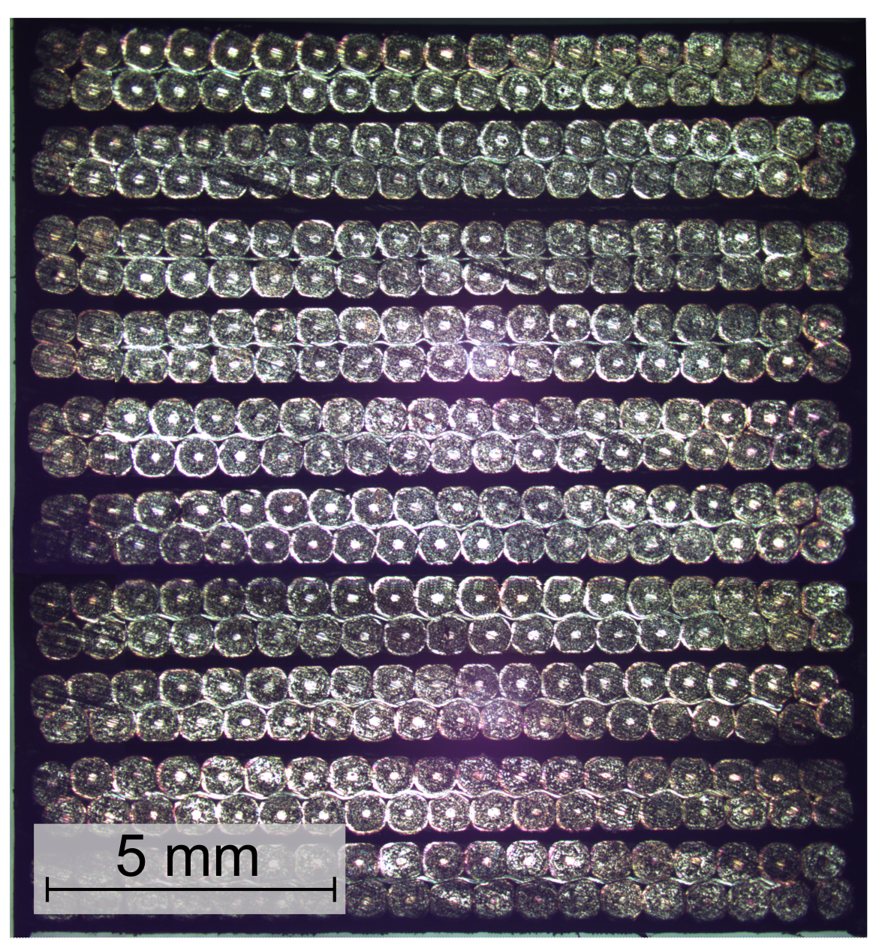
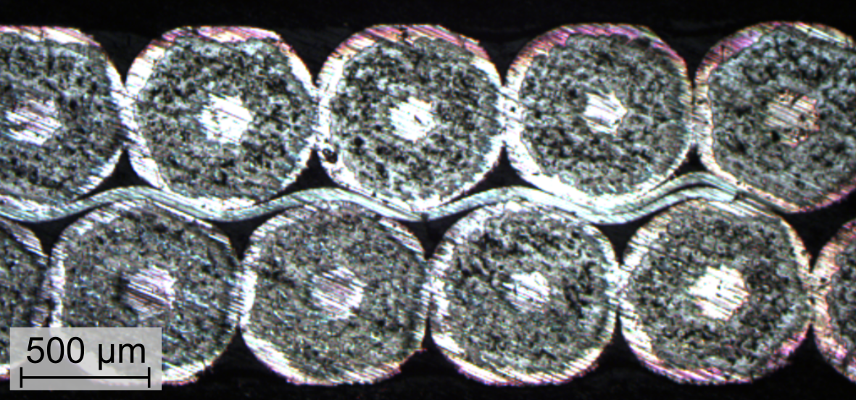
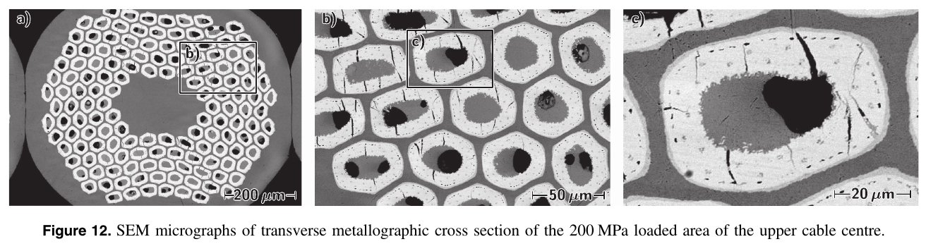
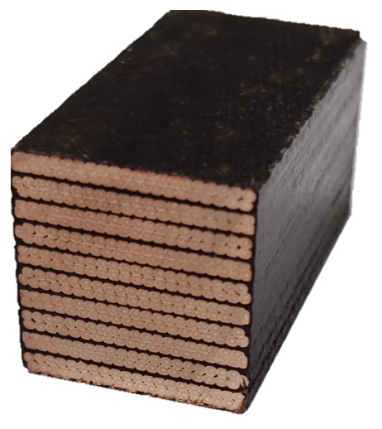
Multiscale structure → heterogeneous
Rutherford cable stack
Vallone, MDP Meeting 2022
Ebermann et al. 2018
~15 mm
~ 1 mm
~750 μm
~50 μm
Cubic level
Stack level
Strand level
Filament level
Epoxy
Strand
Insulation
Stainless-steel core
Copper matrix
Nb₃Sn micro filaments
Nb₃Sn filament
Copper matrix
Void
10-stack cable
Ebermann et al. 2018, Supercond. Sci. Technol. 31 (2018) 065009
Notes:
→ Mechanical compressive testing

Slide 4
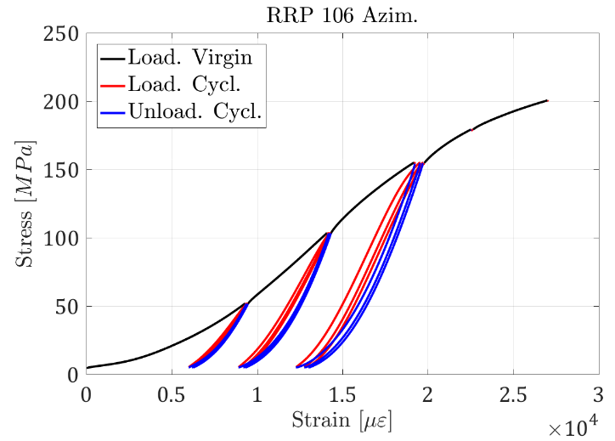
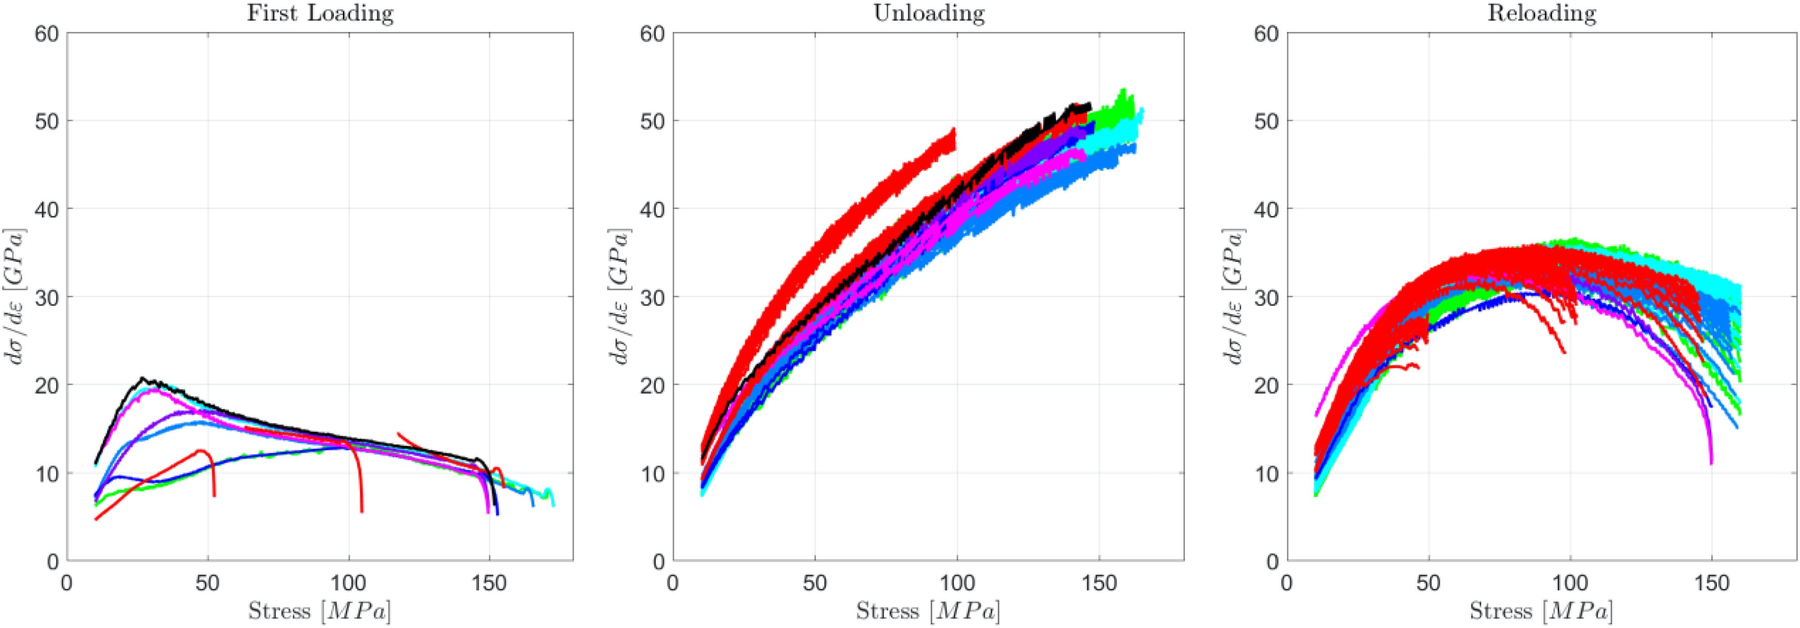
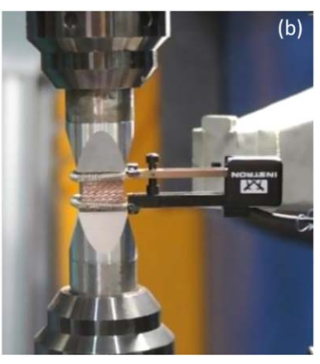
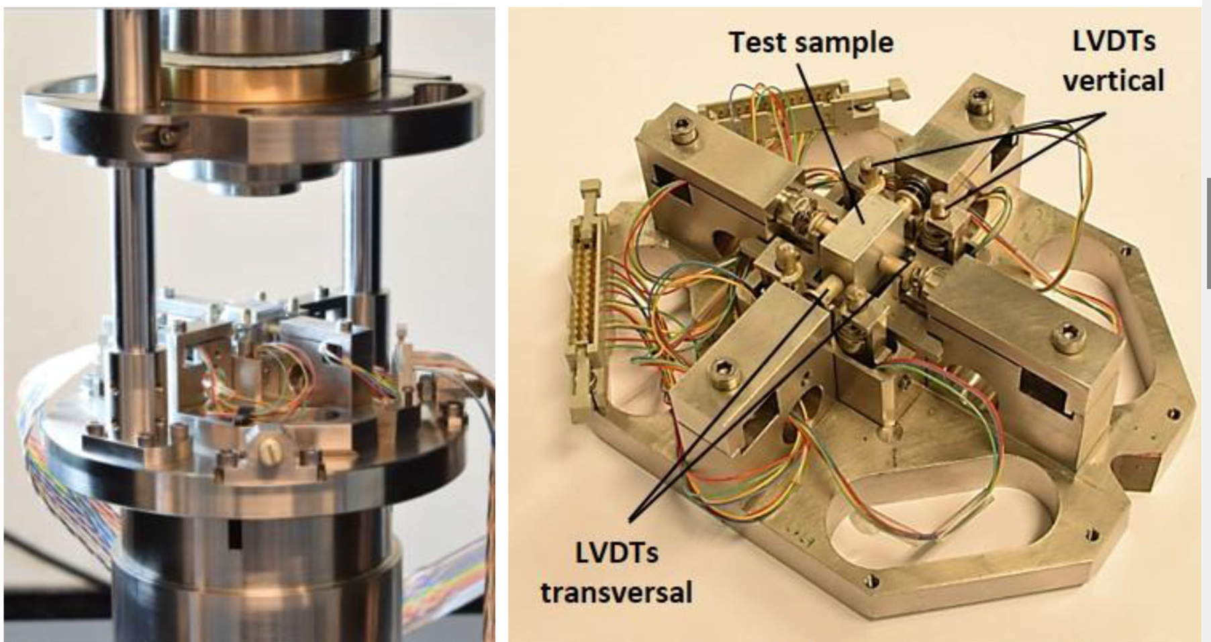


Bibliography
‘Strain – stress’ identification
$${∆d}_{tot}$$
Clip-on extensometer
$$∆d_{s}$$
Scheuerlein et al. 2019
Vallone et al. 2018
LVDT: Linear Variable Differential Transformer
Nonlinear → unloading → modulus
Homogenization
Limitation:
Homogenization: 1D information
Hardly measure at cryogenics (e.g., LN₂)
Fichera et al. 2019
Scheuerlein et al. 2019 Supercond. Sci. Technol. 32 (2019) 045011
Vallone et al. 2018 Transactions on Applied Superconductivity (Volume: 28, Issue: 4, June 2018)
Fichera et al. 2019 Transactions on Applied Superconductivity (Volume: 29, Issue: 7, October 2019)

Slide 5
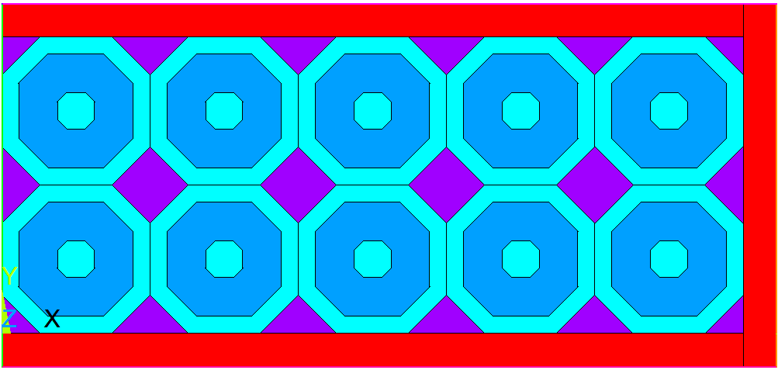
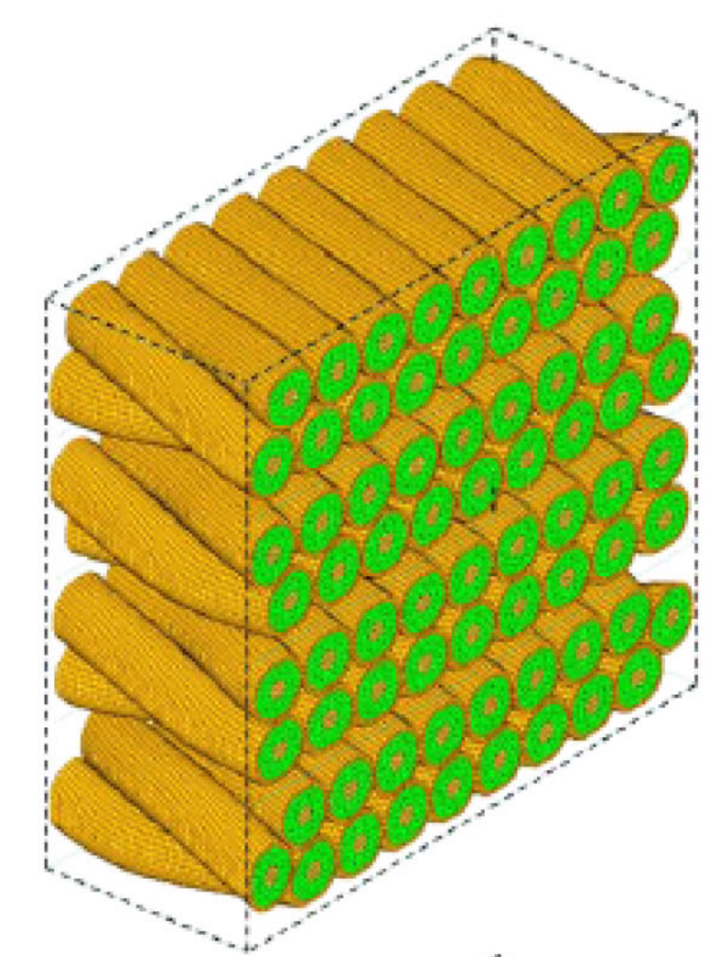
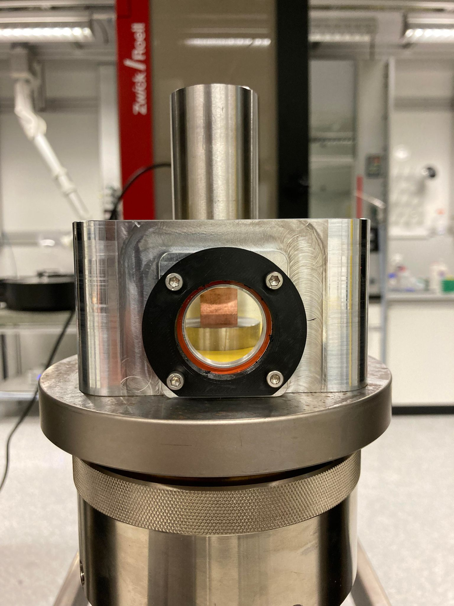

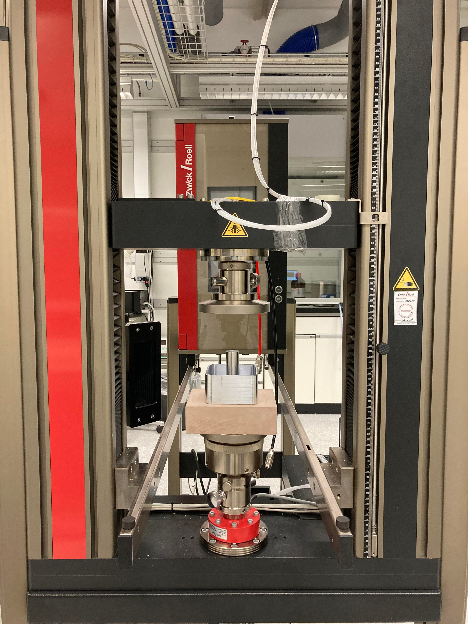
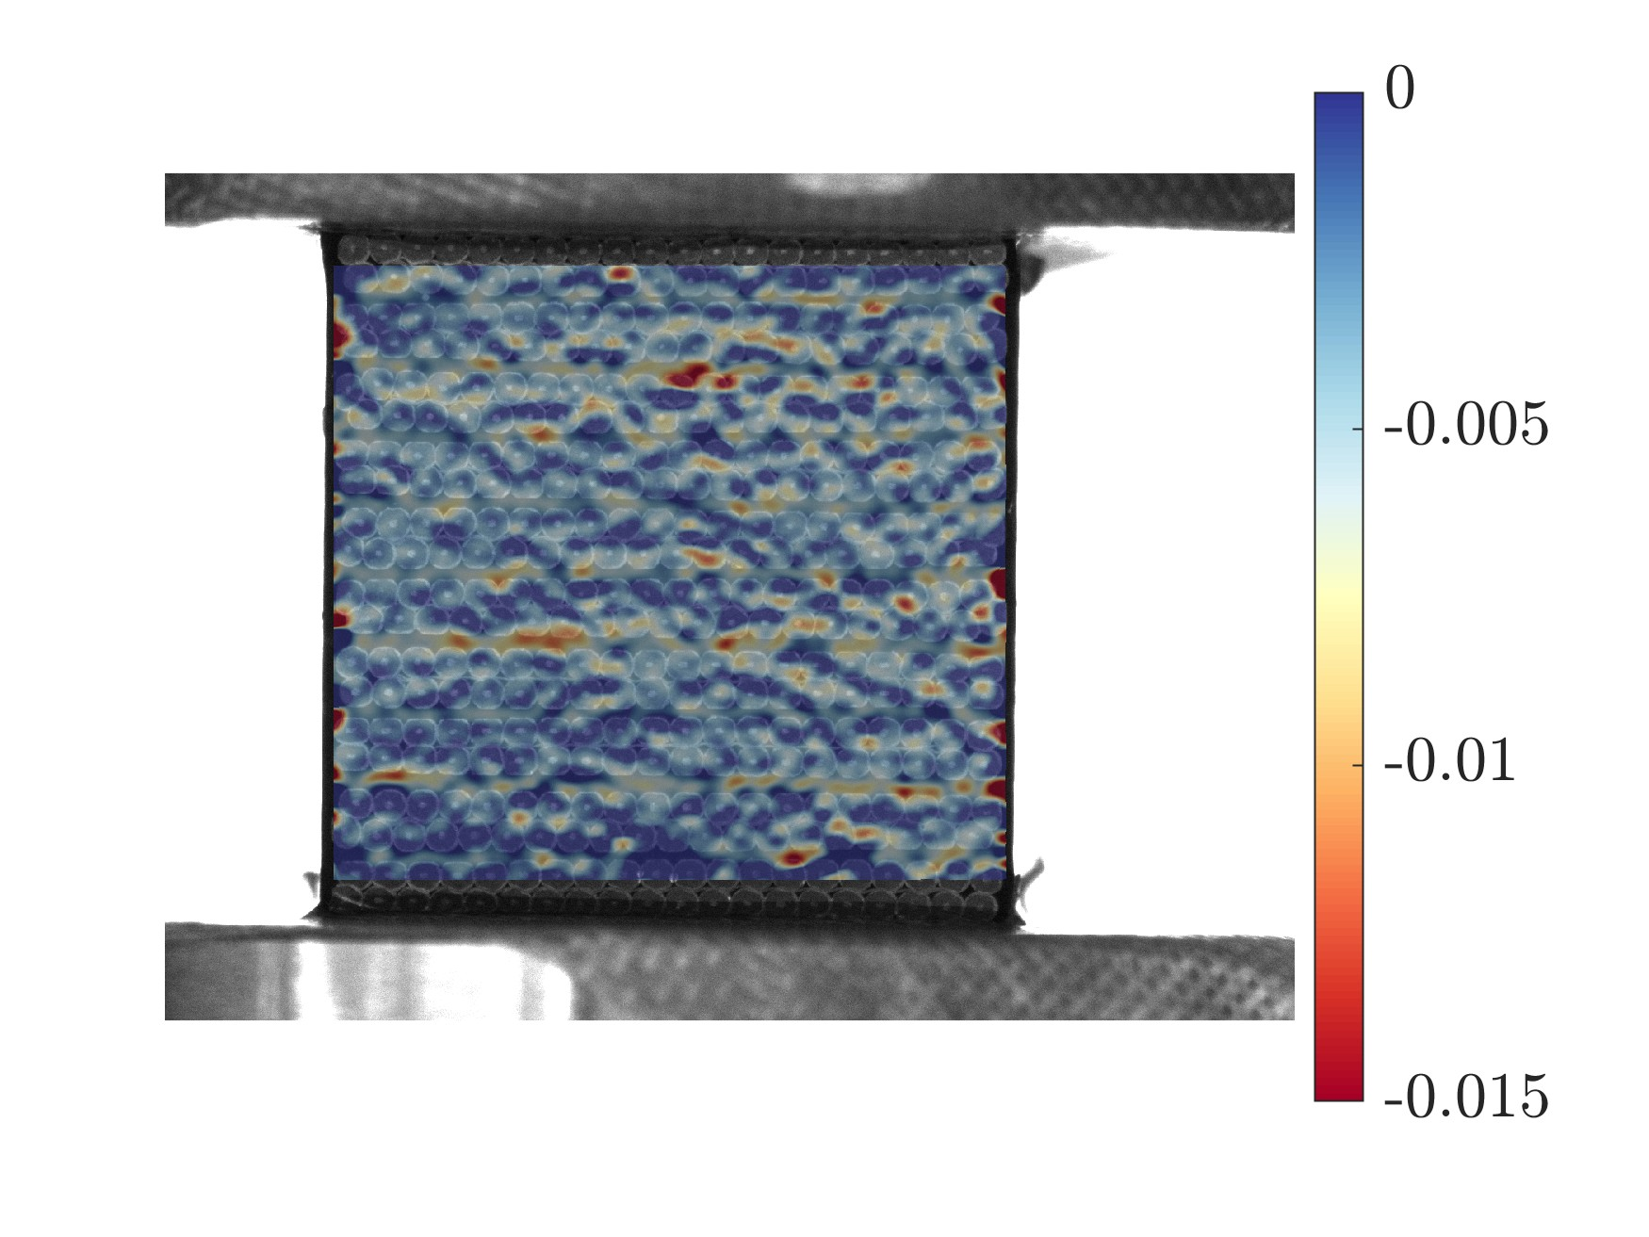
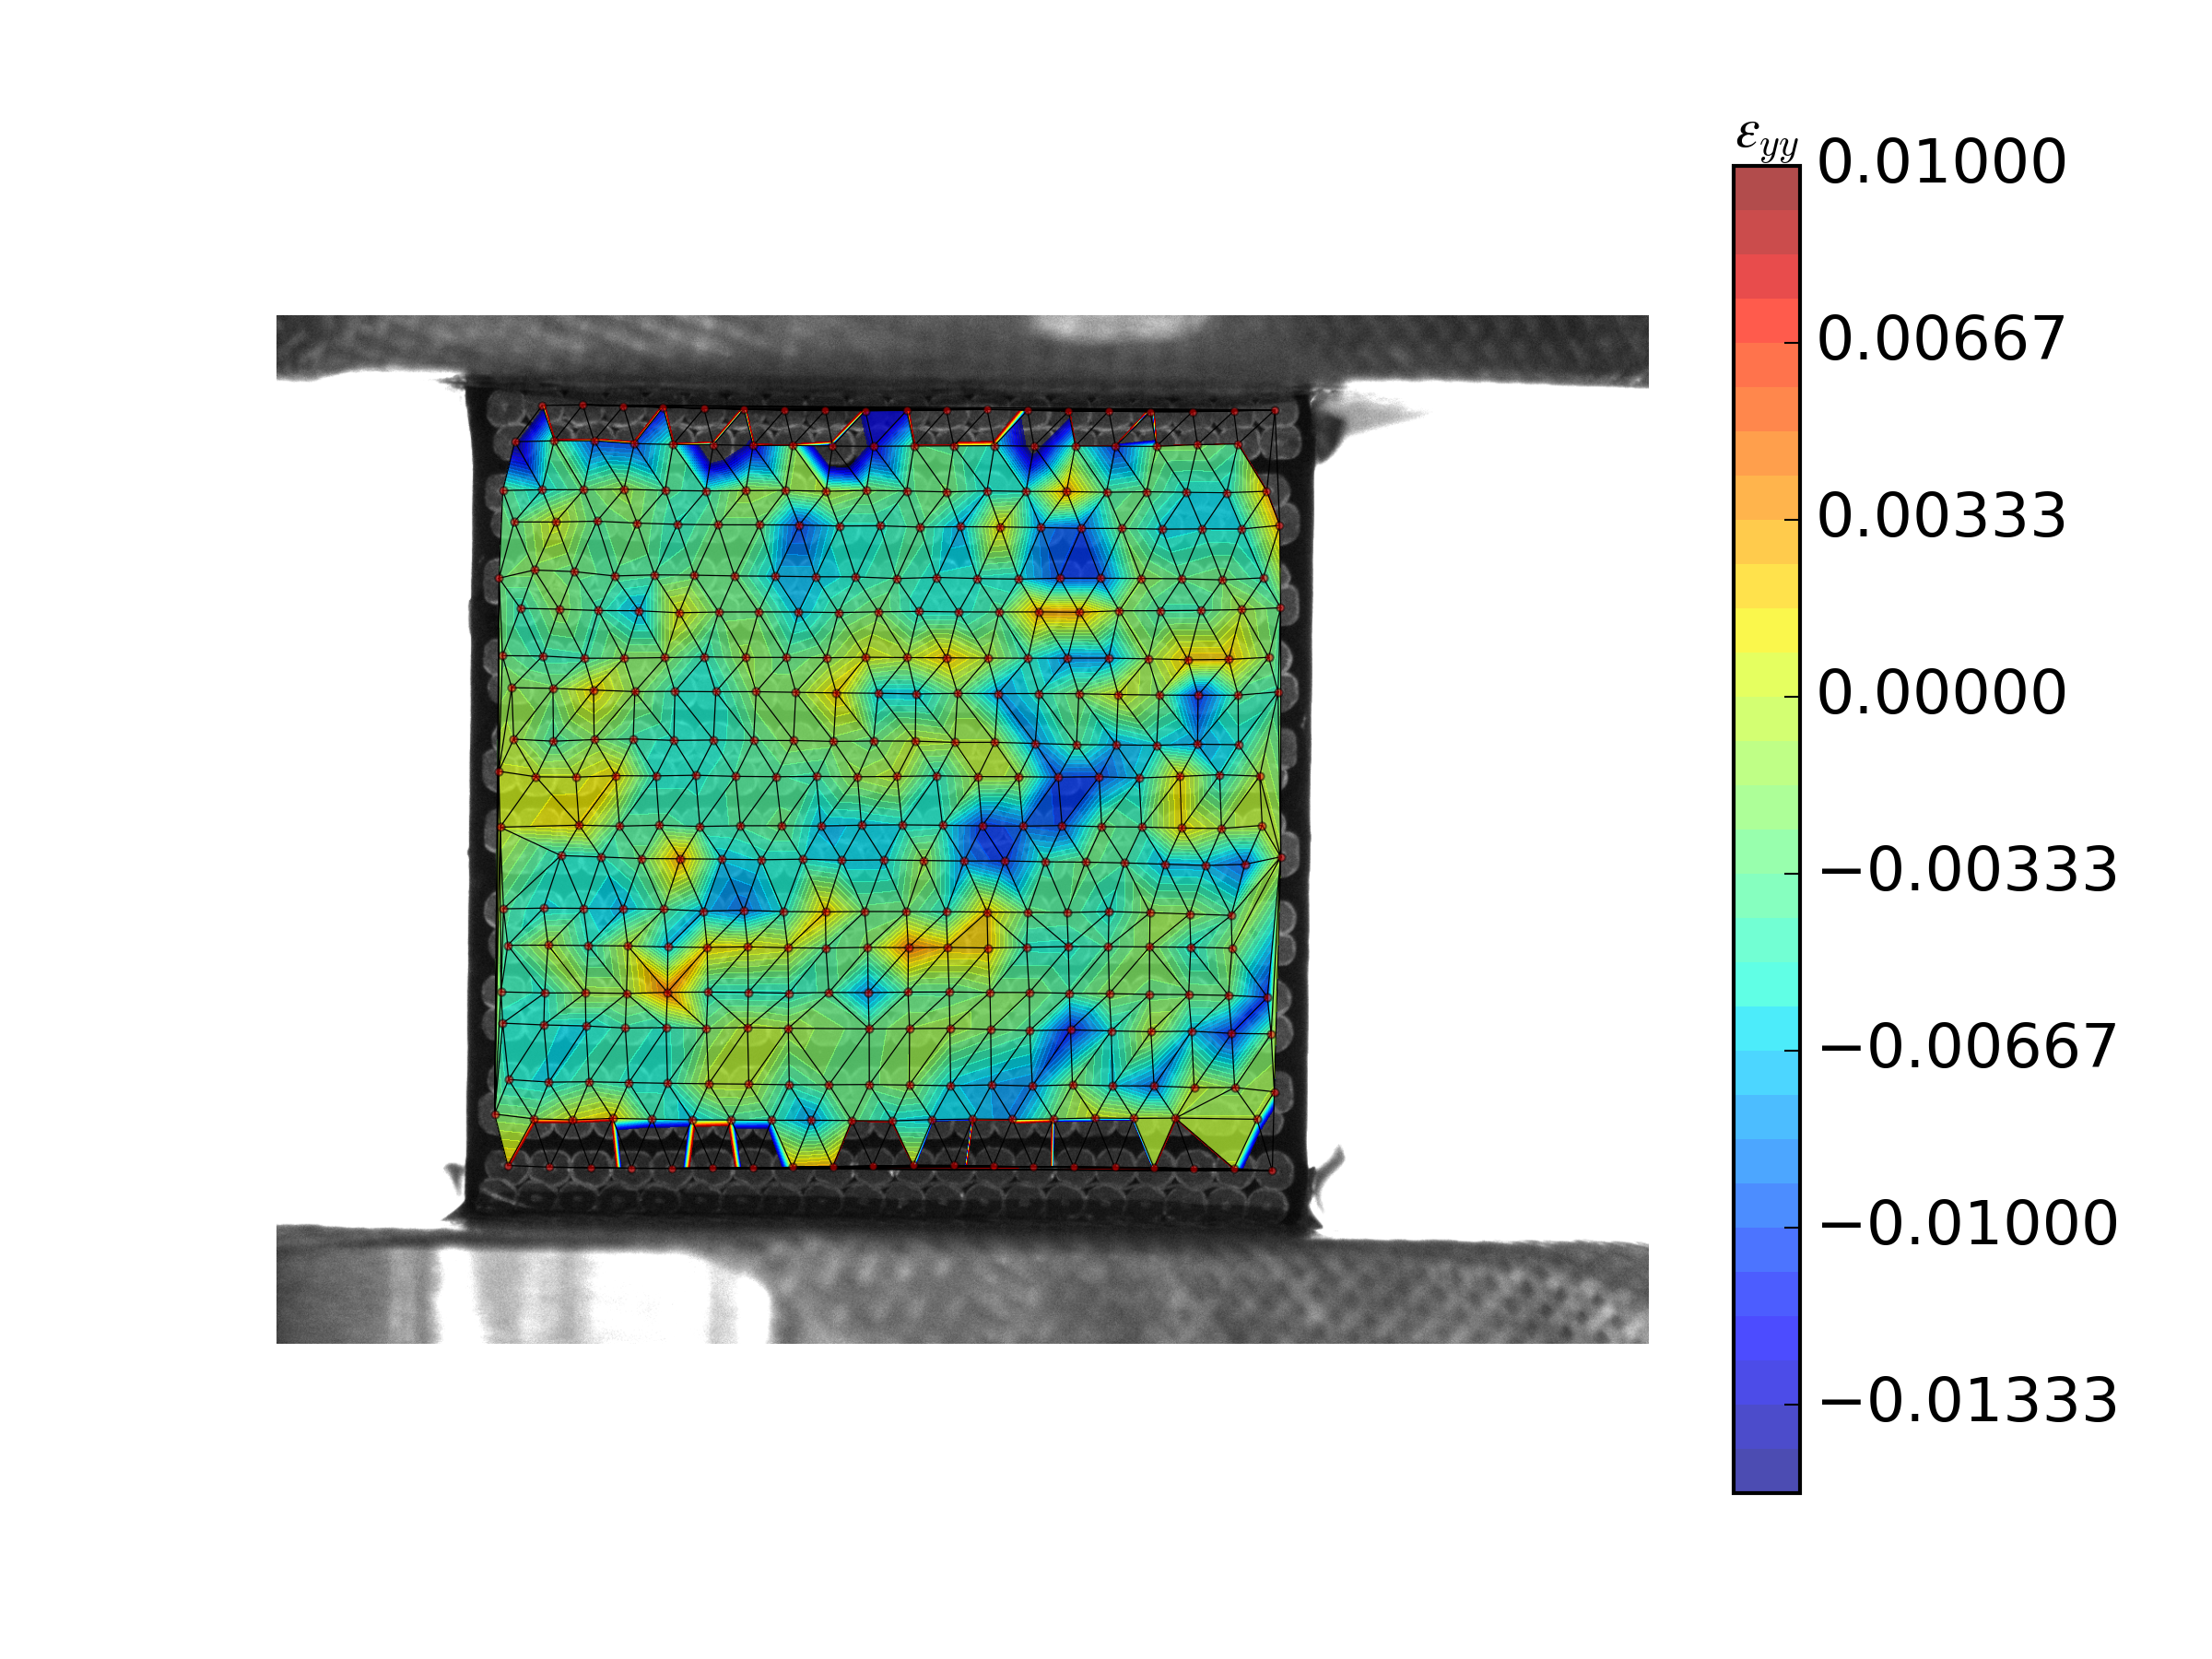
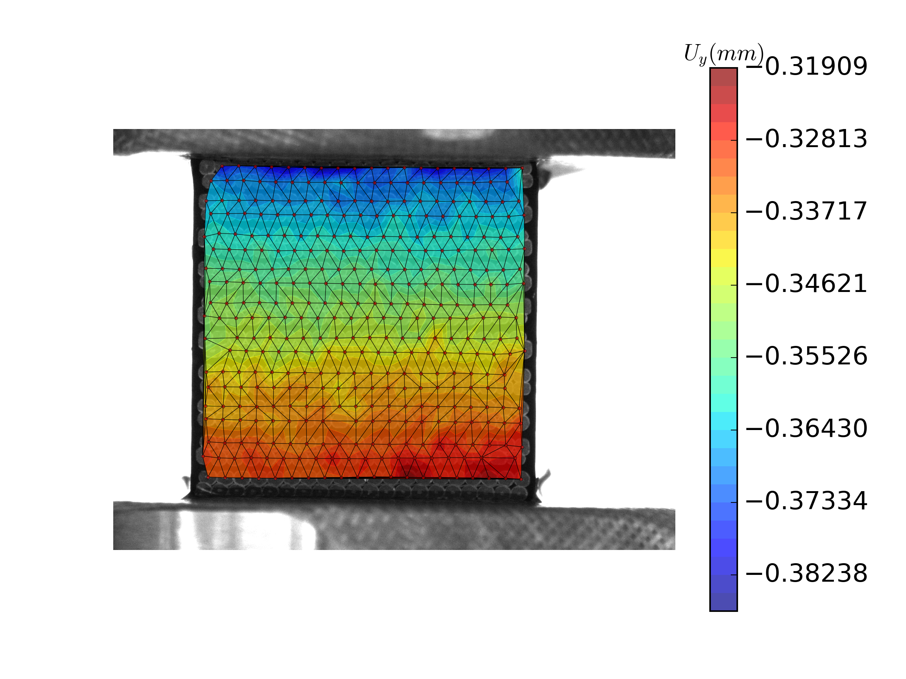
Structure
15 mm
FEM modeling
15 mm
Experiment
20 mm
2D octagon
3D mesh
Component characterization
10-stack
Set-ups at LN₂
Epoxy (CTD101K)
Annealed Copper
Fiber glass etc.
Transverse
Axial/radial/other loads
[Nunio 2019]
Digital Image Correlation (DIC)
- Displacement field
- Strain field
‘Strand’ tracking
Measure by marker
Postprocess strain
Image analysis
Local measurement
Strain ε_{yy} field
Displacement U_{y}
Strain ε_{yy} field

Slide 6
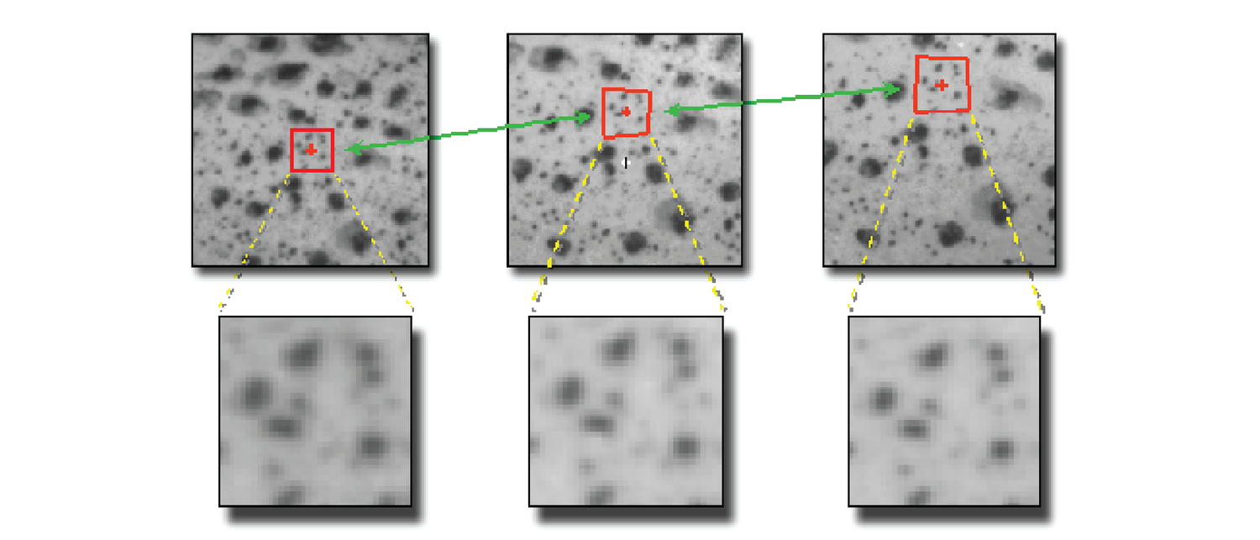
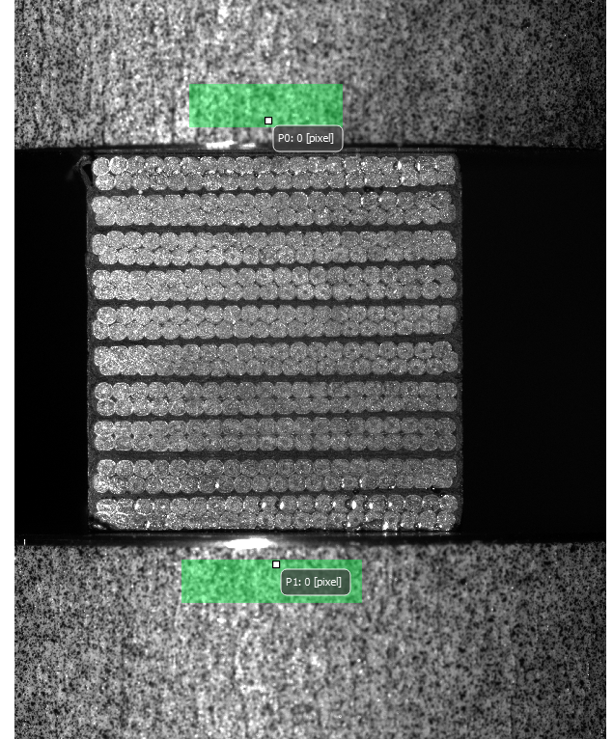
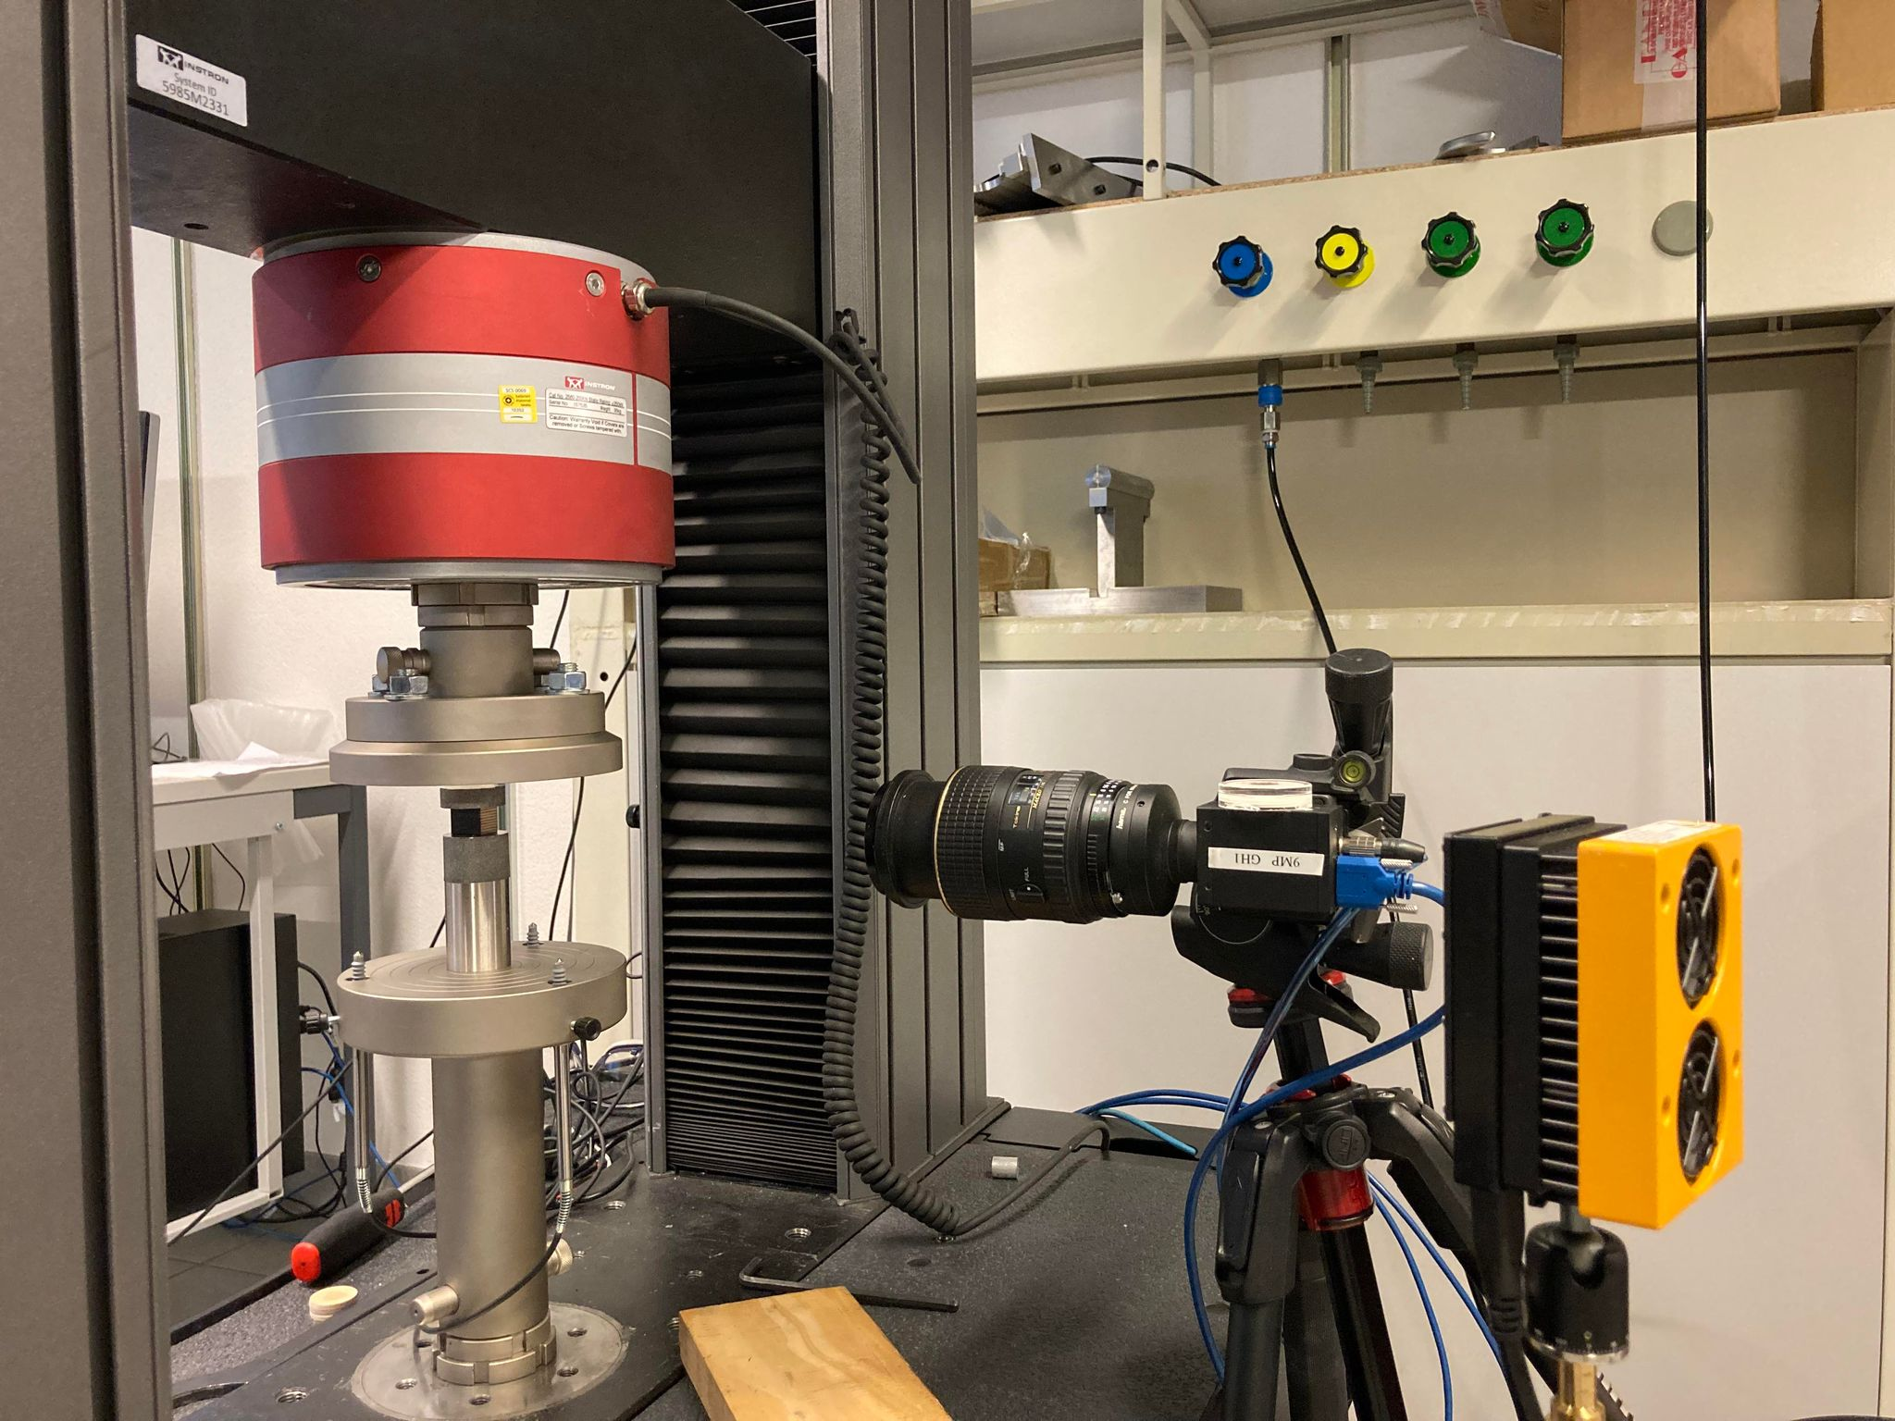

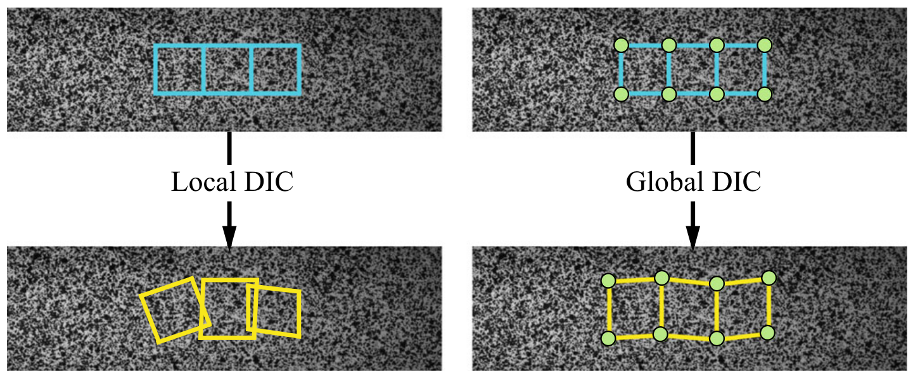
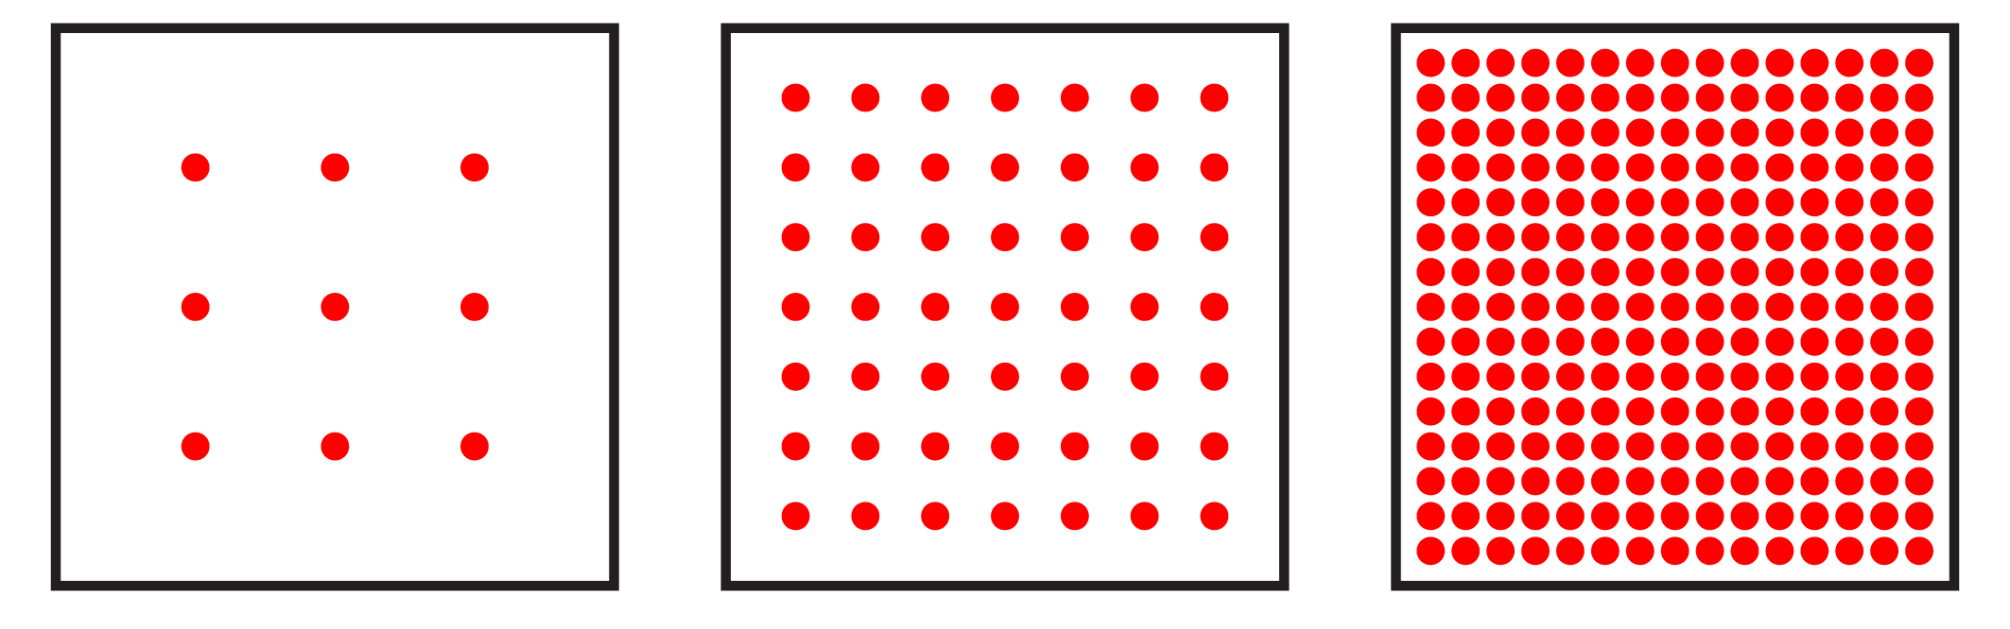
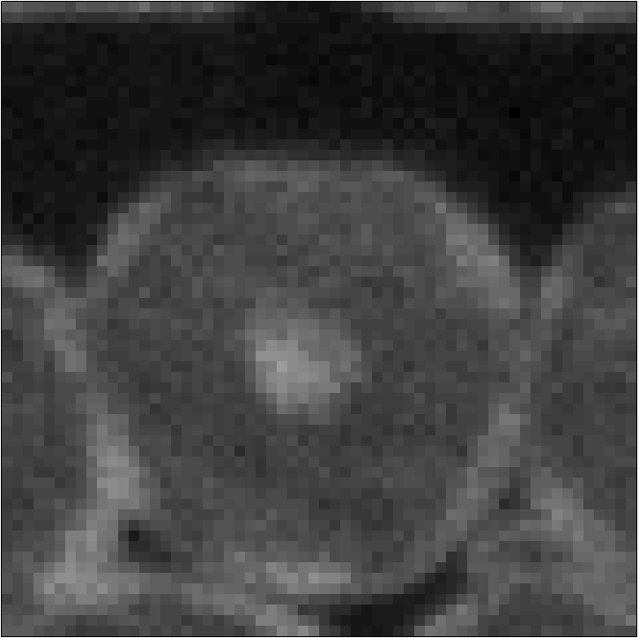

Image analysis: optical extensometer
Digital image correlation (DIC)
Measure local displacement by undeformed markers at cubic level (15 mm)
VIC2d
Courtesy of Tancogne-Dejean @MAVT-Mohr’s lab
Subset size → measure at stack level
Step size → control nodal points within one subset
t₀
60 pixels ~1 mm
t₁
Yang, Bhattacharya, Exp Mech (2019)
2 mm
$$f\left(x,t0\right)≈g\left(x+u\left(x\right),t1\right)$$
1440x1080 px², 17.1 μm/px
Notes:
DIC technique → local or global methods → Experimental set-ups as optical extensometer → stack level: in situ measurement

Slide 7
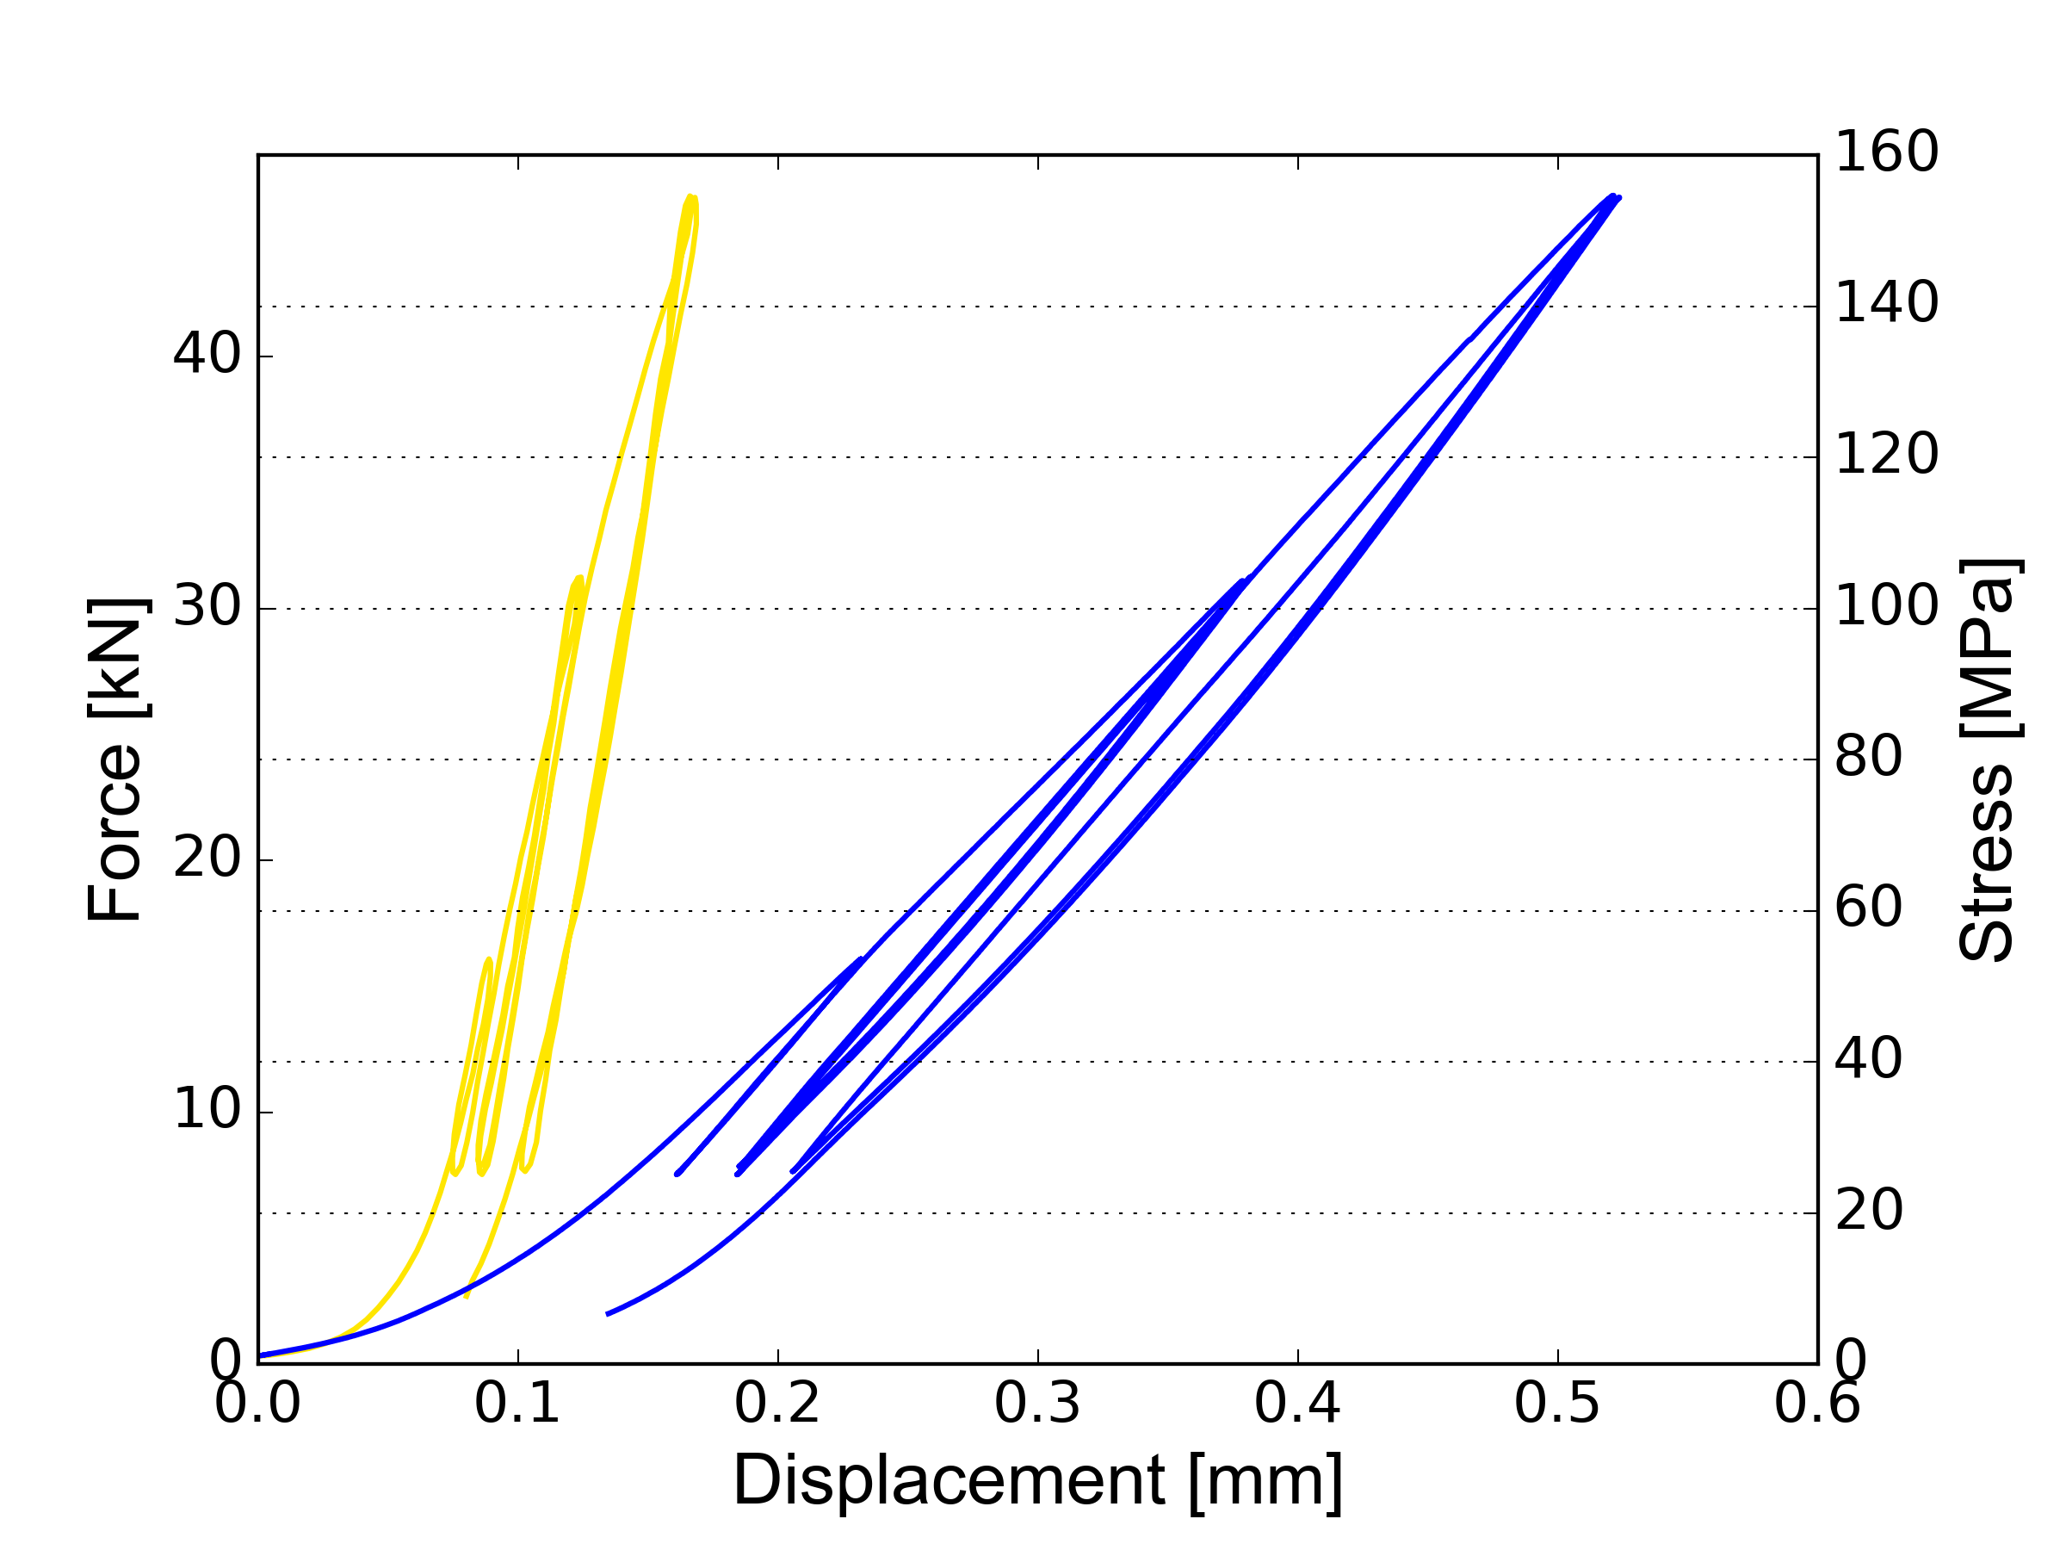
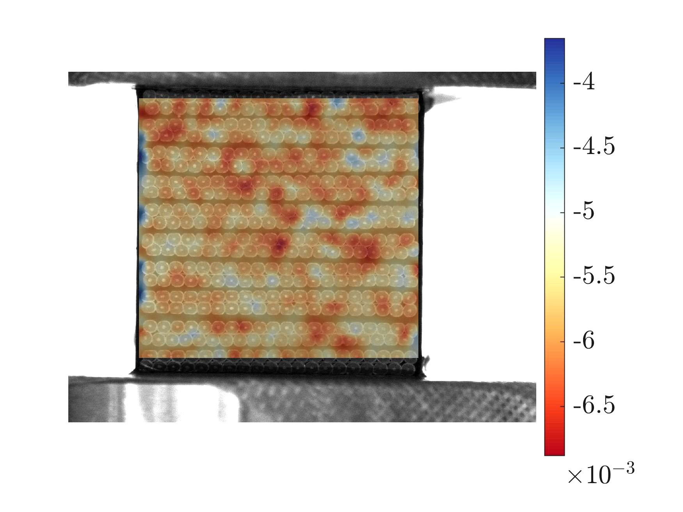
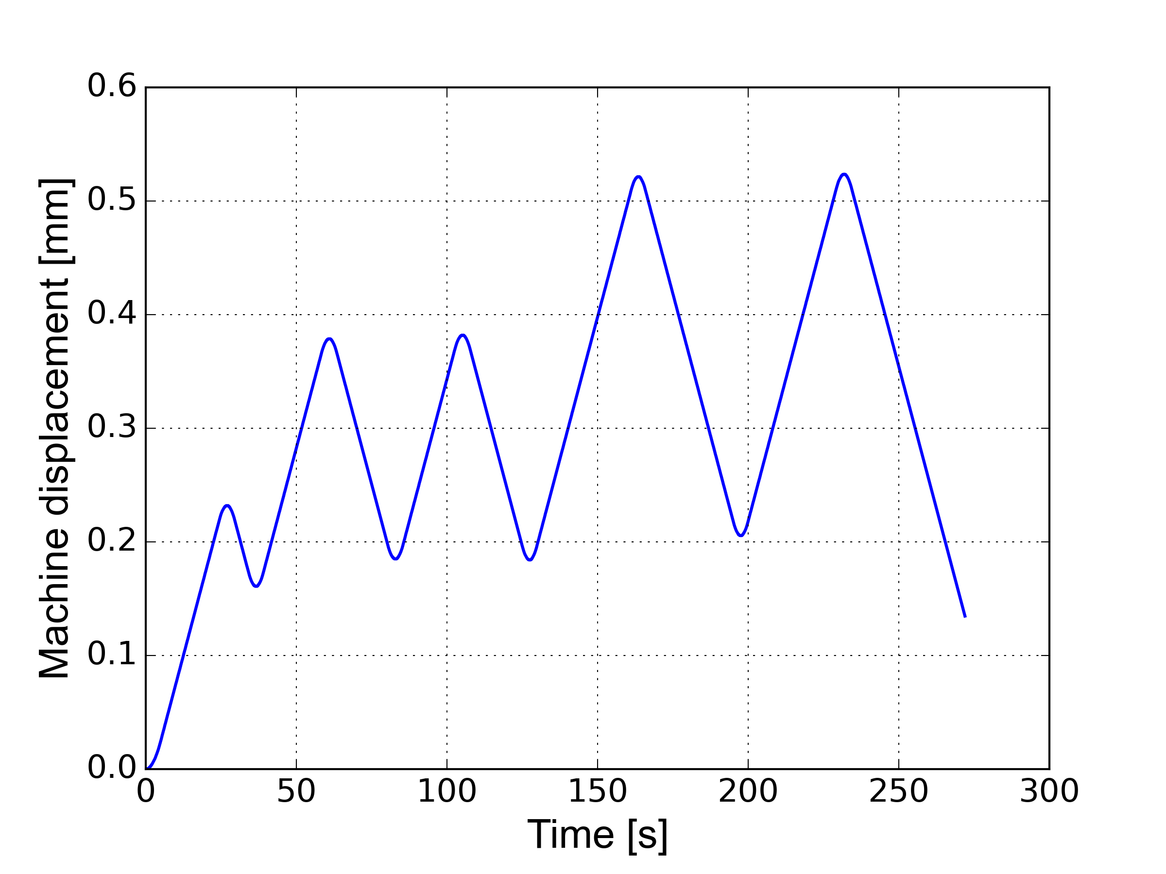
Image analysis: optical extensometer
Cubic level
Stack level
Vertical displacement U_{y} [mm]
Displacement-controlled: 10 μm/s ~ 1 kN/s
Image capture rate: 1 s⁻¹ (273 images)
1D information
2D information

Slide 8
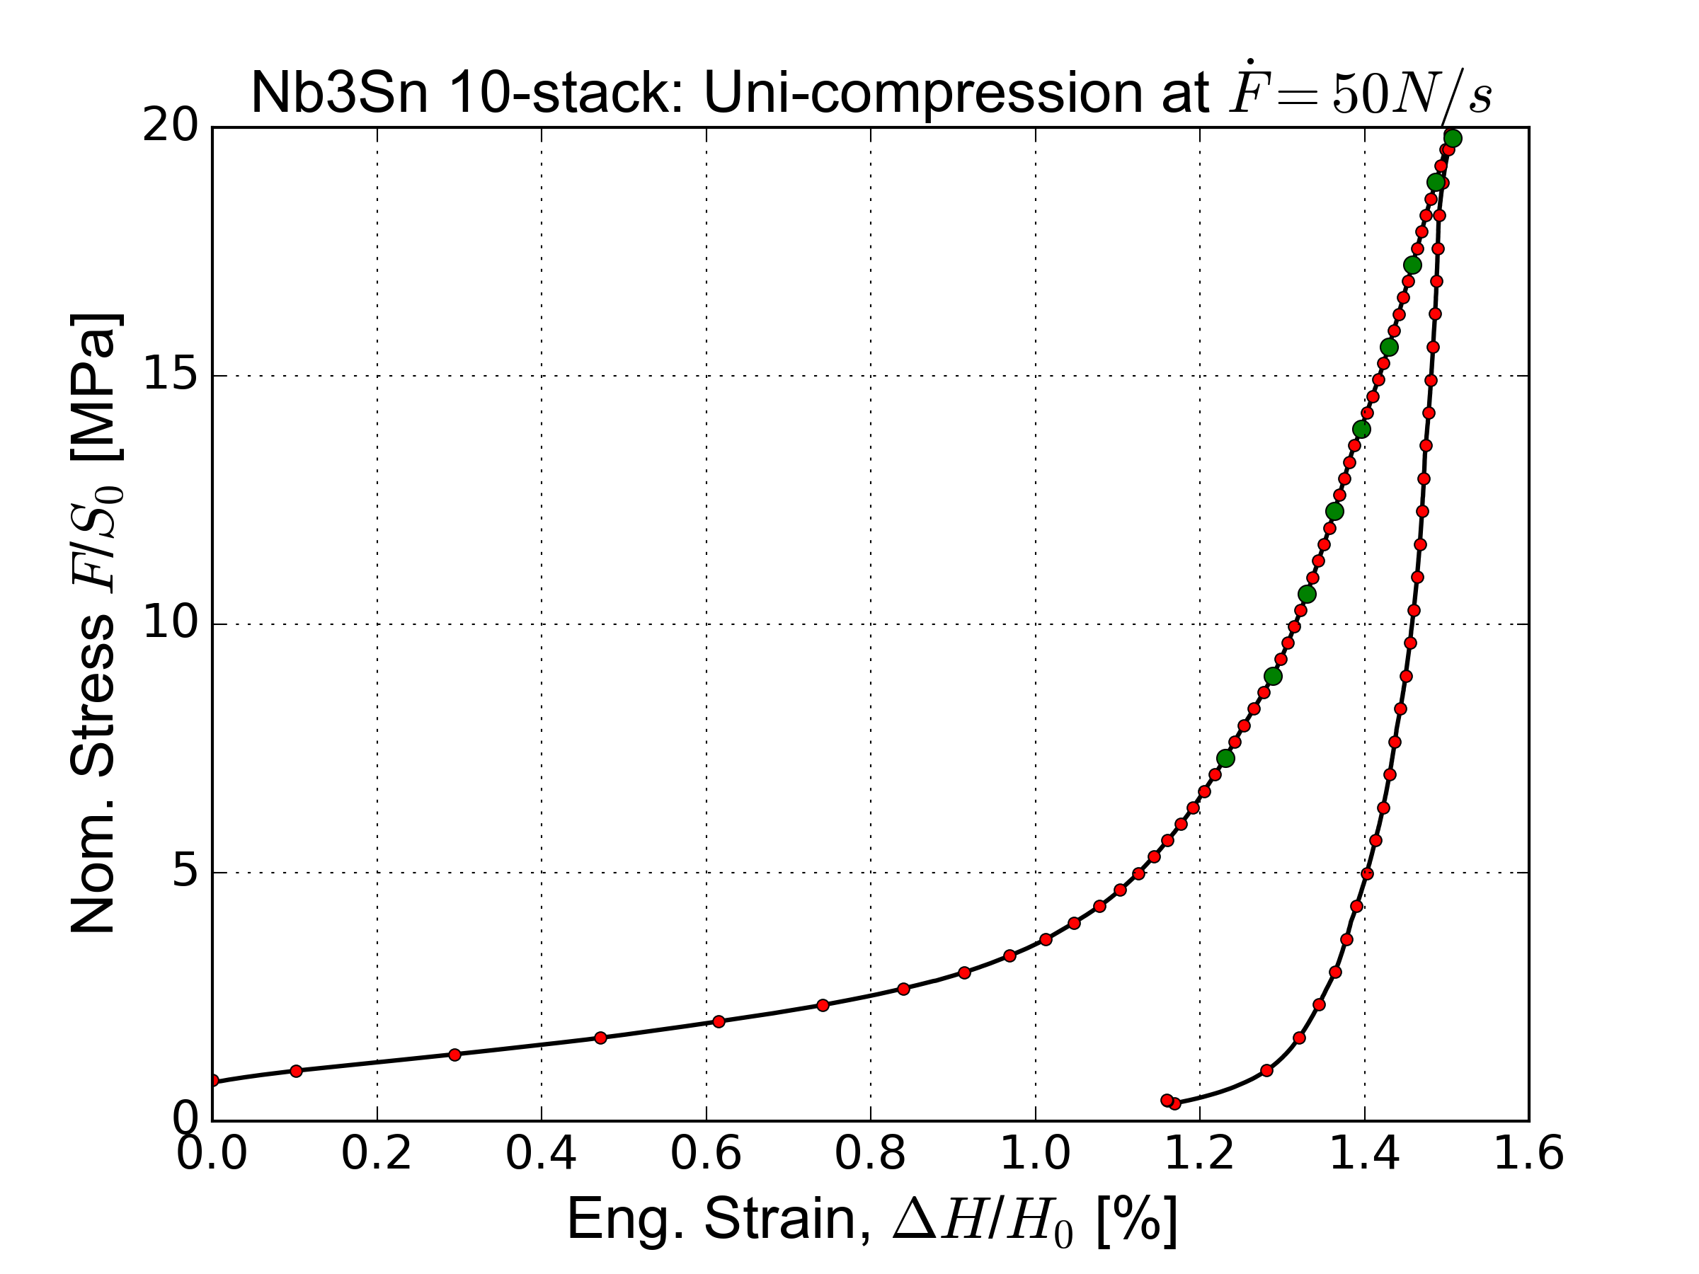
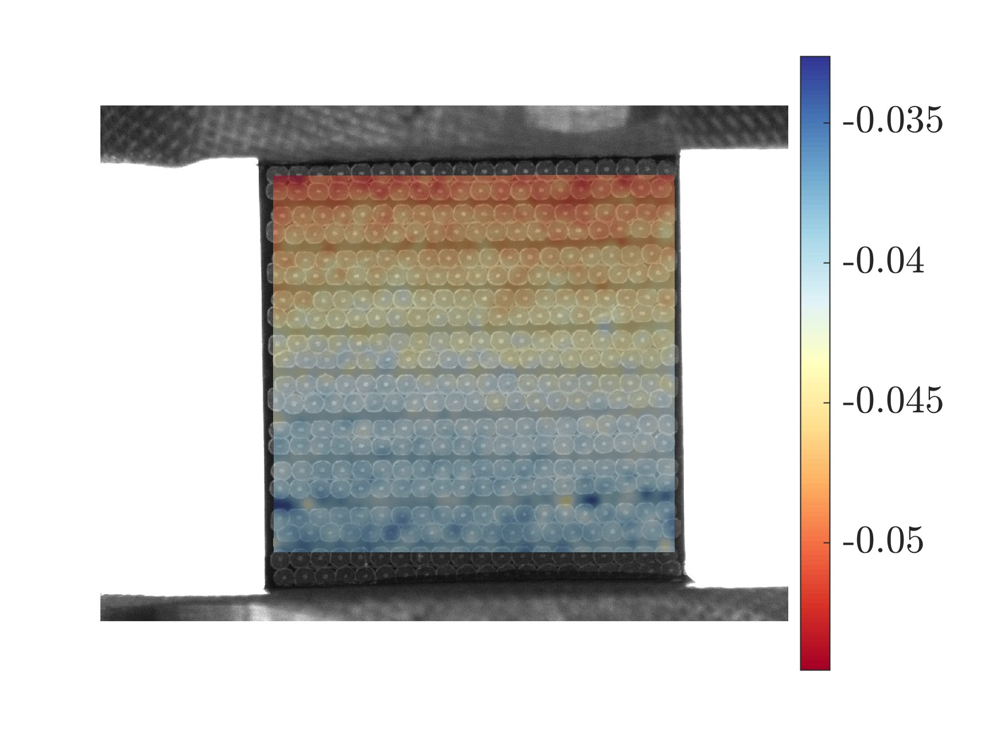
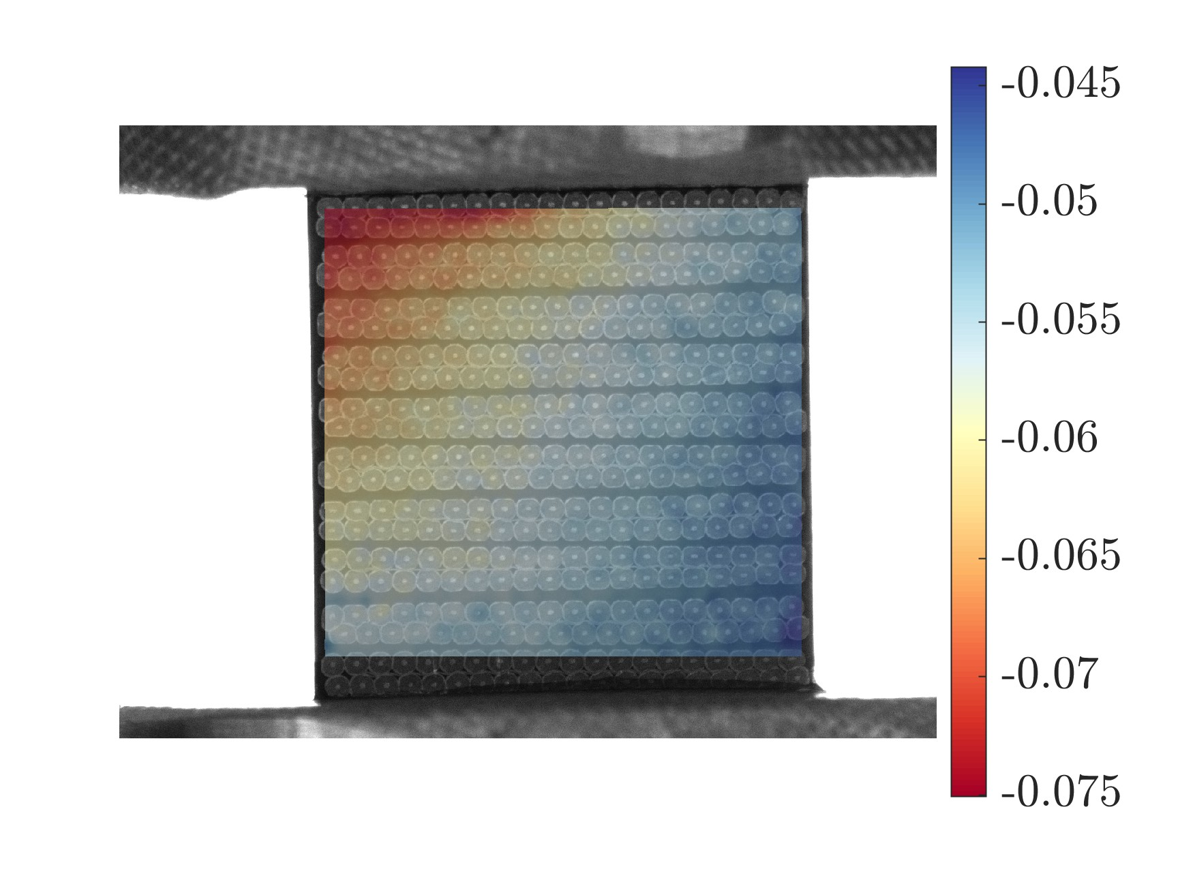
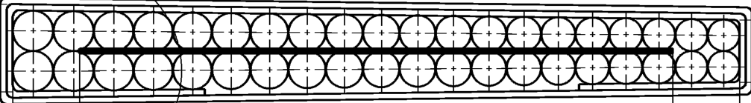
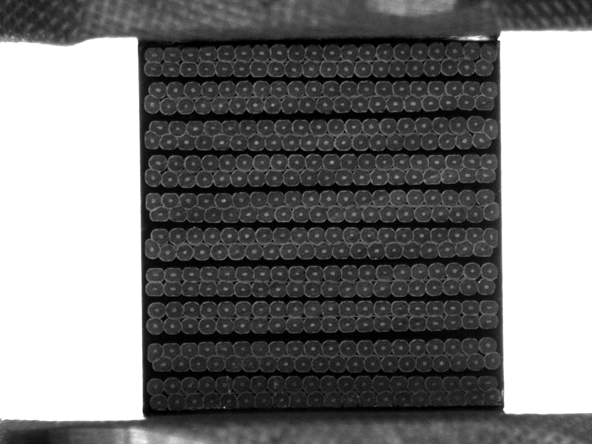
Displacement fields at low force (20 MPa)
Horizontal displacement U_{x} [mm]
Vertical displacement U_{y} [mm]
Deformed
Reference
CERN, 11T dipole magnet (2013)
→ start from 20MPa as pre-loading

Slide 9
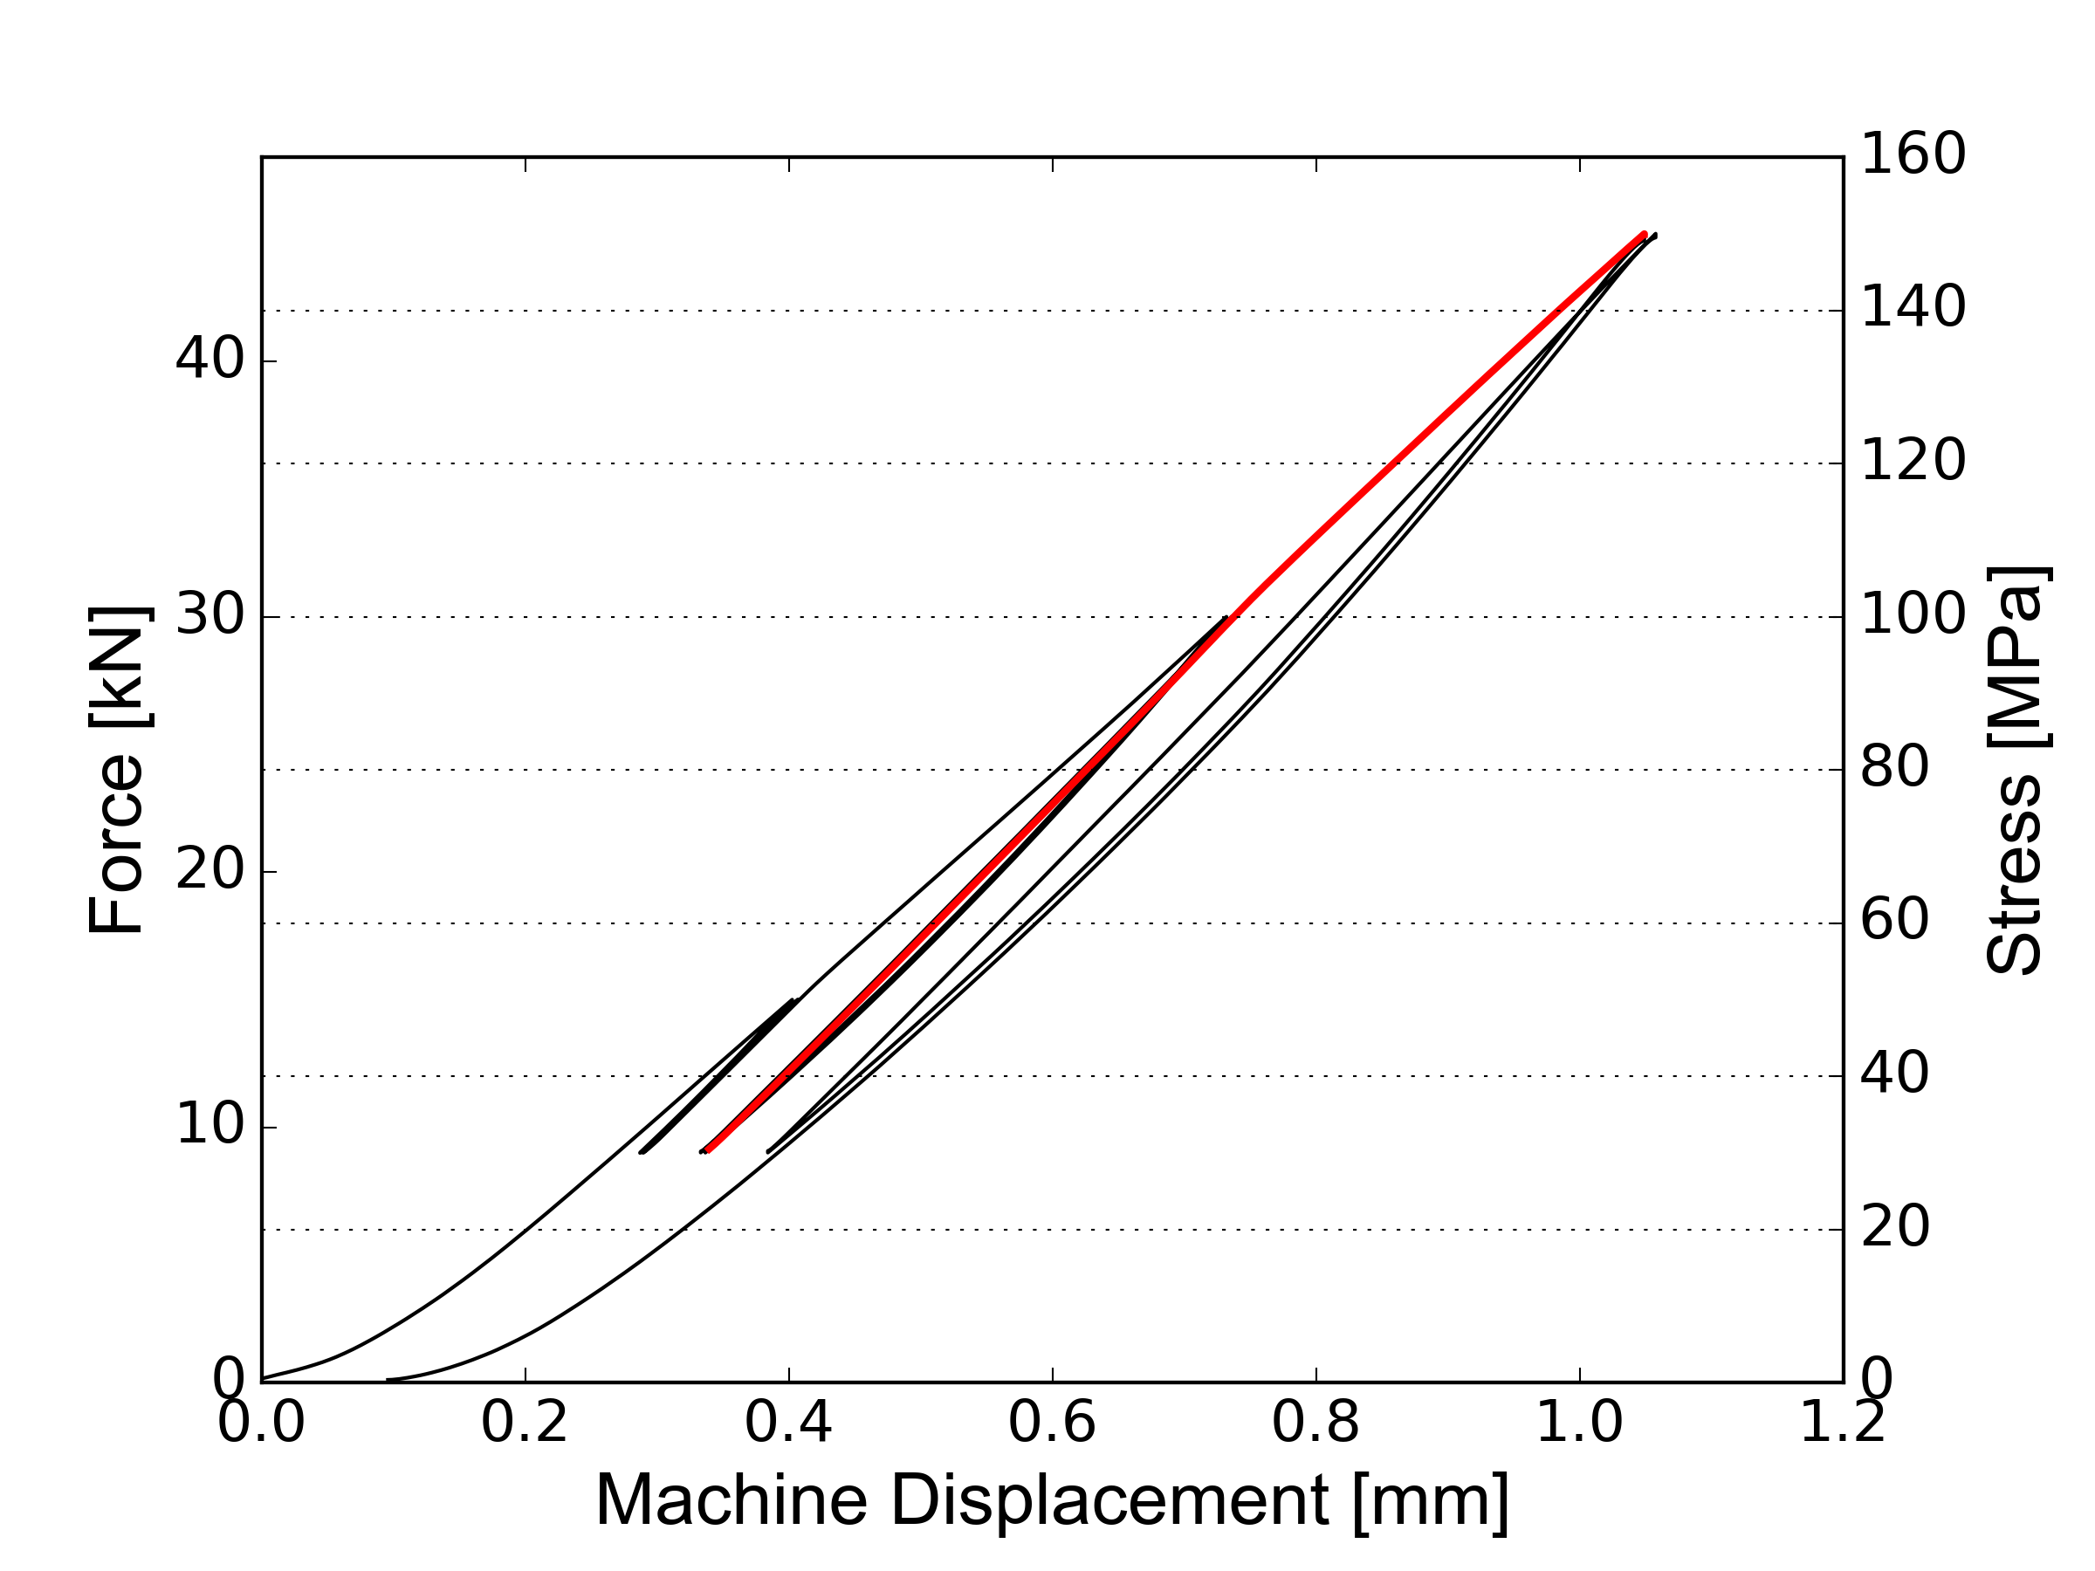
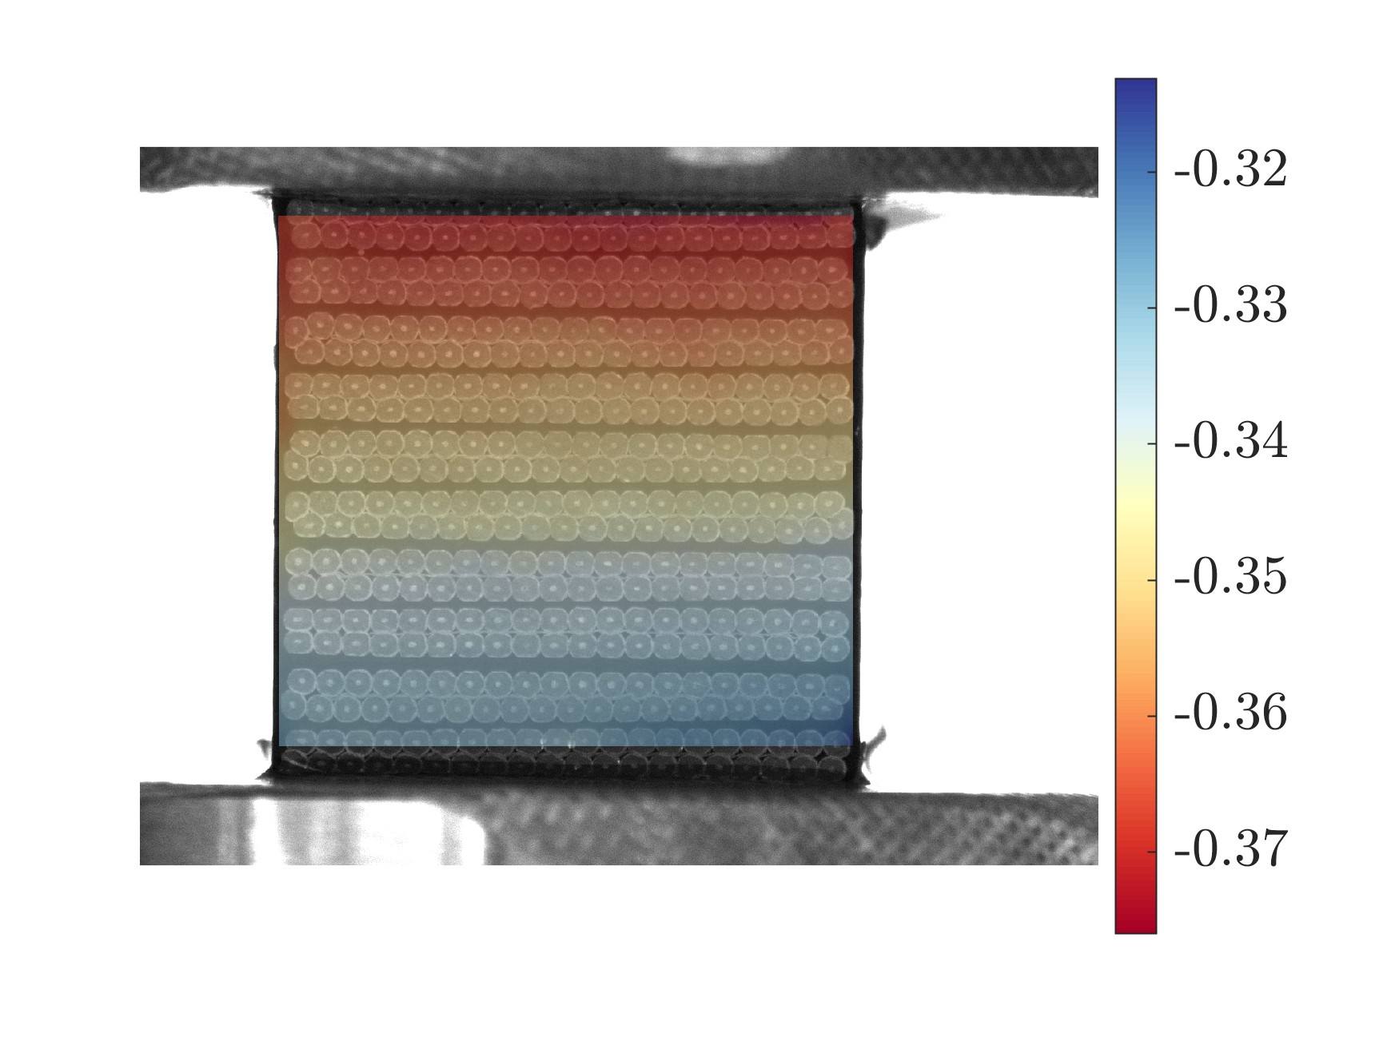

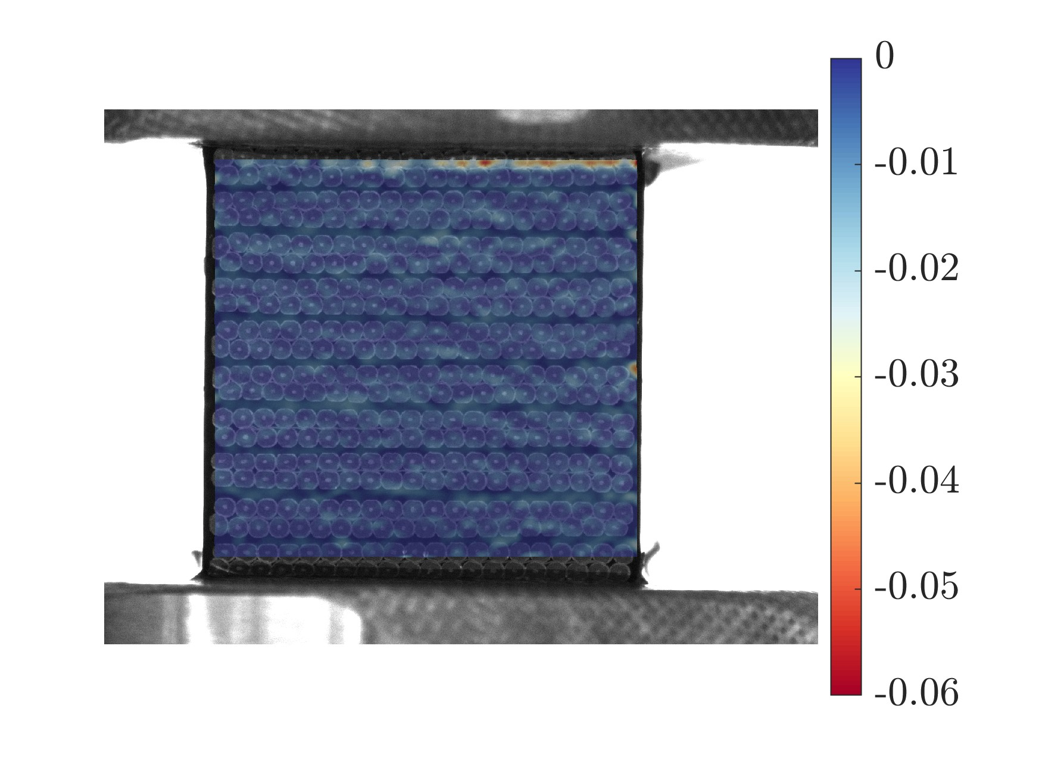
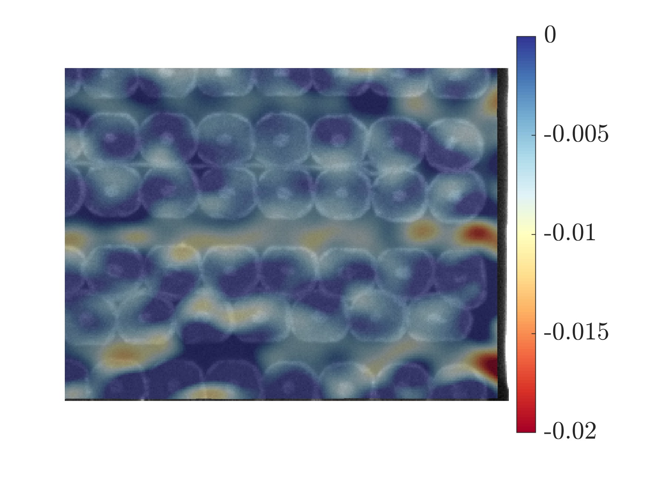
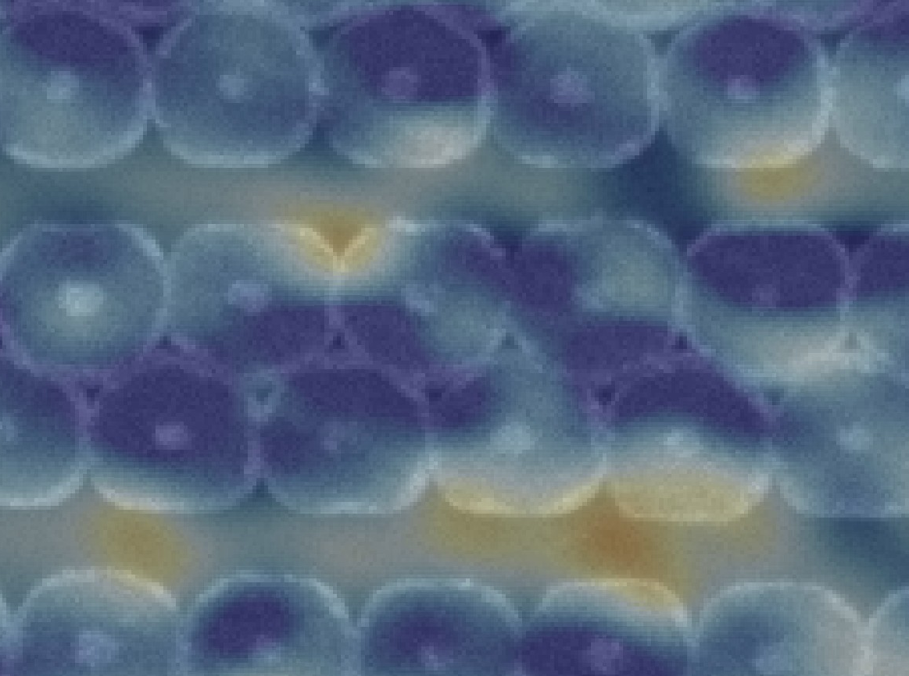
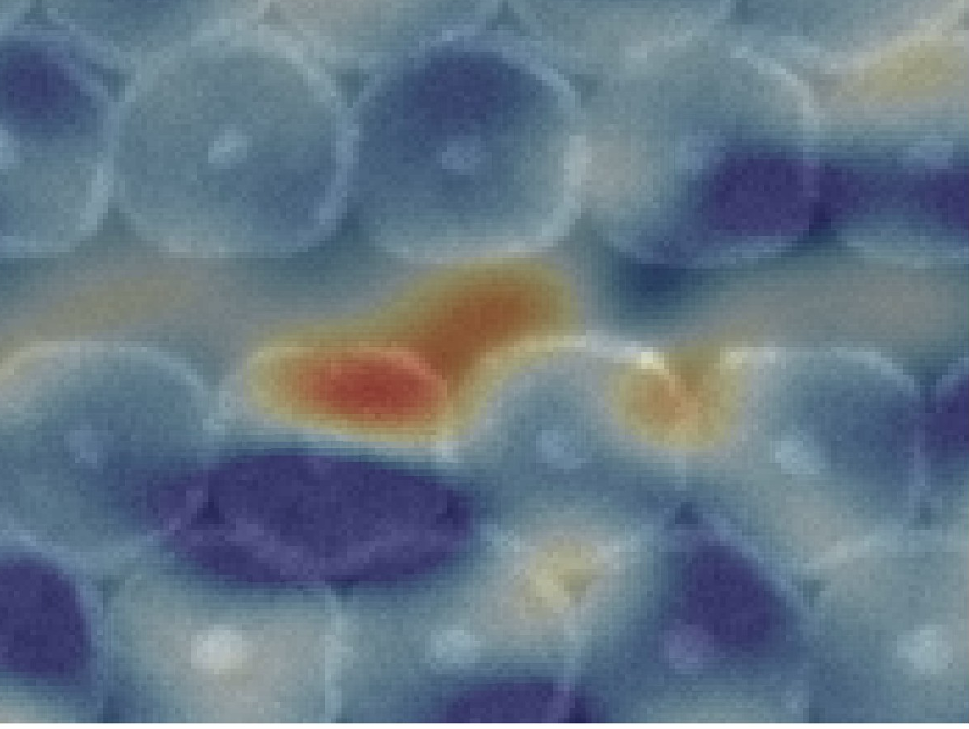
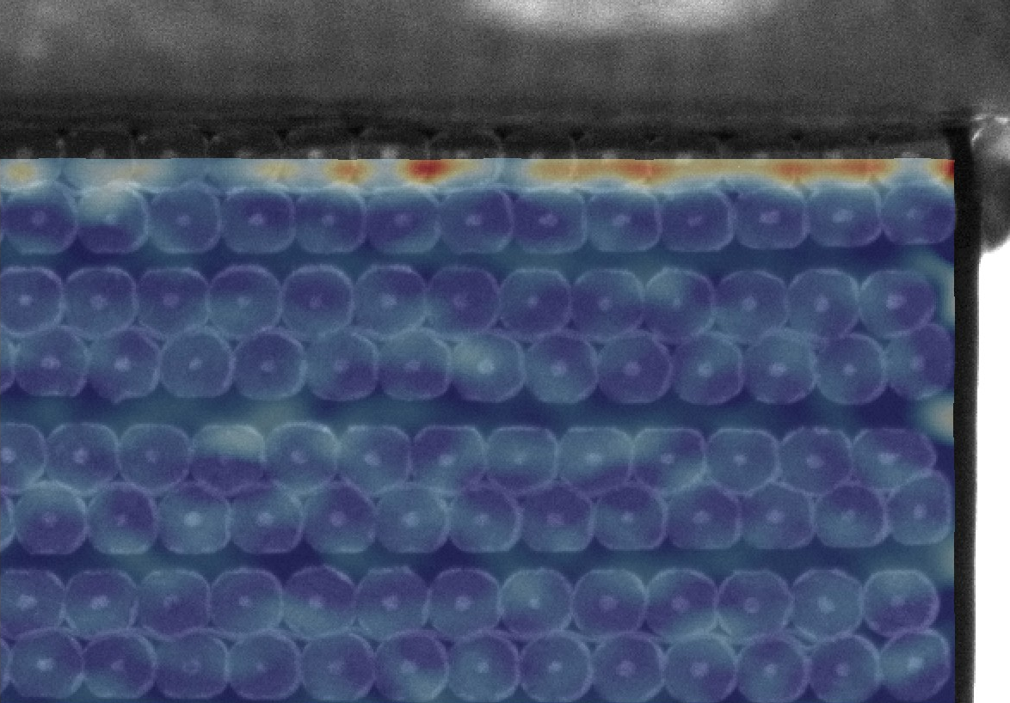
DIC results up to 150MPa
Vertical displacement U_{y} [mm]
Strain ε_{yy} (-)
Deformed
Reference
Strain ε_{yy} (-)
Sample edges (top/bottom) are the most deformed region (6%)
Some insulation layers are 1-2% strain level
The strain values depend on ‘mesh-equivalent’ parameters (subset, step)
Notes:
→ Find a ‘mesh-free’ approach to compare with different tests (camera, resolution etc)

Slide 10
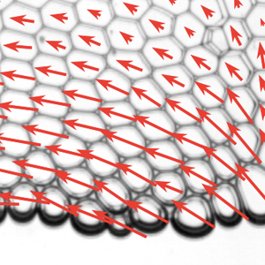
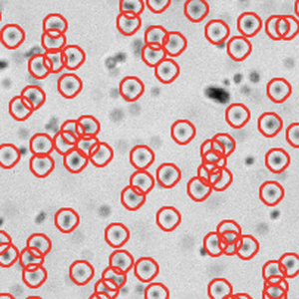
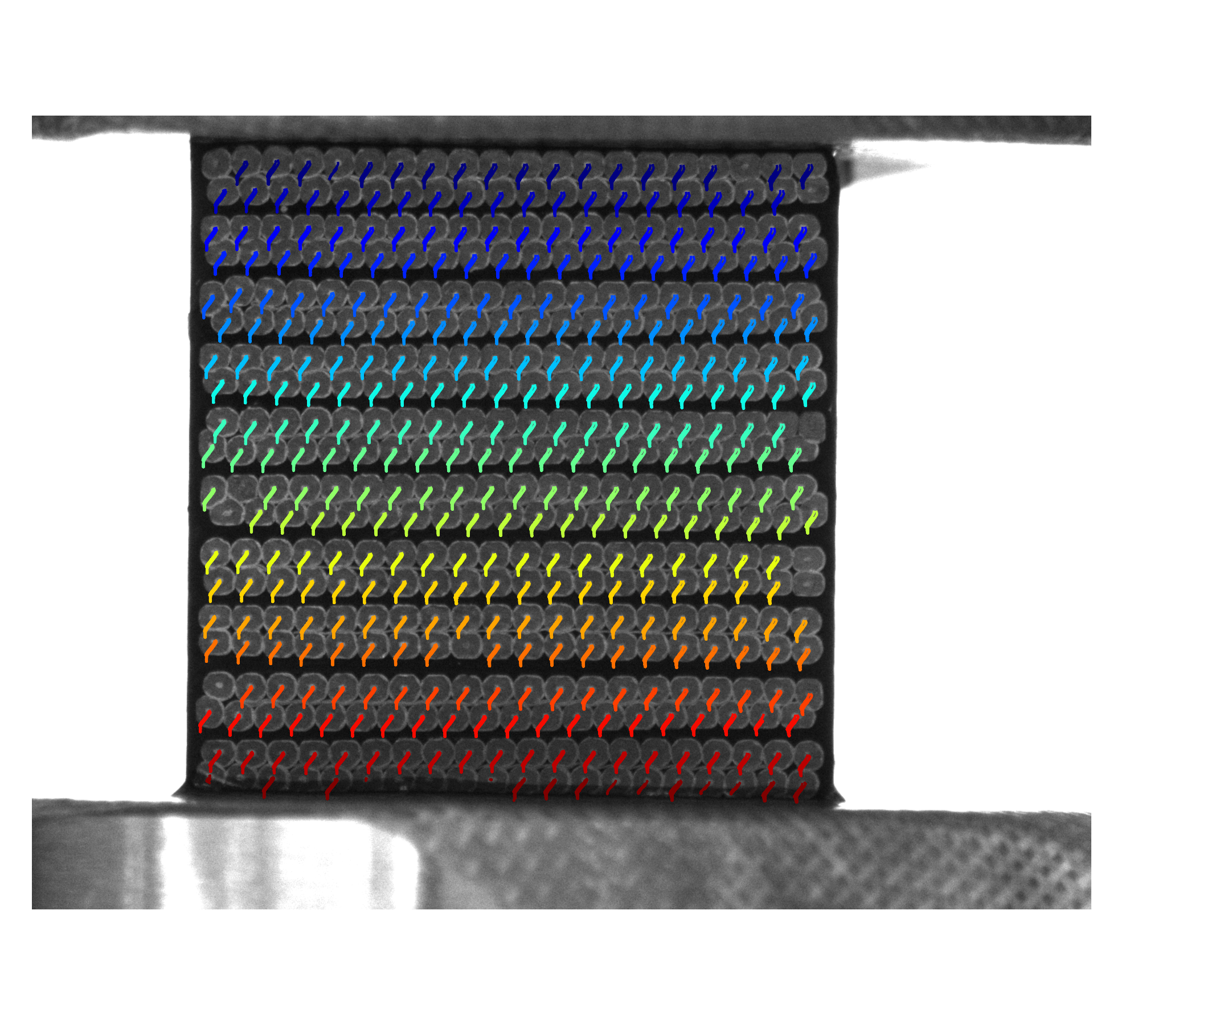
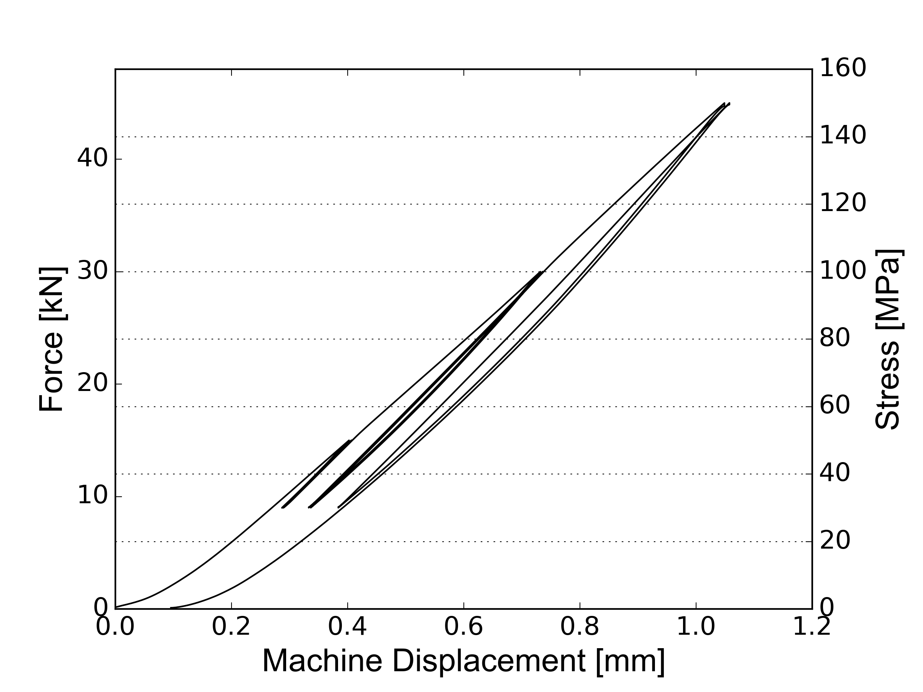
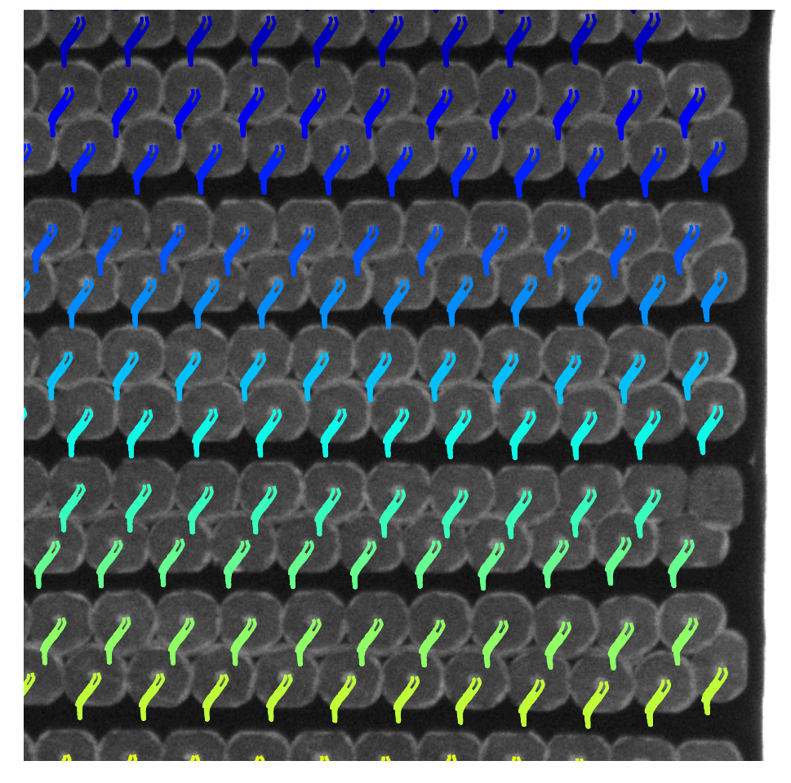
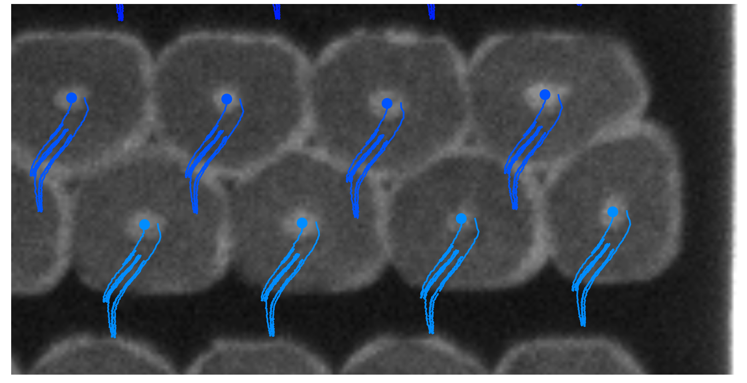
Particle tracking
Trackpy: python package for particle tracking
Strand core as natural mark (d~10 pixels)
Trackpy
Trajectory of each strand-core
1.7 mm
15 mm
Most (380/400) strands are tracked during the loading
There is a horizontal rigid body motion

Slide 11





Fields comparison
Strand-based mesh
VIC2d: subset:35, step:5, 17.1um/px
U_{y} (mm)
Deformed
Reference
ε_{yy}
Particle track method
AL-DIC: 1440x1080 px², subset:20 px, step:5 px
U_{y} (mm)
U_{y} (mm)
There is a good agreement of displacement fields between two approaches.

Slide 12

Strain field
ε_{yy}
1.0%
0.5%
0
-0.5%
-1.0%
-1.5%
Deformation gradient F
$$F={dU}/{dX}+I=\left[{dU_{x}}/{dx}+1,{dU_{x}}/{dy};{dU_{y}}/{dx},{dU_{y}}/{dy}+1\right]$$
Green-Lagrangian strain E
$$E=\frac{1}{2}(F^{T}F−I)$$
Conclusion
Strain localization at inter-stack and intra-stack
Local tensile state (red) exists

Slide 13


From RT to LN₂
Liquid nitrogen
(T_{b} = –196°C, 77 K)
Liquid nitrogen
(T_{b} = –196°C, 77 K)
Liquid nitrogen
(T_{b} = –196°C, 77 K)
Ceramic plate
Ceramic plate
Ceramic plate
Still developing:
Liquid boiling affects image capture
Notes:
Sample in the liquid nitrogen → constant temperature;

Slide 14
Conclusion & Outlook
An in situ full-field deformation measurement is performed at the level of cable stacks via two different image-based analyses
Compressive strain localization can be measured both at inter-stack and intra-stack, even tensile state at few positions
The approach will be applied at cryogenic temperature
The deformation measurement can be compared with the numerical results at multiscale

Slide 15


Strand-like Azulejo (ceramic tilework) in Porto
Any questions?

Slide 16








Correction
$K_{Instron250}$=150 kN/mm
$K_{Zwick50}$= 60 kN/mm
Due to less stiff of Zwick-50 machine, the unload-displacement (hysteresis loop?) is not corrected properly.
$$∆d_{s−corr.}={∆d}_{tot} −{∆d}_{machine}$$
$${∆d}_{s−corr.}={∆d}_{tot} −∆F/K_{machine}$$
Zwick100

Slide 17

Machines with different measurements
Zwick050@D496
Zwick100@D467
Instron250@MAVT-Mohr
Global correction
Global correction
Global correction
DIC
MacroExtenso
DIC
LaserExtenso
DIC
laser

Slide 18


Ongoing work @Z100-D467

Slide 19
Aims
MagComp: Mechanical modelling and failure identification of impregnated Nb3Sn Rutherford cable stacks
Experiment
Numerical simulation
Cube level
15 mm
Stack level
Transverse
15 mm
20 mm
Radial
Working with D. M. Araujo, M. Daly (PSI)
Axial
Characterize mechanical properties of each components at ambient and cryogenics temperature
Perform compressive tests on 10-stack sample
Implement the constitutive model in finite element software

