Slide 1
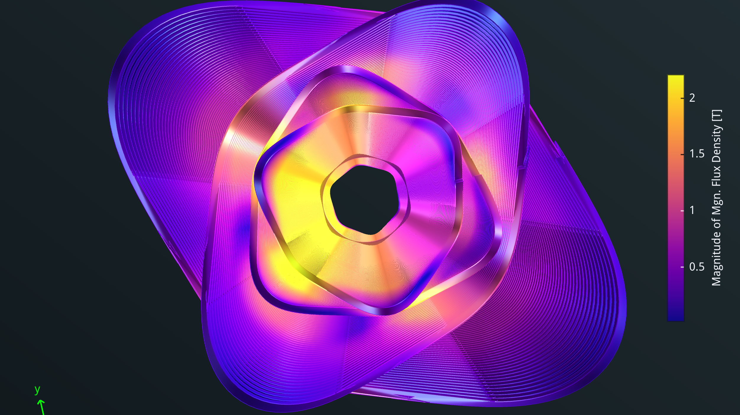



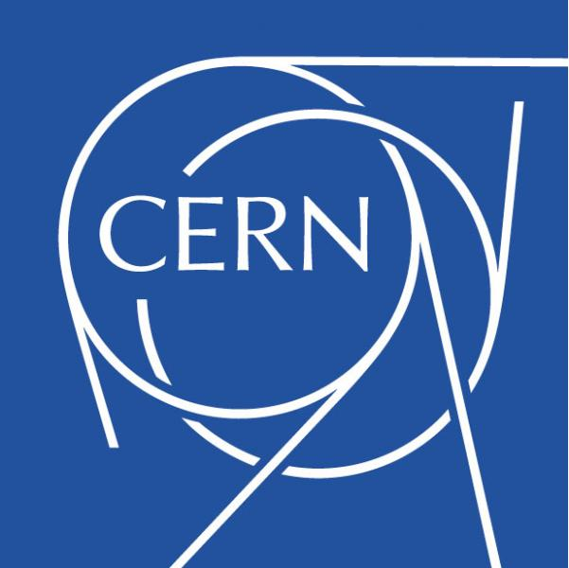

The FCCee-HTS4 project
M. Koratzinos
CHART workshop
11/10/2023
This work is performed under the auspices and with support from the Swiss Accelerator Research and Technology (CHART) program (www.chart.ch).

Slide 2
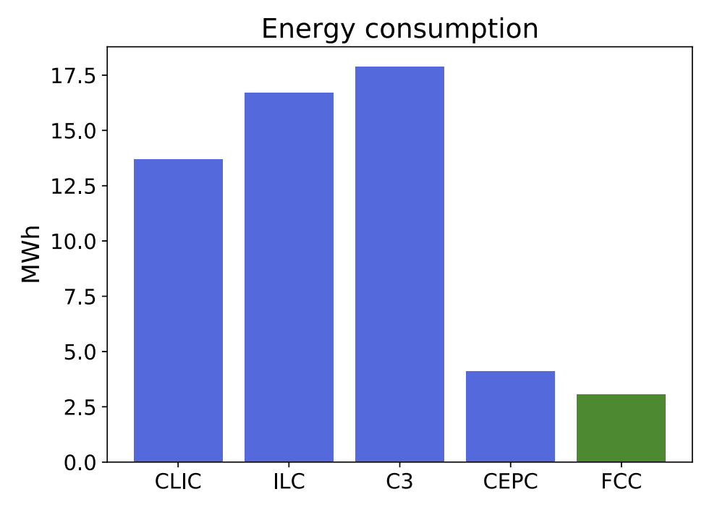
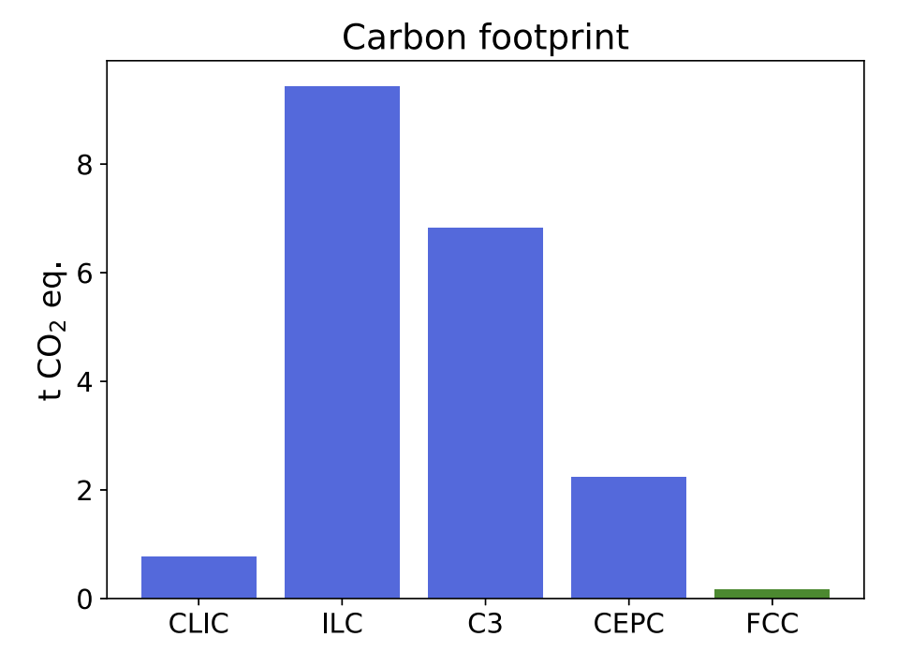
The big picture
Energy consumption per Higgs produced
FCC-ee is the most energy-efficient accelerator proposed (and the one with the smallest CO2 footprint (see “the carbon footprint of proposed e+e- factories”, Janot and Blondel, https://link.springer.com/article/10.1140/epjp/s13360-022-03319-w
This is an attempt to make FCC-ee even more sustainable and at the same time increase performance by looking at the main magnet systems of FCC-ee
We re also looking into increasing the relevance of FCC to society by adopting state-of-the-art technologies and trying to play a leading role in our respective fields
Carbon footprint per Higgs produced

Slide 3
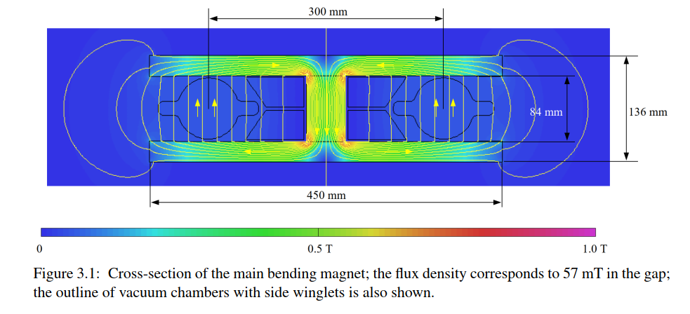
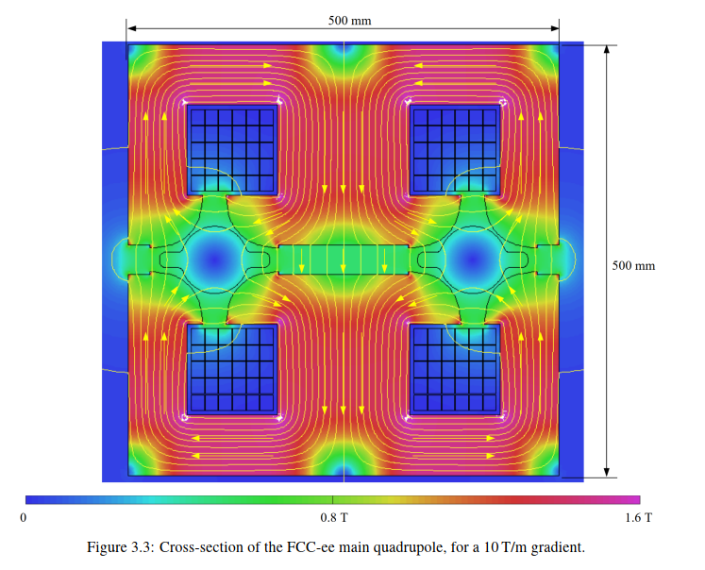
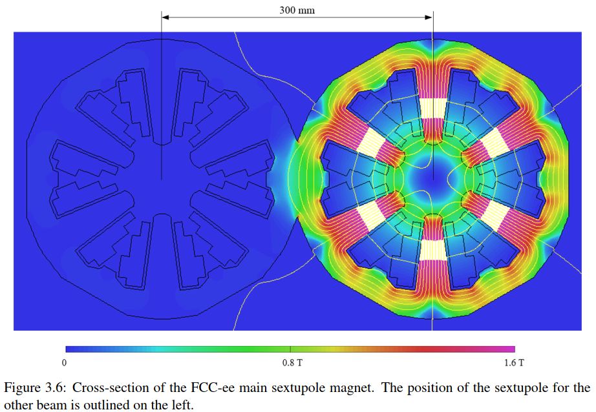
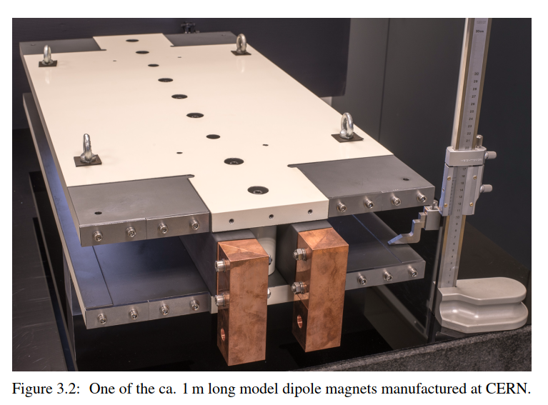
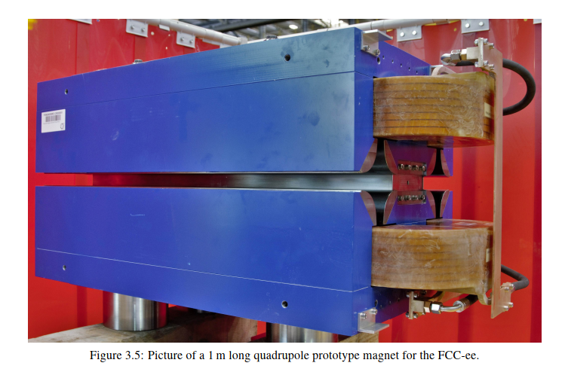
FCC-ee: The power challenge
CDR: FCC-ee is a conventional (warm) accelerator, much like LEP (CERN, 1989-2002)
The FCC-ee CDR has 2900 (20m-long) dipole, 2900 quadrupole and 4704 sextupole magnets, all normal conducting
Every effort was made to have a “power saving” design for the quads (50% saving, but with some compromises)
This power loss is dominated by the quadrupole and sextupole magnets.
CDR
CDR
CDR - prototype
CDR - prototype
(no prototype exists yet)
Big, heavy quads and sextupoles

Slide 4
Power consumption – collider main magnet systems
We pay twice for normal conducting magnets: one through ohmic losses, and again for removing the heat with our cooling and ventilation (CV) system.
Storage Ring | Z | W | H | TT
Beam Energy (GeV) | 45.6 | 80 | 120 | 182.5
Magnet current | 25% | 44% | 66% | 100%
Power ratio | 6% | 19% | 43% | 100%
Dipoles (MW) | 0.8 | 2.6 | 5.8 | 13.3
Quadrupoles (MW) | 1.4 | 4.3 | 9.8 | 22.6
Sextupoles (MW) | 1.3 | 3.9 | 8.9 | 20.5
Power cables (MW) | 1.2 | 3.8 | 8.6 | 20
Total magnet losses | 4.8 | 14.7 | 33.0 | 76.4
Power demand (MW) | 5.6 | 17.2 | 38.6 | 89
CV needs to remove the heat of the storage and booster magnets (100MW at top), storage and booster RF (148 at top) and experiments (8MW). Total is 256MW
The share of storage ring magnets on CV is 35%, or 14MW
Cooling and ventilation |  | Z | W | H | TT
Beam energy (GeV) |  | 45.6 | 80 | 120 | 182.5
Pcv (MW) | all | 33 | 34 | 36 | 40.2
Total contribution of the collider ring magnets is therefore ~100MW at the top, 76% of which comes from the quads and sextupoles

Slide 5
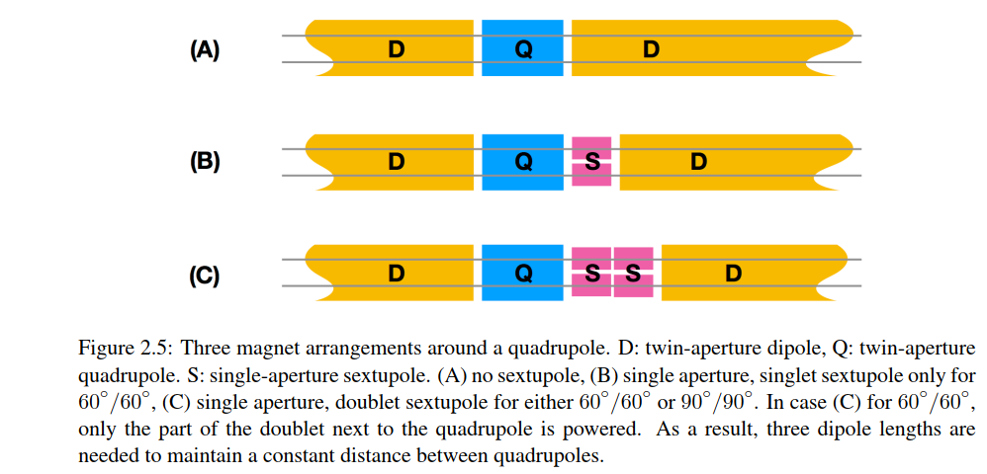
FCC-ee: The power challenge
How can we improve in this design?
1/ Make the magnets superconducting. Then, energy is only spent cooling the magnets (zero Ohmic losses).
2/ Also, we can “nest” the magnets, so that they take less space
This means that there is more space available for bending, so performance of the accelerator also increases.
Potential power reduction for these systems: ~90%
2900 cryostats, 3.5m long each
CDR
CDR
This proposal
Half cell length: 27.9 m
Half cell length: 27.9 m

Slide 6
Other potential gains
Apart from the power consumption reduction, the gains of a nested system are:
The packing factor increases by 7%, so, for the same luminosity, RF power can be reduced by 7%
The higher packing factor also reduces the total voltage needed by the RF by 7%
Total gain ~14% in the price of the RF system (which is O(1BnCHF). If the price of the magnet systems concerned is ~25% of the price of the total RF system, then ~40% of the cost of the cold SSSs is compensated by the reduction in the RF costs!
We aim to produce the superconducting SSSs in the same price envelope as in the CDR.
The optics design is much more flexible:
  No requirement for fixed polarity electron/positron quadrupoles
  Sextupoles available in all SSSs
  Opens the path for 100% filling factor and tapering management (see next slide)
It should be made clear that this is a big change in the design of FCC-ee and many systems are affected, for instance photon stopper design, radiation environment in the tunnel, BPM design, girder design, optics, etc.

Slide 7
Can we do even better?
Move the power supply inside the cryostat instead of the traditional cold magnet/warm power supply (FCCee-CPES project)
This system can naturally be adapted to also have a nested dipole covering the entire length of the SSS (another potential gain of 7% in packing factor, reaching almost 100%).
A nested dipole system (which will be individually powered) will also solve all our tapering needs (maximum dipole strength needed at the top is ~30%).
The inclusion of a nested dipole system is not the baseline solution now, but it is useful to keep it in mind as a possible improvement (plus also an extra complication!).

Slide 8
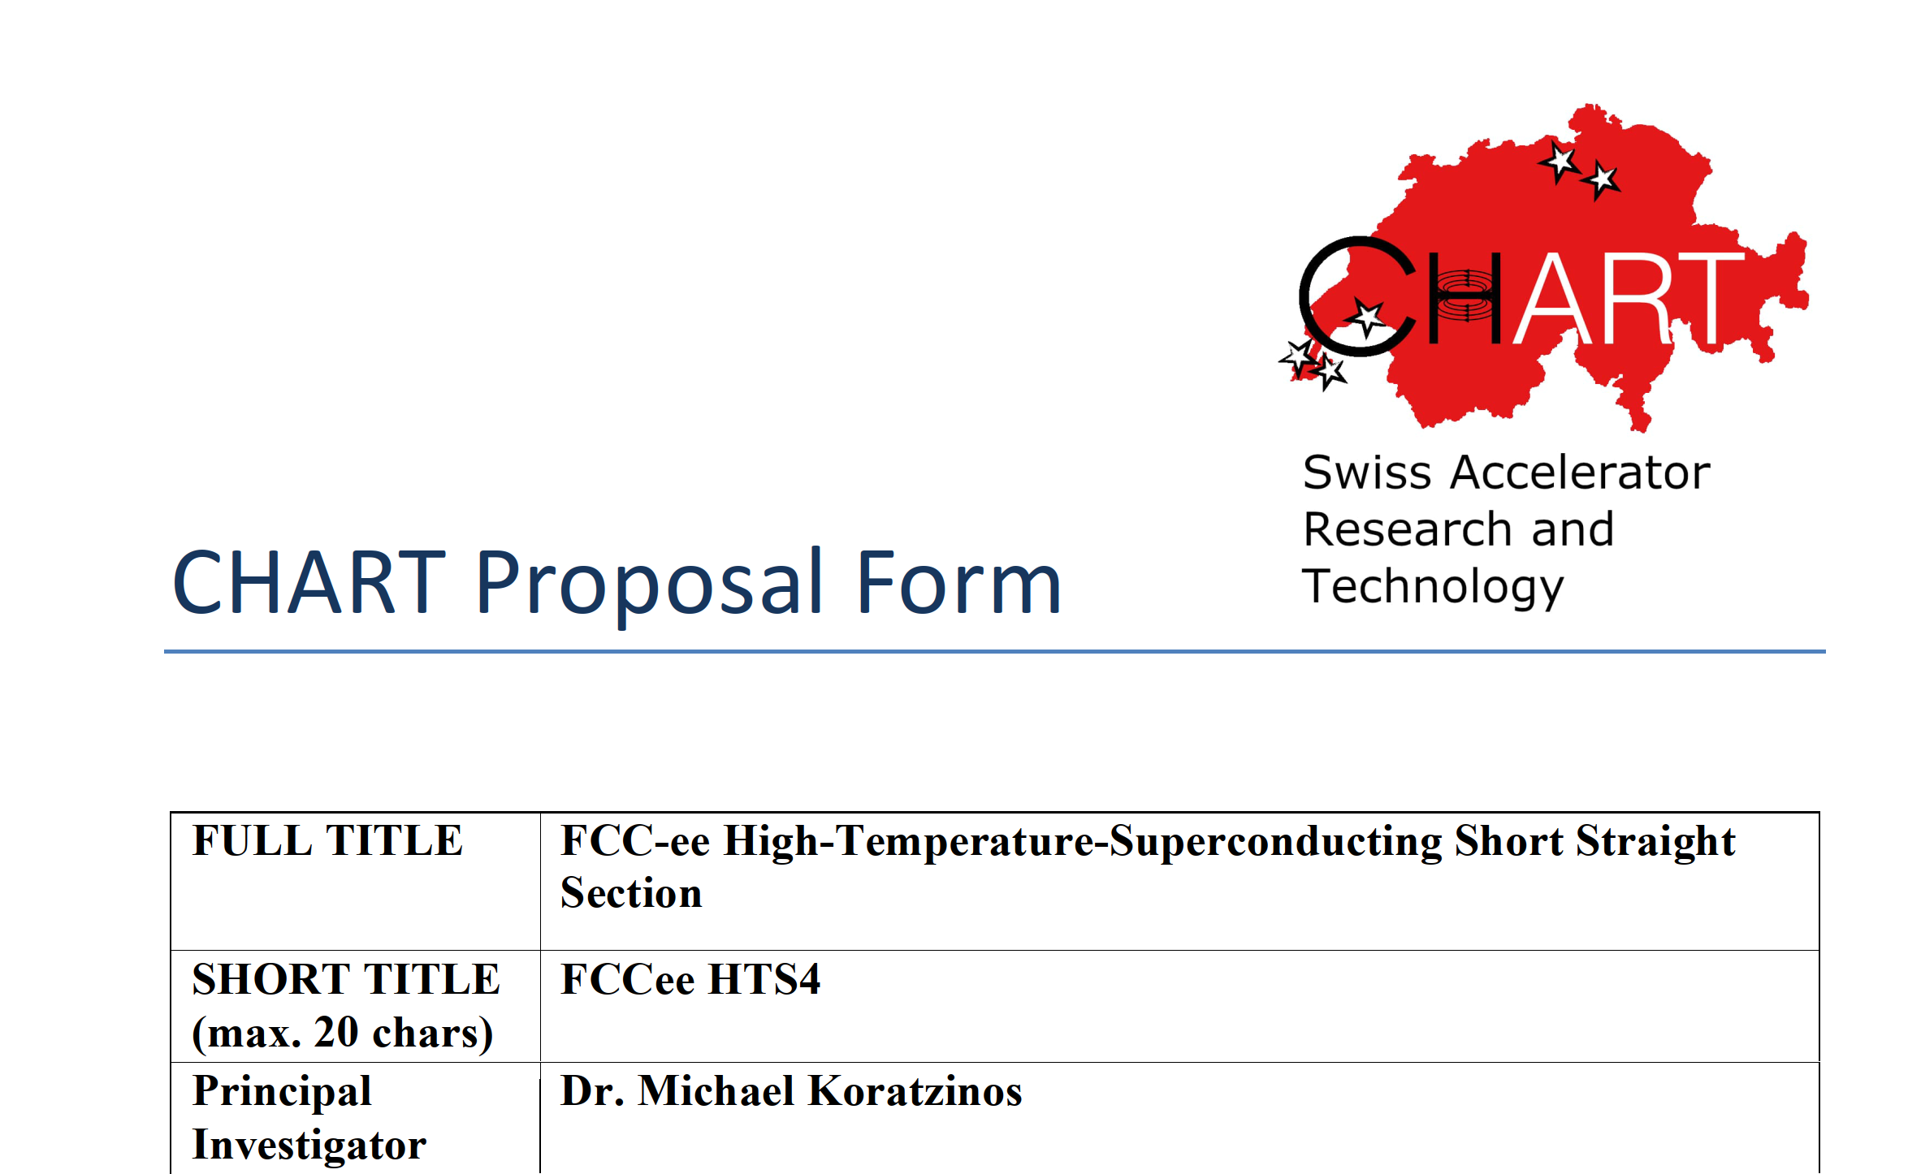
The proposal
A proposal was submitted and approved by the Swiss accelerator research and technology forum CHART in April 2022:
FCCee-HTS4 are: B. Auchmann, J. Kosse, V. Batsari, A. Thabuis,J. Schmidt (from 1 December 2023),M.K.
(Our sister project, FCC-ee CPES, investigating the possibility of a cold power supply system, was also approved at the same session.)

Slide 9
FCCee-HTS4 in a nutshell
Investigate the replacement of all FCC-ee short straight sections (SSSs) that contain arc quads, arc sextupoles and assorted correctors by superconducting ones.
Nest the sextupoles and quadrupoles in the same unit.
Use HTS conductors (ReBCO tapes)
Operate at around 40K
Investigate all integration issues
Produce a ~1m prototype

Slide 10
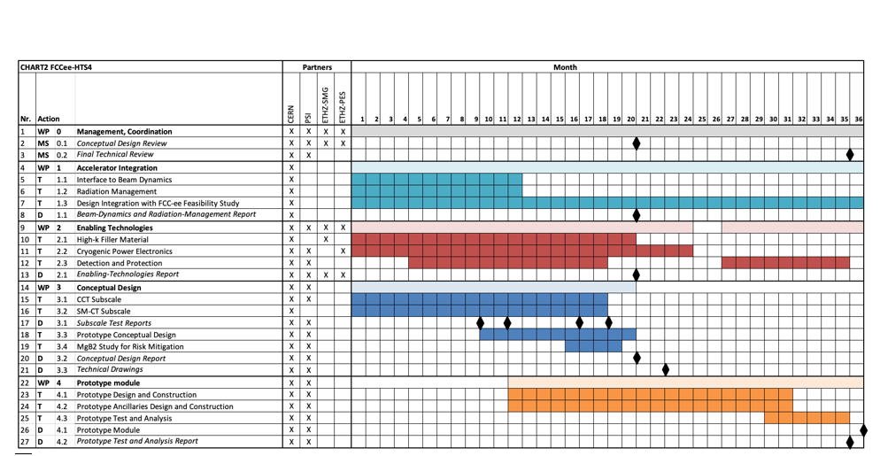
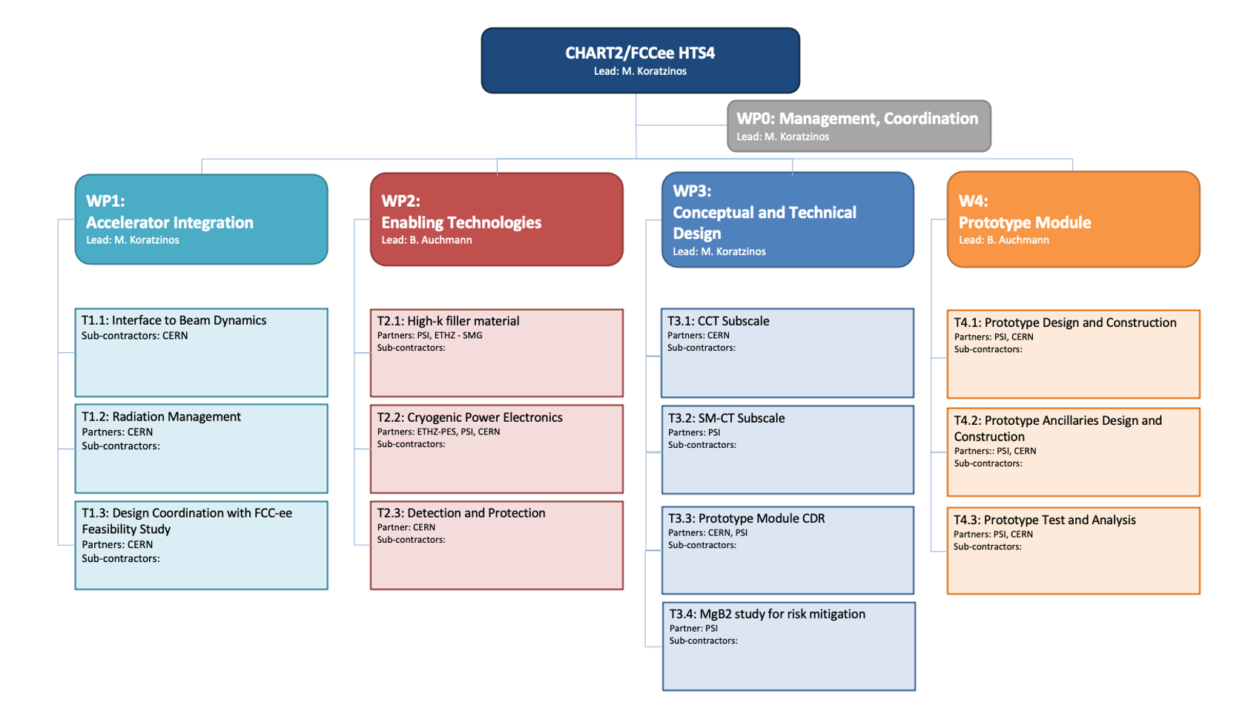
The project
Project duration: 3 years (starting 1/7/2022)
Deliverables:
Beam dynamics report
Enabling technologies report
One or more demonstrator hardware
One prototype designed, manufactured and tested

Slide 11
SSS main parameters
The FCC-ee optics design layout has the following specifications:
Length of quads is 2.9m. Quads should not be shorter, due to SR issues
Strength of quads is 11.84 T/m at tt.
Length of sextupoles is 1.5m. Sextupoles can be made stronger and shorter at will.
Strength of sextupoles is 812 T/m^2 at tt.
Together with necessary gaps and with all services, the length of the SSS will be 3.5m

Slide 12
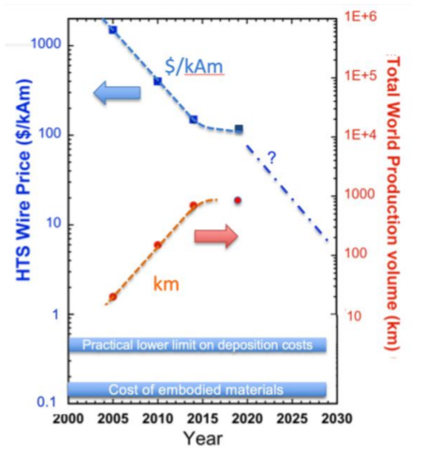
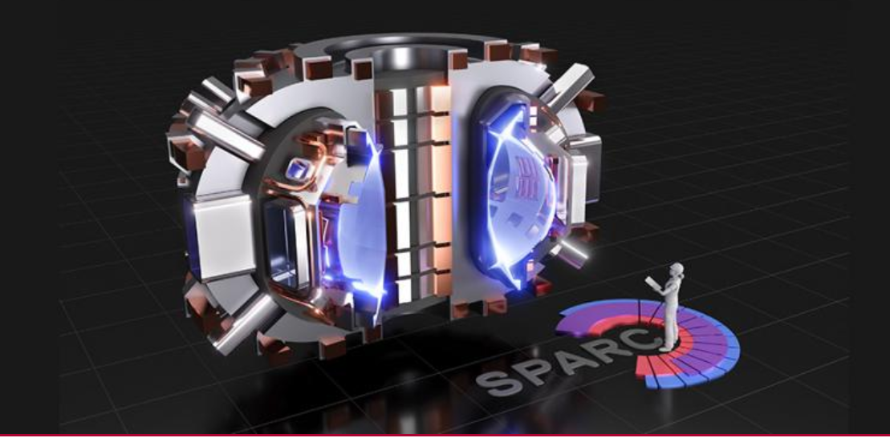
A question of cost
https://www.snowmass21.org/docs/files/summaries/AF/SNOWMASS21-AF7_AF0_Vladimir_Matias-251.pdf
The cold SSS idea cannot cost more than the price of the normal conducting system. The major cost driver today is the HTS conductor
For the above to be the case, we need a reduction in price of HTS tapes of about 3-4 compared to now in 20 years.
We believe that the advent of fusion projects will help reduce the price of HTS by a factor 10 in 20 years, so we think we are competitive.
Synergies with Fusion projects
Cf: SPARC fusion project needs 10,000 kms of HTS cable ~today
Nature, Scientific Reports | (2021) 11:2084 | https://doi.org/10.1038/s41598-021-81559-z

Slide 13
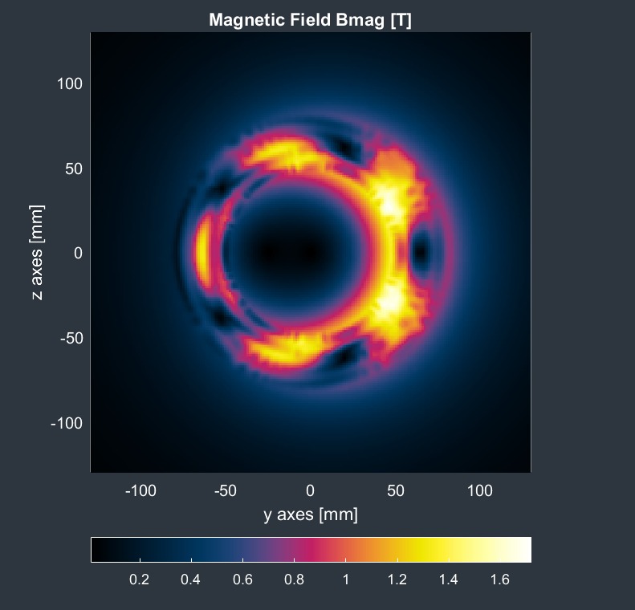
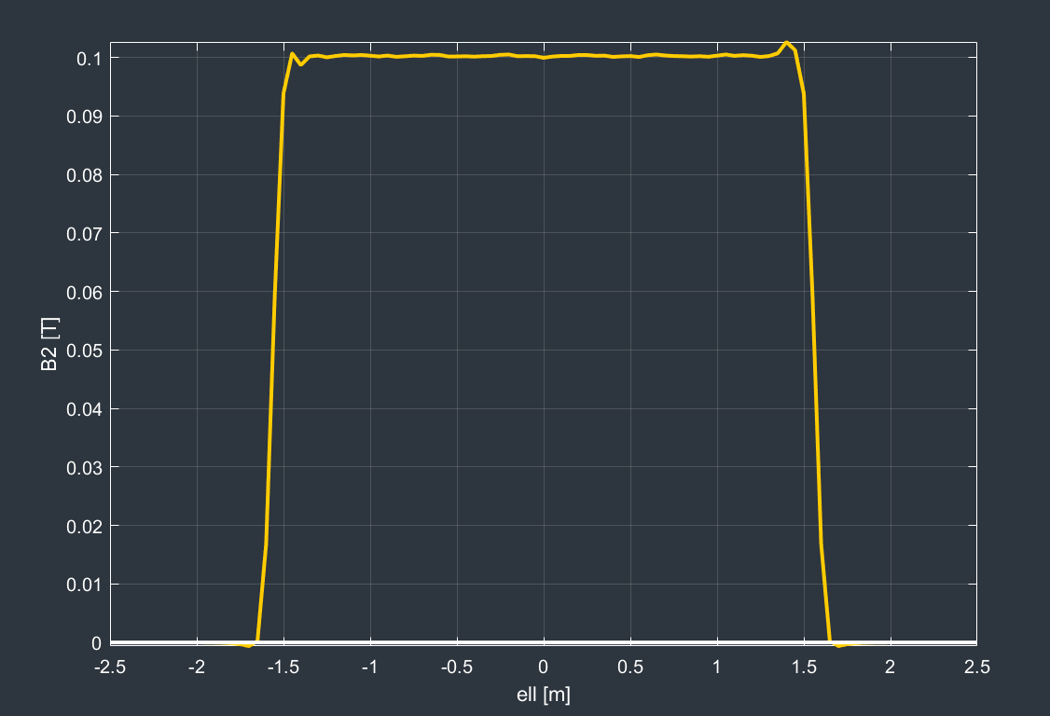
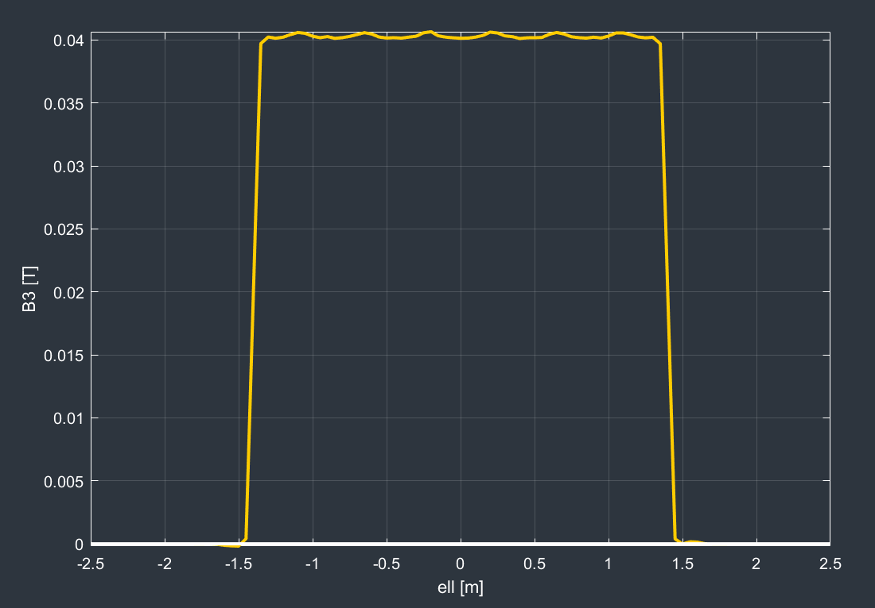
Magnetic analysis
Quad and sextupole at full strength
This is a low field application (1.7T max) gradients: 12T/m; 1000T/m²
There is no problem attaining the performance with today’s HTS tapes
B2 @10mm: 0.1T; B3 @10mm: 0.04T

Slide 14
Demonstrator
Since we are dealing with a new technology (quads and sextupoles using HTS conductor) one (or more) short-length demonstrators are needed to prove that our technology choices are correct.
A sextupole demonstrator has been designed and is being manufactured
The sextupole was chosen since in a nested (quad/sextupole) system, the higher order multipole goes closer to the beam pipe
Progress:
  Magnetic design finished using the RAT GUI from Little Beast Engineering (https://rat-gui.ch/)
  CAD design finished
  Material ordered
  Waiting for manufacturing in the CERN main workshop

Slide 15
Demonstrator – choice of technology
We have chosen a CCT magnet layout due to
  Ease of construction
  Good field quality
  Quick design cycle
Other approaches (i.e. standard cosine-theta) will also be pursued
The use of HTS tape makes the design non-trivial compared to a round-conductor CCT, like the final focus prototype quadrupole already constructed and tested at warm.

Slide 16
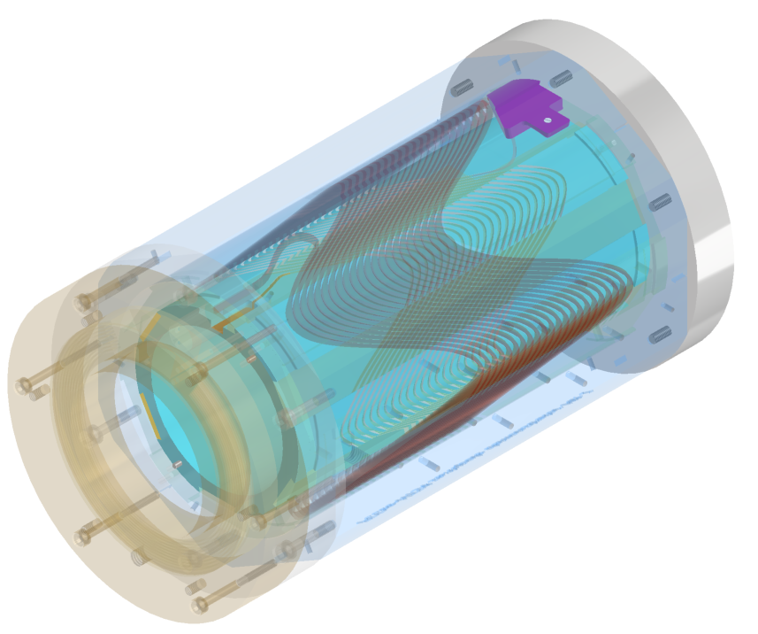
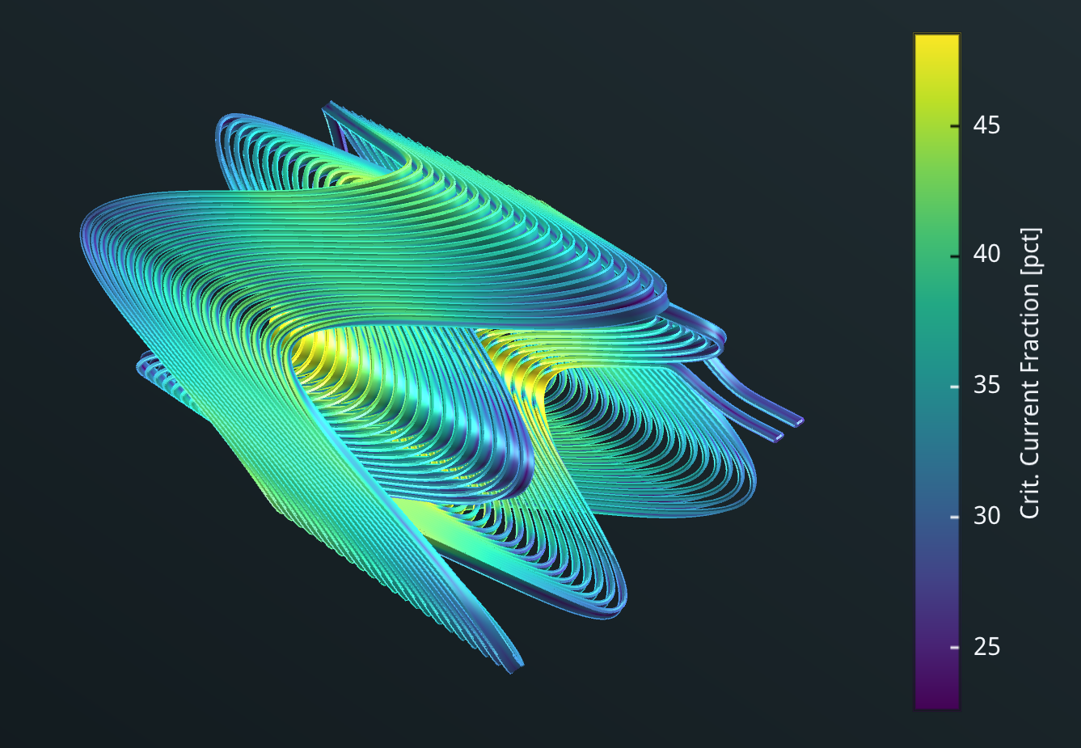
CAD design of sextupole demonstrator
Specifications:
Aperture: 90mm
Current: 260A
Temperature: 40K
Field gradient: 1000T/m2
Max. field @conductor:1.5T
Crit. Current fraction: 49%
Temp. margin: 14K

Slide 17
Manufacturing
For the prototype stage, there are two main manufacturing techniques:
Additive manufacturing (metal 3D printing)
  Advantages: any geometry is realizable
  Disadvantages: surface roughness, a lot of post-processing
Subtractive manufacturing (CNC machine milling)
  Advantages: mirror-like finish
  Disadvantages: not all geometries realizable
  Our choice for the first demonstrator
We are actively looking at both techniques

Slide 18
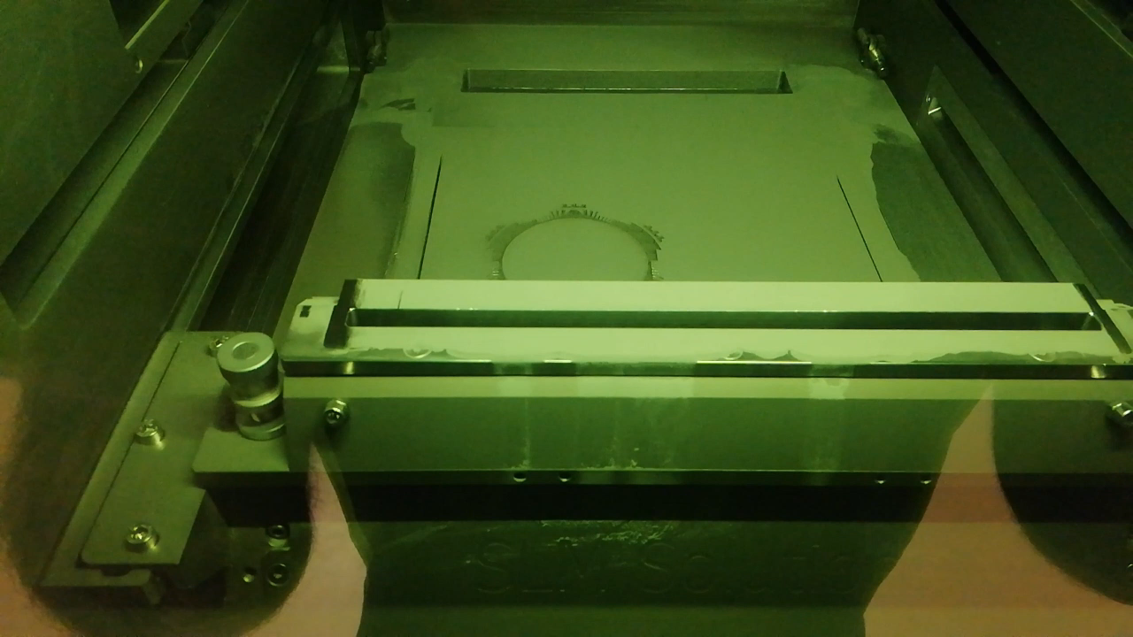
Romain Gerard, Numan Ghazali (EN-MME-FW)

Slide 19
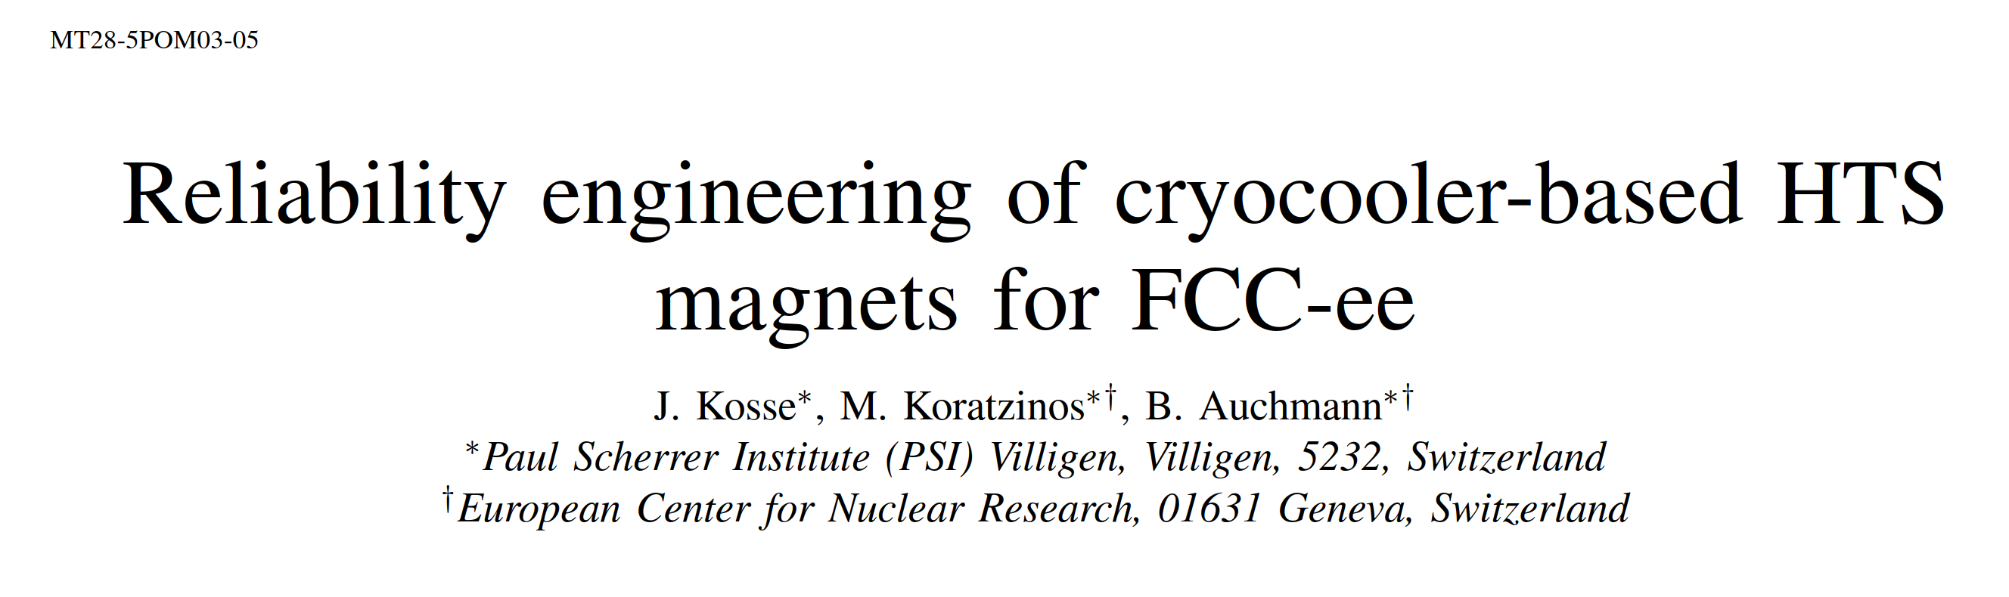
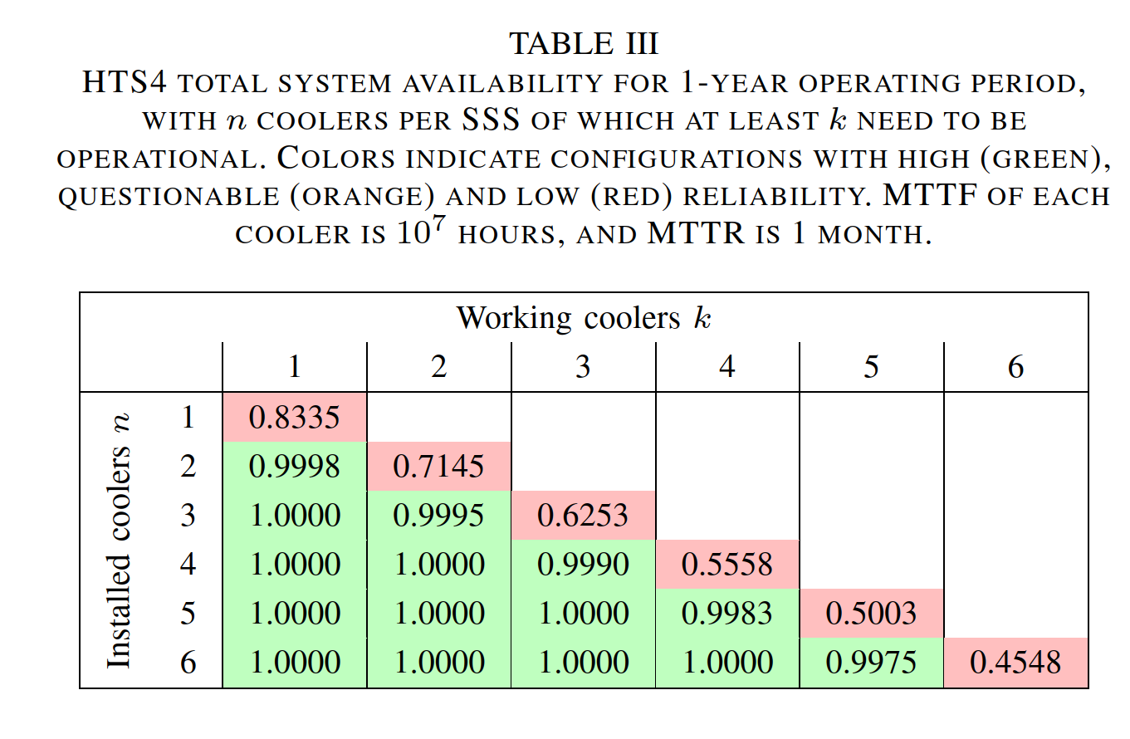
HTS4 in MT28
We are proposing a large, distributed, cryogenic system.
Availability of such a system is paramount.
(a centralized cryogenic system will also be considered)

Slide 20
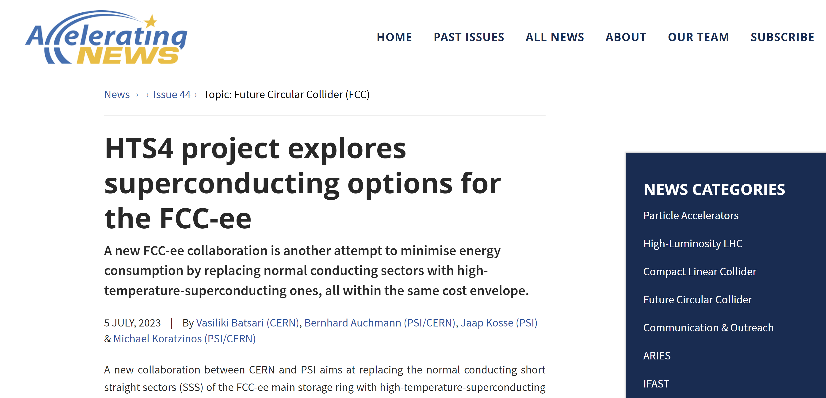
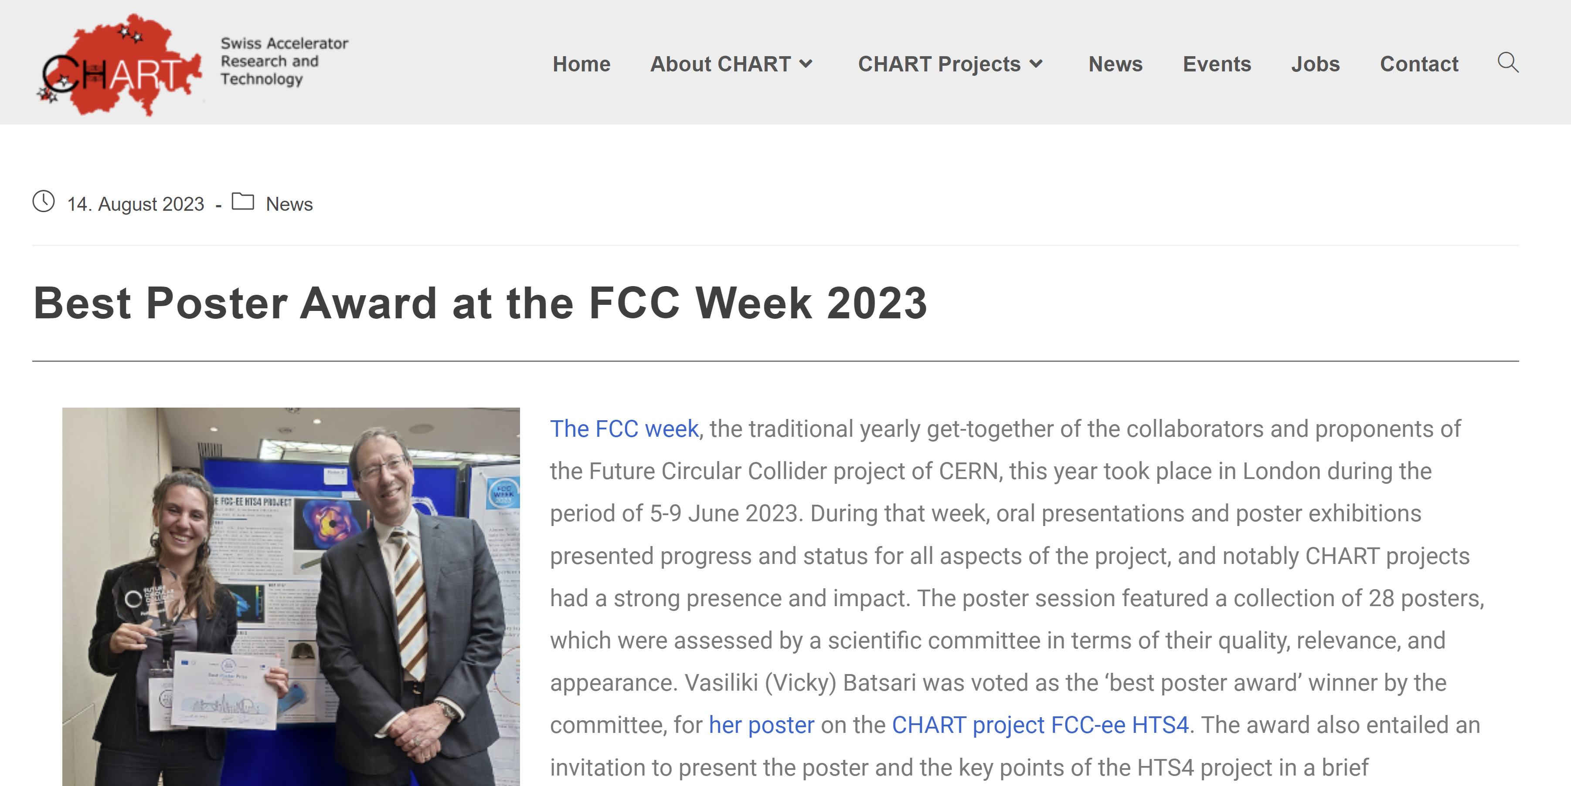
HTS4 in the news

Slide 21

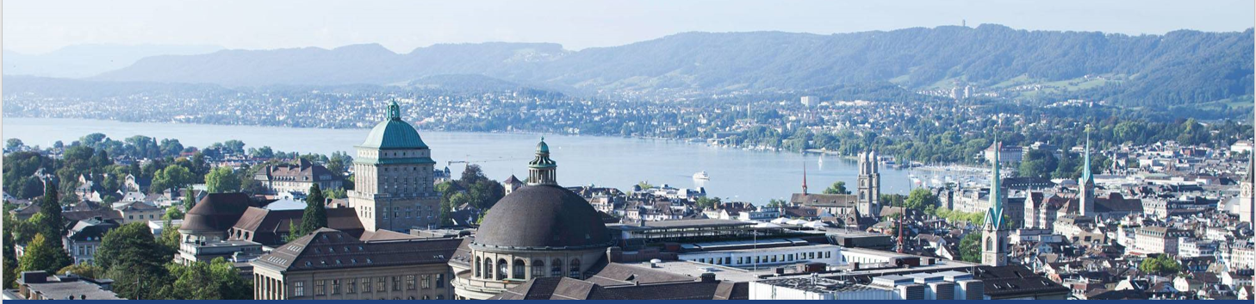
Next presentation
Our sister project!: FCCee CPES (PES, ETHZ)

Slide 22
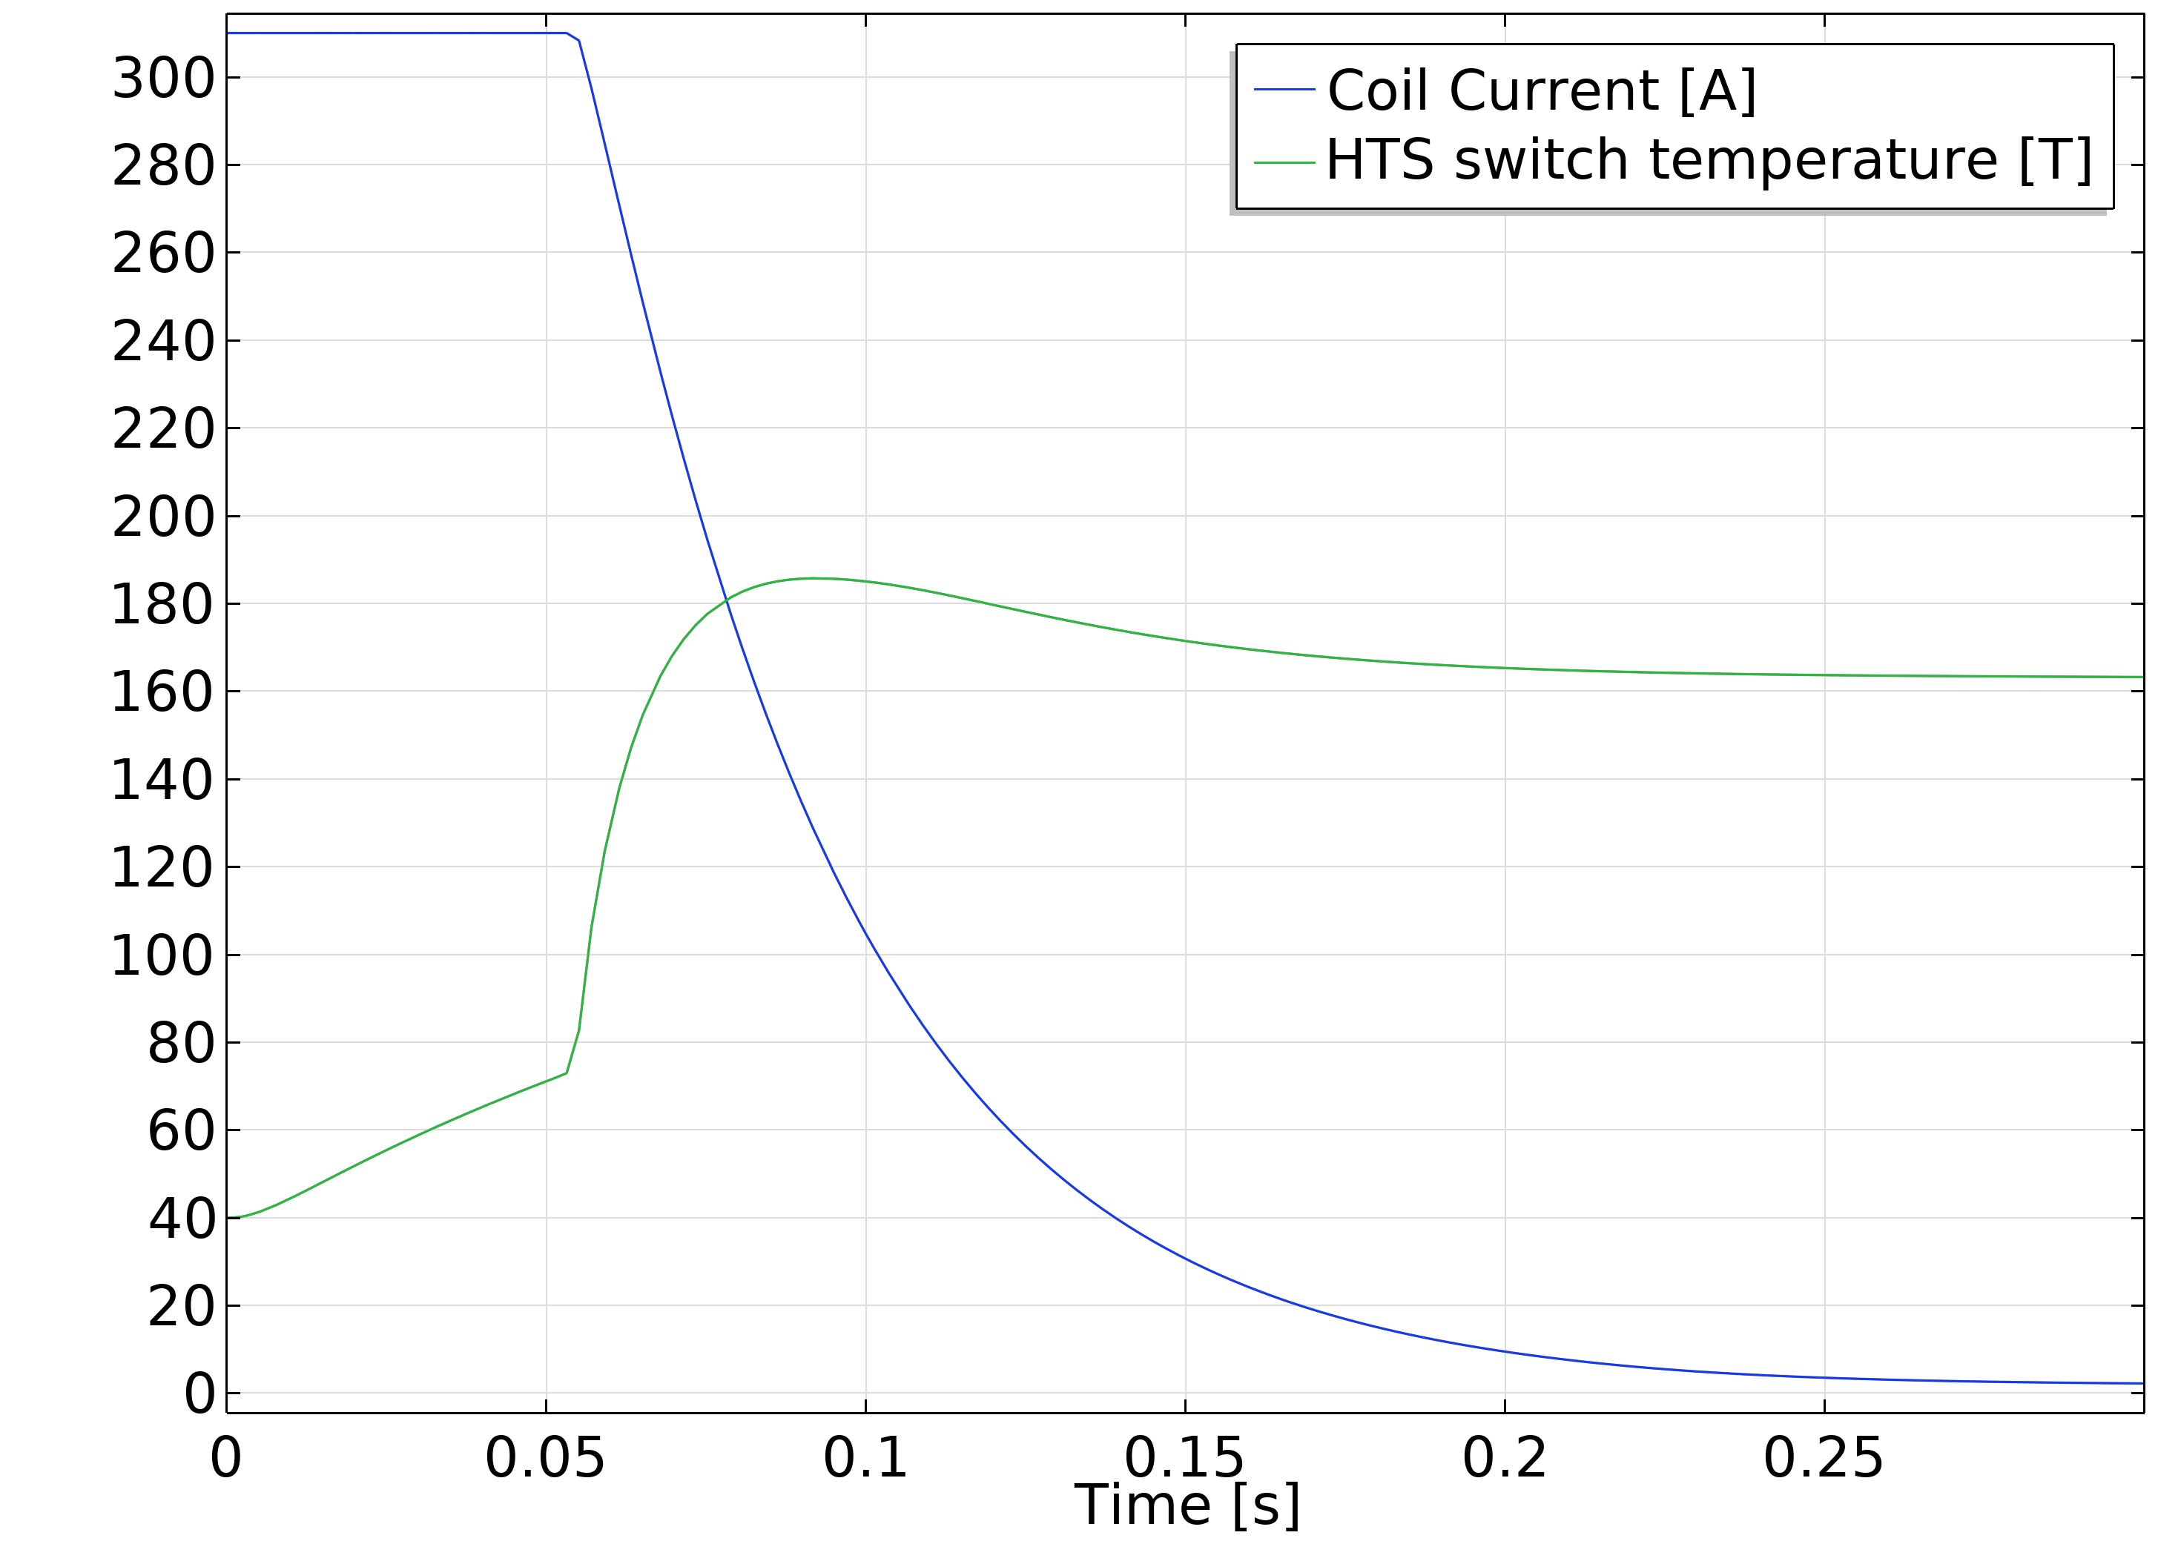
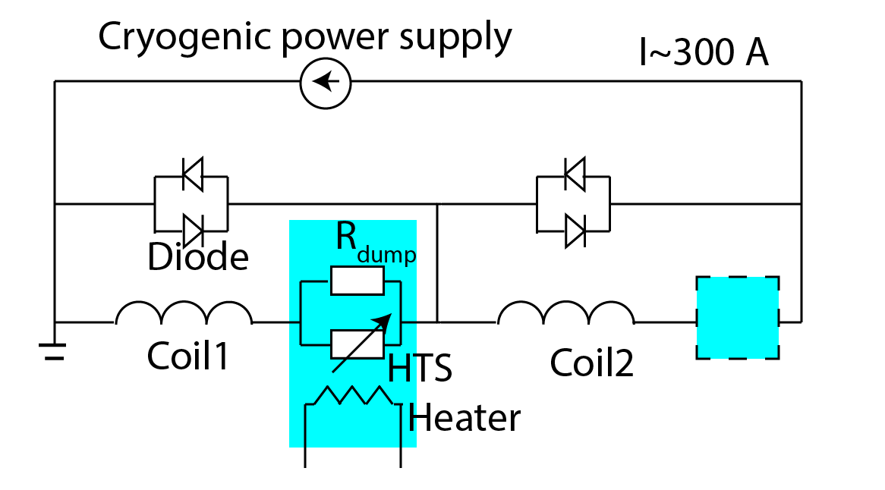
Magnet protection
If we use a cold power supply, the energy extraction system should also be cold
But we do not want the switch to generate heat when idle
Energy extraction via HTS switch
Heater activated
Modular
J. Kosse
Ongoing work

Slide 23
Conclusions
The idea of cold Short Straight Sections has substantial benefits in reducing power consumption and cost, while increasing the performance and flexibility of the accelerator.
The FCCee-HTS4 project aims at demonstrating that this idea is feasible.
Our sister project FCCee CPES goes a step further and aims to reduce cooling costs by developing a power supply that will operate at cryogenic temperatures.
These projects will increase the sustainability credentials of FCC-ee as well as increase its performance.

Slide 24
Thank you

