Slide 1




Muon Collider Feasibility Studies
D. Amorim, D. Schulte, E. Metral, M. Seidel, X. Buffat, T. Pieloni
Acknowledgements: Muon collider collaboration
CHART Meeting 11th October 2023, PSI

Slide 2
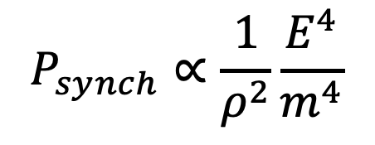
Why Muon Collider?
$$P_{synch}∝\frac{1}{ρ^{2}}\frac{E^{4}}{m^{4}}$$
Muons 200 heavier than electrons
→ SR losses negligibles respect to electrons
First proposal in 1960 (Tikhonin et Budker)
Between 2011-2016, le Muon Accelerator Program (MAP) in US has studied the feasibility of a series of colliders at 1.5 TeV, 3 TeV et 6 TeV
In 2021, an international collaboration (IMCC) has been established to study a possible muon collider with a ECM of 3 TeV, followed by a collider with ECM 10 TeV
The accelerator community in US has shown strong interest in the study (Snowmass et P5)

Slide 3
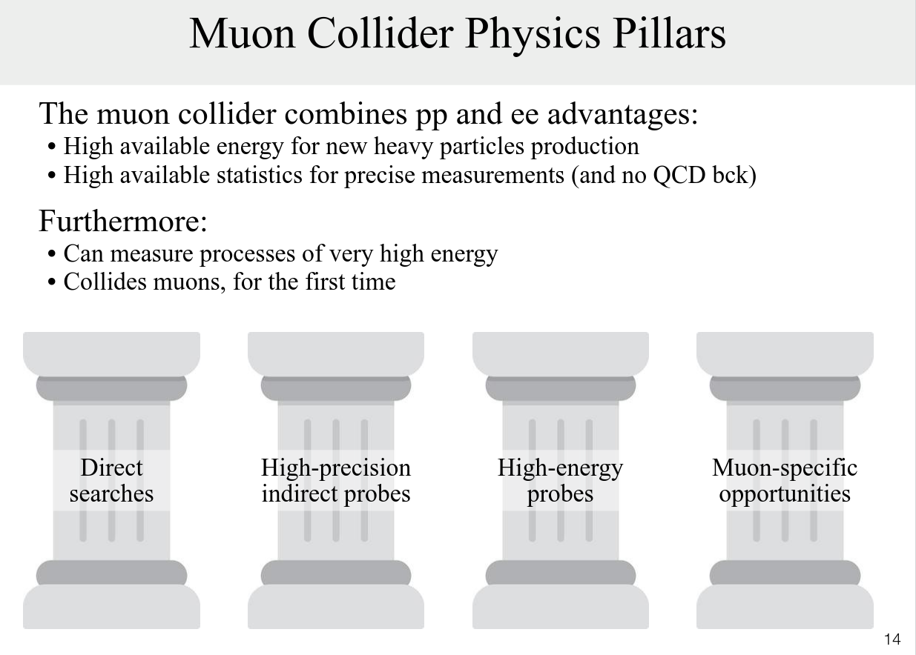
A. Wulzer, MuC Design Meeting (28/11/2022)
+ Neutrino Physics

Slide 4
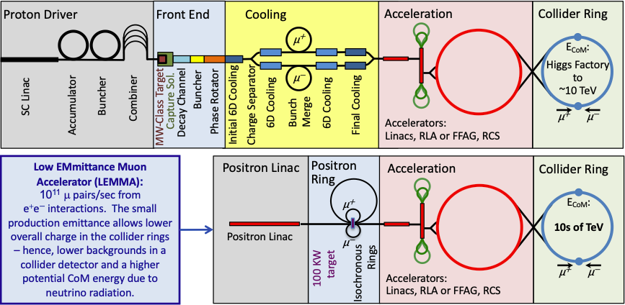
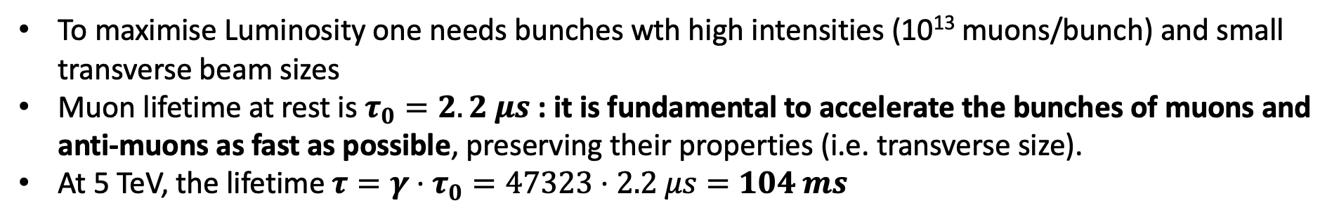
Muon Lifetime and accelerator design
To maximise Luminosity one needs bunches wth high intensities (10¹³ muons/bunch) and small transverse beam sizes
Muon lifetime at rest is $τ_{0}=2.2 μs$ : it is fundamental to accelerate the bunches of muons and anti-muons as fast as possible, preserving their properties (i.e. transverse size).
At 5 TeV, the lifetime $τ=γ⋅τ_{0}=47323⋅2.2 μs=104 ms$
High power proton beam
Production of muons and anti-muons and collection
Ionization Cooling
Acceleration
Collisions

Slide 5
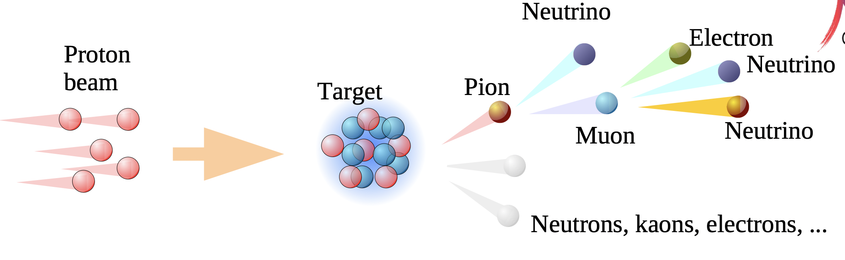
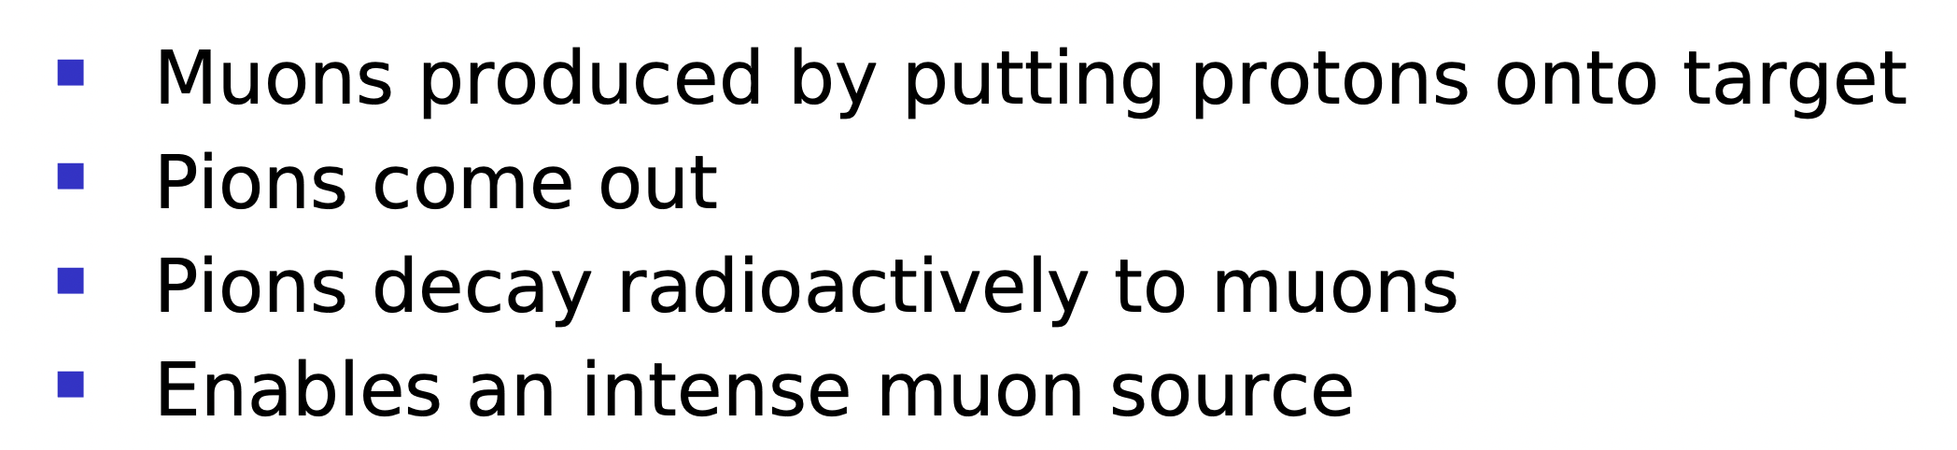
Muon production

Slide 6
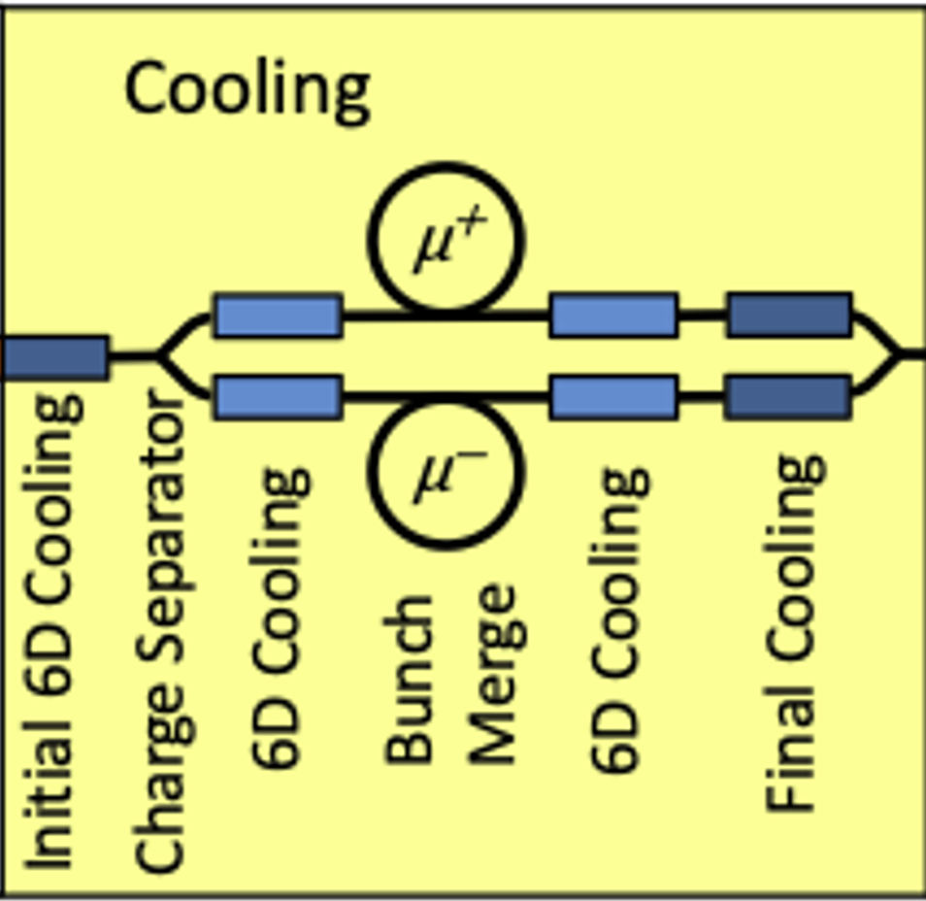
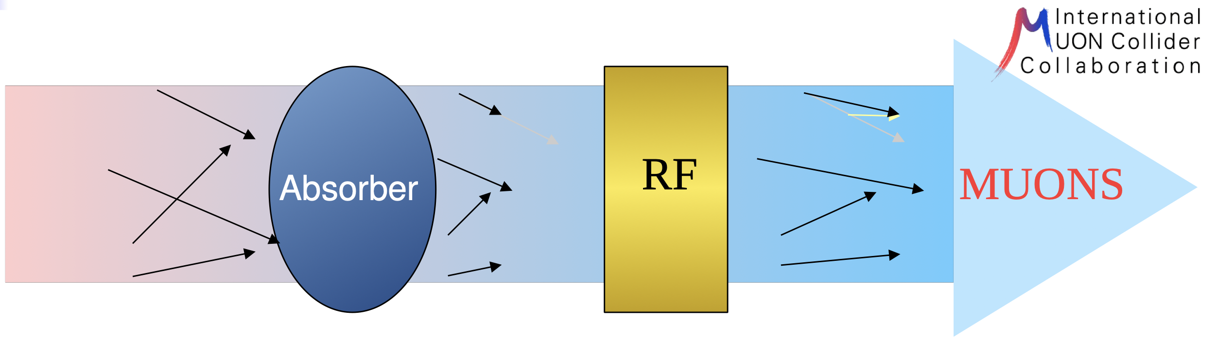
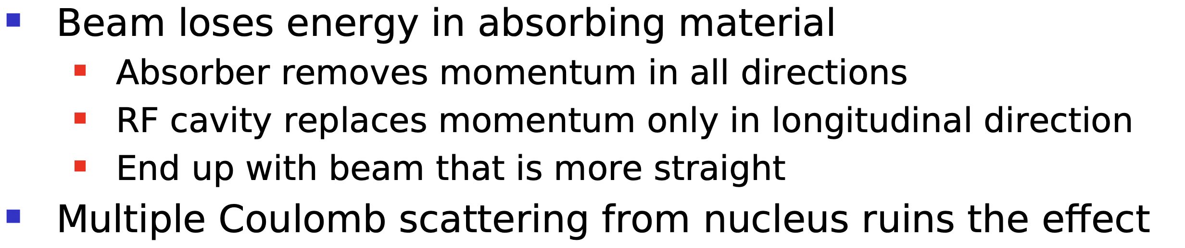
Muon Ionization Cooling
PhD Student @EPFL starting 1st November Josehine Potdevin

Slide 7
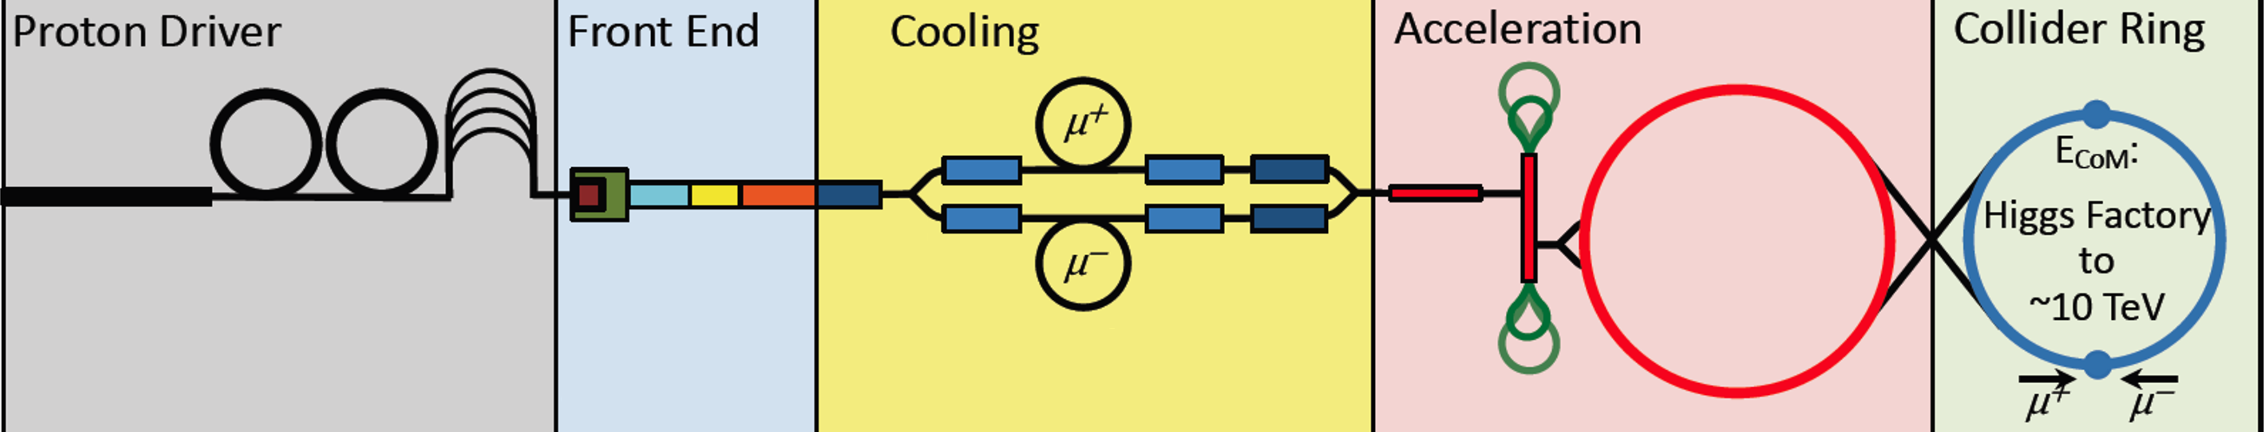
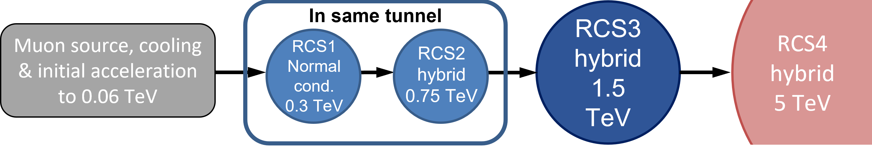
The high-energy complex
Chain of rapid cycling synchrotrons, counter-rotating µ+/µ- beams
→ 60 GeV → 314 GeV → 750 GeV → 1.5 TeV → 5 TeV
Hybrid RCSs have interleaved normal conducting (NC) and superconducting (SC) magnets.
To go to 5 TeV, we have not one but four RCS:
  Tradeoff between the ring size, survival rate, acceleration speed (at low energy, the ring can be smaller and thus we can accelerate faster).

Slide 8
Beam Collective effects Studies
The muon bunches should have high intensity to provide the designed luminosity
  O(10¹³) particles per bunch at the start of the acceleration chain, O(10¹²) in the collider
  Intensities will decay in time due to the muon disintegration
Particles of each bunch will interact electromagnetically on close particles and with the enviroment.
Such interactions can perturbe the particle and bunch motion→ intensity limitations have to be identified!
  Increase in transverse beam size, muon losses, heat load of the equipment…
Multiple effects can occur and need carefull considerations
  Space charge effects
  Impedance
  Beam-beam interactions
  Electron clouds

Slide 9
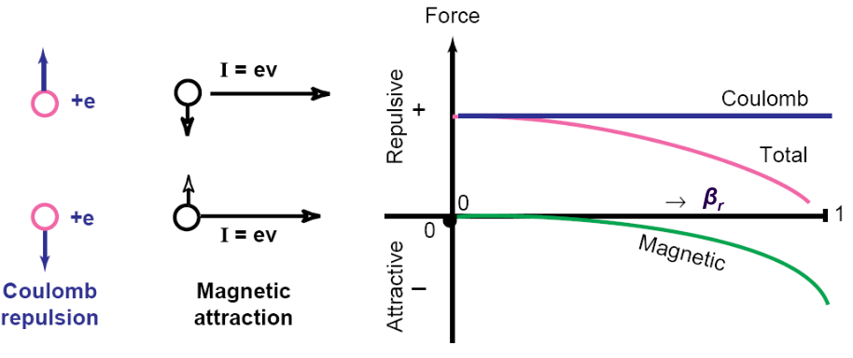
Space Charge
When collected into packages the muons will experience the repulsive Coulomb force
When in motion an attractive magnetic force will develop proportional to the relativistic β
  For β=1 the attractive magnetic force compensates fully the coulomb repulsive one
K. Schindl, Space Charge
For intermediate β the total force will be always repulsive and it’s strenght depends on the bunch intensity and transverse distribution (very non-linear force)

Slide 10
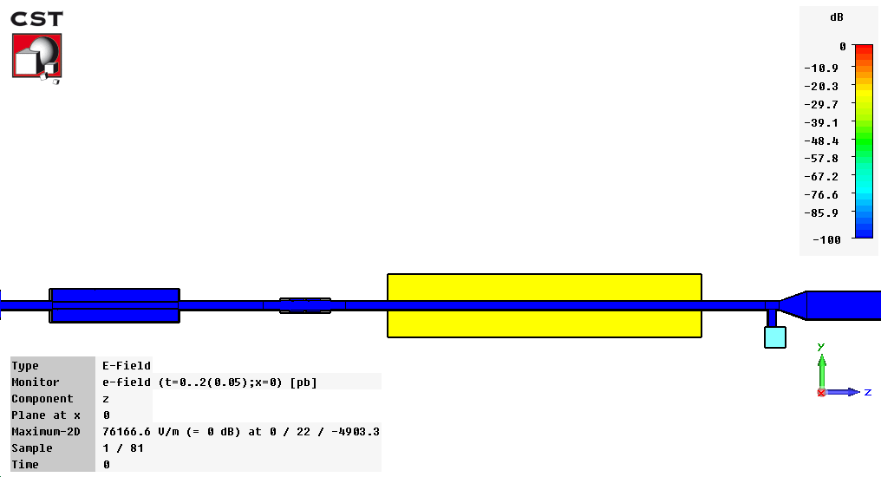
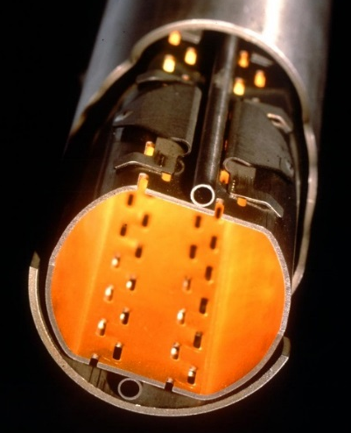
Machine Impedance
Muon bunches will interact electro-magnetically with the enviroment
The machine impedance characterises such effects
Pumping port
+ transition
Kicker
Magnet
BPM
B. Salvant, CST simulation
Chambre à vide LHC
Such wake fields can perturb the particle motion in within the bunch and on the following ones
These effects have to be reduced and optimized at the design stage of the equipments
Notes:
Beam pipe: low resistivity, but very long
Crab: very low resistivity, high Q resonator -> EM field trapped for very long time, can perturb multiple bunches for many turns
Collimator: protection device, made of very resistant material, high restivity -> creates strong WF

Slide 11
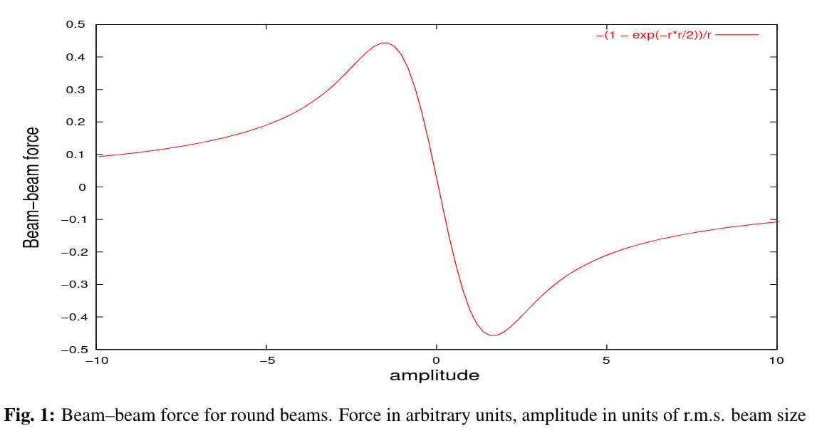


Beam-beam interactions
Interaction Point
Beam $μ^{−}$
Beam $μ^{+}$
Each bunch is a collection of charges →will generate an electromagnetic field
When sharing a common beam pipe, as in IP the field of one beam will perturb the motion of the other and viceversa.
It is a non-linear effect and it depends on the bunch intensity and transverse distributions

Slide 12
First studies for the Muon Collider
Preliminary studies have focused on the high energy collider of 10 TeV
Space Charge : in this part of the accelerator chain the particle energies are very high and the total force acting on the particles is negligible
  This effect will be fundamental for the proton driver and the low energy chain
Electron cloud : collisions will occur between single bunches in the collider→ no build-up occurs
Beam Impedance
Beam-beam interactions

Slide 13
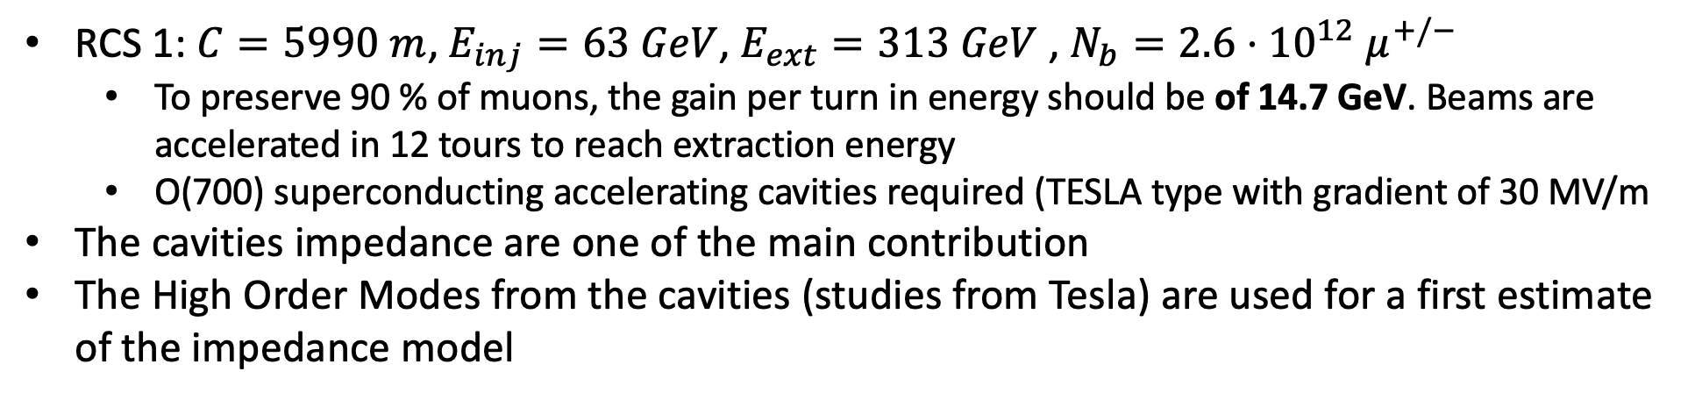
Impedance model and beam stability studies
RCS 1: $C=5990 m$, $E_{inj}=63 GeV$, $E_{ext}=313 GeV$, $N_{b}=2.6⋅{10}^{12} μ^{+/−}$
  To preserve 90 % of muons, the gain per turn in energy should be of 14.7 GeV. Beams are accelerated in 12 tours to reach extraction energy
  O(700) superconducting accelerating cavities required (TESLA type with gradient of 30 MV/m
The cavities impedance are one of the main contribution
The High Order Modes from the cavities (studies from Tesla) are used for a first estimate of the impedance model
RCS 3
Muon Cooling,
Linac, RLA
RCS 1
RCS 2
RCS 4
Collisionneur 10 TeV
60 GeV
313 GeV
750 GeV
1.5 TeV
5 TeV

Slide 14
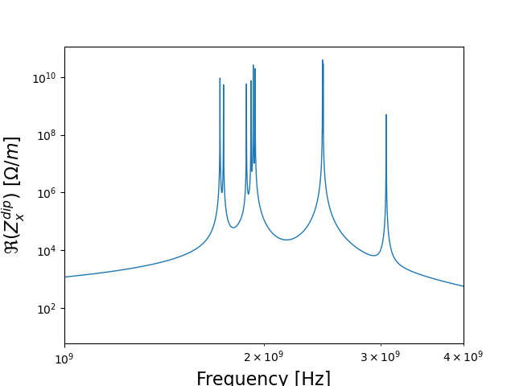
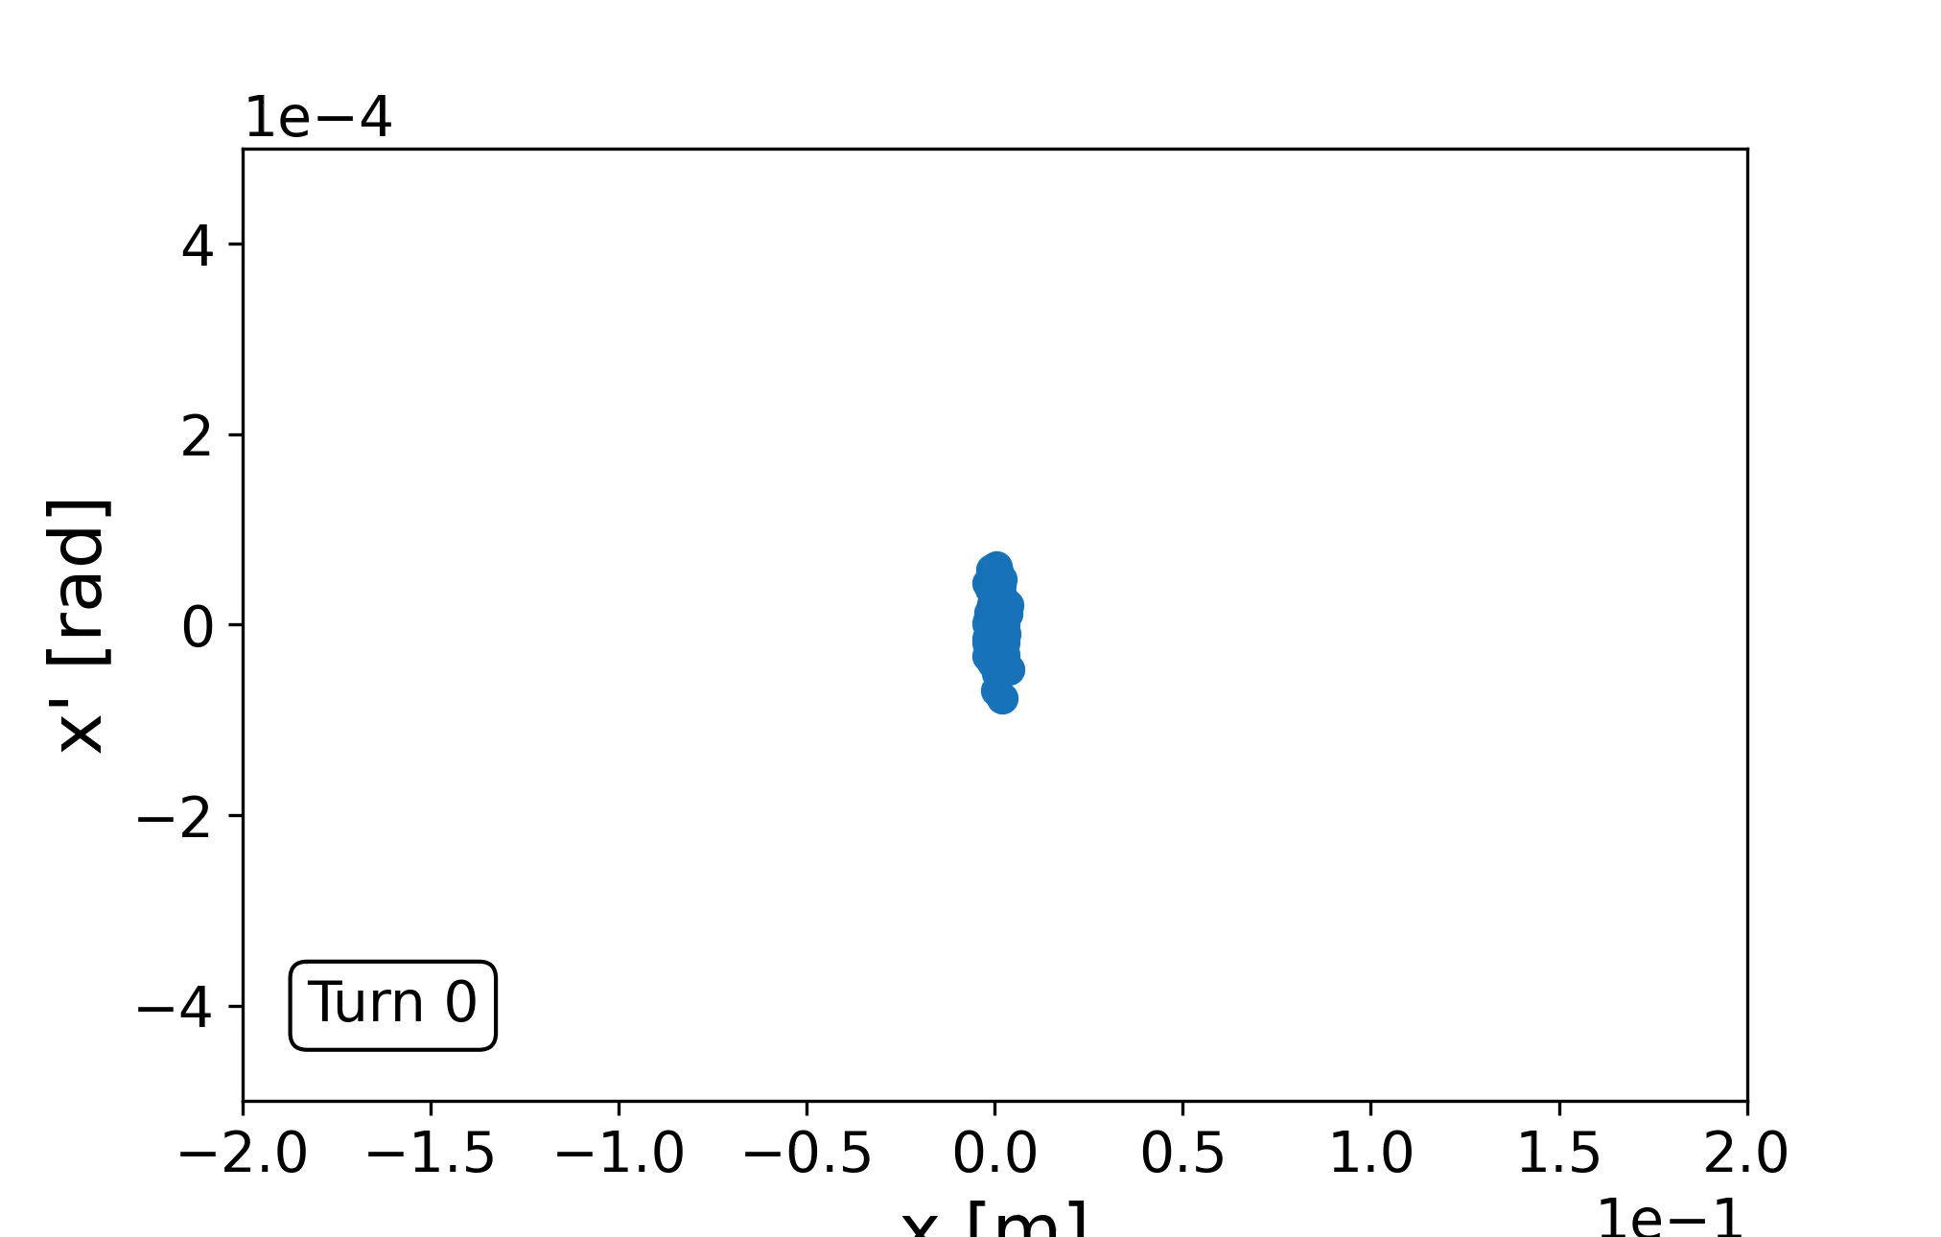
Impedance model and beam stability studies
With the impedance model as it is → tracking simulations of particles done using PyHEADTAIL
  Cavities are distributed over 32 RF stations
The code can include multiple effects (Impedances, feedbacks, electron cloud…)
Damper
Longitudinal map
+ Transverse map
RF station: Acceleration + Impedance
Exemple de trajectoires d’un
Paquet en phase d’espace

Slide 15
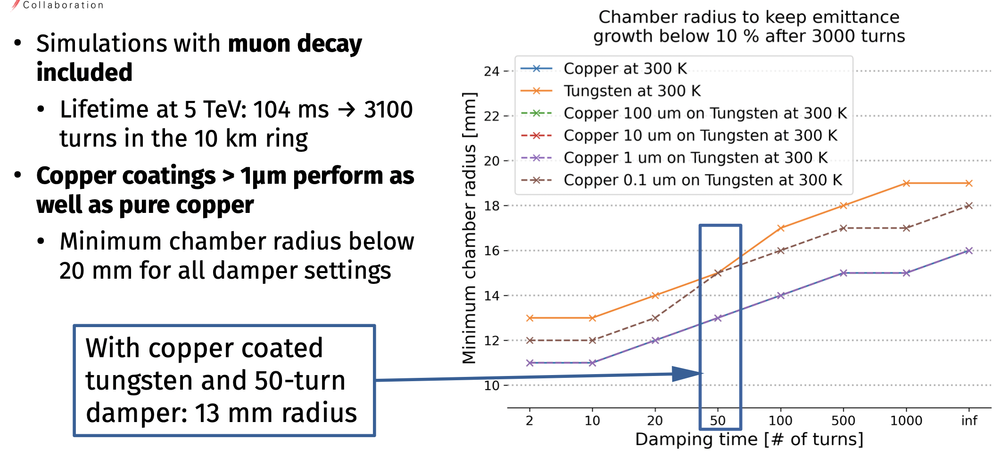
Vacuum Chamber Impedance and stability Studies
Find Minimum chanber aperture which ensures transverse stability
Investigate realistic cases for chamber materials:
  Tungsten shield with copper coating layer (assume 300K)
  Thicker copper coatings → find lower limit

Slide 16
Conclusions
The Project has started!
A first model of the machine impedances for the RCSs exist and stability studies on-going:
  Tools are in place
  First Impedance Model for the 5TeV RCS → Collider
    HOM from the Accelerating cavities (Tesla type)
    Beam chamber material and transverse dimension studies
    Beam-beam effects at collision
    Extend the studies for the collider and for the other RCSs
1st Nov EPFL PhD Student Josephine will start the investigation of the beam dynamics and stability in the Muon cooling system
  Space Charge (lower energies)
  Wake fields in Matter (green field)

Slide 17
Publications and Presentations:
- "Études d'instabilités transverses des faisceaux pour un projet de collisionneur muons anti-muons", contributed talk at the French Physical Society congress on July 5th 2023, giving a general overview of the Muon Collider study and its challenges in terms of beam instabilities, https://indico.ijclab.in2p3.fr/event/8021/sessions/4500/#20230705
"Transverse impedance and beam stability studies for the muon collider ring" in Proceedings of IPAC 2023, https://doi.org/10.18429/JACoW-IPAC2023-WEPL185
"Transverse impedance and beam stability studies for the muon collider Rapid Cycling Synchrotrons" in Proceedings of IPAC 2023, https://doi.org/10.18429/JACoW-IPAC2023-WEPL186
"Status of the collective effects in the collider ring", presentation at the IMCC Annual Meeting 2023, June 2023 https://indico.cern.ch/event/1250075/contributions/5349692/attachments/2670071/4629350/2023-06-21_amorim_COLL10TeV_collective_effects.pdf
"Status of the collective effects in the RCS", presentation at the IMCC Annual Meeting 2023, June 2023, https://indico.cern.ch/event/1250075/contributions/5350200/attachments/2670072/4629351/2023-06-21_amorim_RCS_collective_effects_v2.pdf
"Collective effects", status report at Muon Collider Accelerator design meeting, 5th June 2023, https://indico.cern.ch/event/1283569/contributions/5419198/attachments/2659731/4607066/2023-05-22_MUC_collective_effects_coll10tev_v2.pdf
"Transverse coherent instability studies for the high-energy part of the Muon Collider", proceeding and poster in HB 2023 (High Brightness Hadron Beams workshop), October 2023, to be published, https://indico.cern.ch/event/1138716/

Slide 18
The high-energy complex
Chain of rapid cycling synchrotrons, counter-rotating µ+/µ- beams
→ 60 GeV → 314 GeV → 750 GeV → 1.5 TeV → 5 TeV
Hybrid RCSs have interleaved normal conducting (NC) and superconducting (SC) magnets.
To go to 5 TeV, we have not one but four RCS:
  Tradeoff between the ring size, survival rate, acceleration speed (at low energy, the ring can be smaller and thus we can accelerate faster).
This would be the first hybrid RCSs in the world!

