Slide 1



Polarization Studies
Y. Wu, J. Keintzel, T. Pieloni, F. Carlier, M. Seidel, A. Blondel, D. Barber, E. Gianfelice, D. Sagan, R. Tomas, F. Zimmermann and the EPOL WG
CHART Meeting 11th October 2023, PSI

Slide 2
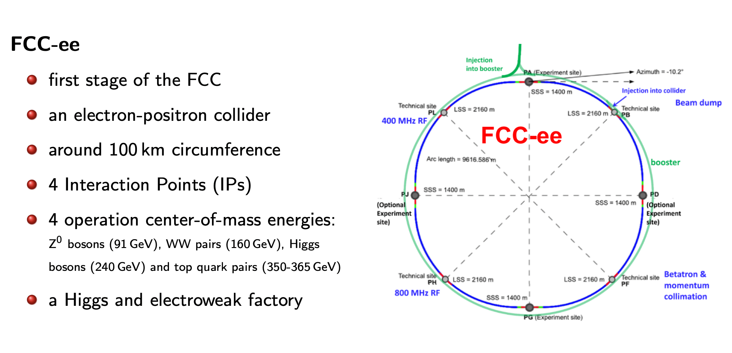
FCC-ee

Slide 3
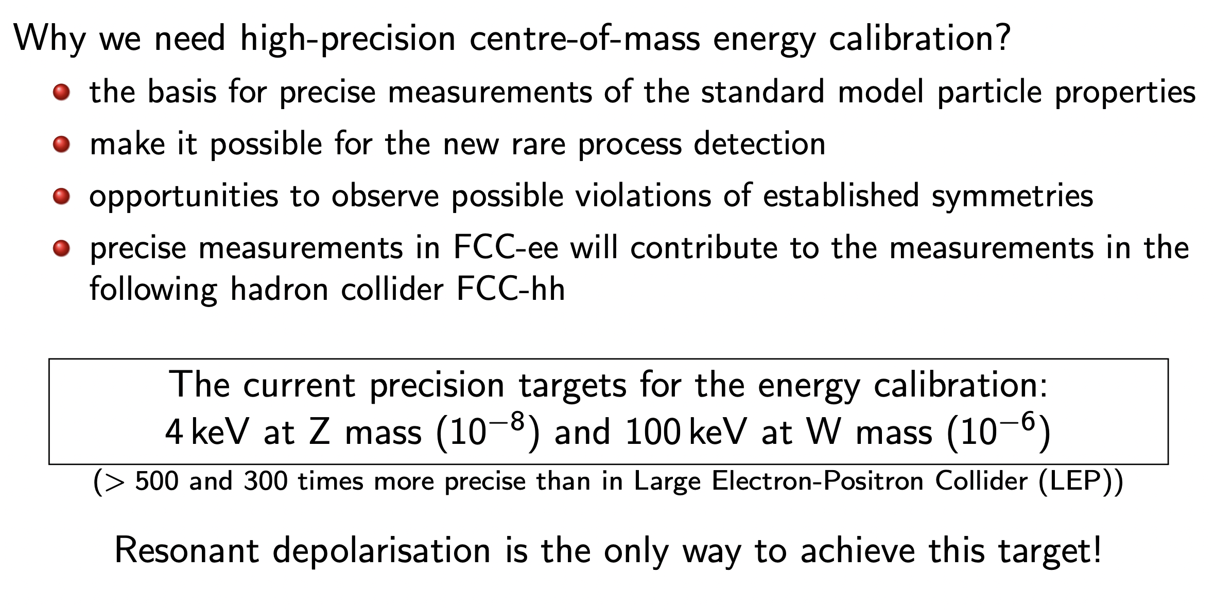

Slide 4
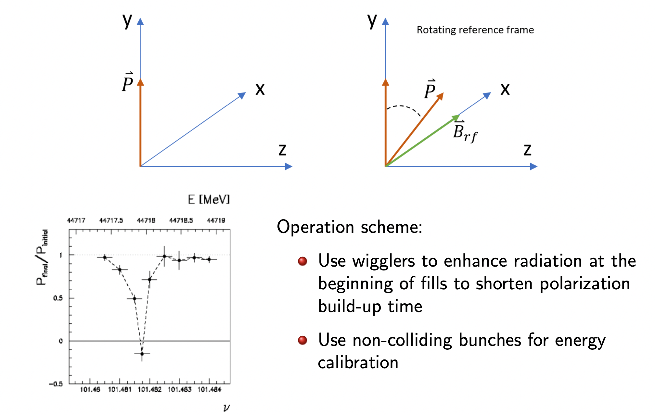
Resonant Depolarization
Build-up experties in polarization
Define models and tools
Study the FCC-ee case and input to the CDR++

Slide 5
Contents
Introduction
Equilibrium polarization in realistic machine
  Simplified error scheme for collider
  Realistic errors and orbit correction scheme
Harmonic Spin Matching techniques: 3 methods compared
Conclusions

Slide 6
Contents
Introduction
Equilibrium polarization in realistic machine
  Simplified error scheme for collider
  Realistic errors and orbit correction scheme
Harmonic Spin Matching techniques: 3 methods compared
Conclusions

Slide 7
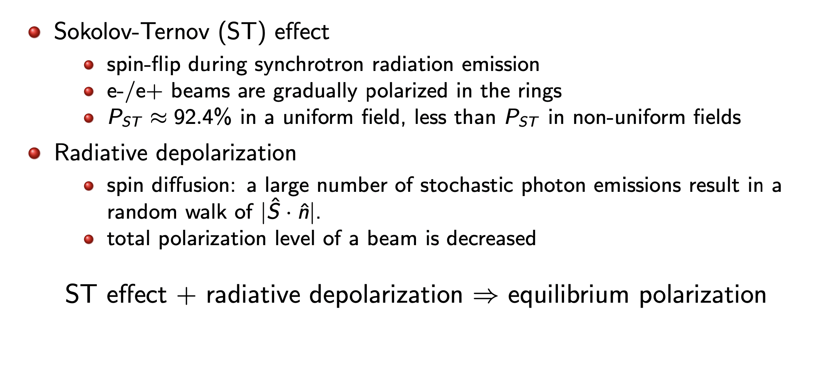
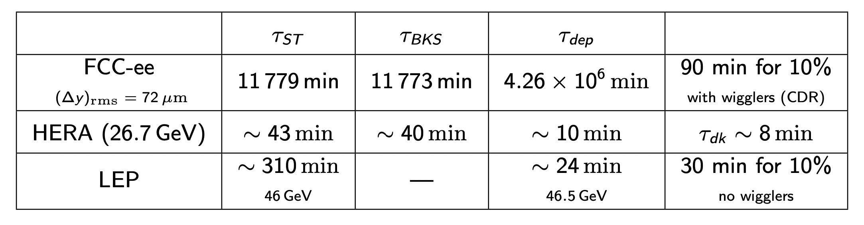
Polarization Beams basics

Slide 8
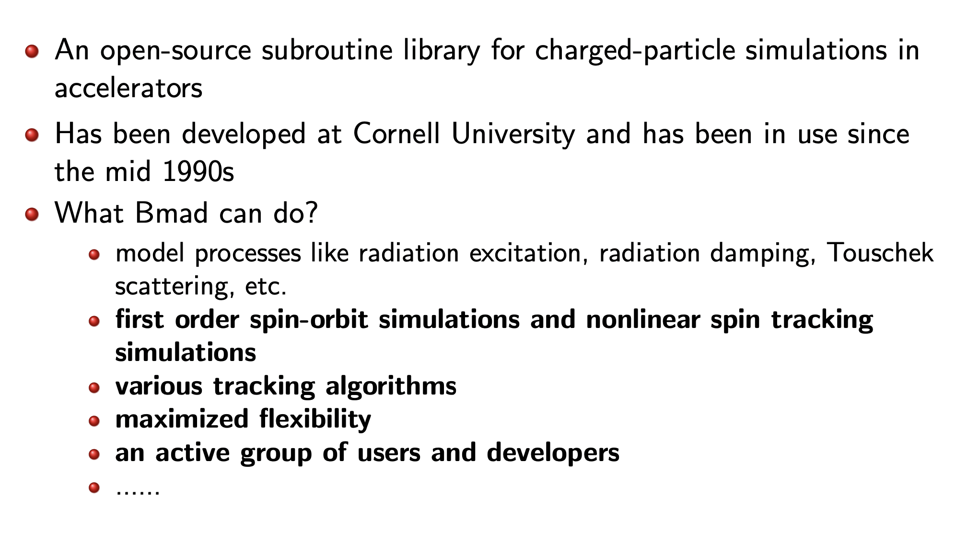
Numerical Tools: BMAD

Slide 9
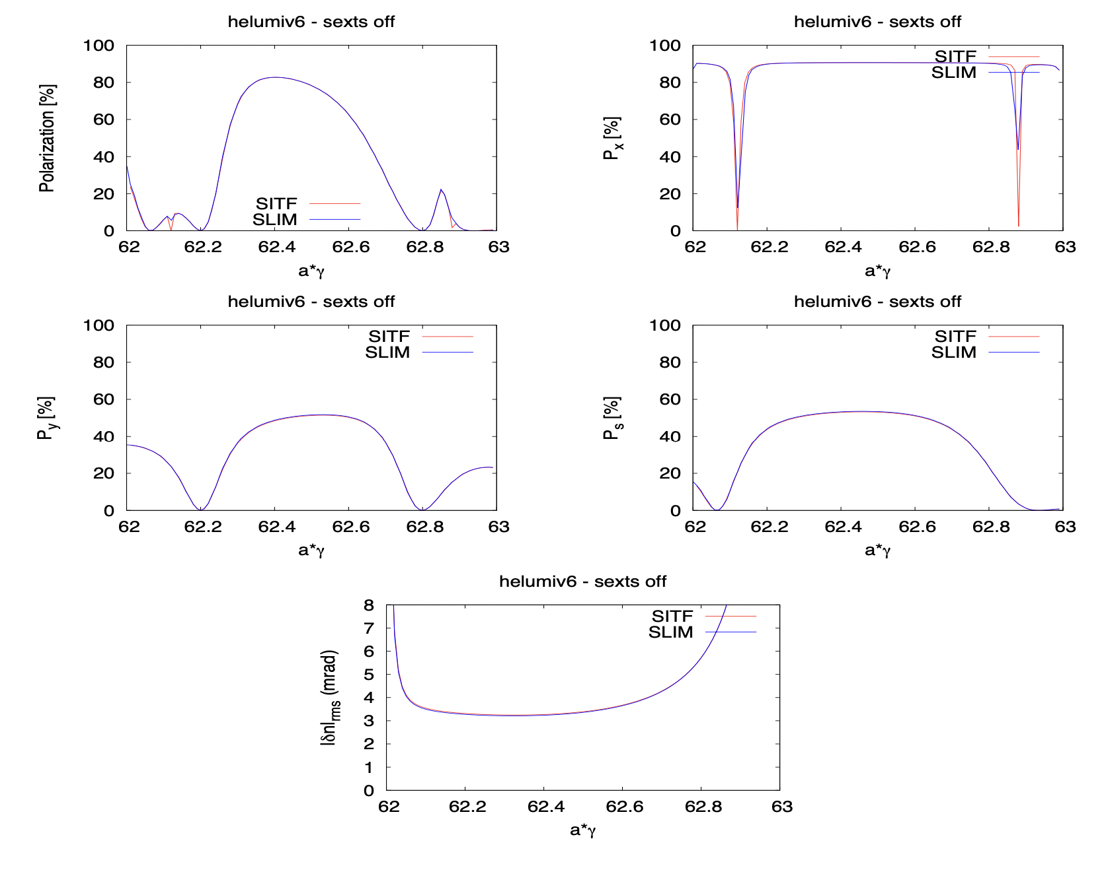
Benchmark to SITROS:
Extensive tests were performed on FCC-ee simplified lattice between:
SITROS (E. Gianfelice) model developed and benchmarked to HERA collider. Reference from CDR.
BMAD by D. Sagan Cornell University (Y. Wu)
Initial results were very different but after breaking down the effects both models show an excellent agreement

Slide 10
Contents
Introduction
Equilibrium polarization in realistic machine
  Simplified error scheme for collider
  Realistic errors and orbit correction scheme
Harmonic Spin Matching techniques: 3 methods compared
Conclusions

Slide 11
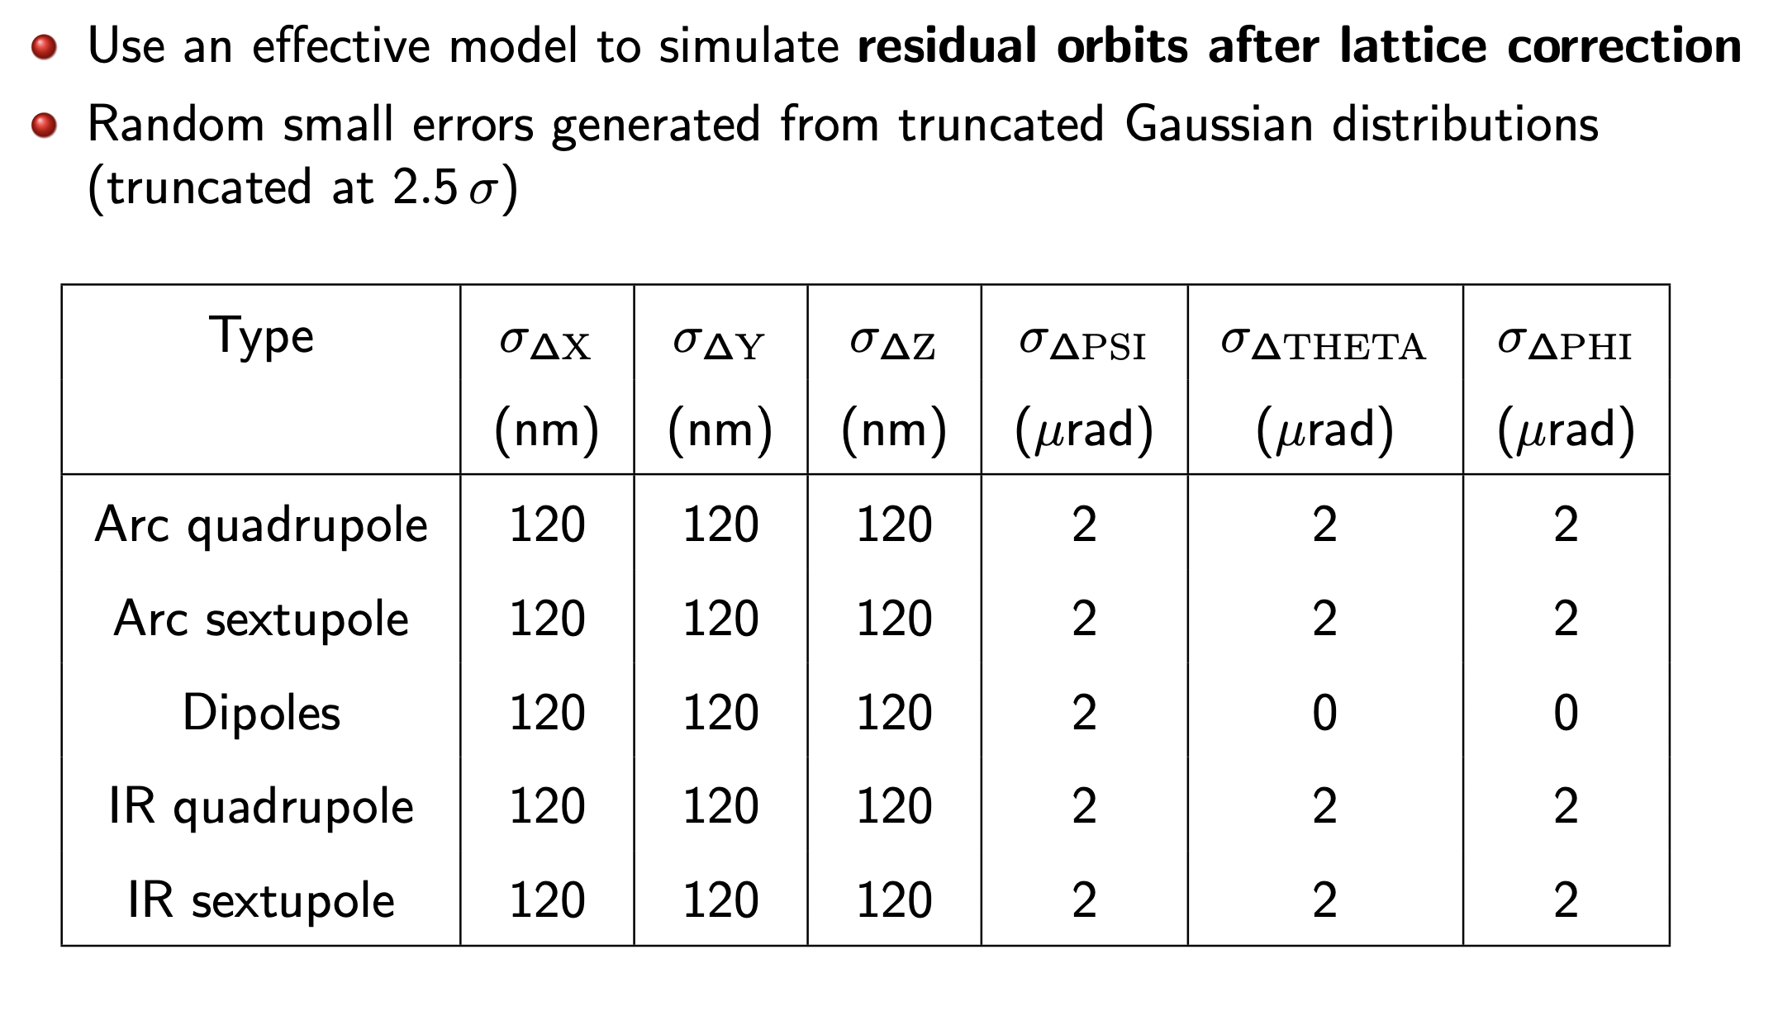
First simplified machine orbit errors model
Polarization is deprecated in the presence of errors.

Slide 12
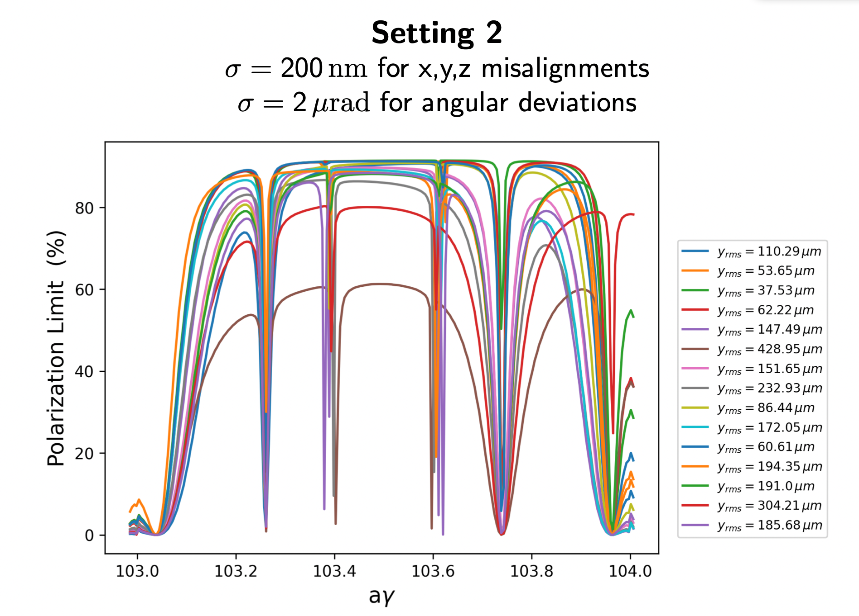
Worse Orbit excursions give larger effects → orbit correction is the key

Slide 13
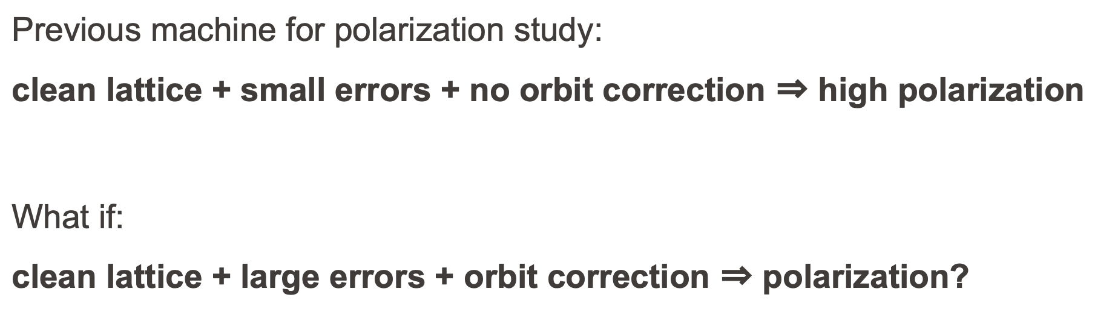
Two ways to test polarizations:

Slide 14
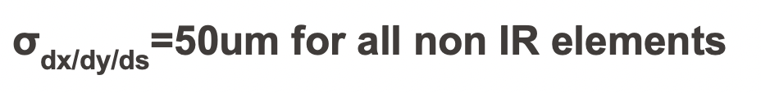
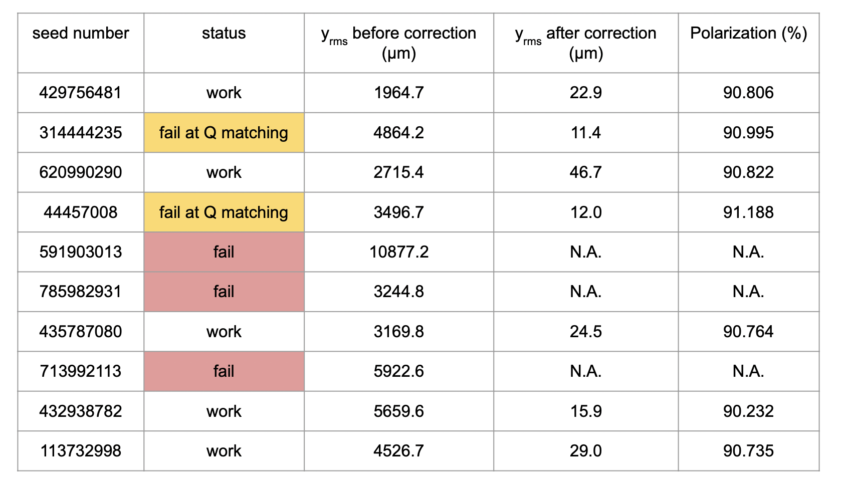
Realistic Machine
Which alignment tolerances can we accept from polarization point of view?
What counts is the closed orbit, if it exist and can be corrected → polarization is large

Slide 15
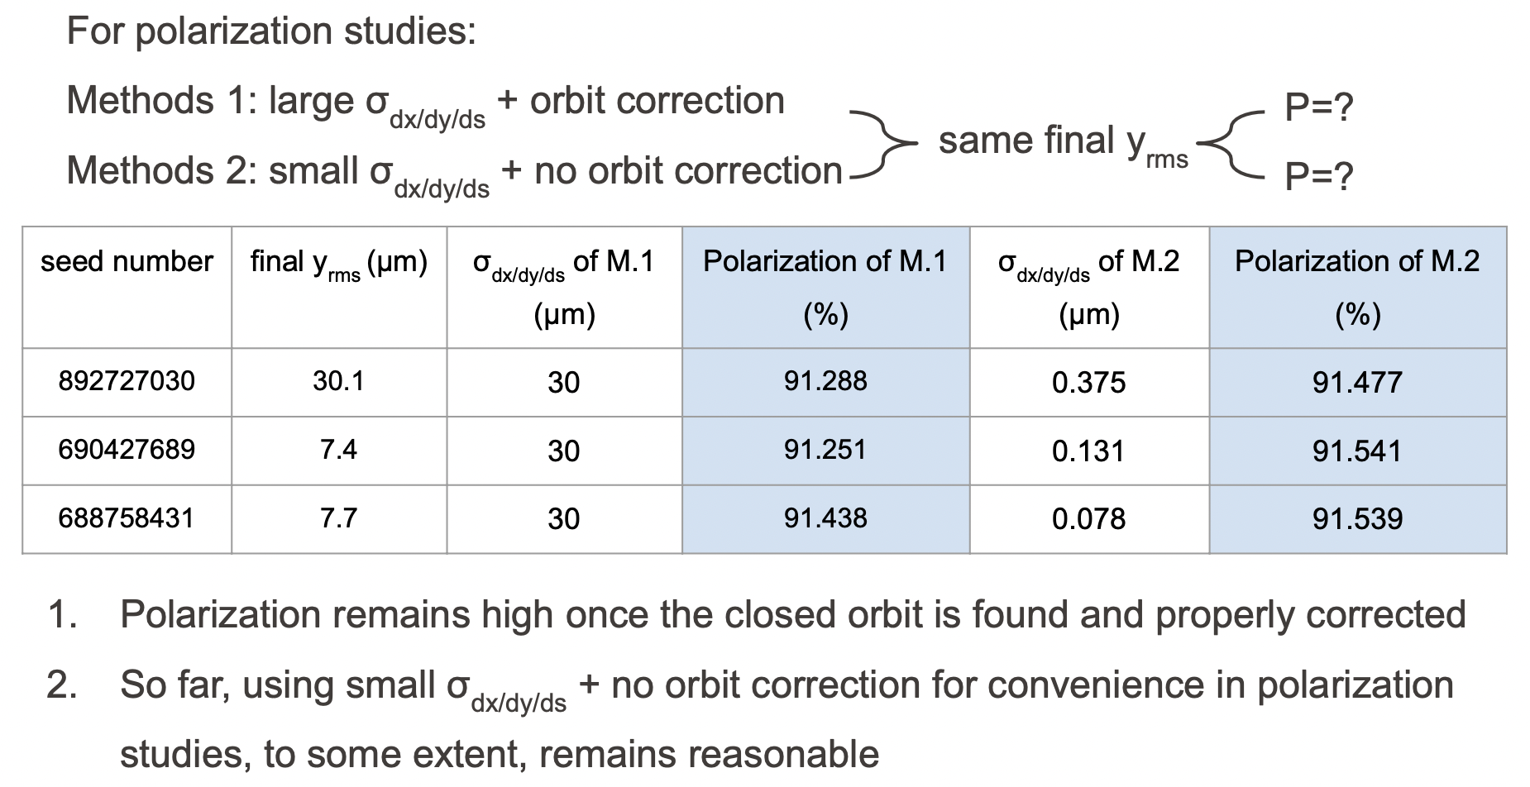
Both approaches lead to similar results: 50 μm give high polarization
Now exploring larger misalignment tolerances ensuring 90% of seed

Slide 16
Contents
Introduction
Equilibrium polarization in realistic machine
  Simplified error scheme for collider
  Realistic errors and orbit correction scheme
Harmonic Spin Matching techniques: 3 methods compared
Conclusions

Slide 17
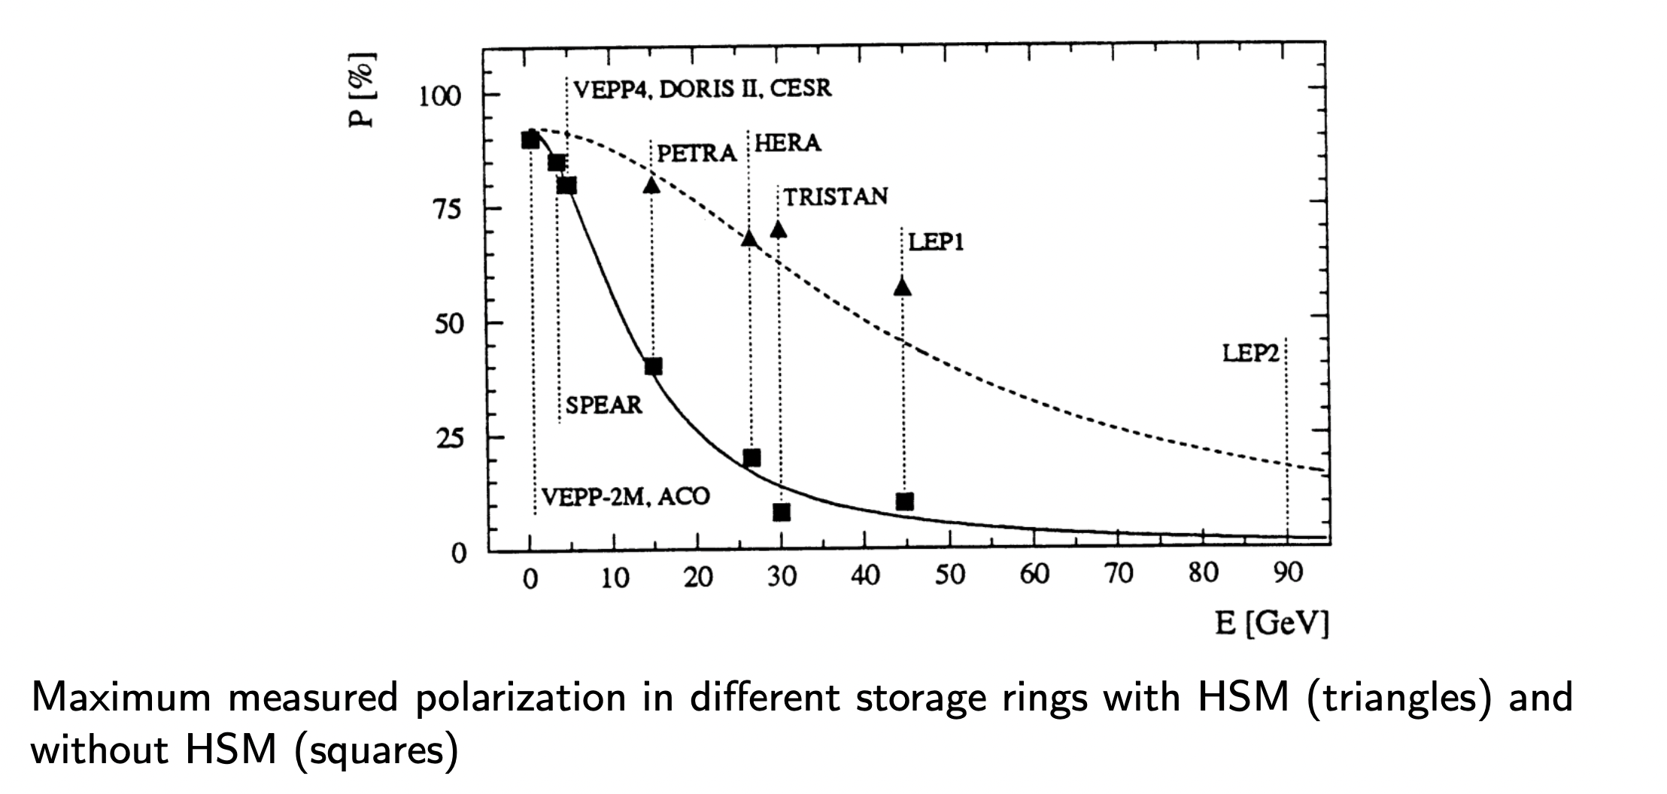
Harmonic Spin Matching to increase polarization levels

Slide 18
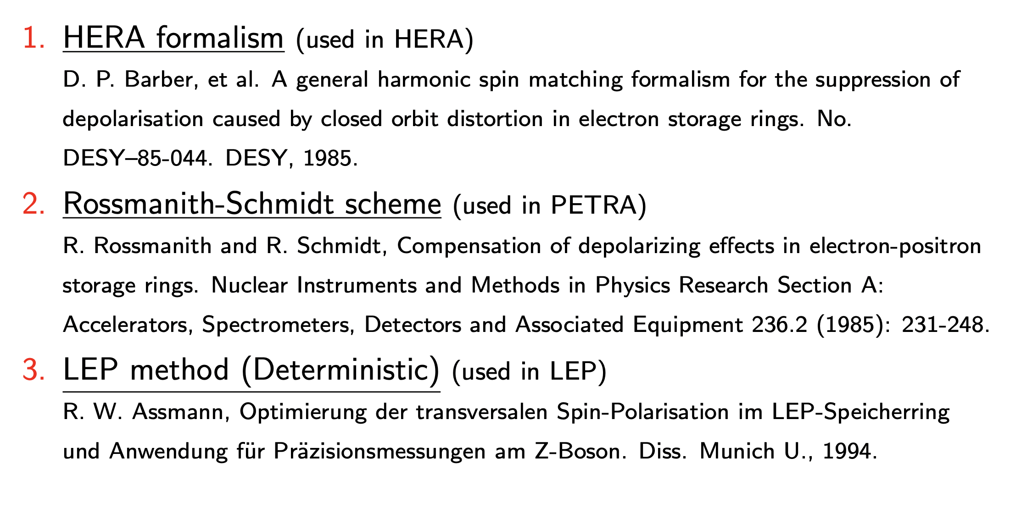
HSM methods:

Slide 19
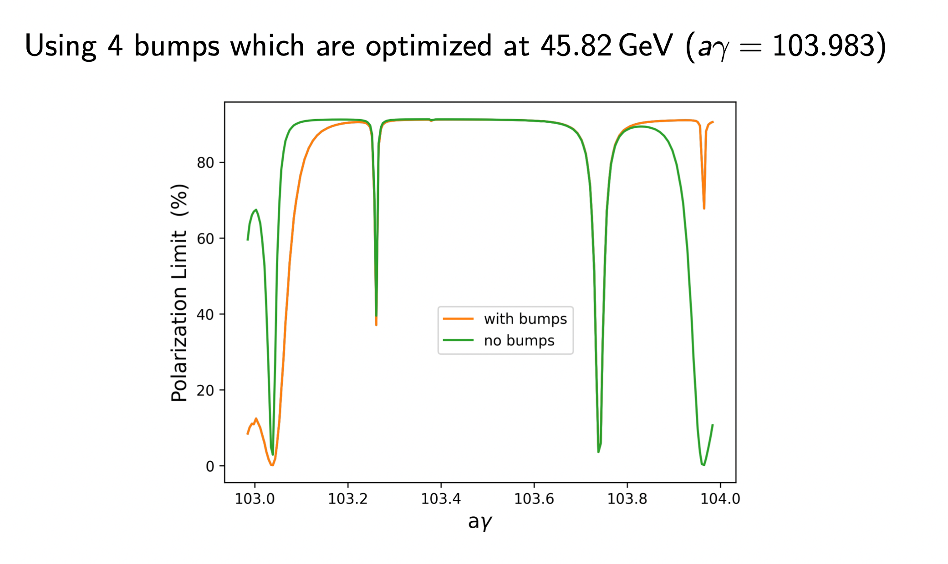
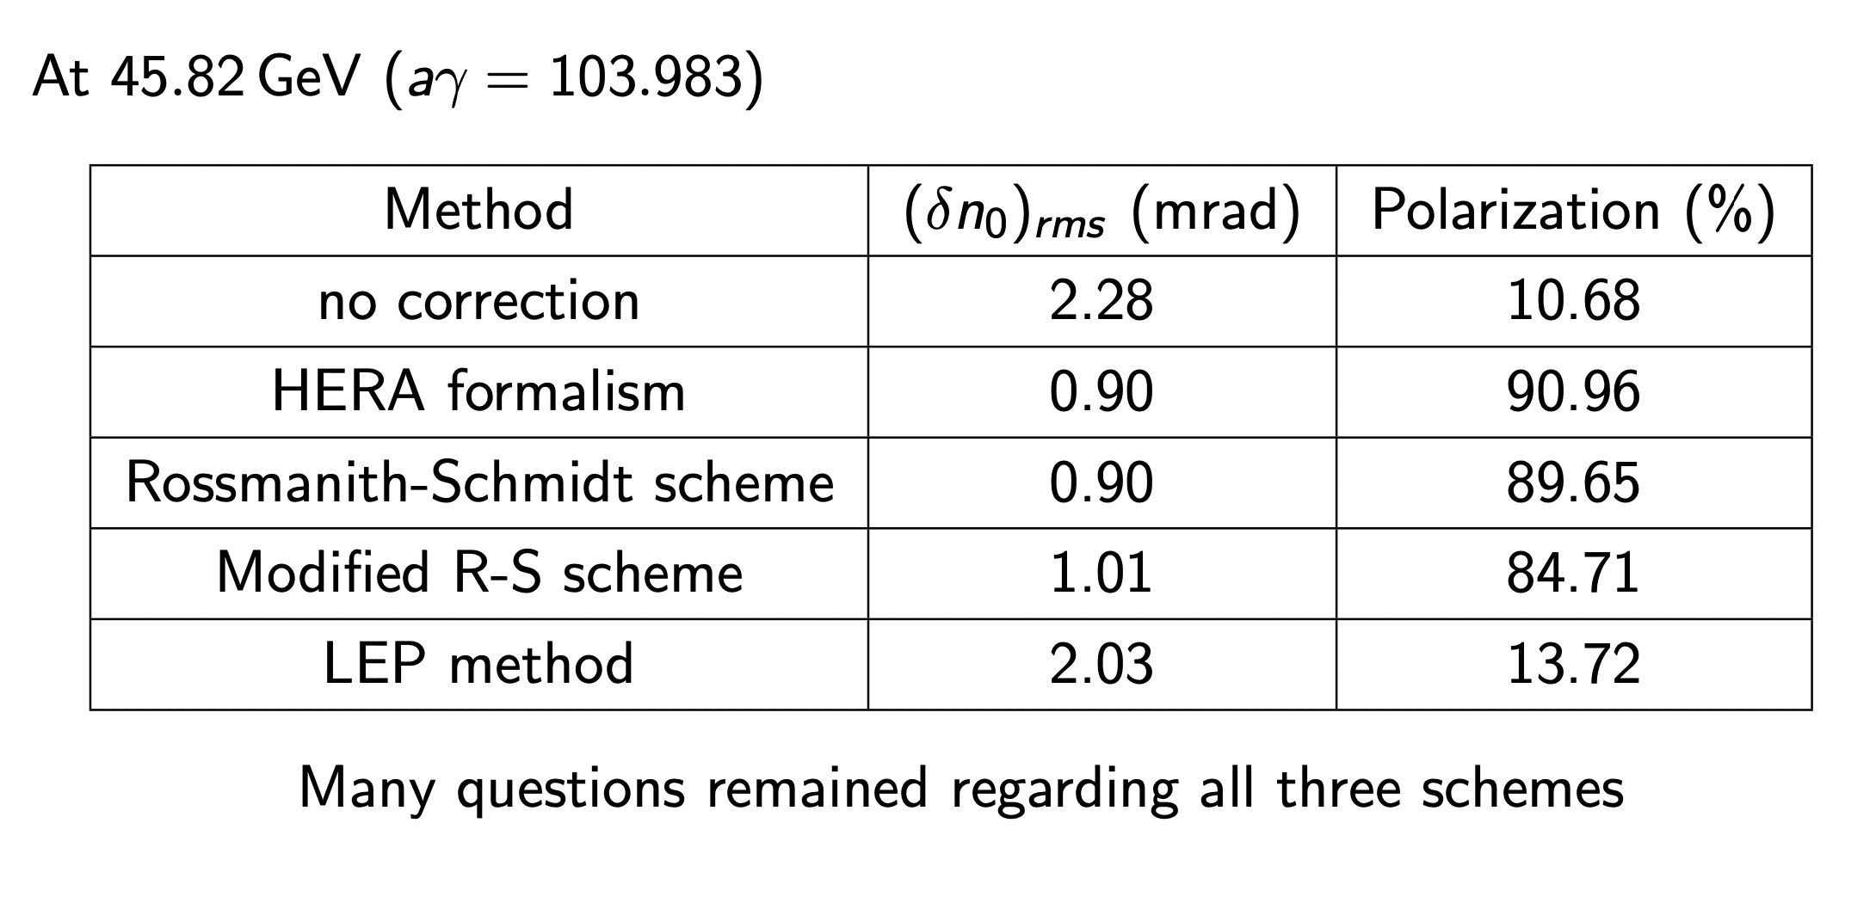
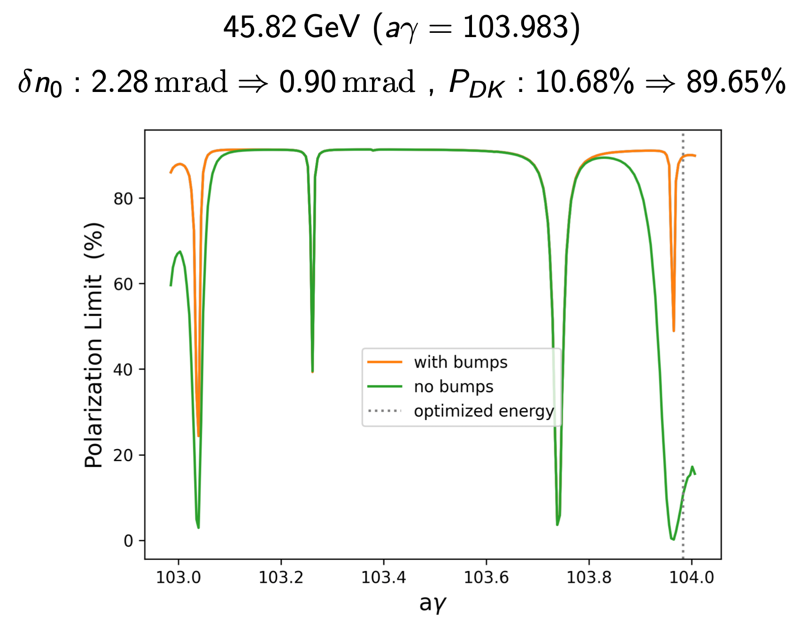
HSM methods:
Methods have been studied
Tools in Place to simulate
Preliminary results

Slide 20
Conclusions
Numerical tools have been benchmarked and are in used for FCC-ee polarization studies (BMAD good support from D. Sagan from Cornell University Code owner)
Benchmark with SITROS took sometime but is now in very good agreement (good collaboration with E. Gianfelice FNAL)
Studies of misalignment errors on polarization level on-going for realistic FCC-ee lattice and orbit correction schemes
  Polarization mainly depends on closed orbit level
  Polarization level is sufficient for energy calibration (5-10%) when closed orbit exist
  @ higher energies feasibility has to be still proved
Harmonic Spin Matching methods investigated and showed great improvement in polarization (HERA, R-S), LEP method to be understood
Resonance depolarization not yet simulated and studied
Possible tests of models on operational machine (KARA @ KIT) under consideration

Slide 21
Publications and Presentations:
Y. Wu, “Spin Polarization Simulations for the Future Circular Collider e+e- using BMAD” 2nd FCC Energy Calibration, Polarization and Mono-chromatisation (EPOL) workshop, CERN, 22 Sep 2022.
Y. Wu, “First trials of harmonic spin matching in the FCC-ee” FCC-FS EPOL group and FCCIS WP2.5 meeting 16, CERN, 15 Dec 2022.
J. Keintzel et al., “FCC-ee energy calibration and polarization”, in PoS, Vol. 414, ICHEP2022, p. 0048.
J. Keintzel et al., “Centre-of-mass energy in FCC-ee”, in Proc. IPAC’22, Bangkok, Thailand, June 2022.
Y. Wu, “Spin Polarization Simulations for the Future Circular Collider e+e- using BMAD” Workshop on Beam Polarization, Hiroshima University, 9 Feb 2023,
Y. Wu, “Updates on the Exploration of Harmonic Spin Matching in the FCC-ee” FCC-FS EPOL group and FCCIS WP2.5 meeting 18 - Joint with FCC-ee tuning meeting, CERN, 16 Feb 2023.
Y. Wu, “Updates on the Exploration of the Possible Spin Matching Methods used in the FCC-ee” FCC-FS EPOL group and FCCIS WP2.5 meeting 21, CERN, 13 Apr 2023,
Y. Wu, “Comparison of Harmonic Spin Matching Schemes using Orbit Bumps in the FCC-ee” FCC Week 2023, London, 5–9 Jun 2023.
Y. Wu, “Comparison of Harmonic Spin Matching Schemes using Orbit Bumps in the FCC-ee” Optics Tuning and Corrections for Future colliders workshop, CERN, 26–28 Jun 2023.
Y. Wu et al., “Spin polarization simulations for the Future Circular Collider e+e- using Bmad”, in Proc. eeFACT'22, Frascati, Italy, September 2022, TUZAS0104, pp. 103-107, 2023.
Y. Wu et al., “Spin-polarization simulations for the Future Circular Collider e+e- using Bmad”, in Proc. IPAC'23, Venice, Italy, May 2023, SUPM010, MOPL055, 2023
J. Keintzel et al., “The status of the energy calibration, polarization and monochromatization of the FCC-ee”, in Proc. IPAC’23, Venice, Italy, May 2023.

Slide 22
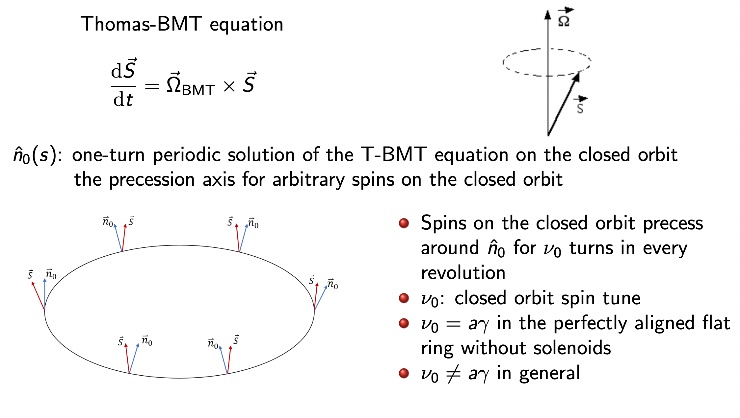
Polarization Beams basics

